Slide 1
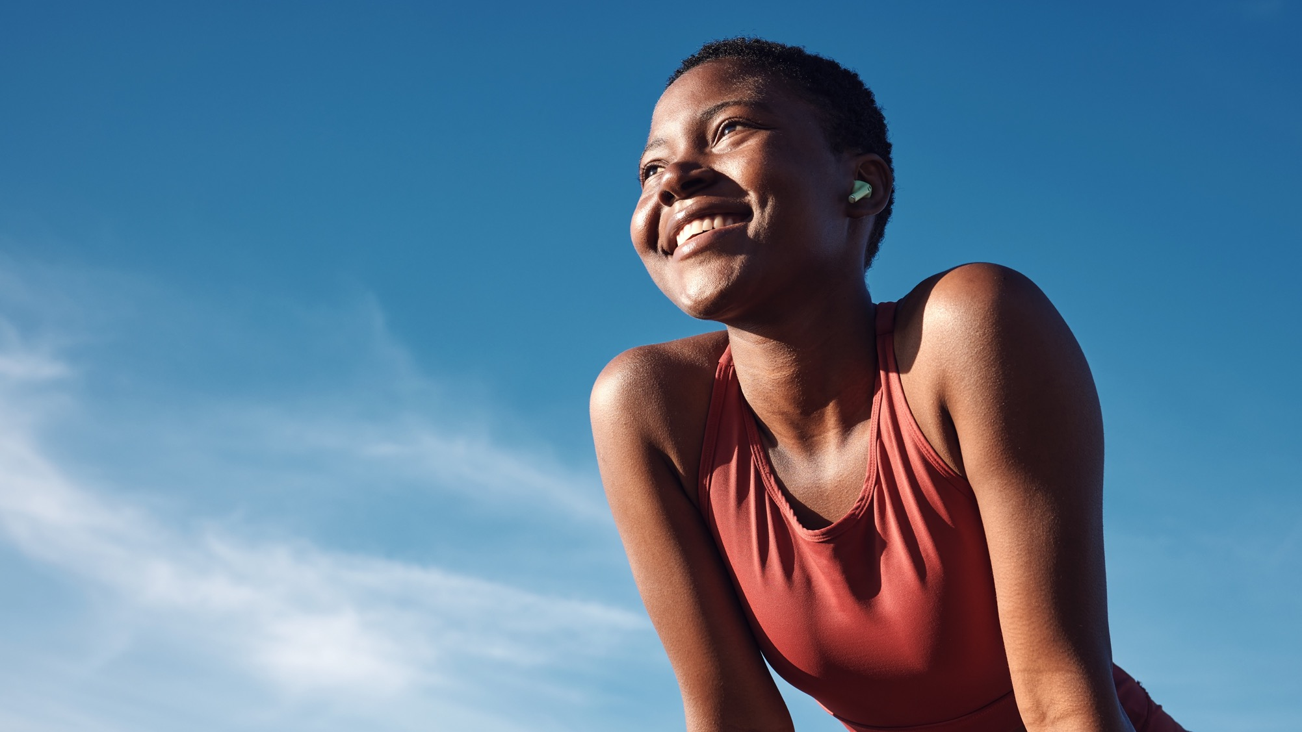



TOOLKIT TO
INCORPORATE
PHYSICAL
ACTIVITY IN
PRIMARY CARE

Slide 2

What is this toolkit and who is it for?
2
This toolkit is for all primary care staff, regardless of your pre-existing interests and knowledge.
The material contained here (and on the RCGP Physical Activity Hub) will help your practice on its journey to improving the health and wellbeing of your staff and patients by increasing physical activity and reducing sedentary behaviour.
It includes introductory information on why physical activity is important and how you can make positive changes by joining the Active Practice Charter. It signposts you to tools and resources – from waiting room posters to guidance on coding, evaluation and funding. But it also highlights the range of external organisations who are doing incredible work in this space.
This toolkit has been conceived as both a starting point for those interested in increasing their practice’s physical activity offer, while also providing links to more detailed resources and learning for those who have already begun the journey.

Slide 3
Key messages
3
Healthy professionals make healthy patients.
There is a strong need to incorporate physical activity into primary care.
Signing up to the Active Practice Charter is simple and rewarding.
There are many ways to achieve Active Practice status.
This toolkit and the physical activity hub contains numerous resources to support you on the journey.
Evaluation and planning is key for more ambitious projects.

Slide 4
Quick-reference guide for becoming an active practice
4
If you are eager to become an Active Practice, this quick-reference guide helps practices understand the
various aspects and signposts you to information, resources and guidance within this document and on the
RCGP’s Physical Activity hub.
Understand why we need to encourage movement in primary care. (Slides 6-12)
Learn more about the Active Practice Charter. (Slides 13-16)
Decide which team member(s) will lead the initiative. (Slide 15)
Prioritise your approach to meeting the Active Practice Charter criteria. (Slides 13-16)
Look at the different ways in which you can meet the criteria. (Slides 18-26)
Explore training and support needs. (Slides 27-33)
Do any initiatives require external funding? (Slides 34-39)

Slide 5
Contents
5
Why do we need movement in primary care
What is involved in the Active Practice Charter
Tools to become an Active Practice
Suggested Training and CPD
Funding
Medical Indemnity
Evaluation
Case study
Acknowledgements

Slide 6
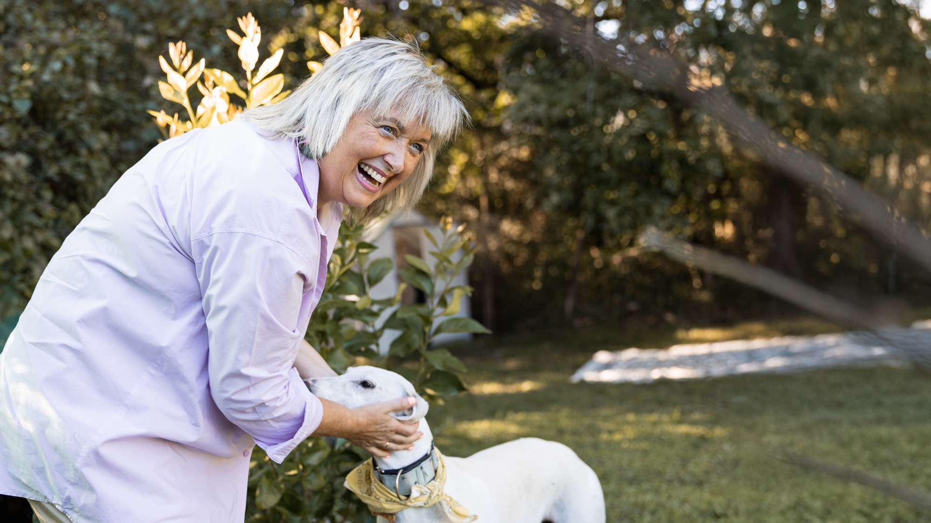


WHY WE NEED MOVEMENT IN PRIMARY CARE
Why physical activity is needed and why primary care is best placed to encourage it

Slide 7
Physical inactivity is a major problem
7
1 in 3 people in the UK do not meet the UK CMO guidelines at 150 minutes per week¹.
Activity is less common for adults with a disability or long-term condition (48% meet the guidelines) compared to those without (69%)¹.
80% of teenagers in the UK are inactive².
Physical inactivity caused 1 in 6 deaths, comparable to smoking and alcohol³.
This is having huge implications on healthcare, social care and the economy.
Notes:
(1) Active Lives Adult Survey November 2022-23 Report: https://www.sportengland.org/research-and-data/data/active-lives
(2) van Sluijs, E. M., Ekelund, U., Crochemore-Silva, I., Guthold, R., Ha, A., Lubans, D., ... & Katzmarzyk, P. T. (2021). Physical activity behaviours in adolescence: current evidence and opportunities for intervention. The Lancet, 398(10298), 429-442.
(3) King A. Health risks of physical inactivity similar to smoking. Nature Reviews Cardiology. 2012;9(9):492-.

Slide 8
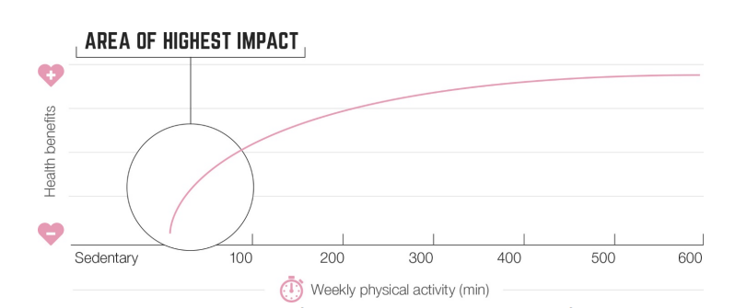

The least active have the most to gain
8
Ref: UK Chief Medical Officers' Physical Activity Guidelines

Slide 9
Primary care is key
9
Practice staff are influential and have wide reach¹.
1 in 4 people say they would be more active if told to be so by a doctor or nurse².
72% of people with a long-term health condition say the NHS is the most trusted source of physical activity advice².
Physical activity promoted in primary care is effective³.
WHO declared physical activity promotion in primary care as a 'best-buy' in an economic-analysis⁴.
The number needed to treat (NNT) to get a patient to reach the physical activity guidelines is 1 in 12... for smoking cessation it is between 1 in 50 and 1 in 120!⁵.
Notes:
(1) McNally S. Exercise: The miracle cure and the role of the doctor in promoting it. Academy of Medical Royal Colleges, London. 2015.
(2) Physical Activity: applying All Our Health, Office for Health Improvement & Disparities; 2015, updated 2022. gov.uk: https://www.gov.uk/government/publications/physical-activity-applying-all-our-health/physical-activity-applying-all-our-health
(3) Kettle VE, Madigan CD, Coombe A, Graham H, Thomas JJC, Chalkley AE, et al. Effectiveness of physical activity interventions delivered or prompted by health professionals in primary care settings: systematic review and meta-analysis of randomised controlled trials. British Journal of Medicine. 2022;376:e068465.
(4) WHO. Tackling NCDs Best buys. Geneva: World Health Organisation; 2017.
(5) Orrow G, Kinmonth A-L, Sanderson S, Sutton S. Effectiveness of physical activity promotion based in primary care: systematic review and meta-analysis of randomised controlled trials. BMJ. 2012;344:e1389 https://www.bmj.com/content/344/bmj.e1389

Slide 10
So why is it not happening?
10
72% of GPs didn't routinely recommend physical activity to patients¹.
Four key barriers exist²:
A lack of time
A lack of knowledge
A lack of resources/support
A lack of finances.
We have no magic cure for time (or money) but this toolkit aims to address 2 and 3...
Notes:
(1) Chatterjee, R., Chapman, T., Brannan, M. G., & Varney, J. (2017). GPs’ knowledge, use, and confidence in national physical activity and health guidelines and tools: a questionnaire-based survey of general practice in England. British Journal of General Practice, 67(663), e668-e675.
(2) Leese, C., Abraham, K., & Smith, B. H. (2023). Narrative review–barriers and facilitators to promotion of physical activity in primary care. Lifestyle Medicine, 4(3), e81

Slide 11
The benefits outweigh the risks
11
Benefits to patients
The benefits of physical activity for people with long-term conditions far outweighs the risks. But despite risk being low, the perceived risk is high. Healthcare professionals have a role in person-centred conversations that address perceived risk and promote the right kind of physical activity for the individual.
Benefits outweigh the risks: a consensus statement on the risks of physical activity for people living with long-term conditions | British Journal of Sports Medicine
Benefits for practices
Improve the health and wellbeing of practice staff and patients, reducing the need for lifelong medicine.
Support the move towards personalised care and social prescribing.
Strengthen connections with the local community.
Improve staff morale, relationships between staff members and with other local practices.
Closer engagement with patient participation groups, with shared projects.
Achieve high CQC ratings and improved patient satisfaction score.
Great for your appraisals and personal professional development (PDPs).

Slide 12
Becoming an Active Practice to foster community connections
12
Community networks foster sustainability
Connections with local communities encourage
long-term engagement in physical activity.
Shared goals and support systems increase
motivation and adherence.
Enhancing patient outcomes through collaboration
Community-based physical activity initiatives improve mental and physical health outcomes.
Strengthening ties with voluntary, community, faith, and social enterprise (VCFSE) organisations amplifies patient reach and support.
The value of the Active Practice Charter
Embedding movement into healthcare enhances patient well-being and prevention strategies.
Community partnerships bring the Active
Practice Charter to life, extending its impact beyond clinical settings.
It’s a shared responsibility
Practices don’t need to work alone—collaborate with VCFSE sectors for shared resources and expertise.
Leverage community assets to co-create sustainable, impactful movement initiatives.
Building healthier, more active communities
Strengthening community connections supports
active lifestyles across all age groups.
Aligning with VCFSE partners creates inclusive, accessible opportunities for everyone.

Slide 13
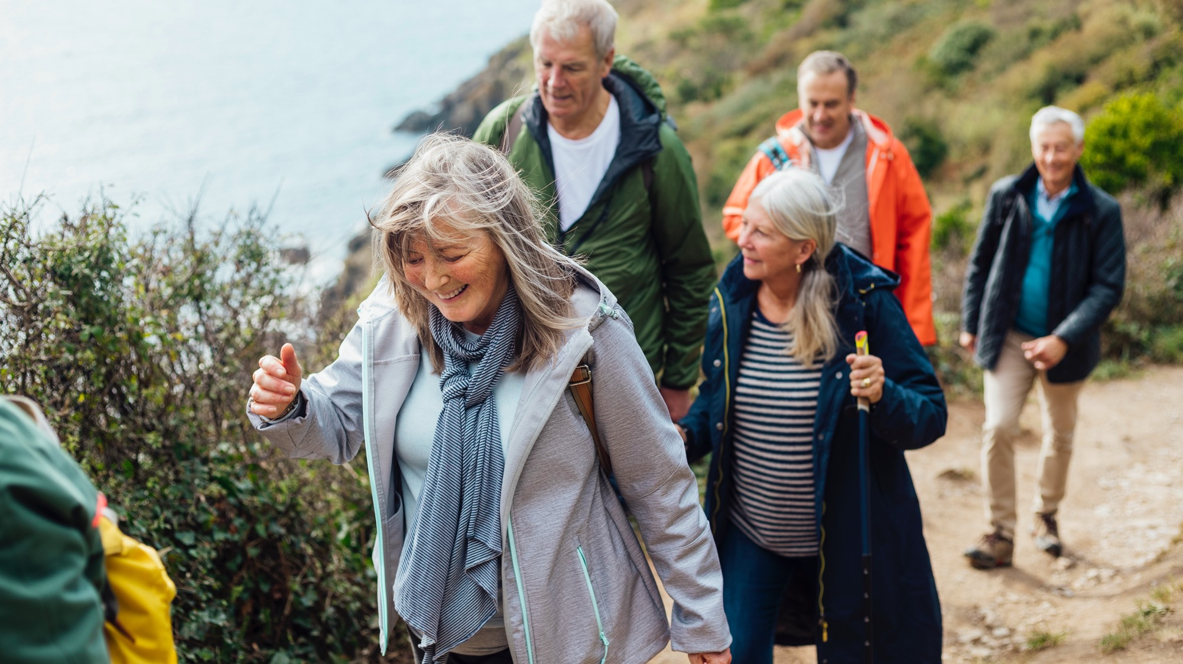
THE ACTIVE
PRACTICE CHARTER
An easy way to increase physical activity, reduce sedentary behaviour and connect with physical activity providers in the community

Slide 14
What is the Active Practice Charter?
14
The Active Practice Charter is a fun and easy way to make simple but impactful changes in your workplace that will demonstrate to your patients and staff that you mean it when you say that movement is the best medicine.
It's free to join and there are lots of simple and creative ideas to help you meet the criteria in this toolkit and
on the Physical Activity Hub. You just need to demonstrate that your practice has taken steps to reduce sedentary behaviour and increase physical activity in staff and patients, and partnered with a local physical activity provider.
You will then join a growing national network of practices making positive changes in their surgeries to boost staff and patent wellbeing.
Achieving the RCGP Active Practice Charter is something to be celebrated, and shared widely with staff, patients, and the wider community. It's a great example of social prescribing ‘in action’, and an excellent case study for the CQC.
Sign up to the Active Practice Charter

Slide 15
Becoming an Active Practice –
the five criteria
15
Becoming an Active Practice is simple – all you need to do is sign up and demonstrate you have taken steps
in the practice to:
Reduce sedentary behaviour in staff
Reduce sedentary behaviour in patients
Increase physical activity in staff
Increase physical activity in patients
Partner with a local physical activity provider
Just like training for a race, the first steps are often the hardest – but practices that have embraced this
approach have found that the benefits in terms of staff morale, patient health and engagement more than
make up for the initial effort.
This initiative does not have to be led by a GP partner, or even a doctor – you may have a member of your
non-clinical practice team who would be best placed to lead the initiative. Medical students, GP trainees,
the social prescriber, first contact physiotherapist, a receptionist or one of the patient participation group
(PPG) team – anyone can lead!
The Physical Activity Hub has many suggestions and resources to help you meet the five criteria.

Slide 16

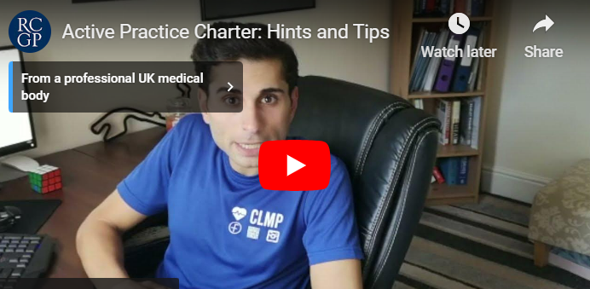
APC: hints and tips video
16

Slide 17
Useful links for becoming an Active Practice
17
Join the movement – become an Active Practice
Active Practice Charter sign-up form
Videos
Active Practice Charter: Hints and Tips
RCGP Physical Activity and Lifestyle project
Swimming as Medicine
External resources and initiatives
Physical activity resources
Supporting patients to change their behaviour
Evidence and guidance
Organisations
Key papers

Slide 18
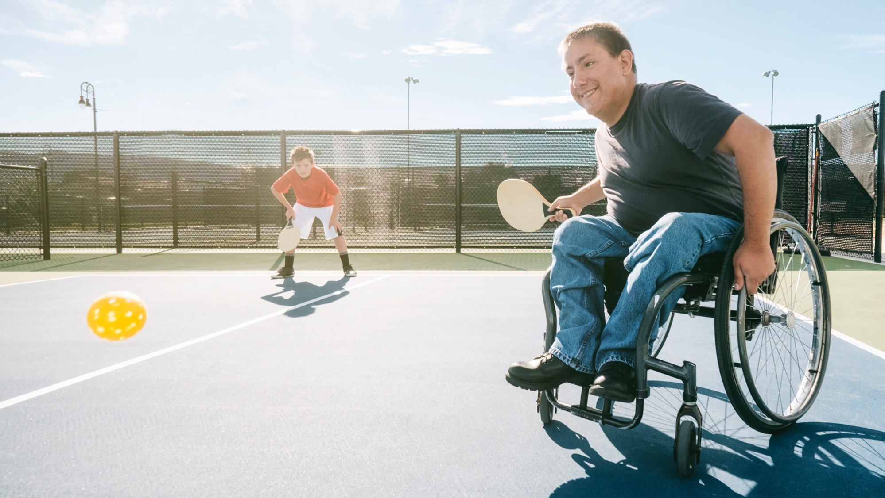

TOOLS TO BECOME
AN ACTIVE PRACTICE
An inventory of resources to help you on your journey of movement

Slide 19
Promotional resources
19
These resources can be downloaded from the Physical Activity Hub and used by practice staff to promote
physical activity to patients.
Posters - we have created a range of posters for you to use in your practice to promote the movement
for movement.
Social media assets - we have created a range of social media assets to help you promote physical activity
to patients digitally.
Text (SMS) templates - these SMS text templates are tailored for a GP practice to encourage patients
to become more active, with a focus on the health benefits. These include parkrun-themed messages.
Adapt content as needed.
→ More information

Slide 20
Patient resources
20
We Are Undefeatable - Supporting people living with long-term health conditions to be active.
This includes a resource pack for healthcare professionals and practice managers.
Couch to fitness - Supports individuals to get active from home. Supported by Sport England.
Stronger my way – This initiative has resources for both patients and professionals to help people with strengthening activity.
Swim England - Swim England has teamed up with the RCGP to encourage healthcare professionals to consider recommending swimming and aquatic activity to their patients. The ‘Swimming as Medicine’ series of videos outline how transformative being active in water can be for individuals.
Healthcare professional resources
Moving medicine - Moving Medicine is an initiative by the Faculty of Sport and Exercise Medicine (FSEM), developed in collaboration with Public Health England and Sport England. Its aim is to promote better patient outcomes through physical activity as medicine. It provides practical, evidence-based tools to help healthcare professionals integrate physical activity discussions into routine care.
→ More information

Slide 21
Population searches and coding
21
Population searches can drive better health outcomes and effective coding helps determine the impact of interventions in quality improvement projects.
Key benefits of searches:
Targeted care delivery
Addresses health inequalities
Efficient resource allocation
Data-driven insights
Coding
Effective coding helps you evaluate your initiatives, such as working to increase physical activity in patients.
This can be done using SNOMED codes.
→ More information

Slide 22
Partnering with a physical activity provider
22
Partnering with a local physical activity provider is a key part of becoming an Active Practice. There are many ways to achieve this, such as signing up to become a parkrun Practice, setting up a local health walk, approaching local activity providers, or connecting with your PCN’s social prescriber to identify local options.
You can also contact your regional Active Partnership team. They are experts in local physical activity resources and assets, are aware of the Active Practice Charter and are there to help.
“
Partnering with our local event has really helped the practice engage closer with the community - A general practitioner
“
“

Slide 23
Benefits of linking with your regional Active Partnership
23
You can connect with your local regional Active Partnership, which will help with the following:
Foster collaboration: Unite organisations with shared goals to achieve greater collective impact.
Enhance reach: Extend access to programmes and initiatives by leveraging partner networks.
Promote innovation: Encourage the sharing of ideas, resources, and expertise to develop new solutions.
Strengthen community engagement: Build trust and lasting connections with diverse communities.
Improve outcomes: Deliver measurable benefits through coordinated, aligned efforts.
Maximise resources: Optimise use of funding, skills, and infrastructure to reduce duplication.
Support sustainability: Create long-term frameworks for growth and resilience.
Raise awareness: Amplify key messages and campaigns to wider audiences.
Drive policy change: Collaborate to influence decision-making and advocate for systemic improvements.
Provide training on physical activity for healthcare professionals.

Slide 24
Partnering with a physical activity provider
24
The Chartered Institute for the Management of Sport and Physical Activity (CIMSPA) – CIMPSA is the professional development body for the UK sport and physical activity sector. GPs can connect with CIMSPA’s local delivery teams. Skills hub managers across the UK engage with all organisations including gyms, leisure centres, community hubs, coaching facilities, local authorities, GP practices and healthcare professionals. CIMSPA provide a kitemark to quality assure the physical activity workforce and has an understanding of driving engagement and participation in a locality. View their case studies.
Mind - Mind and sector partners have worked with people with lived experience of mental health problems (adults and young people), physical activity deliverers (PTs, fitness instructors, coaches and leaders) along with the sports and health sectors to develop guidance to support physical activity deliverers & healthcare professionals specifically signposting moving for mental health. Included are skills, knowledge, training, resources and case studies to provide safe and effective delivery in a range of settings including at home, in the community, and in primary and secondary care. It supports healthcare professional to identify the key aspects they should be looking for when partnering with physical activity providers.

Slide 25
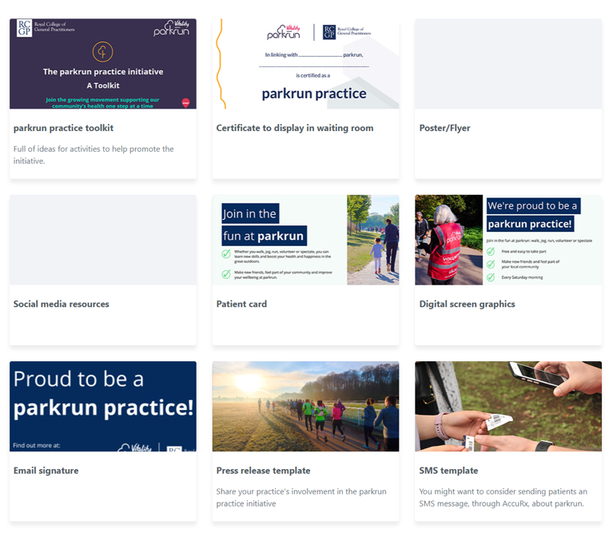
25
parkrun practice
Resources for your practice and patients
The parkrun practice initiative resources available
on the RCGP eLearning platform provide tools and guidance to help practices promote physical activity through parkrun.
Why use parkrun practice resources?
Boosts patient engagement in physical activity
with minimal effort.
Offers ready-made, professional materials to promote parkrun.
Simplifies referrals with tools like SMS templates
and SNOMED codes.
Strengthens team morale through collaborative activities.
Demonstrates the health benefits of community connections
→ More information

Slide 26
Staff benefits
26
Cycle to work scheme - Join over 1.1 million other people with this popular scheme to help support you with the cost of a new bike or bike parts. This link helps partners or practice managers who want guidance on implementation.
Lifestyle related RCGP member benefits – RCGP membership includes a number of discounts on physical activity and lifestyle-related providers.

Slide 27
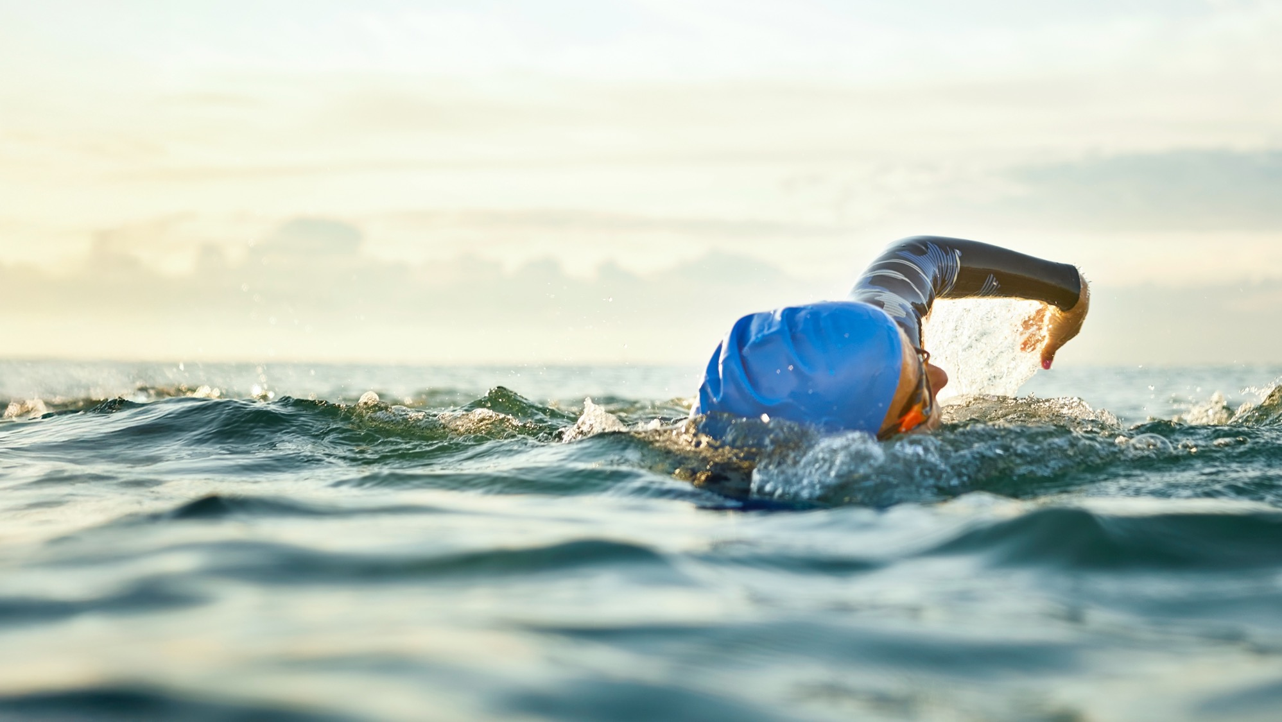
SUGGESTED TRAINING
AND CPD
Suggested Training and CPD
A guide on useful
training and CPD courses

Slide 28
28
Behaviour change and coaching
NHS England Making Every Contact Count is a free online eLearning for health course covering the importance
of preventative medicine within healthcare settings: Making Every Contact Count - eLearning for healthcare
All Our Health, is a free online NHS England eLearning for health module on behaviour change techniques:
NHSE elfh Hub
The Personalised Care Institute accredits health coaching courses, and these can be seen here: Your learning options
The Faculty of Sport and Exercise medicine has produced a course on motivational interviewing (Active Conversations) for physical activity: Online course - Moving Medicine

Slide 29
Free courses on physical activity for health
29
An online NHS eLearning for health course on understanding how physical activity can help patients to manage a number of long-term conditions. Gain confidence in your ability to advocate physical activity to patients: e-lfh.org.uk/programmes/physical-activity-and-health/
On online NHS based eLearning for health course, All Our Health, has a module giving overview of physical activity and the challenges presented by physical inactivity: NHSE elfh Hub
BMJ Learning has produced an online course for clinicians on physical activity in the treatment of long-term conditions: Physical activity in the treatment of long-term conditions Online course | BMJ Learning
Physical Activity Clinical Champions is a training course produced by Public Health England and Sheffield Hallam University to deliver education to healthcare professionals on physical activity. To organise training (either face to face or online) please visit: Physical Activity Clinical Champions (PACC) - Moving Medicine
Swim England eLearning explores the benefits of water-based physical activity for rehabilitation, chronic conditions, and overall wellbeing: Aquatic Activity and Swimming for Health programme

Slide 30
Online resources and support
30
Moving Medicine is an online resource to support clinicians promote physical activity to patients. It includes condition specific advice and evidence, conversation prompts and patient information leaflets: Homepage - Moving Medicine
The Chartered Society of Physiotherapists hosts a page with information and support relating to physical activity promotion: Public health and physical activity | The Chartered Society of Physiotherapy
The Royal Society of Public Health has created a number of resources aimed at Allied Health Professionals to aid in the delivery of preventative care, including physical activity: RSPH | Allied Health Professions hub

Slide 31
31
Physical activity qualifications
The Faculty of Sport and Exercise Medicine diploma in exercise medicine:
FSEM - Diploma in Exercise Medicine – FSEMFSEM
MSc courses such as Physical Activity for Health or equivalent, e.g.:
Physical Activity for Health (MSc) | Moray House School of Education and Sport
CIMSPA education and training: CIMSPA education and training: high quality,
employer-led | CIMSPA

Slide 32
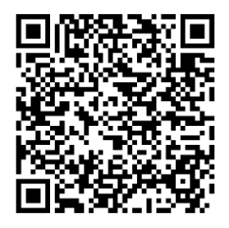
32
Qualifications required to be a
GPwER in lifestyle medicine
Basic qualifications
Primary medical qualification from UK or overseas.
MRCGP or equivalent route to UK general practice (e.g., Certificate
of Eligibility for GP Registration).
Full GMC registration with licence to practise on NHS performers list.
A qualification in Lifestyle Medicine; options include multiple courses which cover the full discipline of lifestyle medicine principles.
Other qualifications in lifestyle medicine containing all six pillars:
The British Society of Lifestyle Medicine Core Accreditation.
International Board of Lifestyle Medicine.
Prescribing Lifestyle Medicine.
Red Whale Lifestyle Medicine
Other qualifications in lifestyle medicine do not contain all six pillars,
but can be combined to cover the full discipline.
More information

Slide 33
33
Further reading
Physical activity guidelines
CMO Physical Activity Guidelines (2019)
WHO Physical Activity Guidelines (2020)
Textbooks
Physical Activity for Health
Psychology of Physical Activity
Popular science books on physical activity
Exercised by Dan Leiberman
Spark: The Revolutionary New Science of Exercise and the Brain by John Ratey

Slide 34

FUNDING
OPPORTUNITIES
Useful tips to help support your projects

Slide 35
35
How to get your projects off the ground
Build a strong business case using provided examples in our resources section.
Identify roles like health coaches, dietitians, social prescribers, and care coordinators to support projects.
Focus on cost-effectiveness, staff development, and patient engagement.
Start with quick wins to achieve Active Practice Charter and/or parkrun Practice status to drive culture
change in your area.
Seek external funding from local councils, active partnerships, and sports legacy funds.
Measure outcomes against your organisations key performance indicators to track impact and success.
BUT REMEMBER, if funding is not available, utilising free universal resources and a small amount
of staff time can allow you to achieve meaningful impact for patients and staff. Funding is a bonus
not a necessity.

Slide 36









Funding approach and options
36
Who has the skills in your team to apply for funding? Consider hiring
a funding consultant
We often worry that offering lifestyle medicine at practice/network level is not financially possible.
Build a team within your organisation with a variety of skills.
Where can we get funding?
Create a business case, aligning to your organisation’s key performance indicators
Sport legacy funding
Local councils
Charities
Explore funding options out there!
National Governing bodies

Slide 37




Example funding applications
37
Group
Consultation
Grant
National Running
Show grant
Think Active
(active partnership)
Live Longer
Better grant
Warwick District Council Physical
Activity and
Sport grant

Slide 38
38
Business case
Definition: A structured proposal that outlines the rationale, benefits, and feasibility of a project to guide decision-making.
Purpose for lifestyle medicine: Demonstrates how initiatives (e.g., group consultations, exercise prescriptions) align with clinical goals and improve patient outcomes.
Key elements:
Problem: Define the health issue to address.
Solution: Outline the proposed lifestyle intervention.
Benefits: Highlight patient outcomes, cost savings, and practice improvements.
Resources: Specify funding, staff, and infrastructure needs.
Approval pathway: Submit to practice or network/cluster leadership or commissioners, linking to health priorities (e.g., NHS Long Term Plan).
Tips: Use evidence-based data, patient feedback, and show scalability for long-term impact.
Example: Leamington PCN - business plan for group lifestyle service

Slide 39
39
Service evaluation
Definition and purpose: Service evaluation measures current practices to assess the standard of service and identify areas for improvement.
Scope: It can focus on specific aspects (e.g., waiting times) or provide a comprehensive review of the entire service.
Approval requirements: Ethical approval is not needed, but may require approval from the relevant organisation you work in.
Process: Systematic research methods are used to evaluate the quality or value of a service, generating evidence for improvements.
Drivers for evaluation: Priorities include new service assessments, innovations, commissioner requests, feedback from users/carers, staff concerns, or productivity issues.
Example: Bedfordshire and Great Yarmouth and Waveney PCTs Improving Healthy Lifestyles QIPP Evaluation Report

Slide 40
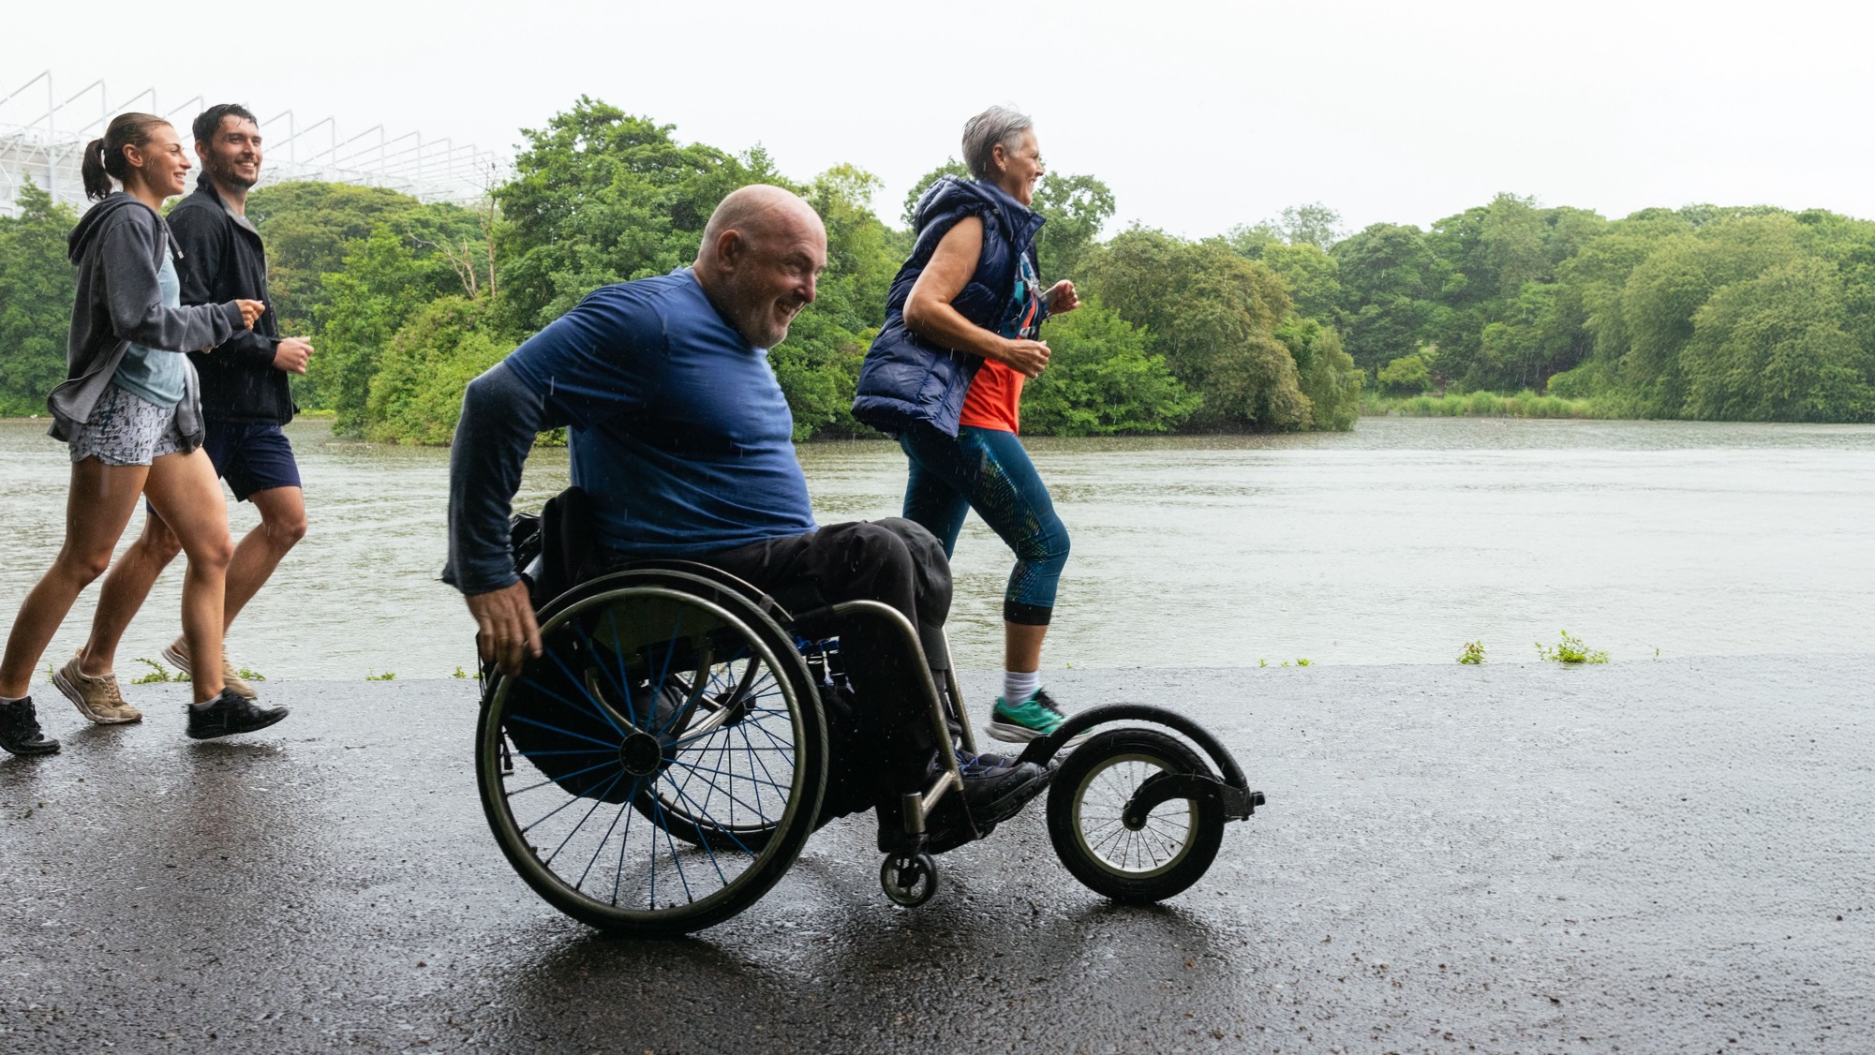
MEDICAL
INDEMNITY
What considerations should you be taking when practicing lifestyle and physical activity

Slide 41
41
Medical indemnity
Indemnity: Ensure adequate insurance covers your full scope of practice; private practice may require additional corporate indemnity.
CQC registration: Lifestyle medicine is a regulated activity; confirm if CQC registration is needed, especially in private settings.
Appraisal and revalidation: Regular GMC appraisal required, covering lifestyle medicine scope and relevant CPD activities.
Complaints policy: Maintain an accessible complaints policy; follow NHS or private sector procedures as applicable.
Data protection: Comply with the Data Protection Act; register as a data controller if practicing independently.
Financial transparency: Be open with patients about fees if applicable and manage any conflicts of interest transparently.
→ More information

Slide 42
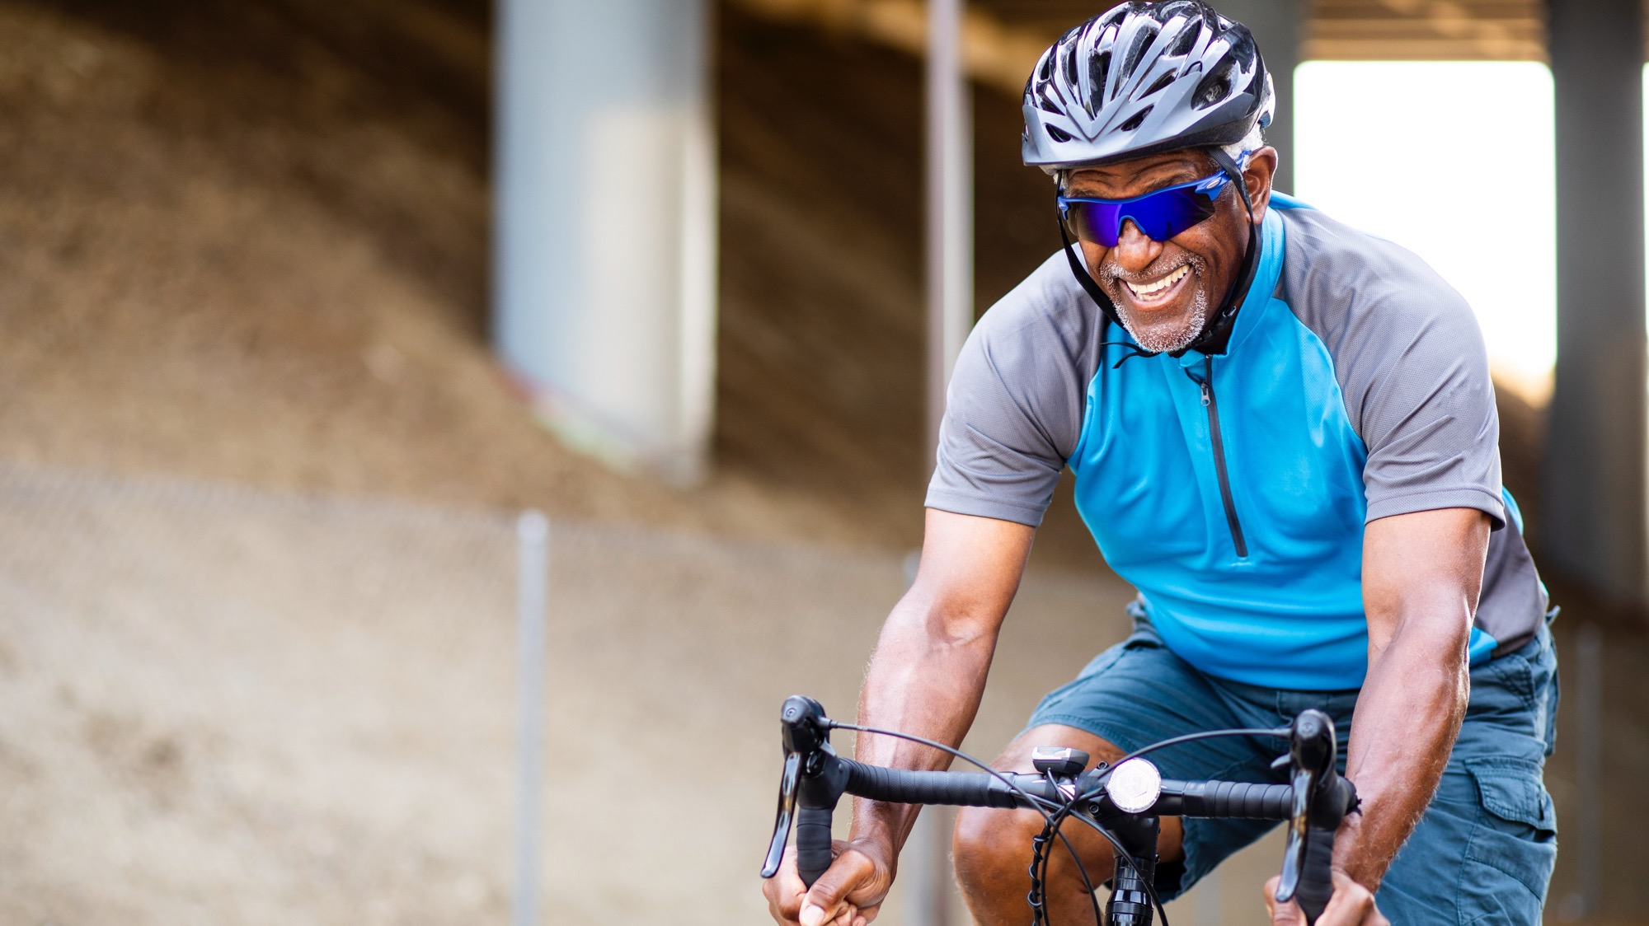
EVALUATION
Quality improvement project templates to support Active Practice evaluation

Slide 43
Evaluation
43
The aim of this template evaluation form is to guide and support your practice in assessing the impact of signing up to Active Practice Charter, alongside streamlining and facilitating quality improvement projects.
The evaluation contains three forms. It has been designed to offer options based upon need and interest, with Part 1 the easiest to perform. All parts can be performed independently or sequentially.
Form 1: demographics and delivery
Form 2: staff questionnaire
Form 3: evaluation of physical activity coding
We hope this evaluation template can help you in assessing how you deliver the Active Practice Charter and its’ potential impact, whilst also assisting you, colleagues or trainees in appraisal/portfolio requirements.
→ More information

Slide 44
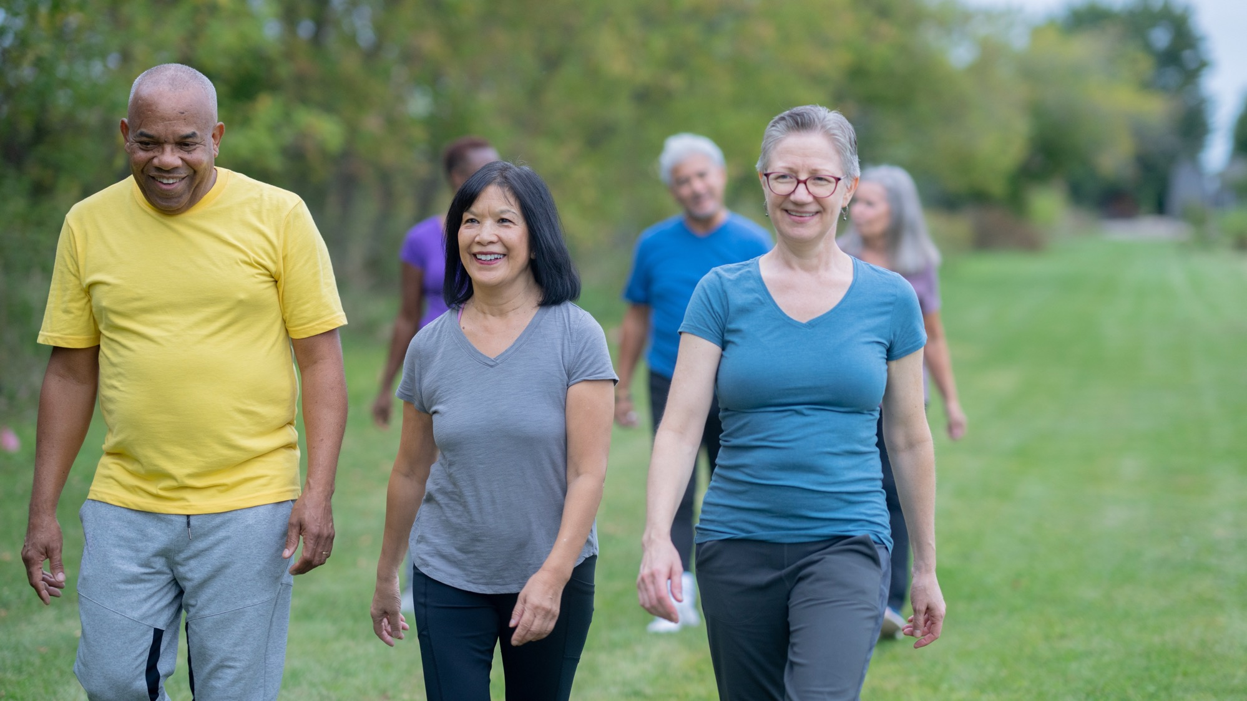
CASE
STUDY
Case study
Active practices in practice!
Active practices in practice

Slide 45
Leamington Spa Primary Care Network
45
Team make-up:
GP with extended role in Lifestyle Medicine
Health and wellbeing coach
Social prescribers x 3
Dieticians x 2
GP ST on rotation 6 monthly with a special interest in Lifestyle Medicine
Patient champions
→ More information

Slide 46
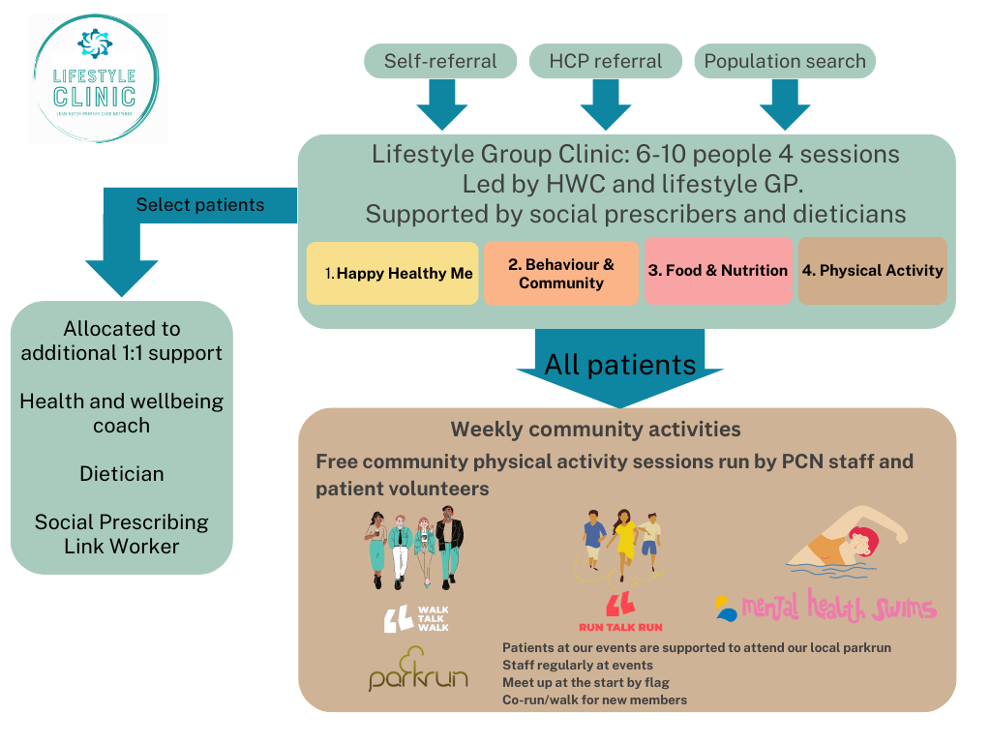
Leamington Spa Model
46
Leamington Spa model

Slide 47
Referral options
47
Self-referral: practice websites and social media
Clinician referral: consultation, lab result or clinic letter
Social prescribing referral: Social prescribing referrals are prioritised to identify and support patients from lower socio-economic backgrounds
Population searching: via clinical systems (SNOMED).
Notes:
Self-referral
Self-referral through practice websites helped identify the most motivated and to remove the barrier of patients needing to arrange an appointment before gaining access to the service.
Clinician referral
If a patient is identified from a consultation, lab result or clinic letter they are offered a referral to the service. Attempting to achieve the needed behaviour change into a tight consultation is near impossible, but looking to get the patient to sign up to the lifestyle group clinics is a more achievable task.
Social prescribing referral
Social prescribing referrals are prioritized to identify and support patients from lower socio-economic backgrounds. They are supported to attend the sessions and the content is designed to support lifestyle changes on a very limited budget. Information is provided on how to access food banks, free physical activity providers and community support.
Population search
To further identify patients with the highest clinical and social need, we run searches on our clinical system. A care coordinator or clinician then contacts the patients to discuss the service and gain consent. Approximately 50-60% of patients contacted took up the offer.
An important aspect when signposting patients to any lifestyle intervention whether within primary care, the fitness sector or community groups is to track progress by entering specific SNOMED codes which can then be searched periodically. There are many potential codes, so agreement must be reached. The Social Prescribing Information Standard was introduced to enable the sharing and recording of information for the whole patient’s journey. Having nationally established lifestyle codes embedded through clinical system templates allows staff to easily select relevant codes (See RCGP Physical Activity Hub codes: https://elearning.rcgp.org.uk/mod/page/view.php?id=15827)

Slide 48
The group sessions
48
Session 1: Happy, healthy me
Session 2: Behaviour, community and hurdles
Session 3: Nutrition, NOT Diet!
Session 4: Physical Activity
Notes:
Session 1: Happy, healthy me (led by GP and health and wellbeing coach)
In session one we spend time discovering who our patients are what matters to them and give them space to outline their health journey and motivations for change. We also outline who we are and look to build confidence and trust. Motivational interviewing techniques are employed to structure the session. A key component is identifying barriers and potential opportunities for behaviour change to shape the upcoming sessions. The structure of the four sessions is outlined and patients are given a workbook with useful information and related content. This includes a 7-day food and mood diary which they return during session two. It is often a very reflective practice for patients and gives them a better appreciation of their behaviour around nutrition.
Session 2: Behaviour, community, and hurdles (led by social prescriber)
In this session, we explore how our behaviours are influenced by our environment and vice versa. Understanding how we think can help us learn to avoid the many pitfalls that result in us straying from a new lifestyle intervention. We discuss the science of behaviour change as outlined in the capability, opportunity, and motivation (COM-B) model (Wilmott et al., 2021) and equip patients with a funded mobile application designed to log identified lifestyle changes and support patients achieve them. We facilitate the group to create their first goal, with a focus on making small, meaningful goals rather than large aspirational ones which often lead to failure. The importance of joining a community like our free fitness club is discussed to help maintain motivation, gain confidence, and overcome hurdles. Many of the hurdles identified are related to social determinants. This is tackled through accessing grant funding and developing mutually beneficial relationships with providers to help patients from low socio-economic backgrounds access healthy food, digital solutions, and physical activity offerings either free or at vastly reduced cost. The fitness club, run by the PCN supports patients to access other community events like parkrun, through promotion and education during the sessions, and then accompanying patients at the event. Collaboration with our local parkrun through the parkrun practice initiative was crucial to achieve this relationship.
Session 3: Nutrition NOT Diet! (led by dietician)
One of the activities is getting patients to tell us the first thing that comes into their head on the mention of the word ‘food’. Many have negative thoughts or emotions towards it. But food is not something to be feared. It is crucial for our survival and health. The right foods can help protect and improve our health. However, the wrong foods can have a substantial impact on quality of life, energy levels and mood. In this session we explore their thoughts around nutrition and help debunk some myths while explaining why we can so often have an unhealthy attitude towards what we eat secondary to the food environment we live in. A large chunk of our patient population at the group clinics lives in the more deprived areas of Leamington where there are limited options to buy affordable healthy food, and many are on means-tested benefits with a restricted budget. We highlight local initiatives who support healthy eating like the Lillington pantry to help them access nutritious food at a vastly reduced cost.
Session 4: Physical activity (led by health and wellbeing coach)
Here, we delve into the crucial role that physical activity plays in promoting both physical and mental well-being. A recurring theme among our patients is their perception of physical activity, often viewing it as a beneficial yet burdensome task, marked by discomfort and strenuous effort. Many individuals express a sense of inability to engage in more active lifestyles, citing constraints such as time limitations, physical or mental health obstacles, or past advisories from healthcare professionals deeming it unsafe. However, it is imperative to note that the consensus statement on risk, as articulated by Reid et al. in 2022, highlights that only a limited number of cases warrant caution against physical activity.
We aim to reshape the mindset around physical activity to enjoyable movement, by emphasizing the joy, fun, and opportunities for connecting with nature and loved ones. In our sessions, we explore various forms of movement and encourage participants to identify personalized approaches to staying active.
As part of our long-term support strategy, we prioritize establishing therapeutic communities for patients with limited social networks. This involves organizing group activities through our fitness club and collaborating with local events like parkrun. Additionally, we cultivate partnerships with various community entities, including ecotherapy, dance, and art groups, providing diverse options for patients. Our association with the local active partnership not only offers support but also guides us to relevant opportunities, ensuring a holistic and community-driven approach.

Slide 49
Physical activity sessions on offer
49
Monday
10:30 Spa Pramblers group for new parents. Buggy walk in South Leamington.
18:30 Walk Talk Walk/Run Talk Run group from a North Leamington GP practice.
Thursday 11:00 Walk Talk Walk group from a South Leamington GP practice.
Twice weekly Swim Together group at the centrally located Leamington Spa Leisure Centre (supported by Mental health swims, Everyone Active and Swim England).
Leamington parkrun, Saturday: patients accompanied to our local event to spectate, volunteer, walk or jog. This program is called ‘path to parkrun’.

Slide 50
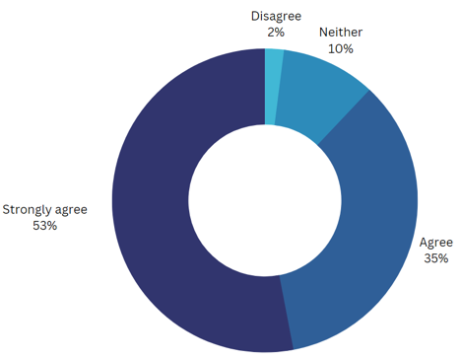
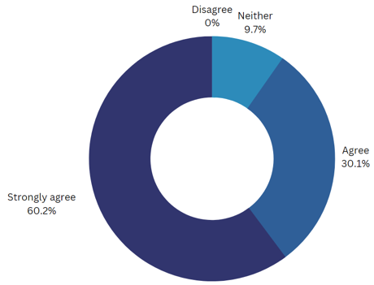
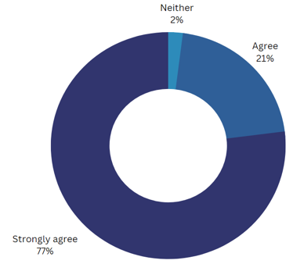
The outcomes
50
Data based on 142 patients who attended Lifestyle Clinic at a North Leamington GP practice location between 09/21 – 11/22.
Do you have increased confidence to make lifestyle changes?
Have you noticed any positive impacts on your physical health?
Have you noticed any positive impacts on your mental health?

Slide 51
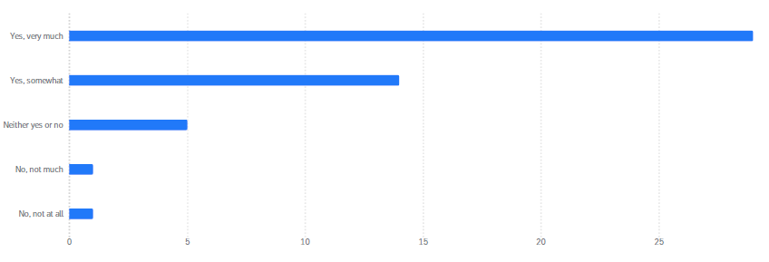
The outcomes
51
Has the Lifestyle Clinic increased your confidence in making positive changes in your life? Please select one and explain your answer where possible

Slide 52
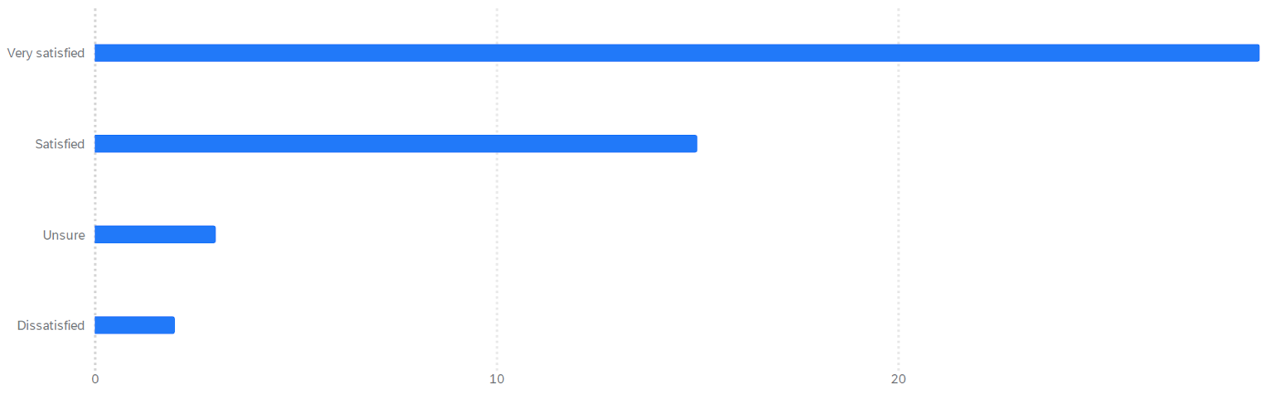
The outcomes
52
The outcomes
What was your overall experience of the LifeStyle Clinic? Please select one and explain your answer where possible

Slide 53
The outcomes
53
The outcomes
Patient feedback
I remember going to my first session when I couldn’t manage 100m without stopping and I had that awful habit of cuffing away on cigarettes. Now, I’m entering organized races and kicked the filthy habit, all thanks to the people who support and give positive encouragement.
Being part of the lifestyle clinic has been life changing for me and I started just after the first lockdown and not looked back! I have gained so much more confidence whilst improving both my physical and mental health. Everyone is so welcoming and supportive.
If has given me increased self belief and a ‘yep, I can do this’ attitude which isn’t easy to achieve especially alone.
I have now joined a gym and go three times a week, we eat a lot less meat and processed foods. I cook from scratch more. This clinic has been life-changing for me and eve enabled to better engage with talking therapy.
Staff feedback
Running the lifestyle service is the highlight of my working week. It is an outlet for creativity, gives me the time and space to have behaviour change conversations with patients in a sensible timeframe, and allows me to work closely with ARRS staff and learn from them – Lead GP
It is a privilege to accompany patients on their health journey. Seeing patients go from attending their first Lifestyle Clinic, to achieving their first health goal is just the best feeling. And with our physical activity groups, not only can I offer activity suggestions – I’m able to be active with them! – Health and Wellbeing Coach
I previously worked in a hospital setting. Coming into a PCN was a new experience and I wondered how I would be utilised. Supporting group clinics and having such incredible options all within the PCN has been a really positive experience – Dietitian
I really enjoy supporting the groups and physical activity sessions. I am passionate about walking and as an older woman from south Asian community I like to role model the benefits of movement to encourage more from my community – Social Precriber
“
“
“
“

Slide 54
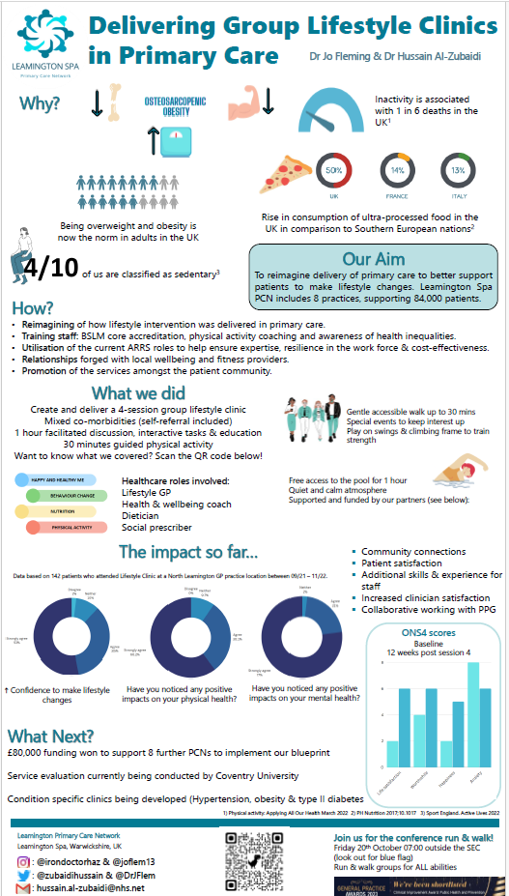
54

Slide 55
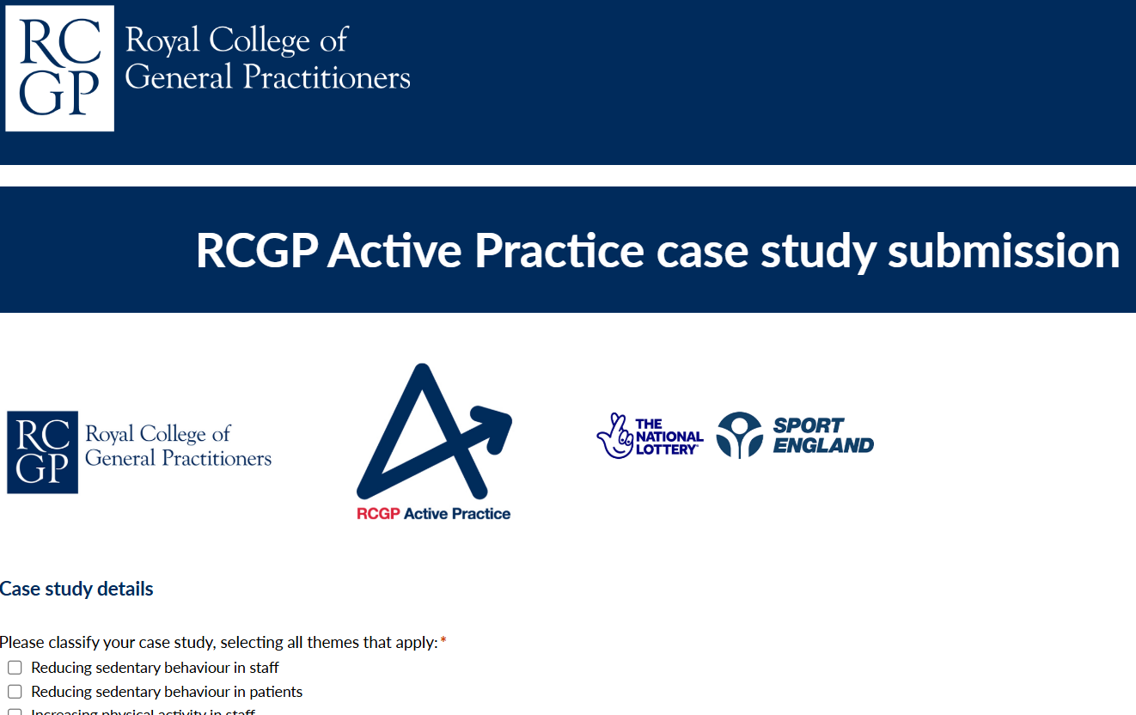
Submit your story
55
We encourage all Active Practices, networks, and clusters to share their inspiring journey with the RCGP Active Practice team! Your story can help highlight the positive impact of integrating physical activity into healthcare. Please use the form to submit your story and inspire others to follow in your footsteps.
→ More information

Slide 56

56
  This toolkit was written by:
Dr Hussain Al-Zubaidi @irondoctorhaz
GP in the West Midlands
Physical Activity and Lifestyle Champion at RCGP
parkrun Health Partnerships Lead
Swim England Health Commission Advisor
Dr Callum Leese @drcalluml
GP in Aberfeldy and Kinloch Rannoch
Academic Fellow in General Practice at University
of Dundee
Physical Activity and Lifestyle Champion at RCGP
Former WHO Consultant
  In collaboration with the RCGP Physical Activity and Lifestyle Project, funded by Sport England and the RCGP. Version 3.
  The Royal College of Practitioners is a network of over 55,000 family doctors working to improve care for patients. We work to encourage and maintain the highest standards of general medical practice and act as the voice of GPs on education, training, research and clinical standards.
  Royal College of Practitioners
  30 Euston Square, London NW1 2FB
rcgp.org.uk
  Royal College of General Practitioners is a registered charity (Number 223106) and Scotland (Number SC0404300).

