Slide 1
Back-up/delayed antibiotic prescriptions Why and how to use them in primary care settings TARGET webinar series: Effective antibiotic prescribing: shared decision-making & delayed prescriptions part 2
Presented by: Dr Linda Strettle
25 November 2021
Notes:
Learning objectives:
Understand the evidence for using back-up/delayed antibiotic prescriptions
Recognise when it is appropriate to use back-up/delayed antibiotic prescriptions
Discover quick and easy tips on how to explain delayed antibiotic prescriptions to patients
Learn different ways to issue delayed antibiotic prescriptions
Who is it for:
Primary care prescribers including: GPs, GPNs, practice managers, pharmacists, AHPs and medical students.
Suggestions for use:
Familiarise yourself with this slide deck
Familiarise yourself with the “Discussing antibiotics with patients: back-up/delayed prescriptions” TARGET website section
Email the slides to all practice staff after the meeting & discuss them with those who couldn’t attend

Slide 2
Aims
Understand the evidence
Recognise when back-up prescriptions are appropriate
Quick and easy tips on how to explain back-up antibiotic prescriptions to patients
Learn different ways to issue back-up antibiotic prescriptions

Slide 3
Terms
Delayed prescriptions
‘Back-up’ prescriptions
Deferred antibiotics
Just-in-case antibiotic
Always explain your intention to the patient
Notes:
There are various terms we can use for delayed or back-up antibiotics and these can mean different things to different people. To be clear, for the purpose of this presentation we are discussing delaying antimicrobial prescribing when there is clinical uncertainty about whether a condition is self‑limiting or is likely to deteriorate. Specifically this is in the context of patients presenting with current acute self-limiting infections rather than about providing rescue packs for acute infections associated with chronic conditions.
Regardless of the terminology you use, it is important that you always explain your intent to the patient – do not assume they understand your terminology.

Slide 4
Why use back-up antibiotic prescriptions?
Reduce patient use of antibiotics
Useful if unsure whether immediate antibiotic is needed
Little difference in symptomatic benefit with immediate vs. back-up antibiotics
Increase patient’s ability to self-manage infections
Prevent complications
Reduce re-consultations
Notes:
Speaker notes
Here are 6 reasons for why should you use back-up/delayed antibiotic prescriptions
In the following few slides we will examine the evidence behind these statements.

Slide 5
Back-up antibiotic prescriptions - Why?
1. Reduce patient use of antibiotics
2014 trial: Only one third of patients use antibiotics when given a back-up prescription
Little P, et al. BMJ 2014; 348 :g1606
doi:10.1136/bmj.g1606
Notes:
Speaker notes
Reduce patient use of antibiotics
Using delayed or back-up antibiotics can actually reduce patient use of antibiotics as many patient will not actually get the antibiotics.
In 2014 - A Large randomized control trail in the UK looked to estimate the effectiveness of different strategies involving delayed antibiotic prescription for acute respiratory tract infections
The study looked at 889 patients aged 3 years and over with acute respiratory tract infection
The study found that only <40% of patients use antibiotics when given a back-up prescription.
Fast forward to 2021 – a telephone survey of 1676 members of the English general public found that only 3% were offered a delayed antibiotic throughout 2020 – note that 75% of these found it completely acceptable and only 4% stated it was unacceptable. – but of these 3%, again only about 40% took the antibiotic.
Additional notes on the 2014 trial (Little et al. 2014)
Patients who were judged not to need immediate antibiotics were randomised to undergo 4 different types of delayed prescription: (1) recontact for a prescription, (2) post-dated prescription, (3) collection of the prescription, (4) and be given the prescription (patient led). During the trial, a strategy of no antibiotic prescription was added as another randomised comparison.
Symptom severity: Minimal differences in mean symptom severity between the strategies involving no prescription and delayed prescription
Symptom duration: Duration of symptoms rated moderately bad or worse also did not differ between no prescription and delayed prescription strategies combined (median 3 days v 4 days; 4.29, P=0.368). There were modest and non-significant differences in patients very satisfied with the consultation between the randomised groups
Strategies of no prescription or delayed antibiotic prescription result in fewer than 40% (around one third) of patients using antibiotics, and are associated with less strong beliefs in antibiotics, and similar symptomatic outcomes to immediate prescription. If clear advice is given to patients, there is probably little to choose between the different strategies of delayed prescription.

Slide 6
Back-up antibiotic prescriptions – Why?
2. Useful if unsure whether immediate antibiotic is needed at that time
English RCT comparing three treatment strategies for sore throat (n=582)
Little, Williamson, Warner et al. BMJ . (1997) 314:722 - 727
Notes:
Presenter notes: There has been much discussion about the use of giving delayed antibiotic prescriptions in acute uncomplicated infections, to reduce antibiotic use and reduce patient expectations (although patients understand the term back-up more easily – so we have now changed to this term. A Cochrane review has recently shown the benefits of this approach, without increasing complications in patients.
This study in acute sore throat is an exemplar. patients in 11 English GP practices were randomised into immediate antibiotics, delayed antibiotics and no antibiotics groups.
There was no difference in recovery rates and high levels of satisfaction with all strategies. Compared to immediate antibiotics those given no antibiotics or delayed antibiotics had a reduction in belief in antibiotics for sore throat and were less likely to visit the GP again for similar symptoms. A more recent study of acute sore throat (the DESCARTE study) in fact showed that complications in those who received immediate were similar to those receiving a back-up prescription even though 30% did not collect the prescription, and in the study complications were higher in the no antibiotic group. Thus giving more control to the patient does help prevent complications, but with a back-up antibiotic safety netting instructions are important.
The back-up prescription is very useful to give to patients who have a high expectation for antibiotics, and can be given using the patient leaflet I will show you.
Detailed results of Little et al: Median duration of antibiotic use differed significantly in the three groups (10 v 0 v 0 days, P < 0.001); 69% of patients in group 3 did not use their prescription. The proportion of patients better by day 3 did not differ significantly (37% v 35% v 30%, P = 0.28), nor did the duration of illness (median 4 v 5 v 5 days, P = 0.39), days off work or school (median 2 v 2 v 1, P = 0.13), or proportion of patients satisfied (96% v 90% v 93%, P = 0.09), although group 1 had fewer days of fever (median 1 v 2 v 2 days, P = 0.04). More patients in group 1 thought the antibiotics were effective (87% v 55% v 60%, P < 0.001) and intended coming to the doctor in future attacks (79% v 54% v 57%, P < 0.001). "Legitimation" of illness-to explain to work or school (60%) or family or friends (37%)-was an important reason for consultation. Patients who were more satisfied got better more quickly, and satisfaction related strongly to how well the doctor dealt with patient's concerns.
In other studies delayed prescriptions have led to the greatest reduction in future consultation in sore throat (Little 2007) and LRTI (Moore 2009).
A Cochrane review of 10 studies has shown that delayed prescriptions reduce antibiotic prescriptions without reducing satisfaction
Antibiotic use (%) Satisfaction (%)
Immediate 93 92
Delayed 32 87
No 14 83

Slide 7
Back-up antibiotic prescriptions - Why?
3. Little difference in symptomatic benefit with immediate vs. back-up
 | Total Duration untreated | Beneficial effect from antibiotics | NNT for one additional patient to benefit | NNT for one additional adverse effect
Otitis media | 4 -12 days | 8-12 hours | 18 | 9
Sore throat | 8 days | 12-18 hours | 6-20 | 15
Sinusitis | 12-15 days | 24 hours | 18 | 8
Bronchitis | 20-22 days | 11-24 hours | 10-22 | 24
Cochrane reviews Otitis media: Venekamp et al (2015); Sore throat: Spinks et al. 2013; Sinusitis: Leminengre M et al. (2012); bronchitis: Smith et al. (2014)
Notes:
Presenter notes:
How useful are antibiotics for common respiratory tract infections? This table includes much of the research on what we know about common respiratory tract infections, how long the symptoms usually last, and how much patients benefit from taking antibiotics. As you can see from the circled column, antibiotics reduce symptoms for between 8 and 24 hours. So at best about 12 hours in otitis media, an illness that lasts for 4 to 8 days; taking a look at the NNT Benefit and NNT Harm columns – 18 patients with OM need to be treated with antibiotics for one patient to benefit, but for 9 patients receiving antibiotics one will experience an adverse effect. For bronchitis, an illness that lasts for about three weeks, the reduction in days with cough was less than half a day and the reduction in days feeling ill was just over half a day with antibiotics.
Any benefit that our patients achieve from antibiotics is tiny and the numbers needed to treat to achieve one satisfactory earlier resolution needs to be weighed against the one in 10 chance of causing side effects such as diarrhoea, vomiting, rash, allergic reaction (1 in 15) or the risk of carrying a resistance bacteria. So, unless symptoms are particularly severe, there is no reason for using antibiotics in the majority of patients presenting with respiratory symptoms because they do not help.
Evidence
This evidence is all outlined in the PHE antibiotic guidelines and NICE CG69, but most recent systematic reviews include:
Otitis media
Venekamp et al (2015) Antibiotics for acute middle ear infection (acute otitis media). Cochrane
http://www.cochrane.org/CD000219/ARI_antibiotics-for-acute-middle-ear-infection-acute-otitis-media-in-children
This systematic review included 13 RCTs involving 3401 children with otitis media (3938 episodes). Pain was not reduced by antibiotics at 24 hours. A third fewer had residual pain at 2-3 days (at which point pain levels are usually substantially reduced) and NNT for an additional beneficial outcome was 20. Antibiotics reduced the number of Tympanic Membrane perforations, but NNT for Benefit is 33. Severe complications were rare and did not differ between children given antibiotics and those given placebo. Antibiotics are most beneficial for children aged <2 yrs with bilateral AOM (NNTB 4) or with both AOM and discharge (NNTB 3). Immediate antibiotics were associated with a substantial increased risk of vomiting, diarrhoea or rash compared with no treatment (NNTH9).
Sore throat
Spinks A et al. (2013) Antibiotics for sore throat. Cochrane
http://onlinelibrary.wiley.com/doi/10.1002/14651858.CD000023.pub4/pdf/abstract
27 RCTs of antibiotics for sore throat vs placebo including 12 835 cases. Antibiotics were most beneficial if given at day three if throat swabs were positive for streptococcus (NNTB 6) compared to NNTB at day 7 of 21. Antibiotics reduced duration of symptoms by 16 hours on average. 90% resolve in 7 days. Advantages may be greater in low income countries (possibly recent travelers from these countries – personal communication Dr L Hendricks) where the risk of rheumatic fever is higher. NNTH is 15.
Little P et al (2013) – 2 studies within the PRISM trial used a Clinical score compared to rapid antigen detection test to guide antibiotic use for sore throats. The RCT using clinical scores to predict streptococcal infection in patients and found that the use of FeverPAIN is likely to moderately improve symptom control and reduce antibiotic use. PHE and NICE guidance suggests Consider immediate antibiotics if symptoms severe or a short 48 hour back-up strategy may be appropriate, when the FeverPAIN score is 4 or over. Consider back-up or no antibiotic if score 2-3.
Sinusitis
Leminengre M et al. (2012) Antibiotics for clinically diagnosed acute rhinosinusitis in adults. Cochrane.
http://onlinelibrary.wiley.com/doi/10.1002/14651858.CD006089.pub4/pdf/abstract
10 RCTs of antibiotics vs placebo including 2450 participants. Irrespective of treatment group 47% of patients were cured after 1 week, 71% after 14 days. 18 patients need to be treated for a faster cure rate between 7 and 14 days. If several of: purulent nasal discharge; severe localised unilateral pain; fever; marked deterioration after initial milder phase, patients were more likely to benefit from antibiotics, when PHE and NICE recommend a back-up antibiotic. One disease related complication (brain abscess) occurred in patient treated with antibiotics, but complications are rare.
Bronchitis/LRTI (without pneumonia)
Smith S et al. (2014) Antibiotic treatment of people with clinical diagnosis of acute bronchitis. Cochrane
http://www.cochrane.org/CD000245/ARI_antibiotic-treatment-people-clinical-diagnosis-acute-bronchitis
17 trials with 5099 participants were included. The number needed to treat for one additional beneficial outcome was 22 (NNTB 22). The reduction in days with cough was 0.46 days and days feeling ill was 0.64 days (CI 1.16-0.13). NNT for an additional adverse effect was 24.

Slide 8
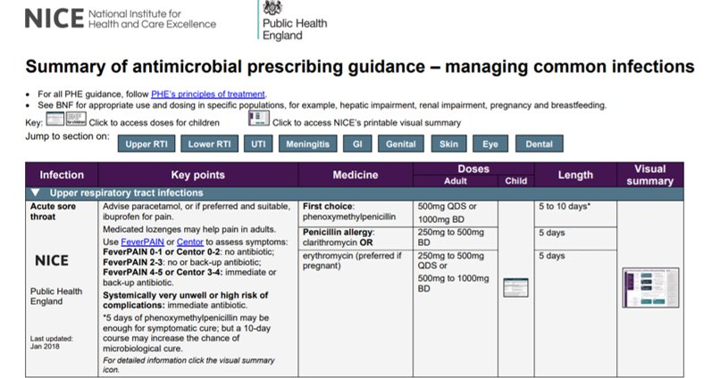
https://www.bnf.org/wp-content/uploads/2021/09/summary-antimicrobial-prescribing-guidance_aug-21_final.pdf

Slide 9
Who is higher risk?
Notes:
Presenter notes:
Serious complications are rare after URTI, sore throats and otitis media. There are some patient groups at slightly higher risk of complications after LRTI or bronchitis and the current guidelines target prescribing for those at highest risk, for example in those aged 65 or older with 2 or more of: recent hospitalisation, diabetes, CCF or recent steroid use. and even then you still have to treat a number of patients for one to benefit.

Slide 10
Back-up antibiotic prescriptions - Why?
4. Increase patient’s ability to self-manage infections
Did not take the delayed antibiotic
97% not given a delayed script
(n=1676)
59%
41%
3% given a delayed script
75% of all respondents felt that it was acceptable to be offered a delayed script by their GP
PHE 2021 General Public Health Seeking Behaviour for RTI survey – in press
Notes:
Presenter notes:
A 2021 telephone survey of 1676 members of the English general public found that only 3% were offered a delayed antibiotic in the previous 12 months. Note that 75% of all respondents found it completely acceptable and only 4% stated it was unacceptable. Of this 3%, again only about 40% took the antibiotic.

Slide 11
Back-up antibiotic prescriptions - Why?
In general, do you support or oppose GPs, nurses or dentists or other healthcare professional prescribing ‘delayed / back-up’ antibiotic prescriptions for the following infections?
% support
2021 | 2020
63% | 50%
59% | 47%
54% | 45%
Base: All adults aged 18+ in England: 2021 (1676); 2020 (2052) : Fieldwork dates: 26 February to 2 March 2021
= significantly higher/lower than 2020
PHE 2021 General Public Health Seeking Behaviour for RTI survey – in press
Notes:
In this same public survey, when all participants were asked do you support or oppose health care professionals prescribing delayed or back-up antibiotic prescriptions for common infections. Over half of those surveyed were in support of using delayed antibiotics for named infections; 63% for urine infections / 59% for ear infections and 54% were in support of using delayed or back-up prescriptions for throat infections. You can see here that public acceptance of delayed antibiotics has also increased since the previous survey in 2020.

Slide 12
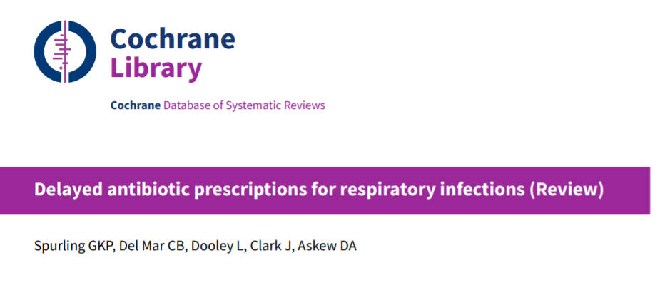
Back-up antibiotic prescriptions - Why?
5/6. Prevent complications (as effectively as immediate antibiotic) & reduce re-consultations (‘doctor shopping’/visits to OOH, A&E)
Little/no difference in:
Re-consultation
Adverse effect
Complications
Spurling GKP, et al. 2017
DOI: 10.1002/14651858.CD004417.pub5.
Notes:
Key presenter point:
Delayed prescriptions do not lead to complications or adverse events
Presenter notes: There has been much discussion about the use of giving delayed antibiotic prescriptions in acute uncomplicated infections, to reduce antibiotic use and reduce patient expectations (although patients understand the term back-up more easily – so we have now changed to this term. A Cochrane review has recently shown the benefits of this approach, without increasing complications in patients.
A Cochrane review from 2017 of 11 studies has shown that:
Comparing delayed vs immediate antibiotics, there was not difference in re-consultation rates
Compared to no antibiotics, delayed antibiotics led to a small reduction in how long pain, fever, and cough persisted in people with colds.
There was little difference in antibiotic adverse effects, and no significant difference in complications.
Spurling GKP, Del Mar CB, Dooley L, Foxlee R, Farley R. Delayed antibiotic prescriptions for respiratory infections. Cochrane Database of Systematic Reviews 2017, Issue 9. Art. No.: CD004417. DOI: 10.1002/14651858.CD004417.pub5.

Slide 13
Back-up antibiotic prescriptions –
How to explain/discuss
Reasons
Reassure patient
Acknowledge
not possible to predict exactly how the illness will progress;
would like the patient to have access to antibiotics if no improvement
T: Be specific about illness timeline/usual course | ‘A typical cough can take 3-4 weeks to clear completely.’
S: Explain shortcomings of antibiotics | Antibiotics don’t help with pain but side effects, such as diarrhoea, nausea and rash, can be experienced by up to 1 in 10 people.’
S: Self-care advice | ‘Pain in the chest or throat is normal due to inflammation, you can take paracetamol, and/or ibuprofen, which will help the pain and soothe the inflammation.’
S: Safety-netting advice | Provide patients with specific information on red-flag symptoms and when they should seek further help
Notes:
Patients are likely to better understand and accept a back-up/delayed antibiotic prescription if you discuss two key points. These can be incorporated in the last four techniques in CHESTSSS (Timeline, Shortcomings, Self-care, Safety-netting).
Patients are likely to better understand and accept a back-up/delayed antibiotic prescription if, in addition to CHESTSSS (especially Timeline, Shortcomings, Self-care, Safety-netting) you provide:
Reasons for giving it
Reassure patient that there is no need for an immediate antibiotic prescription;
acknowledge that it is not possible to predict exactly how the illness will progress;
and that you would like the patient to have access to antibiotics should their symptoms get worse or not improve as expected.

Slide 14
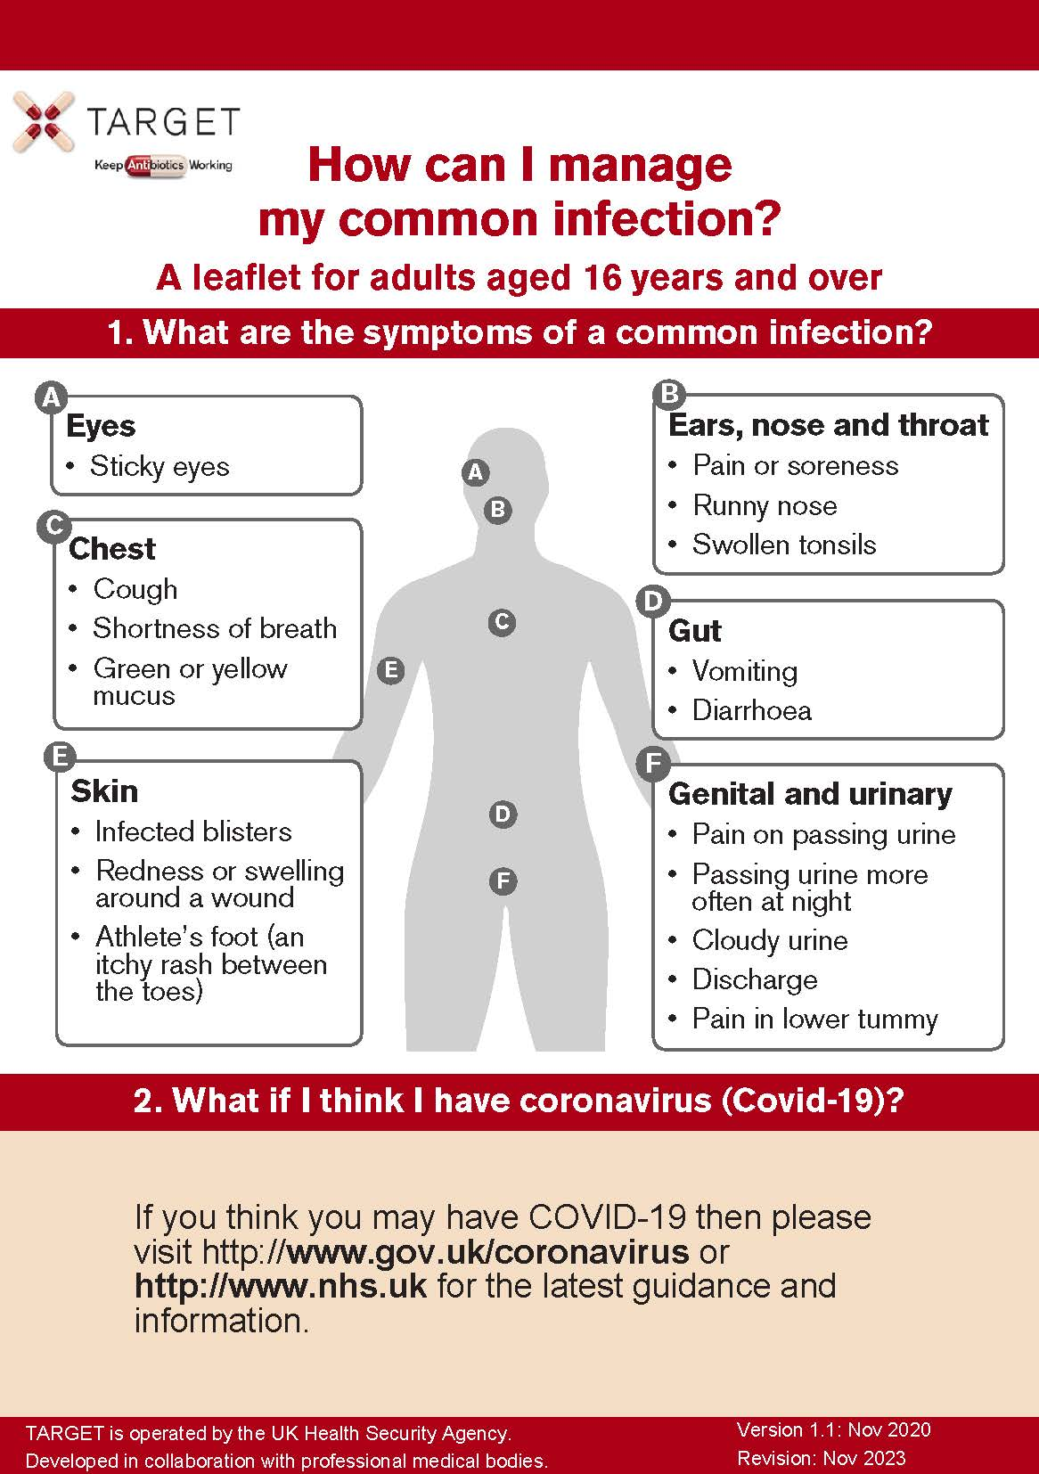
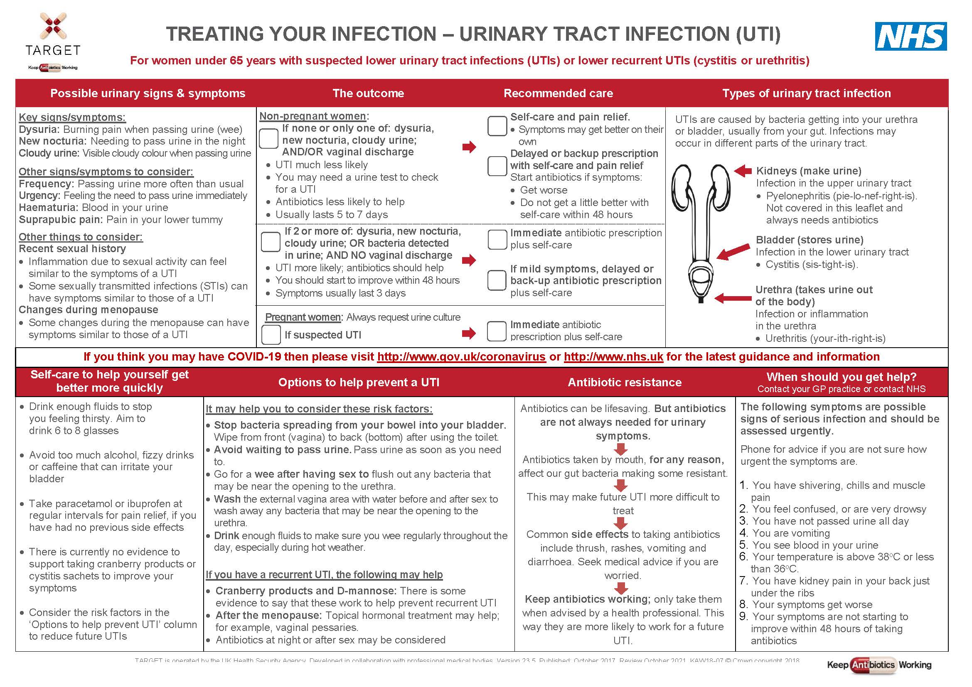
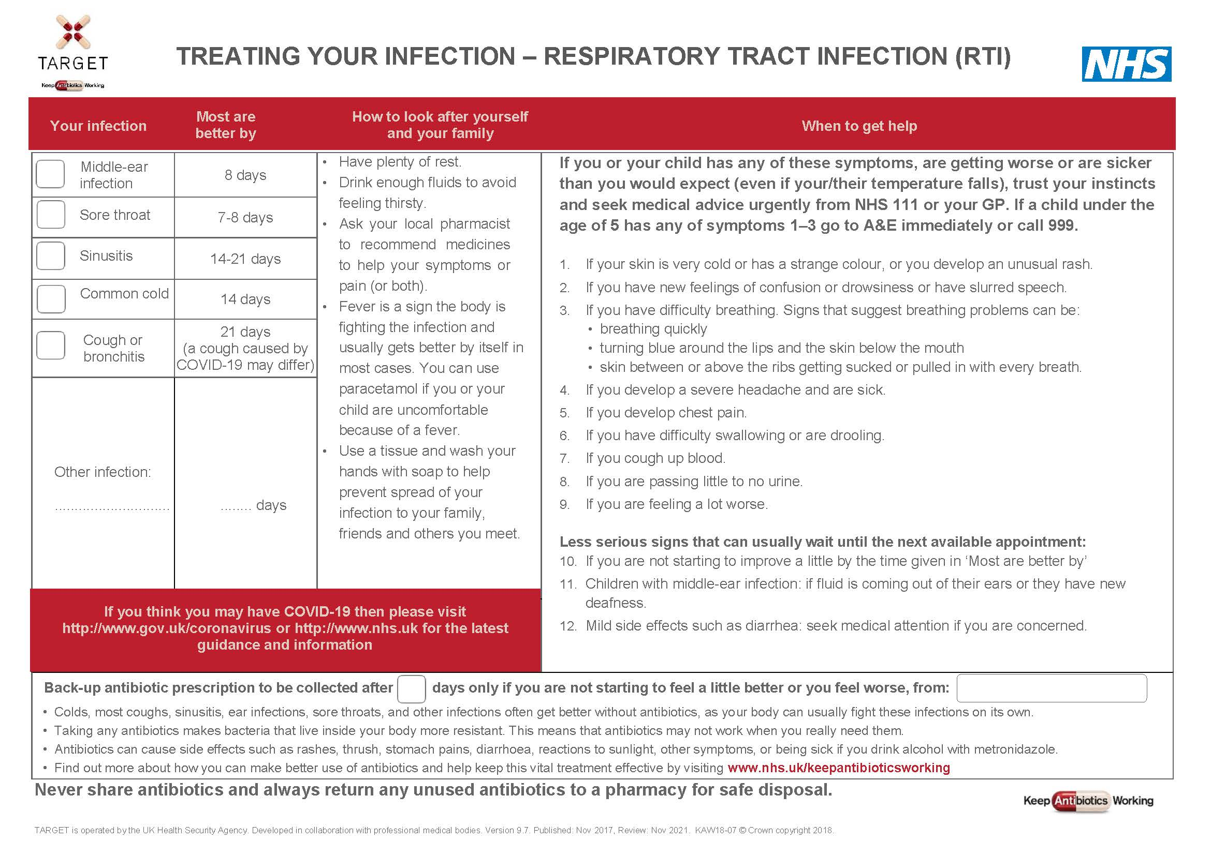
Back-up antibiotic prescriptions -
How to explain/discuss?
Number of days to wait
Tailor advice to experience; history, co-morbidities, & their ability to access antibiotics
Notes:
2. Specify no. of days to wait
Tailor advice to patient’s current experience of infection, prior duration & expected natural history, co-morbidities, & their ability to timely access antibiotics

Slide 15
Back-up antibiotic prescriptions - How?
Issue prescription but advise to get it dispensed only if needed
Post-dated prescription
Collect the prescription from an agreed location
Collect antibiotic now but only use if needed
Contact the practice again to get the prescription
Notes:
Give a prescription with advice to get it dispensed only if needed
Ask patient to collect the prescription from an agreed location
Write a post-dated prescription
Ask patient to contact the practice again to get the prescription
Ask patient to collect antibiotic now but only use if needed.

Slide 16
Back-up antibiotic prescriptions - How?
***Don’t forget to code your treatment choice***
READ codes (Emis, Vision) | SNOMED code (System One) | Definition
8BP0 | 2549788011 | Deferred antibiotic therapy
8CAk | 406111000000113 | Patient advised to delay filling of prescription
8OAN | 2462831000000113 | Provision of TARGET Managing Your Common Infection (Self-Care) Leaflet with back-up antibiotic prescription issued
Notes:
Don’t forget to code your treatment choice. Much of the evidence presented today use Read/Snomed codes to trawl the data, if you haven’t coded its makes it difficult for researchers to understand the benefit or not of any treatment.
The Read/Snomed codes for delayed prescriptions are outlined in this table and you can these slides will be freely available on the TARGET website following this presentation.

Slide 17
Back-up antibiotic prescriptions - When?
You are uncertain about how an infection might progress
The patient remains concerned about illness progression despite you discussing antibiotics
You are concerned that patient may need antibiotics when they will have limited access to medical care

Slide 18
Back-up antibiotic prescriptions Summary
Back-up antibiotics less effective c.f. no prescription of antibiotics in reducing antibiotic uptake?
Yes - slightly higher rates of antibiotic use for back-up, but fine
Back-up will reduce number of patients who come back to see you by 1/3

Slide 19
Back-up antibiotic prescriptions Summary
Medico-legal consequences?: complications
Similar reduction in complications with back-up antibiotics & immediate antibiotics
Less complications in back-up antibiotics & immediate compared to no antibiotics
Two very large cohorts to show that this the case

Slide 20
Back-up antibiotic prescriptions Summary
It takes more time?
Part of good practice anyway!
The key difference is advice about when to consider cashing in

Slide 21
Thank you for all you are doing! www.rcgp.org.uk/targetantibiotics TARGETAntibiotics@phe.gov.uk @TARGETabx

Slide 22
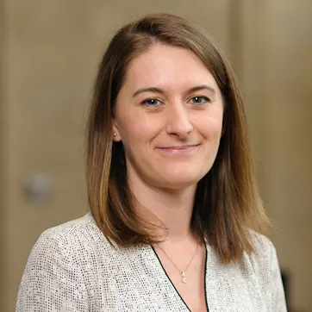
Discussion
Panel Members
Dr Linda Strettle
General Practitioner
Hon Sr Clinical Lecturer
Dr Steve Granier
General Practitioner
Dr Monsey McLeod
Imperial College
Dr Aleksandra Borek
University of Oxford
25/11/2021 V1
www.rcgp.org.uk/TARGETantibiotics
Notes:
Dr Monsey McLeod is Lead Pharmacist for Medication Safety and Anti-infectives Research at the Centre for Medication Safety and Service Quality at Imperial College Healthcare NHS Trust and Honorary Research Fellow at the NIHR Health Protection Research Unit in Healthcare Associated Infection and Antimicrobial Resistance at Imperial College, and at the NIHR Imperial Patient Safety Translational Research Centre. She co-led the STEP-UP Implement Research, in collaboration with colleagues at the University of Oxford, that aims to improve the uptake and sustainability of effective interventions to promote prudent antibiotic use in primary care.
Dr Alexandra Borek is a researcher in health behaviour change. Her research focuses on optimising antibiotic use and implementation of antimicrobial stewardship interventions in primary care; Ola is currently exploring the impact of COVID-19 on antibiotic prescribing and experiences of healthcare workers.

