Slide 1
“I think I need an antibiotic?”
Putting shared decision making into practice
TARGET webinar series:
Effective antibiotic prescribing: shared decision-making & delayed prescriptions
part 1
Presented by: Dr Linda Strettle
25 November 2021
Notes:
Who is it for: Primary care prescribers including: GPs, GPNs, practice managers, pharmacists, AHPs and medical students
Suggestions for use:
Familiarise yourself with this slide deck
Familiarise yourself with the “Discussing antibiotics with patients” TARGET website section
Email the slides to all practice staff after the meeting & discuss them with those who couldn’t attend

Slide 2
Aims
Identify quick and easy communication methods that will enhance your discussions and improve shared decision making with patients
Understand how the use of patient information leaflets can help the shared decision-making process
Notes:
Discussing whether or not an patient needs antibiotics can be tricky, especially if the patient thinks they need them. The aim of this webinar is to ….

Slide 3
Why do we prescribe antibiotics?
Relief of symptoms
Relief of symptoms
Worry about complications
Worry about complications
Previous experience
Previous experience
Patient pressure
Want information and treatment
Notes:
In order to consider how to communicate with patients about the need for antibiotics, its important to understand WHY we prescribe antibiotics in the first instance.
For much of the research available we see clinicians and patients tell a similar story
They want to relieve the symptoms
Worry about complications
Previous experience – On the part of clinicians it is important they are aware of and implement any updated prescribing guidance, on the part of the patient – if they had received antibiotics for a sore throat in the past they may expect it again.
However research also highlights areas of misunderstanding. Evidence shows that prescribers often overestimate patients' expectations for antibiotics and that patients' satisfaction is related to:
Having a careful and thorough examination.
Having their concerns identified and addressed.
Having advice on how to manage their symptoms.
Past research demonstrates that perceived patient demand is correlated with antibiotic prescribing and that clinicians often perceive patient demand where it does not exist. Kohuts findings help explain why clinicians would perceive such demand. Respondents reported risks that come with failing to identify and satisfy inconvincible patients: the emotional drain of trying unsuccessfully to convince them (26) and the conviction that antibiotic prescribing adversely affects patient satisfaction metrics (12,27,28)
So what can we do to change the narrative.

Slide 4
Finding the right words: Why?
Evidence shows that effective communication skills
Increase patient satisfaction & understanding of prescribing decisions
Reduce consultations
Reduce antibiotic prescribing
Notes:
Prescribers already have good general communication skills and have their own individual approaches. However, given short consultations, it is easy to miss out an important element of a consultation or rush over an explanation. This can have a big impact on whether patients are happy with a prescribing decision.
Tweaking your discussions with patients can help:
Increase patient satisfaction: Patients report high levels of satisfaction and enablement in managing their infection, and are more informed about the appropriate use and harms of antibiotics when prescribers discuss antibiotics effectively and when they discuss leaflets interactively.
Reduce consultations: Prudent antibiotic prescribing with effective discussions about antibiotics help reduce re-consultations and future consultations. So it is worth investing a bit of time in these consultations in order to get future benefits.
Reduce your antibiotic prescribing: The examples of how you may tweak your discussions with patients presented here have been shown to be effective in reducing antibiotic prescribing when trialled with prescribers in UK general practice.
This approach and the examples provided in the presentation focus on things to say to patients with acute infections but you may also find them helpful for other consultations.
Additional notes: Evidence of benefits
Evidence shows that prescribers often overestimate patients' expectations for antibiotics and that patients' satisfaction is related to:
Having a careful and thorough examination.
Having their concerns identified and addressed.
Having advice on how to manage their symptoms.
The examples and the CHESTSSS acronym provided in this presentation are based on enhanced communication skills training that has been shown to be effective in a trial [1] with experienced GPs in the UK and on the STAR training [2] also shown effective in a UK-based trial [3]. Evidence from a recent systematic review [4] and a Cochrane overview of reviews [5] also found support for the use of communication skills training and shared decision making as effective strategies to optimise antibiotic prescribing in primary care.
References
Little et al. (2013). Effects of internet-based training on antibiotic prescribing rates for acute respiratory-tract infections: a multinational, cluster, randomised, factorial, controlled trial. The Lancet. 2013; 382(9899):1175-82. https://doi.org/10.1016/S0140-6736(13)60994-0
STAR training. https://www.healthcarecpd.com/course/star-stemming-the-tide-of-antibiotic-resistance
Butler et al. (2012). Effectiveness of multifaceted educational programme to reduce antibiotic dispensing in primary care: practice based randomised controlled trial. BMJ. 2012; 344:d8173. https://doi.org/10.1136/bmj.d8173
Köchling et al. (2018). Reduction of antibiotic prescriptions for acute respiratory tract infections in primary care: a systematic review. Implementation Science. 2018;13(1):47. https://implementationscience.biomedcentral.com/articles/10.1186/s13012-018-0732-y
Tonkin-Crine et al. (2017). Clinician‐targeted interventions to influence antibiotic prescribing behaviour for acute respiratory infections in primary care: an overview of systematic reviews. Cochrane Database of Systematic Reviews. 2017(9). https://doi.org/10.1002/14651858.CD012252.pub2

Slide 5
Finding the right words: How?
Key elements of effective consultations (CHESTSSS)
C: Ask specifically about concerns | ‘What are the things you are most worried about?’
C: Ask specifically about concerns | ‘What are the things you are most worried about?’
H: Discuss history and exam | While doing an examination provide ‘no problem’ commentary ‘Your heart rate is normal, your temperature isn’t raised’
C: Ask specifically about concerns | ‘What are the things you are most worried about?’
H: Discuss history and exam | While doing an examination provide ‘no problem’ commentary ‘Your heart rate is normal, your temperature isn’t raised’
E: Ask specifically about expectations | How do you think I could most help you today?’ or ‘How do you feel about antibiotics?’
C: Ask specifically about concerns | ‘What are the things you are most worried about?’
H: Discuss history and exam | While doing an examination provide ‘no problem’ commentary ‘Your heart rate is normal, your temperature isn’t raised’
E: Ask specifically about expectations | How do you think I could most help you today?’ or ‘How do you feel about antibiotics?’
S: Provide non-serious explanation for symptoms | ‘Your body produces phlegm as a normal reaction to inflammation in your airways. The phlegm catches particles and helps keep your lungs clear.’
C: Ask specifically about concerns | ‘What are the things you are most worried about?’
H: Discuss history and exam | While doing an examination provide ‘no problem’ commentary ‘Your heart rate is normal, your temperature isn’t raised’
E: Ask specifically about expectations | How do you think I could most help you today?’ or ‘How do you feel about antibiotics?’
S: Provide non-serious explanation for symptoms | ‘Your body produces phlegm as a normal reaction to inflammation in your airways. The phlegm catches particles and helps keep your lungs clear.’
T: Be specific about illness timeline/usual course | ‘A typical cough can take 3-4 weeks to clear completely.’
C: Ask specifically about concerns | ‘What are the things you are most worried about?’
H: Discuss history and exam | While doing an examination provide ‘no problem’ commentary ‘Your heart rate is normal, your temperature isn’t raised’
E: Ask specifically about expectations | How do you think I could most help you today?’ or ‘How do you feel about antibiotics?’
S: Provide non-serious explanation for symptoms | ‘Your body produces phlegm as a normal reaction to inflammation in your airways. The phlegm catches particles and helps keep your lungs clear.’
T: Be specific about illness timeline/usual course | ‘A typical cough can take 3-4 weeks to clear completely.’
S: Explain shortcomings of antibiotics | Antibiotics don’t help with pain but side effects, such as diarrhoea, nausea and rash, can be experienced by up to 1 in 10 people.’
C: Ask specifically about concerns | ‘What are the things you are most worried about?’
H: Discuss history and exam | While doing an examination provide ‘no problem’ commentary ‘Your heart rate is normal, your temperature isn’t raised’
E: Ask specifically about expectations | How do you think I could most help you today?’ or ‘How do you feel about antibiotics?’
S: Provide non-serious explanation for symptoms | ‘Your body produces phlegm as a normal reaction to inflammation in your airways. The phlegm catches particles and helps keep your lungs clear.’
T: Be specific about illness timeline/usual course | ‘A typical cough can take 3-4 weeks to clear completely.’
S: Explain shortcomings of antibiotics | Antibiotics don’t help with pain but side effects, such as diarrhoea, nausea and rash, can be experienced by up to 1 in 10 people.’
S: Self-care advice | ‘Pain in the chest or throat is normal due to inflammation, you can take paracetamol, and/or ibuprofen, which will help the pain and soothe the inflammation.’
C: Ask specifically about concerns | ‘What are the things you are most worried about?’
H: Discuss history and exam | While doing an examination provide ‘no problem’ commentary ‘Your heart rate is normal, your temperature isn’t raised’
E: Ask specifically about expectations | How do you think I could most help you today?’ or ‘How do you feel about antibiotics?’
S: Provide non-serious explanation for symptoms | ‘Your body produces phlegm as a normal reaction to inflammation in your airways. The phlegm catches particles and helps keep your lungs clear.’
T: Be specific about illness timeline/usual course | ‘A typical cough can take 3-4 weeks to clear completely.’
S: Explain shortcomings of antibiotics | Antibiotics don’t help with pain but side effects, such as diarrhoea, nausea and rash, can be experienced by up to 1 in 10 people.’
S: Self-care advice | ‘Pain in the chest or throat is normal due to inflammation, you can take paracetamol, and/or ibuprofen, which will help the pain and soothe the inflammation.’
S: Safety-netting advice | Provide patients with specific information on red-flag symptoms and when they should seek further help
Notes:
The CHESTSSS acronym was developed and tested in a randomised-controlled trial [1] which resulted in improved antibiotic prescribing and patient satisfaction when used by experienced GPs in the UK.
CHESTSSS presents specific communication techniques. These techniques have been developed based on patient expectations and needs specific to antibiotic discussions so can be more useful and effective than general approaches (e.g., 'ICE' or 'Calgary-Cambridge' models).
CHESTSSS can help you to remember specific phrases which:
Reassures patients
Increase patient understanding and satisfaction with a prescribing decision
May be particularly helpful for patients who are expecting antibiotics
C- ask specific concerns
Asking the patient specifically about their concerns. This can be difficult as, if not careful, one can sound patronising or give the impression that you have not been listening. However, if concerns are not specifically asked about, the patient will sometimes not share their main worries for fear of being seen as ‘overly-anxious’.
Example phrases you can use:
‘There are probably a number of things that are worrying you about this illness, but what would you say are the things that you are most worried about?’
‘You’ve mentioned the high temperature; is that the thing that is causing you most worry at the moment, or is it something else?’
H – history
A good history and examination, conducted prior to providing the patient with advice and/or reassurance, is an essential component of reassuring patients that their illness is being taken seriously.
Consider:
Providing a "running commentary", especially a "no problem commentary" [7,8], to the patient while doing an examination, for example:
'Your heart rate is normal', 'Your temperature isn't raised', 'Your lungs sound good.“
E- Expectations
Research has shown that there is often a mismatch between what GPs think patients are expecting and what they actually want. A patient that appears ‘demanding’ may actually just want reassurance that the infection has not ‘gone down to the chest’, rather than antibiotics.
Consider:
Asking the patient specifically about their expectations, for example:
'How do you think I could most help you today?'
'Some people have a clear idea about what they are expecting when they come to see me. Is there something that you were hoping for or expecting that we haven't talked about yet?’
S – Symptoms
Telling patients that you can find no sign of serious illness when they are worried about symptoms, might not be enough to make them feel reassured – they just think you have failed to detect how serious their illness is!
Consider:
Finding out what symptoms the patient is concerned about and then providing convincing non-serious explanations for these symptoms [7,8]. For example:
‘Your body produces phlegm as a normal reaction to inflammation in the airways to your lungs. The phlegm catches particles in your airways and helps keep your lungs clear.’
It can be helpful to acknowledge that these non-serious symptoms can still be very disruptive for patients so showing empathy that they are feeling very unwell is important.
T - Timelines
Prescribers might not always set realistic expectations and sometimes suggest that patients will get better ‘in a few days’, when we now know that it often takes much longer than this to recover.
In addition, patients often have unrealistic expectations about how quickly they will recover, and these can lead to unnecessary anxiety and re-consultation.
Consider:
Research has provided us with valuable information on expected duration of common infections. It is useful to tell these durations to patients to reassure them that their symptoms are not unusual.
S - Shortcomings
Prescribers don't always discuss pros and cons of antibiotics with patients, and patients often are not aware that antibiotics have no or very limited benefit for several common infections.
Consider:
Several trials have shown no or limited benefit of antibiotics for several types of common infections. Antibiotics are not usually indicated in sore throat, sinusitis, acute otitis media and acute cough where pneumonia is not suspected. Consider expanding on antibiotics effects on illness duration, AMR and side effects.
S – Self-care
Most patients are looking for something positive that they can do to feel better more quickly.
Consider:
Asking patients what they have done already to manage their symptoms and reassure them that what they are doing will help. Giving reassurance and advice on other things they can do can go a long way to make patients feel more in control and comfortable.
Reinforcing the fact that the patient’s own immune system is their best source of defence, and advise on what they can do themselves to help their body fight the infection. Patient leaflets can support how you discuss self-care advice.
S – Safety netting
Lastly it is important that patients understand what they should be looking out for, and when they should re-consult.
Consider:
Providing patients with specific information on 'red-flag symptoms' and advising them on what to do if symptoms get worse.
Supporting the safety-netting advice by discussing a patient leaflet.
Finally, it can be useful for you to summarise key messages - the natural history, reassurance that nothing serious is going on (assuming you have found no indication for antibiotics) and to check that the patient understands and is happy with the management plan.

Slide 6
Finding the right words: How?
Key elements of effective consultations (CHESTSSS)
C: Ask specifically about concerns | ‘What are the things you are most worried about?’
C: Ask specifically about concerns | ‘What are the things you are most worried about?’
H: Discuss history and exam | While doing an examination provide ‘no problem’ commentary ‘Your heart rate is normal, your temperature isn’t raised’
C: Ask specifically about concerns | ‘What are the things you are most worried about?’
H: Discuss history and exam | While doing an examination provide ‘no problem’ commentary ‘Your heart rate is normal, your temperature isn’t raised’
E: Ask specifically about expectations | How do you think I could most help you today?’ or ‘How do you feel about antibiotics?’
C: Ask specifically about concerns | ‘What are the things you are most worried about?’
H: Discuss history and exam | While doing an examination provide ‘no problem’ commentary ‘Your heart rate is normal, your temperature isn’t raised’
E: Ask specifically about expectations | How do you think I could most help you today?’ or ‘How do you feel about antibiotics?’
S: Provide non-serious explanation for symptoms | ‘Your body produces phlegm as a normal reaction to inflammation in your airways. The phlegm catches particles and helps keep your lungs clear.’
C: Ask specifically about concerns | ‘What are the things you are most worried about?’
H: Discuss history and exam | While doing an examination provide ‘no problem’ commentary ‘Your heart rate is normal, your temperature isn’t raised’
E: Ask specifically about expectations | How do you think I could most help you today?’ or ‘How do you feel about antibiotics?’
S: Provide non-serious explanation for symptoms | ‘Your body produces phlegm as a normal reaction to inflammation in your airways. The phlegm catches particles and helps keep your lungs clear.’
T: Be specific about illness timeline/usual course | ‘A typical cough can take 3-4 weeks to clear completely.’
C: Ask specifically about concerns | ‘What are the things you are most worried about?’
H: Discuss history and exam | While doing an examination provide ‘no problem’ commentary ‘Your heart rate is normal, your temperature isn’t raised’
E: Ask specifically about expectations | How do you think I could most help you today?’ or ‘How do you feel about antibiotics?’
S: Provide non-serious explanation for symptoms | ‘Your body produces phlegm as a normal reaction to inflammation in your airways. The phlegm catches particles and helps keep your lungs clear.’
T: Be specific about illness timeline/usual course | ‘A typical cough can take 3-4 weeks to clear completely.’
S: Explain shortcomings of antibiotics | Antibiotics don’t help with pain but side effects, such as diarrhoea, nausea and rash, can be experienced by up to 1 in 10 people.’
C: Ask specifically about concerns | ‘What are the things you are most worried about?’
H: Discuss history and exam | While doing an examination provide ‘no problem’ commentary ‘Your heart rate is normal, your temperature isn’t raised’
E: Ask specifically about expectations | How do you think I could most help you today?’ or ‘How do you feel about antibiotics?’
S: Provide non-serious explanation for symptoms | ‘Your body produces phlegm as a normal reaction to inflammation in your airways. The phlegm catches particles and helps keep your lungs clear.’
T: Be specific about illness timeline/usual course | ‘A typical cough can take 3-4 weeks to clear completely.’
S: Explain shortcomings of antibiotics | Antibiotics don’t help with pain but side effects, such as diarrhoea, nausea and rash, can be experienced by up to 1 in 10 people.’
S: Self-care advice | ‘Pain in the chest or throat is normal due to inflammation, you can take paracetamol, and/or ibuprofen, which will help the pain and soothe the inflammation.’
C: Ask specifically about concerns | ‘What are the things you are most worried about?’
H: Discuss history and exam | While doing an examination provide ‘no problem’ commentary ‘Your heart rate is normal, your temperature isn’t raised’
E: Ask specifically about expectations | How do you think I could most help you today?’ or ‘How do you feel about antibiotics?’
S: Provide non-serious explanation for symptoms | ‘Your body produces phlegm as a normal reaction to inflammation in your airways. The phlegm catches particles and helps keep your lungs clear.’
T: Be specific about illness timeline/usual course | ‘A typical cough can take 3-4 weeks to clear completely.’
S: Explain shortcomings of antibiotics | Antibiotics don’t help with pain but side effects, such as diarrhoea, nausea and rash, can be experienced by up to 1 in 10 people.’
S: Self-care advice | ‘Pain in the chest or throat is normal due to inflammation, you can take paracetamol, and/or ibuprofen, which will help the pain and soothe the inflammation.’
S: Safety-netting advice | Provide patients with specific information on red-flag symptoms and when they should seek further help
First 5 min of the consultation
Covered in the patient information leaflets
Notes:
Clinicians will usually cover the first 4-5 elements of CHESTSSS in the consultation but tell us they often run out of time to cover E-S-S-S. Patient information leaflets can be a really useful tool to help ensure that all elements of CHESTSSS are being covered and allow patients to digest the information at their own pace.

Slide 7
Discussing a patient leaflet: Why?
Best way to support your verbal advice & help patients remember it
Addresses patient concerns
Empowers patients to self-manage
Improves patient recall
Improves patient satisfaction
Standardises advice given by different prescribers

Slide 8
Discussing a leaflet: How?
Use patient leaflets interactively – not as a parting gift
Personalise leaflet by drawing attention to the parts relevant to the patient

Slide 10
Timelines
Self-Care
Safety-netting
Side effects
Notes:
TIMELINES specifically telling a patient the usual duration of cough (21 days) can be especially helpful in addressing patient expectations of when they will likely feel better. This is more convincing for patients than saying symptoms will get better in "a few days".
SELF CARE
Advise on specific things patients can do to SELF-CARE, e.g.:
Rather than giving general advice ‘rest and drink more water’, be more specific, e.g. ‘take regular paracetamol four times a day to ease the pain’.
SAFETY-NETTING
Empowering patients
Side Effects
In previous studies patients have stated that of they were fully awre of the side effects they may not have taken the antibiotics in the first place

Slide 11
Symptoms
Timelines
Self-Care
Side effects
Safety-netting

Slide 12
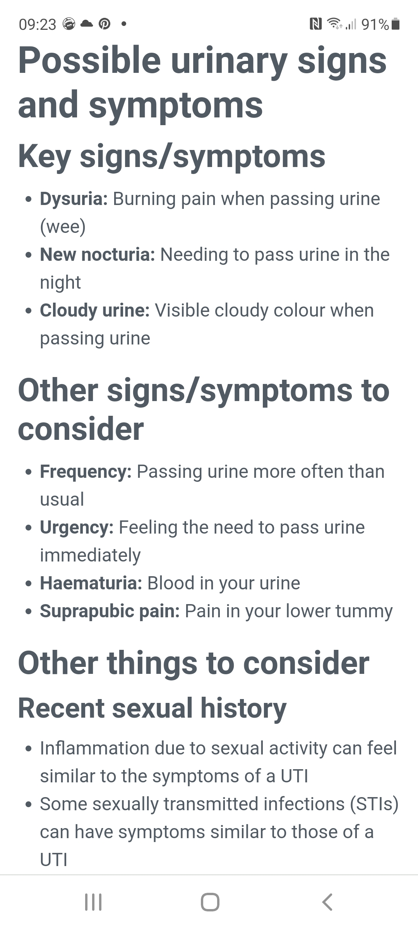
Available in .html

Slide 13
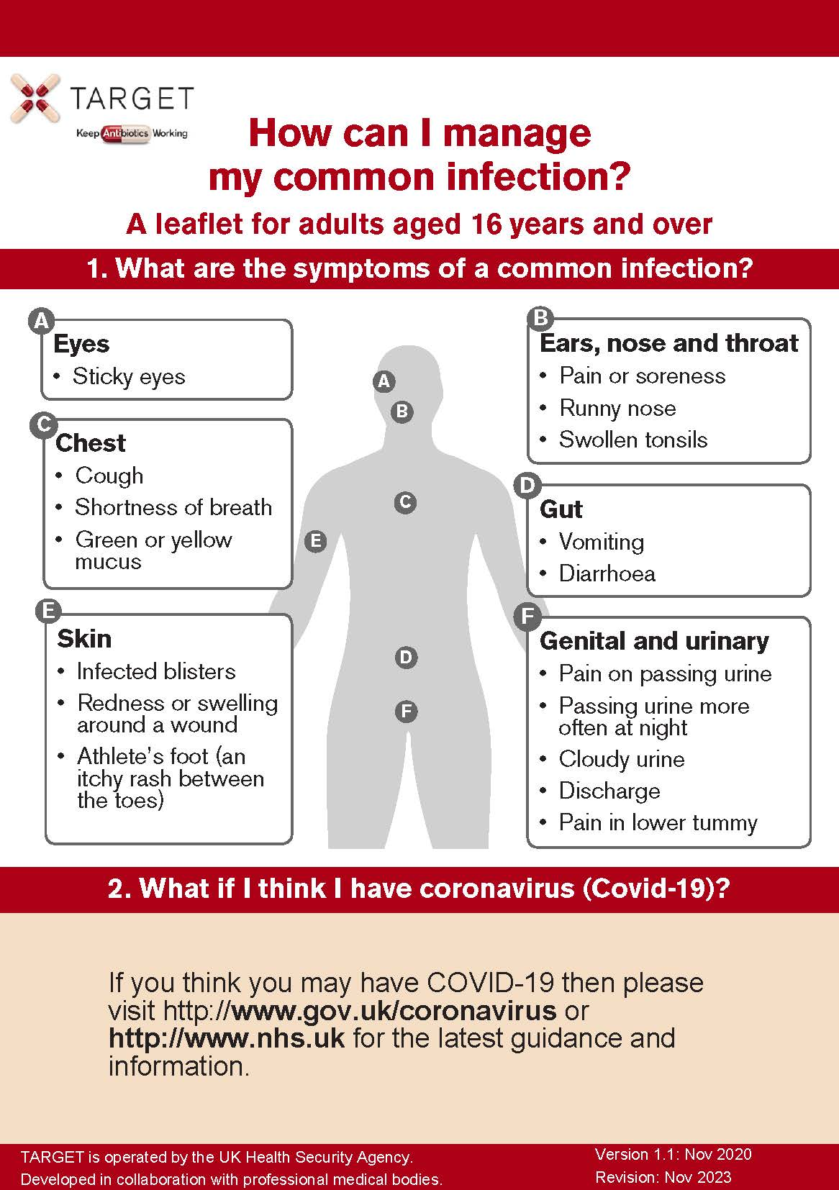
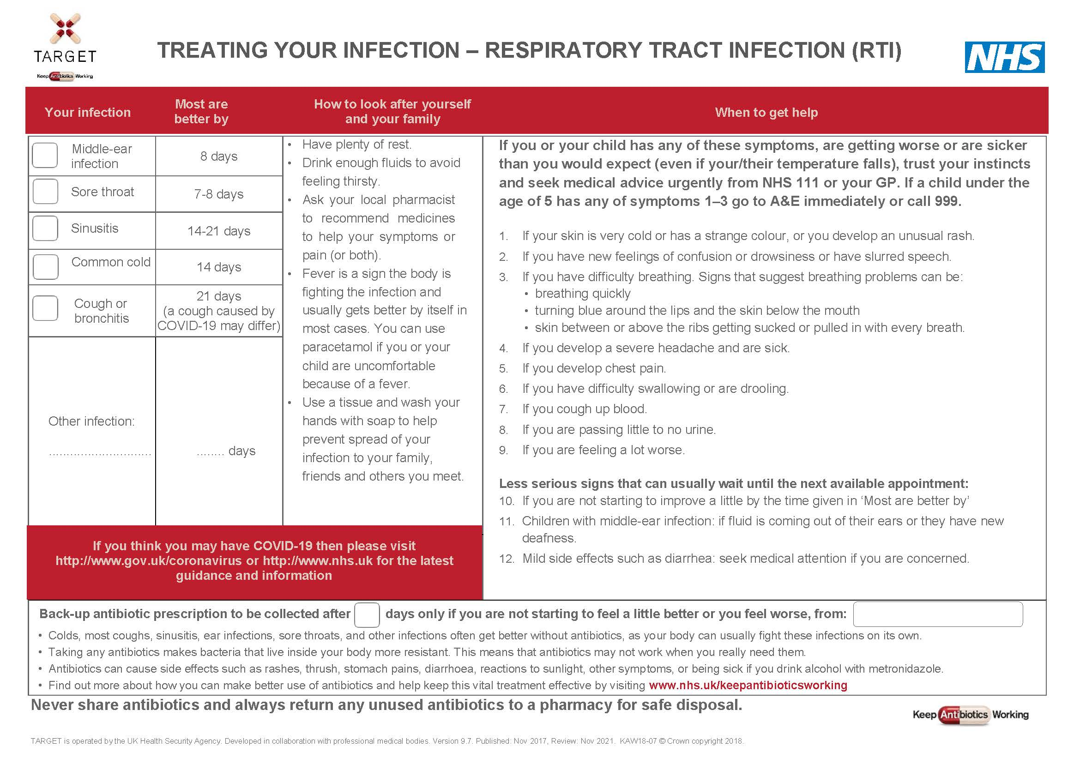
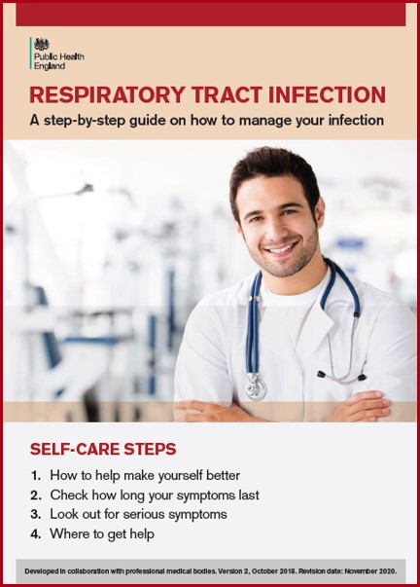
Patient information Leaflets

Slide 14
Thank you for all you are doing! www.rcgp.org.uk/targetantibiotics TARGETAntibiotics@phe.gov.uk @TARGETabx

Slide 15
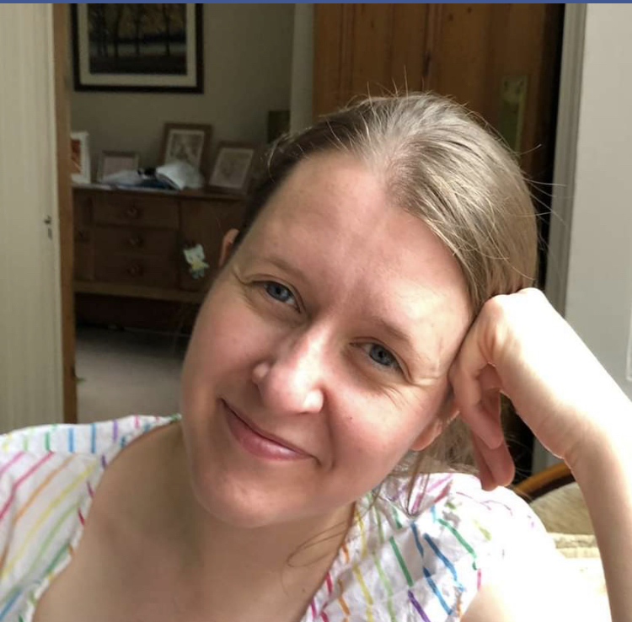
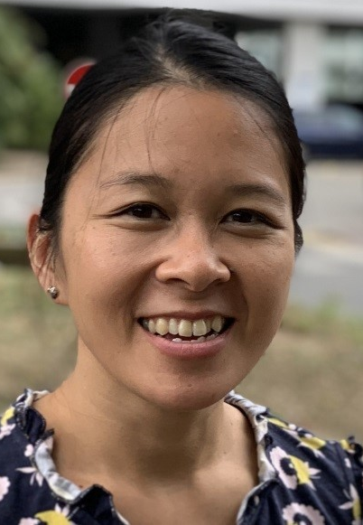
Discussion
Panel Members
Dr Linda Strettle
General Practitioner
Hon Sr Clinical Lecturer
Dr Steve Granier
General Practitioner
Dr Monsey McLeod
Imperial College
Dr Aleksandra Borek
University of Oxford
www.rcgp.org.uk/TARGETantibiotics
Notes:
Dr Monsey McLeod is Lead Pharmacist for Medication Safety and Anti-infectives Research at the Centre for Medication Safety and Service Quality at Imperial College Healthcare NHS Trust and Honorary Research Fellow at the NIHR Health Protection Research Unit in Healthcare Associated Infection and Antimicrobial Resistance at Imperial College, and at the NIHR Imperial Patient Safety Translational Research Centre. She co-led the STEP-UP Implement Research, in collaboration with colleagues at the University of Oxford, that aims to improve the uptake and sustainability of effective interventions to promote prudent antibiotic use in primary care.
Dr Alexandra Borek is a researcher in health behaviour change. Her research focuses on optimising antibiotic use and implementation of antimicrobial stewardship interventions in primary care; Ola is currently exploring the impact of COVID-19 on antibiotic prescribing and experiences of healthcare workers.

