Slide 1
Reviewing patients using long term and repeated antibiotic courses for COPD exacerbations
Worked examples using the TARGET “How to…” Toolkit for patients in Primary Care

Slide 2

How to use this resource
The TARGET COPD ‘How to…’ worked examples are a resource designed to be used with the TARGET COPD ‘How to…’ booklet that aims to support primary care teams to review the appropriateness of antimicrobials in the evidence-based prevention and treatment of chronic obstructive pulmonary disease (COPD) exacerbations.
This slide deck will take you through two worked examples and can be used for your own learning or to deliver to your team. The PowerPoint notes contain further information and slide references
The slides can be used by medical prescribers, non-medical prescribers and pharmacy professionals to review the clinical management of patients at higher risk of antibiotic use due to COPD exacerbation.

Slide 3
Aims
Understand and discuss;
Why it is important to review patients with antibiotics on repeat for COPD or those patients who have used repeated course of rescue pack antibiotic treatment for COPD.
How to review and manage patients with COPD that;
  Have used repeated courses of antibiotics for COPD exacerbations
  Have antibiotics on repeat for COPD
  Require referral
The list of considerations when carrying out a patient review and assessment including prevention education, management of exacerbations and key points on mental health and self-care advice
Notes:
Presenter notes
The aims of this slideset are to show worked examples, of COPD review for patients on long term or rescue pack antibiotics, in primary care.
The recommendations in the scenarios are in line with NICE guidance. There are 2 worked examples, which covers a patient using rescue packs regularly for COPD exacerbation and a patient on long term COPD exacerbation antibiotic prophylaxis with azithromycin still requiring rescue packs. All examples have a list of considerations when conducting a patient review and assessment, the structure and format follows the ‘How to…’ resource in practice scenarios and can be used when reviewing COPD patients in practice.
By using these examples we hope you will be better able to understand and discuss the following;
Why it is important to review patients on antibiotic treatment for COPD
How to review and manage patients with COPD on antibiotic treatment
The list of considerations when carrying out a patient review and assessment including key points on mental health and self-care advice

Slide 4
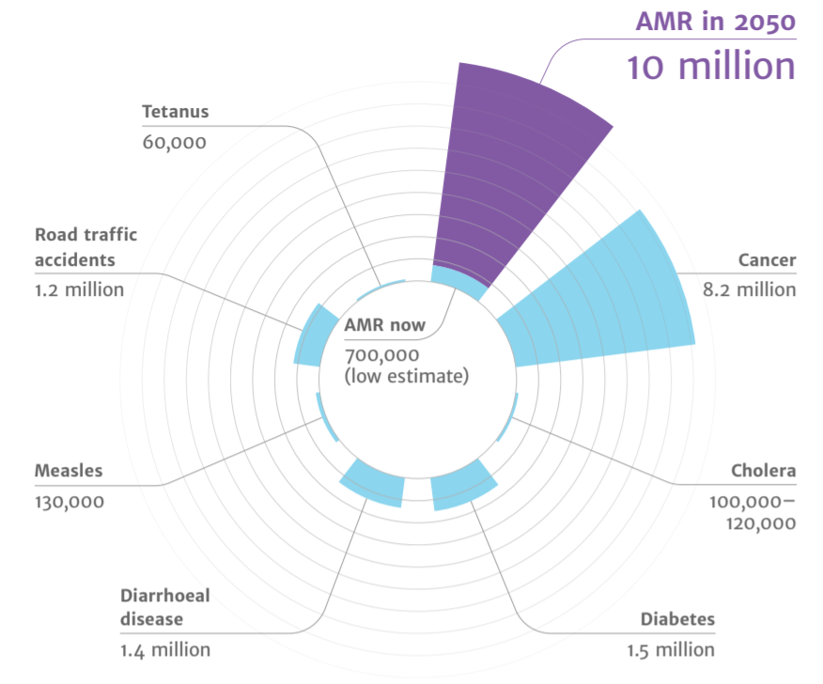
Antimicrobial resistance
AMR
2050
Diabetes
and cancer
combined
Deaths attributed to antimicrobial resistance (AMR) every year
AMR in 2050
10 million
Tetanus
60,000
Road traffic accidents
1.2 million
Cancer
8.2 million
10,000,000
9,700,000
AMR now
700,000
(low estimate)
Cholera
100,00 – 120,000
Measles
130,000
Diarrhoeal disease
1.4 million
Diabetes
1.5 million
(O ’Neill, 2016)
Notes:
Presenter notes
Most of us are aware of the issues associated with AMR in our daily practice (1). However, on a global scale though, recent UN report (2), (April 2019) highlighted that by 2050, AMR could kill 10 million people per year, in its worst-case scenario. This is more than diabetes and cancer combined. This will also come at a cost of £66 trillion pounds.
The TARGET Guide to Resources provides more detail on these measures, and the TARGET toolkit helps to optimise your use of antibiotics.
What does that mean for primary care? We know that around 71% of all antibiotics are prescribed in primary care. Research shows that this equates to 1 in 3 individuals in England that take at least one course of antibiotics or, about 29 million antibiotic items prescribed in England (2021/22 financial year) (3). Whilst the majority of these antibiotics are needed, previous studies estimated that one-fifth to one-third of UK antibiotic prescriptions in primary care are unnecessary or inappropriate. Although we have seen a continuing decline in primary care prescribing since 2014, it is important that we continue to monitor and review our prescribing behaviours. There is a need to continue to review our antibiotic use in line with guidance.
References
The review on antimicrobial resistance, chaired by Jim O’Neill. Tackling drug resistant infections globally: final report and recommendations. 2016. [Available from: https://amrreview.org/sites/default/files/160518_Final%20paper_with%20cover.pdf]
IACG (2019). “No time to wait: securing the future from drug-resistant infection
UK Health Security Agency (2022). English surveillance programme for antimicrobial utilisation and resistance (ESPAUR), Report 2021-2022.

Slide 5
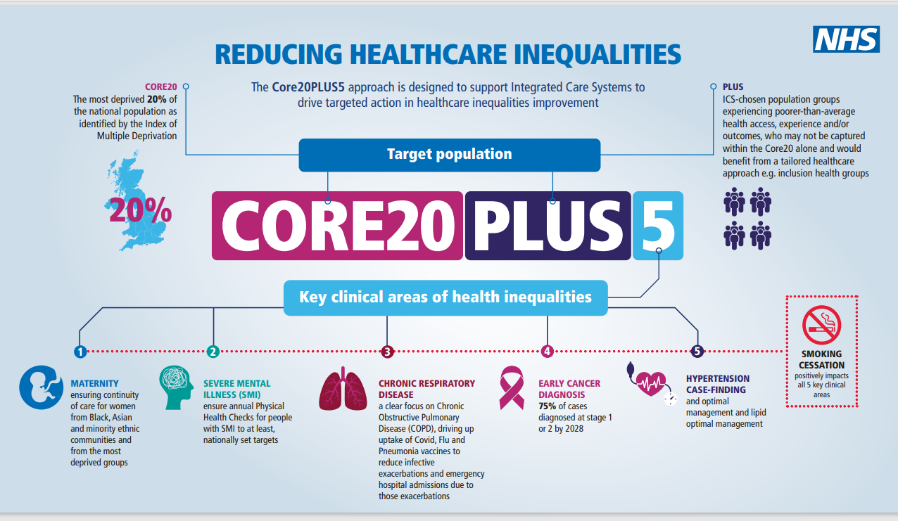
Notes:
Presenter notes
Core20PLUS5 is a national NHS England and NHS Improvement approach to support the reduction of health inequalities at both the National and System level. The approach defines a target population cohort - the ‘Core20PLUS’ - and identifies ‘5’ focus clinical areas requiring accelerated improvement, including COPD.
NHS England » Core20PLUS5 an Approach to Reducing Health Inequalities: supporting information
COPD is considerably more common in the most deprived communities, linked to smoking, outdoor air pollution, poor housing and occupational hazards being more frequent in lower socio-economic areas.
Smoking is a major risk factor for COPD and is generally more common amongst the most deprived communities and in the following groups:
People born into a family of smokers are more likely to smoke
Smoking is more common amongst people with mental health problem
Certain ethnic groups are more likely to smoke than others. Smoking is comparatively prevalent amongst Black Caribbean and Bangladeshi men and White English women (26%).
Smoking rates amongst gay and lesbian people are higher than the general population
People who are homeless are more likely to smoke.
Smoking rates in prisons – with prisoners highly likely to have experienced poverty and mental health problems - are extremely high, at around 80%.
British Lung Foundation - Lung disease and health inequalities briefing.pdf (asthmaandlung.org.uk)
References
1. NHS England. Core20PLUS5 an Approach to Reducing Health Inequalities: supporting information. Available at: https://www.england.nhs.uk/publication/core20plus5-an-approach-to-reducing-health-inequalities-supporting-information/
2. British lung foundation. Briefing: health inequalities and lung disease. Available at: https://www.asthmaandlung.org.uk/sites/default/files/British%20Lung%20Foundation%20-%20Lung%20disease%20and%20health%20inequalities%20briefing.pdf

Slide 6
Why review patients with COPD that use antibiotics frequently?
Individual costs - health, social, psychological, including over-exposure to antibiotics and steroids
The treatment goals of COPD exacerbations are to get the patient better, reducing the negative impact of their current exacerbations and preventing future exacerbations which are associated with disease progression (GOLD, 2022).
Societal costs – economic and reliance on urgent, primary and secondary care services.
1
2
3
Notes:
Presenter notes
So why should you review patients with frequent COPD exacerbations?
COPD is a chronic progressive disease which disproportionately impacts more deprived members of our population. Approx 1.3 million diagnosed, >30,000 deaths/year
COPD exacerbations are one of the most common indications for long-term and/or repeated antibiotic use
It is well established, that exacerbations of COPD contribute to a more rapid disease progression, including accelerated lung function decline, and increased mortality. One single moderate exacerbation has been shown to increase the risk of hospitalization by 21%, and one out of five patients die within a year after their first hospitalization due to an exacerbation. To improve the prognosis of COPD and reduce the impact of the disease on the daily life of patients as well as the risk of long-term COPD-related morbidity and mortality, prevention of exacerbations is a key step in the COPD treatment goals.
References
Hansel TT, Barnes PJ. New drugs for exacerbations of chronic obstructive pulmonary disease. Lancet. 2009;374(9691):744–755. doi: 10.1016/S0140-6736(09)61342-8 [PubMed] [CrossRef] [Google Scholar]
Seemungal TA, Donaldson GC, Paul EA, Bestall JC, Jeffries DJ, Wedzicha JA. Effect of exacerbation on quality of life in patients with chronic obstructive pulmonary disease. Am J Respir Crit Care Med. 1998;157(5 Pt 1):1418–1422. doi: 10.1164/ajrccm.157.5.9709032 [PubMed] [CrossRef] [Google Scholar]
Soler-Cataluna JJ, Martinez-Garcia MA, Roman Sanchez P, Salcedo E, Navarro M, Ochando R. Severe acute exacerbations and mortality in patients with chronic obstructive pulmonary disease. Thorax. 2005;60(11):925–931. doi: 10.1136/thx.2005.040527 [PMC free article] [PubMed] [CrossRef] [Google Scholar]
Løkke A, Lange P, Lykkegaard J, et al. Economic burden of COPD by disease severity - A nationwide cohort study in Denmark. Int J Chron Obstruct Pulmon Dis. 2021;16:603–613. doi: 10.2147/COPD.S295388 [PMC free article] [PubMed] [CrossRef] [Google Scholar]
Mason SE, Moreta-Martinez R, Labaki WW, et al. Respiratory exacerbations are associated with muscle loss in current and former smokers. Thorax. 2021;76(6):554–560. doi: 10.1136/thoraxjnl-2020-215999 [PMC free article] [PubMed] [CrossRef] [Google Scholar]
Rothnie KJ, Mullerova H, Smeeth L, Quint JK. Natural history of chronic obstructive pulmonary disease exacerbations in a general practice-based population with chronic obstructive pulmonary disease. Am J Respir Crit Care Med. 2018;198(4):464–471. doi: 10.1164/rccm.201710-2029OC [PMC free article] [PubMed] [CrossRef] [Google Scholar]
GOLD. Global strategy for the diagnosis, management, and prevention of chronic obstructive lung disease; 2021.

Slide 7
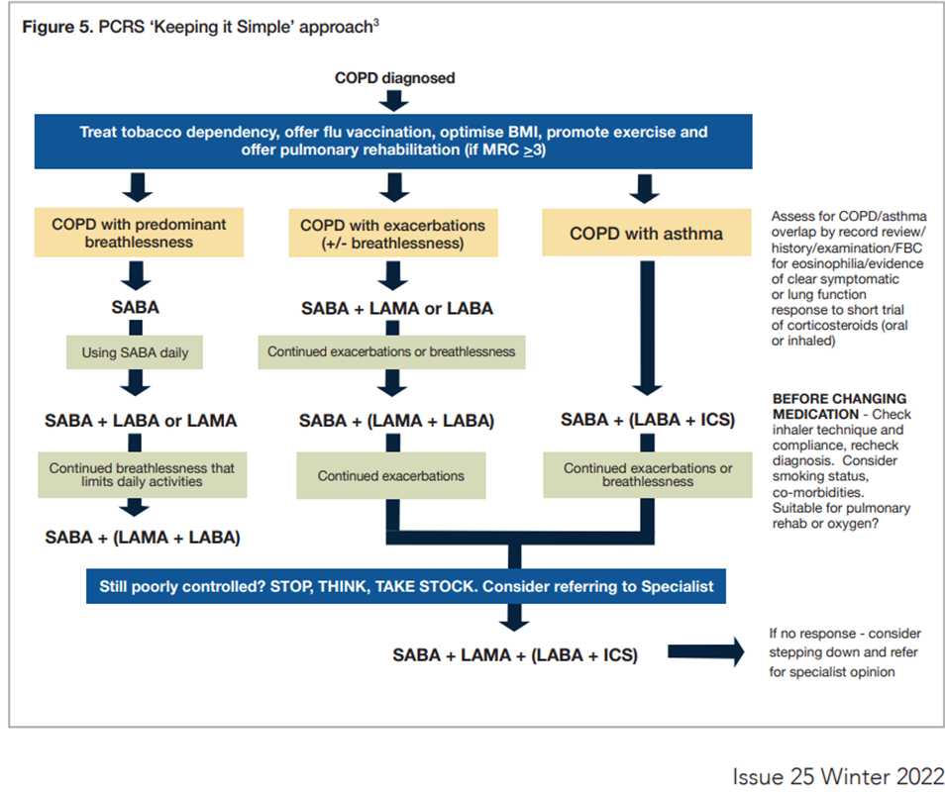
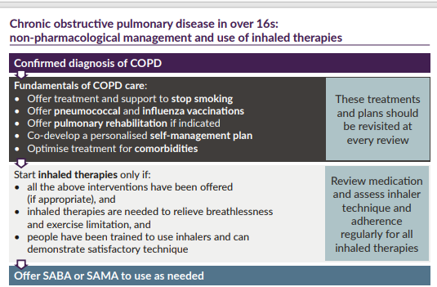
NICE NG115 and GOLD 2022
Notes:
Presenter notes
National guidance is clear on prevention measures and medicines optimisation measures to improve activities of daily life and reduce disease progression. The TARGET ‘How to’ booklet aims to distil what is required from these documents to maximise exacerbation prevention reviews.
References:
NICE, 2018. Resource impact report: Chronic obstructive pulmonary disease in over 16s: diagnosis and management (update) (NG115). Available at: https://www.nice.org.uk/guidance/ng115/resources/resource-impact-report-pdf-6602803741
GOLD. Global strategy for the diagnosis, management, and prevention of chronic obstructive lung disease; 2021.

Slide 8
How to manage patients
Prevention
Education
Action planning
Referral
Notes:
Presenter notes
The key pillars of the review are prevention of exacerbation with lifestyle changes, vaccination and medicines optimisation, education on prevention and management of exacerbations, action planning bespoke to the individual patient and referral where required to key services.
There is guidance on treatment and review of COPD contained within both NICE guidance and GOLD recommendations. The TARGET ‘How to’ booklet aims to distil what is required from these documents to maximise exacerbation prevention reviews.
The booklet is 23 pages and forms part of the ‘How to…?’ series which aims to support primary care teams to review patients that have required antibiotic treatments for COPD exacerbations with evidence-based strategies for prevention.
It is not intended to duplicate or replace national guidelines; its purpose is to provide steps and resources to review patients who have received antimicrobials for the prevention or treatment of COPD exacerbations
The treatment goals of COPD exacerbations are to get the patient better, reducing the negative impact of their current exacerbations and preventing future exacerbations which are associated with disease progression (GOLD, 2022).
The flowchart contained within the booklet contains the steps from patient identification through toembedding a quality improvement approach
References
How to resource for COPD. Antibiotic Stewardship tools, audits and other resources. TARGET Antibiotics toolkit available via RCGP: Antibiotic stewardship tools, audits and other resources: How to..? Resources (repeat and long term antibiotics) | RCGP Learning
GOLD. Global strategy for the diagnosis, management, and prevention of chronic obstructive lung disease; 2021.

Slide 9

Scenario
Prevention
Education
Action planning
Referral
Scenario 1 baseline data
65 year old male called Bernard
COPD diagnosis confirmed with spirometry 4 years ago
Current inhaled therapy:
Salbutamol 2 puffs PRN
Volumatic
Braltus 10mcg once a day
Salmeterol 2 puffs twice a day
1 hospital admission for COPD in last 12 months
4 antibiotic courses issued over the last 12 months and 4 courses of steroids Doxycycline 2 stat then od x 8, Prednisolone 30mg OD x 42
No obvious referrals for pulmonary rehabilitation, mental health support or acute respiratory team in last two years
Vaccination status – has received COVID – 19, Influenza and pneumococcal vaccines
Smoker 20 per day
Last COPD review 12 months ago
Notes:
Presenter notes
An example of a typical patient you may invite for a review.
Patients can be identified from baseline search on clinical systems for patients with repeat acute antibiotic courses (defined as 3 or more courses in last 6 months) and with a coded diagnosis for COPD.
What data can be collected from records prior to consultation? This scenario shows an example of the kind of data that can be helpful when undertaking a review with a patient.

Slide 10
COPD history and quality of life
Scenario
Prevention
Education
Action planning
Referral
Understanding of the diagnosis and condition | Bernard understands his condition
Impact on patient - daily living, occupation, social life | COPD impacts on his daily life about two days a week, it is important for him to have social activity with his family and church. He enjoys singing and would like to be less breathless so he can sing at church services. He is retired but does voluntary work at the local hospice.
Baseline of severity using MRC dyspnoea scale | Bernard gets short of breath when hurrying on level ground or walking up a slight hill- MRC scale 2
Patient thoughts on self- management (triggers, diet, exercise) | He hadn’t thought about triggers before, but thinking now, dust and pollen set him off.
Notes:
Presenter notes:
Even though Bernard has a confirmed diagnosis, does he know what this means?
Impact on patient- Explore Bernard’s own account of the impact of the condition on their life, ask about activities of daily living, occupation, social history.
Establish baseline of severity of symptoms using MRC dyspnoea scale
Explore Bernard’s understanding of COPD then explore this online patient leaflet ‘What is Chronic Obstructive Pulmonary Disease (COPD)?’ to consolidate this information further
Ask your patient what they think they can do themselves to manage their condition better. Then go through this online patient leaflet ‘What can you do to manage your COPD?’ to inform this further.
Invite the patient to think about actions they can take to avoid exposure to triggers for flare-ups (avoid smoking, air pollutants, dust, respiratory virus, get vaccines)
Discuss benefits of healthier diet and exercise to boost immune system
References:
Primary Care Respiratory Society. MRC Dyspnoea Scale. Available at: https://www.pcrs-uk.org/mrc-dyspnoea-scale
Asthma and Lung UK. What is Chronic Obstructive Pulmonary Disease (COPD)? Available at: https://www.asthmaandlung.org.uk/conditions/copd-chronic-obstructive-pulmonary-disease/what-chronic-obstructive-pulmonary-disease
Asthma and Lung UK. What can you do to manage your COPD? Available at: https://www.asthmaandlung.org.uk/conditions/copd-chronic-obstructive-pulmonary-disease/what-can-you-do-manage-your-copd
Asthma and Lung UK. Healthy eating and weight. Available at: https://www.asthmaandlung.org.uk/living-with/healthy-eating
Asthma and Lung UK. Keeping active with a lung condition. Available at: https://www.asthmaandlung.org.uk/living-with/keeping-active

Slide 11
Prevention and optimisation of therapy
Scenario
Prevention
Education
Action planning
Referral
Smoking status and cessation | Bernard knew smoking was bad for him but did not realise that just cutting down would be helpful, so he will try the app.
Inhaler adherence and technique | On discussion, Bernard had not realised that salmeterol was a regular inhaler and had been using salbutamol and salmeterol interchangeably as when required medication He had not been using a spacer as wasn’t sure how to use it
Vaccination uptake | Has received COVID – 19, Influenza and pneumococcal vaccines Has not received shingles vaccine
Pulmonary rehabilitation | He had not heard of pulmonary rehab before but likes the idea of it if he would be able to sing better and do more social activities with his family.
Notes:
Presenter notes
Inhaler adherence and technique: Ask the patient to demonstrate this on their own inhaler(s), provide spacer to be used for all metered dose inhaler(s).
Vaccination uptake: check which vaccines have been given and when, recommend and refer for any outstanding if agreed.
Pulmonary rehabilitation: Improves people’s ability to walk further, helps them feel less tired and breathless when carrying out day-to-day activities. 90% of patients who complete a PR programme have higher activity and exercise levels and report an improved quality of life. If agreed, refer to local service.
Bernard is a current smoker, smoking cessation support should be offered in a supportive way.
Pharmacotherapy options combined with behavioural support are more likely to result in smoking cessation
E-cigarettes are not risk-free but can aid smoking cessation
Refer to local pharmacy for smoking cessation service
Recommend NHS Quit Smoking app – provide instructions/help with installing app
Check inhaler technique to ensure inhaled pharmacotherapy is optimised:
Ask the patient to demonstrate this on their own inhaler(s)
Check patient’s understanding of instructions for their inhaler use
Provide spacer to be used for all metered dose inhalers
Review vaccination status – check which/when, recommend and offer any outstanding
It is recommended that COPD patients have:
SARS-Cov-2 (COVID-19): reduces serious illness and death in COPD patient
Influenza vaccination: reduces serious illness and death in COPD patient
Pneumococcal vaccination: reduces incidence of lower respiratory tract infections
Tdap (dTaP/dTPa): protects against pertussis if not vaccinated during adolescence
Zoster: protects against shingles in ≥50-year-old COPD patients
Offer and refer to local pulmonary rehabilitation (PR) service after detailing its benefits:
Pulmonary rehabilitation: Improves people’s ability to walk further, helps them feel less tired and breathless when carrying out day-to-day activities. 90% of patients who complete a PR programme have higher activity and exercise levels and report an improved quality of life. If agreed, refer to local service.
PR is an exercise and education programme designed for people with lung disease who experience symptoms of breathlessness.
A PR course typically lasts six to eight weeks, with two sessions of around two hours each week, and includes an individually prescribed exercise and education programme including aerobic exercise, resistance training and lifestyle support.
Evidence shows that accessing PR improves people’s ability to walk further, helps them feel less tired and breathless when carrying out day-to-day activities. 90% of patients who complete a PR programme have higher activity and exercise levels and report an improved quality of life.
References
1. NHS Quit smoking. Available at: https://www.nhs.uk/better-health/quit-smoking/
2. NICE guideline [NG209] ‘Tobacco: preventing uptake, promoting quitting and treating dependence’. https://www.nice.org.uk/guidance/ng209
3. GOLD. Global strategy for the diagnosis, management, and prevention of chronic obstructive lung disease; 2021.

Slide 12
Education: Managing exacerbation
Scenario
Prevention
Education
Action planning
Referral
Patient education, use online patient leaflet to discuss flare ups | He thinks a written personalised plan will help him remember what to do in a flare up.
Rescue packs, check what is prescribed (5 days steroid and antibiotic) | Bernard has been using his steroid and antibiotic rescue pack every time he felt more breathless, whether or not there was a change in phlegm. He had also not been initially increasing his salbutamol to see if this helped before starting his rescue pack.
Antibiotic risks and benefit | He hadn’t thought about the side effects from rescue pack medication before, but thought the information was useful.
Sputum sample is recommended to identify organisms if sputum is persistently present and purulent
Notes:
Presenter notes
Does your patient know what to do and where to go in case of a flare-up? Use this online patient leaflet to discuss this in detail together.
Rescue packs - a short course of oral corticosteroids and a short course of oral antibiotics to keep at home as part of the person’s exacerbation action plan is appropriate if they:
Have had an exacerbation within the last year, and remain at risk of exacerbations.
Understand and are confident about when and how to take the medication, and are aware of associated risks and benefits.
Rescue packs, check what is prescribed (5 days steroid and antibiotic) around 50% of COPD exacerbations are thought to be bacterial and antibiotics should be added to oral steroids only if sputum changes colour and increases in volume or thickness beyond their normal day-to-day variation
Discuss antibiotic usage:
Ask your patient to think back to their COPD flare-ups over the last year and how many times they were prescribed a course of antibiotics
Ask if they have a rescue pack and check if it includes oral antibiotics and steroids
Ask how they self-manage exacerbations, including how they use steroids or antibiotics in their rescue pack
Establish whether they are prescribed prophylactic antibiotics for COPD and if so, confirm they are a non-smoker or ex-smoker (due to the lack of effect in smokers
Explain that there are both benefits and risks associated with antibiotic exposure:
Just 1 in 14 patients treated with an antibiotic is expected to benefit
Short-term side effects: GI symptoms, disturbance of normal gut flora
Long term risks of bacteria developing resistance, lack of effective treatment
Only around 50% of COPD exacerbations are thought to be bacterial and antibiotics should be added to oral steroids if their sputum changes colour and increases in volume or thickness beyond their normal day-to-day variation
COPD exacerbations can be triggered by a range of factors including viral infections and smoking, so not all exacerbations will respond to antibiotic therapy
Medication to break down mucus can help shift phlegm and avoid infection
Sputum sample recommended to identify organisms if sputum is persistently present and purulent Recommendations | Chronic obstructive pulmonary disease in over 16s: diagnosis and management | Guidance | NICE
References
Asthma and Lung UK. Managing COPD flare-ups. Available at: https://www.asthmaandlung.org.uk/conditions/copd-chronic-obstructive-pulmonary-disease/managing-copd-flare-ups
2. NICE, 2018. Resource impact report: Chronic obstructive pulmonary disease in over 16s: diagnosis and management (update) (NG115). Available at: https://www.nice.org.uk/guidance/ng115/resources/resource-impact-report-pdf-6602803741
3. Vollenweider DJ, Jarrett H, Steurer-Stey CA, Garcia-Aymerich J, Puhan MA. Antibiotics for exacerbations of chronic obstructive pulmonary disease. Cochrane Database Syst Rev. 2012 Dec 12;12:CD010257. doi: 10.1002/14651858.CD010257. Update in: Cochrane Database Syst Rev. 2018 Oct 29;10:CD010257. PMID: 23235687.

Slide 13
Action Planning
Scenario
Prevention
Education
Action planning
Referral
Triggers: avoid dust and pollen
Lifestyle changes: cut down smoking and try the NHS Quit Smoking app
Prevention measures: pulmonary rehabilitation and zoster vaccine, stay up to date with flu and COVID vaccines
Optimisation of current therapy: use spacer and take salmeterol regularly twice a day
Appropriate management of exacerbations: Rescue pack 5-day duration
  1) adjust short-acting bronchodilator therapy, (increase dose and frequency of salbutamol up to 2 puffs QDS)
  2) take steroid rescue pack if breathlessness interferes with activities of daily living,
  3) add antibiotic rescue pack if sputum colour changes or increases in volume or thickness compared to normal day to-day variation, and
  4) tell the GP practice if rescue pack used.
Safety netting: attend GP if rapid or significant worsening in symptoms or systemically unwell
Next review date: 6 months

Slide 14

Referral for Bernard
Scenario
Prevention
Education
Action planning
Referral
Spirometry
Smoking cessation services
Vaccination
Pulmonary rehabilitation
COPD specialist team
Mental health services
Respiratory consultant
Notes:
Presenter notes
Referral: to primary care/community health services:
To GP/specialist nurse for spirometry diagnosis if not on records
Smoking cessation services if patient smoking and willing to try giving up
Vaccination services, GP or community pharmacy if vaccinations required
Pulmonary rehabilitation if not already tried
Referral to COPD specialist:
For people who have used 3 or more courses of oral corticosteroids and/or oral antibiotics in the last year, investigate the possible reasons for this — consider alternative causes, or referral
Prior to starting long-term prophylactic antibiotic.
Referral to mental health services:
Exacerbations thought to be due to a mental health condition as opposed to COPD disease progression, e.g., breathlessness due to anxiety attacks.
Referral to hospital:
Signs and symptoms suggesting co-morbidity (e.g., bronchiectasis).

Slide 15
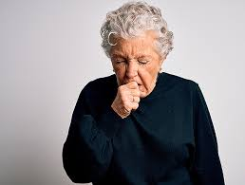
Scenario 2 - Baseline data
Scenario
Prevention
Education
Action planning
Referral
75 year old female - Ann
Diagnosis confirmed with spirometry
Current inhaled therapy:
Salbutamol 2 puffs PRN
Volumatic
Trimbow 87/5/9mcg 2 puffs BD
2 hospital admissions for COPD in last 12 months
6 antibiotic prescriptions issued over the last 6 months for azithromycin COPD prophylaxis and 2 antibiotic prescriptions issued for COPD acute infective exacerbation over last 3 months
Vaccination status –COVID – 19, Influenza, zoster and pneumococcal up to date
Last COPD review 6 months ago at hospital when azithromycin was started by consultant. Sputum culture at that time sensitive to amoxicillin, doxycycline and azithromycin
Ex-Smoker
Pulmonary rehab completed 18 months ago

Slide 16
COPD history and quality of life
Scenario
Prevention
Education
Action planning
Referral
Understanding of the diagnosis and condition | Ann understands her condition
Impact on patient - daily living, occupation, social life | COPD impacts on her daily life about five days a week, this has got worse since her husband died about 9 months ago. She has lost confidence to go out alone and only goes out with her daughter shopping once a week to the local shops. She is retired and is lonely.
Baseline of severity using MRC dyspnoea scale | She has to stop to catch her breath after walking about 100 yards or after a few minutes on level ground – MRC scale 3
Patient thoughts on self- management (triggers, diet, exercise) | She has been breathless more since her husband died, she has been increasingly anxious about the bills and house maintenance and thinks this may be contributing. She no longer feels confident to exercise. She has put on weight and had not realised this was a factor.
Notes:
Presenter notes:
Even though Ann has a confirmed diagnosis, do they know what this means?
Impact on patient- Explore Ann’s own account of the impact of the condition on their life, ask about activities of daily living, occupation, social history.
Establish baseline of severity of symptoms using MRC dyspnoea scale
Explore Ann’s understanding of COPD then explore this online patient leaflet ‘What is Chronic Obstructive Pulmonary Disease (COPD)?’ to consolidate this information further
Ask your patient what they think they can do themselves to manage their condition better. Then go through this online patient leaflet ‘What can you do to manage your COPD?’ to inform this further.
Invite the patient to think about actions they can take to avoid exposure to triggers for flare-ups (avoid smoking, air pollutants, dust, respiratory virus, get vaccines)
Discuss benefits of healthier diet and exercise to boost immune system
References:
Primary Care Respiratory Society. MRC Dyspnoea Scale. Available at: https://www.pcrs-uk.org/mrc-dyspnoea-scale
Asthma and Lung UK. What is Chronic Obstructive Pulmonary Disease (COPD)? Available at: https://www.asthmaandlung.org.uk/conditions/copd-chronic-obstructive-pulmonary-disease/what-chronic-obstructive-pulmonary-disease
Asthma and Lung UK. What can you do to manage your COPD? Available at: https://www.asthmaandlung.org.uk/conditions/copd-chronic-obstructive-pulmonary-disease/what-can-you-do-manage-your-copd
Asthma and Lung UK. Healthy eating and weight. Available at: https://www.asthmaandlung.org.uk/living-with/healthy-eating
Asthma and Lung UK. Keeping active with a lung condition. Available at: https://www.asthmaandlung.org.uk/living-with/keeping-active

Slide 17
Prevention and optimisation of therapy
Scenario
Prevention
Education
Action planning
Referral
Smoking status and cessation | Ann’s records show she is an ex-smoker, but admits since her husband died she has had the odd cigarette, this has crept up and she is now having about 3 per day. She understands this has an impact on her COPD and is keen to stop and agrees to be referred to local services.
Inhaler adherence and technique | Ann’s inhaler technique is good and she is compliant with her medication
Vaccination uptake | Ann’s vaccinations are up to date.
Pulmonary rehabilitation | Ann has had pulmonary rehab before, she found it helpful and would like to have it again to rebuild her confidence around exercise and daily activities and losing weight.
Notes:
Presenter notes:
Inhaler adherence and technique: Ask the patient to demonstrate this on their own inhaler(s), provide spacer to be used for all metered dose inhaler(s).
Vaccination uptake: check which vaccines have been given and when, recommend and refer for any outstanding if agreed.
Pulmonary rehabilitation: Improves people’s ability to walk further, helps them feel less tired and breathless when carrying out day-to-day activities. 90% of patients who complete a PR programme have higher activity and exercise levels and report an improved quality of life. If agreed, refer to local service.
Smoking cessation support should be offered in a supportive way.
Pharmacotherapy options combined with behavioural support are more likely to result in smoking cessation
E-cigarettes are not risk-free but can aid smoking cessation
Refer to local pharmacy for smoking cessation service
Recommend NHS Quit Smoking app – provide instructions/help with installing app
Check inhaler technique to ensure inhaled pharmacotherapy is optimised:
Ask the patient to demonstrate this on their own inhaler(s)
Check patient’s understanding of instructions for their inhaler use
Provide spacer to be used for all metered dose inhalers
Review vaccination status – check which/when, recommend and offer any outstanding
It is recommended that COPD patients have:
SARS-Cov-2 (COVID-19): reduces serious illness and death in COPD patient
Influenza vaccination: reduces serious illness and death in COPD patient
Pneumococcal vaccination: reduces incidence of lower respiratory tract infections
Tdap (dTaP/dTPa): protects against pertussis if not vaccinated during adolescence
Zoster: protects against shingles in ≥50-year-old COPD patients
Offer and refer to local pulmonary rehabilitation (PR) service after detailing its benefits:
Pulmonary rehabilitation: Improves people’s ability to walk further, helps them feel less tired and breathless when carrying out day-to-day activities. 90% of patients who complete a PR programme have higher activity and exercise levels and report an improved quality of life. If agreed, refer to local service.
PR is an exercise and education programme designed for people with lung disease who experience symptoms of breathlessness.
A PR course typically lasts six to eight weeks, with two sessions of around two hours each week, and includes an individually prescribed exercise and education programme including aerobic exercise, resistance training and lifestyle support.
Evidence shows that accessing PR improves people’s ability to walk further, helps them feel less tired and breathless when carrying out day-to-day activities. 90% of patients who complete a PR programme have higher activity and exercise levels and report an improved quality of life.
References
1. NHS Quit smoking. Available at: https://www.nhs.uk/better-health/quit-smoking/
2. NICE guideline [NG209] ‘Tobacco: preventing uptake, promoting quitting and treating dependence’. https://www.nice.org.uk/guidance/ng209
3. GOLD. Global strategy for the diagnosis, management, and prevention of chronic obstructive lung disease; 2021.

Slide 18
Education: Managing exacerbation
Scenario
Prevention
Education
Action planning
Referral
Patient education, use online patient leaflet to discuss flare ups | Ann did not realise that smoking meant the azithromycin she was taking from the consultant would not work as well. She is even more determined to give up now she knows this. She thinks a written personalised plan will help to remember what to do in a flare up.
Rescue packs, check what is prescribed (5 days steroid and antibiotic) | Ann was using her steroid and antibiotic rescue pack every time she felt more breathless, whether or not there was a change in phlegm, as she was worried she might end up in hospital again. She had forgotten about increasing the salbutamol to see if this helped before starting her rescue pack.
Antibiotic risks and benefit | She hadn’t realised that there might be side effects from taking rescue pack medication and she did not know about antibiotic resistance.
Sputum sample is recommended to identify organisms if sputum is persistently present and purulent
Notes:
Presenter notes:
Does your patient know what to do and where to go in case of a flare-up? Use this online patient leaflet to discuss this in detail together: Managing COPD flare-ups | Asthma + Lung UK (asthmaandlung.org.uk)
Rescue packs - a short course of oral corticosteroids and a short course of oral antibiotics to keep at home as part of the person’s exacerbation action plan is appropriate if they:
Have had an exacerbation within the last year, and remain at risk of exacerbations.
Understand and are confident about when and how to take the medication, and are aware of associated risks and benefits.
Rescue packs, check what is prescribed (5 days steroid and antibiotic) around 50% of COPD exacerbations are thought to be bacterial and antibiotics should be added to oral steroids only if sputum changes colour and increases in volume or thickness beyond their normal day-to-day variation
Discuss antibiotic usage:
Ask your patient to think back to their COPD flare-ups over the last year and how many times they were prescribed a course of antibiotics
Ask if they have a rescue pack and check if it includes oral antibiotics and steroids
Ask how they self-manage exacerbations, including how they use steroids or antibiotics in their rescue pack
Establish whether they are prescribed prophylactic antibiotics for COPD and if so, confirm they are a non-smoker or ex-smoker (due to the lack of effect in smokers
Explain that there are both benefits and risks associated with antibiotic exposure:
Just 1 in 14 patients treated with an antibiotic is expected to benefit
Short-term side effects: GI symptoms, disturbance of normal gut flora
Long term risks of bacteria developing resistance, lack of effective treatment
Only around 50% of COPD exacerbations are thought to be bacterial and antibiotics should be added to oral steroids if their sputum changes colour and increases in volume or thickness beyond their normal day-to-day variation
COPD exacerbations can be triggered by a range of factors including viral infections and smoking, so not all exacerbations will respond to antibiotic therapy
Medication to break down mucus can help shift phlegm and avoid infection
Sputum sample recommended to identify organisms if sputum is persistently present and purulent Recommendations | Chronic obstructive pulmonary disease in over 16s: diagnosis and management | Guidance | NICE
References
Asthma and Lung UK. Managing COPD flare-ups. Available at: https://www.asthmaandlung.org.uk/conditions/copd-chronic-obstructive-pulmonary-disease/managing-copd-flare-ups
2. NICE, 2018. Resource impact report: Chronic obstructive pulmonary disease in over 16s: diagnosis and management (update) (NG115). Available at: https://www.nice.org.uk/guidance/ng115/resources/resource-impact-report-pdf-6602803741
3. Vollenweider DJ, Jarrett H, Steurer-Stey CA, Garcia-Aymerich J, Puhan MA. Antibiotics for exacerbations of chronic obstructive pulmonary disease. Cochrane Database Syst Rev. 2012 Dec 12;12:CD010257. doi: 10.1002/14651858.CD010257. Update in: Cochrane Database Syst Rev. 2018 Oct 29;10:CD010257. PMID: 23235687.

Slide 19
Action Planning
Scenario
Prevention
Education
Action planning
Referral
Triggers: Anxiety, exercise
Lifestyle changes: Weight management, mindfulness, smoking cessation
Prevention measures: Stay up to date with vaccines, anxiety management, pulmonary rehabilitation
Optimisation of current therapy: Inhaler compliance, azithromycin review
Appropriate management of exacerbations: Rescue pack 5-day duration
  1) adjust short-acting bronchodilator therapy, (increase dose and frequency of salbutamol up to 2 puffs QDS)
  2) take steroid rescue pack if breathlessness interferes with activities of daily living,
  3) add antibiotic rescue pack if sputum colour changes or increases in volume or thickness compared to normal day to-day variation, and
  4) tell the GP practice if rescue pack used.
Safety netting: attend GP if rapid or significant worsening in symptoms or systemically unwell
Next review date: 3 months (to assess smoking cessation and exacerbations)

Slide 20
Referral for Ann
Scenario
Prevention
Education
Action planning
Referral
Spirometry
Smoking cessation services
Vaccination
Pulmonary rehabilitation
COPD specialist team
Mental health services and social prescriber
Respiratory consultant (if Ann is unable to stop smoking at next review)
Notes:
Presenter notes
Referral: to primary care/community health services:
To GP/specialist nurse for spirometry diagnosis if not on records
Smoking cessation services if patient smoking and willing to try giving up
Vaccination services, GP or community pharmacy if vaccinations required
Pulmonary rehabilitation if not already tried
Referral to COPD specialist:
Prior to starting long-term prophylactic antibiotic.
Frequent exacerbations.
Referral to mental health services:
Exacerbations thought to be due to a mental health condition as opposed to COPD disease progression, e.g., breathlessness due to anxiety attacks.
Referral to hospital:
Signs and symptoms suggesting co-morbidity (e.g., bronchiectasis).
Smoking cessation is important for Ann as azithromycin has been prescribed for prophylaxis, but this is ineffective in smokers.
If Ann is unable to stop smoking then azithromycin should be stopped and Ann referred back to respiratory consultant.
Although Ann has had pulmonary rehab in the past, her confidence with exercise has reduced and she may benefit from re-referral.
Anns symptoms are exacerbated by her mental health difficulties, Ann should be referred to mental health services for anxiety management and bereavement counselling. A social prescriber may be useful if Ann needs support with finances, housing, friendship groups etc)
Referral to a social prescriber may also be useful.

Slide 21
Take home messages
Revisit fundamentals of COPD care
Promote prevention
Optimise inhaler management
Referral – pulmonary rehabilitation, mental health, social prescriber
Exacerbation management advice
Review long term antibiotic prescribing for COPD
Ensure regular monitoring is in place
Ensure coding is correct on clinical system
Notes:
Presenter notes
The fundamentals of COPD care should be revisited at every review.
Promote prevention strategies eg smoking cessation, weight loss, vaccination
Optimise inhaler management including technique and consider other therapies
Refer for pulmonary rehabilitation where indicated.
Consider mental health and/or social prescriber referral where indicated.
Highlight treatment goals of COPD exacerbations are to get the patient better, reducing the negative impact of their current exacerbations and preventing future exacerbations which are associated with disease progression (GOLD, 2022).
Provide exacerbation management advice and written plan including when appropriate to use antibiotics and safety netting.
Review long term antibiotic prescribing for COPD and consider when to stop, trial off or refer.
Ensure coding is correct on clinical system
Ensure regular monitoring is in place

Slide 22
Acknowledgments
Naomi Fleming, Regional antimicrobial stewardship lead East of England NHSE
Alishah Lakha, Regional Pharmacy and Medicines Project Manager, East of England NHSE
Clare Carasco, National Medical Directors Clinical Fellow at NHS England – Prevention Team and Respiratory Registrar

