Slide 1
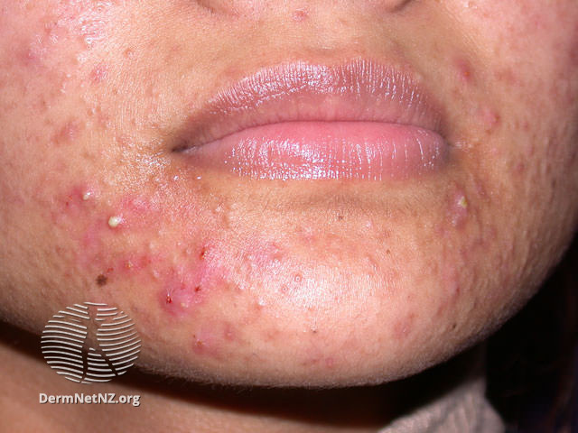
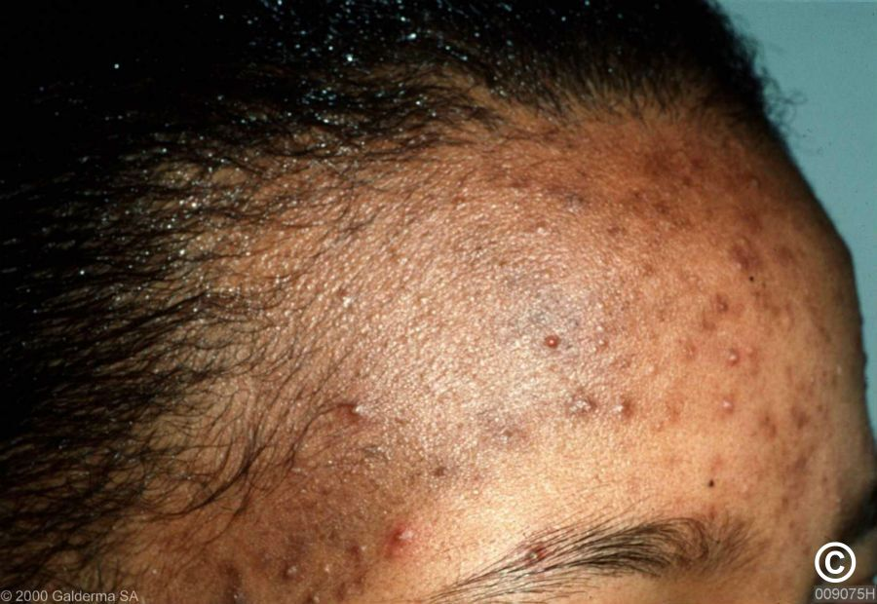
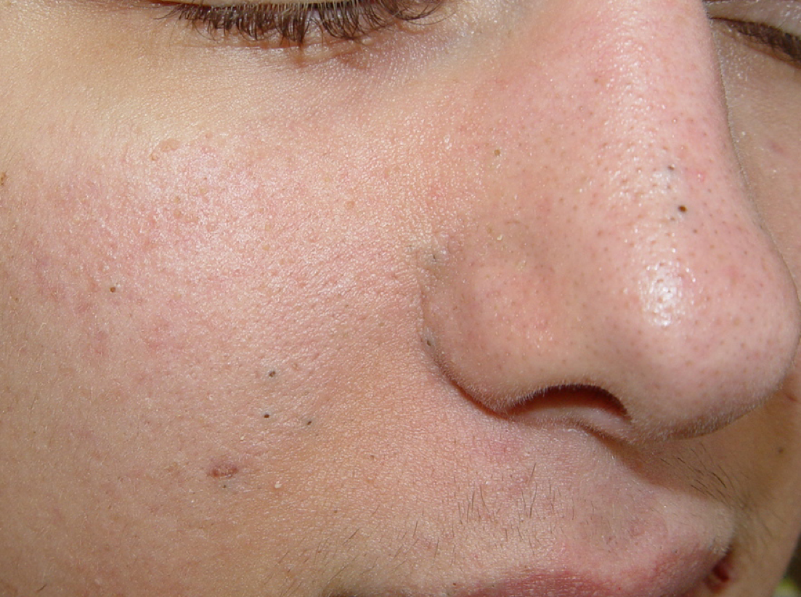
Reviewing patients on antibiotic treatment for acne a Worked examples using the TARGET “How to…” Toolkit for patients in Primary Care
V1

Slide 2
How to use this resource
The TARGET acne ‘How to…’ worked examples are a resource designed to be used with the TARGET acne ‘How to…’ toolkit for the review of antibiotic prescribing of patients with acne in primary care.
This slide deck will take you through three worked examples and can be used for your own learning or to deliver to your team. The PowerPoint notes contain further information and slide references
The slides can be used by medical prescribers, non-medical prescribers and pharmacy professionals to review the clinical management of patients with acne.
V1
September 2026
September 2023
Notes:
Presenter notes
The TARGET acne ‘How to…’ clinical scenarios are a resource designed to be used with the TARGET acne ‘How to…’ toolkit for the review of antibiotic prescribing of patients with acne in primary care. It focuses on those patients that are on repeat or recurrent prescriptions for antibiotics with the aim of stepping down or referring as needed.
It can be used by medical prescribers, non-medical prescribers and pharmacy professionals to review the management of patients with acne.

Slide 3
Aims
Understand and discuss;
Why it is important to review patients on antibiotic treatment for acne
How to review and manage patients with acne that;
Are currently on antibiotic treatment
Require referral
Have dark skin and hyperpigmentation/acne scarring
Require stepping down of treatment
The list of considerations when carrying out a patient review and assessment including key points on mental health and self-care advice
Notes:
Presenter notes
The aims of this webinar are to discuss with you, using worked examples, the need to review patients on antibiotics, in primary care, for acne.
The recommendations in the scenarios are in line with NICE guidance. There are 3 worked examples, which covers a patient currently on treatment, patient requiring appropriate onward referral for acne and patient requiring step down of antibiotic treatment. All examples have a list of considerations when conducting a patient review and assessment, the structure and format follows the ‘How to…’ toolkit in practice scenarios and can be used when reviewing acne patients in practice.
By attending the webinar we hope you will be better able to understand and discuss the following;
Why it is important to review patients on antibiotic treatment for acne
How to review and manage patients with acne on antibiotic treatment
The list of considerations when carrying out a patient review and assessment including key points on mental health and self-care advice

Slide 4
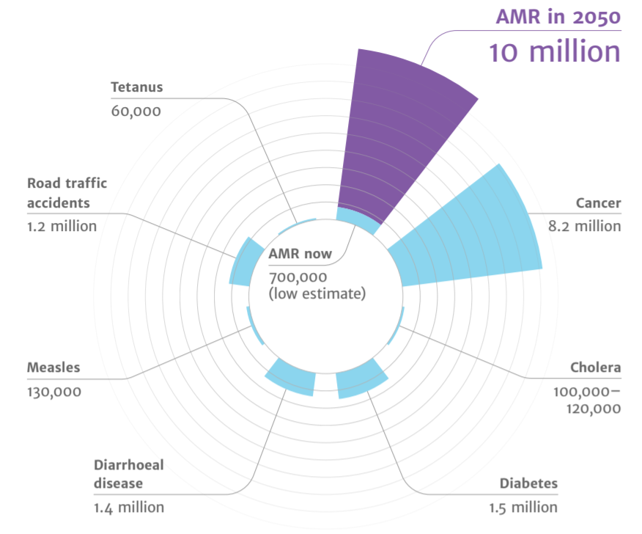
Antimicrobial resistance
AMR
2050
Diabetes
and cancer
combined
Deaths attributed to antimicrobial resistance (AMR) every year
AMR in 2050
10 million
Tetanus
60,000
Road traffic accidents
1.2 million
Cancer
8.2 million
10,000,000
9,700,000
AMR now
700,000
(low estimate)
Cholera
100,00 – 120,000
Measles
130,000
Diarrhoeal disease
1.4 million
Diabetes
1.5 million
(O ’Neill, 2016)
Notes:
Presenter notes
Most of us are aware of the issues associated with AMR in our daily practice (1). However, on a global scale though, recent UN report (2), (April 2019) highlighted that by 2050, AMR could kill 10 million people per year, in its worst-case scenario. This is more than diabetes and cancer combined. This will also come at a cost of £66 trillion pounds.
The TARGET Guide to Resources provides more detail on these measures, and the TARGET toolkit helps to optimise your use of antibiotics.
What does that mean for primary care? We know that around 71% of all antibiotics are prescribed in primary care. Research shows that this equates to 1 in 3 individuals in England that take at least one course of antibiotics or, about 29 million antibiotic items prescribed in England (2021/22 financial year) (3). Whilst the majority of these antibiotics are needed, previous studies estimated that one-fifth to one-third of UK antibiotic prescriptions in primary care are unnecessary or inappropriate. Although we have seen a continuing decline in primary care prescribing since 2014, it is important that we continue to monitor and review our prescribing behaviours. There is a need to continue to review our antibiotic use in line with guidance.
Slide references
The review on antimicrobial resistance, chaired by Jim O’Neill. Tackling drug resistant infections globally: final report and recommendations. 2016. [Available from: https://amrreview.org/sites/default/files/160518_Final%20paper_with%20cover.pdf]
IACG (2019). “No time to wait: securing the future from drug-resistant infection
UK Health Security Agency (2022). English surveillance programme for antimicrobial utilisation and resistance (ESPAUR), Report 2021-2022.

Slide 5
Why review patients with acne?
1
Research has highlighted growing concerns of antibiotic resistance in treatment of acne and prescribing patterns suggest an overuse of antibiotics in patients
2
National data reveal that acne is one of the most common indication for long-term and/or repeated antibiotic use
3
Conversations with patients about withdrawing acne antibiotic treatment have been deemed difficult and sensitive (Platt D, 2021)
Notes:
Presenter notes
So why should you review patients with acne? We know that acne is a common skin condition, and that treatment is determined by the severity of the acne and how much it affects the individual. There are growing concerns about antibiotic resistance in the treatment of acne (1,2). Studies looking at prescribing patterns have found that the most common prescription given at the initial acne consultation was an oral antibiotic alone , closely followed by topical antibiotics (3). National data reveals that acne is one of the most common indication for long-term and/or repeated antibiotic use and a study in 2022 showed that 44.5% of people with a new acne diagnosis received a prescription for long-term antibiotics (4).
Stepping down antibiotics requires a structured review and assessment taking into account that conversations with patients about withdrawing acne antibiotic treatment have been deemed difficult and sensitive
Slide references
Walsh TR, Efthimiou J, Dréno B (2016) Systematic review of antibiotic resistance in acne: an increasing topical and oral threat. Lancet Infect Dis 16, 3, e23–e33.CrossRefGoogle Scholar
Santer M, Francis NA, Platt D, et al.(2018) Stemming the tide of antimicrobial resistance: implications for management of acne vulgaris. Br J Gen Pract 68, 667, 64–65.FREE Full TextGoogle Scholar
Francis NA, Entwistle K, Santer M, et al.(2017) The management of acne vulgaris in primary care: a cohort study of consulting and prescribing patterns using the Clinical Practice Research Datalink. Br J Dermatol 176, 1, 107–115.Google Scholar
Bhate K, Mansfield KE, Sinnott S-J, Margolis DJ, Adesanya E, Francis N et al. Long-term oral antibiotic use in people with acne vulgaris in UK primary care: a drug utilisation study. British Journal of Dermatology. 2022;188(3):361-71

Slide 6
How to manage patients
Treat/Refer
Educate
Advice
Review
Notes:
Presenter notes
Managing patients with acne requires a step-wise approach that incorporates not just the treatment but also how you would include education and self-care advice. Reviewing the patient’s response to treatment is also very important.

Slide 7
Scenario 1 Review outcome: change of treatment
Scenario
Patient review
Treatment
Advice
Consider the following details:
18-year-old female non pregnant
Indication - Acne Vulgaris
Lymecycline 408mg daily for 12 weeks
No topical treatment has been issued
On examination
Moderate to severe acne
Notes:
Presenter notes
The first case covers how to review a patient on antibiotic treatment with moderate to severe acne.
After undertaking a baseline search and analysis of a patient on antibiotic treatment for last 12 weeks, you have the collated the above information prior to the patient coming in for a face-to-face review
Think about or discuss the case and how you would carry out a patient centred review e.g. what questions will you focus on in this review, think about the impact of acne on metal health, treatments tried in the past, and patient’s preferences. Use the “How to…” toolkit to understand how to carry out a review.
Slide references
Image: Acne [Available from: https://dermnetnz.org/topics/acne-vulgaris]

Slide 8
Patient centred review
Scenario
Patient review
Treatment
Advice
 | Item to consider | Patient response
Condition and consultation history | Establish history of patients' condition | Has had acne since puberty
 | Patient baseline habits
 | Are they under a specialist consultant | Not currently under a specialist consultant
Treatment History | Treatment/Prescription history | Lymecycline - once daily No OTC/herbal meds
 | Side effects to treatment | None reported
 | Compliance to treatment | Not using topical treatment – patient did not realise she was meant to continue with topical treatment
 | Patient’s perception of their treatment | Feels current treatment has had minimal effect
Patient Impact and preference | Explore impact acne has had on self-esteem or mental health | Recent weight gain and stress caused by exams. She feels this has made her acne worse. Acne has caused feelings of distress and anxiety and has affected her confidence in going out
 | What are the patient's preferences and expectations from treatment? | aim is to see a noticeable reduction but understands acne may not completely clear happy to continue topical and oral treatment
Notes:
Presenter notes
This table covers several points you can cover in a review.
Now to decide the next steps for this patient. Using the patient responses, and using the “How to…” toolkit, think about or discuss in groups, how you would:
Treat the patient (including onward referral)
Give self-care advice to the patient (including useful resources)
Educate the patient
Review the patient
Has this patient been coded for acne?
Slide references
Image: Acne [Available from: https://dermnetnz.org/topics/acne-vulgaris]

Slide 9
Treating your patient
Scenario
Patient review
Treatment
Advice
Treating or referring the patient
Continue oral antibiotic therapy for a further 12 weeks AND prescribe fixed combination of topical adapalene with topical benzoyl peroxide applied once daily in the evening
Review
Review treatment after 12 weeks
Assess if patient’s acne has improved, and if there has been any side effects to treatment
If acne has completely cleared, consider stopping the antibiotic but continuing the topical treatment
Consider if referral to specialist consultant is required
Review patient acne photos to monitor treatment success
Notes:
Presenter notes
12 weeks is an adequate length of time to identify non-response.
Treatments including topical or oral antibiotics should only last longer than 6 months in exceptional circumstances, with review at 3-monthly intervals: the aim being to discontinue the antibiotic as soon as possible. NICE guidance recommends tetracyclines for acne, there is no benefit in switching at 12 weeks from one tetracycline to another. There is no other class of oral antibiotic recommended by NICE for acne.
Duration of systemic antibiotic treatment
Ideally 3 months, evidence suggests that for most patients there is little additional benefit in using antibiotics for more than 3 months in any given treatment period - however, patients relapsing quickly after stopping treatment may be better suited to 6 month courses
Once stopped, many patients will need to remain on their topical agent
Slide references
NICE. Acne vulgaris: management. 2021 [Available from: https://www.nice.org.uk/guidance/ng198]

Slide 10
Education and advice
Scenario
Patient review
Treatment
Advice
Education
Antibiotics may cause systemic side effects and antimicrobial resistance.
Provide evidence for skin care and diet to help acne
Noticeable effects can take between 6-8 weeks, therefore it is important to complete the course
Aggravating and modifiable risk factors - How to Booklet_Acne_TARGET V1.1_Final.pdf (rcgp.org.uk)
Advice
Mental health services for psychological distress caused by acne and/or scarring – shared care decision on referral
Signpost to digital apps such as - Dermatology digital playbook - Digital playbooks - NHS Transformation Directorate (england.nhs.uk).
Provide advice on contraception – topical retinoids and oral tetracyclines are contraindicated in pregnancy
Oral tetracyclines can cause photosensitivity – use suitable SPF if going out in the sun.
Avoid strong sunlight while using benzoyl peroxide and use oil free sunscreen with SPF30 or above
Notes:
Presenter notes
Important to manage patient expectations and signpost them to resources such as the dermatology digital playbook
See NICE recommendations for providing advice on skin care and diet, summarised below: https://www.nice.org.uk/guidance/ng198/chapter/recommendations#skin-care-advice
Skin care
Advise people with acne to use a non-alkaline (skin pH neutral or slightly acidic) synthetic detergent (syndet) cleansing product twice daily on acne-prone skin.
Advise people with acne who use skin care products (for example, moisturisers) and sunscreens to avoid oil-based and comedogenic preparations.
Advise people with acne who use make-up to avoid oil-based and comedogenic products, and to remove make-up at the end of the day.
Advise people that persistent picking or scratching of acne lesions can increase the risk of scarring.
Diet
Advise people that there is not enough evidence to support specific diets for treating acne.
For general advice about a balanced diet and how it could contribute to wellbeing see Public Health England's Eatwell Guide.
Diet - Although the evidence for a link between diet and acne is not strong, some people with acne have reported improvement in their skin when they follow a low-glycaemic index diet, which can be achieved by:
▪ Increasing the consumption of whole grains, fresh fruits and vegetables, fish, olive oil, garlic.
▪ Decreasing the consumption of high-glycaemic index foods such as sugar, biscuits, cakes, ice creams and bottled drinks (1)
Slide references
PCDS. Acne: acne vulgaris. 2023 [Available from: https://www.pcds.org.uk/clinical-guidance/acne-vulgaris]
NICE. Acne vulgaris: management. 2021 [Available from: https://www.nice.org.uk/guidance/ng198]

Slide 11
Treatment options
Scenario
Patient review
Treatment
Advice
For a complete list of treatment options for acne visit section 3.3.2, table 1 in The “How to…?” Series: Acne Vulgaris. Taken from [NG198]
Notes:
Presenter notes
Treatment options for acne. The table gives options for treating acne depending on its severity.
Learning points
Evidence shows that combinations of topical treatments that included benzoyl peroxide, clindamycin and/or a retinoid (adapalene) were overall more effective than any of these interventions used as topical monotherapies, and this was the case for any severity of acne.
The evidence also showed that a combination of 3 topical agents was less or similarly effective compared with a combination of any 2 agenda, so triple therapy is not recommended (NICE b 2021)
Good practice points:
• Do not use an oral antibiotic monotherapy; combine oral antibiotic with a topical nonantibiotic treatment to treat acne. .
Slide references
NICE. Acne vulgaris: management. 2021 [Available from: https://www.nice.org.uk/guidance/ng198]

Slide 12
Scenario 2 Review outcome: specialist referral
Scenario
Patient review
Treatment
Advice
Consider the following details:
21-year-old female – non pregnant
Current Indication – Acne Vulgaris
Completed 3 months course lymecycline and has been prescribed topical treatments
On examination
Moderate acne
Post inflammatory hyperpigmentation
Notes:
Presenter notes
The next case is looking at an acne case that requires referral for specialist treatment and that is on dark skin
After undertaking a baseline search and analysis, you have the collated the above information prior to the patient coming in for a face-to-face review
Think about or discuss the case and how you would carry out a patient centred review e.g. what questions will you focus on in this review, think about the impact of acne on metal health, treatments tried in the past, and patient’s preferences. Use the “How to…” toolkit to understand how to carry out a review.
Additionally, think about or discuss what do we need to understand about acne on darker skin?
Slide References
Image: PCDS [Available at: https://www.pcds.org.uk/clinical-guidance/acne-vulgaris]

Slide 13
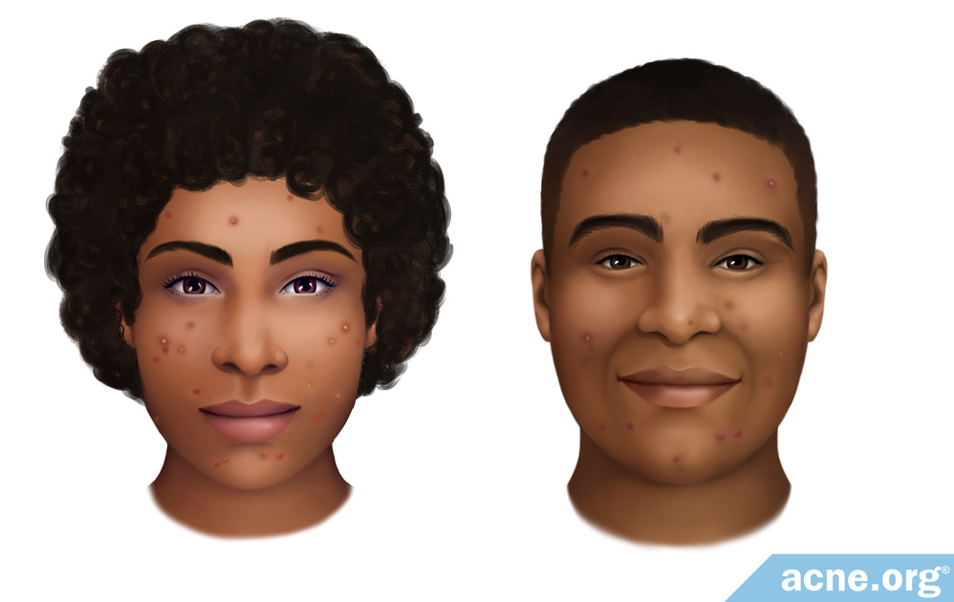
Acne on black skin
Scenario
Patient review
Treatment
Advice
Acne in black skin tends to present more as inflammatory acne (papules and pustules) than non-inflammatory (whiteheads and blackheads)
Tends to have fewer severe acne lesions (nodules & cysts)
Tends to scar less
Has the highest incidence of hyperpigmentation
Has a higher chance of keloid scarring (especially on the chest and back)
Does not tend to suffer with rosacea
Very common in both adolescents and adults of African decent
Notes:
Presenter notes
Acne is not more common in skin of colour however, there is a higher incidence of post-inflammatory hyperpigmentation which can persist for months to years. Because of the risk of significant hyperpigmentation, early and more aggressive treatment should be considered. This also includes early referral for consideration of isotretinoin
Cultural practises such as hair oil can cause secondary acne e.g. pomade acne on the forehead. Additionally, steroid-induced acne can be caused by the topical steroids in skin lightening products (1)
For comedonal acne – recommended treatment is topical retinoids, benzoyl peroxide and azelaic acid. However, if used daily they often cause dryness and irritation, which in skin of colour skin can lead to further hyperpigmentation.
Therefore, initial use should be for shorter periods of time (eg in an evening and washed off before bed) and can also consider using less frequently (eg every 2nd or 3rd day). If treatment is tolerated and does not cause irritation, duration and/or frequency can be increased. (1)
Post-inflammatory hyperpigmentation
Post-inflammatory changes tend to improve very slowly
One treatment that may help some patients is Eucerin DermoPurifyer Post Acne Marks ® (non-NHS)
Slide references
PCDS. Acne: acne vulgaris. 2023 [Available from: https://www.pcds.org.uk/clinical-guidance/acne-vulgaris]
Image: Acne.org [Available from: https://www.acne.org/ethnic-black-skin]

Slide 14
Scenario
Patient review
Treatment
Advice
Patient Centred Review
 | Item to consider | Patient response
Condition and consultation history | Establish history of patients' condition | Has had acne since teenager
 | Patient baseline habits | Generally is well, no low mood reported
 | Are they under a specialist consultant | Not currently under a specialist consultant
Treatment History | Treatment/Prescription history | 12 weeks completed of Lymecycline - once daily Prescribed Topical adapalene 0.1% and Benzoyl Peroxide 5%.
 | Side effects to treatment | No side effects reported
 | Compliance to treatment | Patient is compliant with her oral antibiotics and topical treatment Adheres to skin care advice – avoids using oil-based hair products near forehead
 | Patient’s perception of their treatment | Feels current treatment has had minimal effect
Patient Impact and preference | Explore impact acne has had on self- esteem or mental health | Concerned about scarring, feels compelled to always use camouflage make-up to cover up acne
 | What are the patient's preferences and expectations from treatment? | Would like to try other treatments Happy to be referred to a specialist Would like to see a noticeable improvement in her acne
Notes:
Presenter notes
This table covers several points you can cover in a review.
Now to decide the next steps for this patient. Using the patient responses, and using the “How to…” toolkit, think about or discuss in groups, how you would:
Treat the patient (including onward referral)
Give self-care advice to the patient (including useful resources)
Educate the patient
Review the patient

Slide 15
Treating your patient
Scenario
Patient review
Treatment
Advice
Treating or referring the patient
Refer patient to secondary care for specialist review
Consider a further 12 weeks of oral antibiotic therapy alongside topical treatment whilst patient awaits review by specialist
Review
Review patient after 12 weeks. If patient is being seen by specialist consultant, refer to correspondence for ongoing treatment
Review patient acne photos to monitor treatment success
Notes:
Presenter notes
Consider special considerations for darker skin tones;
Acne is no more common or severe in pigmented skin.
Post inflammatory hyperpigmentation can be more marked, therefore treat early and more aggressively, including earlier consideration of referral to secondary care or a dermatology service
Treatments including topical or oral antibiotics should only last longer than 6 months in exceptional circumstances, with review at 3-monthly intervals: the aim being to discontinue the antibiotic as soon as possible.
Slide references
NICE. Acne vulgaris: management. 2021 [Available from: https://www.nice.org.uk/guidance/ng198]

Slide 16
Education and advice
Scenario
Patient review
Treatment
Advice
Education
Antibiotics may cause systemic side effects and antimicrobial resistance.
Post inflammatory hyperpigmentation can take several months to noticeably reduce
Provide evidence for skin care and diet to help acne
Aggravating and modifiable risk factors - How to Booklet_Acne_TARGET V1.1_Final.pdf (rcgp.org.uk)
Advice
Mental health services for psychological distress caused by acne and/or scarring – shared care decision on referral
Signpost to digital apps such as - Dermatology digital playbook - Digital playbooks - NHS Transformation Directorate (england.nhs.uk).
Provide advice on contraception– topical retinoids and oral tetracyclines are contraindicated in pregnancy
Oral tetracyclines can cause photosensitivity – use suitable SPF if going out in the sun.
Avoid strong sunlight while using benzoyl peroxide and use oil free sunscreen with SPF30 or above
Notes:
Presenter notes
Manage patient expectations for an antimicrobial treatment.
Introduce a proactive strategy to identify potential health inequalities amongst patient populations in accessing treatment, coming forward for diagnosis, following self-care measures, and the differential outcomes of different topical treatments on ethnic skin types
See NICE recommendations for providing advice on skin care and diet, summarised below: https://www.nice.org.uk/guidance/ng198/chapter/recommendations#skin-care-advice
Skin care
Advise people with acne to use a non-alkaline (skin pH neutral or slightly acidic) synthetic detergent (syndet) cleansing product twice daily on acne-prone skin.
Advise people with acne who use skin care products (for example, moisturisers) and sunscreens to avoid oil-based and comedogenic preparations.
Advise people with acne who use make-up to avoid oil-based and comedogenic products, and to remove make-up at the end of the day.
Advise people that persistent picking or scratching of acne lesions can increase the risk of scarring.
Diet
Advise people that there is not enough evidence to support specific diets for treating acne.
For general advice about a balanced diet and how it could contribute to wellbeing see Public Health England's Eatwell Guide.
Diet - Although the evidence for a link between diet and acne is not strong, some people with acne have reported improvement in their skin when they follow a low-glycaemic index diet, which can be achieved by:
▪ Increasing the consumption of whole grains, fresh fruits and vegetables, fish, olive oil, garlic.
▪ Decreasing the consumption of high-glycaemic index foods such as sugar, biscuits, cakes, ice creams and bottled drinks (1)
Slide references
PCDS. Acne: acne vulgaris. 2023 [Available from: https://www.pcds.org.uk/clinical-guidance/acne-vulgaris]
NICE. Acne vulgaris: management. 2021 [Available from: https://www.nice.org.uk/guidance/ng198]

Slide 17
Referral to specialist care
Scenario
Patient review
Treatment
Advice
Urgent referral
People with acne fulminans, refer on the same day to the on-call hospital dermatology team
There is diagnostic uncertainty about patient’s acne
Or acne conglobata: serious form of nodulo-cystic acne with scars and abscesses over/under the surface of the skin
Severe acne/ unresponsive to treatment
Referral to dermatology
Patient with acne experiences significant psychological distress or a mental health disorder, including those with a suspected current or past history of:
Suicidal ideation or self-harm
Severe depressive or anxiety disorder
Body dysmorphic disorder
Referral for mental health
Notes:
Presenter notes
Who to refer;
Urgent referral – acne fulminans (form of acne with sever cutaneous features and systemic symptoms such as fever , arthritis and lethargy. Typically presents in mid-teenage boys who may have had, for a few years, mild acne which, over a matter of a few weeks changes into severe inflammatory acne, especially on the trunk. Delays in treatment result in severe scarring
Diagnostic uncertainty
Severe acne - refer early
Moderate acne only partially responding to treatment and starting to scar and/or causing significant hyperpigmentation (more common in patients with skin of colour)
Patients with associated and severe psychological symptoms, regardless of the physical signs
If referring for possible isotretinoin please make sure of the following:
U&Es, LFTs, and fasting lipids checked
Female patients during their reproductive years need to be on appropriate contraception

Slide 18
Referral to specialist care
Scenario
Patient review
Treatment
Advice
Considerations for referral to dermatology
Mild to moderate acne that has not responded to two completed 12-week courses of treatment
Moderate to severe acne which has not responded to previous treatment (dual therapy including oral antibiotic)
Acne with scarring
Acne with persistent pigmentary changes
Acne of any severity, or acne-related scarring, that is causing or contributing to persistent psychological distress or a mental health disorder
Any patient for whom oral retinoid therapy (isotretinoin) is being considered (NICE b, 2021)
Other
Consider condition-specific management or referral to a specialist (reproductive endocrinologist) if a medical disorder or medication is likely to be contributing to a person's acne
Notes:
Continuation from previous slide
Presenter notes
NICE guidance recommends tetracyclines for acne, there is no benefit in switching at 12 weeks from one tetracycline to another. There is no other class of oral antibiotic recommended by NICE for acne.

Slide 19
Scenario 3 Review outcome: stepping down treatment
Scenario
Patient review
Treatment
Advice
Consider the following details:
24-year-old male
Has been issued 2 prescriptions for lymecycline 408mg in the last 12 months
On examination
Mild acne
Notes:
Presenter notes
The final case will cover reviewing a patient on antibiotic treatment with mild acne
After undertaking a baseline search and analysis of a patient on antibiotic treatment for last 12 weeks, you have the collated the above information prior to the patient coming in for a face-to-face review
Think about or discuss the case and how you would carry out a patient centred review e.g. what questions will you focus on in this review, think about the impact of acne on metal health, treatments tried in the past, and patient’s preferences. Use the “How to…” toolkit to understand how to carry out a review.
Slide references
Image: Acne [Available from: www.gponline.com]

Slide 20
Patient centred view
Scenario
Patient review
Treatment
Advice
 | Item to consider | Patient response
Condition and consultation history | Establish history of patients' condition | Has had acne since teenager
 | Patient baseline habits | Generally is well, though suffers from poor sleep and stress. no low mood reported. Feels acne breakouts due to stress
 | Are they under a specialist consultant | Not currently under a specialist consultant
Treatment History | Treatment/Prescription history | 12 weeks completed of Lymecycline - once daily Has had repeated courses of antibiotics over the last 2 years Prescribed Topical azelaic acid applied twice a day
 | Side effects to treatment | No side effects reported
 | Compliance to treatment | Patient is compliant with his oral antibiotics and topical treatment Adheres to skin-care advice
 | Patient’s perception of their treatment | Concerned about taking too many antibiotics and building resistance
Patient Impact and preference | Explore impact acne has had on self-esteem or mental health | Does not report any negative impact on mental health or self-esteem
 | What are the patient's preferences and expectations from treatment? | Would like to try other treatments Happy to be referred to a specialist if needed Does not want acne to get worse
Notes:
Presenter notes
This table covers several points you can cover in a review.
Now to decide the next steps for this patient. Using the patient responses, and using the “How to…” toolkit, think about or discuss in groups, how you would:
Treat the patient (including onward referral)
Give self-care advice to the patient (including useful resources)
Educate the patient
Review the patient

Slide 21
Treating your patient
Scenario
Patient review
Treatment
Advice
Treating or referring the patient
Discontinue oral antibiotic treatment
Topical treatment to prescribe : Fixed combination of topical adapalene with topical benzoyl peroxide
Review
Review topical treatments at next review appointment in 12 weeks
If acne recurs on cessation of antimicrobial therapy despite topical treatment, review sooner:
if rapid relapse consider a systemic retinoid (via dermatology referral secondary care).
if a longer remission was achieved, an intermittent 3-month course of systemic antimicrobials can be used.
If longer remission is achieved but patient needs more than two repeat courses of three months in one year for relapse, consider referral.
Review photos at next review to monitor condition and appearance
Notes:
Presenter notes
Oral antibiotic treatment should be discontinued and patient prescribed topical treatment for mild acne.
Slide references
NICE. Acne vulgaris: management. 2021 [Available from: https://www.nice.org.uk/guidance/ng198]

Slide 22
Education and advice
Scenario
Patient review
Treatment
Advice
Education
Provide evidence for skin care and diet to help acne
Aggravating and modifiable risk factors - How to Booklet_Acne_TARGET V1.1_Final.pdf (rcgp.org.uk)
Advice
Mental health services for psychological distress caused by acne and/or scarring – shared care decision on referral
Signpost to digital apps such as - Dermatology digital playbook - Digital playbooks - NHS Transformation Directorate (england.nhs.uk).
Oral tetracyclines can cause photosensitivity – use suitable SPF if going out in the sun.
Avoid strong sunlight while using benzoyl peroxide and use oil free sunscreen with SPF30 or above
Notes:
Presenter notes
Best practice points to discuss;
Stress - May manifest itself as acne excoriée, where patients, habitually scratch the spots the moment they appear (1)
See NICE recommendations for providing advice on skin care and diet, summarised below: https://www.nice.org.uk/guidance/ng198/chapter/recommendations#skin-care-advice
Skin care
Advise people with acne to use a non-alkaline (skin pH neutral or slightly acidic) synthetic detergent (syndet) cleansing product twice daily on acne-prone skin.
Advise people with acne who use skin care products (for example, moisturisers) and sunscreens to avoid oil-based and comedogenic preparations.
Advise people with acne who use make-up to avoid oil-based and comedogenic products, and to remove make-up at the end of the day.
Advise people that persistent picking or scratching of acne lesions can increase the risk of scarring.
Diet
Advise people that there is not enough evidence to support specific diets for treating acne.
For general advice about a balanced diet and how it could contribute to wellbeing see Public Health England's Eatwell Guide.
Diet - Although the evidence for a link between diet and acne is not strong, some people with acne have reported improvement in their skin when they follow a low-glycaemic index diet, which can be achieved by:
▪ Increasing the consumption of whole grains, fresh fruits and vegetables, fish, olive oil, garlic.
▪ Decreasing the consumption of high-glycaemic index foods such as sugar, biscuits, cakes, ice creams and bottled drinks (1)
Slide references
PCDS. Acne: acne vulgaris. 2023 [Available from: https://www.pcds.org.uk/clinical-guidance/acne-vulgaris]
NICE. Acne vulgaris: management. 2021 [Available from: https://www.nice.org.uk/guidance/ng198]

Slide 23
Additional information: Relapse
Situation | Response
If acne responds adequately to a course of an appropriate first-line treatment but then relapses | consider either: another 12‑week course of the same treatment, or an alternative 12‑week treatment see NICE. Acne vulgaris: management. 2021 [Available from: https://www.nice.org.uk/guidance/ng198]
If acne relapses after an adequate response to oral isotretinoin and is currently mild to moderate | offer an appropriate treatment option see NICE. Acne vulgaris: management. 2021 [Available from: https://www.nice.org.uk/guidance/ng198]
If acne relapses after an adequate response to oral isotretinoin and is currently moderate to severe, | offer either: a 12-week course of an appropriate treatment option or re-referral, if the person is no longer under the care of the consultant dermatologist-led team.
If acne relapses after a second course of oral isotretinoin and is currently moderate to severe | further care should be decided by the consultant dermatologist-led team. If the person is no longer under the care of the consultant dermatologist-led team, offer re-referral.
Notes:
Slide references
PCDS. Acne: acne vulgaris. 2023 [Available from: https://www.pcds.org.uk/clinical-guidance/acne-vulgaris]

Slide 24
Take home messages
Do not use oral antibiotic monotherapy; combine oral antibiotic with a topical non-antibiotic topical agent to treat acne.
Do not use oral or topical antibiotic treatment for longer than 6 months unless in exceptional circumstances
Use a step-wise approach when reviewing and treating patients with acne
Take note of any mental health issues caused by acne or scarring and refer if required
Treat patients with darker skin tones early and more aggressively, including earlier consideration of referral to secondary care or a dermatology service
Notes:
Slide references
NICE. Acne vulgaris: management. 2021 [Available from: https://www.nice.org.uk/guidance/ng198]

