Slide 1




Reviewing patients using long-term or repeated antibiotic courses for recurrent Urinary Tract Infection (rUTI)
Worked examples using the TARGET “How to…?” Toolkit for patients in Primary Care
Notes:
Presenter notes
References

Slide 2

How to use this resource
The TARGET recurrent UTI ‘How to…?’ worked examples are a resource designed to be used with the TARGET rUTI ‘How to…?’ toolkit for the review of antibiotic prescribing in patients on long-term or repeated antibiotic courses for recurrent UTI.
This slide desk will take you through 4 worked examples and can be used for own learning or to deliver to your team. The PowerPoint notes contain further information and slide references.
The slides can be used by medical prescribers, non-medical prescribers and pharmacy/nursing professionals to review the clinical management of patients with rUTI.
Notes:
Presenter notes
References

Slide 3
Aims of this slide set
Understand and discuss:
Why it is important to review patients on long-term antibiotics for recurrent UTI (rUTI)
How to review and manage patients that:
  Have repeated antibiotic courses for rUTI;
  are on continuous prophylactic antibiotic treatment for rUTIs;
  need referral for rUTIs.
3. The list of considerations when carrying out a patient review and assessment including prevention, education, management of rUTI exacerbations and key points on mental health and self-care advice.
Notes:
Presenter notes
References

Slide 4

The challenge of antimicrobial resistance
One Health approach targets multiple causes of antimicrobial resistance
AMR
2050
Diabetes
and cancer
combined
10,000,000
9,700,000
Deaths per year
(O ’Neill, 2016)
(Scottish One Health AMR/AMU 2022 )
Notes:
Presenter talk
On a global scale, recent UN report (2), (April 2019) highlighted that by 2050, AMR could kill 10 million people per year, in its worst-case scenario. This is more than diabetes and cancer combined. This will also come at a cost of £66 trillion pounds.
(click for animation) While we know that antimicrobial resistance needs to be addressed through the many different social and environmental factors that contribute to it (“One Health”), and a lot of important work is going on in different sectors, we know that humans are the largest consumers of antimicrobials in the UK, so improving how infections are managed in our healthcare is a key step as we work together to reduce resistance.
More information: In 2019, approximately one third of all UK antibiotic medicines were used in animals and two thirds in humans. It is interesting to see these figures side by side, particularly as there are some sources that report that antibiotic use in animals, globally, is higher than in people. That is clearly not the case in the UK. Since much animal antibiotic use is in farm animals, which are typically young animals, it is appropriate that use in animals is lower than use in people.
Slide references
The review on antimicrobial resistance, chaired by Jim O’Neill. Tackling drug-resistant infections globally: final report and recommendations. 2016. [Available from: https://amr-review.org/sites/default/files/160518_Final%20paper_with%20cover.pdf]
IACG (2019). “No time to wait: securing the future from drug-resistant infections”
UK Health Security Agency. English surveillance programme for antimicrobial utilisation and resistance (ESPAUR) Report 2022 to 2023. https://www.gov.uk/government/publications/english-surveillance-programme-antimicrobial-utilisation-and-resistance-espaur-report London: UK Health Security Agency, November 2023
UK Health Security Agency and Veterinary Medicines Directorate. Executive summary Third UK One Health Report. Published 29 November 2023. https://www.gov.uk/government/publications/uk-one-health-report-joint-report-on-antibiotic-use-antibiotic-sales-and-antibiotic-resistance/executive-summary-third-uk-one-health-report
ARHAI Scotland. Scottish One Health Antimicrobial Use and Antimicrobial Resistance in 2022. 21 November 2023. https://www.nss.nhs.scot/publications/scottish-one-health-antimicrobial-use-and-antimicrobial-resistance-in-2022/

Slide 5
Why review patients with recurrent UTI?
National data revealed that recurrent UTI is one of the most common indications for long term and/or repeat antibiotic use. Data from GP surgeries in Wales over 10 years showed 6.0% of women had rUTIs, and 1.7% women were prescribed prophylactic antibiotics for rUTI.¹
1
Timely and regular patient reviews are vital to ensure antimicrobial prescribing appropriateness.²
2
Self-help preventative measures can reduce rUTI and the use of alternatives to antibiotics can be explored with patients.
3
Sanyaolu 2024
UKHSA 2024
Notes:
Presenter talk
A recent Welsh study showed 6.0% of women (n=92,213) had rUTIs, and 1.7% (n=26,862) were prescribed prophylactic antibiotics. Only 49% of prophylactic antibiotic users met the definition of rUTIs before initiation. 81% of women with rUTIs had a urine culture result in the preceding 12 months with high rates of resistance to trimethoprim and amoxicillin. 64% of women taking 60 prophylactic antibiotics had a urine culture result before initiation, and 18% (n=320) of 61 women prescribed trimethoprim had resistance to it on the antecedent sample. Sanyaolu et al 2024
Slide references
Leigh Sanyaolu, Victoria Best, Rebecca Cannings-John, Fiona Wood, Adrian Edwards, Ashley Akbari, Gail Hayward, Haroon Ahmed British Journal of General Practice 2024; 74 (746): e619-e627. DOI: 10.3399/BJGP.2024.0015
UK 5-year action plan for antimicrobial resistance 2024 to 2019. GOV.UK. Available at: UK 5-year action plan for antimicrobial resistance 2024 to 2029 - GOV.UK (www.gov.uk)

Slide 6
Recurrent UTI
Definition: 2 or more UTIs in the last 6 months or 3 or more UTIs in the last 12 months¹
Patients with rUTIs should have a mid-stream urine (MSU) sample sent for culture when symptomatic, prior to antibiotics being initiated, to provide susceptibility results and guide antibiotic treatment. ²
  Empirical antibiotic therapy can be started whilst awaiting results.
  Patients should be counselled on how to provide a specimen to minimise the chance of contamination. Refer to local resources you can use to discuss this information with patients.
  Urine culture should be repeated with each symptomatic episode to provide susceptibility results and guide treatment.
  Do not send a sample after treatment for test of cure. Urine cultures sent in the absence of symptoms are unlikely to be helpful, may detect asymptomatic bacteriuria and lead to inappropriate antibiotic use.
EAU 2017
NICE NG112, 2018
Notes:
Presenter talk
Be aware that in the NICE guidance recurrent UTI:
• includes lower UTI and upper UTI (acute pyelonephritis)
• may be due to relapse (with the same strain of organism) or reinfection (with
a different strain or species of organism)
• is particularly common in women.
Data from a recent Welsh study (Sanyaolu 2024) found of women taking prophylactic antibiotics, 64.2% (n = 9926/N = 15 455) had a urine culture result before initiation and 18.5% (n = 320/N = 1730) of women prescribed trimethoprim had resistance to it on the antecedent sample.
References:
Urinary tract infection (recurrent): antimicrobial prescribing NG112. 2018. Available from: Urinary tract infection (recurrent): antimicrobial prescribing (nice.org.uk)
Leigh Sanyaolu, Victoria Best, Rebecca Cannings-John, Fiona Wood, Adrian Edwards, Ashley Akbari, Gail Hayward, Haroon Ahmed British Journal of General Practice 2024; 74 (746): e619-e627. DOI: 10.3399/BJGP.2024.0015

Slide 7
How to manage patients
Shared Decision Making
1. Advice
2. Prevention
3. Prescribing
4. Review
Notes:
Presenter notes
References

Slide 8

Scenario 1 – Mei Ling
Scenario
Prevention
Education
Referral
Consider the following details:
A 64-year-old female, postmenopausal with recurrent UTI
Has tried personal hygiene measures and self-care treatments including OTC cranberry capsules
On examination/review:
Abdominal examination normal
Has experienced 3 UTIs in the last 12 months
Feels cranberry capsules are not helpful
Notes:
Presenter notes:
Please consider the following scenario…
References

Slide 9

Patient centred review
 | Item to consider | Patient response
Condition and consultation history | Establish history of patients' condition | Experienced recurrent UTIs since going through the menopause (3 in the last 12 months) Vaginal dryness in the last 3 months
 | Patient baseline habits | Practicing personal hygiene measures Eats well and sleeps well
 | Are they under a specialist consultant | Not currently under a specialist consultant
Treatment History | Treatment/Prescription history | OTC cranberry capsules No other relevant medications Acute: 3 courses of nitrofurantoin within last 12 months (MSU completed each time)
 | Side effects to treatment | None reported
 | Adherence to treatment | Compliant with GP advice
 | Patient’s perception of their condition | Feels current prevention strategies have had minimal effect
Patient Impact and preference | Explore impact UTIs have had on self-esteem or mental health | Patient feels concerned with risk of UTIs coming back, creating anxiety and reluctance to plan holidays
 | What are the patient's preferences and expectations from treatment? | Aim is to prevent the UTI infections from occurring Would be happy to trial oral or topical treatment Would like treatment for vaginal dryness
Notes:
Presenter notes
Over the counter (OTC) treatments can be purchased but are not available on prescription, these include cranberry products and D-mannose.
Confirm self-care hygiene advice as per NICE:
Wipe from front to back when going to the toilet
Do not hold urine too long, pass urine when needed
Pass urine after sex to flush out any bacteria
Drink enough fluids not to be dehydrated
Perfumed products may be irritant and vaginal douching is not recommended
References

Slide 10
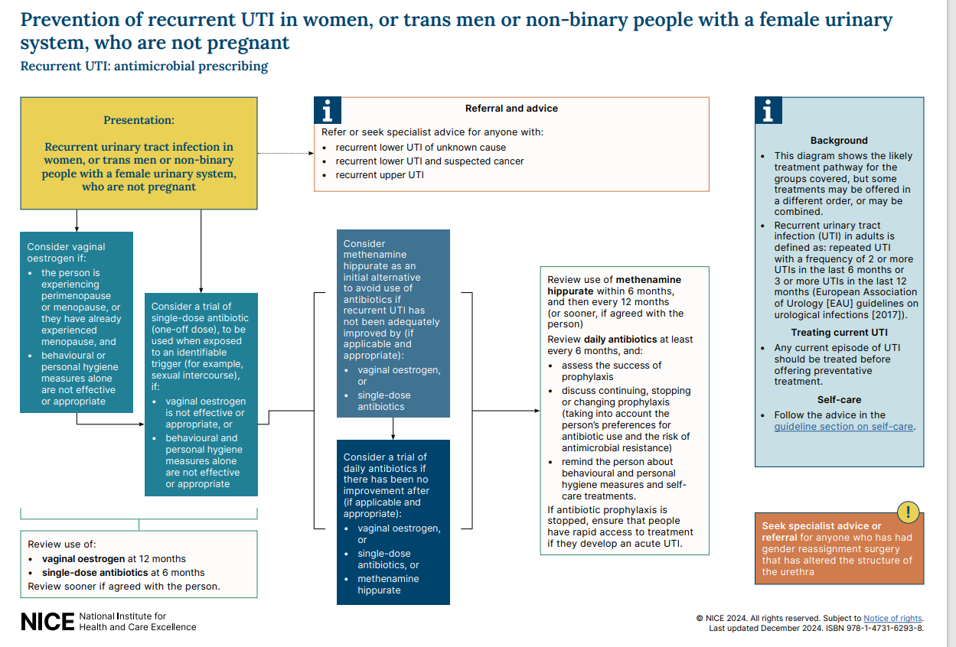
Notes:
Reference:
Figure 1: UTI (recurrent): antimicrobial prescribing. NICE. Available at: https://www.nice.org.uk/guidance/ng112/resources/visual-summary-pdf-6544163629

Slide 11
Management:
Prescribing:
Discuss options with patient
Consider prescribing vaginal oestrogen, explain possible benefits for related symptoms such as vaginal dryness. Vaginal oestrogen use for recurrent UTI prevention is off-licence but is recommended by NICE.
Prevention and Advice:
Continue to practice prevention measures and maintain adequate hydration.
Explain that vaginal oestrogen is absorbed locally – a minimal amount is absorbed into the bloodstream, so this is unlikely to have a significant effect throughout the body.
  Check for any allergies, contra-indications or cautions prior to prescribing², see BNF for details
Signpost patient to menopause help and support groups: Menopause - Help and support - NHS (www.nhs.uk). ⁴
NICE 2018 (updated 2024)
NICE 2025
NHSE
Notes:
References
Reducing the chance of recurrent urinary tract infection in postmenopausal women. NICE. November 2018 (updated December 2024). Available at: NG112 Patient decision aid on reducing the chance of recurrent urinary tract infection (UTI) in postmenopausal women (nice.org.uk)
Intravaginal oestrogen. NICE. January 2025. Available at: Intravaginal oestrogen | Prescribing information | Incontinence - urinary, in women | CKS | NICE
Help and support – menopause. NHS. Available at: Menopause - Help and support - NHS (www.nhs.uk)

Slide 12
Evidence for vaginal oestrogens in recurrent UTI
Vaginal oestrogen cream for 8 months (estriol cream 0.5mg ON for 2/52 then twice weekly) significantly reduced the risk of recurrent infection in postmenopausal women compared with placebo (16.0% [8/50] versus 62.8% [27/43], NNT 3).¹
Vaginal oestrogen cream was significantly more effective than oral antibiotics (ofloxacin 600 mg a day) in reducing the risk of recurrent UTI over a 3-month study period (7.4% [2/27] versus 80.0% [12/15], NNT 2). However, 2 months after the treatments were stopped, no difference was seen in the number of women with recurrent UTI.¹
Vaginal oestrogen administered via a pessary (used daily for 2 weeks then once every 2 weeks) were not as effective as an oral antibiotic (nitrofurantoin 100 mg a day) over a 9-month study period (67% of 86 participants on pessaries had episodes of UTI versus 52% of 85 on nitrofurantoin).¹
Women with recurrent urinary tract infections who collected at least 1 vaginal oestrogen prescription (n=5638) experienced a 52% reduction in urinary tract infection frequency (from 3.9 to 1.8) in the following year.²
Perrotta 2008
Tan-Kim 2023
Notes:
References:
Perrotta C, Aznar M, Mejia R, Albert X, Ng CW. Oestrogens for preventing recurrent urinary tract infection in postmenopausal women. Cochrane Database of Systematic Reviews 2008, Issue 2. Art. No.: CD005131. DOI: 10.1002/14651858.CD005131.pub2. Accessed 14 January 2024.
Tan-Kim J, Shah NM, Do D, Menefee SA. Efficacy of vaginal estrogen for recurrent urinary tract infection prevention in hypoestrogenic women. Am J Obstet Gynecol. 2023;229(2):143.e1-143.e9. doi:10.1016/j.ajog.2023.05.002

Slide 13
Review
Review effectiveness of treatment with vaginal oestrogen within 12 months, or earlier if agreed with the person.
Assess if patient has experienced any UTIs and if there have been any side effects to treatment.
If relevant, discuss other symptoms of the menopause that may have improved, such as vaginal dryness, referring to NICE guideline: Menopause: diagnosis and management (NG23).
If no further (or few mild) UTIs experienced, discuss continued vaginal oestrogen use weighing up benefits and risk. Continue with prevention behaviours (hydration, post coital voiding, personal hygiene etc…).
If UTIs experienced, consider change in treatment or addition of another agent.
NICE NG 112
NICE NG 23
Notes:
Presenter notes:
Key points to shared decision making when prescribing vaginal oestrogen.
Discuss the following with the woman to ensure shared decision-making:
the severity and frequency of previous symptoms
the risk of developing complications from recurrent UTIs
the possible benefits of treatment, including for other related symptoms, such as vaginal dryness
the possible adverse effects such as breast tenderness and vaginal bleeding (which should be reported because it may require investigation)
the uncertainty of endometrial safety with long-term or repeated use
that vaginal oestrogen is absorbed locally – a minimal amount is absorbed into the bloodstream, but this is unlikely to have a significant effect throughout the body
preferences of the woman for treatment with vaginal oestrogen.
Review treatment within 12 months, or earlier if agreed with the woman. In October 2018, this was an off-label use of vaginal oestrogen products. See NICE's information on prescribing medicines
References

Slide 14

Scenario 2 – Robert Smith
Scenario
Prevention
Education
Action planning
Referral
Consider the following details:
45-year-old male, labourer by profession
On examination/review
Now experiencing 2nd UTI episode within 6-month period
Notes:
Presenter notes
References

Slide 15

Patient centred review
 | Item to consider | Patient response
Condition and consultation history | Establish history of patient’s condition | Experiencing 2nd UTI within 6-month period Experiencing more frequent urination at night
 | Patient baseline habits | Smoker: 10/day for the past 5 years Alcohol: 15-20 units over the weekends Reports drinking very little water throughout the day (difficult due to job role) Not sleeping well due to job stress and UTI symptoms
 | Are they under a specialist consultant | Not currently under a specialist
Treatment History | Treatment/Prescription history | Nil OTC/other relevant medications Acute: Nitrofurantoin course 3/12 ago
 | Side effects to treatment | None reported
 | Adherence to treatment | Completed full course of antibiotics 3/12 ago
 | Patient’s perception of their condition | Concerned about new UTI episode causing time off work
Patient Impact and preference | Explore impact UTIs have had on self-esteem or mental health | Patient is suffering with sleeping issues and anxiety since experiencing 2nd UTI
 | What are the patient's preferences and expectations from treatment? | Would like another course of antibiotics Patient cannot afford to have time off work for sickness
Notes:
Presenter notes
References

Slide 16
Management:
Prescribe for acute UTI and refer the patient
Ask patient for a midstream urine sample for culture and susceptibility testing.
Prescribe an empirical course of antibiotics for acute UTI whilst patient awaits review by specialist, review with susceptibility result.
Primary care investigations may include ultrasound scan (USS), bladder residual volume, HbA1C, urea and electrolytes and renal function tests.
Refer patient to secondary care for specialist review.
Notes:
References
Treating your infection – urinary tract infection. TARGET. Available from: TYI-UTI GenPract V23.5 UKHSA.pdf (rcgp.org.uk)

Slide 17
Management cont.…
Prevention and Advice
Avoid too much alcohol – advise on cutting down.
Drink enough fluids to stop the patient feeling thirsty. Aim to drink 6-8 glasses per day.
Take paracetamol or ibuprofen at regular intervals for pain relief, if no previous side effects.
Consider discussing mental health referral for psychological distress caused by work/UTIs shared care decision.
Notes:
References
Treating your infection – urinary tract infection. TARGET. Available from: TYI-UTI GenPract V23.5 UKHSA.pdf (rcgp.org.uk)

Slide 18
Benefits of hydration - Effect of increased daily water intake in premenopausal women with recurrent urinary tract infections
Study design:
12-month RCT in Bulgaria
140 healthy women with recurrent cystitis (≥3 episodes in past year), drinking less than 1.5 L of fluid daily, assigned to hydration or control group
Patients randomly assigned to drink, in addition to their usual fluid intake, 1.5 L of water daily (hydration group) or no additional fluids (control group)
Outcomes:
Cystitis episodes – 111 (mean 1.7) in hydration group and 216 (mean 3.2) in control group
Mean number of antimicrobial regimens used to treat cystitis episodes – 1.9 (95% CI, 1.7-2.2) in hydration group and 3.6 (95% CI, 3.3-4.0) in control group
Mean time interval between cystitis episodes – 142.8 days (95% CI, 127.4-160.1) in hydration group and 84.4 days (95% CI, 75.4-94.5) in control group
Hooton 2018
Notes:
References
We do not have studies in men.
1. Hooton et al, 2018. Effect of increased daily water intake in premenopausal women with recurrent urinary tract infections. JAMA Internal Medicine. doi: 10.1001/jamainternmed.2018.4204

Slide 19
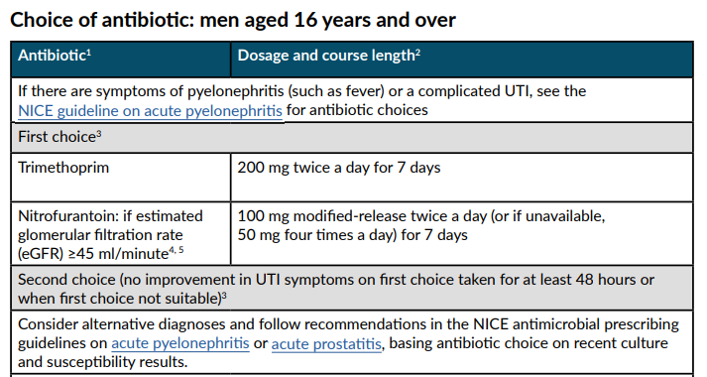
Empirical treatment options for acute UTI
For a complete list of treatment options for urinary tract infection (lower), see NICE [NG109]
Figure 1: UTI (lower): antimicrobial prescribing. NICE.
NICE NG 112
Notes:
Reference:
NICE guidance suggests Trimethoprim or Nitrofurantoin as first line for UTI in men, trimethoprim also penetrates the prostate which may be implicated in some UTIs in men.
Figure 1: UTI (lower): antimicrobial prescribing. NICE. Available from: NG109 Visual summary (nice.org.uk)

Slide 20
Referral to specialist care
Urgent referral
Referral to urology
People with suspected cancer in line with NICE guidance on suspected cancer¹
People with recurrent upper UTI
People with recurrent lower UTI when the underlying cause is unknown
Pregnant people
Children and young people under 16 years in line with the NICE guideline on urinary tract infection in under 16s ²
Men aged 16 years and over
Failure to respond to appropriate antibiotic therapy
Anyone who has had gender reassignment surgery that involved structural alteration of the urethra
NICE NG 112
NICE NG 224
Notes:
Presenter notes
Review MSU results and ensure patient treated for current acute UTI.
References
Suspected cancer: recognition and referral. NICE guideline [NG12]. June 2015. Available from: Overview | Suspected cancer: recognition and referral | Guidance | NICE
Urinary tract infection in under 16;s: diagnosis and management. NICE guideline [NG224]. July 2022. Available from: Overview | Urinary tract infection in under 16s: diagnosis and management | Guidance | NICE

Slide 21

Scenario 3 – Angela Carter
Scenario
Prevention
Education
Action planning
Referral
Consider the following details:
30-year-old female, non pregnant with recurrent UTI
Completed 6-month course of nitrofurantoin 50mg at night
On examination/review:
No breakthrough UTIs within the last 6 months
No adverse effects to treatment
Notes:
Presenter notes
References

Slide 22

Patient centred review
 | Item to consider | Patient response
Condition and consultation history | Establish history of patient’s condition | Has experienced recurrent UTIs since early 20s
 | Patient baseline habits | Generally well
 | Are they under a specialist consultant | Not currently under a specialist consultant
Treatment History | Treatment/Prescription history | 6 months completed of nitrofurantoin 50mg at night Has had repeated courses of antibiotics over the last 2 years Continues to practice personal hygiene measures
 | Side effects to treatment | None reported
 | Adherence to treatment | Patient is compliant to treatment
 | Patient’s perception of their condition | Concerned about risks of coming off antibiotics and UTIs returning
Patient Impact and preference | Explore impact UTIs have had on self-esteem or mental health | Does not report any negative impact on mental health or self-esteem
 | What are the patient's preferences and expectations from treatment? | Would be willing to trial coming off antibiotics with support from health care professional Does not want UTIs to return
Notes:
Presenter notes
References

Slide 23
Management
Discuss discontinuing repeat oral antibiotic prophylaxis – shared care decision.
  Long term antibiotics can cause serious side effects (for nitrofurantoin, this includes pulmonary and liver risks) and require monitoring, see BNF for details.
  Patients that can stop continuous prophylaxis without a return of symptoms reduce the risks of antimicrobial resistance emerging and side effects.
  In a recent trial 48% of patients who stop continuous antibiotic prophylaxis at 6-months, did not return to suffering rUTIs (when assessed 6 months later).¹
  Test of cure is not required in asymptomatic patients at the end of a course of prophylaxis.
  Discuss OTC products such as cranberry products or D-mannose.
  Explain this is a trial off antibiotics – not a hard stop.
  Supply urine sample bottle with instructions of when to use.
  Provide a ‘self-start’ prescription of stand-by antibiotics based on most recent sensitivities.
  Provide information on self-management and stand-by pack advice sheet.
NICE NG 112
NICE NG 224
Harding 2022
Notes:
Presenter notes
A recent trial found that half (48%%, 95% CI: 0.28-0.68) of patients who stopped continuous antibiotic prophylaxis after 12 months, did not return to suffering rUTIs in the following 6 months [30]
References
1. Harding, C., et al., Alternative to prophylactic antibiotics for the treatment of recurrent urinary tract infections in women: multicentre, open label, randomised, non-inferiority trial. BMJ, 2022. 376: p. e068229.

Slide 24
Evidence for Cranberry products
Cranberry is contra-indicated in patients taking warfarin and patients should be advised to consider the sugar content of cranberry products.
Cranberry products (juice, tablets or capsules) probably reduced the risk of symptomatic, culture‐verified UTIs by 26% vs. placebo, in [younger] women with recurrent UTIs (8 studies, 1555 participants: RR 0.74, 95% CI 0.55 to 0.99). ²
Review of 50 RCTs involving 8857 people. Taking cranberries as a juice, tablets or capsules reduced the number of UTIs in women with recurrent UTIs, in children with UTIs and in people susceptible to UTIs following an intervention such as bladder radiotherapy. However, UTIs did not appear to be reduced in elderly institutionalised men and women, in adults with neuromuscular bladder dysfunction and incomplete bladder emptying, or in pregnant women. ³
NICE NG 112
Fu 2017
Williams 2023
Notes:
Presenter notes
NICE found the Evidence for these products was conflicting in different patient groups (non-pregnant women, pregnant women, elderly men and women, and children).
There is currently no established regimen for what dose to use and no formal regulation by health authorities of cranberry products. In particular, the dose suggested may not be included on the package.
References:
Reducing the chance of recurrent urinary tract infection (UTI). Decision aid: user guide and data sources, NICE. Available at: NG112 Patient decision aid user guide for healthcare professionals (nice.org.uk)
Fu Z, Liska D, Talan D, Chung M.. J Nutr. 2017 Dec;147(12):2282-2288. doi: 10.3945/jn.117.254961. Epub 2017 Oct 18. PMID: 29046404. Cranberry Reduces the Risk of Urinary Tract Infection Recurrence in Otherwise Healthy Women: A Systematic Review and Meta-Analysis
Williams G, Stothart CI, Hahn D, Stephens JH, Craig JC, Hodson EM. Cranberries for preventing urinary tract infections. Cochrane Database of Systematic Reviews 2023, Issue 11. Art. No.: CD001321. DOI: 10.1002/14651858.CD001321.pub7. Accessed 14 January 2024.

Slide 25
D-Mannose
D-mannose is a sugar that is found in many types of fruit, including cranberries
D-mannose supplements should be used with caution in diabetes. It may make it harder to control blood sugar.
It is not a medicine but can be bought over the counter or online
Evidence for D-mannose is conflicting, but some women may wish to try D-Mannose, the evidence is conflicting
NICE NG 112
Notes:
Presenter notes
If asked: D-mannose is a sugar that is found in many types of fruit, including cranberries
D-mannose supplements should be used with caution in diabetes. It may make it harder to control blood sugar.
It is not a medicine but can be bought over the counter or online
Although women may wish to try D-Mannose, the evidence is conflicting
References:
Reducing the chance of recurrent urinary tract infection (UTI). Decision aid: user guide and data sources, NICE. Available at: NG112 Patient decision aid user guide for healthcare professionals (nice.org.uk)

Slide 26
Evidence for D-Mannose
A recent study compared those contacting ambulatory care with a clinically suspected UTI managed with D-mannose powder 2g daily [50/294 (51.0%)] to those managed with placebo [161/289 (55.7%)] over 6 months. The number of prescribed antibiotic courses for UTI did not significantly differ between the 2 groups (risk difference, −5%, 95% CI: −13% to 3%, p=0.26).²
A previous study found that a dose of 2g of D-mannose powder in 200ml of water daily for 6 months resulted in significant reduction in the risk of recurrent UTI in non-pregnant women compared with no treatment [ 15 (14.6%) versus 62 (60.8%), NNT 3)] in 98 women presenting with a current UTI and history of recurrent UTI.³
D-mannose was equally effective in reducing recurrent UTI when compared with antibiotic prophylaxis (nitrofurantoin 50mg a day) over 6 months.³
Evidence on D-mannose in combination with other treatments can be found in a Cochrane Review in 2022.⁴
1. NICE NG 112
2. Hayward 2024
3. Kranjčec 2014
4. Cooper 2022
Notes:
Presenter notes
References:
Reducing the chance of recurrent urinary tract infection (UTI). Decision aid: user guide and data sources, NICE. Available at: NG112 Patient decision aid user guide for healthcare professionals (nice.org.uk)
D-Mannose for prevention of recurrent urinary tract infection among women. Hayward et al, 2024. JAMA. Available at: https://doi.org/10.1001/jamainternmed.2024.0264
Kranjčec, B., Papeš, D. & Altarac, S. d-mannose powder for prophylaxis of recurrent urinary tract infections in women: a randomized clinical trial. World J Urol 32, 79–84 (2014). https://doi.org/10.1007/s00345-013-1091-6
Cooper TE, Teng C, Howell M, Teixeira-Pinto A, Jaure A & Wong G. D-mannose for preventing and treating urinary tract infections. Cochrane Database Syst Rev. 2022: 30; 8(8). https://doi.org/10.1002/14651858.cd013608.pub2

Slide 27
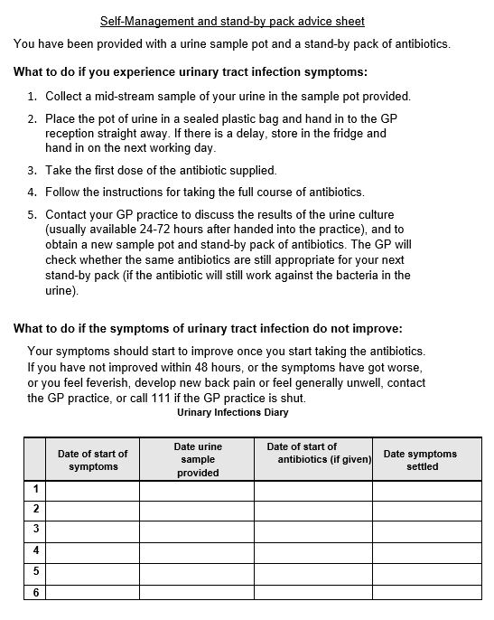
Counselling and advice
Antibiotics may cause systemic side effects and antimicrobial resistance.
Provide TARGET patient information leaflet: Treating Your Infection – Urinary Tract Infection.¹
Supply education on UTI symptoms to look out for.
Provide information on self-management and stand-by pack advice sheet.
Figure 1. Self-Management and stand-by pack advice sheet
NICE NG 112
Notes:
Presenter notes
Figure 1: Self-Management and stand-by pack advice sheet. Source: How to manage and review patients aged 16 and over for the prevention and treatment of Recurrent UTI. First edition. June 2024

Slide 28
Preventative actions
Recommended activities with good evidence
Maintain adequate hydration
  The amount will depend per person, but NHS recommends about 6-8 glasses per day
Recommended activities with limited evidence
Continue to practice personal hygiene measures
  Wash the perineum with water and not scented cleaning products
  Encourage wiping from front to back
  For those who are sexually active, encourage post-coital voiding
Notes:
Presenter notes
References

Slide 29
Review
To provide patient reassurance, discuss review frequency, consider a phone call monthly for the first 3 months then 3-6 monthly to assess progress. It can be medicines management / nursing team that does this.
If UTI recurs on cessation of antimicrobial therapy, review sooner.
Consider underlying causes eg prolapse, retention.
Options for management on review include single dose prophylaxis (based on MSU culture and sensitivities), if trigger can be identified or methenamine (Hiprex).
Consider referring patients to urology who relapse after stopping continuous prophylaxis, if not already recently investigated.
Notes:
Presenter notes
References

Slide 30
General Information: Review
Situation | Response
Stopping continuous antibiotic prophylaxis at review | If no acute UTI breakthroughs, patients can trial stopping continuous prophylaxis to reduce the risk of antimicrobial resistance emerging and side effects. Test of cure is not required in asymptomatic patients at the end of a course of prophylaxis Provide self-care advice and consider appropriate non-antibiotic therapies Supply sample bottle with instructions of when to use and provide a ‘self-start’ prescription of antibiotics based on most recent UTI sensitivity Consider referring patients to urology who relapse after stopping continuous prophylaxis, if not already recently investigated
Changing antibiotic prophylaxis at review | If urine cultures confirm resistance to the current prophylactic agent, stop prophylaxis and undertake clinical review, consider changing to an effective agent based on recent MSU culture and sensitivities and/or whether a referral is required
Notes:
Presenter notes
References

Slide 31
Breakthrough UTIs
In all scenarios discuss behavioural and self-care preventative measures, treat the acute UTI and consider the use of vaginal oestrogens if appropriate or trying methenamine if not already tried.
The first breakthrough infection should be treated according to culture and susceptibility results, ideally with a different antibiotic. If nightly prophylaxis still required, it can be re-started once the acute infection has resolved, if the culture confirms it is still sensitive to the original prophylactic agent.
If the culture shows resistance to the original prophylactic agent and nightly prophylaxis is still required, it should be changed to an antibiotic that shows susceptibility.
If multiple breakthrough UTIs occur (≥2 UTIs in 6 months), prophylaxis has proved ineffective and should be stopped as the patient is exposed to all the risks but none of the benefits of antibiotic treatment..
Notes:
Presenter notes
References

Slide 32
Breakthrough UTIs
If antibiotic prophylaxis is stopped, ensure that patients have rapid access to treatment if they have an acute UTI.
Supply sample bottle with instructions of when to use and provide a ‘self-start’ prescription of antibiotics based on most recent UTI susceptibility.
Explain if patients do get a UTI after stopping, future treatment can be tailored to sample results.
Refer or seek specialist advice on further investigation and management.
Notes:
Presenter notes
References

Slide 33

Scenario 4 – Busola Akinwale
Scenario
Prevention
Education
Action planning
Referral
Consider the following details:
40-year-old female pre-menopausal woman with recurrent UTI
On examination/review
MSU has shown resistance to trimethoprim
Chronic kidney disease (eGFR = 30ml/min), nitrofurantoin not suitable
Notes:
Presenter notes
References

Slide 34

Patient centred review
 | Item to consider | Patient response
Condition and consultation history | Establish history of patient’s condition | Experiencing 2nd UTI within 6-month period
 | Patient baseline habits | Practising personal hygiene measures Eats well and sleeps well
 | Are they under a specialist consultant | Not currently under a specialist consultant
Treatment History | Treatment/Prescription history | Previous UTIs treated with trimethoprim Nil OTC/other relevant medications
 | Side effects to treatment | None reported
 | Adherence to treatment | Compliant with GP advice and acute antibiotic courses
 | Patient’s perception of their condition | Concerned about new UTI episode and resistance to trimethoprim causing treatment failure
Patient Impact and preference | Explore impact UTIs have had on self-esteem or mental health | Patient is concerned with limited treatment options due to her chronic kidney disease
 | What are the patient's preferences and expectations from treatment? | Would like treatment for recurrent UTIs Patient cannot afford to have time off work for sickness
Notes:
Presenter notes
References

Slide 35
Management:
Treating the patient
Ensure current acute UTI treated based on sensitivities
Discuss options with patient
Offer methenamine hippurate (Hiprex) in preference to daily antibiotic prophylaxis for recurrent UTI that has not been adequately improved by the following (if these have been appropriate and are applicable):
  Behavioural measures
  Vaginal oestrogen
  Single-dose antibiotic prophylaxis.
Prevention and Advice
Continue to practice personal hygiene measures and maintain adequate hydration
Provide TARGET patient information leaflet: Treating Your Infection – Urinary Tract Infection
Report any side effects to the GP
NICE NG 112
Notes:
Presenter notes
References

Slide 36
Methenamine hippurate (Hiprex) information
Licensed indications: ¹
Prophylaxis and long-term treatment of chronic or recurrent uncomplicated lower urinary-tract infections
Dose: 1g every 12 hours
Prophylaxis and long-term treatment of chronic or recurrent uncomplicated lower urinary-tract infections in patients with catheters
    Dose: 1g every 8-12 hours
Contra-indications: Gout; metabolic acidosis; severe dehydration
Renal impairment: Avoid if eGFR less than 10 mL/minute/1.73 m²—risk of hippurate crystalluria
Hepatic impairment: Manufacturer advises avoid
Side-effects: Uncommon Epigastric discomfort; skin reactions
Interactions: Acetazolamide, Metolazone, Potassium citrate, Sodium bicarbonate, Sodium citrate, Sulfadiazine, Sulfamethoxazole
BNF 2024
Notes:
Methenamine (hexamine) hippurate requires an acidic urine for its antimicrobial activity, therefore products that alkalinise the urine should be avoided.
It is ineffective for upper urinary-tract infections
Please check to see if local guidance aligns with methenamine use
Reference:
1. Methenamine Hippurate. British National Formulary (BNF). Accessed 8th February 2024. Available at: Methenamine hippurate | Drugs | BNF | NICE

Slide 37
Evidence review for methenamine hippurate for recurrent UTI
A Cochrane Review of methenamine from 2012 reported a meta-analysis of 6 studies (853 participants) suggesting a significant reduction of symptomatic UTI (RR 0.53, 95% CI 0.24 to 1.18) although the authors recommended caution in interpretation due to heterogeneity.¹
In a recent UK RCT, incidence of antibiotic treated urinary tract infections during a 12-month treatment period was 0.89 [0.65-1.12] episodes per person per year in the antibiotics group and 1.38 [1.05-1.72] episodes per person per year in the methenamine group. Absolute difference of 0.49 episode per year (90% CI, 0.15 to 0.84) in favour of antibiotic prophylaxis, but not exceeding the non-inferiority limit of 1 episode of UTI^{2.} Note that patients had a median of 6 self-reported UTIs in the 12 months before trial entry (suggesting both antibiotics and methenamine are effective).
Methenamine was associated with extension of time to UTI from 3.3 months pre-methenamine to 11.2 months post-methenamine, p<0.0001, pre-post analysis of 150 adults with rUTI³
1. Lee BSB 2012
2. Harding 2022
3. Li 2023
Notes:
References
Lee BS, Bhuta T, Simpson JM, Craig JC. Methenamine hippurate for preventing urinary tract infections. Cochrane Database Syst Rev. 2012 Oct 17;10(10):CD003265. doi: 10.1002/14651858.CD003265.pub3. PMID: 23076896; PMCID: PMC7144741. Analysis 1.1.
Harding et al, 2022. BMJ 2022;376:e068229 https://doi.org/10.1136/bmj-2021-0068229
Li et al, 2023. Methenamine for urinary tract infection prophylaxis: a systematic review. https://doi.org/10.1002/phar.2895
Heltveit-Olsen SR, Gopinathan U, Blix HS, Elstrøm P, Høye S. Effect of methenamine hippurate shortage on antibiotic prescribing for urinary tract infections in Norway-an interrupted time series analysis. J Antimicrob Chemother. 2024 Mar 28:dkae078. doi: 10.1093/jac/dkae078. Epub ahead of print. PMID: 38635298.

Slide 38
Review
Review treatment within 6 months:
Assess if patient has experienced any UTIs and if there has been any side effects to treatment.
If no further UTIs experienced, discuss option to stop treatment.
Continue personal hygiene measures. If UTIs recur on cessation of methenamine hippurate, review to re-start methenamine.
If UTIs experienced, consider change in treatment and/or specialist referral
NICE NG 112
Notes:
Presenter notes
References

Slide 39
Take home messages
Use shared care decision making and a step-wise approach when managing patients with recurrent UTI.
Self-care advice on hydration and hygiene measures important for all patients.
Peri-menopausal, menopausal and post-menopausal women benefit from vaginal oestrogens.
Men need referral.
Pre-menopausal women can try self-care measures and OTC products.
Methenamine is recommended NICE before daily antibiotic prophylaxis.
Long-term antibiotic use leads to resistance and side effects.
Side effects are less likely if single-dose antibiotics are used with an identified trigger for UTI compared with daily antibiotic prophylaxis.
Notes:
Presenter notes
References

Slide 40





Further Support

Slide 41
Acknowledgments
Naomi Fleming
Natasha Lal
Alishah Lakha
Emily Cooper
Liam Clayton
Emily Whitehorne
Steering group members:
  Leigh Sanyaolu
  Avril Tucker
  Philippa Moore
  Jacqui Prieto
  Gail Hayward
  Susannah Fraser
  Donna Lecky
  Esther Taborn

