Slide 1
Reviewing antibiotic prescribing for patients with Acne and COPD exacerbations
TARGET Antibiotics Webinar
November 2023

Slide 2
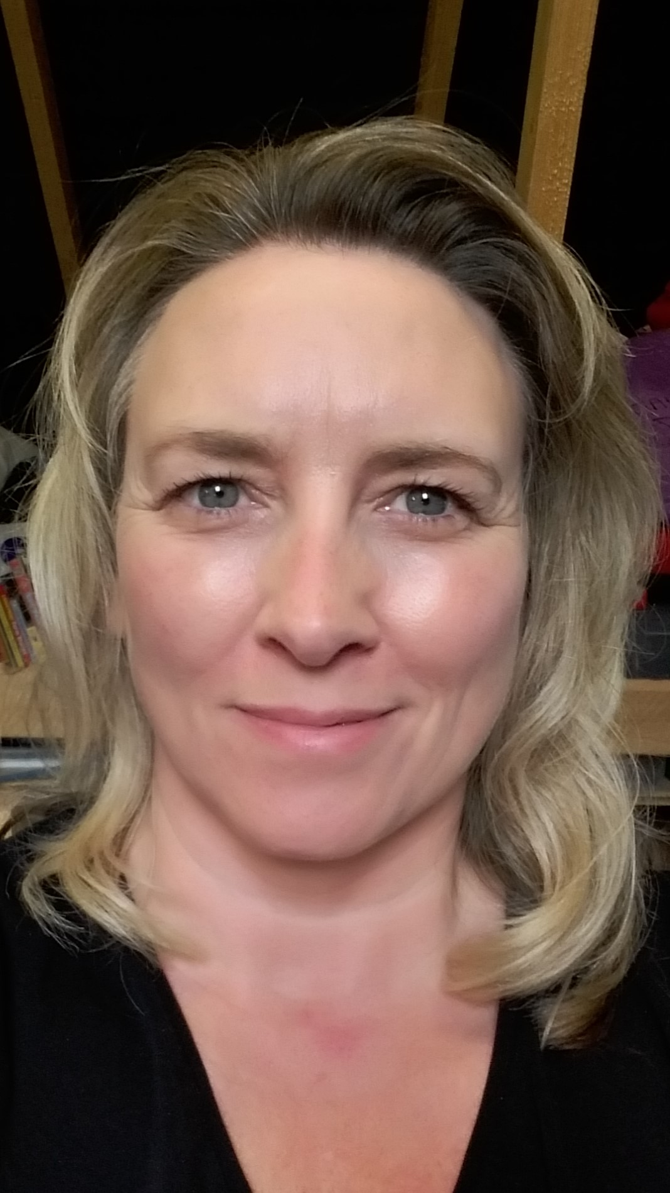
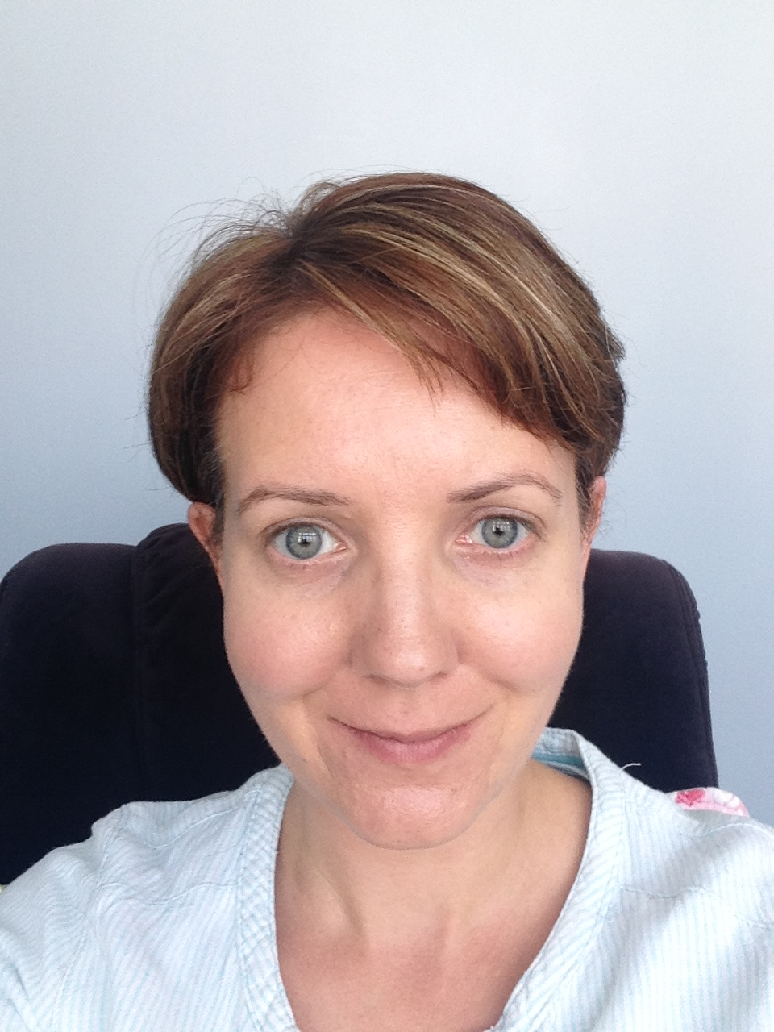
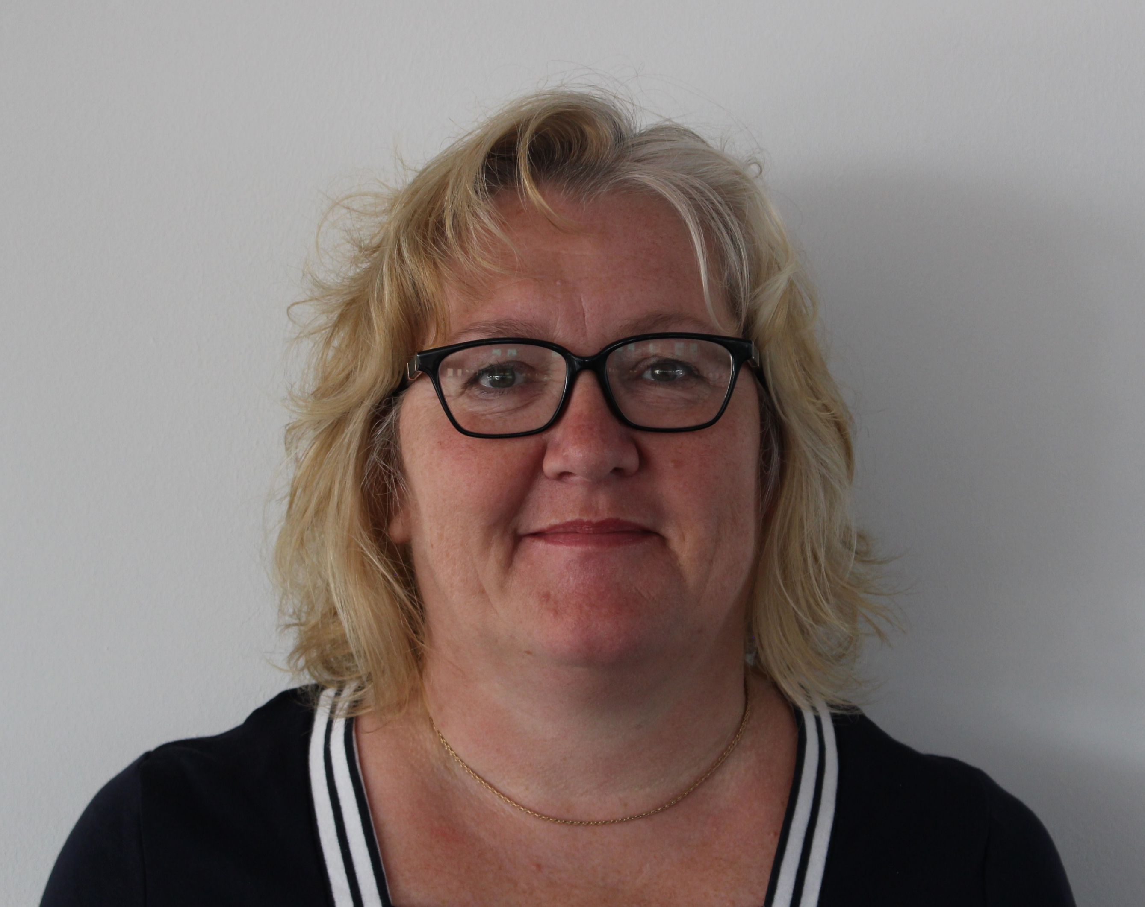
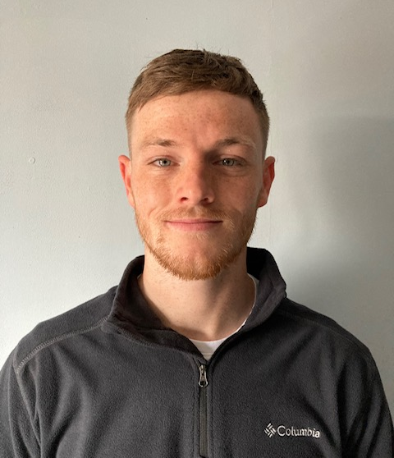
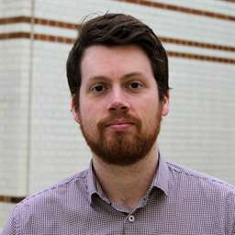
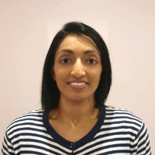
Introductions – TARGET and RCGP
Dr Donna Lecky
Emily Cooper
Catherine Hayes
Eirwen Sides
Julie Brooke
Liam Clayton
Joseph Besford
Camilla Stevenson
Dr Dharini Shanmugabavan

Slide 3
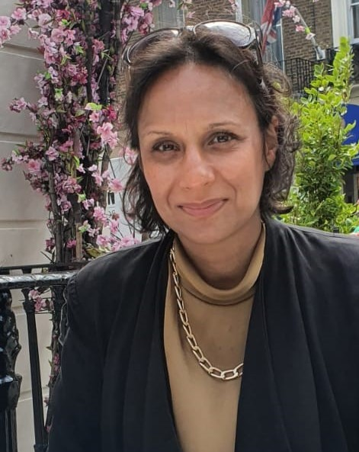
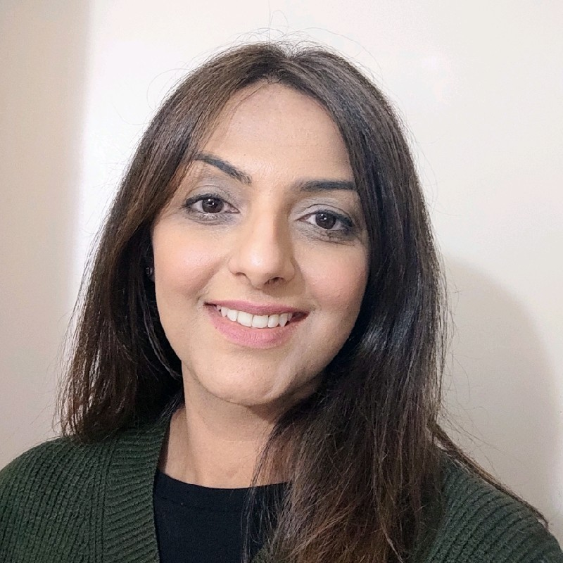
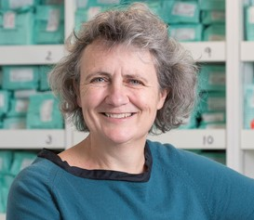
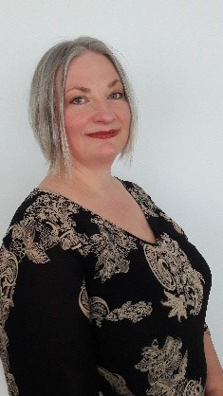
Introductions – speakers and panellists
Shazia Patel
Community Pharmacy Clinical lead, Derbyshire ICB
Alishah Lakha MAPharmT
Regional Pharmacy and Medicines Project Manager, NHS England
Dr Elizabeth Beech MBE
Regional Antimicrobial Stewardship Lead, South West, NHS England
Dr Julia Darko GP Registrar and Former National Medical Director Clinical Fellow
Roxanne Mehmi
Operations Manager/Clinical Pharmacy Technician eQuality PCN
Suprio Dhas
Senior Clinical Pharmacist eQuality PCN
Dr Naomi Fleming
Regional Antimicrobial Stewardship Lead, East of England NHS England

Slide 4
Topics to cover
Time | Talk | Speaker
6:40 | Background and development of ‘How to…’ booklet resources | Shazia Patel
6:45 | Acne worked examples and resource evaluation | Alishah Lakha
6:55 | PrescQIPP Optimising antimicrobial duration dashboard | Elizabeth Beech
7:05 | COPD how to resource and development of COPD-PET Pilot of COPD-PET in general practice | Julia Darko Roxanne Mehmi and Suprio Dhas
7:20 7:30 | Q&A with panel Close
Notes:
6.30pm – Introduction and housekeeping by TARGET team - Emily (10mins)
6.40pm – How to background and Acne resources – Alishah and Shazia (15mins )
6.55pm – Dashboard to support duration workstream - Elizabeth (10mins)
7.05pm – COPD-PET toolkit and implementation in practice – Julia, Roxanne, Suprio (15mins)
7.20pm – Questions and Answers
7.30pm – close

Slide 5
Introduction to TARGET ‘How to…’ resources for acne and COPD
Shazia Patel
Community Pharmacy Clinical lead, Derbyshire ICB

Slide 6
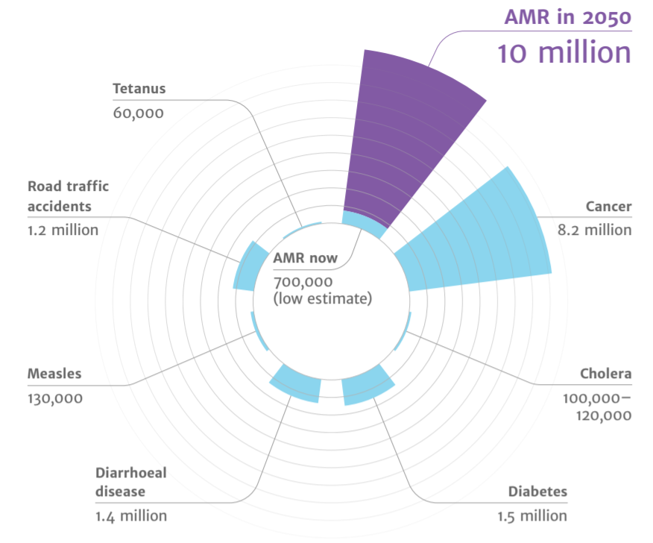
Antimicrobial resistance a major issue
Diabetes
and cancer
combined
AMR
2050
Deaths attributed to AMR every year
AMR in 2050
10 million
Tetanus
60,000
Road traffic accidents
1.2 million
Cancer
8.2 million
10,000,000
9,700,000
AMR now
700,000
(low estimate)
Cholera
100,00 – 120,000
Measles
130,000
Diarrhoeal disease
1.4 million
Diabetes
1.5 million
(O ’Neill, 2016)
November 2023
rcgp.org.uk/TARGETantibiotics
6
Notes:
Presenter talk
Background to how and why produced How to series. I’m sure you are all already aware of the issues associated with AMR in your daily practice. However, on a global scale, 2019 UN report (2), highlighted that by 2050, AMR could kill 10 million people per year, in its worst-case scenario. This is more than diabetes and cancer combined. This will also come at a cost of £66 trillion pounds.
We know that around 80% of antibiotics were prescribed in primary care in England in 2022 (3). Whilst the majority of these antibiotics are needed, previous studies estimated that one-fifth to one-third of UK antibiotic prescriptions in primary care are unnecessary or inappropriate. There is a need to continue to review our antibiotic use in line with guidance.
Slide references
The review on antimicrobial resistance, chaired by Jim O’Neill. Tackling drug-resistant infections globally: final report and recommendations. 2016. [Available from: https://amr-review.org/sites/default/files/160518_Final%20paper_with%20cover.pdf]
IACG (2019). “No time to wait: securing the future from drug-resistant infections”
UK Health Security Agency. English surveillance programme for antimicrobial utilisation and resistance (ESPAUR) Report 2022 to 2023. https://www.gov.uk/government/publications/english-surveillance-programme-antimicrobial-utilisation-and-resistance-espaur-report London: UK Health Security Agency, November 2023

Slide 7
What prompted a focus on acne and COPD?
Acne and COPD exacerbations are one of the most common indications for long-term and/or repeated antibiotic use
In 2022, doxycycline and lymecycline were the second and third most long-term/repeat prescribed antibiotics in primary care
An audit of antibiotic prescribing for COPD during the COVID-19 pandemic across an English primary care network found that antibiotic prescribing was in line with the national and local guidelines in only 28.7% of cases
There is opportunity to target repeat prescribing as a priority for optimising antibiotic prescribing
November 2023
rcgp.org.uk/TARGETantibiotics
Notes:
Presenter talk
National data reveal that acne and COPD exacerbations are one of the most common indications for long-term and/or repeated antibiotic use. There is prescribing data that will be talked about later to support the need to review long term prescribing for acne and COPD.
A recent study looking at English primary care prescribing 2019 – 2021 found that COPD had the highest risk score in getting repeat prescriptions of all common infections (1).
In 2022, doxycycline and lymecycline (most often used for acne treatment) were the second and third most long term/repeat prescribed antibiotics in primary care in England
There may be opportunity to improve adherence to prescribing guidelines. A study audited the adherence of antibiotic prescribing in people with COPD during Covid-19 by using prescribing data from 12 practices linked to the PCN. They found that in only 28.7% of cases, antibiotic prescribing was in line with guidance (i.e. adherence to guidance is low). Treatment duration was the main reason for poor adherence. (3)
A fundamental question is whether frequent repeat antibiotic prescribing, as routine in primary care, is actually effective and safe for the patient. There is limited evidence for the effectiveness of this practice while there are signals of risk of using antibiotics frequently over time (1).
Slide references
1. Zhong, X., Pate, A., Yang, Y.T., et al. 2023. The impact of COVID-19 on antibiotic prescribing in primary care in England: Evaluation and risk prediction of appropriateness of type and repeat prescribing. Journal of Infection, 87(1), pp.1-11. From https://www.sciencedirect.com/science/article/pii/S0163445323002888
3. Thompson, J., Widdows, G. and Parbat, M., 2022. An audit of acute respiratory antibiotic prescribing in COPD patients during the COVID-19 pandemic. International Journal of Pharmacy Practice, 30. From: https://academic.oup.com/ijpp/article/30/Supplement_1/i24/6562300?login=true

Slide 8
Access the How To guides via TARGET toolkit
www.rcgp.org.uk/TARGETantibiotics
November 2023
rcgp.org.uk/TARGETantibiotics
8
Notes:
Presenter talk
The how to guides are published on the TARGET toolkit on the RCGP website. There is a new worked example resource to support the acne resource which Alishah will talk through next.
Available at: https://elearning.rcgp.org.uk/mod/book/view.php?id=12649

Slide 9
Development of the acne and COPD “How to” resources
Time constraints of consultations in practice makes it difficult to provide a targeted review
Need for structured approach to medication review with relevant treatment guidelines, patient facing material, self-care and digital apps
Role play of ‘typical consultation’ with production of the resource
Sent to stakeholders from all regions including antimicrobial leads and comments included in final versions
November 2023
rcgp.org.uk/TARGETantibiotics
9
Notes:
Presenter talk
The aim was to develop a resource for reviewing patients on long term and frequent use of antibiotics.
Time constraints of consultations in practice makes it difficult to provide targeted reviews. The ‘How to’ resources were developed with aim of up-skilling other members of the practice team to undertake effective reviews that will improve patient care and reduce GP appointments for acne and COPD.
It is important to have resources to support teams with consultations to manage patient expectations and develop health literacy.
Stakeholder feedback during the development of the resource was received from 21 respondents. Resources were originally aimed at GP based practice pharmacists and evolved as feedback would be relevant across the primary care team. The final resources include treatment options, self care, digital apps, visual. for structured approach
There are currently two ‘How to…’ booklets, one on acnes and one on COPD. Available at: https://elearning.rcgp.org.uk/mod/book/view.php?id=12649

Slide 10
Shared decision making | Personalised treatment
Safety Is the patient experiencing any side effects from their long-term/repeated antibiotic? Do the side effects outweigh the benefits? Is there any risk of harm due to co-morbidities? Is follow-up monitoring in place where applicable? | Effectiveness What is the antibiotic indication? Is the indication recorded in the patient’s notes? Is the antibiotic appropriate? Is the antibiotic still indicated? Is the antibiotic working? Does the patient still take it or want it? Are long-term conditions well controlled? Should anything be changed?
Clinical skillset
Patient's experience, values and wishes
Clinical evidence
Long-term /repeat antibiotics
Impact on patient's quality of life
November 2023
rcgp.org.uk/TARGETantibiotics
10
Notes:
Presenter talk
The booklets include a structured medication review (SMR) approach that can be conducted by clinical teams to review patients on long term or with repeated courses of antibiotics considering:
Shared decision making
Personalised treatment including impact on patients quality of life
Key safety criteria
Key effectiveness criteria
Within PCN DES (direct enhanced service) guidance there is a structured medication review (SMR) – to include shared decision making and personalised treatment. This diagram gives visual approach on how to give a structured medication review following NHS guidance on SMRs and using principles from NICE guidance.

Slide 11
TARGET ‘How to…’ acne worked examples and resource evaluation
Alishah Lakha MAPharmT
Regional Pharmacy and Medicines Project Manager, NHS England
November 2023
rcgp.org.uk/TARGETantibiotics
11

Slide 12
Why should you review patients on repeat and long term antibiotics for acne?
1
Research has highlighted growing concerns of antibiotic resistance in treatment of acne and prescribing patterns suggest an overuse of antibiotics in patients
2
44.5% of people with a new acne diagnosis received a prescription for long-term antibiotics
3
Conversations with patients about withdrawing acne antibiotic treatment have been deemed difficult and sensitive
November 2023
rcgp.org.uk/TARGETantibiotics
12
Notes:
Presenter talk
We know that acne is a common skin condition, and that treatment is determined by the severity of the acne and how much it affects the individual. There are growing concerns about antibiotic resistance in the treatment of acne (1,2). Doxycycline and lymecycline are the NICE guidance first line oral antibiotics (both tetracyclines).
Studies looking at prescribing patterns have found that the most common prescription given at the initial acne consultation was an oral antibiotic alone, (against NICE guidance), closely followed by topical antibiotics (3).
National data reveals that acne is one of the most common indication for long-term and/or repeated antibiotic use and a study in 2022 showed that 44.5% of people with a new acne diagnosis received a prescription for long-term antibiotics (4).
Stepping down antibiotics requires a structured review and assessment. Conversations with patients about withdrawing acne antibiotic treatment have been deemed difficult and sensitive (5), stepping down antibiotics needs a targeted review and the How to… booklet helps with those conversations
There are also risks of inadequate management include;
acne scarring
Mental health distress
hyperpigmentation
access of online treatments from unregulated providers
Slide references
Walsh TR, Efthimiou J, Dréno B (2016) Systematic review of antibiotic resistance in acne: an increasing topical and oral threat. Lancet Infect Dis 16, 3, e23–e33.CrossRefGoogle Scholar
Santer M, Francis NA, Platt D, et al.(2018) Stemming the tide of antimicrobial resistance: implications for management of acne vulgaris. Br J Gen Pract 68, 667, 64–65.FREE Full TextGoogle Scholar
Francis NA, Entwistle K, Santer M, et al.(2017) The management of acne vulgaris in primary care: a cohort study of consulting and prescribing patterns using the Clinical Practice Research Datalink. Br J Dermatol 176, 1, 107–115.Google Scholar
Bhate K, Mansfield KE, Sinnott S-J, Margolis DJ, Adesanya E, Francis N et al. Long-term oral antibiotic use in people with acne vulgaris in UK primary care: a drug utilisation study. British Journal of Dermatology. 2022;188(3):361-71
Platt D, Muller I, Sufraz A, Little P, Santer M. GPs' perspectives on acne management in primary care: a qualitative interview study. Br J Gen Pract. 2020 Dec 28;71(702):e78-e84. doi: 10.3399/bjgp20X713873. PMID: 33257464; PMCID: PMC7716869.

Slide 13
“How to…” review - worked examples
The three worked examples can be used for your own learning or to deliver to your team and will cover how to review and manage patients with acne that;
Are currently on antibiotic treatment
Require referral
Have dark skin and hyperpigmentation/acne scarring
Require stepping down of treatment
November 2023
rcgp.org.uk/TARGETantibiotics
13
Notes:
Presenter talk
We introduce you to the TARGET acne “how to..” worked examples resource
The TARGET acne ‘How to…’ worked examples are a resource designed to be used with the TARGET acne ‘How to…’ toolkit for the review of antibiotic prescribing of patients with acne in primary care.
This resource will take you through three worked examples and can be used for your own learning or to deliver to your team. The PowerPoint notes contain further information and slide references
The slides can be used by medical prescribers, non-medical prescribers and pharmacy professionals to review the clinical management of patients with acne.

Slide 14
Patient centred review
 | Item to consider
Condition and consultation history | Establish history of patients' condition
 | Patient baseline habits
 | Are they under a specialist consultant
Treatment History | Treatment/Prescription history
 | Side effects to treatment
 | Compliance to treatment
 | Patient’s perception of their treatment
Patient Impact and preference | Explore impact acne has had on self-esteem or mental health
 | What are the patient's preferences and expectations from treatment?
November 2023
rcgp.org.uk/TARGETantibiotics
14
Notes:
Presenter talk
We developed the worked examples using the principles from the How-to toolkit in using a structured step wise approach
After conducting a search on the clinical system for patients with recurrent antibiotic courses for lymecycline and doxycycline and/or coded for acne, we look to carrying out a patient centred review and this table covers the points in the review
Establish a clear history of the patient’s condition, current use of medication and baseline habits alongside lifestyle modifications and treatments tried to-date.
Investigate if any medication may have exacerbated acne (see section 2.2)
➢ Explore any impact their condition has on their self-esteem and mental health. To note: This may need special consideration and appropriate referral (see Section 3.3.3). ➢ Listen to the patient’s concerns and priorities and establish their expectations for management of their condition.
Be aware of any special considerations, e.g.: o Darker skin tones: ▪ Acne is no more common or severe in pigmented skin. ▪ Post-inflammatory hyperpigmentation can be more marked, therefore, treat patients with darker skin tones early and more aggressively, including earlier consideration of referral to secondary care or a dermatology service (PCDS, 2022). o Women of childbearing potential: ▪ ‘Topical retinoids and oral tetracyclines are contraindicated during pregnancy and when planning a pregnancy’, women must use effective contraception or choose alternative treatment to these options (NICE b, 2021). ▪ ‘If a person receiving treatment for acne wishes to use hormonal contraception, consider using the combined oral contraceptive pill in preference to the progestogen-only pill’ (NICE b, 2021).

Slide 15
Step wise approach in managing patients
Each worked example will go through how to manage a patient with acne using a step-wise approach that incorporates treatment and referral, patient education, self-care advice and follow-up reviews.
Treat/Refer
Educate
Advice
Review
November 2023
rcgp.org.uk/TARGETantibiotics
15
Notes:
Presenter talk
Using the responses from the patient centred review, use a step wise approach to managing patients on antibiotic treatment for acne. One to one management of patient:
Treat the patient, initiate, stop, step up or step down treatment in line with NICE guidance, consider need for onward referral to mental health teams or secondary care
Give self-care advice to the patient (including useful resources/apps)– skin care , dietary advice
Make plans to review the patient - Review antimicrobial therapy at 12 weeks, photos to track progress, continue for another 12 weeks as required
Educate the patient – what to expect, importance of compliance, how long it takes for medication to make a difference, completing course

Slide 16
Evaluation of the “How to…” acne resources with pharmacy professionals
In GP practice, acne resources led to increased capability, opportunity and motivation of staff
”Good use of advice for different types of skin colour”
“These are exactly the sort of resources required for pharmacy technicians to be able to carry out reviews”
“Very informative”
In Community pharmacy, potential future roles have been identified in managing acne (reviewing long-term and repeat prescribing) alongside additional needs to undertake these roles (training, PGDs, renumeration)
Use of How to… resources supports the UK’s 5-year National Action Plan to ‘enhance the role of pharmacists in primary care to review the dose and duration of antimicrobial prescriptions (especially long-term or repeat ones) and work with prescribers to review those that are inappropriate through evidence-based, system-wide interventions’ (HM Government, 2019).
November 2023
rcgp.org.uk/TARGETantibiotics
16
Notes:
Presenter talk
Research project evaluating TARGET resources
UKHSA, NHS England and University of Nottingham collaborative survey - of evidence-based interventions (“How to…” resource and worked examples)
To evaluate the “How to…” and associated resources to review long-term and repeat acne treatment in a primary care setting
To understand the feasibility of implementation of the tools and associated resources to upskill pharmacy professionals to provide acne management in primary care and community pharmacy
Pre and post surveys based on the behaviour change COM-B model (Capability, Opportunity and Motivation)
GP practice – 141 respondents, 19 completed the follow up survey Use of the acne How to.. Resources led to increased capability, opportunity and motivation and deemed overall useful to support pharmacy professionals working in GP practice. Section of the toolkit that were the most useful included self-care advice, treatment of acne, reviewing acne using the flow chart and the acne clinical scenarios (worked examples)
Respondents also fed back the following
”Good use of advice for different types of skin colour”
“These are exactly the sort of resources required for pharmacy technicians to be able to carry out reviews”
“Very informative”
In community pharmacy – 44 pharmacy professionals and 10 stakeholders responded
The feasibility survey with community pharmacy supports the integration of pharmacy professionals across health and care systems to deliver medicines optimisation for patients as part of an integrated system. Potential future roles have been identified, alongside additional needs to undertake these roles; the TARGET acne ‘How to’ resources could support pharmacy professionals in the management and review of antimicrobial treatment for acne.

Slide 17
Managing acne in community pharmacy via the Pathfinder programme
NHS England Independent Prescribing (IP) in community pharmacy pathfinder programme
From 2026, all newly qualified pharmacists will be IPs
2 pathfinder sites are undertaking acne review as a clinical model
Opportunity to see how acne can be managed in a community pharmacy setting
Future – joint working between GP and community pharmacy through a joint system wide approach
November 2023
rcgp.org.uk/TARGETantibiotics
17
Notes:
Presenter talk
The pathfinder programme –with the central aim is to support and test different prescribing models to help inform and develop the framework for the commissioning of independent prescribing as part of clinical services in community pharmacy.
The service is the first to nationally fund pharmacists to use their IP qualification and in 2026, all newly qualified pharmacists would become prescribers from the point of registration.
Two pathfinder sites undertaking acne review as clinical model – gives opportunity to see how acne can be managed in community pharmacy setting and support future working between these two settings.

Slide 18
PrescQIPP Optimising antimicrobial duration dashboard
Dr Elizabeth Beech MBE
Regional Antimicrobial Stewardship Lead, South West, NHS England
November 2023
rcgp.org.uk/TARGETantibiotics
18
Notes:
One of NHSE programme workstream to optimise duration of antibiotic therapy. This talk will introduce this programme and demonstrate some of the data available to support the programme.
Available at: https://www.prescqipp.info/our-resources/webkits/antimicrobial-stewardship/

Slide 19
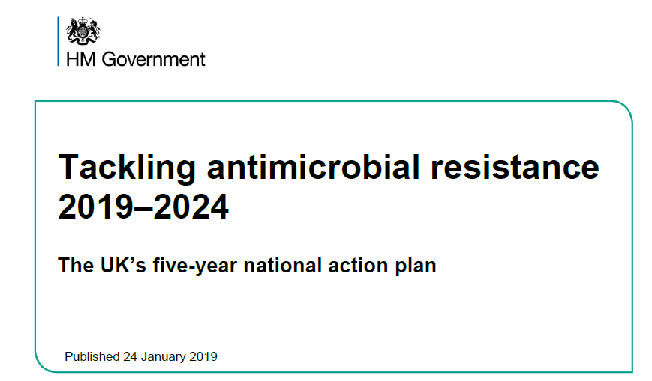
Optimising duration of antimicrobial use in primary care
November 2023
rcgp.org.uk/TARGETantibiotics
19
Notes:
Presenter talk
UK NAP for AMR, one of the ambitions is to optimise antimicrobial use and the success measure is to reduce antimicrobial use by 15%. Optimising duration of antimicrobial use is a great way to meet this target.

Slide 20
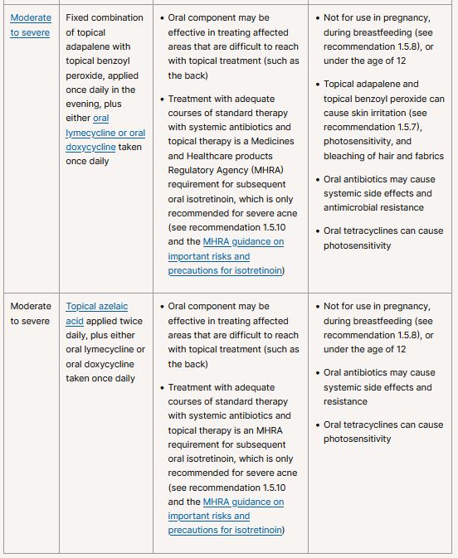
Optimising antimicrobial duration - Acne
November 2023
rcgp.org.uk/TARGETantibiotics
20
Notes:
Presenter talk
Looking at acne prescribing data has required using linked patient data to identify patients prescribed Lymecycline for 3 to 6 months. Able to see duration of prescribing associated with a single patient. This is a metric under development and not yet available publicly. This is a snapshot of data which informs the need for review of patients on long term antibiotics for acne.
NICE guidance for acne recommends lymecycline 480 mg capsules, and as they are not routinely used for any other conditions, we can assume from the routine data that the prescribing activity is related to management of acne. From August 2022 – 2023 65,027 patients had a prescription for lymecycline at least once. Within that can look at quantity of capsules to categorise quantity into four different duration bands. Of these, proportion who are prescribed for longer than 24 months recommended in NICE is 46%.
Acne NICE Guideline NG198 https://www.nice.org.uk/guidance/ng198

Slide 21
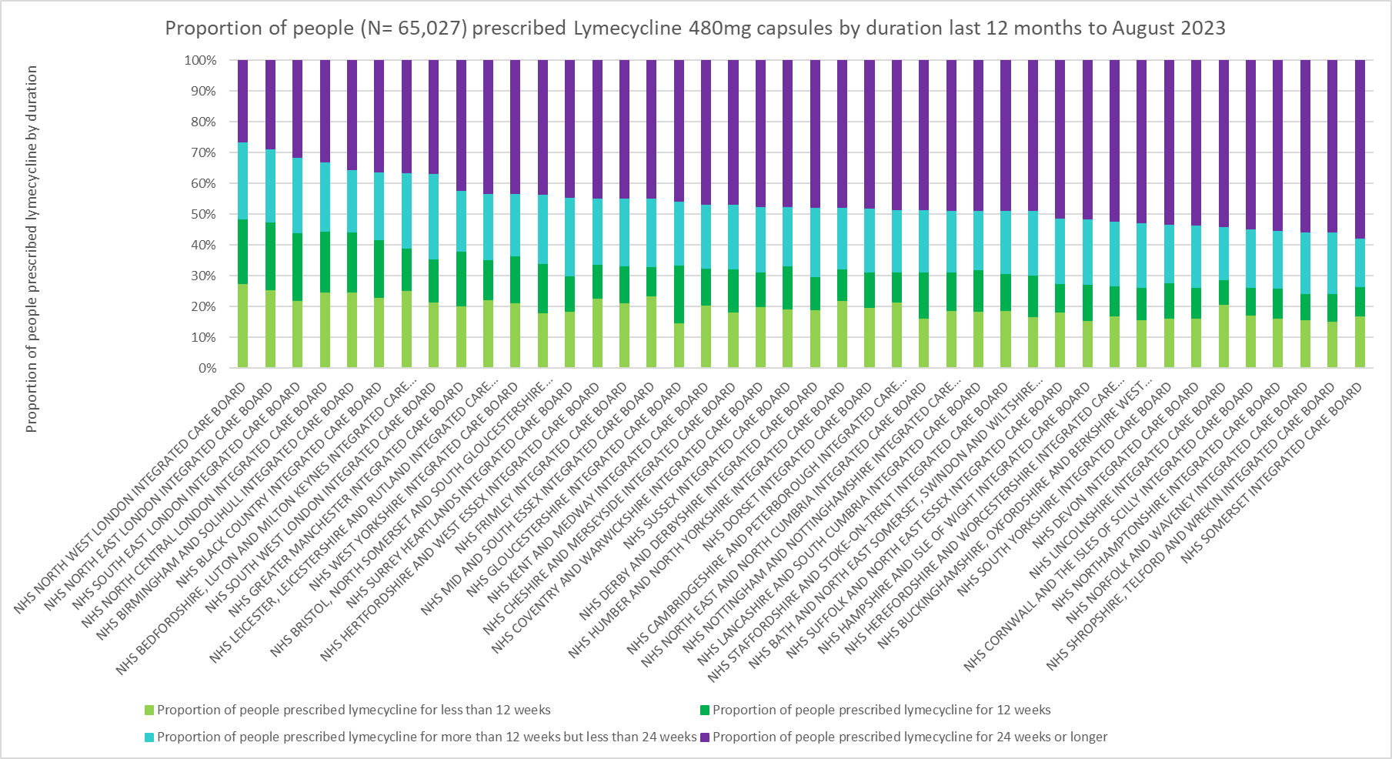
Optimising antimicrobial duration - Acne
November 2023
rcgp.org.uk/TARGETantibiotics
21
Notes:
Presenter talk
Looking at lymecycline duration by integrated care boards demonstrates a degree of variation between ICBs and a pattern of prescribing longer than the 24 week cut off in the NICE guidance. The acne how to toolkit can support process of addressing those patients prescribed lymecycline longer than 24 weeks.

Slide 22
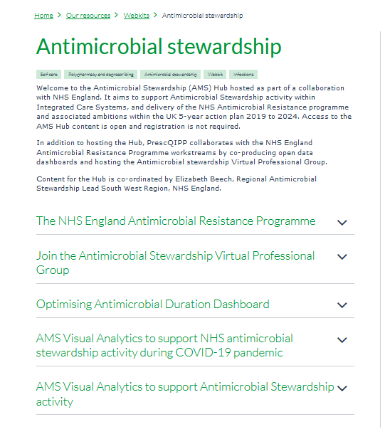
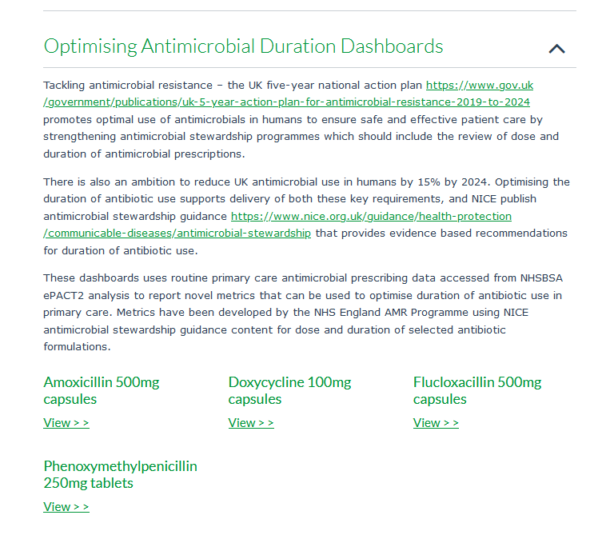
PrescQIPP Optimising antimicrobial duration dashboard
https://www.prescqipp.info/our-resources/webkits/antimicrobial-stewardship/
Notes:
Presenter talk
PrescQIPP is freely accessible and no login is required. It makes data open and accessible by anyone. It can be accessed through the link at the top of the screen: https://www.prescqipp.info/our-resources/webkits/antimicrobial-stewardship/
Then, click ‘AMS Visual Analytics to support Antimicrobial Stewardship activity’, and the year in which you are interested. The information dates back to 2017/18.
Within the hub there is an optmising antimicrobial duration dashboard.
Available at: https://www.prescqipp.info/our-resources/webkits/antimicrobial-stewardship/
Presenter notes

Slide 23
Optimising duration of antimicrobial use
NICE Antimicrobial Prescribing Guidance recommendation | AMOXICILLIN 500MG CAPSULES
WHO DDD | 1500MG
Pneumonia (community-acquired): antimicrobial prescribing NG138 | 500MG three times a day for 5 days (higher doses can be used see BNF) 5Y+
Otitis media (acute): antimicrobial prescribing NG91 | 500MG three times a day for 5 days to 7 days Young people under 18Y
Cough (acute): antimicrobial prescribing NG120 | 500MG three times a day for 5 days 5Y+
Bronchiectasis (non-cystic fibrosis), acute exacerbation: antimicrobial prescribing NG117 | 500MG three times a day for 7 days to 14 days 5Y+
Chronic obstructive pulmonary disease (acute exacerbation): antimicrobial prescribing NG114 | 500MG three times a day for 5 days 18Y+
Urinary tract infection (catheter-associated): antimicrobial prescribing NG113 | 500MG three times a day for 7 days only if culture results available and suspectible non-pregnant women and men
Urinary tract infection (lower): antimicrobial prescribing NG109 | 500MG three times a day for 7 days only if culture results available and suspectible pregnant women
Urinary tract infection (recurrent): antimicrobial prescribing NG112 | 500MG single dose or 250MG at night 16Y+ 250MG at night 5Y+
DURATION METRIC ADOPTED | AMOXICILLIN 500MG CAPSULES WHO DDD 1500MG 5 DAY QUANTITY=15 7 DAY QUANTITY=21
Optimising duration of antimicrobial use – metric development is based on:
High volume antibiotic
amoxicillin
NICE guidance dose and duration
500mg oral TDS 5 days
AMR programme priority workstream
linked to E.coli resistance
Define SMART metrics
AMOXICILLIN 500MG CAPSULE
5 DAY = quantity 15
7 DAY = quantity 21
Uses routinely reported data sets
November 2023
rcgp.org.uk/TARGETantibiotics
23
Notes:
Presenter talk
Four metrics have been developed for optimising antimicrobial duration. Firstly looked at high volume antibiotics – amoxicillin is most often used. The duration metric for amoxicillin is linked to NICE guidance duration. This also links to AMR programme priorities as amoxicillin can drive E coli drug resistance.
Smart metric needed – for amoxicillin this translates to 5 days and 7 days.

Slide 24
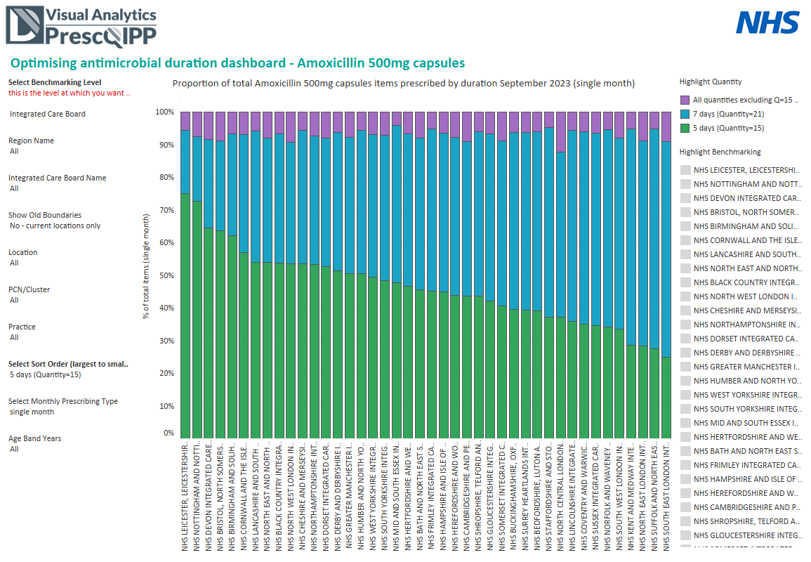
November 2023
rcgp.org.uk/TARGETantibiotics
24
Notes:
Presenter talk
Using these metrics can access data via several ways. Can look at data from different ICBs or practices in order to benchmark prescribing, or you can look at one ICB or practice and look at prescribing over time. Allows you to look at effect of improvement schemes.
In this graph Amoxicillin duration of 5 days (green), 7 days (blue) and other durations (purple). Lots of variation by ICB level, and variation magnified at practice and PCN level.

Slide 25
The ‘How to..’ guide for COPD and development of the COPD-Prevention of exacerbation Toolkit (COPD-PET)
Dr Julia Darko GP Registrar and Former National Medical Director Clinical Fellow
November 2023
rcgp.org.uk/TARGETantibiotics
25

Slide 26
Why review patients with COPD that use antibiotics frequently?
1
Approx 1.2 million diagnosed, >30,000 deaths/year - disproportionately impacts deprived members of our population
2
Detrimental impact on quality of life and ability for patients, leading to significant economic burden for individuals and society
3
Significant reliance on urgent, primary and secondary care services – including over-exposure to antibiotics and steroids
November 2023
rcgp.org.uk/TARGETantibiotics
26
Notes:
Presenter talk
COPD is a chronic disease which affects Approx 1.3 million people and contributes to >30,000 deaths/year (1, 2)
disproportionately impacts deprived members of our population and it carries significant detrimental impact on quality of life and function for patients (3, 4)
Individual and societal costs – health, social, psychological, economic
Significant reliance on urgent, primary and secondary care services – including over-exposure to antibiotics and steroids (5, 6)
National data reveal that COPD exacerbations are one of the most common indications for long-term and/or repeated antibiotic use (7)
More can and should be done to focus on secondary prevention
Slide References:
NICE, 2018. Resource impact report: Chronic obstructive pulmonary disease in over 16s: diagnosis and management (update) (NG115). Available at: https://www.nice.org.uk/guidance/ng115/resources/resource-impact-report-pdf-6602803741
British Lung Foundation: https://statistics.blf.org.uk/copd?_ga=2.240486403.1280140888.1530786569-1901875094.1521199434
Zamzam, M.A., Azab, N.Y., El Wahsh, R.A., Ragab, A.Z. and Allam, E.M., 2012. Quality of life in COPD patients. Egyptian journal of chest diseases and tuberculosis, 61(4), pp.281-289.
Ståhl, E., Lindberg, A., Jansson, S.A., Rönmark, E., Svensson, K., Andersson, F., Löfdahl, C.G. and Lundbäck, B., 2005. Health-related quality of life is related to COPD disease severity. Health and quality of life outcomes, 3(1), pp.1-8.
López-Campos JL, Hartl S, Pozo-Rodriguez F, Roberts CM, on behalf of the European COPD Audit team (2015) Antibiotic Prescription for COPD Exacerbations Admitted to Hospital: European COPD Audit. PLoS ONE 10(4): e0124374. https://doi.org/10.1371/journal.pone.0124374
Smieszek, T., Pouwels, K.B., Dolk, F.C.K., Smith, D.R., Hopkins, S., Sharland, M., Hay, A.D., Moore, M.V. and Robotham, J.V., 2018. Potential for reducing inappropriate antibiotic prescribing in English primary care. Journal of Antimicrobial Chemotherapy, 73(suppl_2), pp.ii36-ii43.
7. Zhong, X., Pate, A., Yang, Y.T., Fahmi, A., Ashcroft, D.M., Goldacre, B., MacKenna, B., Mehrkar, A., Bacon, S.C., Massey, J. and Fisher, L., 2023. The impact of COVID-19 on antibiotic prescribing in primary care in England: Evaluation and risk prediction of appropriateness of type and repeat prescribing. Journal of Infection, 87(1), pp.1-11. (see Table 3)
Safiri S, Carson-Chahhoud K, Noori M, Nejadghaderi S A, Sullman M J M, Ahmadian Heris J et al. Burden of chronic obstructive pulmonary disease and its attributable risk factors in 204 countries and territories, 1990-2019: results from the Global Burden of Disease Study 2019 BMJ 2022; 378 :e069679 doi:10.1136/bmj-2021-069679

Slide 27
‘How to…’ review COPD prescribing
Notes:
Presenter talk
There is guidance on treatment and review of COPD contained within both NICE guidance and GOLD recommendations. The TARGET ‘How to’ booklet aims to distil what is required from these documents to maximise exacerbation prevention reviews.
The booklet is 23 pages and forms part of the ‘How to…?’ series which aims to support primary care teams to review patients that have required antibiotic treatments for COPD exacerbations with evidence-based strategies for prevention.
It is not intended to duplicate or replace national guidelines; its purpose is to provide steps and resources to review patients who have received antimicrobials for the prevention or treatment of COPD exacerbations
The treatment goals of COPD exacerbations are to get the patient better, reducing the negative impact of their current exacerbations and preventing future exacerbations which are associated with disease progression (GOLD, 2022).
The flowchart contained within the booklet contains the steps from patient identification through to embedding a quality improvement approach

Slide 28
Patient consultation as part of the “How to …” review
1. Establish clear patient history
6. Signpost to digital apps or other resources
7. Refer if required
2. Explore patient quality of life in relation to condition
5. Manage patient expectation on antibiotic use, incl. rationale
3. Confirm previous optimisation of non-pharmacological intervention
4. Encourage self-care measures
November 2023
rcgp.org.uk/TARGETantibiotics
28
Notes:
Presenter Talk
The patient consultation aims to establish clear history of the patient’s condition, lifestyle modifications and treatments tried.
Presenter notes
➢ Explore how the patient is affected by their condition (physically and psychologically) to understand what lifestyle modifications and treatments they are prepared to try.
➢ Confirm whether non-pharmacological management and use of inhaled therapies for COPD have been optimised
➢ Encourage self-care measures, including smoking cessation, inhaler adherence and optimised technique, vaccination uptake and pulmonary rehabilitation.
➢ Manage patient expectations regarding use of antibiotics and discuss the rationale behind using/not using antibiotic treatment through shared decision making. Consider visual aids if any language barriers foreseen.
➢ Signpost to digital apps if appropriate to provide alternatives to antibiotic courses (“to help show you when you are ok”). For example: o NHS Respiratory Digital Playbook
Refer if necessary to relevant services

Slide 29
Why develop the COPD-Prevention of exacerbation Toolkit (PET)?
To be used alongside the COPD ‘How to’ guide, a checklist document for primary care teams:
To work through with patients during consultation
Act as a memory aid of steps that should be considered
November 2023
rcgp.org.uk/TARGETantibiotics
29
Notes:
Presenter Talk
Future work highlighted as part of the ‘How to…’ resource was to develop a checklist for primary care teams to use during the consultation and to pilot it in GP practice. This checklist could be used in conjunction with the how to guide to act as an aide memoire of steps that should be considered to avoid or reduce the risk of infection and alternatives to antibiotics before prescribing rescue packs or continuing long-term antibiotic prophylaxis.
A COPD Prevention of Exacerbation Toolkit (COPD-PET) has been developed to support the review of patients prescribed long term, or repeated courses, of antibiotics. The COPD-PET is not yet published but us currently being piloted within GP practices and a respiratory hub in the East of England. The pilot will evaluate patient outcomes, patient and staff satisfaction, and support consideration of adoption and spread in other regions if successful.

Slide 30
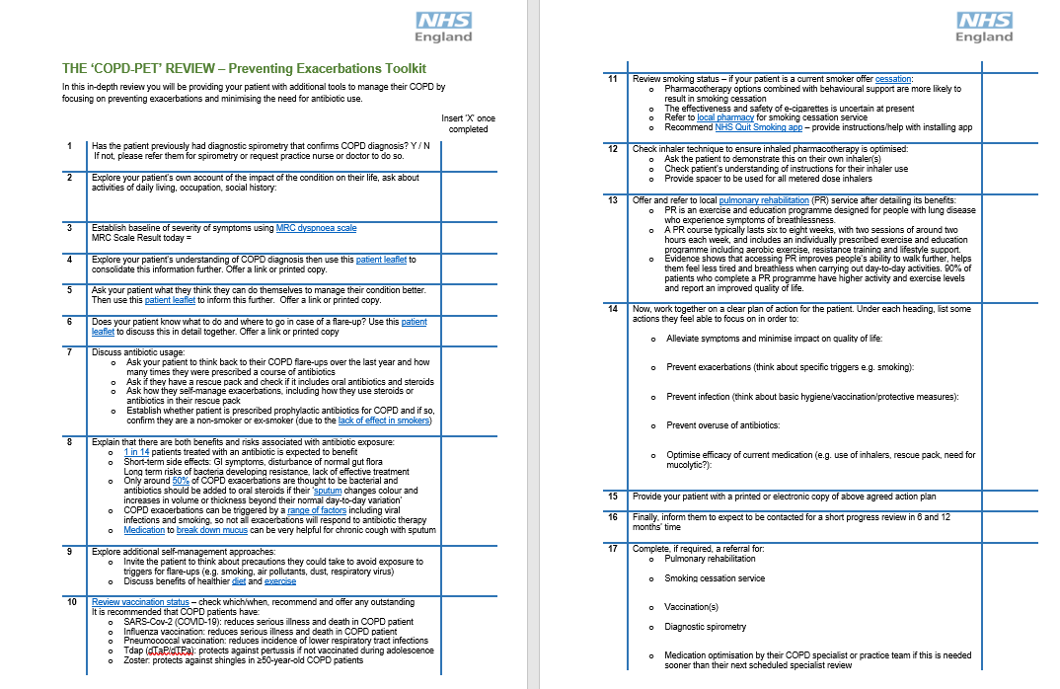
COPD-PET
November 2023
rcgp.org.uk/TARGETantibiotics
30
Notes:
Presenter talk
The COPD-PET checklist
is a step-by-step manual for conducting a focused clinical review aimed at COPD patients with an elevated risk of antibiotic exposure by adopting principles of prevention, self-care and antibiotic stewardship.
It is NOT a guide to acute exacerbation management, NOT a therapeutic guideline
Should be administered by any healthcare professional who is competent in delivering a patient review and has familiarised themselves with the associated reference guidance on COPD management (How to Manage and Review Adults on Long-term and Repeated Antibiotics for the Treatment and Prevention of COPD Exacerbations) as well as the structure of this toolkit.

Slide 31
Identifying and referring a patient for a COPD review
Confirm the diagnosis of an acute infective exacerbation and treat in line with NICE guidance
(first line treatment; amoxicillin 500mg TDS 5 days)
Assess if your patient requires a COPD review
Frequency and severity of exacerbations?
How many antibiotic courses/rescue packs issued?
Date of last COPD review?
Any COPD related hospital admissions?
Does the patient use a spacer device?
Do current preventative medications seem optimal?
Refer to the appropriate clinical team to conduct a COPD review
Notes:
Presenter talk – A full COPD review is not always possible within a GP consultation slot. The aim of the toolkit is to upskill clinical teams in carrying out a COPD review. But what can a GP do in a consultation with a COPD patient?
The example we will use here is for a patient that presents with symptoms of an acute infective exacerbation of COPD in a GP consultation. Note that many exacerbations are not caused by a bacterial infection. Treatment with antibiotics should be in line NICE guidance Recommendations | Chronic obstructive pulmonary disease (acute exacerbation): antimicrobial prescribing | Guidance | NICE
For a patient presenting with symptoms of an acute infective exacerbation of COPD, the GP can;
Manage acute symptoms – antibiotic prescription in line with NICE guidance if required and patient counselling
Check patient notes for when the last COPD review was done (should be annual), and gauge the frequency of exacerbations, the severity, how many antibiotic courses they have had in the las year and whether existing preventative pharmacotherapy seems optimal.
Refer to clinical team for a COPD review If these features suggest that the patient would benefit from further assistance with managing their COPD
The above is important to prevent further exacerbations and can help to reduce the use of antimicrobial treatment
Note; Not all patients with exacerbation need referral

Slide 32
Pilot of the COPD-Prevention of Exacerbation Toolkit (COPD-PET)
Roxanne Mehmi Operations Manager/Clinical Pharmacy Technician eQuality PCN
Suprio Dhas Senior Clinical Pharmacist eQuality PCN
November 2023
rcgp.org.uk/TARGETantibiotics
32
Notes:
Presenter talk
Roxanne - Operations Manager/Clinical Pharmacy Technician eQuality PCN
Suprio Dhas Senior Clinical Pharmacist eQuality PCN
Approached to participate in a pilot of the COPD PET resource to share experience and delivery of the pilot.

Slide 33
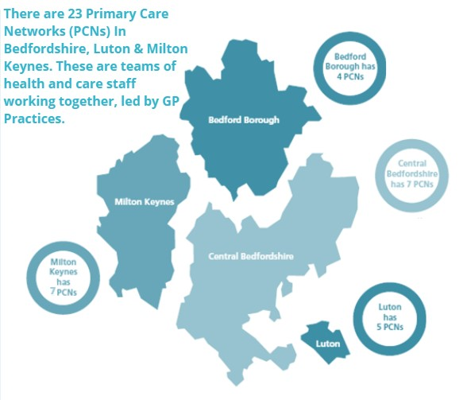
Pilot site – eQuality Primary Care Network (PCN) in Luton part of the Bedfordshire, Luton and Milton Keynes ICS in East of England
The project is a collaboration between NHS England, eQuality PCN and the MLCSU.
1 of 5 PCNs in Luton
Luton
A diverse, densely populated town with over 150 languages and dialects spoken. It has a younger than average population and above average levels of unemployment and deprivation, with high levels of child poverty.
A multidisciplinary clinical team including GPs, nurses, pharmacists, pharmacy technicians and social prescibers
Serves a patient population of approximately 40,000
November 2023
rcgp.org.uk/TARGETantibiotics
33
Notes:
Presenter talk
eQuality PCN is one of 5 PCNs in Luton. Luton is a diverse and densely populated town.
The aim of the pilot is to explore the impact of the toolkit on preventing infective exacerbations and reducing antibiotic use for COPD patients at high risk of recurrent infections. The project is a collaboration between NHS England, eQuality PCN and the MLCSU.

Slide 34
Project preparation
Identify patients with COPD coded diagnosis and 3 or more antibiotic prescriptions within the last 12 months (aim ≥ 100)
Patient engagement to promote clinic attendance. Consider barriers specific to the COPD cohort, localities, logistics etc
Peer discussion making the patient consultation as comprehensive as possible, fully utilising the opportunity of having the patient present face to face and the clinician skill set
Education & Training requirements familiarisation with NICE Guidelines, local COPD formulary and other sources such as the RightBreathe website. Refresh knowledge and identify gaps in learning.
IT support to develop a COPD-PET template on Systm1.
Referral pathways established:
Spirometry
Pulmonary Rehabilitation
Social prescribing-wellbeing
Stop smoking service
November 2023
rcgp.org.uk/TARGETantibiotics
34
Notes:
Presenter talk
We identified patients by extracting data from a recently completed Prescribing Incentive Scheme audit, which identified patients with a similar criteria.
Once this list was exhausted a manual search was created across the 4 sites (40,000 patients).
Focused on public engagement and contacting directly to improve degree of attendance. Considered barriers specific to cohort and well as identifying the learning needs of clinicians and used guidelines and local resources to support gaps in knowledge. IT support helped create a template on systm1 and the team agreed an in house referral pathway.

Slide 35
Outcomes from practice peer discussions
Decision to include additional factors- CVD Des- AF screening tool, BP monitoring, Sats-Oximetry.
Inhaler technique with in check tool for accuracy.
Optimisation of COPD medication at the time of review.
Follow up appointments at 4 weeks after change of meds for continuity of care, (although NMS could have been utilised).
Agreement on how to phrase the introduction and various parts of the consultation to improve patient understanding.
Educational literature and a copy of the care plan for the patient to take home.
November 2023
rcgp.org.uk/TARGETantibiotics
35
Notes:
Presenter talk
Outcomes of practice peer discussions – these are locally agreed additions to the COPD PET toolkit to utilise time with the patients and skillset of the clinicians involved with maximum effect.
Patients booked for follow up reviews – conducted this themselves or continuity of care but recognised this could be conducted by community pharmacy.

Slide 36
Practice Team and Roles
We quickly established a flow for the delivery of the patient consultation, breaking it down into 3 parts;
1. Introduction and COPD PET Tool
2. Clinical examinations
3. Inhaler technique and meds optimisation.
Post consultation referrals sent as per in house pathway.
Notes:
Presenter talk
Used PET checklist to guide consultations, allowing easy flow from introduction to understanding respiratory history, and how the condition is understood and experience by the patient and their quality of life. Directed patients to easy read educational materials and allowed holistic approach to support patients to take control of their condition, for examples helped address barriers to vaccination.
Discussed exacerbation in detail and when patients would use their medication, highlighted issues of AMR and overusing antibiotics. Holistic life style advice and other referral pathways were covered.
Clinical examinations conducted included respiratory medication and reviewed adherence to regimes and inhaler techniques.

Slide 37
Clinical example - COPD with frequent antibiotic prescribing
White Irish 77year old male,
Last COPD review 2019
Ex- Smoker
1 hospital admission for COPD in last 12 months
Weight 90kg
4 COPD exacerbations and 4 rescue packs issued within last 12 months
Vaccination status – Influenza declined, pneumococcal vaccine received 2004
No results of spirometry test to confirm COPD diagnosis
Current prescribed inhaled therapies; Carbocisteine, Anoro Ellipta (LAMA/LABA), Ventolin
Next steps…
Invite patient for a review
November 2023
rcgp.org.uk/TARGETantibiotics
37
Notes:
Presenter talk
An example of a typical patient seen in the clinic.
Additional notes
Baseline search from clinical system to help identify patients that should be reviewed. Alert and prepare for the consultation review
A clinical example including their information from a baseline search for patients with COPD diagnosis and repeat antibiotic therapy
Other points for consideration;
Has patient had previous diagnostic spirometry to confirm COPD diagnosis?
COPD reviews should be done annually

Slide 38
Carrying out the COPD-PET Review
MRC score = 3
Inhaler technique check and therapy optimisation Ventolin changed to Salbutamol Easyhaler, LABA/LAMA changed to Trelegy (triple therapy)
Patient education and support Triggers for breathlessness identified, COPD care plan provided and information on when to use rescue pack and the risks of antibiotic overuse provided.
Vaccination hesitancy addressed- patient agreed to have influenza vaccine.
Referrals to social prescriber, pulmonary rehab and spirometry testing
Notes:
Presenter talk
Noticed lack of confidence in exercise and encouraged overall condition and weight management through exercise regimes and referred to social prescriber. Pulmonary rehab referral to help holistically cope with exacerbations and day to day shortness of breath.
Hesitancy of vaccines addressed and encouraged flu vaccine.
Highlighted knowledge of when to use antibiotics as rescue pack. Patient did not use antibiotics according to correct signs of exacerbation – took antibiotics for longer duration than prescribed (for 7 days rather than 5 days).
Reviewed inhaler technique and considering MRC score, added inhaled steroid medication. Aimed to reduce exacerbations and severity of these.
Put all the information in a care plan for him to take home and booked follow up.
Additional notes
AF screening and BP monitoring completed-out of range advised to hbpm 7/7
Patient empowerment encouraged and vaccination hesitancy addressed

Slide 39
Practice learning
1. Spirometry diagnosis We Identified many patients lost to follow up for spirometry, some with questionable COPD diagnoses.
2. Impact of COVID restricted face to face, annual reviews and spirometry.
3. Tricky cohort to get in for annual reviews therefore we made sure that the patient review and consultation covered all areas of their management and thus providing a good patient experience. This service should lead to better patient attendance for future reviews.
4. Reflection on our own assumption of patient knowledge of their condition when under secondary care.
Notes:
Presenter talk
Key practice learning as a result of piloting this approach. Consultation was long – 45 minutes but could be shortened with practice. Face to face is better for these patients as they are more vulnerable to exacerbations.
Education of patients - assumed that patients would know more about their condition if had been treated under secondary care, but this wasn’t always the case. Important to reiterate previous education.
Believe that the holistic approach for decision making will help to encourage patients to come back for further reviews and reduce acute GP consultations, less hospital visits and help patients generally have better control over their condition and quality of life.

Slide 40
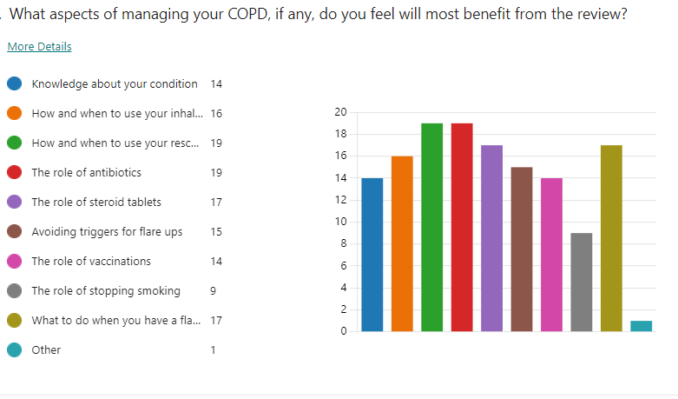
Patient survey
79 patients reviewed by pharmacist and pharmacy technician
24 patient responses post review (30%)
100% respondents felt ‘very involved’ to ‘extremely involved’ in their care
90% of respondents would recommend service to friends and family if they needed similar care
“Staff were very professional, knowledgeable and friendly. Made you feel at ease. First time I have been informed fully of COPD and of how to help manage it. I fully recommend this service.”
November 2023
rcgp.org.uk/TARGETantibiotics
40
Notes:
Presenter talk
Feedback from patients from the first clinics onwards. 79 patients were reviewed and of 24 survey responses, 100% respondents felt ‘very involved’ to ‘extremely involved’ in their care, 90% of respondents would recommend this service to friends and family if they needed similar care or treatment
Particular aspects patients felt most beneficial when and how to use rescue packs and role of antibiotics in their treatment.
Great experience seeing patients face to face and building rapport whilst also providing them with the right education to empower them to better manage their condition.

Slide 41
Next steps for COPD resources
Pilot results will be shared with key teams and inform policy initiatives
Once pilot complete, the COPD-PET will be published in the TARGET toolkit
Further resources to support staff training on COPD will be developed:
A slide set with patient worked examples
A consultation video
If your practice is interested in piloting the COPD-PET please contact:
Dr Naomi Fleming: naomifleming@nhs.net
Are you interested in joining a community of practice for antimicrobial stewardship?
Please contact england.amrprescribingworkstream@nhs.net with email address & job role
November 2023
rcgp.org.uk/TARGETantibiotics
41
Notes:
Presenter talk
Next stages for the clinical team are to do a 6 month and 12 month follow up.
Results will be shared with key team members and inform policy.
Access to COPD PET - it is still in pilot phase and amendments may be made. Once pilot is complete it will be published on TARGET alongside the How To COPD resources
Roughly 6 months left on pilot and then will be available on the toolkit.
If your practice would like to pilot the COPD PET checklist or would like a copy please contact Naomi

Slide 42
Acknowledgements
Daron Gunner - eQuality PCN
Elaine O’Sullivan - eQuality PCN
Simon Petty – eQuality PCN
Jasdeep Sidhu - Midlands and Lancashire CSU
Gurjinder Samra - Midlands and Lancashire CSU
Paula Wilson - Midlands and Lancashire CSU
Dharini Shanmugabavan – RCGP
Joseph Besford – RCGP
Camilla Stevenson - RCGP
Ming Lee – UKHSA
Fionna Pursey
Eleanor Harvey
Kieran Hand – NHS England
Diane Ashiru-Oredope – UKHSA
Naomi Fleming – NHS England
Alishah Lakha - NHS England
Elizabeth Beech - NHS England
Roxanne Mehmi - eQuality PCN
Suprio Dhas - eQuality PCN
Shazia Patel - Derbyshire ICB
Julia Darko - GP Registrar

Slide 43
Thank you
Please complete feedback survey and let us know what topic you would like next!
Sign up for our next two webinars:
Improving antibiotic management of respiratory tract infections: cough and sore throat Tuesday 23 January 2024 | 18:30 - 19:30 | Online
Urinary tract infections: Applying diagnostic and prescribing guidance in practice Thursday 21 March 2024 | 18:30 - 19:30 | Online
Visit www.rcgp.org.uk/TARGETantibiotics to find out more
Notes:
Feedback evaluation at the top of your inbox.

Slide 44
Panel Q&A discussion
Shazia Patel
Community Pharmacy Clinical lead, Derbyshire ICB
Alishah Lakha MAPharmT
Regional Pharmacy and Medicines Project Manager, NHS England
Dr Elizabeth Beech MBE
Regional Antimicrobial Stewardship Lead, South West, NHS England
Dr Julia Darko GP Registrar and Former National Medical Director Clinical Fellow
Roxanne Mehmi
Operations Manager/Clinical Pharmacy Technician eQuality PCN
Suprio Dhas
Senior Clinical Pharmacist eQuality PCN
Dr Naomi Fleming
Regional Antimicrobial Stewardship Lead, East of England NHS England

