Slide 1

Improving antibiotic management of respiratory tract infections: acute cough and sore throat
TARGET Antibiotics Webinar
January 2024
Notes:
Hello everyone
Thanks you for joining TARGET webinar today.
I can't see any of you but I know we have quite a few people subscribed so are looking forward to an informative evening with some good discussion
I am Emily Cooper and I am a programme manager within the TARGET team
This is our 6th webinar in a series we have done through the RCGP, where we will be focusing on Improving antibiotic management of respiratory tract infection – focusing on acute cough and sore throat.
Format - same as previous webinars.
We have panellists who will field questions through the webinar and respond to specific questions at the end.
Please ask questions throughout the presentations using the Q&A function on your screens, you do not need to wait until the end of the talk. If you wish to ask your question anonymously, please tick the anonymous box before submitting your question. We will answer as many questions as possible in the allotted time.
Speakers and panellists will not be responding to the chat/‘raise hand’ function (we can't see it!) this evening so do type questions into the Q&A box.
This webinar will be recorded and the recording will be uploaded to the TARGET toolkit (about 1 month)
You will be sent a link with a brief survey evaluation directly to your email shortly after the webinar, please do assist us in improving our webinars by filling this out.
Click: Next slide

Slide 2





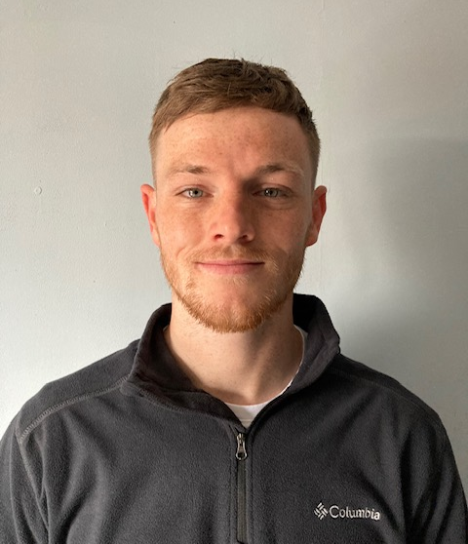



Introductions – TARGET and RCGP
Dr Donna Lecky
Emily Cooper
Catherine Hayes
Ming Lee
Julie Brooke
Liam Clayton
Joseph Besford
Lizzie Richmond
Dr Dharini Shanmugabavan
Notes:
Just want say that though I am speaking on behalf of the team and want to recognize the amazing people working behind the scenes to pull this together.
Especially - a big thank you to Cath, Lizzie and Joe - you won't see – RCGP and TARGET team members who worked on this project
Click – next slide

Slide 3




Introductions – speakers and panellists
Bharat Patel
Clinical Pharmacist
Speaker
Dr Manish Verma
General Practitioner
Panellist
Dr Sanjay Patel
Consultant in Paediatric Diseases and Immunology
Panellist
Dr Mariyam Mirfenderesky
Consultant in Infectious Diseases and Medical Microbiology
Panellist
Notes:
Bharat Patel
Works at the Rushall Medical Practice as a Clinical Pharmacist. He also works as a Senior Tutor for the School of Pharmacy, Keele University and was previously the Head of Medicines Management at Walsall CCG.
Dr Manish Verma
Is a partner at the Rushall Medical Centre working as general practitioner
Dr Sanjay Patel
Dr Patel is a Paediatric Infectious Diseases and Immunology Consultant at Southampton Hospital and is involved in multiple antimicrobial stewardship initiatives across the country.
Dr Mariyam Mir-fender-esky
Is a Consultant in Infectious Diseases and Medical Microbiology
Her work is jointly split with HCAI division UKHSA and within the North Middlesex University Hospital NHS Trust
Click

Slide 4
Aims
Discuss managing and treatment of acute cough and acute sore throat, in line with current NICE prescribing guidance.
Recognise the challenges surrounding the management of RTIs in current healthcare landscape.
Interpret patient perspective on antibiotic prescribing for RTIs.
Utilise evidence-based strategies and resources when discussing antibiotics with patients in the context of RTIs.
Notes:
Presenter talk - EC
This webinar theme was chosen based on feedback from TARGET users requesting webinars focusing on the clinical management of infections presenting in primary care.
Through the webinar we will use clinical scenarios to discuss acute cough and sore throat and refresh our knowledge on management of these conditions in the post COVID-19 context, covering national management guidelines as well as newer guidance and decision tools that are being applied in practice.
Aims include:
Discuss managing and treatment of acute cough and acute sore throat, in line with current NICE prescribing guidance.
Recognise the challenges surrounding the management of RTIs in current healthcare landscape.
Interpret patient perspective on antibiotic prescribing for RTIs.
Utilise evidence-based strategies and resources when discussing antibiotics with patients in the context of RTIs.
Click

Slide 5
Bharat Patel
Clinical Pharmacist
Speaker
Notes:
I will now hand over to Bharat who will take us through the rest of the presentation.

Slide 6
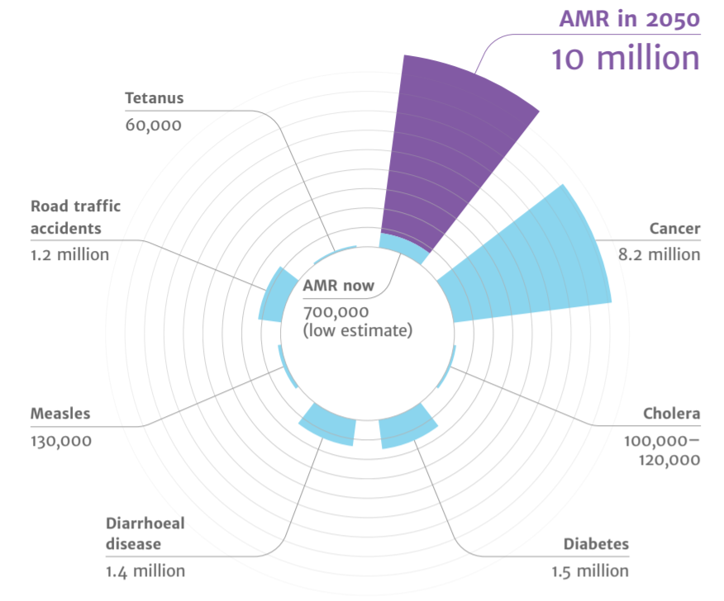
Antimicrobial resistance a major issue
Diabetes
and cancer
combined
AMR
2050
Deaths attributed to AMR every year
AMR in 2050
10 million
Tetanus
60,000
Road traffic accidents
1.2 million
Cancer
8.2 million
10,000,000
9,700,000
AMR now
700,000
(low estimate)
Cholera
100,00 – 120,000
Measles
130,000
Diarrhoeal disease
1.4 million
Diabetes
1.5 million
November 2023
rcgp.org.uk/TARGETantibiotics
6
(O ’Neill, 2016)
Notes:
Presenter talk
I’m sure you are all already aware of the issues associated with AMR in your daily practice. However, on a global scale, recent UN report (2), (April 2019) highlighted that by 2050, AMR could kill 10 million people per year, in its worst-case scenario. This is more than diabetes and cancer combined. This will also come at a cost of £66 trillion pounds.
Slide references
The review on antimicrobial resistance, chaired by Jim O’Neill. Tackling drug-resistant infections globally: final report and recommendations. 2016. [Available from: https://amr-review.org/sites/default/files/160518_Final%20paper_with%20cover.pdf]
IACG (2019). “No time to wait: securing the future from drug-resistant infections”
UK Health Security Agency. English surveillance programme for antimicrobial utilisation and resistance (ESPAUR) Report 2022 to 2023. https://www.gov.uk/government/publications/english-surveillance-programme-antimicrobial-utilisation-and-resistance-espaur-report London: UK Health Security Agency, November 2023

Slide 7
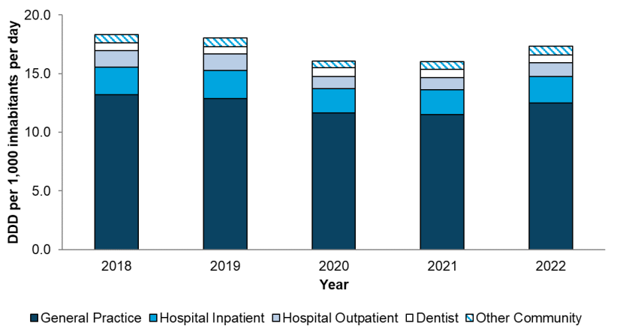
The majority of antibiotics are prescribed in general practice
Total antibiotic consumption by setting
(UKHSA, 2023)
Notes:
Presenter talk
What does that mean for us? We know that over the past 5 years, most antibiotics in England were prescribed in primary care (around 80% in 2022). This data is from the ESPAUR report (English surveillance programme for antimicrobial utilisation and resistance).
The drop in consumption in 2020 and 2021 related to the pandemic should be looked at in isolation and we are seeing a return to similar prescribing as in 2019. This is to be expected but something to monitor going forward.
Presenter notes
Graph – Total antibiotic consumption by setting, expressed as defined daily doses (DDDs) per 1000 inhabitants per day, England, 2018 – 2022
Slide references
(1) UK Health Security Agency (2023). English surveillance programme for antimicrobial utilisation and resistance (ESPAUR), Report 2022-2023.

Slide 8
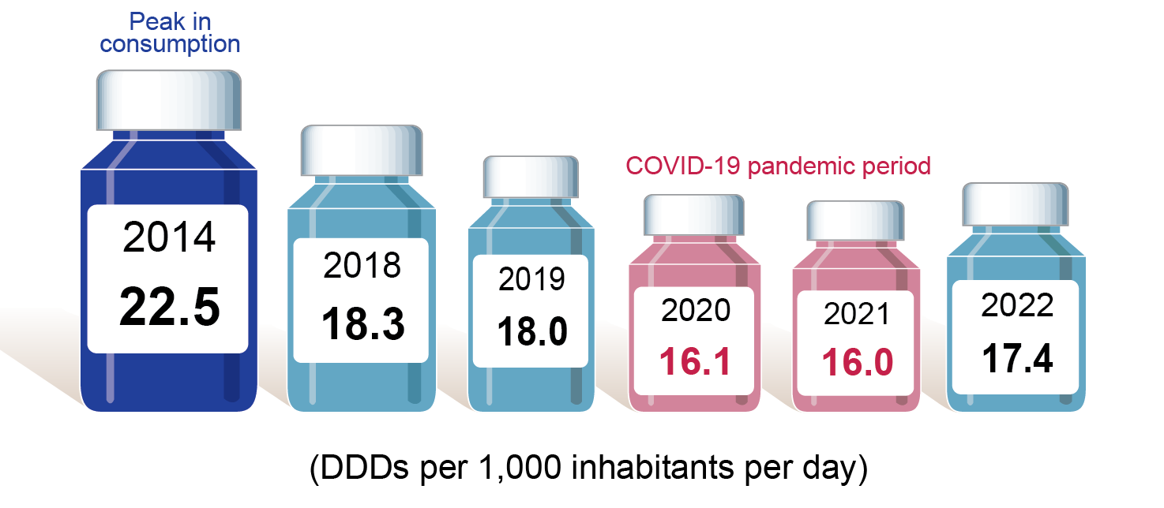
Antibiotic prescribing increased in 2022
Antibiotic prescribing in England 2014-2022
(UKHSA, 2023)
Notes:
Presenter talk
Again a similar pattern for overall antibiotic prescribing and we have seen a gradual fall in antibiotic use for some years since 2014, and again noticing the impact of the pandemic period and a resulting increase in 2022.
Slide references
(1) UK Health Security Agency (2023). English surveillance programme for antimicrobial utilisation and resistance (ESPAUR), Report 2022-2023.

Slide 9
UK prescribing within European context
Total consumption (community and hospital sector) of antibacterials for systemic use by country, EU/EEA and the United Kingdom, 2020 (expressed as DDD per 1 000 inhabitants per day)
Defined Daily Doses (DDD) per 1000 inhabitants per day (2019)
© ECDC
(ECDC, 2019)
Notes:
Presenter notes:
Caveat this is pre-COVID data from ECDC pre-Brexit, but still relevant as we are seeing similar prescribing levels to 2019 now.
We still have some way to go compared to some other European countries. Although as this slide shows in comparison to other European countries in 2019 we prescribe much less than Greece, in the community we do prescribe twice as much as the Netherlands which has a similar population to us. I suggest therefore that there is an opportunity to reduce our community antibiotic prescribing. The differences are partially due to cultural norms in the UK compared to other Northern EU countries who prescribe less for respiratory tract infections.
Extra presenter notes: The EU expresses community antibiotic consumption in Defined Daily Doses per 1 000 inhabitants and per day, which is slightly different to the ADQs used in the UK. Each bar refers to a specific country while the colours indicate the recorded consumption of the different antibiotic classes in that country.
Total community antibiotic consumption ranged from 11 DDD per 1 000 inhabitants and per day in Netherlands to 37 DDD per 1,000 inhabitants and per day in Greece. As in previous years, antibiotics of the penicillin class were the most frequently used antibiotics in all countries .
The UK still prescribes more than any of our northern European colleagues. DDDs (or if we used ADQs) is influenced by antibiotic dose, so as clinicians use of amoxicillin increases from 250 to 500mg routinely, the ADQs and DDDs increase, even if the number of items remains the same.
Slide reference
Antimicrobial consumption in the EU/EEA (ESAC-Net) - Annual Epidemiological Report for 2020. Available at: Https://www.ecdc.europa.eu/en/publications-data/surveillance-antimicrobial-consumption-europe-2020

Slide 10
Why respiratory tract infections?
46% of antibiotics in primary care are prescribed for respiratory tract infections:
Most common reason for prescribing antibiotics in primary care
Majority prescribed for cough symptoms
Sore throat is the 3rd most common reason for prescribing in respiratory tract infections
(Christiaan et al. 2018)
Notes:
Presenter talk
So why respiratory tract infections? RTIs are the most common reason for prescribing antibiotics in primary care – an analysis of a primary care data from 2013 to 2015 found that 46% of antibiotics in primary care are prescribed for respiratory tract infection, the majority of which are for cough symptoms. Sore throat is the third most common reason for prescribing in respiratory tract infections.
Presenter notes
Among prescriptions linked to an informative read code (1),
46.0% linked to RT/ENT
22.7% linked to urogenital tract
16.3% linked to skin (including wounds)
Pouwels - Duration of antibiotic treatment for common infections in English primary care: cross sectional analysis and comparison with guidelines
Data 2013-2015 (2)
Cough and bronchitis (386 972, 41.6% of the included consultations), acute sore throat (239 231, 25.7%), acute otitis media (83 054, 8.9%),
acute sinusitis (76 683, 8.2%), cellulitis (54 610, 5.9%), and acute cystitis (53 010, 5.7%)
Slide references
F Christiaan K Dolk, Koen B Pouwels, David R M Smith, Julie V Robotham, Timo Smieszek, Antibiotics in primary care in England: which antibiotics are prescribed and for which conditions?, Journal of Antimicrobial Chemotherapy, Volume 73, Issue suppl_2, February 2018, Pages ii2–ii10, https://doi.org/10.1093/jac/dkx504

Slide 11

Acute cough
Acute cough
Notes:
Now we’re going to talk about acute cough through a clinical scenario and look at the guidance.

Slide 12
Acute cough in adults background
Background
Clinical scenario
Prescribing
Summary
Evidence
Acute cough
Lasts less than 3 weeks
Most commonly caused by viral upper RTI
41% of acute cough consultations were prescribed antibiotics, however experts advocate that the ‘ideal’ proportion prescribed should be 10%
(NICE, 2023, Pouwels et al. 2018)
Notes:
Presenter talk
According to NICE, acute cough is defined as a cough lasting less than 3 weeks, and is one of the RTI clinical scenarios we will be looking at today.
Acute cough is most commonly caused by viral upper RTI. Other causes include: COVID-19, acute bronchitis, tracheobronchitis, pneumonia, acute exacerbations of asthma, chronic obstructive pulmonary disease, bronchiectasis, pulmonary embolism, or pneumothorax.
Inappropriate antibiotic prescribing for acute cough is an issue. A study of medicals records 2013 – 15 from the Health Improvement Network (a representative cohort of GP practices in England) found that an antibiotic was prescribed in 41% of all acute cough consultations. Previous work has found that the ‘ideal’ proportion should be around 10% for cases of acute cough according to guidance and expert consensus (Pouwels et al. 2018).
Presenter notes
Slide references
(1) NICE (2023). CKS: Cough. Available at: https://cks.nice.org.uk/topics/cough/. [Accessed 06 December 2023]
(2) Pouwels, K.B.; Dolk, F.C.K.; Smith, D.R.M.; Robotham, J.V.; Smieszek, T. (2018). Actual versus ‘ideal’ antibiotic prescribing for common conditions in English primary care. Available at: https://pubmed.ncbi.nlm.nih.gov/29490060/ [Accessed 06 December 2023]

Slide 13

Acute cough clinical scenario
Background
Clinical scenario
Prescribing
Summary
Acute cough
Consider the following details:
45 year old smoker with cough 1/52, green sputum
Temp 37.8°C
Several previous episodes of bronchitis and insists antibiotics ‘always help’
PEFR normal
Scattered course creps and wheeze, vesicular breath sounds, no focal crepitations
Poll - What would you do?
Notes:
Presenter notes
These clinical scenarios covered today can be used again after this webinar to reflect on independently or in a group.
Please consider the following details.
Poll - What would you do?:
A. Prescribe 5 days of doxycycline, with self care and safety netting advice
B. No antibiotic with self care and safety netting advice
C. Delayed antibiotic with self care and safety netting advice
D. Prescribe 5 days of amoxicillin, with self care and safety netting advice

Slide 14
Acute cough clinical scenario: Feedback
Background
Clinical scenario
Prescribing
Summary
Acute cough
45 year old smoker with cough 1/52, green sputum
Temp 37.8°C
Several previous episodes of bronchitis and insists antibiotics ‘always help’
PEFR normal
Scattered course creps and wheeze, vesicular breath sounds, no focal crepitations
Antibiotic little benefit as no co-morbidity
Consider no antibiotics OR if high risk of complications, 7 days back-up antibiotic prescription with safety netting
Share a leaflet with the patient e.g. TARGET RTI leaflet
Advise patient symptom resolution can take 3 weeks
If unclear, consider a point-of-care C‑reactive protein (CRP) test
(NICE 2019)
Notes:
Presenter talk
In this case a no, or back-up antibiotic prescription (7 day) strategy with safety netting advice using a patient leaflet (see TARGET) could be used as the symptoms do not suggest immediate antibiotic use is required. But the clinician needs to assess how ”ill” they consider the patient is.
NICE Guidance for Cough (acute) : antimicrobial prescribing suggests a no antibiotic or a delayed antibiotic prescribing strategy should be agreed for patients with acute URTI/bronchitis who is not at high risk of complications or systematically unwell. Patients should be advised that resolution of symptoms can take up to 3 weeks and that antibiotic therapy will make little difference to their symptoms and may result in side effects. Patients should also be advised to seek a clinical review if condition worsens or becomes prolonged.
If, after clinical assessment, it is unclear if antibiotics are needed for someone with a lower respiratory tract infection, consider a point-of-care C‑reactive protein (CRP) test to support clinical decision making
Presenter notes
The evidence – see references below:
In a European study of 3,000 primary care patients with acute cough across 13 countries, clinical outcome was similar whether antibiotics were given or not (1).
In an RCT of amoxicillin 1g tds vs placebo in 2061 patients 18yrs and over with acute LRTI when pneumonia was not suspected. New or worsening symptoms were significantly less common in amoxicillin (15.9%) than in the placebo group 19.3% (NNT30). Nausea, rash or diarrhoea were significantly more common in the amoxicillin group (number needed to harm 21). There was no increased benefit in those over 60 yrs (2). In this same patient series those with a history of significant co-morbidities experienced a significantly greater reduction in symptom severity between days 2 & 4. Those with a short prior illness <7days, or non smokers antibiotics provided a modest benefit (3).
NICE published guidelines in October 2023 to Suspected acute respiratory infection in over 16s: assessment at first presentation and initial management. These guidelines are to be used in conjunction with the This guideline should be read alongside NICE's antimicrobial prescribing guidelines on acute cough and acute sore throat. The guidelines state: If, after clinical assessment, it is unclear if antibiotics are needed for someone with a lower respiratory tract infection, consider a point-of-care C‑reactive protein (CRP) test to support clinical decision making and:
offer immediate antibiotics if the CRP level is more than 100 mg/litre
consider a back‑up antibiotic prescription if the CRP level is between 20 mg/litre and 100 mg/litre
do not routinely offer antibiotics if the CRP level is less than 20 mg/litre.
Slide references
Butler et al. 2013 - https://www.bmj.com/content/bmj/338/bmj.b2242.full.pdf
Little et al. 2013 - https://www.ncbi.nlm.nih.gov/pmc/articles/PMC3905438/pdf/bjgpfeb2014-64-619-e75.pdf
Moore et al. 2014 - https://bjgp.org/content/bjgp/64/619/e75.full.pdf
NICE Clinical Guidelines [CG237] Suspected acute respiratory infection in over 16s: assessment at first presentation and initial management. Published: 31 October 2023. Last updated: 16 November 2023. Accessed: December 2023. https://www.nice.org.uk/guidance/ng237

Slide 15
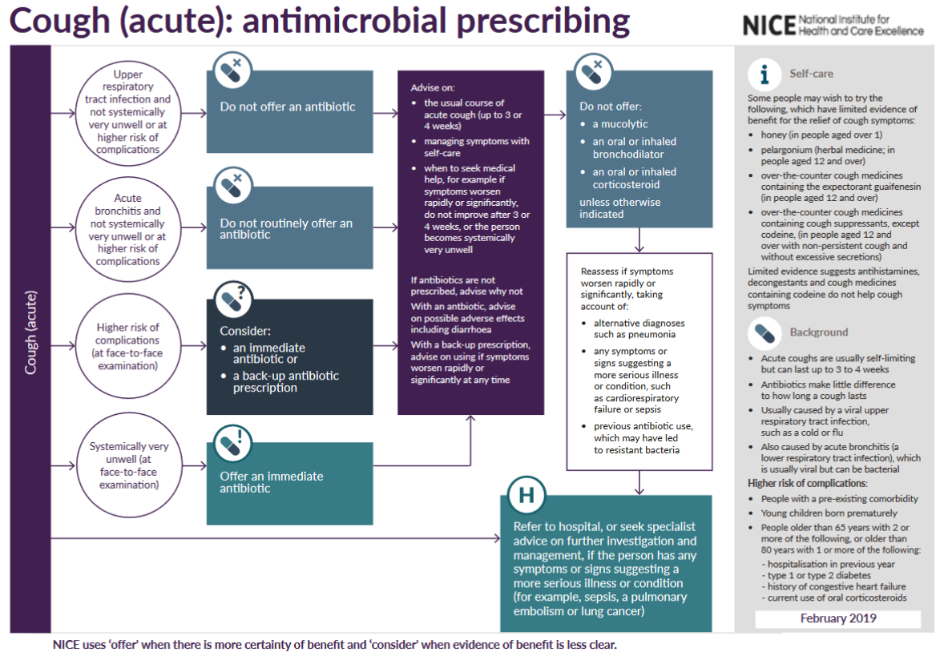
Acute cough antibiotic prescribing
Background
Clinical scenario
Prescribing
Summary
Acute cough
(NICE, 2019)
Notes:
Presenter talk
The TARGET website also links to the NICE national antibiotic guidance for acute cough, which is used by most ICBs to develop their local guidance. Please make sure to check your local guidance.
This is a snapshot of the visual summary of the Management of Infection Guidance for acute cough – last updated January 2022.
Speaker to click through the animations for each part of the guidance.
As you can see each section has information on what criteria is needed to indicate antibiotics should be prescribed. It also provides information on self care.
Presenter notes
We suggest you also refer to your local guidance.
Slide references
NICE (2019). Cough (acute): antimicrobial prescribing. Available at: https://www.nice.org.uk/guidance/ng120/evidence

Slide 16
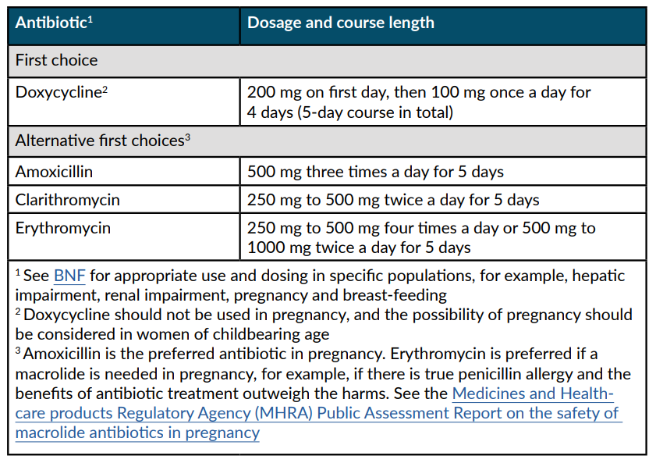
Acute cough antibiotic prescribing for adults
Background
Clinical scenario
Prescribing
Summary
Acute cough
NICE antimicrobial prescribing guidance:
Choice of antibiotic for adults ages 18 years and over
(NICE, 2019)
Notes:
Presenter talk
This is a screenshot of the treatment section of the NICE Management of Infection Guidance for acute cough and includes recommended first and second line antibiotics dose and duration. For acute cough, we suggest that antibiotics have little benefit if no co-morbidity. This NICE guidance also has an extensive rationale section which is really useful if you would like more information for yourself or the patient.
The guidance recommend doxycycline first line; with alternatives of amoxicillin, clarithromycin and erythromycin. Co-amoxiclav is not a recommended first line or second line alternative for acute cough (if pneumonia is not diagnosed).
Presenter notes
We suggest you also refer to your local guidance.
Slide references
NICE (2019). Cough (acute): antimicrobial prescribing. Available at: https://www.nice.org.uk/guidance/ng120/evidence

Slide 17

Evidence: Risk of resistance persists for at least 12 months after prescribing antibiotics
Increased risk of resistant organism
Antibiotic in past 2 months | Antibiotic in past 12 months
2.4 times | 2.4 times
Meta analysis of antibiotic resistance in individuals prescribed antibiotics in primary care RTI
7 studies of patients with RTI: n = 2,605
(Costello et al. 2010)
Notes:
Presenter talk
Take a moment to think. Does your own antibiotic prescribing influence antibiotic resistance in your patients or community?
The risk of resistance is even greater in the first two months after an antibiotic as shown here for RTIs, but is still higher 12 months after antibiotic use for RTIs.
Individuals prescribed an antibiotic in primary care for a respiratory infection have an increased risk of subsequently carrying resistant organisms – so that the next time they have an infection it may be with one of these antibiotic resistant organism. So in conclusion, any antibiotic use increases our future risk of carrying resistant bacteria, even if it is amoxicillin, as this resistance gene is often linked to others like trimethoprim.
Presenter notes
The review referenced included 24 studies; 22 involved patients with symptomatic infection and two involved healthy volunteers; 19 were observational studies (of which two were prospective) and five were randomised trials. In five studies of urinary tract bacteria (14 348 participants), the pooled odds ratio (OR) for resistance was 2.5 (95% confidence interval 2.1 to 2.9) within 2 months of antibiotic treatment and 1.33 (1.2 to 1.5) within 12 months. In seven studies of respiratory tract bacteria (2605 participants), pooled ORs were 2.4 (1.4 to 3.9) and 2.4 (1.3 to 4.5) for the same periods, respectively. Studies reporting the quantity of antibiotic prescribed found that longer duration and multiple courses were associated with higher rates of resistance. Studies comparing the potential for different antibiotics to induce resistance showed no consistent effects. Only one prospective study reported changes in resistance over a long period; pooled ORs fell from 12.2 (6.8 to 22.1) at 1 week to 6.1 (2.8 to 13.4) at 1 month, 3.6 (2.2 to 6.0) at 2 months, and 2.2 (1.3 to 3.6) at 6 months.
Therefore in conclusion, individuals prescribed an antibiotic in primary care for a respiratory infection have an increased risk of carrying resistant organisms – so that the next time they have an infection it is with a antibiotic resistant organism. The effect is greatest in the month immediately after treatment but may persist for up to 12 months. This effect not only increases the population carriage of organisms resistant to first line antibiotics, but also creates the conditions for increased use of second line antibiotics in the community.
Slide references
Costelloe C, Metcalfe C, Lovering A, Mant D, Hay AD. Effect of antibiotic prescribing in primary care on antimicrobial resistance in individual patients: systematic review and meta-analysis. BMJ. 2010 May 18;340:c2096. doi: 10.1136/bmj.c2096. PMID: 20483949. https://pubmed.ncbi.nlm.nih.gov/20483949/ [Accessed 06 December 2023]

Slide 18
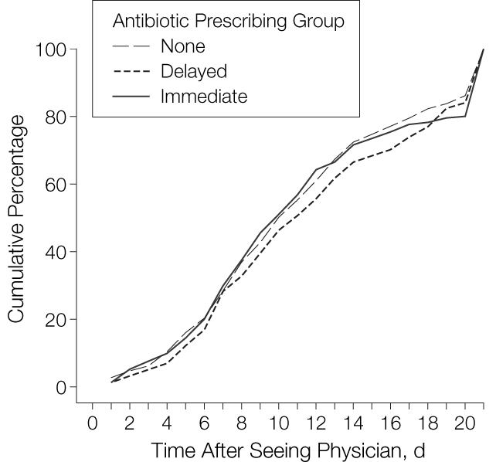
What is the evidence for back-up / delayed prescribing?
Acute cough
Duration of Cough After Physician Visit Until Patient Is Feeling Better
 | Patient satisfaction with treatment
No antibiotic (control Mean SD) | 130/181 (72)
Difference due to delayed antibiotic (95% CI) | 147/190 (77)
Difference due to Immediate antibiotics (95% CI) | 166/194 (86)
p-value | 0.005
(Little et al 2005, Spurling et al. 2017)
Notes:
Presenter talk
There has been much discussion about the use of giving delayed antibiotic prescriptions in acute uncomplicated infections, to reduce antibiotic use and reduce patient expectations. A 2017 Cochrane review has shown the benefits of this approach, without increasing complications in patients (1).
The study in the slide above assessed an information leaflet and antibiotic prescribing strategies for acute lower respiratory tract infection through a randomized controlled trial. Patients recruited by 37 physicians across Bristol and Southampton were randomised into immediate antibiotics, delayed antibiotics and no antibiotics groups. Of the 807 randomised participants, 272 were randomised to delayed antibiotics
The cough remained “a slight problem” for a mean of 11.7 days (in 25% the cough lasted 17 days), and moderately bad for a mean of 6.0 days. Compared with no offer of antibiotics, other prescribing strategies did not alter the primary outcomes.
There was no difference in recovery rates and high levels of satisfaction with all strategies. Overall, there were fewer re-attendances with cough following delayed prescribing and immediate antibiotics in the month after the physician visit compared to no antibiotics (mean attendances for delayed, 0.12; immediate, 0.11; and no antibiotics, 0.19; likelihood ratio [LR] test from Poisson regression, P=.04).
Authors concluded that No offer or a delayed offer of antibiotics for acute uncomplicated lower respiratory tract infection is acceptable, associated with little difference in symptom resolution, and is likely to considerably reduce antibiotic use and beliefs in the effectiveness of antibiotics.
Presenter further information
A Cochrane review of 11 studies has shown that delayed prescribing reduces antibiotic prescriptions without reducing satisfaction
Outcomes Risk with immediate antibiotics* Risk with delayed antibiotics* Relative effect (95% CI)
Antibiotic use:
delayed versus 930 per 1000 348 per 1000 OR 0.04
immediate antibiotics (286 to 401) (0.03 to 0.05)
Patient satisfaction:
delayed versus immediate 909 per 1000 866 per 1000 OR 0.65
Antibiotics (795 to 916) (0.39 to 1.10)
Reconsultation rate: 109 per 1000 113 per 1000 OR 1.04
delayed versus immediate (63 to 196) (0.55 to 1.98)
antibiotics
*Anticipated absolute effects* (95% CI)
Slide References
Spurling GK, et al. Cochrane Database Syst Rev https://www.ncbi.nlm.nih.gov/pmc/articles/PMC6372405/pdf/CD004417.pdf
Little P, Rumsby K, Kelly J, et al. Information leaflet and antibiotic prescribing strategies for acute lower respiratory tract infection: a randomized controlled trial. JAMA. 2005;293(24):3029-3035. doi:10.1001/jama.293.24.3029

Slide 19
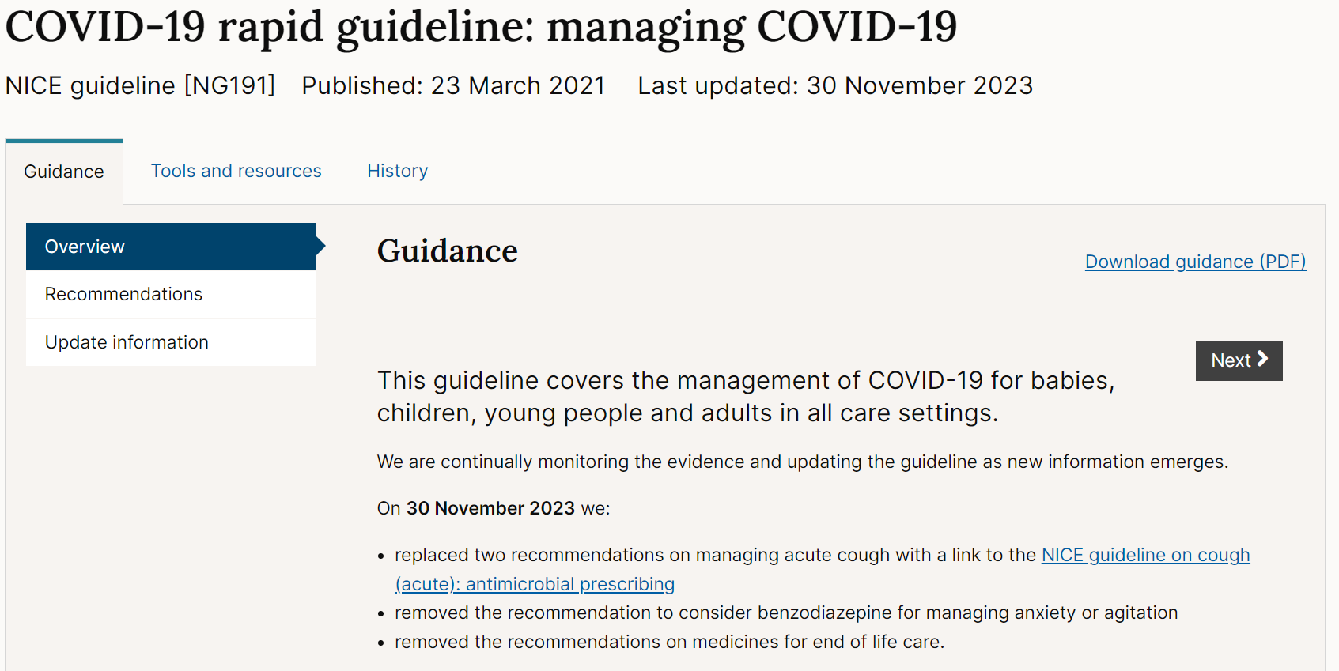
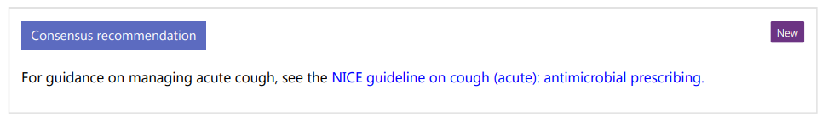
COVID-19 and acute cough management?
Background
Clinical scenario
Prescribing
Summary
Acute cough
(NICE 2023)
Notes:
Content on this slide could change quite rapidly based on disease prevalence so please double check NG191 to confirm that this reflects the most recent changes.
Presenter talk:
We are not going to go into detail regarding the management of COVID– 19 but wanted to highlight how the current management for COVID and acute cough overlap.
NICE publish rapid guidance that covers the management of COVID-19 in the community.
For those with COVID-19, this guidance covers criteria for testing for COVID-19, the signs and symptoms to help identify people with COVID-19 with the most severe illness or at risk for more severe illness and covers care planning according to the individual patient needs, this includes things like patient referral and management with anti-retroviral therapy.
This guidance states that antibiotics should not be used for preventing or treating COVID-19 unless there is clinical suspicion of additional bacterial co-infection, which is rare. Further information is presented on co-infection management.
(click for animation) The COVID-19 rapid guideline guidance links to the NICE APG for acute cough for management guidance, and also highlights some best practice recommendations including:
the clinician should encourage people with cough to avoid lying on their backs, if possible, because this may make coughing less effective.
the clinician should be aware that older people or those with comorbidities, frailty, impaired immunity or a reduced ability to cough and clear secretions are more likely to develop severe pneumonia.
Additional information:
NICE recommend the following signs and symptoms to help identify people with COVID-19 with the most severe illness:
severe shortness of breath at rest or difficulty breathing
reduced oxygen saturation levels measured by pulse oximetry (see the recommendation on pulse oximetry levels that indicate serious illness)
coughing up blood
blue lips or face
feeling cold and clammy with pale or mottled skin
collapse or fainting (syncope)
new confusion
becoming difficult to rouse
reduced urine output.
Evidence as of March 2021 suggests that bacterial co-infection occurs in less than about 8% of people with COVID-19, and could be as low as 0.1% in people in hospital with COVID-19. Viral and fungal co-infections occur at lower rates than bacterial co-infections.
Secondary infection or co-infection (bacterial, viral or fungal) is more likely the longer a person is in hospital and the more they are immunosuppressed (for example, because of certain types of treatment).
The type and number of secondary infections or co-infections will vary depending on the season and any restrictions in place (for example, lockdowns).
References:
NICE guideline [NG191] COVID-19 rapid guideline: managing COVID-19. Published: 23 March 2021. Accessed Dec 2023. https://www.nice.org.uk/guidance/ng191/chapter/Recommendations

Slide 20
STARWAVe was developed to help predict future hospitalisation among children with cough
Background
Clinical scenario
Prescribing
Summary
The seven symptoms and signs are:
Short duration of illness (≤3 days)
Parent reported fever in the previous 24 hours or temperature ≥37.8○C at presentation
Age <2 years
Clinician reported inter/subcostal recession
Clinician reported wheeze on auscultation
Current diagnosis of asthma
Parent reported moderate/severe vomiting in the previous 24 hours
S
T
A
R
W
A
V
(Blair et al 2023)
Notes:
Presenter talk
STARWAVe is a clinical scoring tool developed by researchers at University of Bristol to help predict possible hospitalisation among children who have presented to in-hours primary care with acute (≤28 days) cough and respiratory tract infection (RTI). Unlike some of the algorithms we discuss later, STARWAVe is not currently included in management guidance so please discus with your ICB medicines management leads before rolling it out as part of a practice wide intervention.
STARWAVe was developed in response to primary care clinicians saying they prescribe antibiotics “just in case” children’s illnesses deteriorate. However, as with all tools, use of STARWAVe should support, not replace, clinical judgement.
STARWAVe was used as part of a multi-faceted intervention to improve management of antibiotics for children presenting to primary care with acute cough and respiratory tract infection and was evaluated in a recent randomised controlled trial (CHICO), from Nov 2018 to Sept 2021. The trial period included COVID-19 pandemic, which changed how consultations occurred and rates of infection. Full trial results showed contradictory or non-significant findings. However, when a post hoc sensitivity analysis was conducted that excluded data after March 2020, the findings showed a reduced dispensing rate in the intervention arm (Adjusted rate ratio - 0.967 (95% CI: 0.946 to 0.989), p= 0.003). The findings also showed no difference in hospitalisations or emergency room visits between the intervention and control group.
The value of STARWAVe is to reduce clinical uncertainty when managing children with acute cough.
Children with 0-1 STARWAVe symptoms and signs (67% of all children): are at very low risk (around 1:320) of future admission and a ‘no’ antibiotic strategy should be considered for this group.
Children with 2-3 STARWAVe symptoms and signs (30% all children) who are at ‘normal’ risk of future admission (around 1:70). In keeping with NICE guidelines, a ‘no’ or ‘delayed’ antibiotic prescribing strategy should be considered.
Children with 4 or more STARWAVe symptoms and signs (3% of all children) should be closely monitored for signs of deterioration, with consideration given to proactively arranging same-day or next-day follow-up and prescribing an immediate antibiotic.
Presenter notes
STARWAVe development details are here: https://www.thelancet.com/journals/lanres/article/PIIS2213-2600(16)30223-5/fulltext
The intervention included the STARWAVEe algorithm embedded into GP systems and personalised printout recording decisions made at the consultation, covering common concerns and providing safety netting information, which was based on a leaflet co-designed with parents (Caring for children with cough).
https://www.bristol.ac.uk/media-library/sites/primaryhealthcare/documents/target/caring-for-children-with-cough-leaflet-print-ready.pdf
We found no difference in the rate of hospital admissions at 0.013 (0.010 to 0.018) and 0.015 (0.012 to 0.020) for the intervention and control arms, respectively. This translates into 13 or 15 admissions a year per 1000 children, and the rate ratio was 0.952 (0.905 to 1.003). As 1.003 lies below the 1.01 non-inferiority margin we set, the intervention was considered non-inferior. Pre-specified sensitivity analyses that incorporated hospital admissions with “missing diagnosis” did not change these results (supplementary table A). The seasonal winter peak of hospital admissions was absent during the pandemic (fig 2). The secondary outcome of emergency department attendance rates were 0.045 (0.038 to 0.054) and 0.044 (0.037 to 0.052) for the intervention and control arms, respectively. This translates into approximately 49 and 45 attendances a year per 1000 children; the rate ratio was 1.013 (0.980 to 1.047; P=0.44). Pre-specified sensitivity analyses that incorporated “missing diagnosis” admissions and emergency department attendances are shown in the supplementary material.
References
Blair P S, Young G, Clement C, Dixon P, Seume P, Ingram J et al. Multi-faceted intervention to improve management of antibiotics for children presenting to primary care with acute cough and respiratory tract infection (CHICO): efficient cluster randomised controlled trial BMJ 2023; 381 :e072488 doi:10.1136/bmj-2022-072488
Multi-faceted intervention to improve management of antibiotics for children presenting to primary care with acute cough and respiratory tract infection (CHICO): efficient cluster randomised controlled trial | The BMJ
Bristol University - Using STARWAVe in practice to predict hospitalisation. Available at: https://www.bristol.ac.uk/media-library/sites/primaryhealthcare/documents/target/Using%20STARWAVe%20evidence%20in%20practice%20(19.12.2023).pdf
[accessed 03.01.24]

Slide 21
Acute cough summary
Background
Clinical scenario
Prescribing
Summary
Acute cough
Most patients with acute cough do not require antibiotics
Reducing antibiotic prescribing can reduce consultations
Patients trust you to give reassurance and advice
Notes:
Presenter talk
Summarise points
Presenter notes
Slide references

Slide 22

Acute sore throat
Acute sore throat

Slide 23
Acute sore throat background
Background
Clinical scenario
Prescribing
Summary
Acute sore throat
Usually caused by viral or bacterial infection
Symptoms last around 1 week but most improve before this without antibiotics
General practice penicillin prescribing increased by 22.7% between 2021 and 2022;
  Increase in infection following changes in social mixing due to the COVID-19 pandemic
  Group A strep infection and scarlet fever
  Circulation of influenza and respiratory syncytial virus
(UKHSA, 2023)
Notes:
Presenter talk
Acute sore throat (including pharyngitis and tonsillitis) is self-limiting and often triggered by a viral infection of the upper respiratory tract
Symptoms can last for around 1 week, but most people will get better within this time without antibiotics, regardless of cause (bacteria or virus).
In 2022, general practice penicillin prescribing increased by 22.7% between 2021 and 2022; this was associated with higher than usual circulating viral and bacterial infections and an unusual out of season increase in invasive group A streptococcal (GAS) infections and scarlet fever. 2022 levels are similar to those from 2018
Presenter notes
References
UK Health Security Agency (2023). English surveillance programme for antimicrobial utilisation and resistance (ESPAUR), Report 2022-2023.

Slide 24

Acute sore throat clinical scenario
Background
Clinical scenario
Prescribing
Summary
Acute sore throat
Consider the following details:
18 year old girl
4/7 days sore throat, ‘high’ fever last night, tiredness, cough
Difficulty swallowing
Temp 37.5°C
Slough on swollen red tonsils, palatal petechiae
Cervical and axillary lymphadenopathy
‘Antibiotics helped’ for tonsils last year
Poll - What would you do?
Notes:
Presenter notes:
Walk users through the clinical scenario and use poll to get thoughts
Poll : What would you do?
Don’t offer an antibiotic
Consider no antibiotic or back-up prescription
Consider an immediate antibiotic or back-up prescription
Offer an immediate antibiotic
Slide references

Slide 25
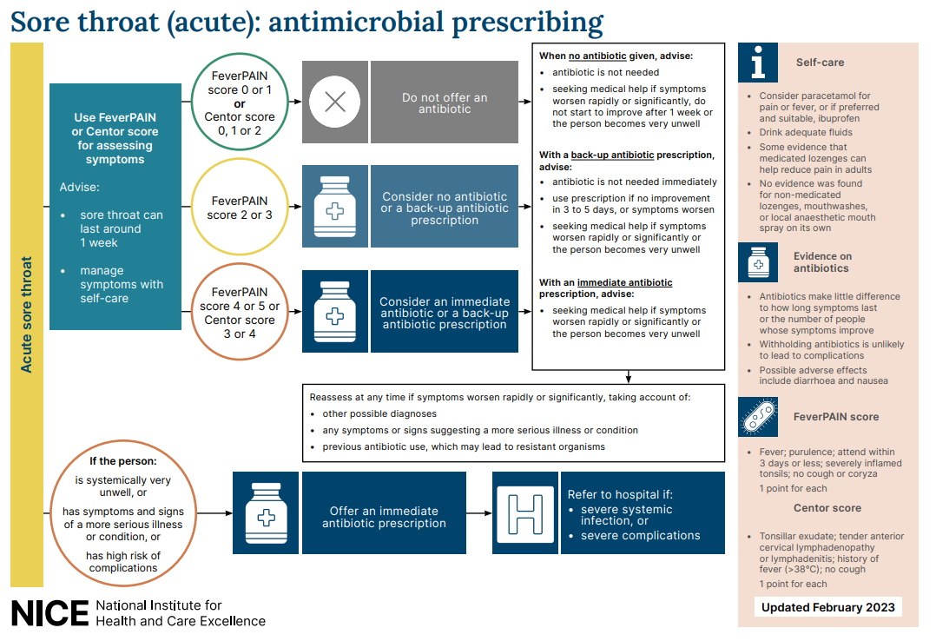
Background
Clinical scenario
Prescribing
Summary
Acute sore throat
(NICE, 2018)
Notes:
Presenter notes:
This is an overview of the NICE guidelines that recommend the use of clinical scoring systems. Lets have a look at the scoring systems in a bit more detail.
Use this section to walk through the guidance
Slide reference:
Sore throat (acute): antimicrobial prescribing NICE guideline [NG84] Published: 26 January 2018
https://www.nice.org.uk/guidance/ng84

Slide 26
Clinical scoring systems
Background
Clinical scenario
Prescribing
Summary
Acute sore throat
Centor criteria
(scores 0-4)
Tonsillar exudate
Tender anterior cervical lymphadenopathy or lymphadenitis
History of fever (over 38°C)
Absence of cough
FeverPAIN criteria
(scores 0-5)
Fever (in last 24 hours)
Purulence (pus on tonsils)
Attend rapidly (within 3 days of symptom onset)
(severely) Inflamed tonsils
No cough or coryza (inflammation of mucus membranes in the nose)
(Centor et al 1981, Little et all 2013, NICE, 2018)
Notes:
Presenter talk
NICE suggest that clinicians should use either the Fever PAIN or CENTOR score to help decide on the management of adult acute sore throat. Many of you will be familiar with one or both of these clinical scoring tools.
Centor has been around since 1981 and was developed to predict the probability of the presence of Streptococcus pyogenes or group A β haemolytic Streptococcus (GABHS) in a throat swab culture.
Centor criteria
Tonsillar exudate
Tender anterior cervical lymphadenopathy or lymphadenitis
History of fever (over 38 degrees Celsius)
Absence of cough
Each of the Centor criteria score 1 point (maximum score of 4). A score of 0, 1 or 2 is thought to be associated with a 3 to 17% likelihood of isolating streptococcus. A score of 3 or 4 is thought to be associated with a 32 to 56% likelihood of isolating streptococcus.
The FeverPAIN score was developed with over 500 UK general practice patients, and then tested in a further cohort of over 600 patients, so the findings of the study are really robust.
The score was not just used to predict Group A strep sore throats like the Centor score, but also other streptococcal sore throats such as C, G.
Each of the FeverPAIN criteria score 1 point (maximum score of 5). A score of 0 or 1 is thought to be associated with a 13 to 18% likelihood of isolating streptococcus. A score of 2 or 3 is thought to be associated with a 34 to 40% likelihood of isolating streptococcus. A score of 4 or 5 is thought to be associated with a 62 to 65% likelihood of isolating streptococcus (NG84).
Fever (during previous 24 hours)
Purulence (pus on tonsils)
Attend rapidly (within 3 days after onset of symptoms)
Severely Inflamed tonsils
No cough or coryza (inflammation of mucus membranes in the nose
You can link to a scoring system at https://ctu1.phc.ox.ac.uk/feverpain/index.php
Whilst both scoring systems are very similar, the Fever PAIN score found that cervical lymphadenopathy was not predictive of streptococcal sore throat, and this may not surprise us as this occurs also in viral sore throats, so does not help to differentiate the two.
Presenter Notes
See NG 84 for more details
Slide references
Centor R, Witherspoon J, Dalton H, et al. The diagnosis of strep throat in adults in the emergency room. Med Decis Making 1981;1:239–46
Little P, Moore M, Hobbs FDR, et al. BMJ Open 2013, 2013;3:e003943. doi:10.1136/bmjopen-2013-003943
***Centor however was specifically developed for adults, so in 2004 McIsaac and team developed modified criteria, which add the age of the patient (+1 if age 3–14, 0 if age 15–44 and -1 if age ≥45), taking into account the fact that GABHS is more prevalent in the age group of 5–15 years. Still, several studies have shown that neither signs and symptoms, nor signs and symptoms combined as prediction rules, were reliable to distinguish between GABHS and non-GABHS pharyngitis.

Slide 27
Feedback: FeverPAIN
Background
Clinical scenario
Prescribing
Summary
Acute sore throat
18 year old girl
4/7 days sore throat, “high” fever last night, tiredness, cough, difficulty swallowing
Temp 37.5°C
Slough on swollen red tonsils, palatal petechiae
Cervical and axillary lymphadenopathy
‘Antibiotics helped’ for tonsils last year
3 of the 5 FeverPAIN criteria– 34-40% likelihood of a beta haemolytic streptococcus.
Could warrant a back-up/delayed antibiotic.
Only 13-18% have streptococcus, close to background carriage. NO antibiotic strategy appropriate with discussion
FeverPAIN 0-1
34-40% have streptococcus. Back-up/ delayed prescription appropriate with discussion
FeverPAIN 2-3
62-65% have streptococcus, consider immediate antibiotic if severe symptoms, or short delayed prescription strategy may be appropriate (48 hrs)
FeverPAIN >4
Notes:
Presenter talk
So lets take a look at using the FeverPAIN score in adults
The Fever PAIN score gives the likelihood of having a streptococcal sore throat, which can be discussed with the patient.
So the FeverPAIN is a five-item score based on Fever (during previous 24 hours), Purulence (pus on tonsils), Attend rapidly (within 3 days after onset of symptoms), Severely Inflamed tonsils, No cough or coryza (inflammation of mucus membranes in the nose)
(FeverPAIN)
You can link to a scoring system at https://ctu1.phc.ox.ac.uk/feverpain/index.php
Bring in scoring and what they represent – each bullet will come in on a separate mouse click.
If the FeverPAIN score is 0 or 1 then the likelihood of a patient having a streptococcus in their throat is 13-18% which is close to the background carriage of streptococci, and therefore antibiotics are not warranted.
Click to bring in:
This patient has 3 of the 5 FeverPAIN criteria (high fever in last 24 hours, purulence, and severe inflammation) – and therefore has a 34-40% likelihood of a beta haemolytic streptococcus. She could warrant a back-up/delayed antibiotic and this needs to be discussed with the patient.
If the Fever PAIN score is >4: there is a 62-65% of having a streptococcus, therefore consider an immediate antibiotic if symptoms are severe, or a short delayed prescribing strategy may be appropriate if symptoms are not severe and the patient is happy to wait and see how their symptoms progress. (48 hour)
Presenter additional background information
References for FeverPAIN score development and testing
Little P, Moore M, Hobbs FDR, et al. BMJ Open 2013, 2013;3:e003943. doi:10.1136/bmjopen-2013-003943
ABSTRACT: Objective: To assess the association between features of acute sore throat and the growth of streptococci from culturing a throat swab. Design: Diagnostic cohort. Setting: UK general practices.
Participants: Patients aged 5 or over presenting with an acute sore throat. Patients were recruited for a second cohort (cohort 2, n=517) consecutively after the first (cohort 1, n=606) from similar practices. Main outcome: Predictors of the presence of Lancefield A/C/G streptococci. Results: Variables significant in multivariate analysis in both cohorts were rapid attendance ( prior duration 3 days or less; multivariate adjusted OR 1.92 cohort, 1.67 cohort 2); fever in the last 24 h (1.69, 2.40); and doctor assessment of severity (severely inflamed pharynx/ tonsils (2.28, 2.29)). The absence of coryza or cough and purulent tonsils were significant in univariate analysis in both cohorts and in multivariate analysis in one cohort.
A five-item score was suggested based on Fever, Purulence, Attend rapidly (3 days or less), severely Inflamed tonsils and No cough or coryza (FeverPAIN) had moderate predictive value (bootstrapped area under the ROC curve 0.73 cohort 1, 0.71 cohort 2) and identified a substantial number of participants at low risk of streptococcal infection (38% in cohort 1, 36% in cohort 2 scored ≤1, associated with a streptococcal percentage of 13% and 18%, respectively). A Centor score of ≤1 identified 23% and 26% of participants with streptococcal percentages of 10% and 28%, respectively
This score was further tested in an RCT: Little P, Hobbs FDR, Moore M. et al. Clinical score and rapid antigen detection test to guide antibiotic use for sore throats: randomised controlled trial of PRISM (primary care streptococcal management). 2013. BMJ. Available from: http://www.bmj.com/content/347/bmj.f5806.
Rationale: A multicentre randomised controlled trial in UK general practices designed to determine the effect of clinical scores that predict streptococcal infection or rapid streptococcal antigen detection tests compared with delayed antibiotic prescribing in patients aged >3 with acute sore throat.
This study compared three strategies for limiting or targeting antibiotic using a validated FeverPAIN score in 631 patients with sore throat: they compared delayed antibiotic prescribing, the use of a clinical score designed to identify streptococcal infection, and the targeted use of rapid antigen tests according to the clinical score. Findings suggest that across a range of practitioners and practices, use of either the simple FeverPAIN clinical score or the clinical FeverPAIN score with a rapid antigen test is likely to moderately improve symptom control and reduce antibiotic use; the addition of the Rapid antigen test to the FeverPAIN score gave no clear advantages compared with use of the FeverPAIN score alone. Use of antibiotics in the clinical score group (60/161) was 29% lower (adjusted risk ratio 0.71, 95% confidence interval 0.50 to 0.95; P=0.02) and in the antigen test group (58/164) was 27% lower (0.73, 0.52 to 0.98; P=0.03). There were no significant differences in complications or reconsultations. The authors therefore suggest the use of the following scoring system and clinical management: With a low FeverPAIN score of 0-1: only 13-18% have streptococcus, close to background carriage and therefore a no antibiotic strategy is appropriate with discussion. With a FeverPAIN score of 2-3: 34-40% have streptococcus, therefore a back-up/delayed antibiotic is appropriate with discussion. With a FeverPAIN score of >4: 62-65% have streptococcus, therefore consider immediate antibiotic if symptoms are severe or a short 48 hour delayed antibiotic prescribing strategy may also be appropriate after agreement with the patient and safety netting advice.

Slide 28
Feedback: Centor
Background
Clinical scenario
Prescribing
Summary
Acute sore throat
18 year old girl
4/7 days sore throat, “high” fever last night, tiredness, cough, difficulty swallowing
Temp 37.5°C
Slough on swollen tonsils, palatal petechiae
Cervical and axillary lymphadenopathy
‘Antibiotics helped’ for tonsils last year
3 of the 4 Centor criteria - more likely to have a group A beta haemolytic Streptococcus.
Could warrant an immediate or back-up/delayed antibiotic.
Centor criteria: History of fever; absence of cough; tender anterior cervical lymphadenopathy and tonsillar exudates.
High negative predictive value (80%), low chance of Group A Beta Haemolytic Streptococci
Centor 0-2
Centor 3 or 4
Chance of GABHS is 40%.
Unwell +
Centor 3 or 4
Chance of developing Quinsy is 1:60.
Notes:
Presenter talk
Lets have a look at the same scenario but using the Centor score.
As we saw before the Centor scoring system is very similar but includes lymphadenopathy which this patient has – giving a score of 3, and suggesting an immediate or back-up antibiotic.
Centor Criteria: History of fever; absence of cough; tender anterior cervical lymphadenopathy and tonsillar exudates. A low Centor score (0-2) has a high negative predictive value (80%) and indicates low chance of Group A Beta Haemolytic Streptococci (GABHS). A Centor score of 3-or-4 suggests the chance of GABHS is 40%. If a patient is unwell with a Centor score of 3-or-4 then the chance of developing Quinsy is 1:60.
This patient has 3 of the 4 Centor criteria (because they have a history of fever, lymphadenopathy, and exudate) – and is therefore more likely to have a group A beta haemolytic Streptococcus. She could warrant an immediate or back-up/delayed antibiotic – however the benefit with immediate antibiotics may still be quite small and needs to be discussed with the patient. Centor leads to more prescribing than Fever PAIN
It may be worth discussing some slightly different scenarios, and what factors makes a clinician more likely to prescribe – and if this is a correct approach.
Slide reference
Centor RM, Whitherspoon JM, Dalton HP, Brody CE, Link K. The diagnosis of strep throat in adults in the emergency room. Med Decision Making 1981;1:239-46.
Studies that back up the use of Centor
Aalbers J, O'Brien KK, Chan WS, Falk GA, Teljeur C, Dimitrov BD, and Fahey T (2011) Predicting streptococcal pharyngitis in adults in primary care: a systematic review of the diagnostic accuracy of symptoms and signs and validation of the Centor score. BMC Medicine, 9:67.
https://www.ncbi.nlm.nih.gov/pmc/articles/PMC3127779/pdf/1741-7015-9-67.pdf
Fine AM, Nizet V, and Mandl KD (2012) Large-scale validation of the Centor and McIsaac scores to predict group A streptococcal pharyngitis. Arch Intern Med, 172(11):847-852.
https://jamanetwork.com/journals/jamainternalmedicine/article-abstract/1157417
Hassan MF, Eida MM, Metwally LA, and Mahmoud HA (2015) Evaluation of Appropriateness of Antibiotic Use and Validation of the Mclsaac-Modified Centor Score for Group A Beta Hemolytic Streptococcal Acute Pharyngitis in Suez Canal Area. Suez Canal University Medical Journal, 18(2):117-124.
https://journals.ekb.eg/article_45612_a3c5f8106208278c29773deb5a076b0e.pdf

Slide 29
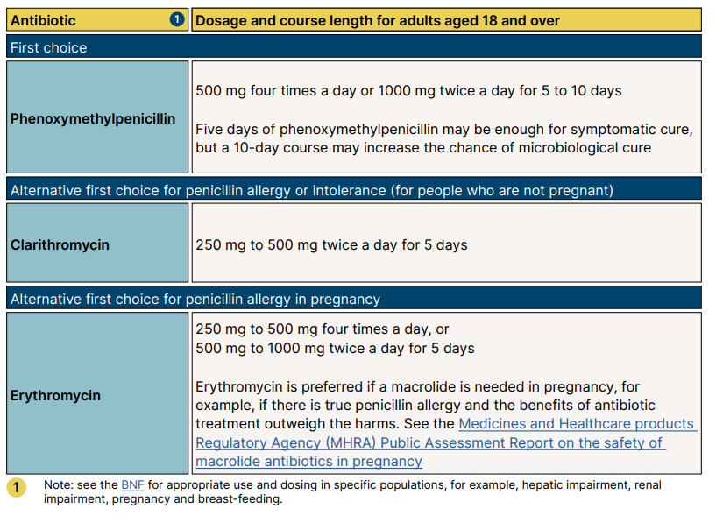
NICE antimicrobial prescribing guidelines for acute sore throat in adults
Background
Clinical scenario
Prescribing
Summary
Acute sore throat
(NICE, 2018)
Notes:
Presenter talk
So we have managed this case in line with National NICE guidance. This is a snapshot of the aims and principles of treatment section of the Antibiotic Prescribing Implementation Tool for acute sore throat. As you can see each section has links to other guidance, comments on when antibiotics should be used, recommended first and second line antibiotics dose and duration. This guidance also has modified dosage information for children.
The guidance recommends oral penicillin V for AST as first line, clarithromycin as second line and erythromycin in pregnancy.

Slide 30



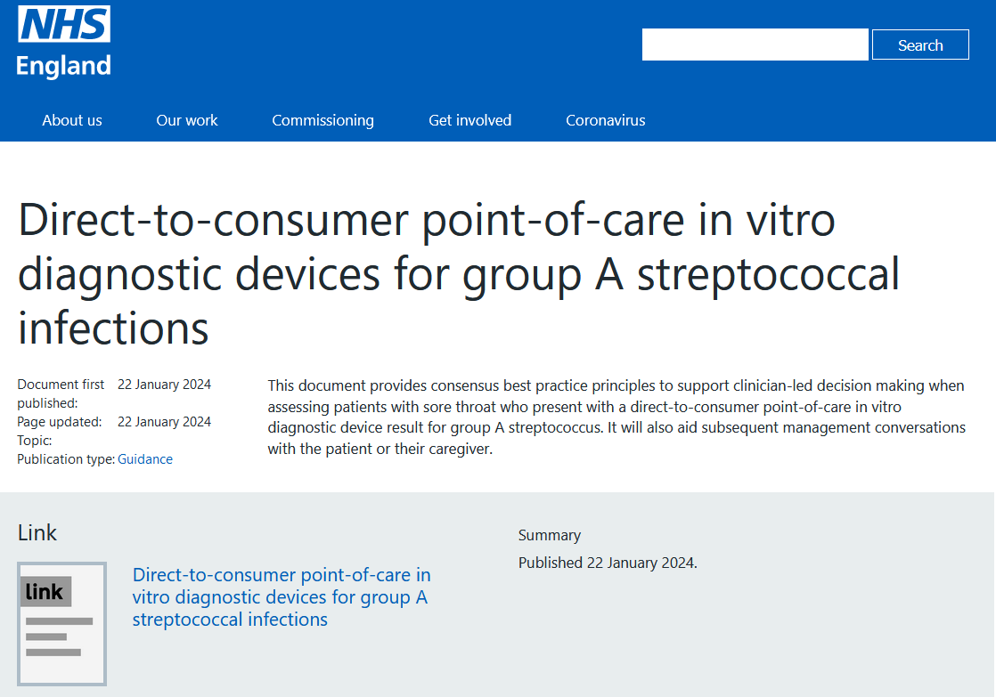
NEW guidance: Direct-to-consumer point-of-care in vitro diagnostic devices for group A streptococcal infections
Best practice principles to support clinician-led decision making
adopt a patient-centric approach
historical performance suggest validity of result cannot always be assured
significance of GAS in the pharynx can be difficult to determine
take account of clinical scoring systems
if uncertain consider sending a swab for culture if it would impact management
regardless of outcome ensure clear safety netting information is provided
Scarlet Fever remains a clinical diagnosis
Acute sore throat
NHSE 2024
Notes:
Presenter talk
This document [published 22 January 2024] provides consensus best practice principles to support clinician-led decision making when assessing patients with sore throat who present with a direct-to-consumer point-of-care in vitro diagnostic device (POC-IVDD) result for group A streptococcus (GAS). It will also aid subsequent management conversations with the patient or their caregiver. There are a range of POC-IVDDs for GAS currently available on the market, and historical performance of POC-IVDDs in several settings and for a variety of pathogens suggest the validity of the result cannot always be assured.
The guidance is available at https://www.england.nhs.uk/publication/direct-to-consumer-point-of-care-in-vitro-diagnostic-devices-for-group-a-streptococcal-infections/
Best practice principles
It is recommended that clinicians adopt a patient-centric approach when interpreting results of a self-administered POC-IVDD designed to detect GAS.
The following best practice principles should be considered:
healthcare professionals are advised to take account of the clinical presentation of the patient and clinical scoring systems, such as FeverPAIN and Centor, alongside the test result to agree a pragmatic and holistic management plan with the patient and/or caregiver. This is especially important when there may be discordance between the test and clinical scoring systems/guidance
in situations of continued uncertainty, healthcare professionals may wish to consider sending a throat swab for culture if it would impact clinical management
the significance of GAS when detected in the pharynx can be difficult to determine; this can range from it being an infecting pathogen, or co-pathogen (for example, exacerbating a viral aetiology), to throat carriage. Tests should not be performed in asymptomatic individuals as the clinical significance of results cannot be determined
patients must receive clear safety netting information regardless of whether antibiotics are prescribed or not. Use of the appropriate TARGET leaflet should be considered
scarlet fever remains principally a clinical diagnosis, and a POC-IVDD result should not replace the need for antibiotic treatment and notification to local health protection teams
Additional notes
These principles were developed by the NHS England (NHSE) Diagnostics Board and the UK Health Security Agency (UKHSA), and include representation from academic and front-line clinicians across primary and secondary care settings. These principles are endorsed by the British Infection Association and the Royal College of General Practitioners. The National Institute for Health and Care Excellence (NICE) is aware of the development of these principles.
Slide reference
NHS England. Guidance: Direct-to-consumer point-of-care in vitro diagnostic devices for group A streptococcal infections. Document first published: 22 January 2024. Accessed 22 January 2024.
https://www.england.nhs.uk/publication/direct-to-consumer-point-of-care-in-vitro-diagnostic-devices-for-group-a-streptococcal-infections/

Slide 31
Acute sore throat summary
Background
Clinical scenario
Antibiotic prescribing
Summary
Acute sore throat
Symptoms last around 1 week but most improve before this without antibiotics
Use Centor or Fever PAIN to guide antibiotic management
Refer to guidance on direct-to-consumer point-of-care in vitro diagnostic devices for group A streptococcal infections
Notes:
Presenter talk
Presenter notes
Slide references

Slide 32
RTI management and shared decision making

Slide 33



The patient perspective: what do patients do when they have an RTI?
74% reported RTI in 2022- 23
55% self managed
(did not consult)
20% consulted
GP surgery
12% consulted
community pharmacy
Source: Basis Research, AMR Survey
Base: All respondents (n=5390), n varies by subgroup (min n=393)*
(AMR Public Perceptions survey 2023, Basis Research)
Notes:
Presenter talk
Data from an online survey of 5390 members of the public in 2023 (a nationally representative sample in England) shows that about ¾ of adults from the general population will say they had a respiratory tract infection in the last year. Of these 54% had a cold/runny nose and 47% a cough.
About ½ (53%) self managed without consulting any healthcare provider.
20% consulted a GP surgery and 12% and a community pharmacy/chemist.
Presenter notes
Slide references
UKHSA AMR Public Perceptions survey, Basis Research, December 2023 – Awaiting peer review and publication.

Slide 34
What did you expect from your contact or visit to the Doctor's surgery, for this most recent illness?
Vs What happened when you contacted or visited the Doctor's surgery [multiple choice question]
Patient expectations compared to reality
Significantly higher / lower vs. expectation
(AMR Public Perceptions survey 2023, Basis Research)
Notes:
Presenter talk
Patients were asked what they expected from contact or visit to the doctor's surgery and then what actually happened from the consultation.
The key take away is that although 40% expected to be prescribed antibiotics, there is a similar proportion expecting to be prescribed treatment to relieve the symptoms. Further more 30% are expecting to receive advice on whether antibiotics are needed.
Presenter notes
Slide references
UKHSA AMR Public Perceptions survey, Basis Research, December 2023 – Awaiting peer review and publication.

Slide 35
Patients generally trust the advice from their healthcare professional
3%
disagree
4%
disagree
6%
disagree
88%
Agree or strongly agree
78%
Agree or strongly agree
74%
Agree
Trust GP’s advice whether antibiotics are required
Trust nurses' advice whether antibiotics
are required
Trust pharmacists' advice whether antibiotics
are required
Source: Basis Research, AMR Survey
Base: All respondents (n=5390)
(AMR Public Perceptions survey 2023, Basis Research)
Notes:
Presenter talk:
In the same survey respondents were asked if they trust “their GP’s/nurse's/pharmacist's advice as to whether they need antibiotics or not”
You can see looking at the light grey and red bars, that respondents generally trusted their healthcare providers advice about weather they needed antibiotics or not. This is slightly skewed towards the GPs but is still very high across professions.
References:
UKHSA AMR Public Perceptions survey, Basis Research, December 2023 – Awaiting peer review and publication.

Slide 36
CHESTSSS can help frame discussions about antibiotics
C: Ask specifically about concerns
H: Discuss history and exam results/findings
E: Ask specifically about expectations
S: Explain the cause of symptoms
T: Be specific about illness timeline/usual course
S: Explain shortcomings of antibiotics
S: Self-care advice
S: Safety-netting advice
First 5 min of the consultation
Covered in the TARGET patient information leaflets
Notes:
Presenter talk
So what can you do in a short consultation to discuss management of infection with a patient? The CHESTSSS acronym was developed and tested in a randomised-controlled trial [1] which resulted in improved antibiotic prescribing and patient satisfaction when used by experienced GPs in the UK.
CHESTSSS presents specific communication techniques. These techniques have been developed based on patient expectations and needs specific to antibiotic discussions so can be more useful and effective than general approaches, helping you to remember specific phrases which:
Reassures patients
Increase patient understanding and satisfaction with a prescribing decision
May be particularly helpful for patients who are expecting antibiotics
Walk users through the acronym here using the points on the screen.
We know that clinicians are busy (click for animation), however most of these points can be covered in the first 5 min as you go through the consultation. For instance you can provide a “running commentary” on findings as you conduct an exam or explain the cause of symptoms a patient may be experiencing.
(click for animation)The final 4 point can be covered if you use a patient information leaflet to discuss management with a patient.
Further speaker information:
C- ask specific concerns
Asking the patient specifically about their concerns. This can be difficult as, if not careful, one can sound patronising or give the impression that you have not been listening. However, if concerns are not specifically asked about, the patient will sometimes not share their main worries for fear of being seen as ‘overly-anxious’.
Example phrases you can use:
‘There are probably a number of things that are worrying you about this illness, but what would you say are the things that you are most worried about?’
‘You’ve mentioned the high temperature; is that the thing that is causing you most worry at the moment, or is it something else?’
H – history
A good history and examination, conducted prior to providing the patient with advice and/or reassurance, is an essential component of reassuring patients that their illness is being taken seriously.
Consider:
Providing a "running commentary", especially a "no problem commentary" [7,8], to the patient while doing an examination, for example:
'Your heart rate is normal', 'Your temperature isn't raised', 'Your lungs sound good.“
E- Expectations
Research has shown that there is often a mismatch between what GPs think patients are expecting and what they actually want. A patient that appears ‘demanding’ may actually just want reassurance that the infection has not ‘gone down to the chest’, rather than antibiotics.
Consider:
Asking the patient specifically about their expectations, for example:
'How do you think I could most help you today?'
'Some people have a clear idea about what they are expecting when they come to see me. Is there something that you were hoping for or expecting that we haven't talked about yet?’
S – Symptoms
Telling patients that you can find no sign of serious illness when they are worried about symptoms, might not be enough to make them feel reassured – they just think you have failed to detect how serious their illness is!
Consider:
Finding out what symptoms the patient is concerned about and then providing convincing non-serious explanations for these symptoms [7,8]. For example:
‘Your body produces phlegm as a normal reaction to inflammation in the airways to your lungs. The phlegm catches particles in your airways and helps keep your lungs clear.’
It can be helpful to acknowledge that these non-serious symptoms can still be very disruptive for patients so showing empathy that they are feeling very unwell is important.
T - Timelines
Prescribers might not always set realistic expectations and sometimes suggest that patients will get better ‘in a few days’, when we now know that it often takes much longer than this to recover.
In addition, patients often have unrealistic expectations about how quickly they will recover, and these can lead to unnecessary anxiety and re-consultation.
Consider:
Research has provided us with valuable information on expected duration of common infections. It is useful to tell these durations to patients to reassure them that their symptoms are not unusual.
S - Shortcomings
Prescribers don't always discuss pros and cons of antibiotics with patients, and patients often are not aware that antibiotics have no or very limited benefit for several common infections.
Consider:
Several trials have shown no or limited benefit of antibiotics for several types of common infections. Antibiotics are not usually indicated in sore throat, sinusitis, acute otitis media and acute cough where pneumonia is not suspected. Consider expanding on antibiotics effects on illness duration, AMR and side effects.
S – Self-care
Most patients are looking for something positive that they can do to feel better more quickly.
Consider:
Asking patients what they have done already to manage their symptoms and reassure them that what they are doing will help. Giving reassurance and advice on other things they can do can go a long way to make patients feel more in control and comfortable.
Reinforcing the fact that the patient’s own immune system is their best source of defence, and advise on what they can do themselves to help their body fight the infection. Patient leaflets can support how you discuss self-care advice.
S – Safety netting
Lastly it is important that patients understand what they should be looking out for, and when they should re-consult.
Consider:
Providing patients with specific information on 'red-flag symptoms' and advising them on what to do if symptoms get worse.
Supporting the safety-netting advice by discussing a patient leaflet.
Finally, it can be useful for you to summarise key messages - the natural history, reassurance that nothing serious is going on (assuming you have found no indication for antibiotics) and to check that the patient understands and is happy with the management plan.
Slide references
Clinicians will usually cover the first 4-5 elements of CHESTSSS in the consultation but tell us they often run out of time to cover E-S-S-S. Patient information leaflets can be a really useful tool to help ensure that all elements of CHESTSSS are being covered and allow patients to digest the information at their own pace.
Presenter notes
Slide references

Slide 37
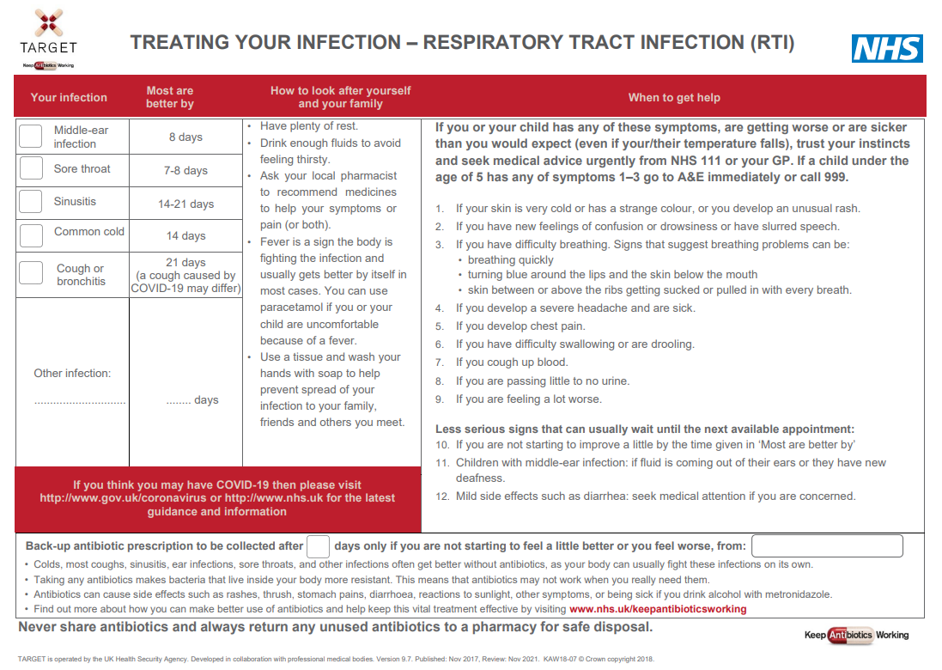
TARGET Treating Your Infection RTI leaflet
Timelines: ‘Most are better by’ section to help patients know when to (re) consult
Safety netting
COVID-19 information
Back-up prescription
Information about antibiotics & AMR
Notes:
Presenter talk
This is an example of the TARGET RTI patient information leaflet which has been designed to be used by clinicians in discussion with patients.
These are freely available to download and print and there are web page versions which can be texted to patients. If you use Accurx there are existing templates if you search for TARGET under templates.
Slide references
TARGET leaflets are available on the TARGET toolkit hub: https://elearning.rcgp.org.uk/course/view.php?id=553#section-0

Slide 38
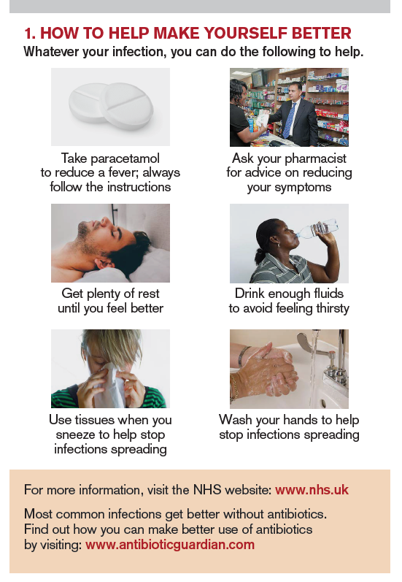
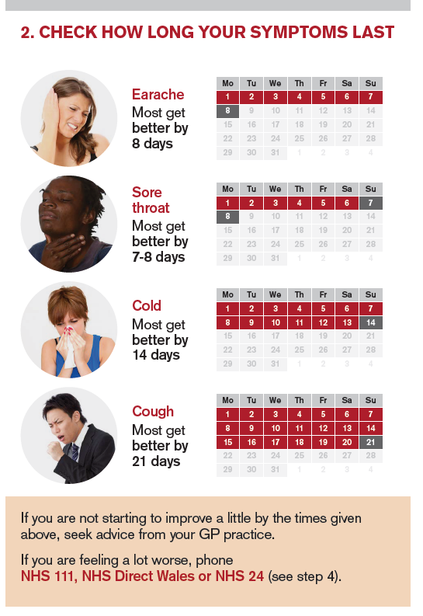
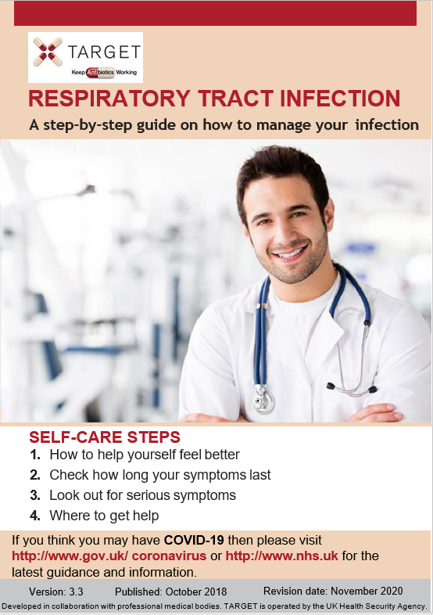
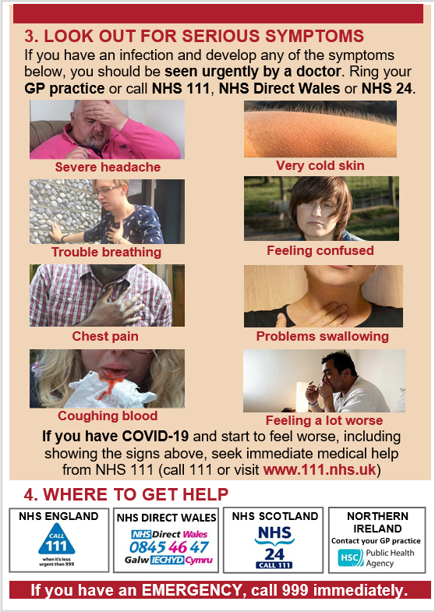
TARGET pictorial TYI RTI leaflet
Notes:
Presenter talk
The TARGET leaflet is also available in a pictorial booklet version with the same information.
All leaflets are translated into around 30 different languages.
Slide references
TARGET leaflets are available on the TARGET toolkit hub: https://elearning.rcgp.org.uk/course/view.php?id=553#section-0

Slide 39
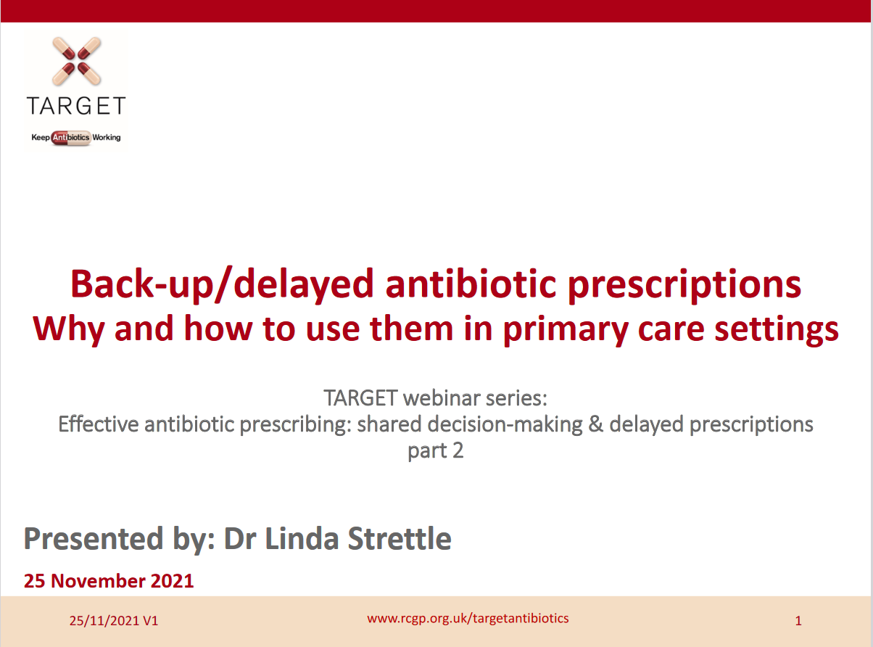

Back-up/delayed antibiotic prescriptions
www.rcgp.org.uk/TARGETantibiotics
-> Visit ‘learning resources for prescribers’ to access the recording and slide deck
Notes:
Presenter talk
We will briefly touch on back-up and delayed antibiotic prescriptions, but there is a previous TARGET webinar from 2021 you can access from the website which goes into depth on using these.

Slide 40
Prescribing can influence patients understanding and expectations
English RCT comparing treatment strategies for respiratory tract infection (n=889)
Delayed antibiotic
Delayed antibiotic
Little 2014, BMJ, Extracted from supplementary table 2
Notes:
Presenter Talk
This slide covers one study within a review conducted by Little et al in in 2014 focused on upper respiratory tract infections and included patients 889 patients over 3 years of age from 25 practices. Patients who were not judged to need an immediate antibiotic, were randomised into no antibiotic or delayed prescribing group (n=556).
There was no significant effect of antibiotic prescribing strategy on symptom severity or temperature. Higher levels of satisfaction were reported for the patient led and collection approaches, although the limited sample size for this outcome resulted in no significant differences overall (2.38, P=0.667). Those given antibiotics were more likely to believe that antibiotics were effective (click for arrow) despite immediate antibiotics having no significant effect on symptom severity or duration.
The back-up prescription is very useful to give to patients who have a high expectation for antibiotics, and can be given alongside the TARGET patient information leaflets.
Additional presenter notes
Additional information on delayed prescribing you can cover:
A 2017 Cochrane review found that symptoms for sore throat were only modestly improved by immediate antibiotics compared with delayed antibiotics (5 studies - Spurling 2017) also found no significant difference in patient satisfaction in delayed vs. immediate groups in studies focusing on respiratory tract infections (6 studies).
You can also include information about safety by covering the DESCARTE study:
A study of acute sore throat (the DESCARTE study – Little 2013) showed that complications in those who received immediate were similar to those receiving a back-up prescription even though 30% did not collect the prescription, and in the study complications were higher in the no antibiotic group. Thus giving more control to the patient does help prevent complications, but with a back-up antibiotic safety netting instructions are important.
Little 2014 study:
Health professionals decided in negotiation with patients whether immediate antibiotics were needed. Total of 889 patients, of these 333 (37%) were prescribed immediate antibiotics
If antibiotics were not needed, patients were randomised into four delayed prescribing groups (n=556, 63%):
Recontact for prescription (n=123)
Post-dated prescription (n=114)
Collection of the prescription (n=105)
Or patient led (the patient was given to use if needed) (n=106)
Immediate antibiotics given (n=333) symptoms documented (n=280)
For symptom severity, we saw no evidence of a significant interaction between antibiotic strategy and analgesia use
For the randomised no/delayed groups
There was no significant effect of strategy on symptoms severity, duration and small differences in temperature control.
Antibiotic use did not differ significantly between no/delayed prescribing strategies, with the lowest use reported in the no prescription group
Consultations in the following month were similar (RR: 2.97, P=0.563) and were not significantly different after the first month (RR: 4.11, P=0.391).
Belief in antibiotics was strong but not significantly different between no or delayed groups,
Inclusion of the non-randomised immediate prescription group
No significant effect of antibiotic prescribing strategy on symptom severity or temperature
Antibiotic use differed significantly with 97% of patients reporting antibiotic use in the immediate arm
More patients believed antibiotics were very effective despite immediate antibiotics having no significant effect on symptom severity or duration.
There was no significant difference in satisfaction rates across the groups
A 2017 Cochrane review of delayed prescriptions for respiratory infection found that:
A strategy of immediate antibiotics is more likely to confer the modest benefits of antibiotics on clinical outcomes such as symptoms for acute otitis media and sore throat than delayed antibiotics (moderate certainty evidence according to GRADE assessment).
Immediate antibiotics had similarly high levels of patient satisfaction to delayed antibiotics (91% versus 86% - moderate certainty evidence according to GRADE assessment).
Delayed antibiotics had higher levels of patient satisfaction than no antibiotics (87% versus 82% - moderate certainty evidence according to GRADE assessment).
Delayed antibiotic prescribing strategies achieved markedly lower rates of antibiotic use compared to immediate antibiotics (31% versus 93% - moderate certainty evidence according to GRADE assessment).
Requiring the patient to return for a prescription resulted in even lower antibiotic use (27%) than giving a prescription at the time of the consultation with instructions to fill the prescription if symptoms worsened (38%).
No antibiotics achieved lower rates still of antibiotic use compared to delayed antibiotics (14% versus 28%)- moderate certainty evidence according to GRADE assessment).
Slide References
Spurling GKP, Del Mar CB, Dooley L, Clark J, Askew DA. Delayed antibiotic prescriptions for respiratory infections. Cochrane Database of Systematic Reviews 2017, Issue 9. Art. No.: CD004417. DOI: 10.1002/14651858.CD004417.pub5. Accessed 23 January 2023.
Little P, Moore M, Kelly J, Williamson I, Leydon G, McDermott, L, Mullee M, Stuart B. Delayed antibiotic prescribing strategies for respiratory tract infections in primary care: pragmatic, factorial, randomised controlled trial. BMJ 2014;348.
Moore M, Little P, Rumsby K, Kelly J, Watson L, Warner G, Fahey T, Williamson I. Effect of antibiotic prescribing strategies and an information leaflet on longer-term reconsultation for acute lower respiratory tract infection. Br J Gen Pract. 2009 Oct;59(567):728-34. doi: 10.3399/bjgp09X472601. PMID: 19843421; PMCID: PMC2751917.
Little P, Stuart B, Hobbs FD, Butler CC, Hay AD, Campbell J, Delaney B, Broomfield S, Barratt P, Hood K, Everitt H, Mullee M, Williamson I, Mant D, Moore M; DESCARTE investigators. Predictors of suppurative complications for acute sore throat in primary care: prospective clinical cohort study. BMJ. 2013 Nov 25;347:f6867. doi: 10.1136/bmj.f6867. PMID: 24277339; PMCID: PMC3898431.
Little P, Stuart B, Hobbs FD, Butler CC, Hay AD, Delaney B, Campbell J, Broomfield S, Barratt P, Hood K, Everitt H, Mullee M, Williamson I, Mant D, Moore M; DESCARTE investigators. Antibiotic prescription strategies for acute sore throat: a prospective observational cohort study. Lancet Infect Dis. 2014 Mar;14(3):213-9. doi: 10.1016/S1473-3099(13)70294-9. Epub 2014 Jan 17. PMID: 24440616.

Slide 41
Public awareness of delayed/back up prescribing has increased but is still low
Y2 COVID-19
Y1 COVID-19
Pre COVID-19
Base: All adults aged 18+ in England: 2022 (1663), 2021 (1676); 2020 (2052) :
Awareness of delayed prescribing has increased
January 2023
(AMR Public Perceptions survey 2022,)
Notes:
Presenter talk
When we look at the public survey data, on the publics awareness of delayed antibiotics we see an interesting picture building.
Take home message: Awareness of delayed prescribing has increased slightly in the last few years but almost 70% of the population are not aware of what a delayed prescription is.
Additional presenter notes
There seemed to be an increased awareness of delayed prescribing during the first year of the pandemic, with a significant increase in the percentage of people who said they were fully aware of what an antibiotic was (red/beige section) – and this remained constant in 2022. On the other hand, those who said they were not aware of delayed prescribing (light grey section) initially decreased in 2021 only to rise again tin 2022 – closer to pre-pandemic levels.
Slide References
(1) Manuscript out for publication

Slide 42
Around half of members of the public support the prescription of delayed antibiotics for a variety of different infections
Support of delayed antibiotic prescription
Don’t know
Strongly oppose
Tend to oppose
12%
Oppose
11%
Oppose
11%
Oppose
Neither support nor oppose
Tend to support
47%
Support
49%
Support
52%
Support
Strongly support
Base: All respondents (n=5390)
January 2024 www.rcgp.org.uk/TARGETantibiotics
(AMR Public Perceptions survey 2023, Basis Research)
Notes:
Presenter talk
When asked about their support or opposition of delayed prescribing for throat, ear and urine infections around half tend to or strongly support, and 11 – 12% oppose. Many answer that they don’t know or that they neither support nor oppose, again suggesting that more awareness is needed.
There is advice on communication around delayed antibiotic prescription in the TARGET toolkit in the ‘Discussing antibiotics with patients’ section
Slide reference
UKHSA AMR Public Perceptions survey, Basis Research, December 2023 – Awaiting peer review and publication.

Slide 43
Coding back-up antibiotic prescriptions
***Don’t forget to code your treatment choice***
READ codes (Emis, Vision) | SNOMED code (System One) | Definition
8BP0 | 2549788011 | Deferred antibiotic therapy
8CAk | 406111000000113 | Patient advised to delay filling of prescription
8OAN | 2462831000000113 | Provision of TARGET Managing Your Common Infection (Self-Care) Leaflet with back-up antibiotic prescription issued
Notes:
Speaker notes:
Don’t forget to code your treatment choice. Much of the evidence presented today use Read/Snomed codes to trawl the data, if you haven’t coded its makes it difficult for researchers to understand the benefit or not of any treatment.
The Read/Snomed codes for delayed prescriptions are outlined in this table and you can these slides will be freely available on the TARGET website following this presentation.

Slide 44
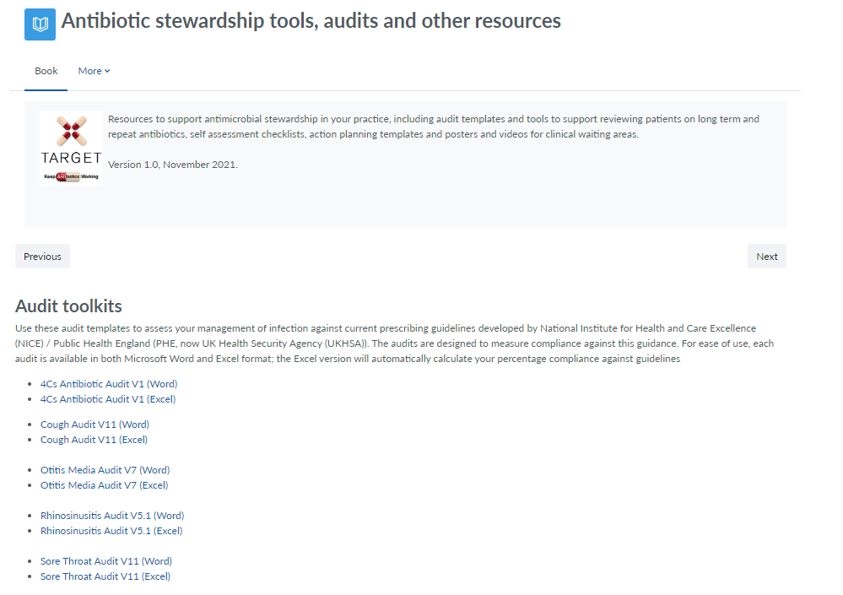
TARGET audit toolkits
    Acute otitis media
    UTI
    Acute sore throat
    Acute cough
    Otitis externa
    Acute rhinosinusitis
Excel templates auto calculates prescribing compliance for you!
Notes:
Presenter talk
Finally, how can you measure your or your practice’s compliance to NICE guidance for RTIs? TARGET have audit templates for a number of different infections under the section titled “Antibiotic stewardship tools, audits and other resources”
Audits adherence to NICE antimicrobial prescribing guidelines
MS Word and Excel
Includes step-by-step instructions
Calculates % adherence to guidelines
Summary report
Performance reflection questions
Allows to track performance
Slide reference
TARGET audits are available on the TARGET toolkit hub: https://elearning.rcgp.org.uk/course/view.php?id=553#section-0

Slide 45
Acknowledgements
Bharat Patel - Clinical Pharmacist
Sanjay Patel - Consultant in Paediatric Diseases and Immunology
Manish Verma – General Practitioner
Mariyam Mirfenderesky - Consultant in Infectious Diseases and Medical Microbiology
Eirwen Sides – UKHSA
Emily Cooper – UKHSA
Donna Lecky – UKHSA
Catherine Hayes - UKHSA
Harry Ahmed – General Practitioner
Philippa Moore – Consultant microbiologist
Dharini Shanmugabavan – RCGP
Joseph Besford – RCGP
Lizzie Richmond - RCGP

Slide 46
Thank you
Please complete the feedback survey and let us know what topic you would like next!
Sign up for our next webinar:
Urinary tract infections: Applying diagnostic and prescribing guidance in practice
Thursday 21 March 2024 | 18:30 - 19:30 | Online
Visit www.rcgp.org.uk/TARGETantibiotics to find out more
Notes:
Feedback evaluation at the top of your inbox.

Slide 47
Panel discussion
Bharat Patel
Clinical Pharmacist
Speaker
Dr Manish Verma
General Practitioner
Panellist
Dr Sanjay Patel
Consultant in Paediatric Diseases and Immunology
Panellist
Dr Mariyam Mirfenderesky
Consultant in Infectious Diseases and Medical Microbiology
Panellist
Notes:
Click: Intro slide
Here is a slide with our amazing speakers and panellists – EC to introduce them
Bharat Patel
Works at the Rushall Medical Practice as a Clinical Pharmacist. He also works as a Senior Tutor for the School of Pharmacy, Keele University
Dr Manish Verma
Is a partner at the Rushall Medical Centre working as general practitioner
Dr Sanjay Patel
Dr Patel is a Paediatric Infectious Diseases and Immunology Consultant at Southampton Hospital and is involved in multiple antimicrobial stewardship initiatives across the country.
Dr Mariyam Mir-fen-der-esky
Is a Consultant in Infectious Diseases and Medical Microbiology who works with UKHSA and within the North Middlesex University Hospital NHS Trust

