Slide 1
Skin infections
Incorporating NICE antimicrobial prescribing guidelines
TARGET antibiotics
2023
Notes:
AUDIENCE: Primarily primary care Prescribers, GPs, pharmacists, nurses, A&E clinicians, students
COVERING Skin infection topics (listed), based on NICE prescribing guidelines updated 2020/21 & Clinical Knowledge Summaries

Slide 2





Introductions
Linda Strettle
General practitioner
Speaker
Philippa Moore
Consultant medical microbiologist
Panellist
Avril Tucker
Antimicrobial pharmacist
Panellist
Krishna Gohil
Clinical lead: NWCSP
Panellist
Rachael Lee
Clinical Implementation Manager: NWCSP
Panellist
NWCSP: National wound care strategy programme
Notes:
Feel free to put your individual questions to the panel

Slide 3
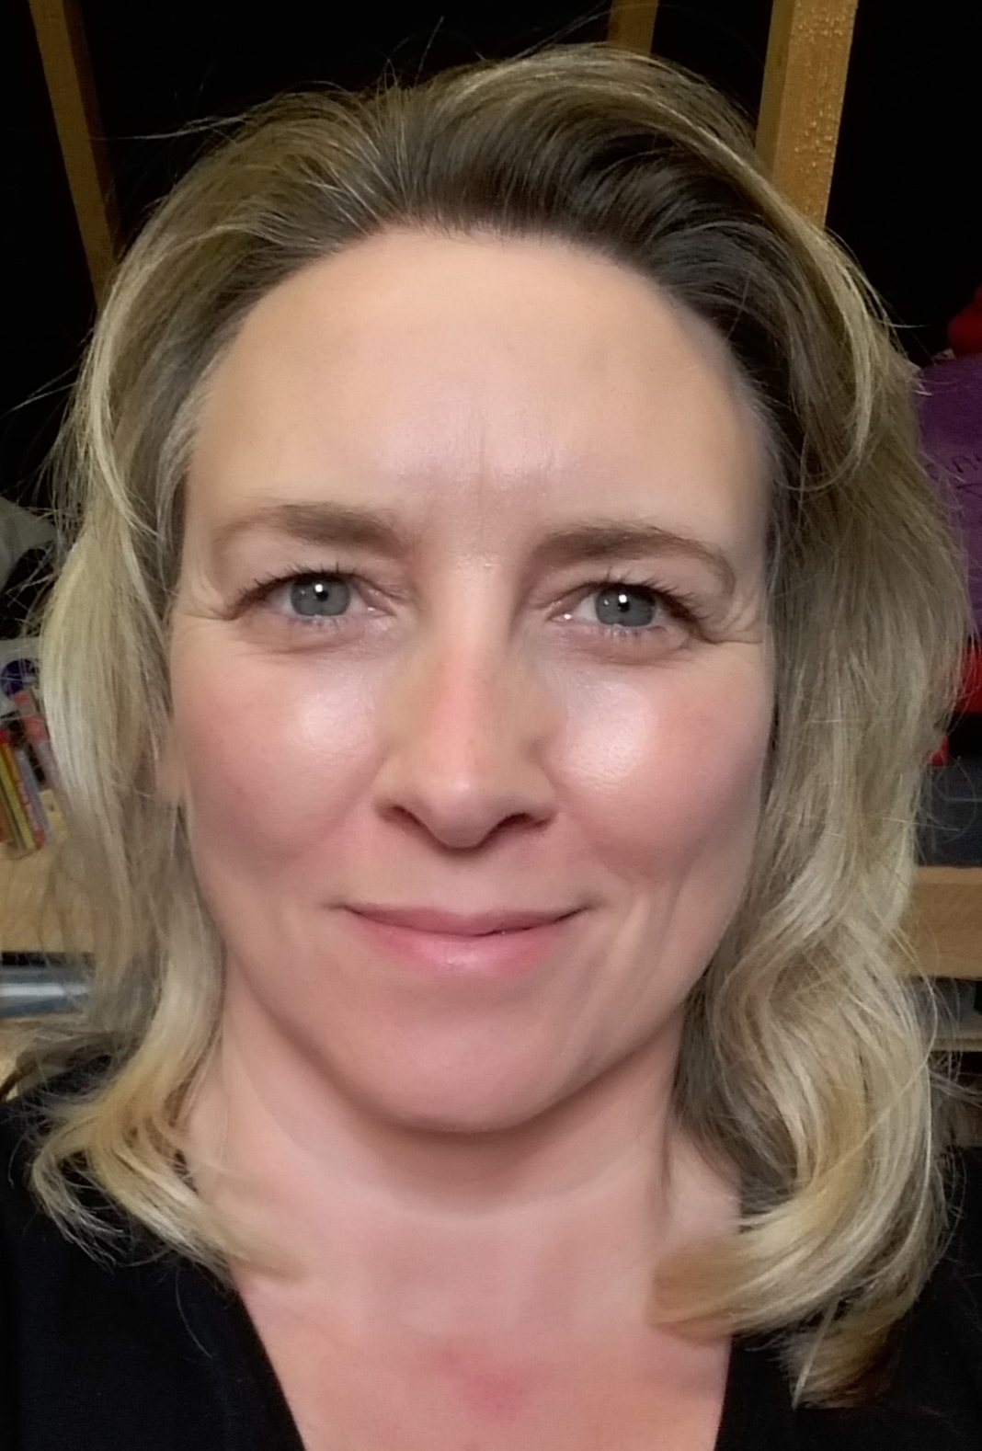



Introductions – TARGET Team
Donna Lecky
Head, Primary Care & Interventions Unit
Emily Cooper
Programme manager
Catherine Hayes
Project manager
Fionna Pursey
Research Project Support officer
Notes:
Feel free to put your individual questions to the panel

Slide 4

Development team
Dr Tessa Lewis | General practitioner
Dr Claire Neill | General practitioner
Dr Harry Ahmed | Academic GP at Cardiff university
Dr Leigh Sanyaolu | Academic GP at Cardiff University
Dr Philippa Moore | Consultant medical microbiologist
Dr Theresa Lamagni | Head of Gram Positive Section division at UKHSA
Dr Sabine Bou-Antoun | Principal scientist at UKHSA
Kathleen Hartigan | Advanced Nurse Practitioner
Dr Nick Francis | Academic GP at Southampton university
Dr Naomi Fleming | Antimicrobial stewardship lead for the East of England
Camilla Stevenson | Project manager at RCGP
Dr Dharini Shanmugabavan | Medical director at RCGP
Notes:
Presenter talk
We would like to say thank you for all those who have helped develop this webinar.

Slide 5
Aims
Understand and discuss
Management and treatment of impetigo, cellulitis and leg ulcers in line with NICE prescribing guidance for skin infections
Prescribing rates and resistance trends for impetigo, cellulitis and leg ulcers in England
Antimicrobial stewardship (AMS) of skin infections
Notes:
Presenter talk
The aims of this webinar are to discuss with you, using clinical scenarios, the need for optimising antibiotic prescribing for certain skin conditions.
We will cover NICE prescribing guidelines for 3 conditions: Impetigo, leg ulcers and cellulitis. By attending this webinar we hope you will be better able to do the following three things:

Slide 6
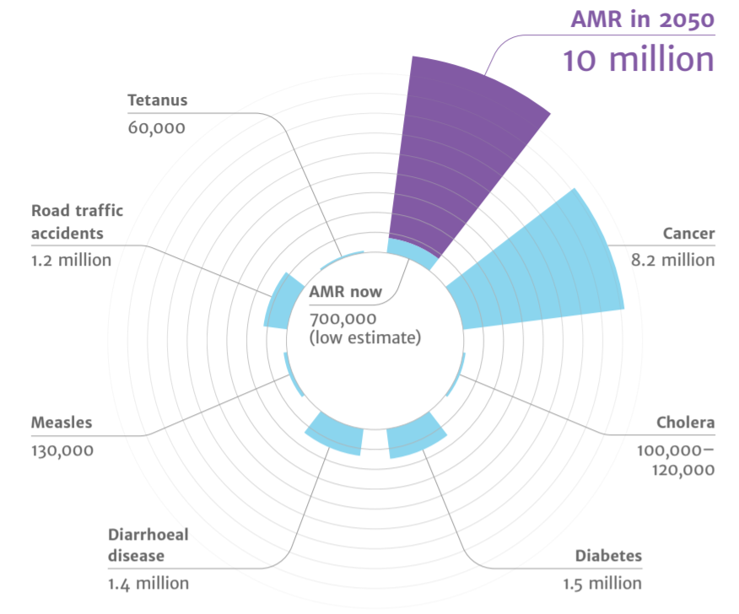
Deaths attributable to AMR each year
Context
AMR
2050
Diabetes
and cancer
combined
Deaths attributed to antimicrobial resistance (AMR) every year
AMR in 2050
10 million
Tetanus
60,000
Road traffic accidents
1.2 million
10,000,000
Cancer
8.2 million
9,700,000
AMR now
700,000
(low estimate)
Cholera
100,00 – 120,000
Measles
130,000
Diarrhoeal disease
1.4 million
Diabetes
1.5 million
(O ’Neill, 2016)
Notes:
Presenter talk
There is much information available about the threat and consequences of antimicrobial resistance but lets put that into context. A recent UN report (2), (April 2019) highlighted that by 2050, AMR could kill 10 million people per year, in its worst-case scenario. This is more than diabetes and cancer combined. This will also come at a cost of £66 trillion pounds.
There have been a number of initiatives and developments at a national level to get people thinking responsibly about antibiotic prescribing. NICE issued guidance on Antimicrobial Stewardship (NG 15); the NHS and Public Health England jointly issued a Patient Safety Alert around AMS; there are prescribing quality measures and incentives and the DH would like us to get back to the level of prescribing that we had in 2010.
The TARGET Guide to Resources provides more detail on these measures, and the TARGET toolkit helps to optimise your use of antibiotics.
Slide references
The review on antimicrobial resistance, chaired by Jim O’Neill. Tackling drug-resistant infections globally: final report and recommendations. 2016. [Available from: https://amr-review.org/sites/default/files/160518_Final%20paper_with%20cover.pdf]
IACG (2019). “No time to wait: securing the future from drug-resistant infections”

Slide 7
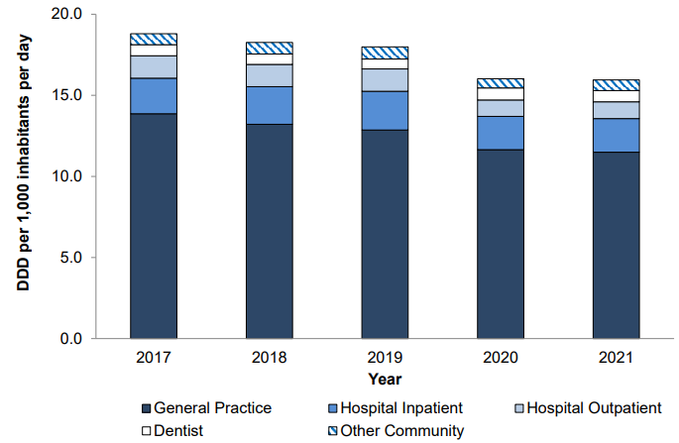
The majority of antibiotics are prescribed in General Practice
Total antibiotic consumption by setting
(UKHSA, 2022)
Notes:
Presenter talk
What does that mean for us? We know that 1 in 3 individuals in England take at least one course of antibiotics in a year and the majority of these (around 80%) are prescribed in primary care. And despite the decline in antibiotic prescribing between 2017-2021, the majority of antibiotic prescribing still occurs in primary care (GP setting). This data is from the ESPAUR report (English surveillance programme for antimicrobial utilisation and resistance).
The drop during 2020 and 2021 is likely to be temporary. We need to continue our efforts.
Presenter notes
Graph – Total antibiotic consumption by setting, expressed as DDDs per 1000 inhabitants per day, England, 2017 – 2021
Slide references
(1) UK Health Security Agency (2022). English surveillance programme for antimicrobial utilisation and resistance (ESPAUR), Report 2021-2022.

Slide 8
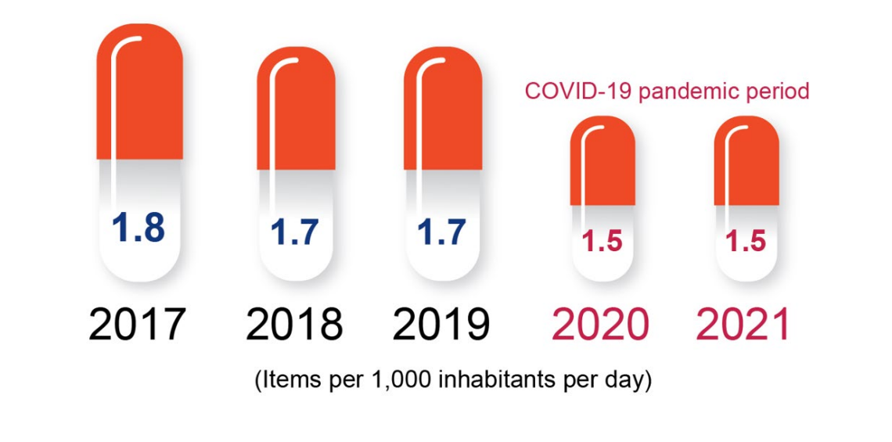
Why focus on antimicrobial stewardship in primary care?
Antibiotic prescribing in England 2017-2021
(UKHSA, 2022)
Notes:
Presenter talk
The good news is that in 2015 we saw the first fall in antibiotic use in general practice for some years and this trend continued into 2021.
The ESPAUR report was published in November 2022. It is an annual report that includes national data on antibiotic prescribing and resistance, antimicrobial stewardship implementation, and awareness activities in England.
The 2022 report showed that:
Overall antibiotic consumption declined - predominantly driven by reductions in primary care utilisation in 2020.
NOTE IMPACT OF COVID-19 PANDEMIC
Slide references
(1) UK Health Security Agency (2022). English surveillance programme for antimicrobial utilisation and resistance (ESPAUR), Report 2021-2022.

Slide 9
Antibiotic consumption
(European centre for disease prevention and control, 2019)
Notes:
Presenter talk
However we still have some way to go compared to some other European countries. Although as this slide shows in comparison to other European countries in the community we prescribe much less than Greece, which has a major resistance problem. However we do prescribe almost twice as much as the Netherlands which has a similar population to us. This suggests therefore that there is an opportunity to reduce our community antibiotic prescribing. The differences are partially due to cultural norms in the UK compared to other Northern EU countries who prescribe less for respiratory tract infections.
Presenter notes
The EU expresses community antibiotic consumption in Defined Daily Doses per 1 000 inhabitants and per day, which is slightly different to the ADQs used in the UK. Each bar refers to a specific country while the colours indicate the recorded consumption of the different antibiotic classes in that country.
Total community antibiotic consumption ranged from 11 DDD per 1 000 inhabitants and per day in Netherlands to 37 DDD per 1,000 inhabitants and per day in Greece. As in previous years, antibiotics of the penicillin class were the most frequently used antibiotics in all countries .
The UK still prescribes more than any of our northern European colleagues. DDDs (or if we used ADQs) is influenced by antibiotic dose, so as clinicians use of amoxicillin increases from 250 to 500mg routinely, the ADQs and DDDs increase, even if the number of items remains the same.
Slide references
(1) European Centre for Disease Prevention and Control. Antimicrobial consumption in the EU/EEA. 2019.
https://www.ecdc.europa.eu/sites/default/files/documents/Antimicrobial-consumption-in-the-EU-Annual-Epidemiological-Report-2019.pdf

Slide 10
Why skin infections?
16.3% of antibiotics in primary care are prescribed for skin infection
  Majority prescribed for “boil or abscess”,
  Cellulitis is the 3rd most common reason for prescribing in skin infections
  56% of all β-Lactamase-resistant penicillin are linked to a skin problem
  About 50% of codes for “impetigo” are linked to an oral antibiotic prescription
GPs want more information to support daily practice for cellulitis and leg ulcers
Notes:
Presenter talk
So why skin infections? After RTIs and UTIs, skin infections are the third most common reason for prescribing antibiotics in primary care - over 16% of antibiotics in primary care are prescribed for skin infection, the majority of which are for abscess and boils.
Additionally, one study researching what English GPs say they need – found that GPs ranked leg ulcers and cellulitis in the top 6 conditions they would like more evidence in to support their daily practice (3).
Presenter notes
Among prescriptions linked to an informative read code (1),
46.0% linked to RT/ENT
22.7% linked to urogenital tract
16.3% linked to skin (including wounds)
Pouwels - Duration of antibiotic treatment for common infections in English primary care: cross sectional analysis and comparison with guidelines
Data 2013-2015 (2)
Cough and bronchitis (386 972, 41.6% of the included consultations), acute sore throat (239 231, 25.7%), acute otitis media (83 054, 8.9%),
acute sinusitis (76 683, 8.2%), cellulitis (54 610, 5.9%), and acute cystitis (53 010, 5.7%)
Slide references
F Christiaan K Dolk, Koen B Pouwels, David R M Smith, Julie V Robotham, Timo Smieszek, Antibiotics in primary care in England: which antibiotics are prescribed and for which conditions?, Journal of Antimicrobial Chemotherapy, Volume 73, Issue suppl_2, February 2018, Pages ii2–ii10, https://doi.org/10.1093/jac/dkx504
Pouwels K B, Hopkins S, Llewelyn M J, Walker A S, McNulty C A, Robotham J V et al. Duration of antibiotic treatment for common infections in English primary care: cross sectional analysis and comparison with guidelines BMJ 2019; 364 :l440 doi:10.1136/bmj.l440
Lecky, D.M.; Granier, S.; Allison, R.; Verlander, N.Q.; Collin, S.M.; McNulty, C.A.M. Infectious Disease and Primary Care Research—What English General Practitioners Say They Need. Antibiotics 2020, 9, 265. https://doi.org/10.3390/antibiotics9050265

Slide 11
Resistance to second line antibiotics
Flucloxacillin is often the oral antibiotic of choice for many skin infections
Alternative oral antibiotics are often required (e.g. for penicillin allergies)
Macrolides (e.g. clarithromycin) are often the alternative choice:
English surveillance programme for antimicrobial utilisation and resistance - 2021-2022 ESPAUR
  18.6% of meticillin-susceptible staph. (MSSA) are resistant to macrolides
  53% of meticillin-resistant staph. (MRSA) are resistant to macrolides
Recent NICE antimicrobial prescribing guidelines:
  Impetigo (Aug 2020)
  Cellulitis and erysipelas (Sept 2019)
  Leg ulcer infection (Aug 2020)
Notes:
Presenter talk
Resistance among S. aureus to flucloxacillin and other antibiotics, is a key area of concern. The recent 2021-2022 ESPAUR report has reported resistance data for second line/ alternative antibiotics. Although flucloxacillin is often the first drug of choice for a lot of skin infections, alternatives are essential (e.g. for those with penicillin allergies). For macrolides (e.g. clarithromycin) it was reported 18.6% of MSSA and 53% of MRSA are resistant to macrolides.
This emphasises the importance of appropriate prescribing for skin infections.
So to help support appropriate prescribing, we will be discussing the recent NICE antimicrobial prescribing guidelines for the following skin infections..
Slide references
(1) UK Health Security Agency. English surveillance programme for antimicrobial utilisation and resistance (ESPAUR), Report 2021-2022. 2022.

Slide 12
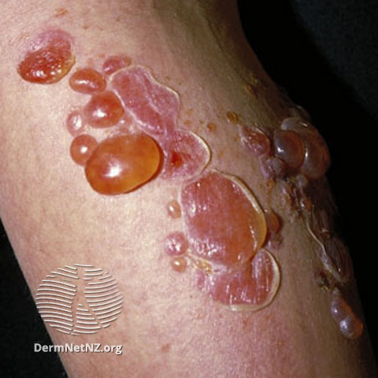
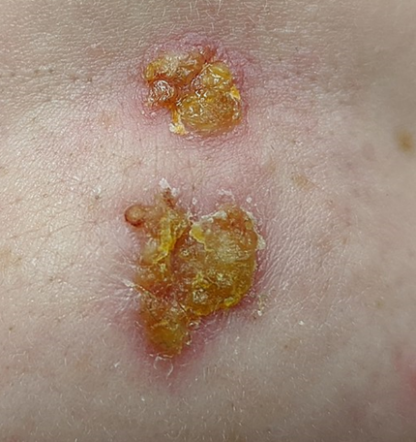
Impetigo background
Background
Clinical Scenario
Antibiotic Prescribing
Summary
Bullous impetigo
more common in <2yrs
Impetigo
Highly contagious, common bacterial infection of the skin
Annual incidence ~ 2.8% <4 years old, and 1.6% in 5–15 years old
Peak incidence in warmer weather
Incubation period 4 - 10 days
Typically Staphylococcus aureus, but also Streptococcus pyogenes
Meticillin-resistant Staphylococcus aureus impetigo increasing
Spread is by direct contact (with discharges from the scabs of an infected person) or indirect contact with a contaminated environment
Non-bullous impetigo
most common age 2-5yrs
James Heilman, MD
Notes:
Presenter talk
The first skin infection we will cover is impetigo. There are two distinct presentations: Bullous which are flaccid fluid filled vesicles and blisters, which rupture leaving a thin flat yellow/brown crust
And non-bullous where lesions begin as thin walled vesicles or pustules, they release exudate forming a characteristic golden/brown crust
Presenter notes
Although it can affect anyone, impetigo is most frequently observed in children. It is usually a mild condition and complications are rare. Cold sores can be mis-diagnosed as impetigo. Ask about (i) Recurrent episodes at the same site. (ii) Lesions may be preceded by discomfort, burning, tingling, itching, paraesthesia
Appearance: Crops of vesicles that rupture, leaving superficial ulcers that crust over and heal (usually without scarring)
Methicillin-resistant Staphylococcus aureus impetigo increasing (2)
Slide references
NICE CKS. Impetigo. 2022 [Available from: https://cks.nice.org.uk/topics/impetigo/.]
Galli L, Novelli A, Ruggiero G, Stefani S, Fortina AB. Pediatric impetigo: an expert panel opinion about its main controversies. Journal of Chemotherapy. 2022;34(5):279-85.
Image: Bullous Impetigo [Available from: https://dermnetnz.org/images/impetigo-images]
Image: Non-bullous impetigo - James Heilman MD – Creative commons

Slide 13
Impetigo Clinical Scenario
Background
Clinical Scenario
Antibiotic Prescribing
Summary
Impetigo
Video call with parent:
5year old daughter
Spot on her cheek over 3 days, 50p sized area
Several other yellow crusty lesions; other spots under chin
Otherwise well, no allergies.
You diagnose impetigo (non-bullous)
James Heilman, MD
Notes:
Presenter notes
If presenting this virtually we suggest having a mentimeter poll for all clinical scenarios
Ask the audience to consider the attached clinical scenario and possible treatment options
Slide references
Image: Non-bullous impetigo - James Heilman MD – Creative commons

Slide 14
Impetigo Clinical Scenario
Background
Clinical Scenario
Antibiotic Prescribing
Summary
Impetigo
What are your treatment recommendations?
Clarithromycin (oral)
Hydrogen peroxide cream
Flucloxacillin
Fusidic acid 2%
Tip: If antiseptic/ hydrogen peroxide not used this time,
can suggest at onset if future lesions
Notes:
This slide is animated, the correct answer will appear on the mouse click, and click again to reveal useful tip/information.
Presenter talk
There is two correct answers here: you could prescribe Hydrogen peroxide cream or Fusidic acid 2%.
The consideration of hydrogen peroxide is one of the biggest changes in the NICE guidance we discuss today. In the next few slides we will look at the prescribing guidance in more depth and why hydrogen peroxide is now recommended (for localised non-bullous impetigo).

Slide 15
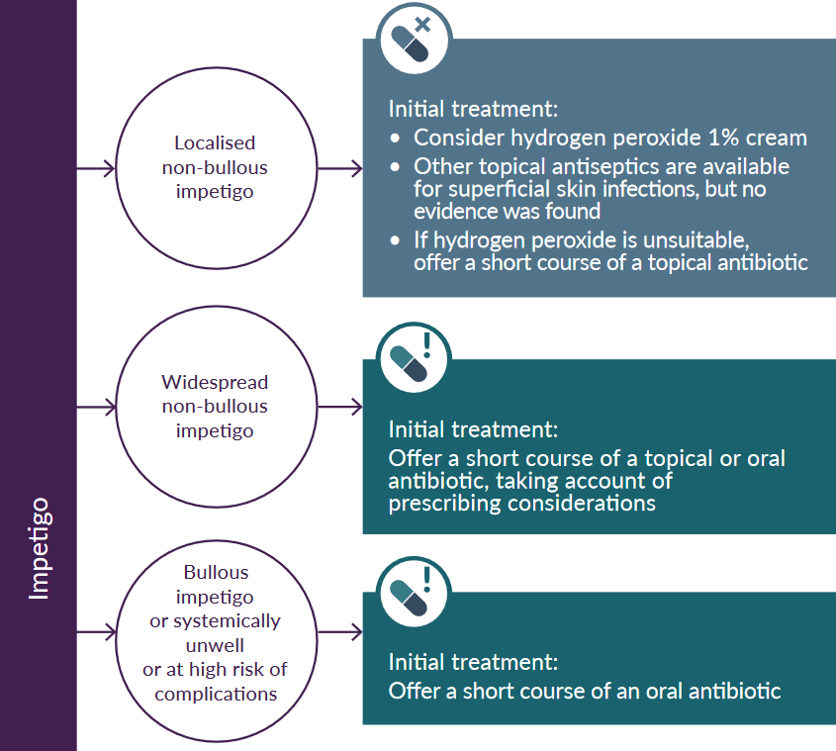
Treatment for localised non-bullous
Background
Clinical Scenario
Antibiotic Prescribing
Summary
Impetigo
(NICE NG 153, 2020)
Notes:
Presenter talk
Lets first look at the NICE prescribing guidance, the first scenario highlighted with the red circle is for localised non-bullous impetigo (the same as the clinical scenario example). The guidance states to consider hydrogen peroxide or if this is unsuitable then a topical antibiotic (e.g. Fucidin 2% cream).
Hydrogen peroxide has not previously been widely used therefore the next slide will look at the evidence and practical implications.
Presenter notes
One important note is this is a ‘consider recommendation’ (1): (NICE terminology, not as strong as offer see below for further info)
Further information – guideline wording
1.1.12 Consider hydrogen peroxide 1% cream for people with localised non-bullous impetigo who are not systemically unwell or at high risk of complications. Although other topical antiseptics are available for treating superficial skin infections, no evidence was found for using them to treat impetigo.
1.1.3 If hydrogen peroxide 1% cream is unsuitable, offer a short course of a topical antibiotic for people with localised non-bullous impetigo who are not systemically unwell or at high risk of complications [NICE NG153]
Further information - NICE terminology
(It is not mandatory to apply NICE recommendations, - the guideline does not override the responsibility to make decisions appropriate to the circumstances of the individual, in consultation with them and their families and carers or guardian)
Recommendation for
A strong recommendation is given when there is high-certainty evidence showing that the overall benefits of the intervention are clearly greater than the disadvantages. This means that all, or nearly all, patients will want the recommended intervention.
Recommendation against A strong recommendation against the intervention is given when there is high-certainty evidence showing that the overall disadvantages of the intervention are clearly greater than the benefits. A strong recommendation is also used when the examination of the evidence shows that an intervention is not safe.
Conditional recommendation for A conditional recommendation is given when it is considered that the benefits of the intervention are greater than the disadvantages, or the available evidence cannot rule out a substantial benefit of the intervention while assessing that the adverse effects are few or absent. This recommendation is also used when patient preferences vary.
Conditional recommendation against A conditional recommendation is given against the intervention when it is judged that the disadvantages of the intervention are greater than the benefits, but when this is not substantiated by strong evidence. This recommendation is also used when there is strong evidence of both beneficial and harmful effects, but when the balance between them is difficult to determine. Likewise, it is also used when patient preferences vary.
Consensus recommendation A consensus recommendation can be given for or against the intervention. This type of recommendation is used when there is not enough evidence to give an evidence-based recommendation, but the panel still regards it as important to give a recommendation.
Slide References
(1) NICE. Impetigo: antimicrobial prescribing [NG153], 2020. [Available from: https://www.nice.org.uk/guidance/ng153]

Slide 16
Evidence for hydrogen peroxide use
Background
Clinical Scenario
Antibiotic Prescribing
Summary
Impetigo
Topical fusidic acid 2% vs. Hydrogen peroxide cream 1% (both bd-tds for up to 21 days)
No significant difference for cure or improvement (S Koning, 2012)
Hydrogen peroxide does not lead to antimicrobial resistance
11.2% of MSSA and 23.1% of MRSA resistant to fusidic acid in 2021 (ESPAUR)
Other topical antiseptics - no studies found
Advice
Available OTC [Crystacide]
“should be prescribed on NHS ..due to high retail price”
Dry film will appear on the skin after application, can be washed off with water
Avoid contact with the eyes.
Do not use on large or deep wounds.
Do not apply to healthy skin.
Can bleach fabric
(1) https://www.prescqipp.info/our-resources/webkits/hot-topics/
Notes:
This slide is animated, click to make “Advice” section appear
Presenter talk
A 2012 Cochrane Review assessed the effects of treatments for impetigo (2).
Findings highlighted that topical antibiotics were as effective as oral antibiotics for the treatment of impetigo, and that topical fusidic acid (2% twice to three times a day for up to 21 days) was not significantly different to hydrogen peroxide cream (1% twice to three times a day for up to 21 days) in children with impetigo for cure or improvement (follow-up not reported; 1 RCT, n=256, 82.0% versus 71.9%, RR 1.14, 95% CI 1.00 to 1.31; moderate quality evidence).
Nor was there any significant difference in the number of children experiencing adverse events leading to withdrawal (1 RCT, n=256, 2.3% versus 0%, RR 7.00, 95% CI 0.37 to 134.16; low quality evidence) or the number of children with mild side effects (1 RCT, n=256, 7.0% versus 10.2%, RR 0.69, 95% CI 0.31 to 1.56; low quality evidence).
It is important to highlight here that hydrogen peroxide does not lead to antibiotic resistance. The ESPAUR report 2021-2022 highlights percentage of MSSA resistant to fusidic acid as 11.2% and MRSA as 23.1% (3)
Presenter notes
The alternative topical antibiotic if resistance to fusidic acid suspected or confirmed is mupirocin
When deciding which to prescribe, some practicalities to consider are (4):
Does hydrogen peroxide bleach skin? “Whilst hydrogen peroxide can bleach darker hair and skin. The NICE committee noted that there were no warnings in the BNF or BNFC regarding skin bleaching for hydrogen peroxide. They agreed that this wasn’t likely at a 1% concentration”
Avoiding contact with eyes – hydrogen peroxide may be less appropriate choice for toddlers & v young children who may be more likely to rub into eyes
Other topical antiseptics are available for superficial skin infections, but no evidence was found for using these on impetigo.
Reasonable to encourage antiseptic or Hydrogen peroxide at onset if future lesions
Hydrogen peroxide: approx £11-14 ; NHS cost £8.07/25g (generics may become available) Fucidin cream NHS tariff £2.74 /15g
Slide References
Prescqipp. Hot Topics: Hydrogen peroxide 1% cream for impetigo. [Available from: https://www.prescqipp.info/our-resources/webkits/hot-topics/.
Koning S, van der Sande R, Verhagen AP, van Suijlekom-Smit LW, Morris AD, Butler CC, Berger M, van der Wouden JC. Interventions for impetigo. Cochrane Database Syst Rev. 2012 Jan 18;1(1):CD003261. doi: 10.1002/14651858.CD003261.pub3. PMID: 22258953; PMCID: PMC7025440.
UK Health Security Agency. English surveillance programme for antimicrobial utilisation and resistance (ESPAUR), Report 2021-2022. 2022
NICE. Impetigo: antimicrobial prescribing [NG153], 2020. [Available from: https://www.nice.org.uk/guidance/ng153]

Slide 17
Treatment for bullous impetigo
Background
Clinical Scenario
Antibiotic Prescribing
Summary
Impetigo
(NICE NG 153, 2020)
Notes:
Presenter talk
Now on to the other types of impetigo:
To focus on the bottom circle: This is for bullous impetigo in people who are systemically unwell or at high risk of complications. The guidance here is to offer oral (or admit) as with all the common infection prescribing guidelines.
Now lets look at the prescribing considerations: next slide
Slide references
(1) NICE. Impetigo: antimicrobial prescribing [NG153], 2020. [Available from: https://www.nice.org.uk/guidance/ng153]

Slide 18
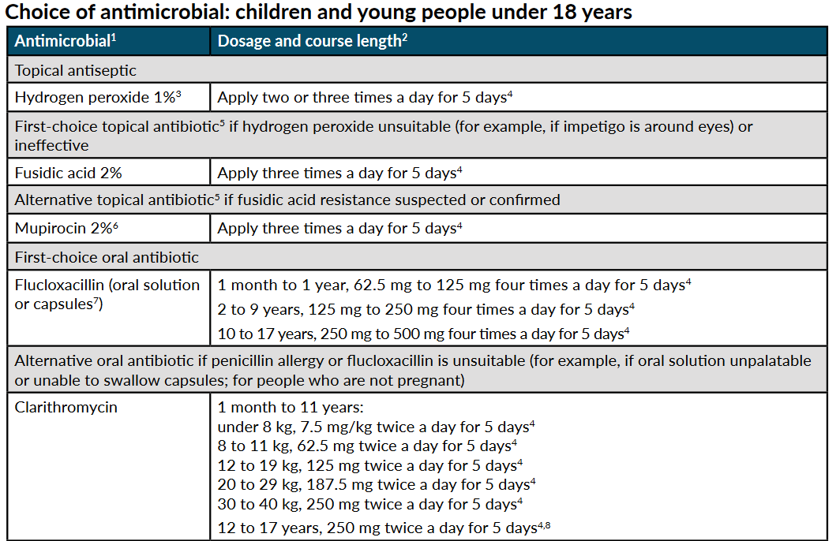

Impetigo NICE summary table
Background
Clinical Scenario
Antibiotic Prescribing
Summary
Impetigo
5 days
Frequent recurrence
Send a skin swab
Consider nasal swab & treatment for suppression.
(NICE NG 153, 2020)
Notes:
Presenter talk
This slide contains the NICE guidance summary table. We can see here the first line oral antibiotic is flucloxacillin for 5 days and the alternative antibiotic is clarithromycin if penicillin allergy.
Often children are not keen on the taste of flucloxacillin suspension. If child refuses to take then can follow NICE guidance for “if flucloxacillin is unsuitable” and offer clarithromycin
Note on the slide what to do if frequent recurrence of impetigo.
We don’t go into detail on suppression or decolonisation here but further information can be found on CKS - https://cks.nice.org.uk/topics/boils-carbuncles-staphylococcal-carriage/
Presenter notes
NICE Summary table of treatment choice.
5-day course is appropriate for most, can be increased to 7 days based on clinical judgement, depending on the severity and number of lesions
Slide references
(1) NICE (2020). "Impetigo: antimicrobial prescribing [NG153]." from https://www.nice.org.uk/guidance/ng153

Slide 19
Background
Clinical Scenario
Antibiotic Prescribing
Summary
Treatment for widespread bullous impetigo
Impetigo
(NICE NG 153, 2020)
Notes:
Presenter talk
The final type of impetigo is widespread non-bullous impetigo (middle circle). Notice the guidelines here say topical or oral antibiotic – NOT dual topical+oral
This is an important decision, that requires consideration. So how do we make the choice?
Slide references
(1) NICE. Impetigo: antimicrobial prescribing [NG153], 2020. [Available from: https://www.nice.org.uk/guidance/ng153]

Slide 20
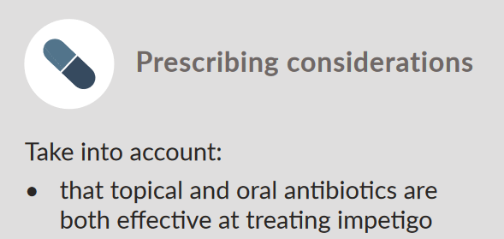



Widespread non-bullous
Topical or oral?
Background
Clinical Scenario
Antibiotic Prescribing
Summary
Impetigo
=
1. Consider the evidence
No statistically significant difference in effectiveness
2. Patient preference?
Topical likely less to cause side-effects
3. Effective administration?
Topical straightforward application for localised infection
AMR can develop rapidly with extended or repeated topical antibiotic
Notes:
This slide is animated, click to make red AMR text appear
Presenter talk
First we consider the evidence of the effectiveness of topical vs oral. And as previously stated, the 2012 Cochrane review highlighted no difference in outcomes between topical vs oral antibiotics.
Therefore we can factor in patient preference/side effects and the effective administration of topical antibiotics for a localised infection.
It is important to consider that AMR can develop rapidly with extended or repeated topical antibiotic – consider what the patient has been given previously
Presenter notes
Patient preference: Topical likely to cause fewer side effects, application usually straightforward for localised impetigo
Palatability & frequent dosing oral antibiotic liquids can be challenging .Paediatrician reported young children (e.g.6yrs) able to swallow tablets. Resources to support tablet swallowing https://www.medicinesforchildren.org.uk/helping-your-child-swallow-tablets (e.g. turning head to side, not backwards)
Evidence impetigo topical vs oral Effectiveness
Based on SR & MA Koning et al 2012 (1), a number of analyses found no statistically significant differences in clinical effectiveness (outcome - cure or improvement) but a large analysis was topical mupirocin vs oral erythromycin adults & children 10RCTs N=581 mod quality evidence. Another was Fucidin vs erythromycin babies lower quality evidence
ER evidence for route of administration of antibiotics for impetigo comes from 1 systematic review and meta-analysis (Koning et al. 2012), and 2 RCTs Al-Samman et al. 2014 (n=52) [IM Cef] (2) and Bowen et al. 2014 (non-inferiority trial; n=508)[cotrim vs IM.] (3).
Slide references
Koning S, van der Sande R, Verhagen AP, van Suijlekom-Smit LW, Morris AD, Butler CC, Berger M, van der Wouden JC. Interventions for impetigo. Cochrane Database Syst Rev. 2012 Jan 18;1(1):CD003261. doi: 10.1002/14651858.CD003261.pub3. PMID: 22258953; PMCID: PMC7025440.
Al-Samman, Dina K. Comparison of single-dose ceftriaxone versus seven days cefadroxil in addition to fucidic acid cream as adjuvant therapy for the treatment of children with impetigo. Pharmacie Globale. 2013;4(9).
Bowen AC, Tong SY, Andrews RM, O'Meara IM, McDonald MI, Chatfield MD, et al. Short-course oral co-trimoxazole versus intramuscular benzathine benzylpenicillin for impetigo in a highly endemic region: an open-label, randomised, controlled, non-inferiority trial. Lancet. 2014;13-19(9960):2132-40.

Slide 21
Impetigo – treatment for widespread non bullous
Background
Clinical Scenario
Antibiotic Prescribing
Summary
Impetigo
5 days
Frequent recurrence
Send a skin swab
Consider nasal swab & treatment for suppression.
(NICE NG 153, 2020)
Notes:
Presenter talk
For widespread non-bullous impetigo, topical antibiotics include fusidic acid 2% for 5 days or mupirocin 2% if resistance to fusidic acid is suspected/confirmed
Presenter notes
NICE Summary table of treatment choice.
5 days topical & oral . 5-day course is appropriate for most, can be increased to 7 days based on clinical judgement, depending on the severity and number of lesions
Do not offer combination topical+oral
Slide references
(1) NICE. Impetigo: antimicrobial prescribing [NG153], 2020. [Available from: https://www.nice.org.uk/guidance/ng153]

Slide 22
Background
Clinical Scenario
Antibiotic Prescribing
Summary
Impetigo antibiotic prescribing
Impetigo
New impetigo NICE guidance (aug 2020)
New impetigo NICE guidance (aug 2020)
Notes:
Presenter talk
Here we have prescribing data for the first line topical antibiotic (fusidic acid) and alternative topical antibiotic (mupirocin). This data has been given to us by the UKHSA antimicrobial prescribing team.
The line at August 2020 shows when the NICE guidance was published.
The initial drop in fusidic acid and mupirocin use was before the new guidance was published and therefore could be attributed to Covid-19. For fusidic acid we can see the number of items dispensed slowly start to rise again. This is a reminder that the guidance for localised non-bullous impetigo is to consider hydrogen peroxide as an alternative to the topical antibiotic and to keep prescribing rates lower. For mupirocin lower levels of prescribing have been maintained. A caveat for this data is we cannot solely attribute it to impetigo prescribing as it is data for all antibiotic items dispensed.
Presenter notes
Could perhaps highlight to audience that individuals can use fingertips public health data to look at prescribing in their area/practice “AMR local indicators”
Slide references
Data obtained from UKHSA antimicrobial prescribing team

Slide 23

Impetigo infection control advice
Background
Clinical Scenario
Antibiotic Prescribing
Summary
Hygiene
Exclusion Criteria
Impetigo
Condition is highly infectious:
Wash affected areas with soap and water:
  Wash hands regularly particular after touching a patch of impetigo
  Avoid scratching affected areas
  Avoids sharing towels
  Clean potentially contaminated toys and play equipment. [CKS]
  Children should be excluded from school nursery or childcare until:
  lesions are crusted and healed or
  48 hours after commencing antibiotic treatment [UKHSA]
  Food handlers are required by law to inform employers immediately if they have impetigo [CKS]
Direct patients to https://www.nhs.uk/conditions/impetigo/ for self care advice
www.rcgp.org.uk/TARGETantibiotics
Notes:
Presenter talk
One thing to take particular care with is the highly infectious nature of impetigo. It is spread by direct contact with discharges from the scabs of an infected person and the bacteria invade skin through minor abrasions and then spread to other sites by scratching. Infection is spread mainly on hands, but indirect spread via toys, clothing, equipment and the environment may occur.
Because of this there is specific infection control advice. This is highlighted on the slide. For healthcare workers there should be caution especially if working with v vulnerable/ immunocompromised people. And food handlers are to report to employers immediately, according to law.
Presenter notes
The exclusion advice will increase the enthusiasm for antibiotics vs antiseptic. Oral /topical antibiotic is not specified by UKHSA. UKHSA is not expected to alter this guidance.
Slide references
(1) UKHSA. Health protection in children and young people settings, including education 2023 [Available from: https://www.gov.uk/government/publications/health-protection-in-schools-and-other-childcare-facilities#impetigo.

Slide 24
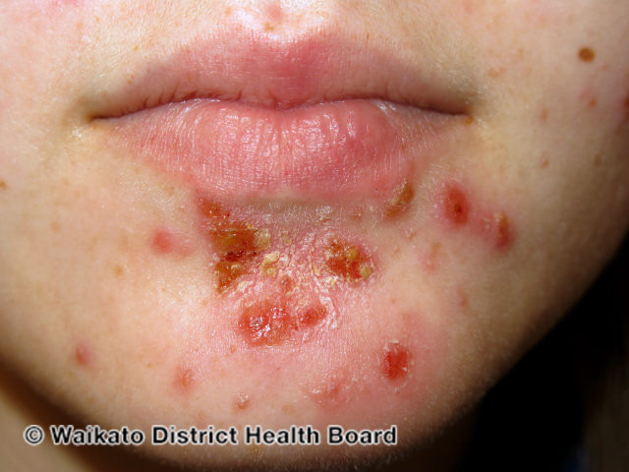
Impetigo NICE Guidance 153
Summary
Background
Clinical Scenario
Antibiotic Prescribing
Summary
Impetigo
Will you change your practice?
✓ Evidence supportive of topical antiseptic / hydrogen peroxide
✓ Antibiotic effectiveness: topical = oral
✓ Avoid extended or repeated use of topical antibiotics – risk resistance
! For Bullous impetigo – offer oral antibiotic
Rx Treatment course 5 days for most
IMPORTANT TO REMEMBER infection control and self-care advice!
Notes:
Presenter talk
That’s all for impetigo, to summarise the key points:
Evidence suggests no significant difference in use of hydrogen peroxide over topical antibiotics
The evidence also highlighted that topical antibiotics were as effective as oral antibiotics for the treatment of impetigo
Repeated use of topical antibiotics can lead to antimicrobial resistance
Offer an oral antibiotic for bullous impetigo
And most treatment course last 5 days for impetigo
Presenter notes
Discussion tips
What is the important gap between evidence and current practice?
Use of antiseptics is interesting, but oral = topical antibiotic for impetigo has better evidence and is important in terms of antimicrobial resistance & preserving the microbiome - or avoid repeated use Fucidin
Slide references
(1) Image: Impetigo [Available from: https://dermnetnz.org/images/impetigo-images]

Slide 25
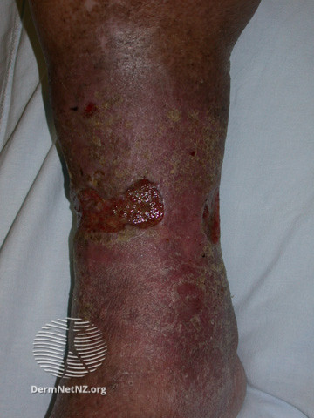
Leg ulcer background
Background
Clinical Scenario
Antibiotic Prescribing
Summary
Leg Ulcer
Prevalence estimated between 1.5 and 3 per 1,000 population (UK)
Classification includes: venous (~70%), arterial, mixed disease, other
Venous leg ulcers can take more than 2 weeks to heal and tend to develop on the inside of the leg, just above the ankle.
Assessment needed regarding sampling and prescribing
Notes:
Presenter talk
We will now move onto leg ulcers, our second condition.
Leg ulceration is mainly cause by venous inefficiency, making up 70% of leg ulcers. Other classifications are:
arterial -10% of leg ulcers
mixed disease - 15% of leg ulcers
less common causes - 5% of leg ulcers (2)
They can take a long time to heal and occur above the malleolus which differentiations them from a foot ulcer.
Presenter notes
There are a several different prevalence figures. The figure of between 1.5-3 per 1000 population was selected due to evidence from the references (1-3).
The recommendations signpost to relevant clinical guidelines or outline evidence-informed care to manage lower limb ulcers that will improve healing and optimise the use of healthcare resources
[Available from: https://www.nationalwoundcarestrategy.net/wp-content/uploads/2021/04/Lower-Limb-Recommendations-WEB-25Feb21.pdf]
Slide references
Adeyemi Adeyi SM, Indrajit Gupta,. Leg Ulcers in Older People: A Review of Management. British Journal of Medical Practitioners. 2009;2(3):21-8.
Agale SV. Chronic Leg Ulcers: Epidemiology, Aetiopathogenesis, and Management. Ulcers. 2013;2013:413604.
Nelson EA, Adderley U. Venous leg ulcers. BMJ Clin Evid. 2016;2016.
Image: Leg ulcer [Available from: https://dermnetnz.org/topics/leg-ulcer-images]

Slide 26
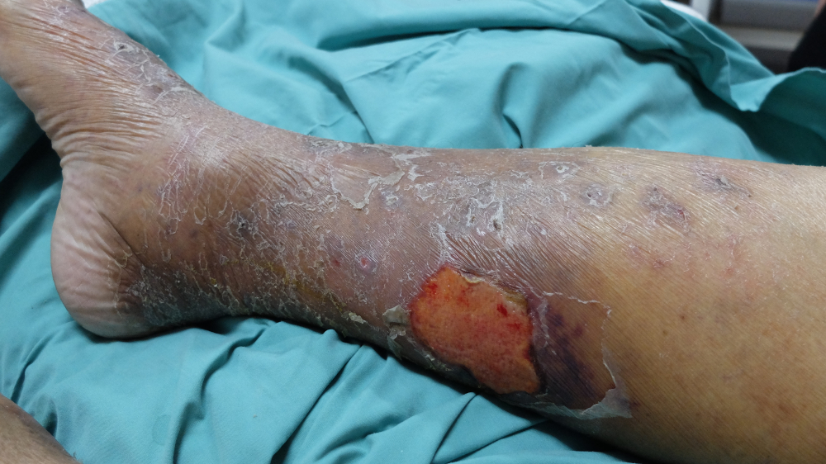
Leg Ulcer Clinical Scenario
Background
Clinical Scenario
Antibiotic Prescribing
Summary
Leg Ulcer
74 year old lady
Seen by the district nurse, who requests antibiotics
Leg ulcer at routine dressing, greenish discharge and characteristic odour
No other signs or symptoms
PMHx: Osteoarthritis, hypertension
What do you do?
www.rcgp.org.uk/TARGETantibiotics
Notes:
Presenter notes
Ask the audience to consider the attached clinical scenario and possible treatment options
PMHx – past medical history
Slide references
(1) Image: Leg ulcer [Available from: https://www.shutterstock.com/image-photo/leg-ulcer-secondary-cellulitis-preceeded-by-1106340626]

Slide 27
Leg Ulcer Clinical scenario
Background
Clinical Scenario
Antibiotic Prescribing
Summary
Leg Ulcer
What are your treatment recommendations?
Commence oral antibiotics immediately
Send swab sample and arrange review with results
Consider referral for IV antibiotics
Dress wound and arrange clinical review
The patient should be advised to monitor for redness or swelling, and any systemic upset and to contact for sooner follow up if this occurs.
Notes:
This slide is animated, the correct answer will appear on the mouse click
Presenter Talk
The correct answer is option 4 – the patient should be advised to monitor for redness or swelling, and any systemic upset and to contact for sooner follow up if this occurs.
So why do some leg ulcers not require antibiotic treatment?
Presenter notes
Discussion points:
Will you decline to prescribe if no documented signs/symptoms of infection?
Dressings – different dressings will alter the surface of an ulcer.
Antibiotics aim to target the deeper bacteria i.e. stop the ulcer getting deeper larger and more painful . A spreading cellulitis associated with an ulcer is most likely to be caused by staph & strep
No robust evidence has been identified to support the superiority of any dressing type over another for any type of leg wounds. Therefore, simple low-adherent dressings with sufficient absorbency are recommended as first line care but this recommendation does not replace clinical judgement and decision making in relation to the needs of the individual patient
Often cannot distinguish those patients who may benefit from silver or honey dressings although can be considered if standard dressings not leading to healing with other factors taken into account (elevation, control oedema and diabetes etc).

Slide 28
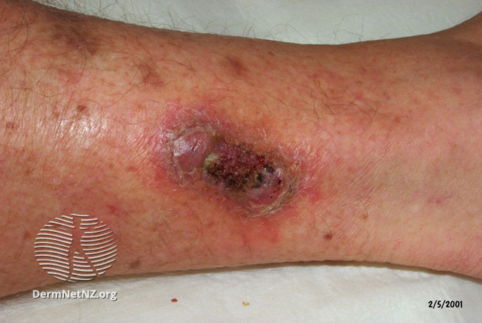
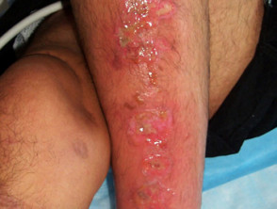
Few leg ulcers are clinically infected
Background
Clinical Scenario
Antibiotic Prescribing
Summary
Leg Ulcer
UNINFECTED ULCER
(minimal surrounding erythema)
INFECTED ULCER
DermNetNZ.org
Important to manage underlying conditions to promote healing
(E.g. venous insufficiency, oedema)
Only treat if symptoms / signs of infection:
Increased pain, fever, redness or swelling spreading beyond ulcer, localised warmth
www.rcgp.org.uk/TARGETantibiotics
Notes:
Presenter Talk
An important note is few leg ulcers are clinically infected, most are colonised. - Abx don’t promote healing if not clinically infected - Systemic antibiotics will not get to the surface of an ulcer as there is no mechanism for delivery into slough – antibiotics deal with bacteria invading into normal tissue that cause the ulcer to deepen, enlarge, produce inflammation etc
A need to treat underlying condition e.g. venous insufficiency & oedema
Optional:
Pseudomonas commonly causes colonisation – it has a characteristic fresh cut grass odour and a typical blue-green colour. Widespread in soil water /moist environments and hospital patients may be colonised at moist sites, such as ulcers
It tends to have a low virulence unless the host is compromised
Tends to be mild but HAI is more severe.
The clinical scenario example had this greenish discharge/characteristic smell however as pseudomonas is more commonly a coloniser - antibiotics will not promote healing if the wound is not clinically infected.
Presenter Notes
Many causes: There are various types of ulcers with different aetiology: pressure sores, diabetic foot ulcers, venous leg ulcers, arterial ulcers, autoimmune conditions such as pemphigus/pemphigoid. All ulcers are invariably colonised by a polymicrobial flora.
Ankle brachial pulse index (ABPI) (1)
Between 0.8 and 1.3 suggests no evidence of significant arterial disease .Compression may be safely applied in most people.
Greater than 1.3 may suggest the presence of arterial calcification, such as in some people with diabetes, rheumatoid arthritis, systemic vasculitis, atherosclerotic disease, and advanced chronic renal failure. For values above 1.5, the vessels are likely to be incompressible, and the result cannot be relied on to guide clinical decisions. Care must be taken in interpreting ABPI results in people with these conditions, as they may be misleadingly high [CKS]
Refer/specialist advice if more serious illness eg sepsis , necrotising fasciitis osteomyelitis consider if not responding to abx
Slide references
NICE. How should I interpret ankle brachial pressure index (ABPI) results? 2021. [Available from: https://cks.nice.org.uk/topics/leg-ulcer-venous/diagnosis/interpretation-of-abpi/]
Image: Uninfected ulcer [Available from: https://dermnetnz.org/topics/leg-ulcer-images]
Image: Infected ulcer [Available from: https://dermnetnz.org/topics/leg-ulcer-images]

Slide 29
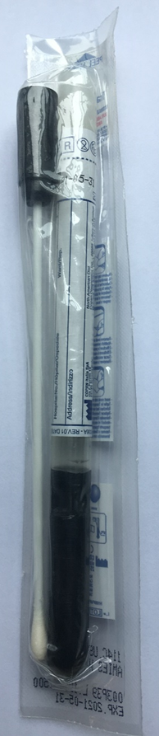

Do not swab leg ulcer at initial presentation
Background
Clinical Scenario
Antibiotic Prescribing
Summary
Initial presentation: Do not swab initially (non-diabetic people)
Worsening or not improving: Consider swab (after cleaning) if symptoms or signs of the infection
Leg Ulcer
HOW to…
When swabs taken from infected ulcers, they should be taken after cleansing and debridement
Notes:
Presenter talk
Advice is not to swab at initial presentation, however, if patient returns with leg ulcer that is not improving or worsening then consider a swab.
UK standards for microbiology investigations state that when swabs taken from infected ulcers, they should be taken after cleansing and debridement. If this is not done, the swab may detect bacteria from overlying polymicrobial slough (including pseudomonas), rather than the invasive causative organism invading normal tissue.
This will give false indication of infection and therefore lead to inappropriate antimicrobial prescribing.
However, GPs often receive swab results taken by others. In this case it is important to use clinical examination to assess if infected or not. Despite receiving a positive swab result.
Key message is to remember to look for signs of infection before prescribing
Slide references
(1) NICE. Scenario: Venous leg ulcers, 2021. [Available from: https://cks.nice.org.uk/topics/leg-ulcer-venous/management/venous-leg-ulcers/]

Slide 30
When to consider antibiotics for leg ulcers
Background
Clinical Scenario
Antibiotic Prescribing
Summary
Leg Ulcer
First line, as cellulitis flucloxacillin 500mg qds 7 days
because usually Staphylococcus aureus
(Penicillin allergy: clarithromycin or doxycycline)
It will take some time for a leg ulcer infection to resolve
Not expected until after antibiotic course completed
However, advise to seek medical help if condition worsens at any time, or does not start to improve within 2-3 days of starting treatment.
Offer an antibiotic for adults when there are symptoms or signs of infection (e.g. redness or swelling spreading beyond the ulcer, localised warmth, increased pain or fever).
When choosing antibiotics, consider:
Severity of symptoms or signs
Risk of developing complications
Previous antibiotic use
www.rcgp.org.uk/TARGETantibiotics
Notes:
Presenter talk
Antibiotics aim to target the deeper bacteria i.e. stop the ulcer getting deeper larger and more painful. A spreading cellulitis associated with an ulcer is most likely to be caused by staph & strep – therefore treat with flucloxacillin (500mg 7 days)
Give advice to seek medical help if symptoms or signs of infection:
• worsen rapidly or significantly at any time, or
• do not start to improve within 2 to 3 days of starting treatment
Be aware that it will take some time for a leg ulcer infection to resolve, with full resolution not expected until after the antibiotic course is completed. [NG152] -and therefore a further course of antibiotics may not be needed
Presenter notes
It is worth noting fluclox 500mg is not going to be adequate for very extensive cellulitis and IVs may be needed– follow NICE guidance for severe infection:
Co-amoxiclav 500/125 mg three times a day orally for 7 days
Cefuroxime 750 mg to 1.5 g three or four times a day IV
Further information - Very long standing ulcers that have failed to heal on treatment, might need to consider whether any underlying osteomyelitis
Slide references
(1) NICE. Leg ulcer infection: antimicrobial prescribing [NG152], 2020. [Available from: https://www.nice.org.uk/guidance/ng152]

Slide 31
Leg Ulcer NICE Guidance 152
Summary
Background
Clinical Scenario
Antibiotic Prescribing
Summary
Leg Ulcer
Will you change your practice?
✓ Few leg ulcers are clinically infected, most are colonised
✓ Important to manage underlying conditions to promote healing
✓ Initial presentation: Do not swab, even if it might be infected
! Antibiotics do not promote healing when not clinically infected
Rx Cellulitis flucloxacillin 500mg qds 7 days
www.rcgp.org.uk/TARGETantibiotics
Notes:
Presenter notes
To summarise:
- Few leg ulcers are clinically infected, most are colonised
- Important to manage underlying conditions to promote healing
- During initial presentation, NICE advices that you do not swab, even if it might be infected
Our take-home point is - Antibiotics do not promote healing when not clinically infected
And when a leg ulcer is infected treat with Cellulitis flucloxacillin 500mg qds 7 days
Slide references
(1) Image: Leg ulcer [Available from: https://dermnetnz.org/topics/leg-ulcer-images]

Slide 32
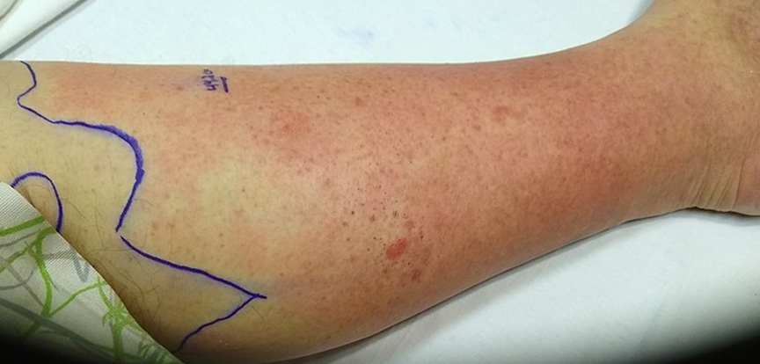
Cellulitis
Background
Clinical Scenario
Antibiotic Prescribing
Summary
Cellulitis
Acute bacterial infection of the dermis and subcutaneous tissue
Incidence 0.2 to 24.6 per 1000 person-years in different populations
Commonly Strep pyogenes and Staph aureus
Requires entry via disruption to the skin
Usually unilateral (and more commonly lower limb)
Most resolve with treatment, though recurrence is common
Risk factors
Skin trauma
Ulceration
Obesity
Notes:
Presenter talk
Cellulitis is the third and final condition we will be focussing on today.
NICE guidance groups both Erysipelas and cellulitis together. Erysipelas is a superficial infection, affecting the upper layers of the skin, while cellulitis affects the deeper tissues. They can overlap, so it is not always possible to make a definite diagnosis between the two.
We will refer to cellulitis throughout the webinar however treatment of erysipelas is the same.
Some background information of cellulitis includes: incidence rates (found to be between 0.2 and 24.6 per 1000 person-years (1,2)), causative bacteria include Strep pyogenes and Staph aureus, and infection occurs when bacteria enter via a disruption to the skin.
Slide references
Dalal A, Eskin-Schwartz M, Mimouni D, Ray S, Days W, Hodak E, et al. Interventions for the prevention of recurrent erysipelas and cellulitis. Cochrane Database Syst Rev. 2017;6(6):Cd009758.
NICE. Cellulitis – acute, 2023 [Available from: https://cks.nice.org.uk/topics/cellulitis-acute/.]
Image: Cellulitis – picture obtained with patient consent

Slide 33
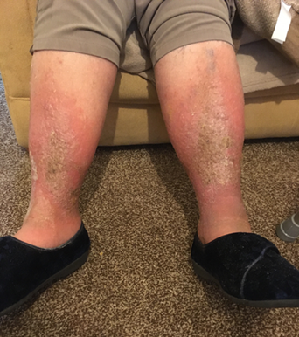
Background
Clinical Scenario
Antibiotic Prescribing
Summary
Cellulitis Clinical Scenario
Cellulitis
77 year old lady, contacted by carer:
Inflamed, painful, swollen lower legs, out of sorts and not eating much
Says had tablets 3 months ago for this
PMHx: Osteoarthritis, Hypertension
Penicillin allergy
No thermometer but doesn’t feel feverish, no shivers, aches or sweats
Has a BP monitor & agrees to check obs: Pulse 98/min , BP 146/73
Cellulitis in people with dark skin tones may present as a painful swollen area of skin with change in colour and altered texture
Notes:
This slide is animated, click for point on dark skin tones, and click again for the clinical scenario image
Presenter notes
Ask the audience to consider the attached clinical scenario and possible treatment options
Note on dark skin tones, language used for cellulitis such as “redness” is not always applicable
Slide references
(1) Image: Cellulitis mimic – picture obtained with patient consent

Slide 34


Background
Clinical Scenario
Antibiotic Prescribing
Summary
Cellulitis Clinical Scenario
Cellulitis
What do you do at this point?
Prescribe clarithromycin
Prescribe co-amoxiclav
Prescribe doxycycline
None of the above
What else might it be? Chronic conditions, usually bilateral: Varicose eczema/venous insufficiency, lipodermatosclerosis lymphoedema
Heart failure
(amlodipine, felodipine)
Notes:
Answer revealed through animation, and click again for discussion point
Presenter talk
To summarise, the question is for a 77yr-old, red painful swollen lower legs, malaise, obs normal
The answer is “None of the above” - no antibiotics at this point as uncertain diagnosis
Bilateral cellulitis is unlikely
Need further information to diagnosis
Presenter notes
Differential Diagnosis:
Unilateral swelling – DVT, Bakers cyst , thrombophlebitis
Chronic usually bilateral but if worse on one side, it may be difficult to exclude superimposed cellulitis (if it was cellulitis doxy or clarithro ok )
Slide references
(1) Image: Cellulitis mimic – picture obtained with patient consent

Slide 35
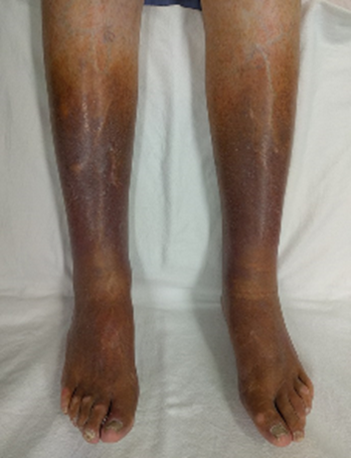
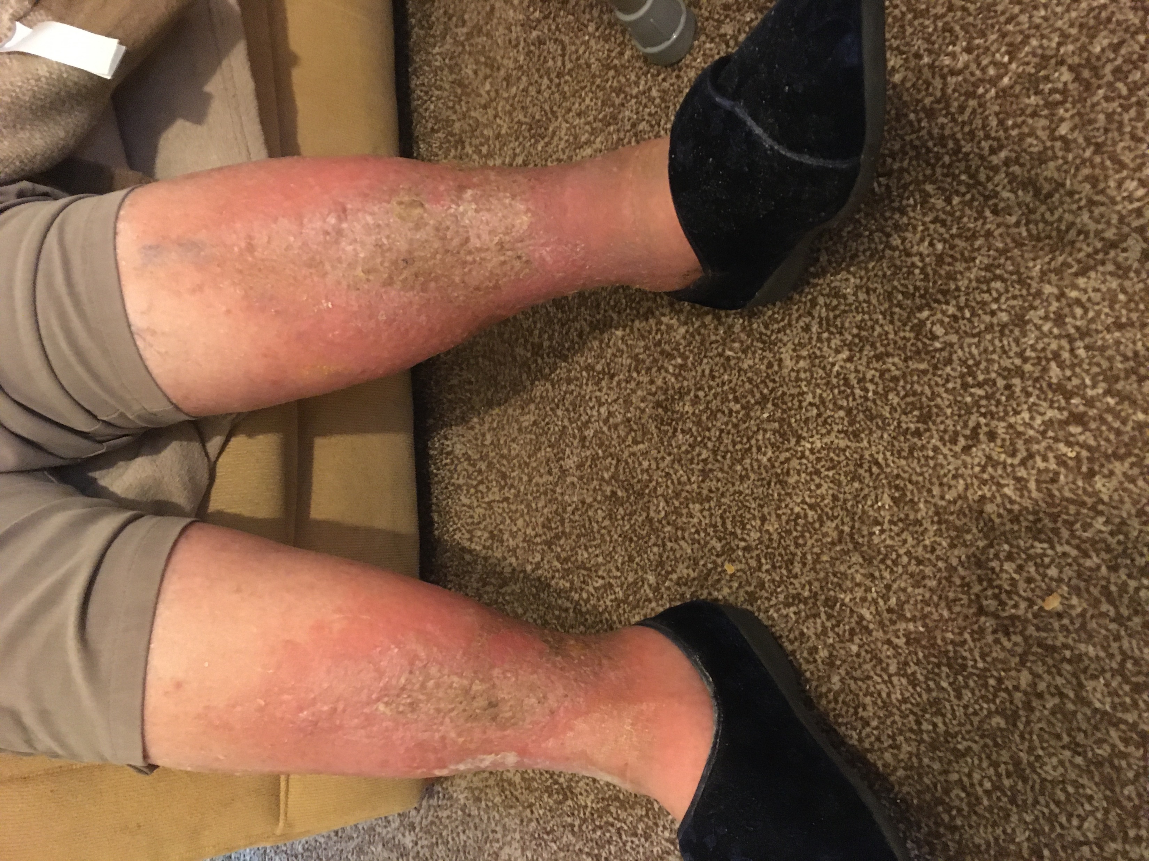

Conditions misidentified as cellulitis
Venous eczema and lipodermatosclerosis
Background
Clinical Scenario
Antibiotic Prescribing
Summary
Cellulitis
Venous skin changes can be caused by:
Venous insufficiency: due to venous valve incompetence or impaired calf muscle pump
Deep vein thrombosis: Can have unilateral presentation and be related to venous insufficiency
Examination, varying severity:
Hyperpigmentation (haemosiderin)
Venous eczema red, itchy, flaky, +/- pain, blisters, swelling
Lipodermatosclerosis from chronic inflammation and fibrosis:
  Acute lipodermatosclerosis (sclerosing panniculitis) - painful inflammation above ankles
  Chronic lipodermatosclerosis painful, hardened, tight, 'inverted champagne bottle
venous insufficiency
Advice:
Keep active, weight loss, leg elevation, emollient
Compression stockings (after ABPI)
Acute flares – topical corticosteroid
Notes:
This slide is animated, click for information on varying severity and click again for advice
Presenter talk
This slide highlights conditions often misidentified for cellulitis
Self care is important and advice includes elevation, keep physically active , weight loss if high BMI
And do not use compression stocking if active cellulitis (1)
Presenter notes
NHS website info excellent (2)
CKS varicose eczema/lipodermato (3)
DVT (4)
Venous insufficiency
Risks: Immobility, obesity, VVs, previous DVT
Symptoms: heaviness, aching, swelling, and itching, typically worse at end of day, relieved by leg elevation
DVT
Risks –previous DVT, cancer, >60yr old, obesity,
Symptoms: Unilateral localised pain, tenderness, skin changes, which include oedema, redness, and warmth, and vein distension.
Slide references
National Wound Care Strategy Programme. Recommendations for Lower Limb Ulcers. 2020. [Available from: https://www.nationalwoundcarestrategy.net/wp-content/uploads/2021/04/Lower-Limb-Recommendations-WEB-25Feb21.pdf]
NHS. Varicose eczema 2019 [Available from: https://www.nhs.uk/conditions/varicose-eczema/.
NICE CKS. Venous eczema and lipodermatosclerosis 2022 [Available from: https://cks.nice.org.uk/topics/venous-eczema-lipodermatosclerosis/.
NICE CKS. Deep vein thrombosis 2022 [Available from: https://cks.nice.org.uk/topics/deep-vein-thrombosis/.
Image: Cellulitis mimic – picture obtained with patient consent
Image: Venous Insufficiency - James Heilman MD – Creative commons

Slide 36


Cellulitis Clinical Scenario
Background
Clinical Scenario
Antibiotic Prescribing
Summary
Cellulitis
83-year old male:
A warm red swollen and painful left lower leg, and now covers a 15cm area
You notice a small abrasion on the side of his foot (he remembers he had knocked it in the garden)
O/E Temp 37.7
PMHx: Ischemic heart disease, atrial fibrillation, hypertension
Notes:
This slide is animated, click to reveal that an antibiotic should be offered
Presenter notes
Ask the audience to consider the attached clinical scenario and possible treatment options
Slide references
(1) Image: Cellulitis – picture obtained with patient consent

Slide 37
Cellulitis Clinical Scenario
Background
Clinical Scenario
Antibiotic Prescribing
Summary
Cellulitis
Clinical scenario answer
5-7 days recommended
A longer course (up to 14 days in total) may be needed based on clinical assessment.
Skin takes time to return to normal, full resolution at 5 - 7 days is not expected.
What antibiotic course length would you give?
5 days
7 days
10 days
14 days
Evidence
1RCT fluoroquinolone 5 vs 10days n=87
Notes:
This slide is animated, click to reveal answer, and click again for further information
Presenter talk
We have established that an antibiotic will be prescribed but what course length would be appropriate?
(In this case study the patient is not diabetic)
The answer is either 5 or 7 days. However a longer course may be recommended based on clinical assessment.
Presenter notes
Evidence for cellulitis course length
Five days versus 10 days of a fluoroquinolone
One systematic review (Kilburn et al 2010) included 1 RCT which compared 5 days of a fluoroquinolone (oral levofloxacin) with 10 days of a fluoroquinolone (oral levofloxacin) at the same daily dose.
Oral levofloxacin for 5 days was not significantly different to oral levofloxacin for 10 days for the outcome of ‘symptom free or reduced’ at end of treatment, 14 days follow-up (1 RCT, n=87, 97.7% versus 97.7%, RR 1.00, 95% CI 0.94 to 1.07; high quality evidence). (1)
Slide references
(1) Kilburn SA, Featherstone P, Higgins B, Brindle R. Interventions for cellulitis and erysipelas. Cochrane Database Syst Rev. 2010;2010(6):Cd004299.

Slide 38

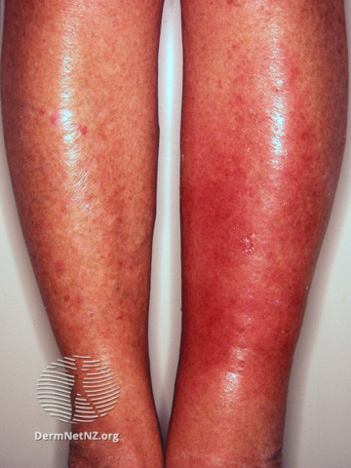
Diagnosis and risk factors
Background
Clinical Scenario
Antibiotic Prescribing
Summary
Usually unilateral. Bilateral leg cellulitis is rare.
Acute onset: red, painful, hot, swollen, and tender skin, that spreads rapidly, fever & malaise
Check for skin break/organism entry site e.g. wound/trauma, macerated skin, fungal skin infection, concomitant skin disorder
Cellulitis
Other Risk factors & comorbidities which may complicate or delay resolution of infection:
Oedema, venous insufficiency, obesity
Diabetes
Peripheral vascular disease
Immunosuppression
See CKS for further information
Notes:
Presenter talk
This slide is to help highlight signs and symptoms of cellulitis to aid with diagnosis and therefore appropriate antibiotic prescribing.
Also to highlight risk factors that may complicate the infection
Presenter notes
NICE doesn’t stratify treatment according to severity. (1)
Class I — there are no signs of systemic toxicity and the person has no uncontrolled comorbidities.
Class II — the person is either systemically unwell or systemically well but with a comorbidity (for example peripheral arterial disease, chronic venous insufficiency, or morbid obesity) which may complicate or delay resolution of infection
Class III — the person has significant systemic upset, such as acute confusion, tachycardia, tachypnoea, hypotension, or unstable comorbidities that may interfere with a response to treatment, or a limb-threatening infection due to vascular compromise.
Class IV — the person has sepsis or a severe life-threatening infection, such as necrotizing fasciitis
Consider underlying comorbidities (such as diabetes mellitus) that predispose to infection
Slide references
NICE CKS. Cellulitis - acute 2023 [Available from: https://cks.nice.org.uk/topics/cellulitis-acute/.]
Image: Cellulitis [Available from: https://dermnetnz.org/image-catalogue/bacterial-skin-infection-images?stage=Live]

Slide 39
Acute complications
Background
Clinical Scenario
Antibiotic Prescribing
Summary
Cellulitis
  Necrotizing fasciitis:
    Destructive, severe, rapidly progressive soft tissue infection
    Involves the deep subcutaneous tissues and fascia (and occasionally muscles), which is characterized by extensive necrosis and gangrene of the skin and underlying structures.
    Early symptoms – intense pain out of proportion to skin damage
    Group A streptococcus is a major causative agent in Type II necrotizing fasciitis.
    Rapid progression, skin discolouration , crepitus, bulla, gangrene
    Refer – IV antibiotics & surgical
  Myositis: inflammation of muscle due to infection.
  Sepsis (potentially fatal).
  Subcutaneous abscesses.
  Post-streptococcal nephritis
Notes:
Presenter talk
Here we highlight a range of acute complications of cellulitis
Slide references
NICE. Cellulitis - acute 2023 [Available from: https://cks.nice.org.uk/topics/cellulitis-acute/.]
CDC. Type II Necrotizing Fasciitis 2022 [Available from: https://www.cdc.gov/groupastrep/diseases-hcp/necrotizing-fasciitis.html#:~:text=Necrotizing%20fasciitis%20can%20affect%20any,accompanied%20by%20the%20following%20signs%3A&text=The%20pain%20experience%20by%20the,of%20the%20local%20skin%20infection.

Slide 40


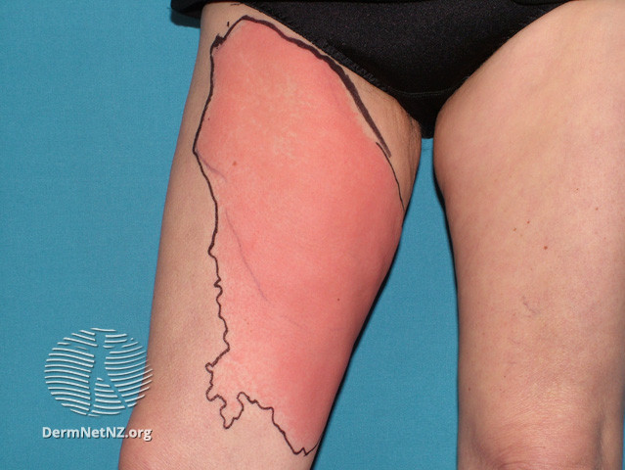




Cellulitis
Management
Background
Clinical Scenario
Antibiotic Prescribing
Summary
Cellulitis
Most common causative pathogens Streptococcus pyogenes and Staphylococcus aureus, therefore flucloxacillin first line
Consider swab if skin broken,
+ risk uncommon pathogen e.g.
Manage underlying conditions E.g. diabetes, venous insufficiency eczema and oedema
(calcium channel blockers)
Penetrating injury,
Exposure to water-borne organisms
Infection acquired outside UK
Consider marking extent with single-use surgical marker pen
Notes:
Presenter talk
For management of cellulitis you can (1):
Consider swabbing if there is evidence of a penetrating injury and risk of exposure to an uncommon pathogen (water-borne or infection acquired outside of UK)
Use a surgical pen to mark the outline of the extent of infection for future comparison
Manage underlying conditions
Presenter notes
Less common organisms include: beta haemolytic streps inc G (which can also cause necrotizing fasciitis), C occas and B, Streptococcus pneumoniae, Haemophilus influenzae, Gram negative bacilli and anaerobes
Risk for atypical organisms (2):
profound immunosuppression
animal or human bites
intravenous drug use (including skin-popping
sea or freshwater exposure (to broken skin) including pools and spas
exposure to animals, fish, or reptiles
Slide references
NICE. Cellulitis - acute 2023 [Available from: https://cks.nice.org.uk/topics/cellulitis-acute/.
Sullivan T, de Barra E. Diagnosis and management of cellulitis. Clinical Medicine. 2018;18(2):160-3.
Image: Cellulitis {Available from: https://dermnetnz.org/topics/cellulitis]

Slide 41
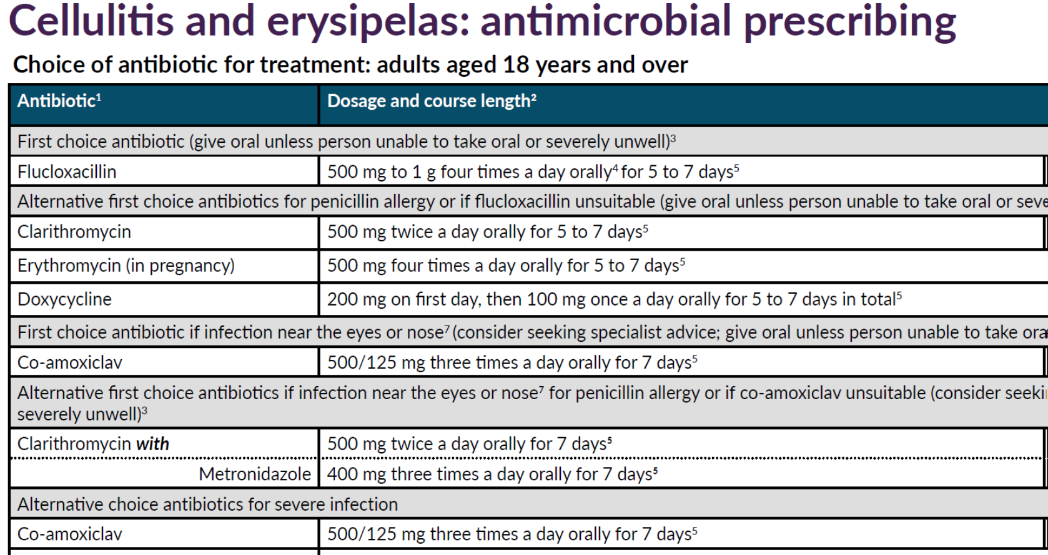
Background
Clinical Scenario
Antibiotic Prescribing
Summary
Cellulitis
(NICE NG 141, 2019)
Notes:
Presenter talk
Here we have the NICE summary table for cellulitis antimicrobial prescribing
As previously discussed Flucloxacillin (500mg 5-7 days) is the first choice antibiotic.
But alternative first choice antibiotics if penicillin allergy include clarithromycin, erythromycin and also doxycycline
If infection is near the eyes or nose there are different recommendations with first choice as co-amoxiclav or clarithromycin with metronidazole if penicillin allergy.
Presenter notes
Guideline rationale : “oral antibiotics should be used in preference to intravenous antibiotics where possible. Intravenous antibiotics should only
be used for people who are severely ill, unable to tolerate oral treatment, or where oral treatment would not provide adequate coverage or tissue penetration”
Remember to check the BNF for considerations if someone has renal/hepatic impairment. And consider prescribing differences for obese patients.
Slide references
NICE. Cellulitis and erysipelas: antimicrobial prescribing NG141 2019 [Available from: https://www.nice.org.uk/guidance/ng141.]

Slide 42
Seasonal flucloxacillin prescribing
Background
Clinical Scenario
Antibiotic Prescribing
Summary
Cellulitis
Winter months
Notes:
This slide is animated, click to highlight winter months
Presenter talk
Here we have antibiotic prescribing data for 5 different antibiotics. Flucloxacillin is in green and is the first choice antibiotic for cellulitis. The three alternative antibiotic choices are clarithromycin (dark blue), erythromycin (for pregnancy and in grey) and doxycycline (light blue). We also have co-amoxiclav data which is first choice for infection around the eyes and nose.
(click for animation) We can see quite a clear seasonal pattern for some of the antibiotics with flucloxacillin prescribing high in summer and doxycycline and clarithromycin high in winter. As with the impetigo data we cannot contribute this solely to cellulitis and so seasonal patterns are likely due to other conditions for the alternative antibiotics. And for the jump in winter 2022 likely due to a change in guidance for acute sore throats
However, it is important to highlight we want to preserve these antibiotics and use only when necessary, especially for macrolides such as clarithromycin which have high resistance rates as previously discussed.
Presenter notes
Could perhaps highlight to audience that individuals can use fingertips public health data to look at prescribing in their area/practice “AMR local indicators”
Slide references
Data obtained from UKHSA antimicrobial prescribing team

Slide 43

Safety netting advice
Background
Clinical Scenario
Antibiotic Prescribing
Summary
Cellulitis
Advice & reassessment:
• Skin will take time to return to normal after finishing the antibiotics
• Seek medical help/reassess if:
  - Worsen rapidly or significantly at any time,
  - Or do not start to improve in 2 to 3 days
  - The person is very unwell, has severe pain, or redness or swelling
Admit if they have any symptoms or signs suggesting a more serious illness or condition, such as orbital cellulitis, osteomyelitis, septic arthritis, necrotising fasciitis or sepsis.
Notes:
Presenter talk
This slide contains some safety netting advice to help with management.

Slide 44

Cellulitis NICE Guidance 141
Summary
Background
Clinical Scenario
Antibiotic Prescribing
Summary
Cellulitis
✓ Exclude other causes of skin redness & oedema
✓ Look for site of entry e.g. skin break
✓ Usually affects one limb, bilateral cellulitis is rare
! Manage underlying conditions
Rx First line - flucloxacillin (500mg/1g), 4 times a day, 5-7 days (up to 14 days)
Give prevention advice and advise that skin takes some time to return to normal after antibiotics finished
Notes:
Presenter talk
Finally to summarise the cellulitis key learning points:
- Exclude other causes of skin redness & oedema
- Look for site of entry e.g. skin break
- Usually affects one limb, bilateral cellulitis is rare
- It is important to manage underlying conditions
- And the first line antibiotic is flucloxacillin (500mg/1g), 4 times a day, 5-7 days (up to 14 days)
Presenter notes
Possible discussion points:
In your experience do people get repeated courses of antibiotic for cellulitis
Study BJGP by Teasdale (1) found approx. 2/3 people surveyed reported receiving no information about cause or prevention of recurrence. (also important to name condition)
Slide references
Teasdale E, Lalonde A, Muller I, Chalmers J, Smart P, Hooper J, et al. Patients’ understanding of cellulitis and their information needs: a mixed-methods study in primary and secondary care. British Journal of General Practice. 2019;69(681):e279-e86.
Image: Cellulitis {Available from: https://dermnetnz.org/topics/cellulitis]

Slide 45
Summary table
Condition | Course length | Footnote
Impetigo | 5 days | 5-day course is appropriate for most Can be increased to 7 days based on clinical judgement, depending on the severity and number of lesions
Leg Ulcer | 7 days | 7 day course of flucloxacillin is the first line guidance. It is important to manage underlying conditions to promote ulcer healing Antibiotics do not promote healing when not clinically infected
Cellulitis | 5-7 days | A longer course (up to 14 days in total) may be needed based on clinical assessment. However, skin does take time to return to normal, and full resolution at 5 to 7 days is not expected.
Notes:
Presenter talk
Here we have a short summary table for antibiotic course lengths.

