Slide 1
Common infections in extraordinary times
Decision points for remote management
General Practice and Out of Hours
Dr Tessa Lewis

Slide 2
Aims
Identify key decision points for remote management of common infections (ENT, COVID-19, cough, urinary infection, insect bites)
Identify people most likely to benefit from antibiotics
Recognise risk and cognitive bias (’something bad happening’)
Back-up prescribing – Practicalities
Notes:
Introduction – some of you will be experts at triage & remote consultation. Others quickly adapted to the new ways of working in March 2020. Inevitably you will be familiar with much what I’m covering but the aim is:
Provide opportunity to check ‘mind-lines’ (how you usually manage a condition) are up to date
Identify key decision points REMOTE Mx infections - people most likely to benefit from antibiotics
How we assess risk
How back-up prescribing can help
Before we look at specific conditions, I want to consider a couple of background issues. We are all increasingly familiar with the concerns of antimicrobial resistance - as are our patients and importance of reserving antibiotics for when we need them.
Consider E.coli, normally harmless commensal bacteria found in gut, however can be harmful in other body sites, urinary tract
E.coli is the commonest cause of UTI. If cystitis gets worse or patient has pyelonephritis, this can lead to E.coli Blood stream infection.

Slide 3
Question 1
Estimate the rate of E.coli blood stream infections, which are resistant to co-amoxiclav
0-10%
11-20%
21-30%
31-40%
Over 40%
Notes:
Question 1: E.coli bloodstream infections: estimate % resistant to co-amoxiclav.
Take a moment to note down your estimate

Slide 4
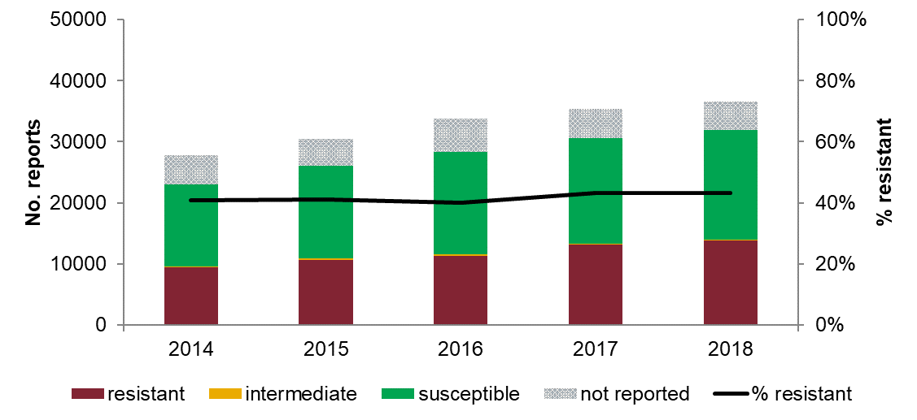
Q1: Answer & Rationale
Estimate the rate of E.coli blood stream infections, which are resistant to co-amoxiclav
0-10%
11-20%
21-30%
31-40%
Over 40%
E. coli isolates from blood resistant to co-amoxiclav, England, 2014-2018
43%
Public Health England (PHE). (2018). Antimicrobial resistance quarterly surveillance: March 2018.
Notes:
Bloodstream infection (BSI) still increasing – both rate of BSI and % resistant to at least one key antibiotic
Graph: x-axis = bars from years 2016-18; y-axis =no. reports; black line = % E.coli BSI resistant to co-amoxiclav
Rate E.Coli BSI resistant to co-amoxiclav 43% is striking
E.Coli resistance co-amoxiclav: lab-MSU 20 % (varies by locality 10.8 - 30.7%)
That is why co-amoxiclav is no longer first line recommended for pyelonephritis currently – may change in time / inevitable later
Mx UTI, especially recurrent UTI, key to reducing antimicrobial resistance / BSI

Slide 5

Why do we prescribe antibiotics?
Relief of symptoms
Worry about complications/more serious illness
Patient pressure
The Patient Perspective 2017 n=249
Why they visited GP with RTI (not cold/runny nose)
Advice: self care & relief of symptoms, 25- 35%
Worry: more serious illness
Expecting antibiotics 38%
Cause & duration
ASK EARLY Patient’s concerns, purpose of call
Notes:
Patient perspective survey McNulty 2017:
Easy for us to assume patients want antibiotics
Why do patients visit and what do they expect?
Many looking for advice on self care and symptom relief, 38% expecting antibiotics
Some looking for cause & duration
A proportion worried about more serious illness
People have increased aware of antimicrobial stewardship concerns
Ask early about patient concerns

Slide 6

Challenges in Practice:
AMS vs Sepsis
Spectrum of illness & risk
LOW RISK
HIGH RISK
Young adult
Fit and well
Symptoms - recent mild
Signs - none
Age extremes
Comorbidities
Polypharmacy
Recent admission
Recurrent illness
Social circumstances
Condition-specific considerations
Remote Assessment V4
Notes:
Perception of risk
The challenge for primary care is concerns of both antimicrobial stewardship and Sepsis
Primary care staff can be considered risk managers. People at one end of the spectrum fit and well, others are high risk. Both extremes relatively straightforward: observe/treat/admit
In middle area of uncertainty
Can’t assume hospital is safest option, (even before COVID-19 - older person out of their normal environment, falls, definitely increase resistant infections)
Can feel ‘safer’ route of ‘doing something’ and giving antibiotics, as well as risking antimicrobial resistance, could cause diarrhoea, incontinence, dehydration, acute kidney injury (AKI)
Uncertainty in between often red/amber area that is the most challenging for decision-making: decision fatigue
Uncertainty can be narrowed. Confidence in the evidence help identify who is at high risk for bacterial infection and who is at high risk for resistant infection

Slide 7

Challenges in Practice:
AMS vs Sepsis
Spectrum of illness & risk
LOW RISK
HIGH RISK
Young adult
Fit and well
Symptoms - recent mild
Signs - none
Age extremes
Comorbidities
Polypharmacy
Recent admission
Recurrent illness
Social circumstances
Condition-specific considerations
SIGNS Home readings
Temp, pulse, BP, blood glucose, PFR
Oximetry: Caution – don’t use smart-phone apps
Notes:
Risk spectrum COVID-19 remote consultation
Most of these risk factors can be assessed from the persons record & over the phone
But COVID-19 pandemic it is the SIGNS which are more difficult
SIGNS Home readings:
Temperature, pulse, blood pressure, blood glucose, PFR [Greenhalgh T, et al. BMJ 2020; 368 :m1182]
Oximetry: Caution – [CEBM] smart-phone apps - not reliable

Slide 8
Tips for telephone consultations
Begin the conversation
Establish who you are talking to and purpose of call
Check
Safety netting
Specific advice
• Persisting or worsening symptoms e.g. SoB
• Stay at home advice
• Where to seek help
Establish if COVID-19 is suspected
Symptoms
Telephone appropriate?
Duration of illness short
No red flags
Diagnosis is clear
Home readings
Medication
Symptoms of deterioration
Existing conditions
Remote May be appropriate where the patient’s clinical or treatment request is straightforward [GMC]
Face to face Diagnostic uncertainty about cause or severity
Several remote assessments for same problem * Shared decision
Stockley S and Neighbour R (RCGP). (2020). Top 10 tips for COVID-19 telephone consultations.
Hazell T et al. (RCGP). (2020). Coronavirus - Top 10 tips on what to do in primary care
Greenhalgh T, et al. BMJ 2020; 368 :m1182
Notes:
Telephone triage
Establishing purpose early: Clinical assessment, Reassurance, Referral, Certificate, Advice on self-isolation
Deciding on remote vs face to face
Remote “may be appropriate where the patients clinical or treatment request is straightforward” [GMC]. Similarly Face to face - Diagnostic uncertainty about cause or severity [Stockley and Neighbour (RCGP) (2020)]
Shared decision making principles should ideally be used when deciding whether a face to face appointment is needed. GP will also have to take into account the resources available to them and how important it is to reduce footfall (this may vary depending on local COVID-19 prevalence).
Several remote assessments for same problem [Hazell et al. (RCGP) (2020)]. Has the patient had several phone or video appointments for the same option? If so then they probably need to be seen in person.
Medico-legally clinical staff need to be able demonstrate that satisfactory assessment and decision making has taken place. If you aren’t sure, it would be better to see the patient face to face [Hazell et al. (RCGP) (2020)]
If you do have to call people in, take the full history remotely whenever possible to minimise patient and clinician exposure [Tessa Lewis]

Slide 9
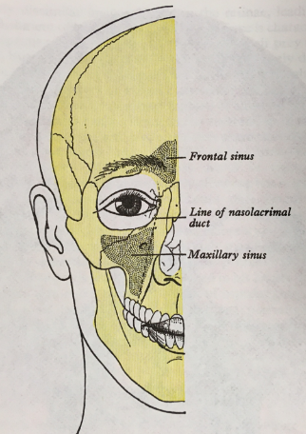

Sinusitis
Question 2
  Sinusitis is a common diagnosis accounting for approx. 8% antibiotic prescriptions
What percentage of acute sinusitis infections are viral?
    30%
    50%
    70%
    over 90%?
Smieszek, T., et al. (2018). DOI: 10.1093/jac/dkx500
https://www.nice.org.uk/guidance/ng79
Notes:
Question 2: Acute sinusitis
Thanks to committee who volunteered to identify key messages
Estimate the percentage
Percentage viral estimate 98% in EARLY phases according to NICE evidence review
Studies suggest 8% of antibiotic prescribing is for sinusitis (Smieszek et al. 2018). High for a condition that is largely viral and where antibiotics make little difference

Slide 10

Remote Assessment
Sinusitis
  * Common cold
  Allergic rhinitis
  Nasal foreign body
  Dental pain
  Sinonasal tumour
  Migraine
  Giant cell arteritis
  Temporomandibular joint dysfunction
  Neuropathic or atypical facial pain.
  Is it really sinusitis?
  Other causes for facial pain symptoms
Notes:
Differential diagnosis:
Acute sinusitis - usually triggered by a viral URTI.
A lot can get put down to sinusitis , remote - Important to get the history of preceding URTI consider alternative diagnoses (Many patients have had previous Rx antibiotics - but would have got better anyway)
Personally I find TMJ quite common cause for facial pain – remotely ask patient to put hand on jaw joint & open mouth – leads to discussion of teeth grinding & stress.

Slide 11
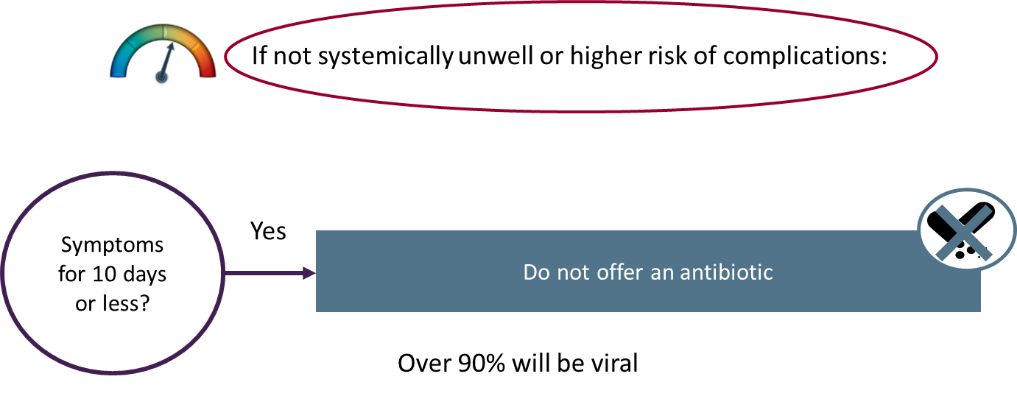
Sinusitis (Acute)
NICE Guidance 79
Coronavirus (COVID-19) General Practice & Out of Hours
Notes:
Less than 10 days: left side/low risk on risk meter/spectrum
All managing common infections guidelines: Identify (the people who are at the red end of our risk meter ) people systemically very unwell, have symptoms & signs of a more serious illness or condition, or are at high risk of complications. [NICE REC 1.1.8]. Offer an immediate antibiotic prescription… or further appropriate investigation
Risk spectrum – condition-specific risk, <10days is very low
People symptoms around 10 days or less, Do not offer an antibiotic prescription. [NICE REC 1.1.1] - more likely to be associated with a cold rather than viral or bacterial acute sinusitis.

Slide 12
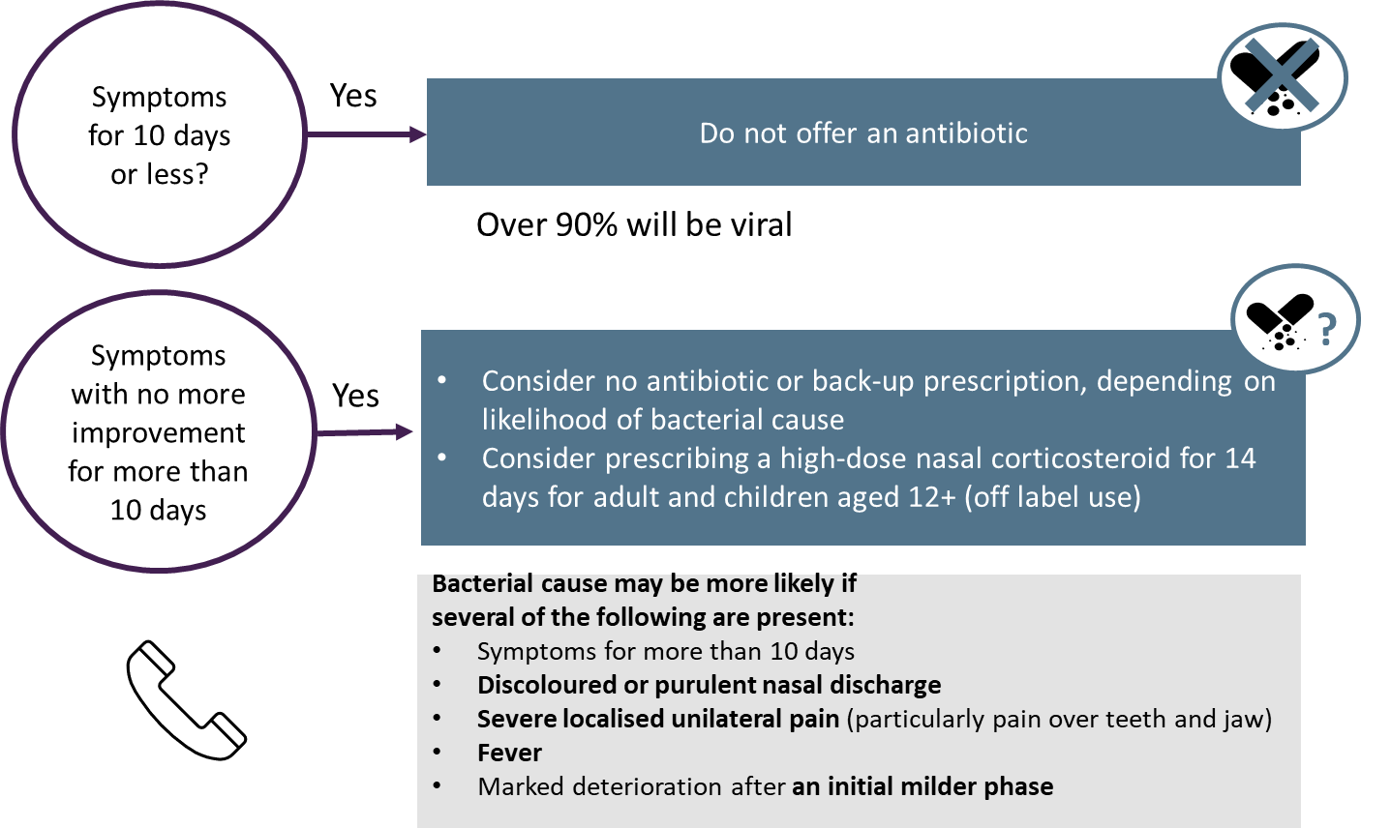
Sinusitis- Acute
NICE Guidance 79
mometasone 200 mcg bd
fluticasone 110 mcgs bd
Notes:
Over 10 days - Middle of risk meter
People with symptoms over 10 days
Consider no antibiotic or back-up antibiotic prescription, depending on likelihood of bacterial cause
Bacterial cause may be more likely if
Symptoms for more than 10 days
Discoloured or purulent nasal discharge
Severe localised unilateral pain (particularly pain over teeth and jaw)
Fever
Marked deterioration after an initial milder phase

Slide 13

Question 3
Acute Sinusitis:
What is the recommended first choice antibiotic?
(Select one)
a) Amoxicillin
b) Co-amoxiclav
c) Phenoxymethylpenicillin
d) Doxycycline
Notes:
High dose nasal corticosteroid 2 weeks vs placebo
High dose Intranasal steroids, stat sign, unclear if clinically important. NNT 17 for 1 additional person with acute sinusitis improved or resolved symptoms
Tip if you’re recommending them, blow nose before using
Medicines used not licensed for acute sinusitis, so off label: high dose mometasone [Nasonex] 200 micrograms bi-daily fluticasone 110 micrograms bi-daily

Slide 14

Sinusitis (Acute)
Antibiotic Choice
Evidence
Antibiotic vs. placebo
NNT: 7-21 days depending on the outcomes
Little effect on illness duration
Harms: NNH
All adverse effects: 8-11
Diarrhoea: 18
Symptoms last 2-3 weeks
Severe complications 1:32 000 (otherwise healthy adults)
Notes:
Antibiotic recommendations: symptoms >10days
Penicillin first line narrow-spectrum first choice (reflecting high proportion viral/strep)
Co-amoxiclav if more unwell or higher risk , doxy penicillin allergy
5 days , shorter course than previously recommended
At 2 weeks half resolved , ¾ improved. Placebo. Lasts 2-3wks
Abx vs placebo. Where statistically significant benefits, NNT ranged between 7 -21 depending on the outcomes considered, little effect on the duration of illness
Adverse Effects Antibiotics significantly more adverse events than placebo. (NNH) 8- 11 for all Adverse effects, approx 18 for diarrhoea.
Summary acute sinusitis
Acute sinusitis comfortably done over the phone - need the history of URTI to support diagnosis
Symptoms last 2-3 weeks, complications are v. rare
Shared decision making if patient undecided

Slide 15

Cognitive Bias & Assessing Risks
Availability bias
Stories from the media or friends easily come to mind
Probability neglect
The amount of concern is not adequately sensitive to the probability of harm.
Hindsight bias
Hindsight is great!
(It can be very difficult to reset the scenario once the outcome is known)
Notes:
Cognitive bias and assessment of risk
Thinking, fast and slow Daniel Kahneman
consider how our cognitive biases can alter our perception of risk and uncertainty
Availability bias. Stories from experience/media or friends (sepsis, clostridium or superbugs) easily come to mind. Alter our & our pts enthusiasm for antibiotics. Don’t alter underlying stats
Availability bias, COVID-19 high in our minds, remember alternative diagnoses
‘Probability neglect’ - concern not adequately sensitive to probability of harm.
easy to ignore the many uneventful scenarios and important to know the actual risk of something bad happening. E.g. acute sinusitis Dutch study (Hansen et al. 2012), severe complications estimated 1:12,000 children, 1:32,000 adults otherwise healthy. [guideline]
Hindsight bias : [We also don’t have the benefit of hindsight, … an appropriate assessment & decision can be made but the patient’s condition may still deteriorate. Daniel Kahneman in his book outlines how it can be very difficult to reset scenario once you know the outcome.
We have had CMO letters letter to support appropriate prescribing,
NICE NG15 “Encourage and support prescribers only to prescribe antimicrobials when this is clinically appropriate.”
Current challenge - normal times, face to face very easy to document set of observations – brings discussion back to whether or not to assess remotely & highlights Importance of safety netting

Slide 16
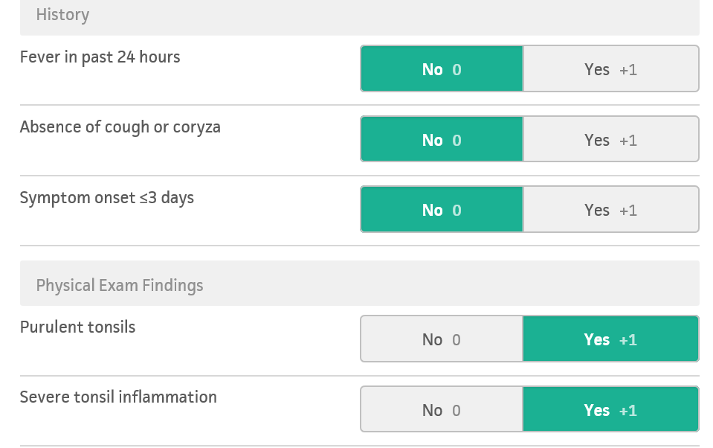
Sore Throat
Use a score e.g. FeverPAIN or Centor
Only examine oropharynx of children if essential [RCPCH] *Use PPE
Sore throat may be a symptom of COVID-19 . Ask about high temperature, a new continuous cough, a loss of, or change to, sense of smell or taste
Notes:
Sore throat
Sore throat may be a symptom of COVID-19 or flu-like illness. Once you have asked about COVID-19 test results & symptoms, & excluded COVID-19 as cause, (high temperature, a new continuous cough, a loss of, or change to, sense of smell or taste)
Sore throat is predominant symptom, assess whether likely to be strep sore throat.
Non-pandemic times NICE - Use criteria for Centor/ FeverPain (UK based >3yrs) *desktop calculator/ Medcalc. Mini-audit - No calculator -cough missed (important part of viral picture- cough runny nose & sore throat)
Advice – only examine throat if essential, (transmission risk including asymptomatic), Use PPE including visor
Remote - parental description / start with score of 2

Slide 17

Sore Throat
Remote Assessment
FeverPAIN remote assessment
Consider using parental description (do not actively encourage parental examination)
If tonsil appearance unknown, consider starting with a feverPAIN score of 2
Remember
Most people feel better after 1 week, with or without antibiotics
Withholding antibiotics is unlikely to lead to complications
Notes:
FeverPAIN 4/5 Immediate or back-up
Lasts about a week +/- antibiotics
Course length ? Normally 5 days…10 days - increased biological cure e.g. recurrent
Most people feel better after 1 week, with or without antibiotics.

Slide 18

Sore Throat
NICE guidance can then be followed
FeverPAIN score
4 or 5
Consider an immediate antibiotic or a back-up antibiotic prescription
5 days of phenoxymethylpenicillin may be enough for symptomatic cure;
10-day course may increase the chance of microbiological cure e.g. in recurrent tonsillitis
Recommended
duration of treatment?

Slide 19

Otitis Media in Children
Remote Assessment Decision Points
Recurrent episodes?
2 Age under 2 years?
Discharge perforation or otitis externa?
2 ears- bilateral (may be difficult to identify remotely in a toddler)
STAR Severity systemic upset, vomiting
WARS Pain despite adequate analgesia- dose based on weight
R2-D2
Notes:
Otitis Media
Difficult & careful over the phone in a younger child/ Remote diagnosis of OM especially in <2yrs may be difficult, judgement individual case of confidence/ need to see face to face particularly if systemically unwell
What are your decision points that alter management? Pause
Very unpleasant– important to check adequate analgesia (NICE – paracetamol & ibuprofen)
Remotely - can establish discharge, recurrent, bilateral,
People most likely to benefit from antibiotics <2yrs , discharge, bilateral & systemically unwell

Slide 20


Otitis Media in Children
NICE Guidance 91
Children and young people with acute otitis media and otorrhea
Children under 2 years with acute otitis media in both ears
Groups who may be more likely to benefit from antibiotics
Severity systemic upset, vomiting
Pain despite adequate analgesia- dose based on weight
Offer an immediate antibiotic
systemically very unwell,
symptoms & signs of more serious illness
high risk of complications.

Slide 21
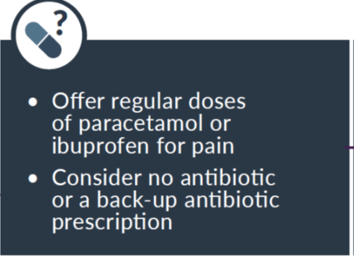
Otitis Media in Children
Evidence on antibiotics
Antibiotics make little difference to:
  The number of children whose symptoms improve
  The number of children with recurrent infections, short-term hearing loss or perforated ear drum
Complications such as mastoiditis are rare with or without antibiotics
Age over 2, no otorrhoea
Notes:
Otitis media over 2 years old
Over 2year olds – analgesia +/- back-up prescription
lasts 3-7 days
Think of our cognitive biases NNT mastoiditis >4000

Slide 22
COVID-19: Assessing Breathlessness & Severity by Phone or Video
A good history is important (evidence-cov.id/assess-dyspnoea)
1. Ask the patient to describe their breathing in their own words, and assess the ease and comfort of their speech. Ask open ended questions and listen to whether the patient can complete their sentences:
2. Align with the NHS 111 symptom checker, which asks three questions (developed through user testing but not formally evaluated ):
3. Focus on change.
A clear story of deterioration is more important than whether the patient currently feels short of breath.
4. Interpret the breathlessness in the context of the wider history and physical signs. For example, a new, audible wheeze and a verbal report of blueness of the lips in a breathless patient are concerning.
Are you so breathless that you are unable to speak more than a few words?
Are you breathing harder or faster than usual when doing nothing at all?
Are you so ill that you've stopped doing all of your usual daily activities?
Is your breathing faster, slower, or the same as normal?
What could you do yesterday that you can’t do today?
What makes you breathless now that didn’t make you breathless yesterday?
Caution
COVID-19 results
How is your breathing today?
Notes:
Cough, breathlessness & pneumonia
Reminder that COVID-19: Continuous means coughing a lot 1+ hour, or 3+ coughing episodes/ 24 hours
Assessing cough & shortness of breath / Assessing severity
These tips helpful from March 2020 Trisha Greenhalgh useful:
- open ended & listen complete sentences How is your breathing today –
ASK /=NHS 111 - Are you breathing harder or faster than usual when doing nothing at all?”
“Are you so ill you've stopped doing your usual daily activities?”
Change: Is your breathing faster, slower, same as normal?”
“What makes you breathless now that didn’t make you breathless yesterday?”
Often have COVID-19 results available. Beware negative results

Slide 23

Assessing Severity
[NICE NG165] Usual physical examination will be limited during COVID-19.Suspect community-acquired pneumonia of any cause (adult) if:
temperature above 38ºC
respiratory rate above 20 breaths per minute
heart rate above 100 beats per minute
new confusion.
The Oxford COVID-19 evidence service team advised:
Auscultation reserve for those where it is crucial to decision making.
Roth score to assess breathlessness over the phone, does not provide an accurate assessment of hypoxia
Notes:
Assessing severity
NICE COVID rapid guideline: recognises physical examination will be limited,
Diagnose Comm Acquired Pneumonia on basis of pyrexia 38 [patient reported temperature or from symptoms of sweats rigors aches] RR over 20, HR over 100, new confusion
NICE: Where pulse oximetry is available use oxygen saturation levels below 92% (below 88% in people with COPD) on room air at rest to identify seriously ill patients
WHO give oxygen if sats <90%; Severe pneumonia fever cough RR >30 & sats <90
Oxford EBM generally advise listening to the chest & blood pressure should be reserved for those where it is crucial to decision making.

Slide 24

Cough & Pneumonia During COVID-19
Severity Scores & Red Flags
Roth score [CEBM ]
CRB65 [NICE NG165]
Confusion, RR over 30, BP, age over 65
not validated in people with COVID-19.
Requires BP -may be difficult/undesirable during pandemic
risks cross-contamination
Red flags [NICE NG165]
Severe shortness of breath at rest or difficulty breathing
Coughing up blood
Blue lips or face
Feeling cold and clammy with pale or mottled skin
Collapse or fainting (syncope)
New confusion
Becoming difficult to rouse
Little or no urine output.
Notes:
Cough & pneumonia, in terms of scores and red flags
Red flags – as you’d expect for severe illness
Roth score
Roth score [CEBM] does not provide an accurate measure of hypoxia [NICE - may underestimate hypoxia]
CRB65 Normal times acute cough antibiotics only if seen & encouraged to assess severity of pneumonia with CRB65 [NICE NG165] Confusion, RR over 30, BP, age over 65
not validated in people with COVID-19.
Requires blood pressure - may be difficult/undesirable during pandemic
Risks cross-contamination

Slide 25
What is the role of antibiotics in early & mild COVID-19 disease?
Do not offer an antibiotic for treatment or prevention of pneumonia if:
COVID-19 is likely to be the cause and
symptoms are mild.
Inappropriate antibiotic use may reduce availability if used indiscriminately, and broad-spectrum antibiotics in particular may lead to Clostridioides difficile infection and antimicrobial resistance. [NICE NG165]
A review of studies published on hospitalized COVID-19 patients identified that while 72% (1450/2010) of patients received antibiotics, only 8% (62/806) demonstrated superimposed bacterial or fungal co-infections.^{4 [WHO]}
Notes:
Antibiotics mild/early
COVID Positive /strongly suspected
Do not offer antibiotics in early & mild COVID-19 disease -for the reasons we are familiar with of risk of Clostridioides & AMR.
WHO study found that in hospitalised patients – more severe disease only 8% had a superimposed infection (whilst 72%) received antibiotics
Similar findings in UK study in pre-print. 254 patients admitted to ICU = hospitalised (most sick COVID) pts England, only 5.5% bacterial infection within 48hrs of admission i.e. limited evidence for community-acquired bacterial co-infection in hospitalised adults with COVID-19

Slide 26

Cough & Pneumonia
Viral or Bacterial Pneumonia?
COVID-19 viral pneumonia may be more likely if
History of typical COVID-19 symptoms for about a week
Severe muscle pain (myalgia)
Breathless but no pleuritic pain
Exposure to known or suspected COVID-19 (household/workplace)
Bacterial cause of pneumonia
[primary community acquired] may be more likely if:
Becomes rapidly unwell after only a few days of symptoms
Does not have a history of typical COVID-19 symptoms
Pleuritic pain
Has purulent sputum
Notes:
Viral or bacterial pneumonia:
Often COVID test results available. As before beware false negatives.
NICE recognise difficulties in community of diff between viral & bacterial pneumonia. Useful criteria/sense check of people more likely to have bacterial pneumonia & benefit from antibiotics:
Rapidly unwell after only a few days of symptoms
Does not have a history of typical COVID-19 symptoms
Pleuritic pain
Has purulent sputum

Slide 27
Question 4
Cough
If prescribing antibiotics for people
with acute cough or pneumonia,
what is the recommended antibiotic course length?
Notes:
Question 4 course length for NON-COVID acute cough pneumonia
Course length – relatively easy decision compared with whether or not to prescribe
COVID 5 days as with pre-COVID-19: Acute sinusitis, cough, COPD, pneumonia (5 days)

Slide 28

Treatment of Suspected Pneumonia in the Community
Offer an oral antibiotic if:
Likely cause is bacterial or
Unclear whether the cause is bacterial or viral and symptoms are more concerning or
they are at high risk of complications
Suspected pneumonia (adults)
First-choice antibiotic during the COVID-19
doxycycline 200 mg on the first day, then 100 mg once a day for 5 days in total (not in pregnancy)
alternative: amoxicillin 500 mg 3 times a day for 5 days.
Do not routinely use dual antibiotics.
E.g. older or frail,
pre-existing comorbidity
such as immunosuppression
or significant heart or lung disease
(e.g. bronchiectasis or COPD),
history of severe illness following
previous lung infection.
Notes:
Treatment
Offer an oral antibiotic if:
Likely cause is bacterial or
Unclear whether the cause is bacterial or viral and symptoms are more concerning or high risk of complications
First choice is doxycycline 5 days. Note to mind-lines – non-pandemic times the likely organism is strep hence amoxicillin best choice
Ignore pack size

Slide 29

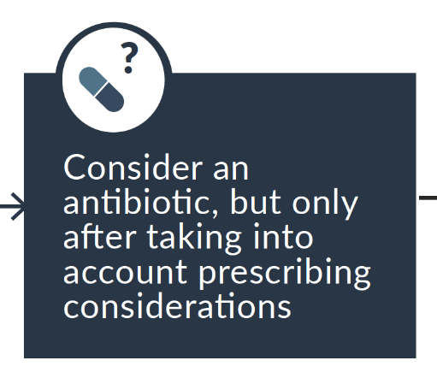
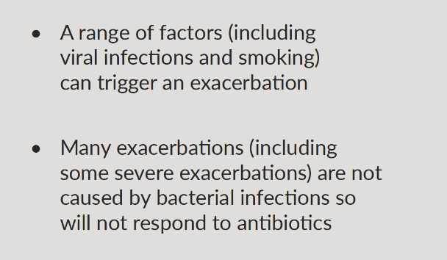
COPD Guidance Prior to COVID-19
Chronic Obstructive Pulmonary Disease
(Acute exacerbation): antimicrobial prescribing
In community (classified as mild- moderate exacerbation): NNT 14
Up to 1 month after treatment starting, for failure to resolve or improve
Notes:
Remote consulting useful starting point PRE-COVID COPD guideline
COPD exacerbations NOT all bacterial infections, can be triggered by viral infections, smoking, many will not respond to antibiotics
COPD Guidance Vollenweider SR >2000 adults,
Effect of antibiotics Appeared greater in people with increasing severity of exacerbation based on care setting (Care setting was used a marker of the severity)
In community, need to treat 14 people to avoid one treatment failure

Slide 30
COPD
COVID-19 RAPID Guideline
Rescue packs if symptoms of COVID-19?
Tell patients not to start a short course of oral corticosteroids and/or antibiotics for symptoms of COVID-19, for example fever, dry cough or myalgia
How does COVID-19 alter your advice to people with COPD who are smoking?
Strongly encourage patients with COPD who are still smoking to stop, to reduce the risk of poor outcomes from COVID-19 and their risk of acute exacerbations.
Notes:
COPD COVID-19
Rescue packs : NICE advises us to tell patients not to start steroids and/or antibiotics for COVID-19 symptoms e.g. fever, dry cough or myalgia
How does COVID-19 alter your advice to people with COPD who are smoking? It may be that patients are stressed & less likely to stop however
Some smokers may find the risk of poor outcomes from COVID-19 a motivating & change where they are on the (behaviour change cycle) reason to stop.
Back-up prescribing can also be useful here (sputum sample but consider risks of travel etc)

Slide 31
Back-Up Antibiotic Prescribing
De la Poza- URTI Including Sinusitis
As effective as an immediate antibiotic prescription
No significant differences in adverse events compared with an immediate antibiotic prescription
Significantly lower rates of antibiotic collection:
delayed collection prescription group (26%)
patient-led back-up prescription group (35%)
immediate prescription group (89%)
How do you manage back-up prescribing locally?
Notes:
Back-up prescribing
Evidence: Respiratory Tract Infections: As effective as an immediate antibiotic prescription symptom severity & duration
No significant differences in adverse events compared with an immediate antibiotic prescription
Significantly lower rates of antibiotic use (collection)
delayed collection prescription group (26%)
patient-led back-up prescription group (35%)
immediate prescription group (89%)

Slide 32
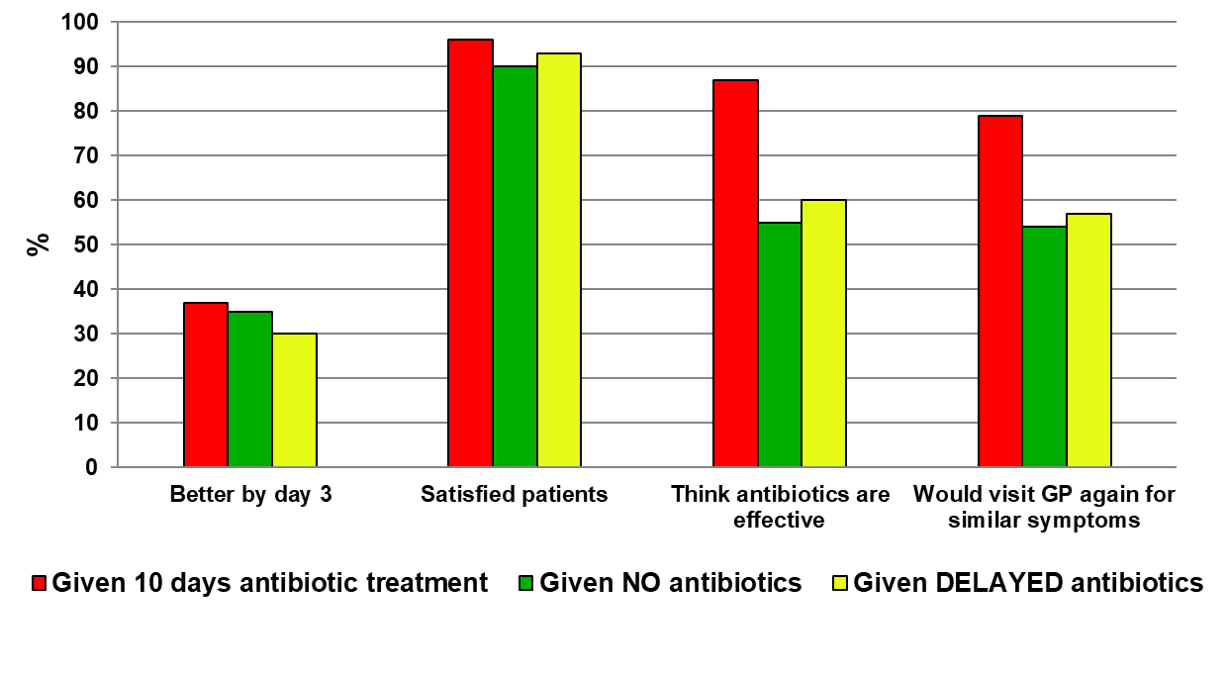
What is the evidence for the back-up / delayed prescribing?
English RCT comparing three treatment strategies for sore throat (n=582)
Clinical Scenario
Acute Sore Throat
Notes:
Back-up prescribing
Study, Acute sore throat by Little, UK, how it can change beliefs in antibiotics & likelihood of visiting GP – CM will cover in webinar part 2
(Better by Day 3; Satisfied; think antibiotic effective; would visit GP again for similar symptoms)
Citizens jury 2016 “How should patients & public contribute to AMS, what support can the NHS offer” – back-up prescriptions should be much more widely used
Back-up is useful if high expectation of antibiotics, can give TARGET /RCGP leaflet updated for COVID-19

Slide 33
Back-up prescribing
How To Do It
It’s easy, but needs to be done properly
(and will then reduce antibiotic use)
Remember the 6 R’s
Reassurance
Reasons not to use antibiotics (side effects/allergy/AMR)
Relief: support Paracetamol (v limited use of NSAIDS)
Realistic natural history [ OM 8d; sore throat 7-8d; acute sinusitis 2-3wk), Cough 3 wks.]
Reinforce key message: only use if getting worse or not even starting to settle in the expected average time
Rescue (safety netting)
Notes:
How to do it – what you’d normally do/common practice
Reassurance
Reasons not to use antibiotics (side effects/allergy/AMR)
Relief: support Paracetamol
Realistic natural history [ OM 8 days; sore throat 7-8days; acute sinusitis 2-3weeks), Cough 3 weeks]
Reinforce key message: only use if getting worse or [not improving]
Rescue (safety netting)

Slide 34
UTI- Remote Assessment Decision Points
Is it really a UTI?
Exclude urethral and vaginal causes of urinary symptoms
Vaginal discharge? (80% do not have UTI)
Consider post-menopausal atrophy & STI [PHE]
Ask about severity Pyelonephritis? Sepsis?
What type of UTI? Catheter, recurrent, lower, pyelonephritis? Structural or functional abnormality which increase the risk of a more serious outcome or treatment failure?
UTI unlikely if
no urgency, frequency,
visible haematuria, suprapubic tenderness
2 out of 3 = likely UTI
Notes:
Suspected UTI is a common problem, 3 key questions
Is it really a UTI? Vaginal soreness - discharge
Severity
If it is a UTI, what type? Uncomplicated lower UTI woman? Recurrent? Pyelonephritis? - Catheter-associated?
Phone/remote assessment 2 out of 3 = likely UTI , None - UTI unlikely; Middle of risk meter – balance judgements

Slide 35
UTI (Lower)
Duration of Treatment
3 days: Simple cystitis in women only (non-pregnant)
7⁺ days:
Pyelonephritis (e.g. fever)
Pregnancy
Complicated UTI
Men
Complicated includes:
Structural/functional abnormality
Underlying disease, which increases risk of more serious outcomes/ treatment failure
*See pyelonephritis guideline
National Institute for Health and Care Excellence (NICE). (2018). Urinary tract infection (lower): antimicrobial prescribing [NG109]. www.nice.org.uk/guidance/ng109/
Notes:
UTI – 3 days
3 days uncomplicated cystitis in non-pregnant women only
Everything else 7 days including men, pregnancy

Slide 36
Question 5
Which of the following would NOT be suitable to treat pyelonephritis?
(Select all that apply)
Trimethoprim (known sensitivity)
Cefalexin
Nitrofurantoin
Fosfomycin
Pivmecillinam
Notes:
Antibiotics not suitable Rx pyelonephritis? Select all that apply.
Trimethoprim (known sensitivity)
Cefalexin
Nitrofurantoin
Fosfomycin
Pivmecillinam
Choice RECS for pyelonephritis Cefalexin – suitable for women, men, pregnancy & children
Based on E.Coli national resistance data lab MSUs so may be different locally & may be subject to change, but this is current national guidance
Resistance rates: That is why co-amoxiclav is no longer first line recommendation for cephalexin currently – may change in time / inevitable

Slide 37
Question 5
Answer & Rationale
Which of the following would NOT be suitable to treat pyelonephritis?
(Select all that apply)
Trimethoprim (known sensitivity)
Cefalexin
Nitrofurantoin
Fosfomycin
Pivmecillinam
Antibiotics that don't achieve adequate levels in renal tissue e.g. nitrofurantoin, fosfomycin & pivmecillinam, are to be avoided [NG111].
Notes:
Answers
Antibiotics that don't achieve adequate levels in renal tissue, such as nitrofurantoin, fosfomycin and pivmecillinam, are to be avoided. [NG111]
Trimethoprim does reach adequate levels in the kidney but only use if MSU shows known to be sensitive

Slide 38

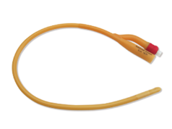
Catheter UTI
87 yr.-old man, cognitive impairment, long-term indwelling catheter. Antibiotic request, more confused, urine dip +ve “off the scale”.
What do you want to ask?
Fever?
Pelvic discomfort, flank pain?
Confusion: Duration & details, other causes?
PINCH ME
Why dipped?
Notes:
87 year-old man cognitive impairment, more confused urine dipped and it’s off the scale, a long-term indwelling catheter fever/pelvic/flank pain, confusion,

Slide 39
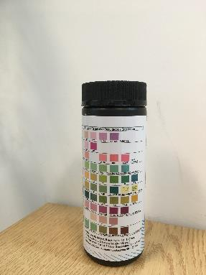

UTI in Adults
Healthcare professionals do not use dipstick testing to diagnose UTIs in adults with urinary catheters [QS90].
The patient's clinical need for catheterisation should be reviewed regularly and the urinary catheter removed as soon as possible [CG139].
39
NICE. (2015). UTI in adults [QS90].
NICE. (2012). Healthcare-associated infections: prevention and control in primary and community care [CG139].
Notes:
Do not use dipstick testing to diagnose UTIs in adults with urinary catheters
All indwelling colonised/positive within a month
Use of dip catheter – issue in your area, good mini-audit, small numbers/ but also noted lost to TWOC
Need for catheterisation should be reviewed found

Slide 40
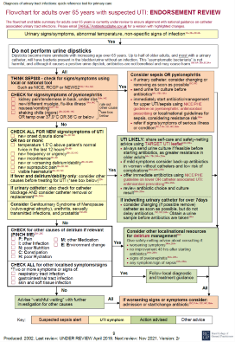
PINCH ME
Flowchart for adults over 65 with suspected UTI
Check for other causes of delirium if relevant
P: Pain
I: other Infection
N: poor Nutrition
C: Constipation
H: poor Hydration
M: other Medication
E: Environment change
40
Public Health England (PHE). (2019). Flowchart for adults over 65 years with suspected UTI. www.rcgp.org.uk/TARGET-QRT
Notes:
PINCH ME
PHE diagnostic flow chart
Confusion or delirium? PINCH ME – useful reminder
P: Pain
I: other Infection
N: poor Nutrition
C: Constipation
H: poor Hydration
M: other Medication
E: Environment change

Slide 41

Insect Bites
Remote Assessment
Advice
Advise people that:
A community pharmacist can advise about self care treatments
Skin redness and itching are common and may last for up to 10 days
It is unlikely that the skin will become infected
Avoiding scratching may reduce inflammation and the risk of infection
They should seek medical help if symptoms worsen rapidly or significantly at any time, or they become systemically unwell
NICE Guidance 182
Be aware that:
A rapid onset skin reaction is likely to be inflammatory or allergic reaction rather than an infection
Most insect bites or stings will not need an antibiotic
Notes:
Insect bites
Rapid onset – inflammatory/allergic
Most won’t need antibiotics
Itching common, try not to scratch – increase risk of infection

Slide 42
Summary
Common Infections Remote Assessment
Remote? Medico-legally demonstrate satisfactory assessment & decision- making. If you aren’t sure, it would be better to see the patient face to face
Identify persisting or deteriorating symptoms & recurrent patient/NHS contacts
Remember spectrum of risk & beware cognitive biases
Antibiotics make little difference to clinical outcome in most cases of sinusitis, OM & sore throat
Course length: Acute sinusitis, cough, COPD, pneumonia (5d)
Consider back-up prescribing (6 R’s)
Encourage self-care options & NHS website
Document safety netting advice [MPS]
Notes:
Summary
We have discussed importance of identifying who is suitable for remote
Considering remote: Identify persisting or deteriorating symptoms & recurrent patient/NHS contacts
[Toni Hazel RCGP 10 tips 9.9.2020] medico-legally clinical staff need to be able demonstrate that satisfactory assessment and decision making has taken place. If you aren’t sure, it would be better to see the patient face to face
Antibiotics make little difference to clinical outcome in most cases of sinusitis,
OM & sore throat, sore throat 7-8days; acute sinusitis 2-3weeks, Cough 3 weeks;
Remember spectrum of risk & beware cognitive biases, actual risk of complications
Consider back-up prescribing
Course length: 5/7sinusitis cough pneumonia COPD
Encourage self-care options & NHS website
Document safety netting advice given [MPS]
Resources – RCGP/TARGET *leaflets, quiz slide-set for within clinical meetings UTI or sinusitis

Slide 43
Thank you
If you have any queries, please contact TARGETAntibiotics@phe.gov.uk
Acknowledgements
With thanks to volunteers from the NICE Managing Common Infections prescribing guideline committee who identified learning points and contributed to similar learning materials. Particularly Ian Hill-Smith,
John Morris, Cliodna McNulty, Carole Pitkeathley, Avril Tucker, Caroline Ward, Alastair Hayes, Kieran Hand, Mitul Patel, Tessa Lewis (lead)

