Slide 1
Using National Antibiotic resources to help improve antibiotic prescribing
“There are few public health issues of potentially greater importance for society than antibiotic resistance”
2013 CMO Prof Dame Sally Davies
Remote Assessment V4
Notes:
Slide one presenter notes:
As Dame Sally Davies, stated “There are few public health issues of potentially greater importance for society than antibiotic resistance” Next slide.
Added notes
The top part of this notes section is for presenters to use during the workshop, and can be used verbatim or paraphrased.
Extra notes below contain extra background information about the evidence base for the information on the slides and details about the references quoted, or how to obtain particular information or resources.
Underlined notes are instructions.
If you want to use the voice over at any time please make sure your laptop or PC has functional speakers and they are not on mute.
While you are waiting for staff to arrive it is really useful to get them to think about their current antibiotic prescribing practice by
getting them to complete the self-assessment checklist available at https://www.rcgp.org.uk/clinical-and-research/resources/toolkits/target-antibiotic-toolkit.aspx (see slide 2)
Giving them the TARGET patient leaflet to look at (available at https://www.rcgp.org.uk/clinical-and-research/resources/toolkits/target-antibiotic-toolkit.aspx )
Print out and ask the group to consider and chat about some of the case studies in the presentation.

Slide 2
Learning in this webinar
Understand
How and why we prescribe antibiotics
The evidence showing the link between antibiotic prescribing and resistance in your patients
how reducing antibiotic prescribing can reduce antibiotic resistance, and also patient consultations
AMS strategies to use with patients
Where to find and how to use TARGET materials
The benefits of exploring your antibiotic prescribing in more detail
Notes:
Today I am going to discuss
How and why we prescribe antibiotics
The evidence showing the link between antibiotic prescribing and resistance in your patients
how reducing antibiotic prescribing can reduce antibiotic resistance, and also patient consultations
AMS strategies to use with patients
Where to find and how to use TARGET materials
The benefits of exploring your antibiotic prescribing in more detail

Slide 3
Actual antibiotic prescribing in Primary Care vs appropriate rates
Condition/syndrome | Actual prescription (UK THIN data) | Ideal prescription: PHE EE median (IQ range) | Ideal prescription: ESAC EE acceptable range
Acute cough | 40% | 10% (6 – 16%)
Acute bronchitis | 92% | 13% (6 – 22%) | 0 – 30 %
Acute sore throat | 60% | 13% (7 – 22%) | 0 – 20% (tonsillitis)
Acute rhinosinusitis | 92% | 11% (5 – 18%) | 0 – 20%
Acute otitis media 6mo – 2yr 2yr – 18yr | 96% 94% | 19% (9 – 33%) 17% (8 – 30%) | 0 – 20%
Notes:
I am often asked what exactly we mean by prescribing appropriately – in terms of the actual rate at which we should prescribe
This table shows the condition, the % of patients actually prescribed an antibiotic for that condition in 2018, and how often primary care experts in national and European groups think that we should be prescribing
The THIN study show that UK GP staff prescribed antibiotics in 40 to 96% of respiratory infections. Ideal prescription rates developed with primary care experts in the field by these PHE and European Surveillance on Antimicrobial Consumption groups suggest we still have a long way to go and that we probably prescribe antibiotics unnecessarily in many cases.
Looking at acute sore throat we prescribe in 60% when we should be prescribing in only a maximum of 1 in 5 patients.
An important thing to note during COVID-19 is that 44 % of patients will have a sore throat during their illness – but COVID patients have other symptoms as well
1. http://bmjopen.bmj.com/content/4/10/e006245.ful
2. http://qualitysafety.bmj.com/content/early/2011/03/21/bmjqs.2010.049049.abstract
Slide table shows: Percentage of patients prescribed antibiotics (THIN) and the percentages that experts believe are appropriate (results from PHE expert elicitation (EE) work and EE by ESAC).

Slide 4
Evidence: Risk of resistance persists for at least 12 months after your prescribing
 | Increased risk of resistant organism (pooled odds ratio)
 | Antibiotic in past 2 months | Antibiotic in past 12 months
RTI 7 studies: n = 2,605 | 2.4 times (1.4 - 3.9) | 2.4 times (1.3 – 4.5)
UTI 5 studies | 2.5 times (2.1 – 2.9) | 1.33 times (1.2 – 1.5)
A meta analysis of English Primary Care
Costello et al. BMJ. (2010) 340:c2096.
Notes:
Presenter notes:
Why does it matter if we prescribe unnecessarily?
take a moment to reflect. Is antibiotic resistance important in your practice? (Pause)
Does your own antibiotic prescribing influence antibiotic resistance in your patients or community? (pause)
Resistance is now with us in primary care and
The risk of resistance is over two times in the first two months after an antibiotic as shown here for Respiratory Tract infections, but is still higher 12 months after antibiotic use for RTIs.
So any antibiotic use increases our future risk of carrying resistant bacteria, even if it is amoxicillin, as this resistance gene is often linked to others like trimethoprim. And this fact has been shown in UK primary care.
Details of paper:
http://www.bmj.com/content/340/bmj.c2096.long
The review included 24 studies; 22 involved patients with symptomatic infection and two involved healthy volunteers; 19 were observational studies (of which two were prospective) and five were randomised trials. In five studies of urinary tract bacteria (14 348 participants), the pooled odds ratio (OR) for resistance was 2.5 (95% confidence interval 2.1 to 2.9) within 2 months of antibiotic treatment and 1.33 (1.2 to 1.5) within 12 months. In seven studies of respiratory tract bacteria (2605 participants), pooled ORs were 2.4 (1.4 to 3.9) and 2.4 (1.3 to 4.5) for the same periods, respectively. Studies reporting the quantity of antibiotic prescribed found that longer duration and multiple courses were associated with higher rates of resistance. Studies comparing the potential for different antibiotics to induce resistance showed no consistent effects. Only one prospective study reported changes in resistance over a long period; pooled ORs fell from 12.2 (6.8 to 22.1) at 1 week to 6.1 (2.8 to 13.4) at 1 month, 3.6 (2.2 to 6.0) at 2 months, and 2.2 (1.3 to 3.6) at 6 months.
Therefore in conclusion, individuals prescribed an antibiotic in primary care for a respiratory infection have an increased risk of carrying resistant organisms – so that the next time they have an infection it is with a antibiotic resistant organism. The effect is greatest in the month immediately after treatment but may persist for up to 12 months. This effect not only increases the population carriage of organisms resistant to first line antibiotics, but also creates the conditions for increased use of second line antibiotics in the community.

Slide 5
Why do we prescribe antibiotics?
Relief of symptoms
Worry about complications/more serious illness
Patient pressure
Notes:
Presenter notes:
So, how do we change antibiotic prescribing?
Lets go back to the fundamentals of practice.
Why do we prescribe? Pause
We prescribe mainly for 3 reasons.
Firstly, we want to help our patients to get better. We want to relieve their symptoms and we believe that antibiotics will help.
Secondly, we prescribe because we worry that if we don’t patients may develop complications or more serious illness.
We also prescribe because we think patients expect a prescription, usually antibiotics. Let’s take a look at these three reasons for prescribing and examine the evidence supporting each of these reasons.

Slide 6
1. Relief of symptoms Symptom benefit from antibiotics
 | Total duration untreated | Beneficial effect from antibiotics | NNT for one additional patient to benefit | NNT for one additional adverse effect i.e. NNH
Otitis media | 4 -12 days | 8-12 hours | 18 | 9
Sore throat | 8 days | 12-18 hours | 6-20 | 15
Sinusitis | 12-15 days | 24 hours | 18 | 8
Bronchitis | 20-22 days | 11-24 hours | 10-22 | 24
How do we communicate this information to patients?
Cochrane reviews Otitis media: Venekamp et al (2015);
Sore throat: Spinks et al. 2013; Sinusitis: Leminengre M et al. (2012); bronchitis: Smith et al. (2014)
Notes:
Key points
This table again shows a lot of information but lets go back to the sore throat.
Without antibiotics, a sore throat will usually get better in around 8 days.
However if treated with an antibiotic the individual MAY feel symptom relief 12 – 18 hrs earlier
Thus they will still have a sore throat for 7.5 days.
But this doesn’t happen in every case, you still need to treat 6 – 20 patients (the NNT) for one to attain this benefit.
The number needed to harm is only 15 individuals.
Presenter notes:
How useful are antibiotics for common respiratory tract infections? This table includes much of the research on what we know about common respiratory tract infections, how long the symptoms usually last, and how much patients benefit from taking antibiotics. As you can see from the circled column, antibiotics reduce symptoms for between 8 and 24 hours. So at best about 12 hours in otitis media, an illness that lasts for 4 to 8 days; taking a look at the Number needed to Treat (NNT) Benefit and NNT Harm columns – 18 patients with OM need to be treated with antibiotics for one patient to benefit, but for 9 patients receiving antibiotics one will experience an adverse effect. For bronchitis, an illness that lasts for about three weeks, the reduction in days with cough was less than half a day and the reduction in days feeling ill was just over half a day with antibiotics.
Any benefit that our patients achieve from antibiotics is tiny and the numbers needed to treat to achieve one satisfactory earlier resolution needs to be weighed against the one in 10 chance of causing side effects such as diarrhoea, vomiting, rash, allergic reaction (1 in 15) or the risk of carrying a resistance bacteria. So, unless symptoms are particularly severe, there is no reason for using antibiotics in the majority of patients presenting with respiratory symptoms because they do not help.
Evidence
This evidence is all outlined in the PHE antibiotic guidelines and NICE CG69, but most recent systematic reviews include:
Otitis media
Venekamp et al (2015) Antibiotics for acute middle ear infection (acute otitis media). Cochrane
http://www.cochrane.org/CD000219/ARI_antibiotics-for-acute-middle-ear-infection-acute-otitis-media-in-children
This systematic review included 13 RCTs involving 3401 children with otitis media (3938 episodes). Pain was not reduced by antibiotics at 24 hours. A third fewer had residual pain at 2-3 days (at which point pain levels are usually substantially reduced) and NNT for an additional beneficial outcome was 20. Antibiotics reduced the number of Tympanic Membrane perforations, but NNT for Benefit is 33. Severe complications were rare and did not differ between children given antibiotics and those given placebo. Antibiotics are most beneficial for children aged <2 yrs with bilateral AOM (NNTB 4) or with both AOM and discharge (NNTB 3). Immediate antibiotics were associated with a substantial increased risk of vomiting, diarrhoea or rash compared with no treatment (NNTH9).
Sore throat
Spinks A et al. (2013) Antibiotics for sore throat. Cochrane
http://onlinelibrary.wiley.com/doi/10.1002/14651858.CD000023.pub4/pdf/abstract
27 RCTs of antibiotics for sore throat vs placebo including 12 835 cases. Antibiotics were most beneficial if given at day three if throat swabs were positive for streptococcus (NNTB 6) compared to NNTB at day 7 of 21. Antibiotics reduced duration of symptoms by 16 hours on average. 90% resolve in 7 days. Advantages may be greater in low income countries (possibly recent travelers from these countries – personal communication Dr L Hendricks) where the risk of rheumatic fever is higher. NNTH is 15.
Little P et al (2013) – 2 studies within the PRISM trial used a Clinical score compared to rapid antigen detection test to guide antibiotic use for sore throats. The RCT using clinical scores to predict streptococcal infection in patients and found that the use of FeverPAIN is likely to moderately improve symptom control and reduce antibiotic use. PHE and NICE guidance suggests Consider immediate antibiotics if symptoms severe or a short 48 hour back-up strategy may be appropriate, when the FeverPAIN score is 4 or over. Consider back-up or no antibiotic if score 2-3.
Sinusitis
Leminengre M et al. (2012) Antibiotics for clinically diagnosed acute rhinosinusitis in adults. Cochrane.
http://onlinelibrary.wiley.com/doi/10.1002/14651858.CD006089.pub4/pdf/abstract
10 RCTs of antibiotics vs placebo including 2450 participants. Irrespective of treatment group 47% of patients were cured after 1 week, 71% after 14 days. 18 patients need to be treated for a faster cure rate between 7 and 14 days. If several of: purulent nasal discharge; severe localised unilateral pain; fever; marked deterioration after initial milder phase, patients were more likely to benefit from antibiotics, when PHE and NICE recommend a back-up antibiotic. One disease related complication (brain abscess) occurred in patient treated with antibiotics, but complications are rare.
Bronchitis/LRTI (without pneumonia)
Smith S et al. (2014) Antibiotic treatment of people with clinical diagnosis of acute bronchitis. Cochrane
http://www.cochrane.org/CD000245/ARI_antibiotic-treatment-people-clinical-diagnosis-acute-bronchitis
17 trials with 5099 participants were included. The number needed to treat for one additional beneficial outcome was 22 (NNTB 22). The reduction in days with cough was 0.46 days and days feeling ill was 0.64 days (CI 1.16-0.13). NNT for an additional adverse effect was 24.

Slide 7
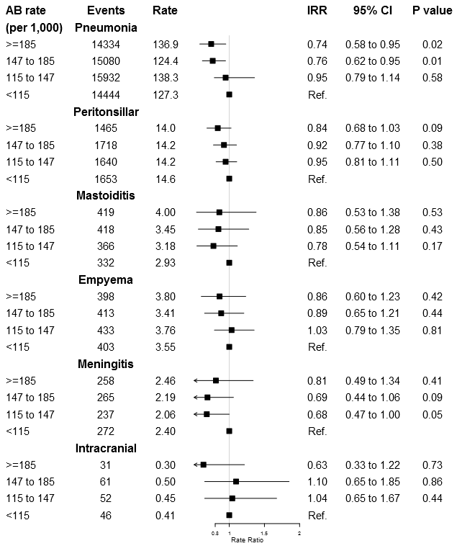
2. Worry about complications Antibiotics and complications
UK study examined complications in practices with range of antibiotic use
Majority of infections no significant differences (CI crosses 1, p>0.05)
Calculated that in a practice of 7,000, a 10% reduction in antibiotic prescribing for RTI might expect:
1 additional pneumonia each year
1 additional peritonsilar abscess each 10 years
BMJ 2016 Gulliford http://www.bmj.com/content/354/bmj.i4245
Notes:
Presenter notes:
This Table is really important and shows the Relative Risk (RR) for six complications in general practices with a range of antibiotic prescribing,
Column One shows the practices divided into 4 groups (quartiles by their prescribing rate with the highest at the top.
Column two and three show the number and rate of complications in each group.
Columns four and five show the risk of the complications compared to the lowest prescribing group.
The final columns show the confidence around that estimate and the p value – less than 0.05 being significant.
As you can see I have highlighted the majority in green
Serious complications are rare after URTI, sore throats and otitis media.
However pneumonia rates are significantly higher - so in a practice of 7,000, this study indicates that a 10% reduction in antibiotic prescribing for RTI might expect:
1 additional pneumonia each year
1 additional peritonsillar abscess each 10 years
So this is why we need to carefully assess for risk of complications in LRTI or bronchitis
current NICE guidelines suggest targeting antibiotic prescribing at those at highest risk,
for example in those aged 65 or older with 2 or more of: recent hospitalisation, diabetes, CCF or recent steroid use.

Slide 8
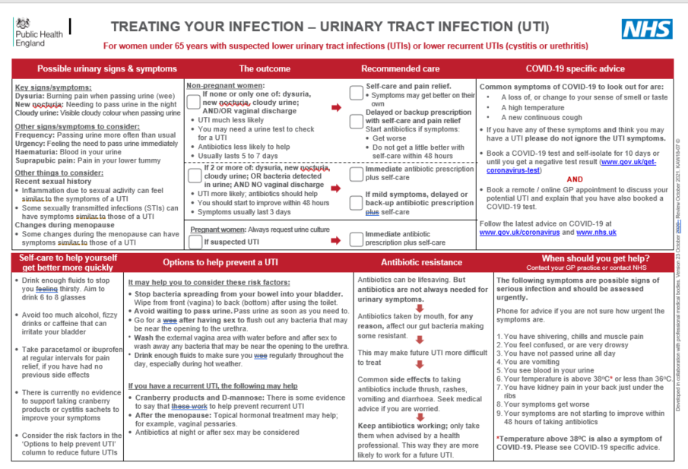
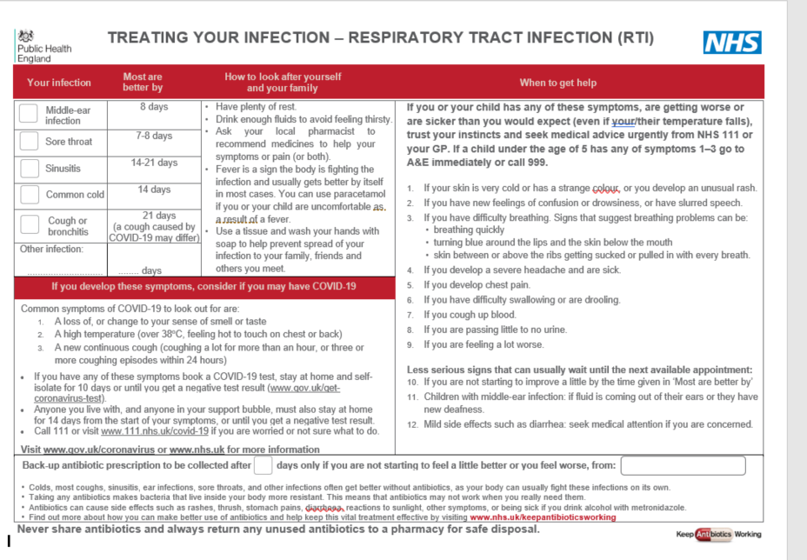
Reducing complication risk
Careful clinical assessment, including targeting treatment to those most at risk– using diagnostic flowcharts, symptom scores: FeverPAIN; STARWAVe
Back-up / delayed antibiotics
Safety netting including patient information leaflets
Notes:
Presenter notes:
So most of the really large systematic reviews show that complications are rare.
With careful clinical assessment of need for antibiotics using these PHE leaflets with diagnostic prompts,
You can encourage the use of the PHE UTI, diarrhoea and vaginal discharge flowcharts and NICE visual summaries
and rule out more serious illness using clinical scoring tools,
FeverPAIN can be used for acute sore throat
And STARWAVe that I will cover in a moment in children
Backup/delayed antibiotics allow you to work with your patient to reduce the risks of complications. The PRISM trial shows that a back up prescriptions for sore throat helps to reduce complication rates.
We need to provide clear advice around duration of illness and what symptoms or signs may mean that urgent care is needed. These can be reinforced by using patient information leaflets available on the TARGET toolkit.

Slide 9
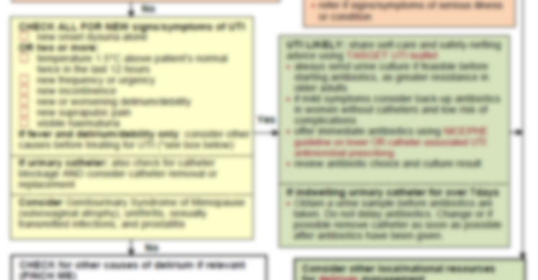
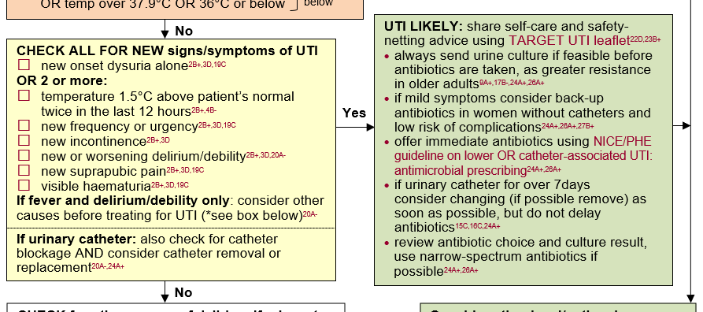
PHE UTI Diagnostic Tool: Diagnostic Flowchart over 65s
Link to Diagnostic Flowchart over 65s
Notes:
This is part of the UTI flowchart for over 65 year olds
This has been downloaded from the target website over 50,000 times.
The flowcharts for UTI stress the importance of excluding genital causes first as vaginal discharge is rarely present in UTI.
To exclude sepsis and pyelonephritis
NOT to use dipsticks in most patients and especially not in the over 65s
Reflect on the yellow box which shows the NEW signs and symptoms of UTI to look out for in these patients.
The box highlights the importance of checking for catheter blockages,
And the importance of considering catheter removal or replacement,
This flowchart and others are on the RCGP TARGET webiste
The flowchart also highlights the importance of always sending a urine for culture in this age group if antibiotics are started.
The UTI flowcharts are useful for non-medical prescribers and to set up telephone triaging
Details of papers:
19.Chu CM. Diagnosis and Treatment of Urinary Tract Infections Across Age Groups. American Journal of Obstetrics and Gynaecology. 2018. Available from: www.ajog.org/article/S0002-9378(17)32805-3/pdf
RATIONALE: An expert review of diagnosis and treatments of UTIs in different age groups. Authors suggest that the most diagnostic symptoms of UTIs include change in frequency, dysuria, urgency, and presence or absence of vaginal discharge, but suggest that UTIs may present differently in older women. Other symptoms include suprapubic, vaginal, and urethral tenderness, as well as haematuria. It is important to note that systemic symptoms, such as nausea, vomiting, flank pain, upper back pain, and fevers may indicate ascension of infection to the upper urinary tract and should not be treated as uncomplicated UTI.
20.Balogun SA, Philbrick JT. Delirium, a Symptom of UTI in the Elderly: Fact or Fable? A Systematic Review. Can Geriatr J. 2014;17(1):22-6. Available from: www.ncbi.nlm.nih.gov/pmc/articles/PMC3940475/pdf/cgj-17-22.pdf
RATIONALE: A systematic review that looked at the relationship between delirium and UTI. A search was conducted for published studies from 1966 through 2012 using the MESH terms “urinary tract infection” and “delirium”, limited to humans, age 65 and older. Of the 11 identified studies, 5 met inclusion criteria of being primary studies that addressed the association of UTI and delirium. The studies were 4 cross-sectional observational studies and 1 case series. The methodological strength of the studies was evaluated using 6 standards adapted from a previous systematic review. Only 2 of the 5 studies adequately matched or statistically adjusted for differences in comparison groups. None of the studies evaluated subjects with equal intensity for the presence of delirium and UTI, nor did they have objective criteria for either diagnosis. In subjects with delirium, UTI rates ranged from 25.9% to 32% compared to 13% in those without delirium. In subjects with UTI, delirium rates ranged from 30% to 35%, compared to 7.7% to 8% in those without UTI. Though the studies examined conclude that there is an association between UTI and delirium, all of them had significant methodological flaws that likely led to biased results. It is difficult to ascertain the degree to which UTIs cause delirium and more research is needed to clarify the relationship. The authors conclude that it is reasonable to assume that there is an association between delirium and sufficiently symptomatic UTI, just as there is for delirium and multiple other infections/conditions. It is also reasonable to conclude that asymptomatic bacteriuria, without dysuria, frequency, bladder discomfort, or fever, is unlikely to cause a patient to become delirious (Gau 2009) and that factors other than an abnormal urinalysis play a more dominant role in the development of delirium.
21.Portman DJ, Gass ML, Vulvovaginal Atrophy Terminology Consensus Conference P. Genitourinary syndrome of menopause: new terminology for vulvovaginal atrophy from the International Society for the Study of Women's Sexual Health and the North American Menopause Society. Maturitas. 2014;79(3):349-54. Available from: www.ncbi.nlm.nih.gov/pubmed/25179577
RATIONALE: Consensus report from 2012. The Board of Directors of the International Society for the Study of Women's Sexual Health (ISSWSH) and the Board of Trustees of The North American Menopause Society (NAMS) acknowledged the need to review current terminology associated with genitourinary tract symptoms related to menopause. To do this they co-sponsored a terminology consensus conference, which was held in May 2013 and agreed that the term genitourinary syndrome of menopause (GSM) is a medically more accurate, all-encompassing, and publicly acceptable term than vulvovaginal atrophy. Symptoms of GSM are associated with a decrease in oestrogen and other sex steroids involving changes to the labia majora/minora, clitoris, vestibule/introitus, vagina, urethra and bladder. The syndrome may include but is not limited to genital symptoms of dryness, burning, and irritation; sexual symptoms of lack of lubrication, discomfort or pain, and impaired function; and urinary symptoms of urgency, dysuria and recurrent urinary tract infections. Women may present with some or all of the signs and symptoms. The term was presented and discussed at the annual meeting of each society. GSM is currently used as the as a term to cover both atrophic vaginitis and vaginal atrophy in more recent references found during the review for the UTI diagnostic flowcharts.
22.Little P. Antibiotics or NSAIDs for uncomplicated urinary tract infection? BMJ. 2017;359:j5037. Available from: www.ncbi.nlm.nih.gov/pubmed/29117972
RATIONALE: An editorial discussion around antibiotics or NSAID’s for UTIs. The author suggests Paracetamol could be used more regularly as the first line analgesic in UTIs as it seems to be associated with a lower risk of adverse outcomes compared to nonsteroidal anti-inflammatories. The authors conclude however, that more evidence is needed to support the use of paracetamol in treating UTIs.
23.Little P, Moore MV, Turner S, Rumsby K, Warner G, Lowes JA, et al. Effectiveness of 5 different approaches in management of urinary tract infection: randomised controlled trial. BMJ. 2010;340:c199. Available from: www.ncbi.nlm.nih.gov/pubmed/20139214
RATIONALE: Randomised controlled trial to assess the impact of different management strategies in UTIs in primary care. The study included 309 non-pregnant women aged 18-70 presenting with suspected UTI who were randomised to 5 management approaches: empirical antibiotics; empirical delayed (by 48 hours) antibiotics; or targeted antibiotics based on a symptom score (2 or more of urine cloudiness, urine smell, nocturia, or dysuria), a dipstick result (nitrite or both leucocytes and blood), or a positive result on mid-stream urine analysis. Self-help advice was controlled in each group. The outcomes of symptom severity (days 2 to 4) and duration, and use of antibiotics were assessed. Patients had 3.5 days of moderately bad symptoms if they took antibiotics immediately. There were no significant differences in duration or severity of symptoms. There were differences in antibiotic use (immediate antibiotics 97%, mid-stream urine 81%, dipstick 80%, symptom score 90%, delayed antibiotics 77%; P=0.011) and in sending mid-stream urine samples (immediate antibiotics 23%, mid-stream urine 89%, dipstick 36%, symptom score 33%, delayed antibiotics 15%; P<0.001). Patients who waited at least 48 hours to start taking antibiotics re-consulted less (hazard ratio 0.57 (95% confidence interval 0.36 to 0.89), P=0.014) but on average had symptoms for 37% longer than those taking immediate antibiotics (incident rate ratio 1.37 (1.11 to 1.68), P=0.003), particularly the mid-stream urine group (73% longer, 22% to 140%; none of the other groups had more than 22% longer duration). The authors concluded that all management strategies achieve similar symptom control. There is no advantage in routinely sending mid-stream urine samples for testing, and antibiotics targeted with dipstick tests with a delayed prescription as backup, or empirical delayed prescription, can help to reduce antibiotic use.
24.National Institute for Health and Care Excellence. Urinary tract infection (catheter associated): antimicrobial prescribing – Draft for Consultation. Nice guidelines. Published May 2018. Available from: www.nice.org.uk/guidance/indevelopment/gid-apg10005
RATIONALE: This guideline sets out an antimicrobial prescribing strategy for catheter associated UTI. It aims to optimise antibiotic use and reduce antibiotic resistance. Final publication of the guidelines should occur in November 2018 so information presented here is should only be used as reference and readers should refer to the finalised guidance once published. The draft states that the longer a catheter is in place, the more likely bacteria will be found in the urine, treatment is only needed for symptomatic catheter-associated UTI not asymptomatic bacteriuria (apart from in pregnant women with asymptomatic bacteriuria, see the NICE antimicrobial prescribing guideline on lower UTI). Consider removing or changing the catheter before treating the infection if it has been in place for more than 7 days. Catheters should be removed rather than changed where possible. When collecting a urine sample from the sampling port of the catheter use aseptic technique and send for culture and susceptibility testing. If the catheter has been changed, obtain the sample from the new catheter. If the catheter has been removed obtain a mid-stream specimen of urine. Take account of the severity of symptoms and consider waiting until urine culture and susceptibility results are available before prescribing an antibiotic for catheter-associated UTI. Offer an antibiotic (see the recommendations on choice of antibiotic) to people with catheter-associated UTI, taking into account: the severity of symptoms, the risk of developing complications, previous urine culture and susceptibility results, and previous antibiotic use. When urine culture and susceptibility results are available: review the choice of antibiotic, and change the antibiotic according to susceptibility results if the bacteria are resistant and symptoms are not already improving, using narrow spectrum antibiotics wherever possible.
25.Michaels T, Sands J. Dysuria: Evaluation and Differential Diagnosis in Adults. American Family Physician. 2015;92(9). Available from: www.ncbi.nlm.nih.gov/pubmed/26554471
RATIONALE: A review of evidence based approaches for the evaluation of adult patients with dysuria. The authors state that the most common cause of acute dysuria is infection, especially cystitis. Other infectious causes include urethritis, sexually transmitted infections, and vaginitis. Non-infectious inflammatory causes include a foreign body in the urinary tract and dermatologic conditions. Non-inflammatory causes of dysuria include medication use, urethral anatomic abnormalities, local trauma, and interstitial cystitis/bladder pain syndrome. Prostatitis can present with dysuria. An initial targeted history includes features of a local cause (for example vaginal or urethral irritation), risk factors for a complicated UTI (eg. male sex, pregnancy, presence of urologic obstruction, recent procedure), and symptoms of pyelonephritis. Often the most relevant findings on physical examination are sex-specific, including inspecting for infectious or atrophic vaginitis and STIs in women, and prostatitis and STIs in men. Women with vulvovaginal symptoms should be evaluated for vaginitis. Urethritis should be suspected in younger, sexually active patients with dysuria and pyuria with­out bacteriuria; in men, urethral inflamma­tion and discharge is typically present. In patients with suspected urethritis, a ure­thral, vaginal, endocervical, or urine nucleic acid amplification test for Neisseria gonor­rhoeae and Chlamydia trachomatis is indi­cated. Men with prostatitis may have deep perineal pain and obstructive urinary symptoms, whereas those with epididymo-orchitis may have localized testicular pain. Any complicating features or recurrent symptoms warrant a history, physical examination, urinalysis, and urine culture. Findings from the secondary evaluation, selected laboratory tests, and directed imaging studies enable physicians to progress through a logical evaluation and determine the cause of dysuria or make an appropriate referral.
26.National Institute for Health and Care Excellence. Urinary tract infection (lower): antimicrobial prescribing. Nice guidelines. Published October 2018. Available from: www.nice.org.uk/guidance/ng109
RATIONALE: This guideline (produced by the NICE Public Health and Social Care Guidelines Team) sets out an antimicrobial prescribing strategy for lower urinary tract infection. It aims to optimise antibiotic use and reduce antibiotic resistance. It is clearly stated which antibiotics should be used for infections in tables within the guidelines and these tables are also included in the visual summaries that accompany the guidelines. The recommendations state that advice should be given on self-care to all those with expected a lower UTI. This includes paracetamol for pain, adequate intake of fluids, and no evidence was found on cranberry products to treat a lower UTI. Obtain a mid-stream urine sample before prescribing antibiotics for pregnant women and men with lower UTI and send for culture and susceptibility testing. Consider a back-up antibiotic prescription or an immediate antibiotic prescription for women with lower UTI who are not pregnant. Take account of: the severity of symptoms; the risk of developing complications; previous urine culture and susceptibility results; previous antibiotic use which may have led to resistant bacteria; preferences of the woman for antibiotic use. If a urine sample has been sent for culture and susceptibility testing and an antibiotic prescription has been given: review the choice of antibiotic when microbiological results are available, and change the antibiotic according to susceptibility results if bacteria are resistant and symptoms are not already improving, using a narrow spectrum antibiotic wherever possible. Safety-netting advice should be provided specific to seeking medical help if symptoms worsen rapidly or significantly at any time, do not start to improve within 48 hours of taking the antibiotic, or the person becomes systemically very unwell.
27.Little P, Moore MV, Turner S, Rumsby K, Warner G, Lowes JA, et al. Effectiveness of 5 different approaches in management of urinary tract infection: randomised controlled trial. BMJ. 2010;340:c199. Available from: www.ncbi.nlm.nih.gov/pubmed/20139214
RATIONALE: Randomised controlled trial to assess the impact of different management strategies in UTIs in primary care. The study included 309 non-pregnant women aged 18-70 presenting with suspected UTI who were randomised to 5 management approaches: empirical antibiotics; empirical delayed (by 48 hours) antibiotics; or targeted antibiotics based on a symptom score (2 or more of urine cloudiness, urine smell, nocturia, or dysuria), a dipstick result (nitrite or both leucocytes and blood), or a positive result on mid-stream urine analysis. Self-help advice was controlled in each group. The outcomes of symptom severity (days 2 to 4) and duration, and use of antibiotics were assessed. Patients had 3.5 days of moderately bad symptoms if they took antibiotics immediately. There were no significant differences in duration or severity of symptoms. There were differences in antibiotic use (immediate antibiotics 97%, mid-stream urine 81%, dipstick 80%, symptom score 90%, delayed antibiotics 77%; P=0.011) and in sending mid-stream urine samples (immediate antibiotics 23%, mid-stream urine 89%, dipstick 36%, symptom score 33%, delayed antibiotics 15%; P<0.001). Patients who waited at least 48 hours to start taking antibiotics re-consulted less (hazard ratio 0.57 (95% confidence interval 0.36 to 0.89), P=0.014) but on average had symptoms for 37% longer than those taking immediate antibiotics (incident rate ratio 1.37 (1.11 to 1.68), P=0.003), particularly the mid-stream urine group (73% longer, 22% to 140%; none of the other groups had more than 22% longer duration). The authors concluded that all management strategies achieve similar symptom control. There is no advantage in routinely sending mid-stream urine samples for testing, and antibiotics targeted with dipstick tests with a delayed prescription as backup, or empirical delayed prescription, can help to reduce antibiotic use.

Slide 10
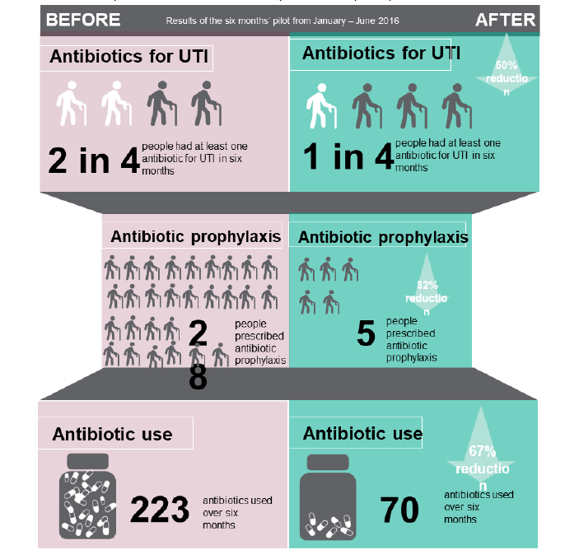
Case Study NHS BANES ToDipOrNotToDip
Improvement programme focused on:
Improved diagnosis of UTI with reduced dipsticks
Improved GP practice /care home communication
good hydration / avoiding acute kidney injury (AKI
Improving antibiotic use)
56%
82%
Results:
Reduced calls to GP practices for inappropriately diagnosed UTI
CCG67%
Notes:
What is benefit of not using urine dipsticks?
Here we present a case study of the BANES region who successfully eliminated use of urine dipsticks as a UTI diagnostic tool in over 65s.
The improvement programme included
Improved diagnosis of UTI with reduced dipsticks
Improved GP practice /care home communication
good hydration / avoiding acute kidney injury
Improving antibiotic use
Use of red top bottles which contains boric acid for preserving the urine and increase sampling
The improvement programme led to
a reduction in antibiotic use for UTI from 1 in 2 residents to 1 in 4.
Reduction in long term antibiotic prophylaxis for UTI
Overall reduction in antibiotic use.
Reduced calls to GP practices
So it really is worth discussing use of the flowcharts and leaflets with your staff and care homes and more widely in your community
Extra notes
The information on this slide can appear to some as contradictory. You may want to explain here that it is suspected that asymptomatic bacteriuria may have a protective factor against UTIs, and thereby treating asymptomatic bacteriuria patients may be at a higher risk for developing a symptomatic UTI and therefore at risk for urosepsis and AKI. In this example, by eliminating use of urine dipsticks, asymptomatic bacteriuria was not being treated and therefore it is suspected that this protected the patients against future UTIs and associated risks.

Slide 11
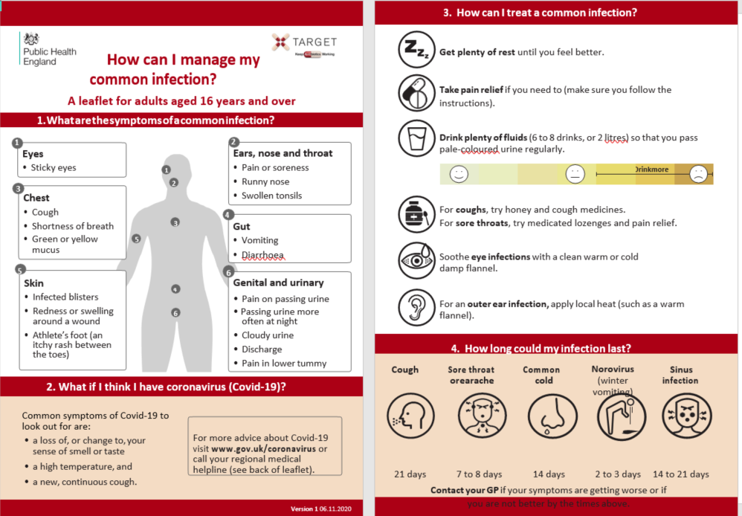
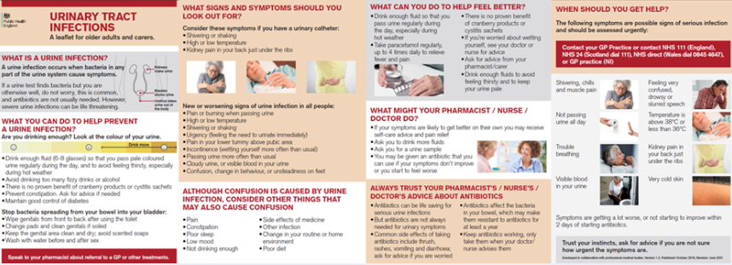
Patient Information Leaflets
Notes:
The TARGET patient information leaflets are useful tools to help guide and direct these discussions.
We have modified the leaflets to include advice about COVID, and at the request of community pharmacy staff have added a general leaflet covering common infections.

Slide 12
Using STARWAVe to predict hospitalisation in children
STARWAVe was developed from 8,394 UK children aged 3m-16y, presenting to GP practice with acute (≤28d) COUGH & RTI
Clinical Scenario
Acute Otitis Media
Children with score
0-1 (67%): very low risk (around 1:320) of future admission so can use ‘no’ antibiotic strategy
2-3 (30%) ‘normal’ risk of future admission (around 1:70). Suggest no or delayed antibiotic
4 or more (3% of all children) should be closely monitored for signs of deterioration, as 11.7%, ~1:9 admitted. Prescribe immediate antibiotic. Arrange same-day or next-day follow-up
Remote Assessment V4
Hay et al. Lancet 2016
Notes:
Using STARWAVe in practice to predict hospitalisation
STARWAVe is a tool to predict future hospitalisation among children who have presented to in-hours primary care with acute (≤28 days) cough and respiratory tract infection (RTI). It was developed in response to primary care clinicians saying they prescribe antibiotics “just in case” children’s illnesses deteriorate.
It is an exciting development in the antimicrobial stewardship field, and the tool has good prognostic properties. However, no clinical test or decision aid tool is perfect, and its effects on antibiotic use have yet to be tested in clinical practice. Where used, we believe it should support, not replace, clinical judgement.
It was developed from 8394 children aged between 3 months and 16 years.
Children with stable or infected asthma exacerbation were included.
Children at high risk of complications (e.g. immunocompromised and cystic fibrosis) were excluded.
78 (0.9%) of children were admitted for their RTI in the following 30 days. Hospital discharge diagnoses were: lower respiratory tract infection (19%); bronchiolitis (18%); viral wheeze (15%); upper respiratory tract infection (13%); croup (8%); infected exacerbation of asthma (8%); tonsillitis (6%); viral illness (5%); febrile illness (3%); and pneumonia (1%). 27% of discharge diagnoses were suggestive of a bacterial cause.
We found seven symptoms and signs (STARWAVe measurable in routine clinical practice,) all increasing the probability of children being admitted to hospital for their respiratory infection.
We showed that the STARWAVe symptoms and sign score can be used to divide children who have presented to general practice into very low, normal and high risk of future hospital admission.
We believe STARWAVe’s the main value is to reduce clinical uncertainty
Children with 0-1 STARWAVe symptoms and signs (67% of all children): are at very low risk (around 1:320) of future admission and we believe a ‘no’ antibiotic strategy should be considered for this group.
Children with 2-3 STARWAVe symptoms and signs (30% all children) who are at ‘normal’ risk of future admission (around 1:70). In keeping with NICE guidelines, we believe a ‘no’ or ‘delayed’ antibiotic prescribing strategy should be considered
Children with 4 or more STARWAVe symptoms and signs (3% of all children) should be closely monitored for signs of deterioration, (as 11.7%, around 1:9 were admitted) with consideration given to proactively arranging same-day or next-day follow-up and prescribing an immediate antibiotic.
For full details see http://www.thelancet.com/journals/lanres/article/PIIS2213-2600(16)30223-5/abstract
The follow up RCT is called CHICO and is still underway in 2020– recruited to target and now in follow up phase – due for reporting late 2021
Group did try to adapt for COVID, but we’re not sure if it has been useful for clinicians or not – essentially they said that the only safe way to use the rule with remote consultation is not to use it if you are not sure if the variable (e.g. wheeze) is present…

Slide 13
3. Patient Pressure The patient perspective: A 2020 survey showed patients trust their HCP’s advice
I trust my…
…advice as to whether or not I need an antibiotic
McNulty et al. Ipsos Mori 2020; Base: All respondents (2,022); Fieldwork: 24th Jan–24thFeb 2020
Notes:
Key point
Most importantly very recent data shows that Patients trust pharmacists, nurses and GPs advice as to whether they need an antibiotic
therefore it is worth sharing the need, or not, for antibiotics and discussing self care in consultations
Presenter notes:
We know patients trust GPs, nurses and pharmacists to give them advice.
87% of participants in a 2020 survey of 2022 randomly selected members of the English public reported that they trusted their GP’s advice as to whether they needed antibiotics or not; 76% trusted their nurse and 71% trusted their pharmacist. So there is a great opportunity for clinicians and pharmacists to share information with patients about the need or not for antibiotics. It’s worth sharing information about the need or not for antibiotics in consultations, and self care
Extra presenter notes:
The 2020 survey also showed that 55% of of participants who had taken antibiotics or had an infection in the last year (received some information about the illness or antibiotics.
Most participants were given information verbally (75%). Almost one-fifth (18%) were given the information in a printed format, and the professional went through or discussed the printed information with them in 45%. 16% were given information at a pharmacy. Almost one-fifth (18%) were given information on how to take antibiotics.
This survey is also supported by another recent large Eurobarometer survey showing that 90% of the UK public would use their GP as a trustworthy source of antibiotic information.
http://ec.europa.eu/health/antimicrobial_resistance/docs/ebs_338_en.pdf

Slide 14
Prescribing: Consultation rates related to acute cough & cold
537 UK GP practices 1995-2011
In a longitudinal study, practices who reduced prescribing experienced a reduced consultation rate
Thus patients can be retrained not to expect antibiotics reducing your consultations
Notes:
So will reducing prescribing antibiotics in RTIs benefit you?
This study shows how rate of prescribing antibiotics in 537 UK GP practices over time for acute coughs and colds (shown in red) runs in parallel to consultation rates for those infections.
Think about your own prescribing – how often do you use amoxicillin for coughs?
In this study there was marked variation in the percentage of patients in each practice that were prescribed antibiotics.
The variation was NOT influenced by age or social group.
This variation in practice antibiotic prescribing persists.
CLICK TO BRING IN: In another longitudinal study Ashworth et al showed that practices that reduced their antibiotic prescribing also reduced their consultations for RTI,
suggesting that patients can be retrained not to expect antibiotics and as a result consult less. So reducing your workload – or at least allowing you to concentrate on other things!
This suggests that all of us could probably improve our antibiotic prescribing – but those at the higher end of the range could do so more than others. Think about your own prescribing – do you think you are at the upper end? If yes you may wish to consider CRP more actively
Extra presenter notes from reference: Hawker et al. J Antimicrob Chemother. 2014: doi:10.1093/jac/dku291. http://jac.oxfordjournals.org/content/early/2014/08/01/jac.dku291.full
Trends in antibiotic prescribing in primary care for clinical syndromes subject to national recommendations to reduce antibiotic resistance, UK 1995–2011: analysis of a large database of primary care consultations.
This study measured trends in antibiotic prescribing in UK primary care in relation to nationally recommended best practice.
Patients and methods: A descriptive study linking individual patient data on diagnosis and prescription in a large primary care database, covering 537 UK general practices during 1995–2011.
Results: The proportion of cough/cold episodes for which antibiotics were prescribed decreased from 47% in 1995 to 36% in 1999, before increasing to 51% in 2011. There was marked variation by primary care practice in 2011 [10th–90th percentile range (TNPR) 32%–65%]. Antibiotic prescribing for sore throats fell from 77% in 1995 to 62% in 1999 and then stayed broadly stable (TNPR 45%–78%). Where antibiotics were prescribed for sore throat, recommended antibiotics were used in 69% of cases in 2011 (64% in 1995). The use of recommended short-course trimethoprim for urinary tract infection (UTI) in women aged 16–74 years increased from 8% in 1995 to 50% in 2011; however, a quarter of practices prescribed short courses in≤16% of episodes in 2011.
For otitis media, 85% of prescriptions were for recommended antibiotics in 2011, increasing from 77% in 1995. All these changes in annual prescribing were highly statistically significant (P,0.001).
Conclusions: The implementation of national guidelines in UK primary care has had mixed success, with prescribing for coughs/colds, both in total and as a proportion of consultations, now being greater than before recommendations were made to reduce it. Extensive variation by practice suggests that there is significant scope to improve prescribing, particularly for coughs/colds and for UTIs.
Ashworth et al BJGP Variations in antibiotic prescribing and consultation rates for acute respiratory infection in UK general practices 1995–2000. analysed data from the General Practice Research Database, including all registered patients from 108 practices between 1995 and 2000. For each practice, numbers of consultations for acute respiratory tract infections and the proportion of consultations resulting in an antibiotic prescription were obtained. An age- and sex-standardised consultation ratio (SCR) and standardised prescription ratio (SPR) were calculated for each practice. We evaluated whether SPR and SCR values were associated.
The results showed that for the mid-year data (1997), the crude consultation rate for all acute respiratory infections ranged from 125–1110 per 1000 registered patients at different practices; the proportion of consultations with antibiotics prescribed ranged from 45–98%. After standardising for varying age and sex structure of practice populations, practices with lower SPR values had lower SCR values (r = 0.41; P<0.001). This association was observed in each study year. Moreover, practices that demonstrated reductions in SPR between 1995 and 2000 also showed reductions in SCR (r = 0.27; P = 0.005).

Slide 15
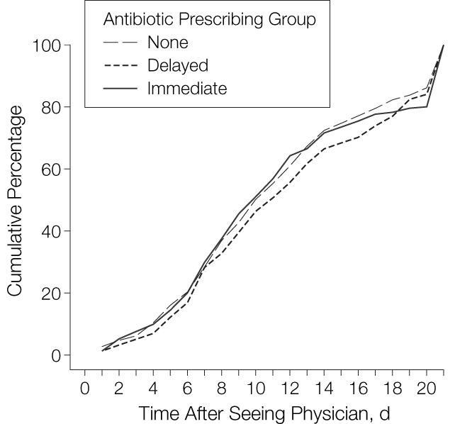
Back-up / delayed prescribing The evidence
Duration of Cough After Physician Visit Until Patient Is Feeling Better
In 37 GP practices in Bristol area
Patient satisfaction with treatment
Treatment Choice | Patients
No antibiotic | 130/181 (72%)
Delayed antibiotic | 147/190 (77%)
Immediate antibiotics | 166/194 (86%)
Notes:
I have mentioned back up prescribing already
Many systematic reviews have been published showing the benefits of this approach in reducing unnecessary prescribing. This study shows that cough duration was similar in patients given no, delayed or immediate antibiotics.
There was no difference in recovery rates and high levels of satisfaction with all strategies. Overall, there were fewer re-attendances with cough following delayed prescribing and immediate antibiotics in the month after the physician visit compared to no antibiotics (mean attendances for delayed, 0.12; immediate, 0.11; and no antibiotics, 0.19; likelihood ratio [LR] test from Poisson regression, P=.04).
Presenter notes: There has been much discussion about the use of giving delayed antibiotic prescriptions in acute uncomplicated infections, to reduce antibiotic use and reduce patient expectations (although patients understand the term back-up more easily – so we have now changed to this term. A Cochrane review has recently shown the benefits of this approach, without increasing complications in patients.
This study in acute cough is an exampler. Patients recruited by 37 physicians across Bristol and Southampton were randomised into immediate antibiotics, delayed antibiotics and no antibiotics groups. Of the 807 randomised participants, 272 were randomised to delayed antibiotics.
The cough remained “a slight problem” for a mean of 11.7 days (in 25% the cough lasted 17 days), and moderately bad for a mean of 6.0 days. Compared with no offer of antibiotics, other prescribing strategies did not alter the primary outcomes.
There was no difference in recovery rates and high levels of satisfaction with all strategies. Overall, there were fewer re-attendances with cough following delayed prescribing and immediate antibiotics in the month after the physician visit compared to no antibiotics (mean attendances for delayed, 0.12; immediate, 0.11; and no antibiotics, 0.19; likelihood ratio [LR] test from Poisson regression, P=.04).
Authors concluded that No offer or a delayed offer of antibiotics for acute uncomplicated lower respiratory tract infection is acceptable, associated with little difference in symptom resolution, and is likely to considerably reduce antibiotic use and beliefs in the effectiveness of antibiotics.
A Cochrane review of 11 studies has shown that delayed prescribing reduces antibiotic prescriptions without reducing satisfaction
Outcomes Risk with immediate antibiotics* Risk with delayed antibiotics* Relative effect (95% CI)
Antibiotic use:
delayed versus 930 per 1000 348 per 1000 OR 0.04
immediate antibiotics (286 to 401) (0.03 to 0.05)
Patient satisfaction:
delayed versus immediate 909 per 1000 866 per 1000 OR 0.65
Antibiotics (795 to 916) (0.39 to 1.10)
Reconsultation rate: 109 per 1000 113 per 1000 OR 1.04
delayed versus immediate (63 to 196) (0.55 to 1.98)
antibiotics
*Anticipated absolute effects* (95% CI)
Spurling GKP, Del Mar CB, Dooley L, Foxlee R, Farley R. Delayed antibiotic prescriptions for respiratory infections. Cochrane Database of Systematic Reviews 2017, Issue 9. Art. No.: CD004417. DOI: 10.1002/14651858.CD004417.pub5.

Slide 16
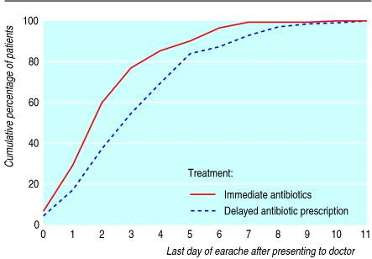
Duration of symptoms of AOM in children after seeing doctor
Immediate versus delayed antibiotics:
Clinical Scenario
Acute Otitis Media
No difference in:
School absence
Pain
distress scores
As benefits mainly AFTER 24 hours when pain less
25 hours shorter illness duration
Notes:
In this UK study of 315 children with AOM
On average, symptoms resolved after 3 days.
Children prescribed antibiotics immediate did have a shorter illness (−1.1 days (95% confidence interval −0.54 to −1.48)), fewer nights disturbed (−0.72 (−0.30 to −1.13)), and slightly less paracetamol consumption (−0.52 spoons/day (−0.26 to −0.79)).
CLICK But There was no difference in school absence or pain or distress scores since benefits of antibiotics occurred mainly after the first 24 hours—when distress was less severe.
One quarter of Parents (36/150children ) given delayed antibiotic prescriptions used them, and 77% were very satisfied. Fewer children in the delayed group had diarrhoea (14/150 (9%) v 25/135 (19%), χ²=5.2, P=0.02). Fewer parents in the delayed group believed in the effectiveness of antibiotics and in the need to see the doctor with future episodes
Pragmatic randomised controlled trial of two prescribing strategies for childhood acute otitis media
Paul Little, Clare Gould, Ian Williamson, Michael Moore Greg Warner, Joan Dunleavey BMJ. 2001 Feb 10; 322(7282): 336–342.
Objective: To compare immediate with delayed prescribing of antibiotics for acute otitis media.
Design: Open randomised controlled trial.
Setting: General practices in south west England.
Participants: 315 children aged between 6 months and 10 years presenting with acute otitis media.
Interventions: Two treatment strategies, supported by standardised advice sheets—immediate antibiotics or delayed antibiotics (antibiotic prescription to be collected at parents' discretion after 72 hours if child still not improving).
Main outcome measures: Symptom resolution, absence from school or nursery, paracetamol consumption.
Results: On average, symptoms resolved after 3 days. Children prescribed antibiotics immediately had shorter illness (−1.1 days (95% confidence interval −0.54 to −1.48)), fewer nights disturbed (−0.72 (−0.30 to −1.13)), and slightly less paracetamol consumption (−0.52 spoons/day (−0.26 to −0.79)). There was no difference in school absence or pain or distress scores since benefits of antibiotics occurred mainly after the first 24 hours—when distress was less severe. Parents of 36/150 of the children given delayed prescriptions used antibiotics, and 77% were very satisfied. Fewer children in the delayed group had diarrhoea (14/150 (9%) v 25/135 (19%), χ²=5.2, P=0.02). Fewer parents in the delayed group believed in the effectiveness of antibiotics and in the need to see the doctor with future episodes.
Conclusion: Immediate antibiotic prescription provided symptomatic benefit mainly after first 24 hours, when symptoms were already resolving. For children who are not very unwell systemically, a wait and see approach seems feasible and acceptable to parents and should substantially reduce the use of antibiotics for acute otitis media.

Slide 17
Back up/delayed prescribing The Patient Perspective: What patients do when given a delayed script?
Did not take the delayed antibiotic
96% not given a delayed script
48%
52%
4% given a delayed script
77% of all respondents felt that it was acceptable to be offered a delayed script by their GP
Remote Assessment V4
McNulty et al. Ipsos Mori 2017; Base: All respondents 2020 (2,052); Fieldwork: 24th Jan–24thFeb 2020
Notes:
Presenter notes:
This survey of the public showed that 4% of 2,052 members of the general public in 2020 reported being given a Back-up /delayed antibiotic prescription, that is equivalent to over 2and a hlf million scripts - so the strategy is being used.
48% reported not taking the antibiotic
When asked to score the acceptability of being given a delayed/back-up antibiotic out of 10 (where 1 completely unacceptable and 10 completely acceptable) the mean score was 8.17, with 43% scoring completely acceptable, and only 1 (3%) respondent scored 1.
Of those 89 participants reporting being given a delayed/back-up antibiotic prescription, 52% reported starting to take it and 48% said they did not. (The sample size is too small to say any more about this group offered delayed antibiotics. )
The commonest indication for a delayed/back-up antibiotic, as in 2017, was for chest infection, but urine infection now constitutes 19% (16% in 2017, 7% in 2014).
So what is the Implication? With the continued low use, and lack of understanding of what it is by the general public and more than a quarter opposing the practice – more education and explanation will be needed, but the suggestion of great variation by area suggests that local activity may be having an affect
Further notes for presenter: - other questions were asked about delayed antibiotics
One-fifth of the general public (21%) know something about delayed /back-up antibiotic prescriptions; and 12% of them fully aware, with a further 10% knowing the name or something about the practice. Women, those with children and those in social grades AB were more informed.
Support for delayed/backup antibiotic prescribing. Half (50%) were supportive of the practice in urine infections, 47% in ear infections and 45% in throat infections. More people tended to support (32%) delayed/backup antibiotic prescribing than tended oppose (15%).
25-34 years compared with older (over 65 Years) more likely to support. There is no difference by gender, parent of child and social grade.

Slide 18
HOW TO DO IT: II
? Re contact
? Post date
? Ask to collect
? Give it
Notes:
So how should we give a delayed antibiotic script?
We can ask patients to
? Re contact surgery
? Post date a written prescription – or write instructions on the electronic prescription – asking that it should not be collected before a certain date, and is only valid for a certain time.
? Ask the patient to collect it from the surgery
? Or Give the patient a prescription handing over complete control

Slide 19
WHICH WAY TO DELAY?
PIPS TRIAL
 | No Ab | Re contact | Postdate | Collect | Patient-led | LR chip
Sx Severity | 1.62 | 1.60 | 1.82 | 1.68 | 1.75 | 0.6
Duration days mod bad Symps (median) | 3 | 4 | 4 | 4 | 4 | 0.3
Belief in Abs | 71% | 74% | 73% | 72% | 66% | 0.8
Ab Use | 26% | 37% | 37% | 33% | 39% | 0.3
Vsatisfied | 79% | 74% | 80% | 88% | 89% | 0.8
Symptom severity1º outcome:0 = no problem…6 as bad as it could be; alpha 0.71-0.79; srm 1.6
Notes:
Antibiotic use is very similar what ever strategy you use – being lowest with the no antibiotic option.
Satisfaction is greatest with the patient led option – but there was no significant difference in this outcome

Slide 20
COMMON CONCERNS 2?
It is not as effective as no offer of a prescription?
Yes slightly higher rates of antibiotic use, but fine
It will reduce number of patients who come back to see you by 1/3
Medico-legal consequences?: complications
Similar reduction in complications compared with an immediate antibiotics
Two very large cohorts to show that this the case
It takes more time?
Most of the 6 Rs you should be doing anyway
The key difference is advice about when to consider cashing in
Notes:
What are the common concerns with delayed prescribing?
It is not as effective as no offer of a prescription?
Yes slightly higher rates of antibiotic use, but fine – use in patients who are more demanding
And It will reduce number of patients who come back to see you by 1/3
Medico-legal consequences?: complications
Similar reduction in complications compared with an immediate antibiotics
Two very large cohorts show that this the case, as especially with patient control they can collect the antibiotics as soon as needed.
A study of use in UTI showed that similar cases of PN if delayed antibiotic script is given with a NSAID
It takes more time?
Most of the 6 Rs you should be doing anyway
The key difference is advice about when to consider cashing in

Slide 21
WHAT NEXT?
Paul Littles advice: Try it: patients like it and you will get quicker
It’s easy, but do it properly (and will then reduce antibiotic use)
Remember the 6Rs (most of which are simply good practice!):
Reassurance;
Reasons not to use antibiotics
Relief: paracetamol (v limited NSAIDs)
Realistic natural history 1/2 week (OM), 1 wk. (throat), 2 wks. (sinus) 3 wks. (chest)
Reinforce key message: ONLY use if getting worse or not even STARTING to settle in the expected average time
Rescue (Safety netting)
Aim to keep it for the 20-30% where you are unsure
Audit to check how often you are using it
It will reduce complications and save you time
Fewer complications than no prescription;
Fewer repeat consultations compared with no prescription or immediate
Notes:
Paul Littles advice: Try it: patients like it and you will get quicker
It’s easy, but do it properly (and will then reduce antibiotic use)
Remember the 6Rs (most of which are simply good practice!):
Reassurance;
Reasons not to use antibiotics
Relief: paracetamol (v limited NSAIDs)
Realistic natural history 1/2 week (OM), 1 wk. (throat), 2 wks. (sinus) 3 wks. (chest)
Reinforce key message: ONLY use if getting worse or not even STARTING to settle in the expected average time
Rescue (Safety netting)
Aim to keep it for the 20-30% where you are unsure
Audit to check how often you are using it
It will reduce complications and save you time
Fewer complications than no prescription;
Fewer repeat consultations compared with no prescription or immediate

Slide 22
The TARGET Website
Remote Assessment V4
Notes:
I have mentioned the TARGET website on several occasions already
This is the landing page – it is easy to find if you just seach on TARGET antibiotics
USE THE CURSOR TOOL
GO THROUGH EACH ENDING AT THE THE AUDITS AND THEN MOVE FORWARD WITH SLIDES

Slide 23
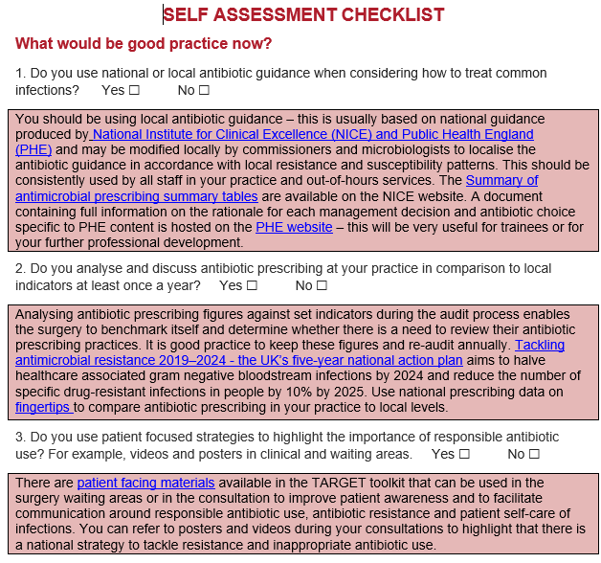
Self Assessment Checklist to complete whilst waiting for whole team
Notes:
The Primary Care Self Assessment tool is a tool for you to decide and measure how far you are along the road to optimising antibiotic prescribing in your practice.
It highlights the different strategies you can use and how you can find resources to support THEM – you may wish to go tto the website and do this after this webinar – or ask others in your practice to do this before a meeting to discuss your results.

Slide 24
TARGET: Acute Cough Audit
The TARGET website has audit templates for:
Acute otitis media
UTI
Sore Throat
Acute Cough
Otitis Externa
Acute Rhinosinusitis
Excel template auto calculates prescribing compliance for you!
Remote Assessment V4
24
Notes:
The TARGET audits can be used to identify how compliant prescribers are with PHE and NICE prescribing and diagnostic guidance.
The audits can be recorded on a printed word document or are carried out in excel which will auto calculate your compliance against guidelines.
These are really useful to find out exactly when and why you prescribe – and can be used towards your CPD and improve patient care.

Slide 25
Sources to visualise primary care antibiotic prescribing data
PrescQIPP
PHE Fingertips
Open Prescribing
NHS England Dashboard
ePACT2
25
www.rcgp.org.uk/targetantibiotics
Notes:
There are now many ways you can explore your antibiotic prescribing in a really useful way to help inform what audits you may wish to undertake in your practice.
You will mainly find using
PrescQIPP
PHE Fingertips
Open Prescribing
The easiest

Slide 26
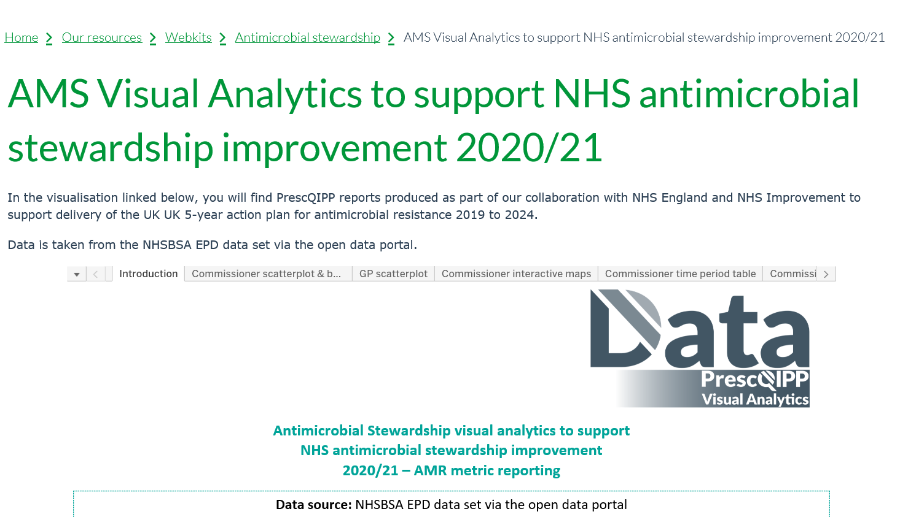
TCCG PrescQipp Metrics Total Antibacterial items/STAR PU 12 months to Aug 2020 Target: Less than 0.965
https://www.prescqipp.info/our-resources/webkits/antimicrobial-stewardship/ams-visual-analytics-to-support-nhs-antimicrobial-stewardship-improvement-202021/
Notes:
This slide gives a link to the PrescQipp website which gives you most of the data that will help you inform and then improve your antibiotic use. This may be done by your local medicine manager for you.

Slide 27
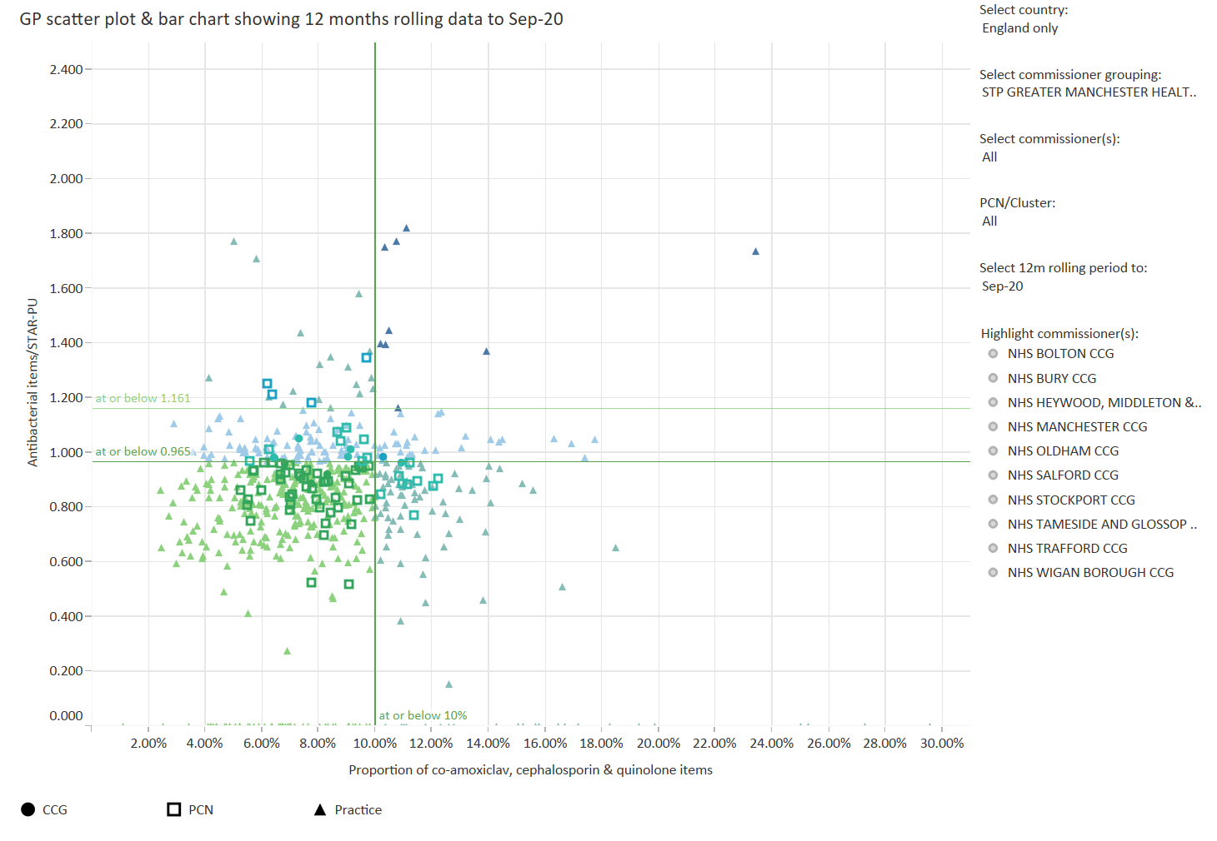
Antibacterial items/STAR-PU
Antibacterial items/STAR-PU
Notes:
When you click the link you then need to choose the data that you want to look at in a bar across the top of the charts that will appear.
In this example I have suggested we look at GP scatter plot
You need to then select the country – here I have picked England only, the commissioner grouping – here I have picked one at random – STP greater manchester, and PCN cluster – again I have selected all.. If you want to be more selective you can highlight specific CCGs and you will have far fewer practices in the scatter plot, and you will be more familiar with them.
This is a fantastic graphic to show where you how your practice compares with others., for total antibiotics in the vertical axis and % of the total of the so called 3Cs along the horizontal axis.
When you are on the website you can use your cursor to identify each data point – and this tells you exactly where that practice is in terms of national indicators

Slide 28
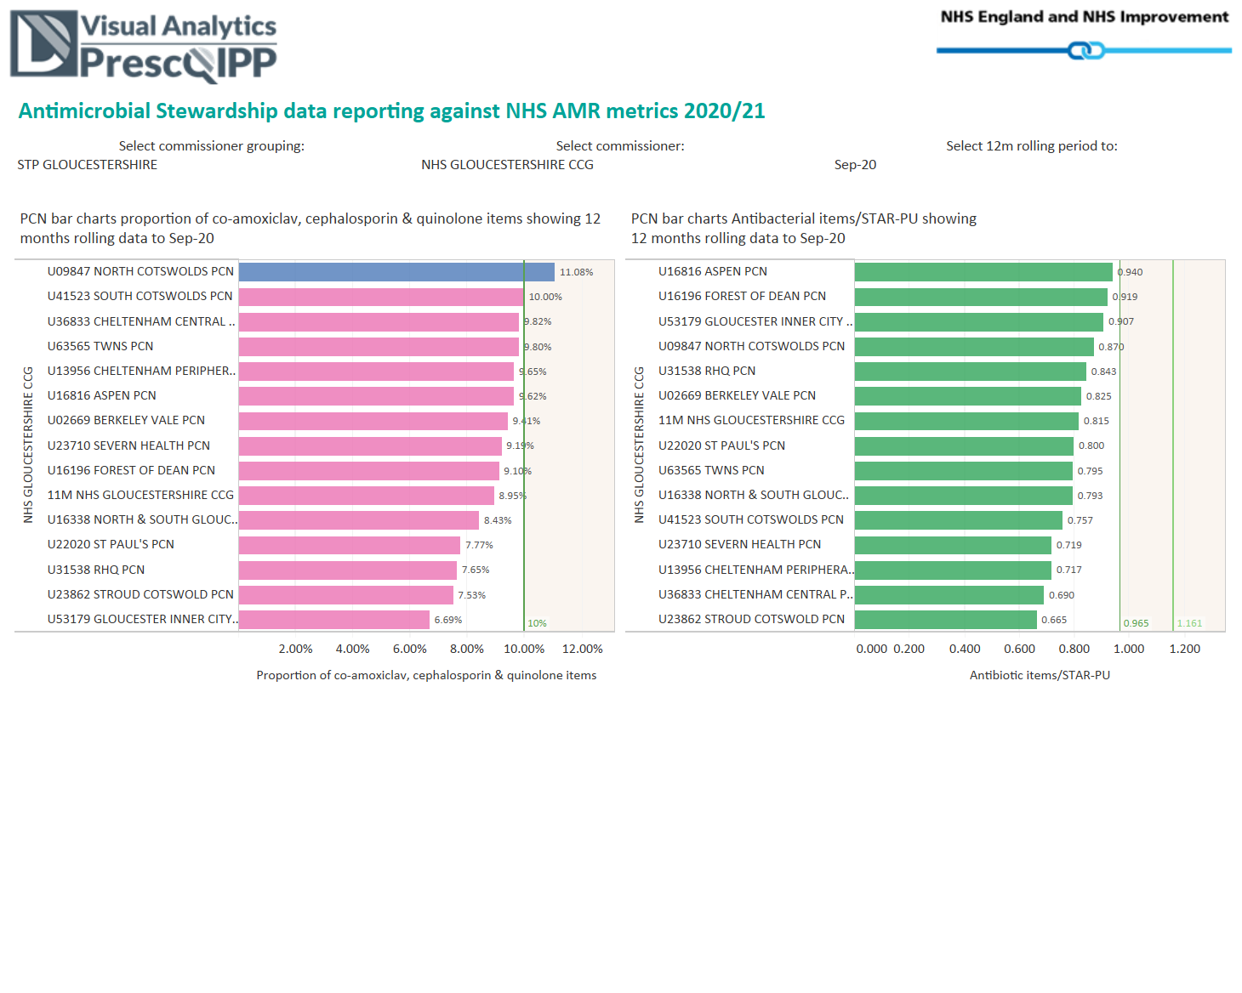
Notes:
In this example I have suggested we look at bar charts by primary care network.,
CLICK and have in the same way as before selected STP Gloucestershire –
this shows the GP practices total antibiotics /STAR PU allowing for list size and age, and the proportion of co-amoxiclav, cephalosporin and quinolone items.
Using the website you can also look at time period trends of total antibiotics 3Cs or particular antibiotic, by CCG, Primary care network or practice

Slide 29
Notes:
The national guidance is advising increased nitrofurantoin use – you can use presQipp or visit fingertips to examine your nitrofurantoin and trimethoprim use - your local medicine manager can produce graphs like this one.

Slide 30
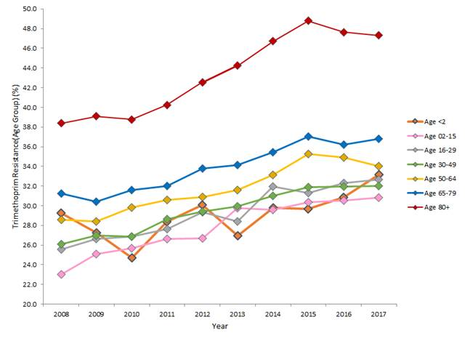
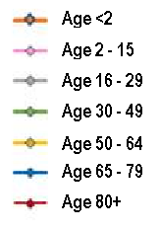
Why nitrofurantoin first-line? Trimethoprim resistance is very high
Clinical Scenario
Urinary Tract Infection
Nitrofurantoin replaced trimethoprim as 1st line in PHE guidance December 2014
47%
37%
Risk of resistance remains
2.5 x at 6 m post antibiotic
Notes:
Why do we need to use nitrofurantoin first line for most patients?
Trimethoprim resistance increased until 2015 and especially in the over 80s
Since 2015 resistance to trimethoprim has dropped – but not enough yet to recommend its use empirically. This is evidence that decreasing use in the UK can help reverse upward trends in antibiotic resistance.
However remember nitrofurantoin should not be used if upper UTI is suspected or the eGFR is less than 45 ml/min. Another choice may be pivmecillinam if your laboratory undertakes susceptibility testing on this antibiotic.
Furthermore, all patients should be told to come back to the GP if their symptoms haven't improved by 3 days or have got worse despite antibiotics. You can still use trimethoprim if you have a urine susceptibility, or the patient is younger, or your local susceptibility data indicates that resistance is very low.
It would be useful do your own audit of your practice results, to see how many women with suspected UTI have one, what they are prescribed, the clinical outcome in your patients with UTI, and see if there has been an increase in patients returning after being given trimethoprim.
Background information.
The data for the 80 and over age group in Wales shows a statistically significant reduction in the resistance rate for trimethoprim between 2015 and 2017 from 48.8% [48.1, 49.5] to 47.3% [46.7, 47.9]. [95% Confidence Intervals are shown in brackets].
The reduction in trimethoprim resistance in other age groups between 2015 and 2017 is not statistically significant.
This data from Welsh primary care patients (who I think would be considered similar to the rest of the UK!), shows that antibiotic resistance is significantly higher in those over 80 years.
This data does not represent the data for all patients presenting to you with acute uncomplicated UTI, as we know most GPs tend to only send urines to the laboratory from patients with recurrent UTI or persistent symptoms, but it certainly gives us some indication of the greater resistance in the elderly and how it is slowly increasing over time.
It is likely to be about half the rate showed on this biased lab data in community patient urines.
What are the implications of this data? It suggests that nitrofurantoin would be a better choice first line in acute uncomplicated UTI as resistance is lower. However nitrofurantoin should not be used if upper UTI is suspected or the eGFR is less than 45 ml/min. Another choice may be pivmecillinam if your laboratory undertakes susceptibility testing on this antibiotic. Furthermore, all patients should be told to come back to the GP if their symptoms haven't improved by 3 days or have got worse despite antibiotics. You can still use trimethoprim if you have a urine susceptibility, or the patient is younger, or your local susceptibility data indicates that resistance is very low. Alternatively you could do your own audit of your practice results, to see how may women with suspected UTI have one, what they are prescribed, the clinical outcome in your patients with UTI, and see if there has been an increase in patients returning after being given trimethoprim.

Slide 31
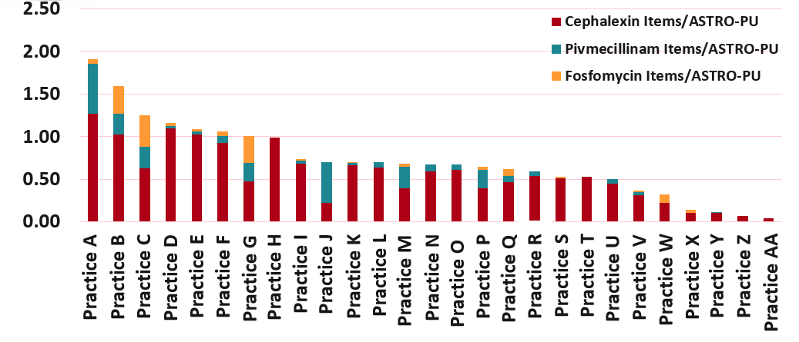
Cephalexin, Pivmecillinam & Fosfomycin Items per 1,000 ASTRO-PU
August 2019 to July 2020
Remote Assessment V4
31
Notes:
You or your medicine manager can also produce graphs showing use of other UTI agents. This is useful to see what other practices like yours are doing.

Slide 32
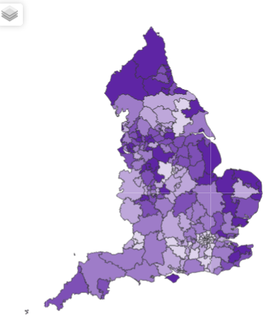
Fingertips AMR Local Indicators
https://fingertips.phe.org.uk/profile/amr-local-indicators
Since April 2016 146 indicators launched in six domains:
Antimicrobial Resistance (AMR)
Antibiotic Prescribing
Healthcare-Associated Infections (HCAI)
Infection Prevention and Control (IPC)
Antimicrobial stewardship (AMS)
Supporting NHS England Initiatives
By
CCG, General Practice,
NHS acute Trust, lab
32
Courtesy of Dr Diane Ashiru-Oredope
Johnson AP et al. 2017. JAC
Notes:
Started with approx 50 indicators
Have added new indicators almost every month since launch

Slide 33
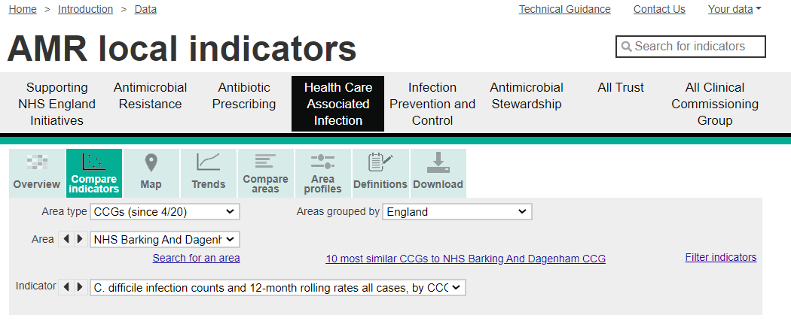
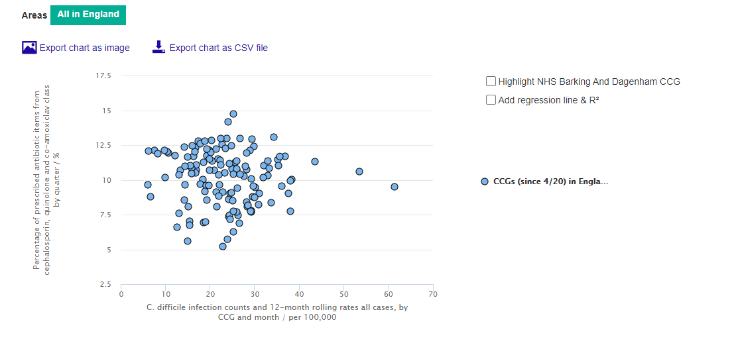
F
Fingertips
Broad-spectrum antibiotics vs Clostridium difficile rates
Allows comparison by CCG
all AMR indicators
other public health data available
33
Notes:
This graph shows Broad-spectrum antibiotics vs Clostridium difficile rates
And shows how they are related
Allows comparison by CCG of
all AMR indicators
other public health data available

Slide 34
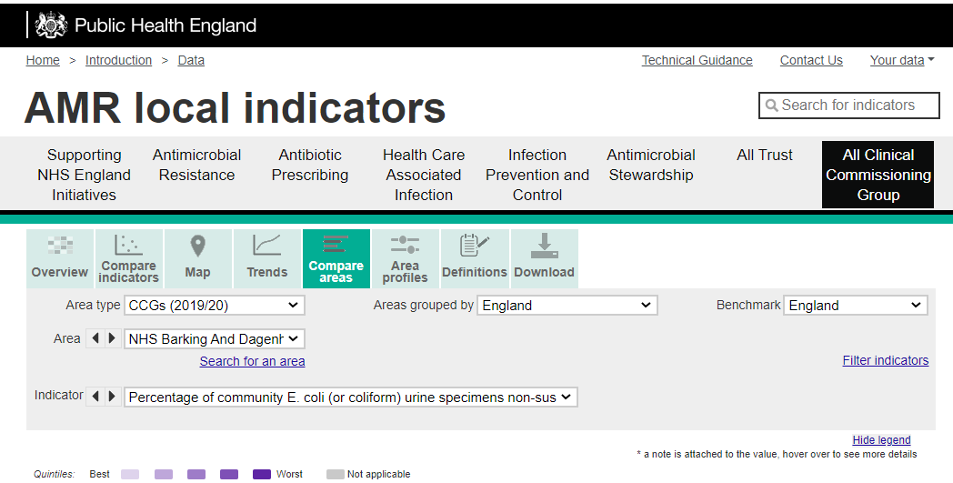
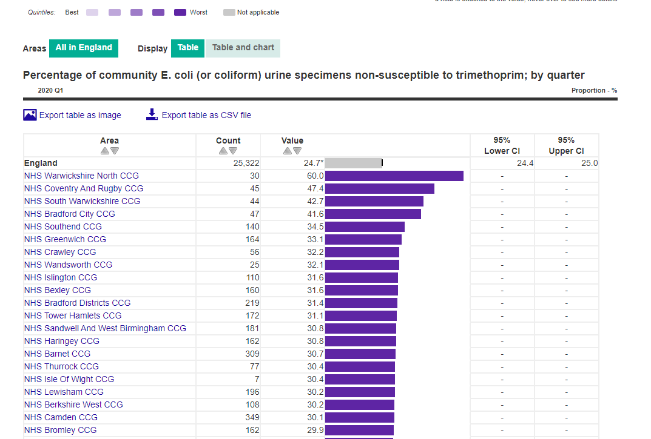
Percentage of community E. coli (or coliform) urine specimens non-susceptible to trimethoprim; by quarter
34
Courtesy of Dr Diane Ashiru-Oredope
Notes:
Fingertips also gives you local antibiotic resistance data
This one shows the Percentage of community E. coli (or coliform) urine specimens resistant to trimethoprim; by quarter

Slide 35
Key 2020 antibiotic prescribing messages
Back-up prescribing works
Reducing prescribing helps reduce workload
The benefit achieved from prescribing antibiotics in otitis media in children is small
Do not dipstick over 65s
Prescribe doxycycline for acute cough
Prescribe cefalexin for pyelonephritis
Develop an action plan on how to use the diagnostic flowcharts, leaflets and audits

Slide 36
Action planning: Developing priorities, for you now
Aim: to improve antibiotic use and help control resistance
HOW
Pause the webinar and spend a few minutes noting what you can do in your practice to help improve
Your antibiotic use
Antibiotic prescribing in your practice
Please note
who will do it
How it will be attained
When it will be attained by
Notes:
Take a moment now to reflect on what you can do to improve antibiotic use and help control resistance
PAUSE
Here are some suggestions from recent workshop attnedees
Make sure everyone has access to antibiotic guidance
Use the diagnostic flowcharts to help patient triage
Use back-up/delayed prescribing (the leaflet will help)
Use leaflets to safety net and increase patient understanding
Develop computer prompts to increase use of leaflets and flowcharts – use Accurix or Ardens
Use Fingertips or PrescQipp to monitor usage
Do an antibiotic audit with action planning
Give an individual responsibility of taking these forward

Slide 37
Action planning: Developing priorities, for you now
Aim: to improve antibiotic use and help control resistance
HOW
Make sure everyone has access to antibiotic guidance
Use the diagnostic flowcharts to help patient triage
Use back-up/delayed prescribing (the leaflet will help)
Use leaflets to safety net and increase patient understanding
Develop computer prompts to increase use of leaflets and flowcharts – use Accurix or Ardens
Use Fingertips or PrescQipp to monitor usage
Do an antibiotic audit with action planning
Decide now who will be responsible for each of these agreed actions
Notes:
Take a moment now to reflect on what you can do to improve antibiotic use and help control resistance
PAUSE
Here are some suggestions from recent workshop attnedees
Make sure everyone has access to antibiotic guidance
Use the diagnostic flowcharts to help patient triage
Use back-up/delayed prescribing (the leaflet will help)
Use leaflets to safety net and increase patient understanding
Develop computer prompts to increase use of leaflets and flowcharts – use Accurix or Ardens
Use Fingertips or PrescQipp to monitor usage
Do an antibiotic audit with action planning
Give an individual responsibility of taking these forward

Slide 38
Many thanks to everyone at the RCGP and in the PCIU for facilitating this webinar
Please complete the evaluation form bit.ly/TARGETcascaded
to receive your CPD certificate.
If you have any queries, please contact TARGETAntibiotics@phe.gov.uk
TARGETantibiotics@phe.gov.uk

