Slide 1
Audits as an antimicrobial stewardship tool
TARGET Antibiotic Toolkit
2023
Notes:
Audience: Mainly primary care prescribers, GPs, nurses, clinical pharmacists, antimicrobial pharmacists, those assigned to carry out clinical prescribing audits

Slide 2
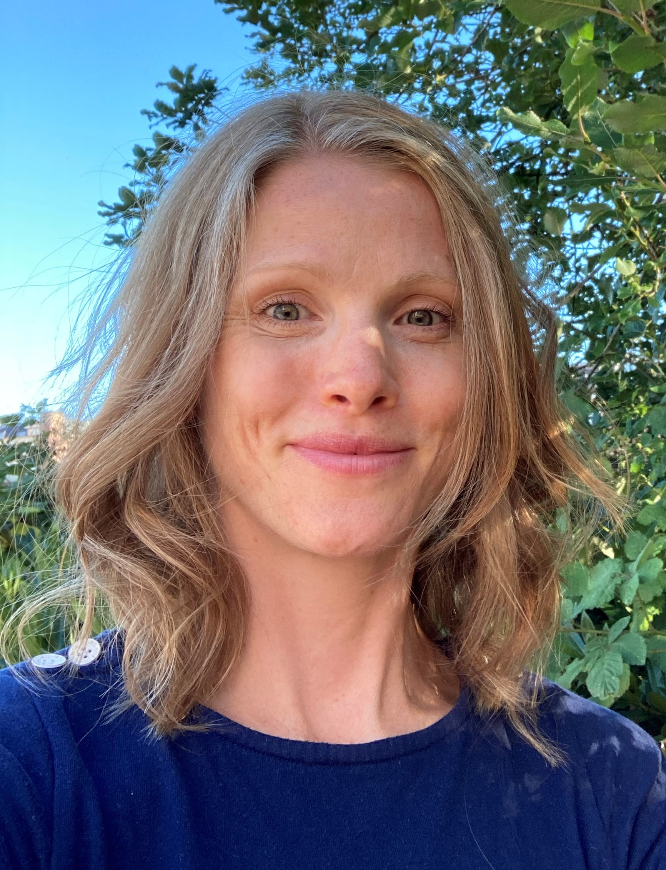
Introductions
Erica Elsden (Speaker)
Lead Medicines Optimisation Pharmacist,
NHS Hampshire & Isle of Wight Integrated Care Board
Dr Philip Anyanwu (Panellist)
Associate Professor,
Public Health, University of Warwick
Clara Tam (Panellist)
Antimicrobial Pharmacist,
NHS Betsi Cadwaladr University Health Board, Wales
Notes:
Presenter talk
Erica Elsden works in Hampshire and Isle of Wight ICB and her role is Lead Medicines Optimisation Pharmacist. She leads a team of 4 Medicines Optimisation Pharmacists; we work across 33 GP practices in the South Eastern Hampshire Area supporting prescribing quality, safety and efficiency, with a strong focus on antimicrobial stewardship (AMS). She has used the TARGET audits for many years as a part of AMS initiatives. Her background is in community pharmacy and she moved from there into Clinical Commissioning Group (CCG)/ Integrated Care Board (ICB) roles in 2017.
Dr Philip Anyanwu is an Associate Professor (Reader) in Public Health at Warwick Medical School. He is an Epidemiologist with research interests in infectious disease epidemiology, social epidemiology, digital health, and public health policy evaluation using big data. He has experience leading and delivering research projects evaluating the mechanism of impact of policies on antimicrobial stewardship, smoking in adults and children, COVID-19, and the inequalities therein. Philip has a specific interest in the evaluation of digital applications for the management of infectious diseases, especially in low- and middle-income countries (LMICs).
Philip’s scholarship activities include knowledge exchange on evidence-based pedagogic practices in higher education in low and middle-income countries. He is a co-applicant on a Horizon 2020 project on infectious disease outbreak investigation capacity building in Africa.
Clara Tam has been an antimicrobial pharmacist working at Betsi Cadwaladr University Health Board (BCUHB) since 2020. She is also a member of the Welsh Antimicrobial Pharmacy Group (WAPG). She supports BCUHB antimicrobial stewardship programme across primary care and secondary care. As part of her role, she routinely supports general practice in optimising antimicrobial prescribing through audits and feedback.

Slide 3
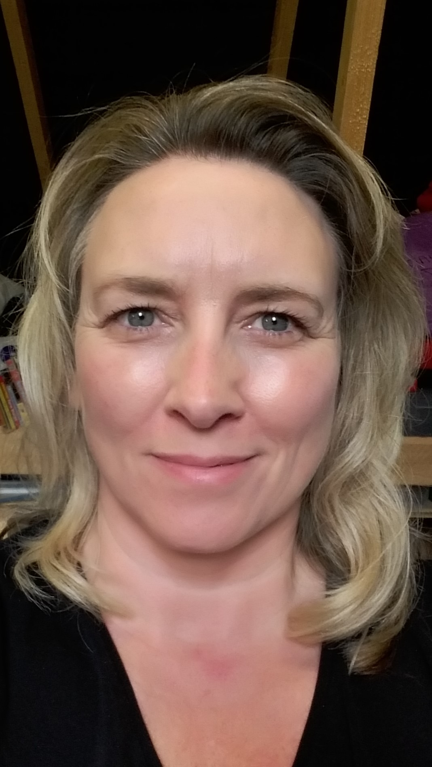
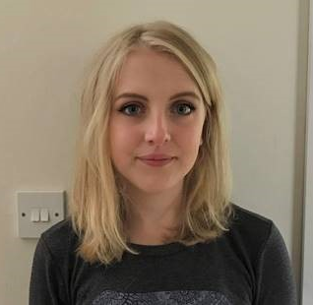
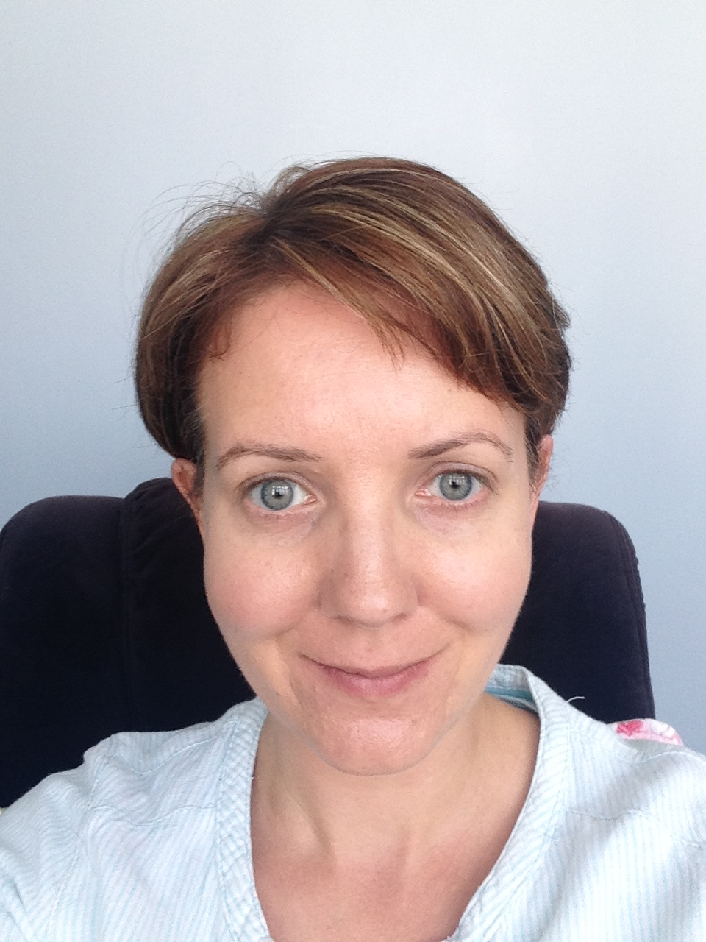
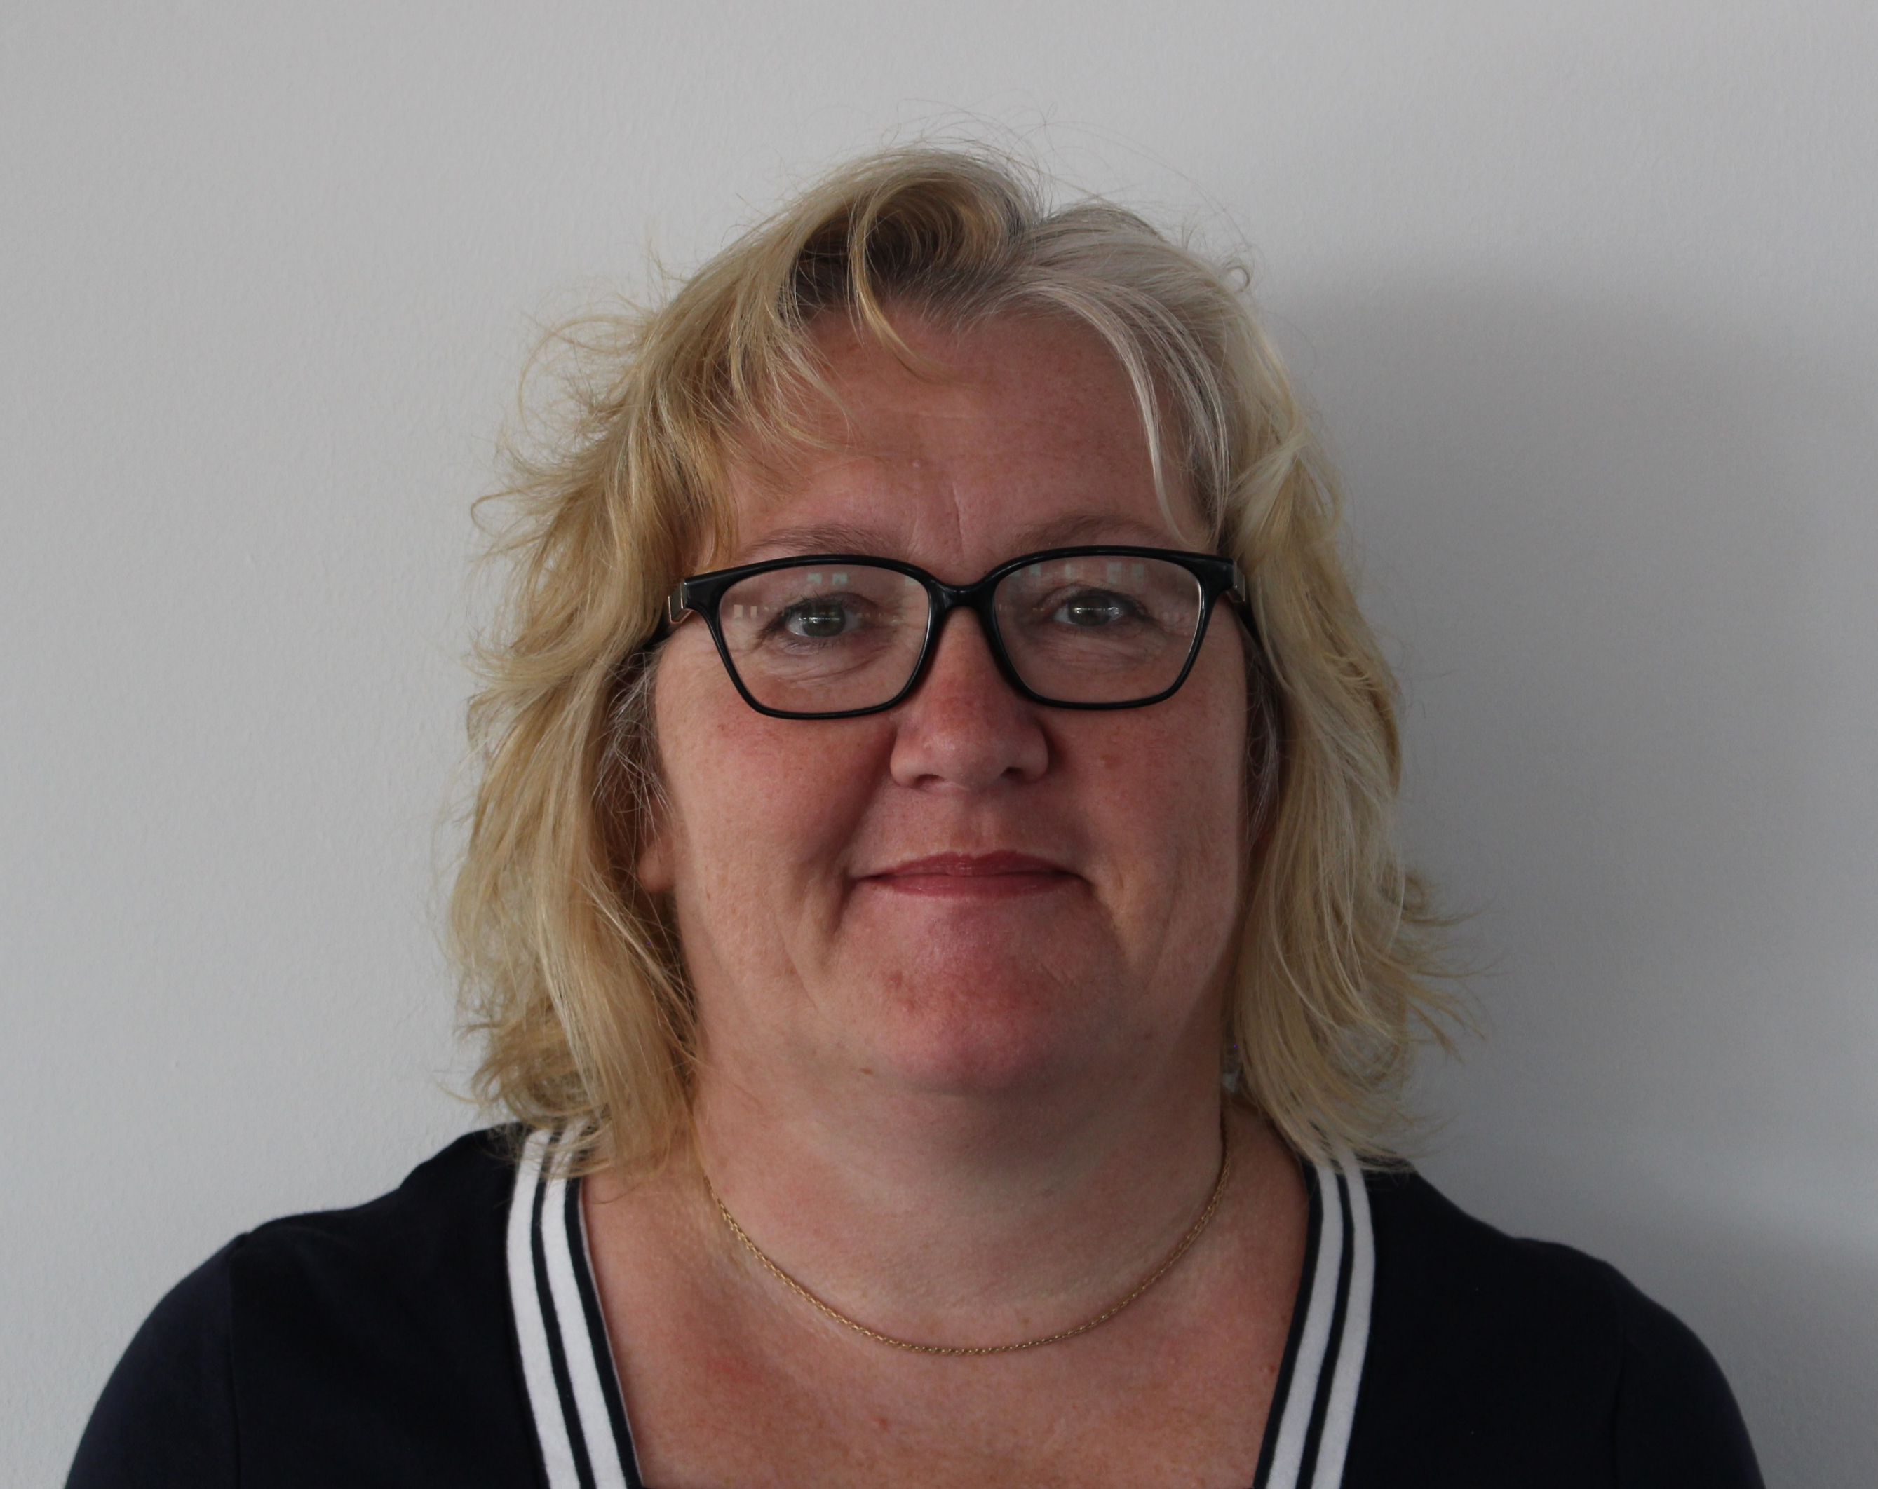
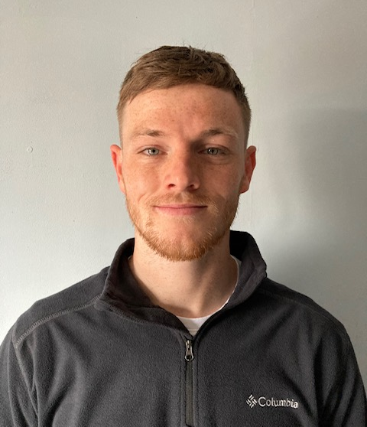
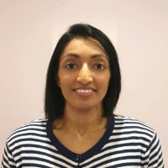
Introductions – TARGET and RCGP
Dr Donna Lecky
Cath Hayes
Emily Cooper
Eirwen Sides
Fionna Pursey
Julie Brooke
Liam Clayton
Camilla Stevenson
Dr Dharini Shanmugabavan
Notes:
Presenter talk

Slide 4
Topics to cover
Background and context
Why use audit and feedback?
Prescribing data sources
Available audit tools
Practical tips
Case study: How a practice improved UTI management by using audits and other tools
Notes:
Presenter talk
In this webinar we will cover:
Background and context to antimicrobial resistance and prescribing in primary care.
The benefits of using audit and feedback, including evidence to support audit and feedback.
Highlight some sources of prescribing data.
Audit tools that are free and available for you to use in your practice.
Practical tips that will support you when carrying out an audit.
A real-life case study that demonstrates how a practice improved UTI management by using audits and other tools.

Slide 5
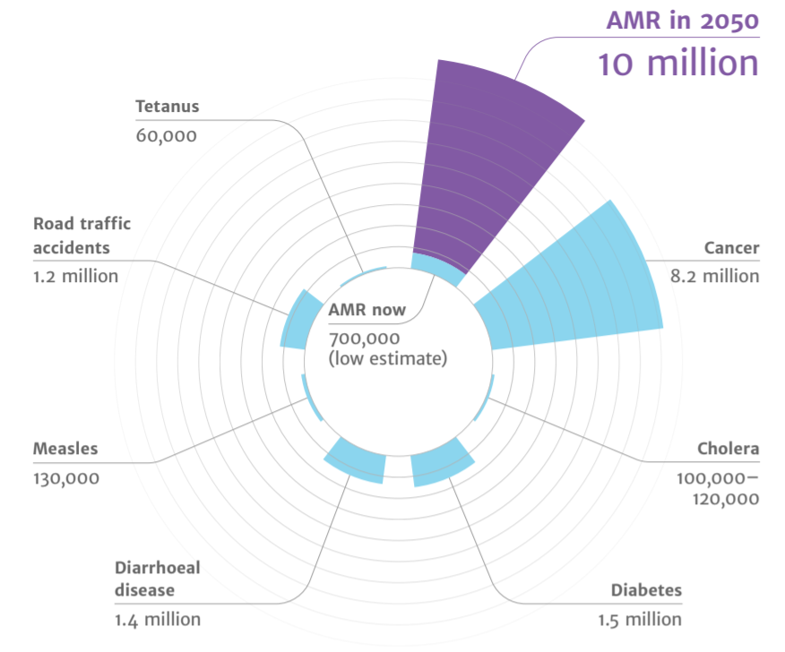
Antimicrobial resistance a major issue
Diabetes
and cancer
combined
AMR
2050
Deaths attributed to AMR every year
AMR in 2050
10 million
Tetanus
60,000
Road traffic accidents
1.2 million
10,000,000
9,700,000
Cancer
8.2 million
AMR now
700,000
(low estimate)
Cholera
100,00 – 120,000
Measles
130,000
Diarrhoeal disease
1.4 million
Diabetes
1.5 million
(O ’Neill, 2016)
Notes:
Presenter talk
I’m sure you are all already aware of the issues associated with AMR in your daily practice. However, on a global scale though, recent UN report (2), (April 2019) highlighted that is nothing is that by 2050, AMR could kill 10 million people per year, in its worst-case scenario. This is more than diabetes and cancer combined. This will also come at a cost of £66 trillion pounds.
There have been a number of initiatives and developments at a national level to get people thinking responsibly about antibiotic prescribing. NICE issued guidance on Antimicrobial Stewardship (NG 15); the NHS and Public Health England jointly issued a Patient Safety Alert around AMS; there are prescribing quality measures and incentives and the DH would like us to get back to the level of prescribing that we had in 2010.
The TARGET Guide to Resources provides more detail on these measures, and the TARGET toolkit helps to optimise your use of antibiotics.
Slide references
The review on antimicrobial resistance, chaired by Jim O’Neill. Tackling drug-resistant infections globally: final report and recommendations. 2016. [Available from: https://amr-review.org/sites/default/files/160518_Final%20paper_with%20cover.pdf]
IACG (2019). “No time to wait: securing the future from drug-resistant infections”

Slide 6
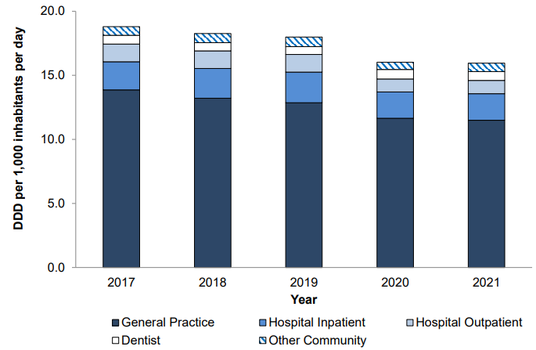
Majority of antibiotics are prescribed in general practice
Total antibiotic consumption by setting
May 2023
Notes:
Presenter talk
What does that mean for us in primary care? We know that around 71% of all antibiotics are prescribed in primary care. Research show that this equates to 1 in 3 individuals in England take at least one course of antibiotics or, about 29 million antibiotic items prescribed in England (2021/22 financial year).
Whilst the majority of these antibiotics are needed, previous studies estimated that one-fifth to one-third of UK antibiotic prescriptions in primary care are unnecessary or inappropriate. Although we have seen a continuing decline in primary care prescribing since 2014, it is important that we continue to monitor and review our prescribing behaviours.
There is a need to continue to review our antibiotic use in line with guidance. The guidance is based on national resistance patterns and evidence. Which leads nicely onto the next slide.
Presenter notes
Graph – Total antibiotic consumption by setting, expressed as DDDs per 1000 inhabitants per day, England, 2017 – 2021
Slide references
(1) UK Health Security Agency (2022). English surveillance programme for antimicrobial utilisation and resistance (ESPAUR), Report 2021-2022.

Slide 7
Why audit antibiotic prescribing?
Evaluate, support and promote good prescribing practices
Improve the quality of prescriptions
Improve prescribing safety in general practice
(Hughes, 2012)
Notes:
Presenter talk
By definition, a clinical audit is a quality improvement cycle that involves measuring healthcare effectiveness against agreed, evidence-based standards for high quality and taking action to guide practice in line with these standards (Burgess, 2011).
Firstly, audits evaluate, support and promote good prescribing practices, for example adherence to existing prescribing guidelines.
Secondly, audits can help improve the quality of prescriptions which can improves the quality of healthcare provided.
Finally, audits can improve prescribing safety in general practice, for example checking the correct drug/duration/dose or monitoring repeat prescriptions. Inappropriate drug/duration/dose or inappropriate repeat prescriptions can have implications for antimicrobial resistance.
Slide references
Burgess, R. 2011. New Principles of Best Practice in Clinical Audit. 2nd ed. Radcliffe Publishing Ltd.
Care in Mind. 2020. The importance of Clinical Audit (Online). Care in Mind. Available at: https://www.careinmind.co.uk/2020/11/27/the-importance-of-clinical-audit/ (Accessed on 22 August 2022)
Hughes, M. 2012. Clinical Audit: A Manual for Lay Members of The Clinical Audit Team. Health Quality Improvement Partnership

Slide 8
Why use audit and feedback?
Identify areas for improvement and areas to celebrate
Personal development & reflection on own antibiotic prescribing
Practice-wide reflection on antibiotic prescribing
Problem solving
Action to support positive change
Optimise prescribing & reduce AMR
May 2023
Notes:
Presenter talk
Now to focus on audit and feedback in particular. Why is it useful?
It can be used to help teams identify areas for improvement and areas to celebrate. For example, perhaps an audit might show that a practice might need to work on improving prescribing the correct course length of antibiotic in line with national guidelines.
It can be used for personal development and reflection on own antibiotic prescribing.
As well as personal reflection, it can also be used for practice wide reflection on antibiotic prescribing, for example presenting audit results visually in a practice meeting to discuss.
Audits are a useful tool for problem solving. We will get into a real life example of this later on.
Having considered all of this, audit and feedback of results can be used to develop a plan of action to help sup[port positive change.
So how does this impact the bigger picture? All of the points mentioned on the slide can help optimise antibiotic prescribing and reduce antimicrobial resistance.

Slide 9
Audit and feedback cycle for positive change
Identify area for review
Carry out audit
Interpret & feedback results
Action plan
Positive change
Notes:
Presenter talk
This slide shows stages of the audit and feedback cycle.
Identify the area for review – this could be a known problem prescribing area, an area identified by a Quality premium or for personal reflection purposes.
Audit prescribing in this area – identify what you are auditing – treatment based on condition, specific antibiotic prescribing regardless of condition, provision of advice, or something else.
It is crucial to then interpret and reflect on findings to either self, individuals or team depending on how and what you are auditing.
This leads into what is arguably the most important element of the audit cycle – action planning – what, if anything, is required to change and how do you plan to do this, when do you plan to review, etc. It is strongly recommend that if this is recommendations for a whole practice, then you get the whole practice views and opinions.
Finally implementing the action plan.
And repeat as necessary.
Slide references
Adapted from Hughes, M. 2012. Clinical Audit: A Manual for Lay Members of The Clinical Audit Team. Health Quality Improvement Partnership

Slide 10
Audit and feedback: effectiveness
Cochrane Review of randomised controlled trials
Audit and feedback increases healthcare professional compliance with desired practice
Feedback may be more effective when:
Baseline performance is low
The source is a supervisor or colleague
Provided more than once
Delivered in both verbal and written formats
It includes explicit targets & an action plan
Notes:
Presenter talk
Now we will highlight some evidence that demonstrates the benefits and effectiveness of using audit and feedback. This slide shows some findings from a Cochrane Review of randomised controlled trials of audit and feedback.
It showed that audit and feedback increases healthcare professional compliance with desired practice. Findings indicated that feedback may be more effective when baseline performance is low, the source is a supervisor or colleague, it is provided more than once, it is delivered in both verbal and written formats, and when it includes both explicit targets and an action plan. In addition, the effect size varied based on the clinical behaviour targeted by the intervention.
The authors concluded that audit and feedback generally leads to small but potentially important improvements in practice. Few studies included in the review looked at patient outcomes as a primary outcome, suggesting that further research is needed in this area.
Presenter notes
After excluding studies at high risk of bias, there were 82 comparisons from 49 studies featuring dichotomous outcomes, and the weighted median adjusted risk difference (RD) was a 4.3% (interquartile range (IQR) 0.5% to 16%) absolute increase in healthcare professionals' compliance with desired practice. Multivariable meta‐regression indicated that feedback may be more effective when baseline performance is low, the source is a supervisor or colleague, it is provided more than once, it is delivered in both verbal and written formats, and when it includes both explicit targets and an action plan. In addition, the effect size varied based on the clinical behaviour targeted by the intervention.
Slide references
Ivers N, Jamtvedt G, Flottorp S, Young J et al 2012. Audit and Feedback: effects on professional practice and healthcare outcomes. Cochrane Database Syst Rev, Cd000259

Slide 11
Audit and feedback can reduce antibiotic prescribing
Baseline
Follow-up
Control group
Randomised controlled trial
8.3
- 0.4
7.9
Audit & feedback intervention group
8.5
- 1.0
7.5
(Antibiotic items per 100 NHS treatment claims)
Notes:
Presenter talk
This slide shows another study that looked at the effectiveness of audit and feedback in the dental practice setting. It was a randomised controlled trial, where all 795 antibiotic prescribing NHS dental practices in Scotland were randomly allocated to receive or not receive audit and individualised feedback.
Firstly, they measured baseline antibiotic prescribing, which was 8.3 antibiotic items per 100 NHS treatment claims in the control group, and 8.5 items per 100 treatment claims in the group that used audit and feedback (so slightly higher than the control group).
[Click to show follow-up]. After follow-up antibiotic prescribing had decreased by 0.4 antibiotic items per 100 NHS treatment claims in control practices and by 1.0 in the audit and feedback practices. This represents a significant reduction in dentists' prescribing rate in the audit and feedback group relative to the control group.
Slide references
Elouafkaoui P, Young L, Newlands R, Duncan E et al 2016. An Audit and Feedback intervention for reducing antibiotic prescribing in General Dental Practice. The Rapid Cluster Randomised Control Trial. Plos Med, 13, e1002115.

Slide 12
Audit and feedback thought to increase engagement & help achieve antibiotic targets
Workshop with AMS leads within Clinical Commissioning Groups (CCGs)
Audits help increase engagement between GP practices and commissioning groups to achieve Quality Premium antibiotic targets
Notes:
Presenter talk
This slide shows the outcome of a workshop exploring the experiences of antimicrobial stewardship (AMS) leads within CCGs in selecting and adopting strategies to help achieve the QP antibiotic targets. Key themes were identified from the notes on discussions and observations from the workshop. It was identified that audits help increase engagement between with GP practices and commissioning groups to achieve Quality Premium antibiotic targets.
The authors concluded that national targets, rather than financial incentives are key for engaging stakeholders in quality improvement in antibiotic prescribing.
Slide references
Anyanwu, P E, Borek, A J, Tonkin-Crine, S, Beech, E and Costelloe, C. 2020. Conceptualising the integration of Strategies by Clinical Commissioning Groups in England toward the Antibiotic Prescribing Targets for The Quality Premium Incentive Scheme: A Short Report. Antibiotics (Basel), 9

Slide 13
What data can be used to look at prescribing?
PrescQIPP
OpenPrescribing
Fingertips
ePACT/ePACT2
Notes:
Presenter talk
Databases provide information on antibiotic prescribing down to the practice-level. First, we will show you how to access prescribing data in each of these different data sources.
Note that this does not provide specific information tailored to individual patients, diagnosis and management decision. This more detailed information is needed to complete a TARGET audit. We will go into more detail on this later.

Slide 14
https://www.prescqipp.info/our-resources/webkits/antimicrobial-stewardship/
Notes:
Presenter talk
PrescQIPP is freely accessible and no login is required. It can be accessed through the link at the top of the screen: https://www.prescqipp.info/our-resources/webkits/antimicrobial-stewardship/
Then, click ‘AMS Visual Analytics to support Antimicrobial Stewardship activity’, and the year in which you are interested. The information dates back to 2017/18.
We will now look at the data visualisation features available through PrescQIPP.
Presenter notes
Other resources available on PrescQIPP include:
Bulletins and briefings: clinical evidence, information and guidance about a range of treatments and conditions
Data: to help commissioners benchmark their activity and identify where they can make the biggest difference
Web kits: practical tools and materials such as patient information and letters, pathways and audits
Webinars: support learning on a variety of relevant topics

Slide 15
PrescQIPP: Accessing prescribing data Gloucestershire ICB (Mar 2022 – Feb 2023)
Notes:
Presenter talk
PrescQIPP will be updated at the start of each month. You can visualise prescribing data by region, integrated care board (ICB), primary care network (PCN) and GP practice.
To view antibiotic prescribing data, click the “trend antibiotic items by selected commissioner” tab at the top of the screen. [Click mouse to show the tab]
This graph plot shows the variation in total number of antibiotic items on the vertical Y axis, and the month on the X axis.
This menu on the right hand side of the window will allow you to filter locations and drugs. [Click mouse to show filter options] This includes the following:
Filter organisation grouping, for example ICB of interest. In this case, Gloucestershire ICB is selected
Filter drug sub paragraph, for example cephalosporins
Filter chemical substances i.e. specific antibiotics such as amoxicillin
As you can see on this graph, amoxicillin is the most prescribed antibiotic in terms of total items prescribed.

Slide 16
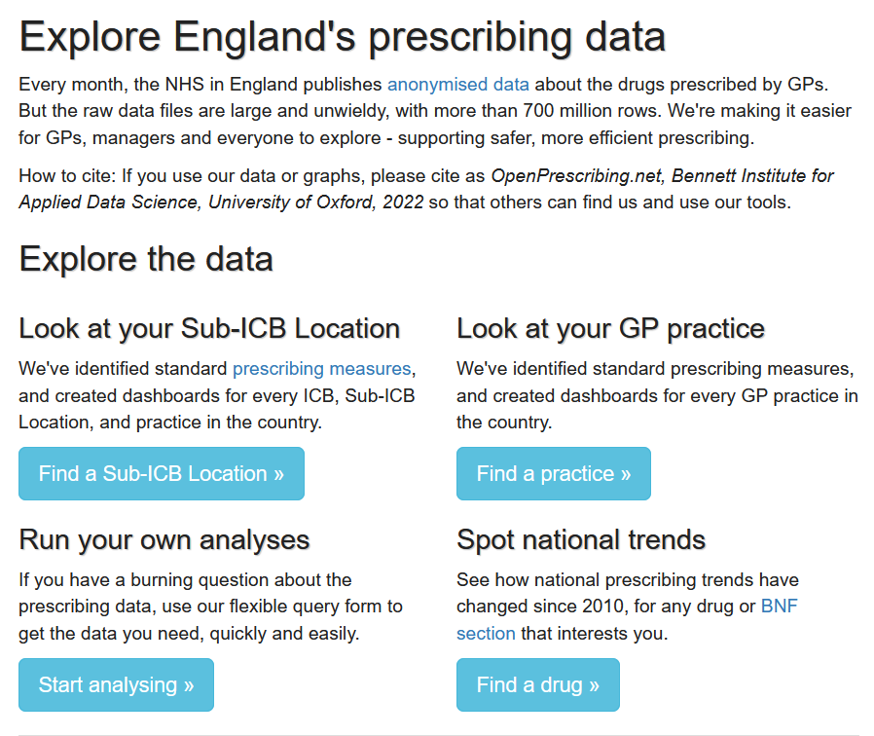
openprescribing.net/
OpenPrescribing
Open access
Drug prescribing
Monthly prescribing alerts
Notes:
Presenter talk
OpenPrescribing is open access and allows you to look at drug prescribing and can provide monthly prescribing alerts. Data can be viewed from national trends down to the sub- integrated care board (ICB) and GP practice level. You can run your own analyses.

Slide 17
Notes:
Presenter talk
To run your own analyses, click here.

Slide 18
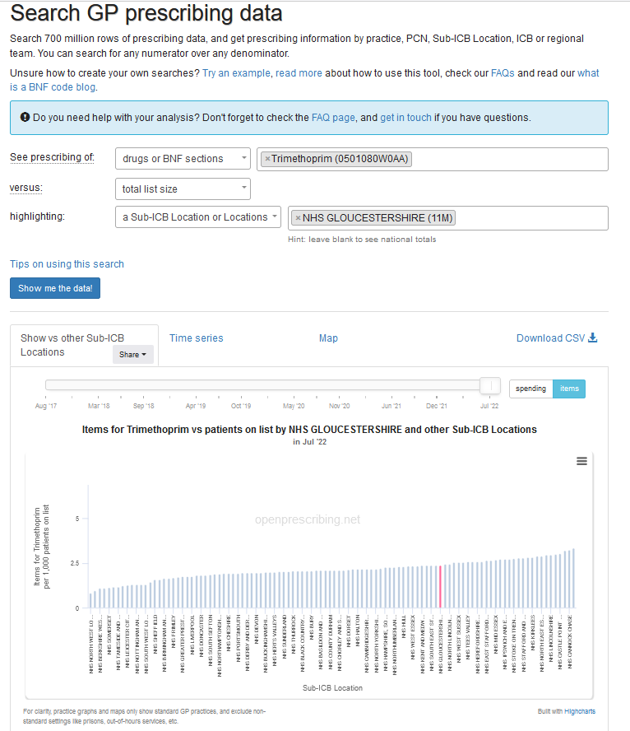
OpenPrescribing: Run your own analysis
1. Choose prescribing drug
2. Compare against
Nothing
Drugs or BNF sections
Total list size
STAR-PUs for antibiotics
3. Highlight
Practice(s)
Sub-ICB location(s)
PCN(s)
ICB(s)
Region
Gloucestershire ICB
Notes:
Presenter talk
You can select the drug of interest. Here we have selected trimethoprim [Click mouse to highlight]. You can then choose which measures to compare against, for example nothing, drugs, total list size or STAR-PUs for antibiotics. The you can highlight your location, this could be at practice sub-integrated care board (ICB) location, primary care network (PCN), ICB and region level.
[Click mouse to show graph]. This graph shows the variation in items of trimethoprim per 1,000 patients on list on the Y axis by sub-ICB location in July 2022. Here we have chosen to highlight Gloucestershire ICB in red.
Presenter notes
STAR-PUs

Slide 19
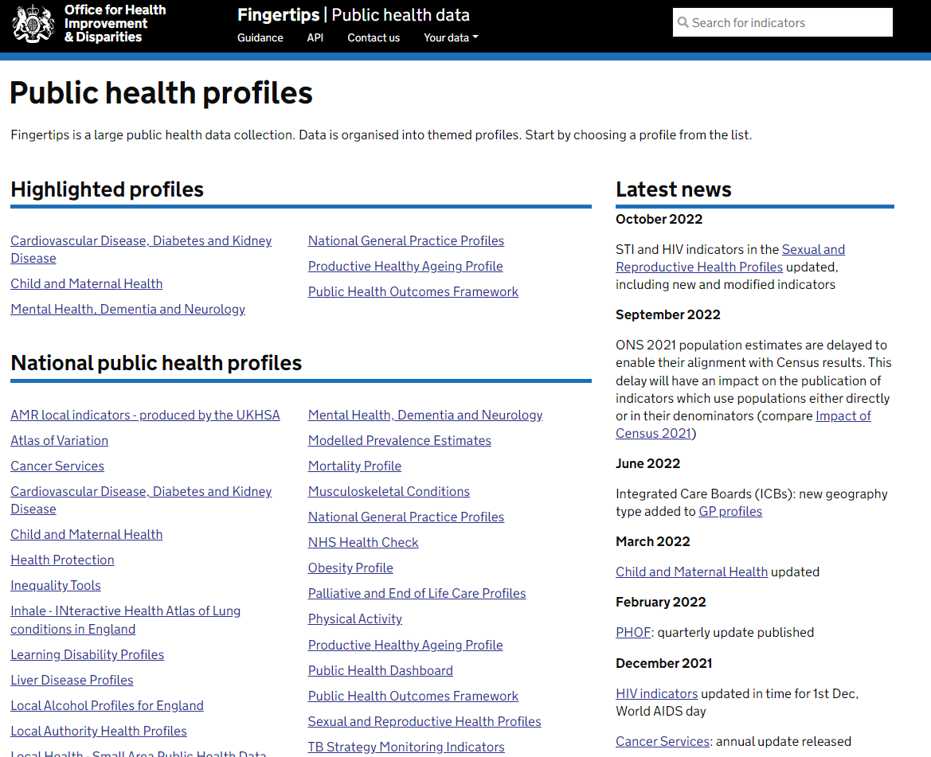
fingertips.phe.org.uk/
Open access
Browse indicators at different geographical levels
Benchmark against the regional or England average
Export data to use locally
Notes:
Presenter talk
Fingertips is also open access and allows you to browse antimicrobial resistance indicators at different geographical levels. You can compare data against the regional or English average and export data to use locally. To access the data you click here on “AMR local indicators”. It is produced by the UK Health Security Agency (UKHSA, formerly Public Health England).

Slide 20
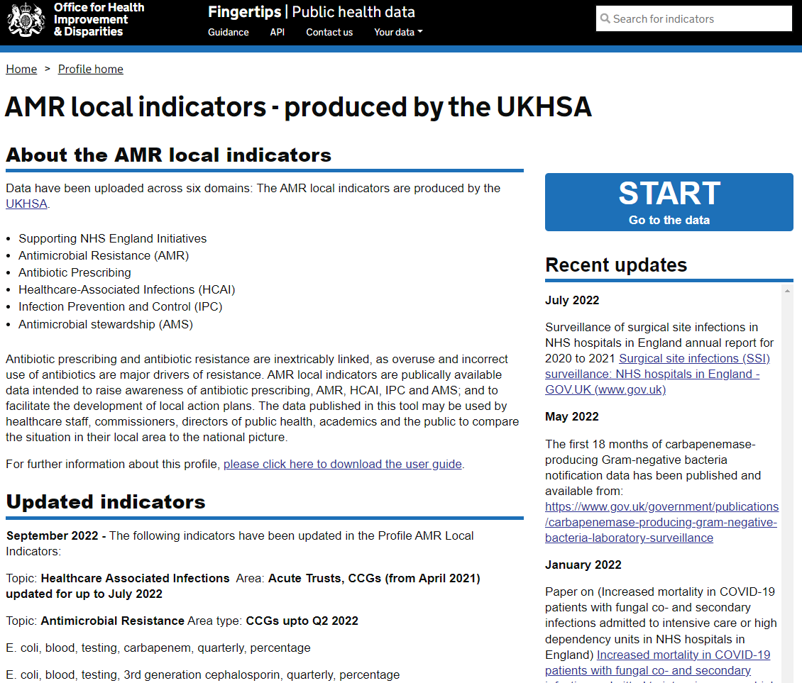
Notes:
Presenter talk
Then you click on “START” here on the right.

Slide 21
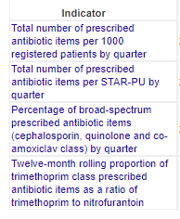
Notes:
Presenter talk
Then, once you are in the AMR local indicators section, you click on the “Antibiotic Prescribing” tab at the top. [Click mouse to highlight “Antibiotic Prescribing” tab]
[Click mouse to highlight overview]. Then this tab shows you an overview, or you can compare indicators, trends, areas and export data.
[Click mouse to highlight area filters]. This section allows you to filter and group by different geographical levels, right down to the GP practice level.
[Click mouse to highlight the key]. The different shades of purple represent the best to worst performing quintiles for different indicators.
[Click mouse to highlight GP practices]. Here at the top are GP practices, so you can view different indicators by GP practice.
[Click mouse to highlight indicators]. Here on the left are the different indicators you can look at, including number of antibiotic items prescribed, percentage of broad spectrum prescribed antibiotic items and trimethoprim to nitrofurantoin ratio.

Slide 22
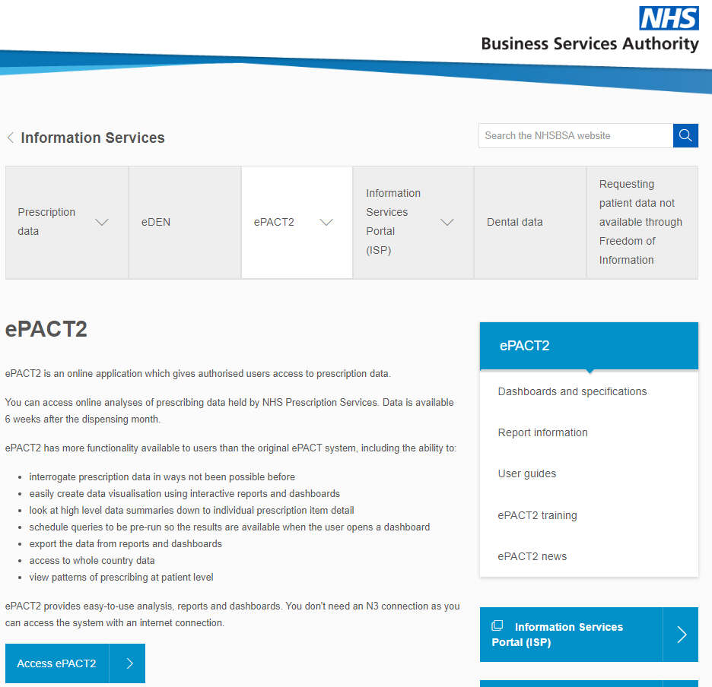
ePACT2 www.nhsbsa.nhs.uk/access-our-data-products/epact2
Registration with ePACT2
Dashboards
Prescribing reports
Customised for your GP/ICB
Notes:
Presenter talk
You have to register with ePACT2 and it provides dashboards and prescribing reports. It can be customised for your GP or Integrated Care Board.

Slide 23
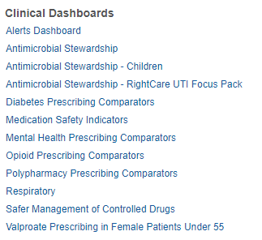
ePACT2 www.nhsbsa.nhs.uk/access-our-data-products/epact2
Notes:
Presenter talk
After logging into ePACT2 these are the different dashboards you can navigate through.

Slide 24
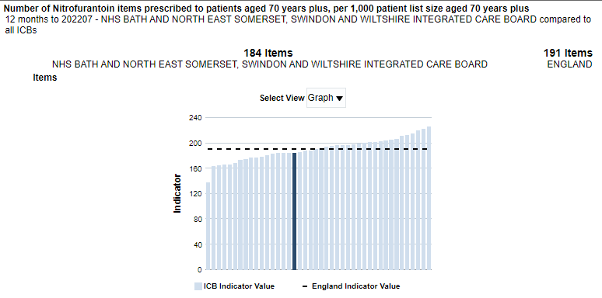
ePACT2 www.nhsbsa.nhs.uk/access-our-data-products/epact2
Notes:
Presenter talk
Selecting UTI Focus Pack enables you to view ICB prescribing rates against national and regional data.

Slide 25
TARGET audit templates
rcgp.org.uk/TARGETantibiotics
Audits adherence to NICE antimicrobial prescribing guidelines
MS Word and Excel
Includes step-by-step instructions
Calculates % adherence to guidelines
Summary report
Performance reflection questions
Allows to track performance
Notes:
Presenter talk
Now moving onto the TARGET Antibiotic Toolkit audit templates that are free to download and use. They are available here on the TARGET Antibiotic Toolkit [Click mouse to highlight audits section] under the section titled “Antibiotic stewardship tools, audits and other resources” [Click mouse to enlarge audits section].
How many of you have used TARGET audit templates before? [Give a couple of minutes to respond]
You will need additional information to complete these other than just antibiotic prescribing, as these audits, as they help assess diagnosis of infections and antibiotic prescribing against national guidelines. They are available in Microsoft Word and Excel formats, so you can choose your preference to complete digitally or in hard copy. They are simple to carry out, as each audit template includes step by step to walk you through how to carry out searches and complete the audit. There is a summary report and performance reflection questions to support your team in reflecting and acting on the results. They allow you and your team to track performance periodically.

Slide 26
TARGET audit templates
RTI audits
Acute cough
Acute otitis media
Acute rhinosinusitis
UTI audits
UTI non-catheterised patients over 65
Uncomplicated UTI for women under 65
UTI for catheterised patients
Antibiotic specific
‘4Cs’ broad-spectrum antibiotics
Notes:
Presenter talk
These are the audit templates TARGET have for different infections (respiratory and urinary tract), and the new ‘4C’ broad-spectrum antibiotics audit.

Slide 27
Uncomplicated UTIs for women under 65
Patients with specific condition/ prescription
Evidence of diagnostic/ management decision
Antibiotic choice
Dose/ frequency
Course length
Providing advice: self-care, safety netting, use of TARGET leaflet
Notes:
Presenter talk
Here on the screen is the different information you need to complete a TARGET audit, including: patients with specific condition/ prescription; evidence of diagnostic/ management decision; antibiotic choice; dose/ frequency; course length; and providing advice such as self-care, safety netting, use of TARGET leaflet. It is important to note that it is not just the drug type/ choice that is audited in the TARGET audits. Factors such as dose and duration are really important causes of inappropriate antibiotic prescribing.
[Click mouse to show summary report and reflection questions]. On the right is the summary report and outputs that are measured in TARGET audit templates, including percent compliance with national guidance (auto-calculates in Excel version) e.g. in terms of diagnostic/ management decision, antibiotic choice and dose. There is a section where the results can be summarised and questions to encourage reflection on you or your team’s performance. This means that performance can be tracked and reflected upon regularly.

Slide 28
Tailoring your approach to suit your practice: practical tips & ideas
Identify an audit lead
Incorporate as part of standard practice e.g. once every year/ quarter/ month
Audit and reflect on your own prescribing and/or the practice as a whole.
Coding of infections:
Inconsistency can impact data accuracy, search for specific antibiotics
Improving coding will make audits easier
Carry out audit
Notes:
Presenter talk
Feedback from qualitative work with GPs has indicated that lack of time is a key barrier to prescribers carrying out audits. Your practice could identify an audit lead to champion audits, supported by other members of the practice team to share the workload. For example, some team members could be responsible for carrying out searches and others could complete the audit itself. Audits could be carried out by practice staff including primary care prescribers, GPs, nurses and clinical pharmacists. With guidance, receptionists could export data from prescribing data sources to support with carrying out audits. NHS Integrated Care Board medicines optimisation teams also carry out audits as part of their work.
To maximise the benefit of audits, they should be incorporated as part of standard practice, for example your team could choose to audit antibiotic prescribing once every year, quarter or month. You can choose a specific time period to audit e.g. prescribing over one month.
If you are a prescriber, you could audit your own prescribing to self-reflect. For GPs, this can contribute to your revalidation (RCGP, 2022). You could choose to audit your practice as a whole.
Each TARGET audit template includes infection codes to search for, or if this does not yield enough results you can also search for specific antibiotics for infections e.g. UTI antibiotics if you are carrying out a UTI audit for patients over 65. Barriers to auditing include inconsistent coding, as it can impact the accuracy or completeness of data. Improving coding of infections and standardising across your team will make audits easier.
After this live webinar, the live recording and slides will be made available on the TARGET Toolkit. This could be used as audit refresher training for practice staff.
Slide references
Royal College of General Practitioners (2022). Appraisal and revalidation mythbusters. Available from: https://www.rcgp.org.uk/your-career/revalidation/mythbusters [Accessed 17 May 2023].

Slide 29
Tailoring your approach to suit your practice: practical tips & ideas
Consider factors that might impact results e.g. data availability, seasonal variation, population demographics
Feedback: clear, visual, use strategies including verbal, paper, electronic
Compare results against targets
Use practice meetings to present results, engage & develop an action plan
Interpret & feedback results
Notes:
Presenter talk
When interpreting your results there are some factors to consider. For example the availability of data, seasonal variation and population demographics. It might be useful to compare audit results from the same month in the previous year.
The way in which feedback is provided is key, it should be clear, visual and different strategies can be used such as verbal, on paper or electronic. If you recall one of the earlier slides, evidence shows that feedback may be more effective when: the source is a supervisor or colleague; provided more than once; and delivered in both verbal and written formats.
Comparing audit results against team or national targets could be useful to gauge performance.
Feedback could be provided during practice meetings, which gives an opportunity for the whole team to reflect on areas for improvement and areas for celebration. This can help engage all staff and develop an action plan to support positive change.
Slide references
Ivers N, Jamtvedt G, Flottorp S, Young J et al 2012. Audit and Feedback: effects on professional practice and healthcare outcomes. Cochrane Database Syst Rev, Cd000259

Slide 30
Tailoring your approach to suit your practice: practical tips & ideas
Develop action plan tailored to specific roles, with timelines
Whole practice approach
TARGET Toolkit has resources to help implement action plan
Re-audit regularly to monitor progress & change
Action plan & positive change
Notes:
Presenter talk
Now, a key part of the audit cycle is to act on its results. To facilitate this, your team could develop an action plan tailored to specific roles, with timelines. The TARGET Toolkit has resources to support development and implementation of action plans.
Adopting a whole practice approach helps to create positive change. I will highlight a real-life example of this in the next few slides.
To get the most out of this process, you could re-audit regularly to monitor progress and change.

Slide 31
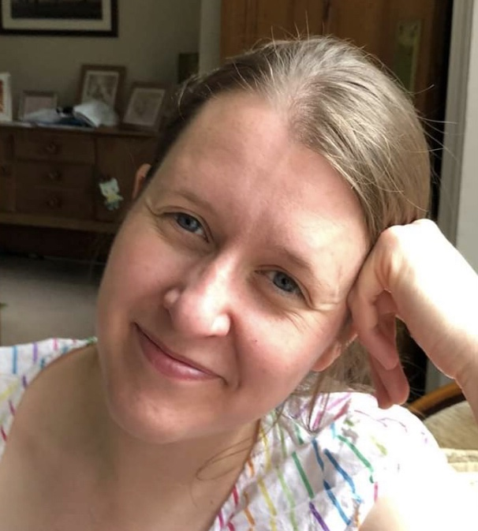
Case study: How a practice improved UTI management by using audits & other tools
Dr Linda Strettle,
GP, The Village Surgery, Rotherham
Notes:
Presenter talk
We are now going to talk about a real life example. If you want to find out more, take a look at the RCGP blog which will be linked in the slide notes. It is written by Dr Linda Strettle, a GP whose practice improved UTI management by using audits and other tools. This is a great example of how audits can be used an antimicrobial stewardship tool.
Slide references
Royal College of General Practitioners (RCGP) (2021). How our practice got better at UTI management. Available from: https://www.rcgp.org.uk/Blog/UTI-Management . [Accessed: 28 April 2023]

Slide 32
UTI audit case study: The issue
In 2020, 20-30 urine samples per day dropped to reception by patients, with incomplete forms
Further treatment prompted by urine dipstick result
Inefficient & risk for patient safety
Identify area for review
Notes:
Presenter talk
Firstly, the area for review was identified. The practice had a problem with ‘drop off’ urine samples. In 2020, patients were dropping off around 20-30 urine samples per day at our receptions. Patients would hand in their sample and complete a short form about their symptoms, which was often incomplete. All further treatment was then prompted by urine dipstick result.
Linda discussed this with the nursing team and they realised that this process was inefficient, time consuming and a risk for patient safety. They knew that a change was necessary. Linda attended TARGET antimicrobial stewardship training to help support in tackling this issue.
Slide references
Royal College of General Practitioners (RCGP) (2021). How our practice got better at UTI management. Available from: https://www.rcgp.org.uk/Blog/UTI-Management . [Accessed: 28 April 2023]

Slide 33
UTI audit case study: Championing change
Needed evidence and guidance to engage the practice team
TARGET AMS workshop & UTI resource suite
Carried out TARGET UTI over 65s patient audit to assess practice diagnosis & management against national guidelines
Carry out audit
Notes:
Presenter talk
Linda knew she needed to have evidence and guidance behind her to support and engage the practice team in change. She became a TARGET approved trainer by attending antimicrobial stewardship (AMS) workshops. Workshop slides can be found on the TARGET Toolkit in the “TARGET Tools to Train Prescribers” section of the website.
Using what she’d learnt from the workshops, the TARGET UTI Resource Suite documents and prescribing information from Fingertips and Open Prescribing, Linda assessed the problem.
Linda carried out the TARGET UTI over-65 non-catheterised patient audit to assess their practices’ diagnosis and management of UTI against national diagnostic and prescribing guidance.
Slide references
Royal College of General Practitioners (RCGP) (2021). How our practice got better at UTI management. Available from: https://www.rcgp.org.uk/Blog/UTI-Management . [Accessed: 28 April 2023]
TARGET Antibiotics (2023). TARGET Antibiotics Toolkit. Available from: rcgp.org.uk/TARGETantibiotics . [Accessed: 15 May 2023]

Slide 34
UTI audit case study: Whole practice approach
Audit showed that:
Urine dipstick results were driving diagnosis & treatment of UTIs in over 65s: not recommended in guidance
Above national average on trimethoprim prescribing compared to nitrofurantoin
Issuing longer courses of antibiotics than recommended by NICE
Interpret & feedback results
Notes:
Presenter talk
The audit gave proof that urine dipstick results were driving diagnosis and treatment of UTIs in the over 65 age group. However, the guidance recommends that clinical assessment rather than urine dipstick results should drive prescribing in this age group.
Their practice was also above national average on trimethoprim prescribing compared to nitrofurantoin, and were issuing longer course lengths of antibiotics than NICE guidance recommended.
Slide references
Royal College of General Practitioners (RCGP) (2021). How our practice got better at UTI management. Available from: https://www.rcgp.org.uk/Blog/UTI-Management . [Accessed: 28 April 2023]

Slide 35
UTI audit case study: Whole practice approach
Presented audit evidence to engage whole practice:
Receptionists, nurses, GPs & management
Tailored level of information depending on role
Delivered focused adapted TARGET AMS workshop to all clinicians
Interpret & feedback results
Notes:
Presenter talk
To engage the whole practice, Linda presented the evidence to our receptionists, nurses, GPs and management. She tailored the level of information depending on their role. Having all the practice staff on board at every stage was key.
She delivered a focused adapted TARGET AMS workshop to all practice clinicians to provide evidence of how their practice was performing compared with national guidance.
Slide references
Royal College of General Practitioners (RCGP) (2021). How our practice got better at UTI management. Available from: https://www.rcgp.org.uk/Blog/UTI-Management . [Accessed: 28 April 2023]

Slide 36
UTI audit case study: Whole practice approach
Receptionists: Developed simple protocols & process flowcharts for reception staff to encourage ‘consultation first’ rather than ‘dipstick first’
Clinicians: Developed UTI diagnostic flowcharts, distributed to all consultation rooms
Patients: If receptionists received challenges from patients about change of policy, reached out to patient directly to explain reasons
Gathered feedback from staff throughout process
Action plan & positive change
Notes:
Presenter talk
Linda drafted protocols for reception staff, and created some simple process flowcharts to shift patients towards a ‘consultation first’ rather than ‘dipstick first’ model. Having the support of the receptionists was key, as they are the first port of call for patients.
For clinicians, Linda developed flowcharts for UTI diagnosis and had laminated copies of the TARGET UTI flowcharts in all consulting rooms.
When receptionists received challenges from patients about our change of policy, Linda reached out to the patient directly and personally via letter explaining the reasons behind the change. She asked them to engage with the practice to discuss the changes, encouraging feedback and input from the individual patient. The team suspected that often patients wanted reassurance that their symptoms had been noticed and felt dropping a urine sample off achieved this. Instead their process provided this reassurance through a consultation.
Throughout the process, Linda continued to gather feedback from staff and make adaptations accordingly.
Slide references
Royal College of General Practitioners (RCGP) (2021). How our practice got better at UTI management. Available from: https://www.rcgp.org.uk/Blog/UTI-Management . [Accessed: 28 April 2023]

Slide 37
UTI audit case study: Outcomes 2020 vs 2021 (post-policy change)
Urine sample ‘drop offs’ dropped from 20-30 unsolicited samples pre-policy change to 5 clinician-requested samples per day
Less total antibiotic prescriptions for UTIs post- vs pre-policy change for similar time period
Clearer documentation of rationale for UTI diagnosis
More documented safety-netting & discussions with patients regarding risks of antibiotics & AMR
Action plan & positive change
Notes:
Presenter talk
So, what changed after taking measures to address the issue? Linda re-audited in 2021, which was post-policy change.
Urine sample ‘drop offs’ significantly decreased, from 20-30 unsolicited urine samples pre-policy change to five clinician-requested urine samples per day.
Other positive outcomes included less total prescriptions of antibiotics for UTIs in 2021 vs 2020 for a similar time period. There was clearer documentation of areas including, rationale for UTI diagnosis more clearly, safety-netting and discussions regarding risks of antibiotics and antimicrobial resistance.
Slide references
Royal College of General Practitioners (RCGP) (2021). How our practice got better at UTI management. Available from: https://www.rcgp.org.uk/Blog/UTI-Management . [Accessed: 28 April 2023]

Slide 38
UTI audit case study: Outcomes 2020 vs 2021 (post-policy change)
Positive changes for staff:
Reception staff felt empowered, had support of whole team
Nursing staff spent less time processing samples
Clinician workload shifted from managing urine sample results to consultations to assess patients in line with national guidance
Action plan & positive change
Notes:
Presenter talk
This has had a positive effect on the whole practice team. Reception staff felt empowered to refuse to accept unsolicited urine samples, and had the support of the whole team to do so. Nursing staff spent much less time processing these samples and linking patient to sample.
There was a shift in clinician workload, from managing urine sample results to consultations where patient assessment is in line with national guidance.
The guidance and resources from TARGET supported clinicians at the practice to have the discussions around UTIs with patients.
Slide references
Royal College of General Practitioners (RCGP) (2021). How our practice got better at UTI management. Available from: https://www.rcgp.org.uk/Blog/UTI-Management . [Accessed: 28 April 2023]

Slide 39
Case study: key points
Use TARGET audit templates & other TARGET Toolkit resources to support positive change
Whole practice approach
Problem solving
Part of a wider action plan
Notes:
Presenter talk
So summarise, this is a great example of how audits and other resources can be used as tools to support positive change and antimicrobial stewardship.
The whole practice approach is key to addressing problems.

Slide 40
Thank you!
Avril Tucker | Antimicrobial pharmacist
Erica Elsden | Lead medicines optimisation pharmacist
Busola Daramola | Chief pharmacist
Clara Tam | Antimicrobial pharmacist
Dr Harry Ahmed | General practitioner
Dr Linda Strettle | General practitioner
Camilla Stevenson | Project manager at RCGP
Dr Dharini Shanmugabavan | Medical director at RCGP
Notes:
Presenter talk
In addition to the TARGET Team, we would like to say thank you to all those who have helped develop and contribute to this webinar.

