Slide 1
Urinary tract infections: Applying diagnostic and prescribing guidance in practice
TARGET Antibiotics Webinar
March 2024
Notes:
Hello everyone
Thank you for joining the TARGET webinar today.
I can't see any of you but I know we have quite a few people subscribed so are looking forward to an informative evening with some good discussion
I am XXXXXX
This is our 8th webinar in a series we have done through the RCGP, where we will be focusing on Applying diagnostic and prescribing guidance of urinary tract infections.
Hope to meet expectations and needs
Format - same as previous webinars. Our speaker(s) will present for around 40 - 45 mins and we will have 15 mins at the end dedicated to Q&A discussion with our panellists.
Panellists will field questions through the webinar and respond to specific questions at the end
Housekeeping
Please ask questions throughout the presentations using the Q&A function on your screens, you do not need to wait until the end of the talk. If you wish to ask your question anonymously, please tick the anonymous box before submitting your question. We will answer as many questions as possible in the allotted time.
Panellists will be able to provide written replies and tag some questions to answer verbally during the Q&A session at the end
Speakers and panellists will not be responding to the ‘raise hand’ function (we can't see it!) this evening so do type questions into the Q&A box.
This webinar will be recorded and the recording will be uploaded to the TARGET toolkit (about 1 month)
You will be sent a link with a brief survey evaluation directly to your email shortly after the webinar, please do assist us in improving our webinars by filling this out.
Click: Next slide

Slide 2
Introductions – TARGET and RCGP
Dr Donna Lecky
Emily Cooper
Catherine Hayes
Ming Lee
Julie Brooke
Liam Clayton
Joseph Besford
Lizzie Richmond
Dr Dharini Shanmugabavan
Notes:
Just want say that though I am speaking on behalf of the team but these are the people doing the work…
A big thank you to Liam, Lizzie and Emily - you won't see – RCGP and TARGET team pulling all of this together
Click – next slide

Slide 3
Introductions Speakers and panellists
Dr Philippa Moore
Consultant Medical Microbiologist, Gloucestershire Hosp. NHS Foundation Trust
Panellist/Speaker
Elizabeth Beech MBE
Regional Antimicrobial Stewardship Lead South West Region, NHS England
Panellist/Speaker
Naomi Fleming
Regional Antimicrobial Stewardship Lead East of England Region, NHS England
Panellist
Avril Tucker
Antimicrobial Pharmacist,
NHS Wales
Panellist
Dr Leigh Sanyaolu
General Practitioner and Doctoral Fellow at Cardiff University
Panellist
Notes:
Click: Intro slide
Here is a slide with our amazing speakers and panellists – DL to introduce them
Thank you to our speakers and panellists for supporting this event

Slide 4
Aims
Discuss antibiotic resistance rates and trends linked to urinary tract infections (UTIs)
Capture and discuss ways to assess prescribing trends for your practice and locality
Identify and discuss national diagnostic and prescribing guidance specific to the management of UTIs in different patient groups
Utilise evidence-based strategies and resources when discussing antibiotics with patients in the context of UTIs
Notes:
Presenter talk - DL
This webinar theme was chosen based on feedback from TARGET users requesting webinars focusing on the clinical management of infections presenting in primary care. Through the webinar we will use clinical scenarios to UTIs and refresh our knowledge on management of these conditions, covering national management guidelines as well as newer guidance and decision tools that are being applied in practice.
Through this webinar, we will:
Discuss antibiotic resistance rates and trends linked to urinary tract infections (UTIs)
Capture and discuss ways to assess prescribing trends for your practice and locality
Identify and discuss national diagnostic and prescribing guidance specific to the management of UTIs in different patient groups
Utilise evidence-based strategies and resources when discussing antibiotics with patients in the context of UTIs.

Slide 5
Dr. Philippa Moore Consultant Medical Microbiologist Speaker
Notes:
I will now hand over to Philippa

Slide 6
The challenge of antimicrobial resistance
One Health approach targets multiple causes of antimicrobial resistance
AMR
2050
Diabetes
and cancer
combined
10,000,000
9,700,000
(O ’Neill, 2016)
(Scottish One Health AMR/AMU 2022 )
Notes:
Presenter talk
I’m sure you are all already aware of the issues associated with AMR in your daily practice. However, on a global scale, recent UN report (2), (April 2019) highlighted that by 2050, AMR could kill 10 million people per year, in its worst-case scenario. This is more than diabetes and cancer combined. This will also come at a cost of £66 trillion pounds.
(click for animation) While we know that antimicrobial resistance needs to be addressed through the many different social and environmental factors that contribute to it (“One Health”), and a lot of important work is going on in different sectors, we know that humans are the largest consumers of antimicrobials in the UK, so improving how infections are managed in our healthcare is a key step as we work together to reduce resistance.
More information: In 2019, approximately one third of all UK antibiotic medicines were used in animals and two thirds in humans. It is interesting to see these figures side by side, particularly as there are some sources that report that antibiotic use in animals, globally, is higher than in people. That is clearly not the case in the UK. Since much animal antibiotic use is in farm animals, which are typically young animals, it is appropriate that use in animals is lower than use in people.
Slide references
The review on antimicrobial resistance, chaired by Jim O’Neill. Tackling drug-resistant infections globally: final report and recommendations. 2016. [Available from: https://amr-review.org/sites/default/files/160518_Final%20paper_with%20cover.pdf]
IACG (2019). “No time to wait: securing the future from drug-resistant infections”
UK Health Security Agency. English surveillance programme for antimicrobial utilisation and resistance (ESPAUR) Report 2022 to 2023. https://www.gov.uk/government/publications/english-surveillance-programme-antimicrobial-utilisation-and-resistance-espaur-report London: UK Health Security Agency, November 2023
UK Health Security Agency and Veterinary Medicines Directorate. Executive summary Third UK One Health Report. Published 29 November 2023. https://www.gov.uk/government/publications/uk-one-health-report-joint-report-on-antibiotic-use-antibiotic-sales-and-antibiotic-resistance/executive-summary-third-uk-one-health-report
ARHAI Scotland. Scottish One Health Antimicrobial Use and Antimicrobial Resistance in 2022. 21 November 2023. https://www.nss.nhs.scot/publications/scottish-one-health-antimicrobial-use-and-antimicrobial-resistance-in-2022/

Slide 7
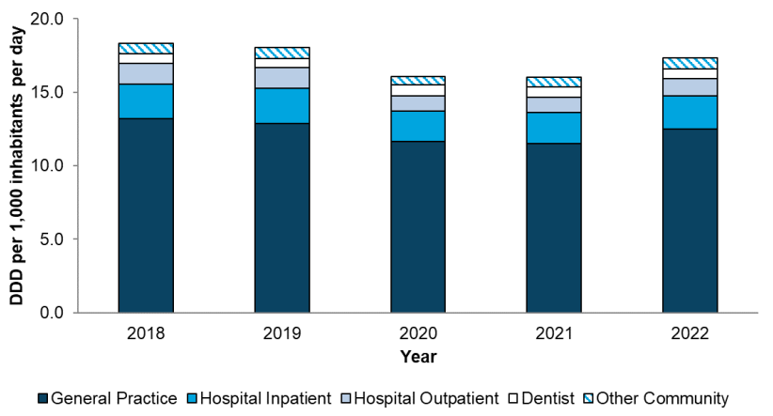
The majority of antibiotics are prescribed in general practice
Total antibiotic consumption by setting
(UKHSA, 2023)
Notes:
Presenter talk
What does that mean for us? We know that over the past 5 years, most antibiotics used by people in England were prescribed in primary care (around 80% in 2022). This data is from the ESPAUR report (English surveillance programme for antimicrobial utilisation and resistance).
The drop in consumption in 2020 and 2021 related to the pandemic should be looked at in isolation and we are seeing a return to similar prescribing as in 2019. This is to be expected but something to monitor going forward.
Presenter notes
Graph – Total antibiotic consumption by setting, expressed as defined daily doses (DDDs) per 1000 inhabitants per day, England, 2018 – 2022
Slide references
(1) UK Health Security Agency (2023). English surveillance programme for antimicrobial utilisation and resistance (ESPAUR), Report 2022-2023.

Slide 8
Antibiotic prescribing increased in 2022
Antibiotic prescribing in England 2014-2022
(UKHSA, 2023)
Notes:
Presenter talk
Again a similar pattern for overall antibiotic prescribing and we have seen a gradual fall in antibiotic use for some years since 2014, and again noticing the impact of the pandemic period and a resulting increase in 2022.
Although some of this increase was related to lowered thresholds for prescribing for suspected Group A strep in the winter of 2022, urogenital tract infections account for approximately 1/4 of prescriptions for infections provided in primary care, highlighting the importance of addressing prescribing for this group specifically.
Slide references
(1) UK Health Security Agency (2023). English surveillance programme for antimicrobial utilisation and resistance (ESPAUR), Report 2022-2023.

Slide 9
Clinical Scenario: Urinary Tract Infection (UTI)
www.rcgp.org.uk/TARGETantibiotics

Slide 10
Clinical Scenario: UTI – women under 65 years
Please consider the following details:
35 year old
Strong smelling urine
Dysuria over 2 days
Frequency
Recent laparoscopy and removal endometriosis
Had trimethoprim in the past month for suspected UTI post operation
What more could you ask?
www.rcgp.org.uk/TARGETantibiotics
Notes:
Presenter talk
What more should you ask? Well – there are significant things to consider from a diagnostic and management perspective. For instance:
Other non-UTI symptoms – vaginal discharge, other GU symptoms, relationship to intercourse and sexual contacts,
Any symptoms of pyelonephritis – loin pain, rigors, fever.
Find out more about the symptom severity and duration,
Other urinary symptoms like nocturia, haematuria,
Other risk factors for antibiotic resistance or infection: hospitalisation details, perioperative complications, other antibiotics.
Travel to country with high antibiotic resistance rates.
Presenter Notes
These cases are examples that can be printed out and discussed in pairs or groups, or with the group as a whole.
Allow the participants to discuss the case for 2 minutes and specifically ask several different people what they would do and /or prescribe.
There is another scenario later in the slide deck focusing on older adults which you could use as well as or instead of the one for women under 65 years

Slide 11
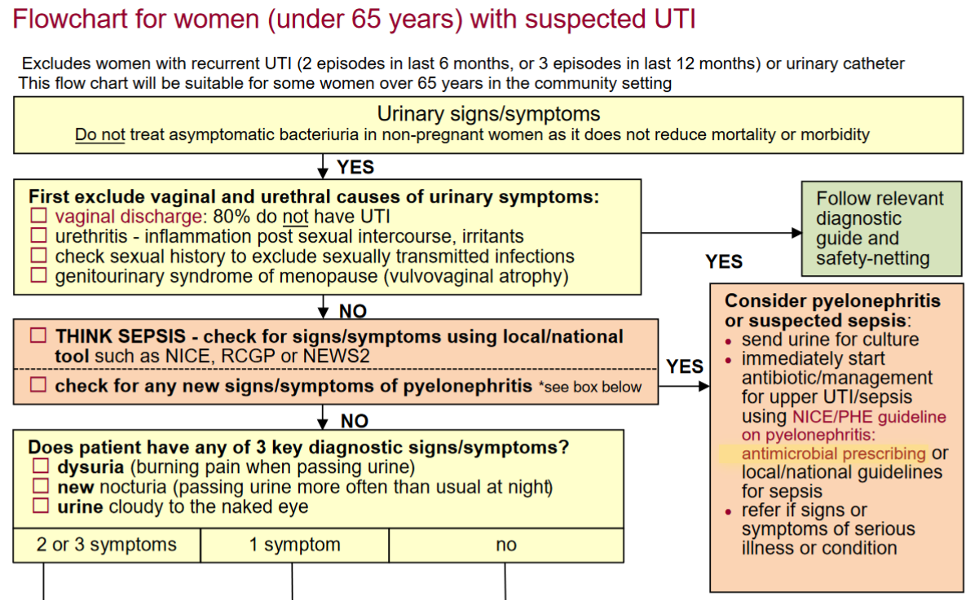
UKHSA UTI Diagnostic Tool:
Next slide
Diagnosis of urinary tract infections: quick reference guide for primary care, UKHSA, October 2020
Notes:
Presenter talk
UKHSA publishes a quick reference tool for diagnosing uncomplicated lower UTI in different groups including women under the age of 65 years (without a urinary catheter).
This is a snapshot of the decision– last updated October 2022. The content of the tool is currently out for review and we are looking for feedback from a user perspective (link will be shared by email).
I am going to walk you thorough the flowchart section by section…
Presenter notes
Go through each section of the flowchart and discuss the key points and decision making.
Highlight the links to the TARGET toolkit for patient information leaflets and the links to key NICE management guidance
See next slide for evidence underpinning guidance
Ensure you have checked for updates of the tool using the hyperlink below
See notes on next slide if you want to talk about the evidence underpinning the recommendations
Slide References
https://www.gov.uk/government/publications/urinary-tract-infection-diagnosis

Slide 12
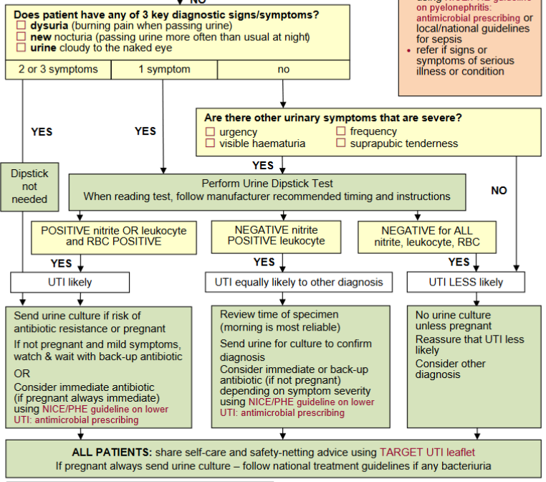
UKHSA UTI Diagnostic Tool:
www.rcgp.org.uk/TARGETantibiotics
Notes:
Presenter talk
Continue to walk the users through the flowchart….
If you want to provide more evidence about the signs and symptoms that are included in the flowchart you can refer to these publications:
The three key symptoms were based on a validation study using clinical scores and urine dipsticks conducted by Little et al in 2010
Included 434 women with at least 2 urinary symptoms of UTI and no vaginal discharge (62 different practices in England)
PPV strong for clinical symptoms of dysuria, nocturia or cloudy urine and dipsticks but poor negative predictive values
Dipsticks performed slightly better but NPVs also low
Findings showed that patients with suspected UTI who have dysuria, nocturia (any severity), and cloudy urine probably do have UTI
But we need to be cautious about excluding patients based on the absence of these features or negative dipstick results
One thing that we will potentially change in the updated flowchart is more information about actions when a woman has blood in her urine but negative nitrites or leukocytes.
Other symptoms and the use of dipsticks was included based on other reviews:
In a review of 9 studies by Bent et al (2002)¹
Dysuria, frequency, haematuria, costovertebral angle tenderness and back pain were predictive of UTI - dipstick useful if woman is symptomatic
Highlight need to rule out vaginal infection/irritation
Giesen et al (2010) identified 16 studies (3,711) patients²
Identified dysuria, frequency, haematuria, nocturia, and urgency as predictive
Combining positive dipstick test results, particularly tests for nitrites, with symptoms increases post-test probability
Diagnostic accuracy varied between studies and difficult to standardize symptoms/signs
Presenter notes
Go through each section of the flowchart and discuss the key points and decision making.
Highlight the links to the TARGET toolkit for patient information leaflets and the links to key NICE management guidance
Ensure you have checked for updates of the tool using the hyperlink below
You can use the points above if you would like to provide more evidence behind the symptoms used.
Slide References
https://www.gov.uk/government/publications/urinary-tract-infection-diagnosis
Little, P., et al. Validating the prediction of lower urinary tract infection in primary care: sensitivity and specificity of urinary dipsticks and clinical scores in women. Br J Gen Pract. 2010; 60(576): 495-500. Available from: www.ncbi.nlm.nih.gov/pmc/articles/PMC2894378/
Bent S, Nallamothu BK, Simel DL, Fihn SD, Saint S. Does this woman have an acute uncomplicated urinary tract infection? JAMA. 2002 May;287(20):2701-2710. Available from: www.ncbi.nlm.nih.gov/pubmed/12020306
Giesen, L. G. et al. Predicting acute uncomplicated urinary tract infection in women: a systematic review of the diagnostic accuracy of symptoms and signs. BMC Family Practice. 2010;11(78). Available from: www.ncbi.nlm.nih.gov/pubmed/20969801

Slide 13
What about those at higher risk of asymptomatic bacteriuria like older adults and those with a urinary catheter?
Clinical Scenario
Urinary Tract Infection
80 year old resident in nursing home
Strong smelling urine, but clear looking
Increasing confusion over 2 days
No history of fever, temp 37.4°C.
Has had antibiotics in past for suspected UTI
What do you think a urine dipstick result will be?
1. Positive for all
+ Nitrite
+ Leukocyte
+ RBC
2. Positive nitrite, negative leukocyte and RBC positive
+ Nitrite
- Leukocyte
+ RBC
3. Positive nitrite, positive leukocyte and RBC negative
+ Nitrite
+ Leukocyte
- RBC
4. Negative for all
- Nitrite
- Leukocyte
RBC
www.rcgp.org.uk/TARGETantibiotics
Notes:
Presenter Talk:
The treatment of UTI in older people should follow the same principles as in younger patients and should be based on whether the infection is uncomplicated or whether there is evidence of pyelonephritis or bacteraemia.
Empirical diagnosis of UTI in delirium: For residents who do not have an indwelling catheter, minimum criteria for initiating antibiotics included acute dysuria alone or fever (>37.9ºC or 1.5ºC increase above baseline temperature) and at least one of the following: new or worsening urgency/incontinence, frequency, signs of irritation of the urinary tract such as suprapubic pain or flank or loin tenderness, or gross haematuria [Loeb et al 2005].
A positive urine culture or dipstick test will not differentiate between UTI or asymptomatic bacteriuria, and there is no robust evidence for the use of leucocyte esterase or nitrite by urine dipstick testing in women aged 65 years and above in long-term care facilities or in frail elderly people requiring assisted living services (SIGN 160).
Patients with asymptomatic bacteriuria may also have white blood cells in the urine, as the immune system does not differentiate between asymptomatic carriage and infection.
UTI should be considered if there are signs of septicaemia and generalized illness: nausea, vomiting, rigors, new or increasing malaise and confusion, tachycardia, tachypnoea, poor peripheral circulation, reduced urine output, low blood pressure.
For patients with recent hospitalisation or antibiotics or operation, consideration should be given to the prescription of pivmecillinam, co-amoxiclav or ciprofloxacin over trimethoprim, but if these are prescribed always safety net and send a urine specimen for culture and susceptibility, so that treatment can be modified on receipt of the culture result.
Presenter Notes:
A systematic literature review covering quantitative primary studies that assess the urine dipstick as a tool in diagnosing urinary tract infection in older adults was conducted by Eriksen and Bing-Jonsson and published in 2015 (42) [2a-]. The review summarised 6 studies that looked at urine dipstick use, and the correlation to positive urine culture. The authors found there was a PPV of leukocytes and nitrites on a urine dipstick ranging from 31% to 93% and an NPV ranging from 49% to 100%. The authors conclude that dipsticks are more useful for ruling out a positive urine culture (than in) but summarise a number of limitations that clinicians need to be aware of and highlight reasons why dipsticks may give a false positive or negative in this group.
An observational study conducted by Ducharme and others in 2007, looked at the use of urine dipsticks to identify patients with a positive urine culture in 2 cohorts (43) [2b]. Each cohort included 100 patients aged 65 years presenting in an emergency department with no UTI symptoms (non-infectious/systemic complaints) or non-specific UTI symptoms (acute confusion, weakness or fever without focal symptoms). Patients with common UTI symptoms were excluded. A positive dipstick was determined by any leukocyte-esterase or nitrite or both and a positive culture; any single organism count greater than 10⁵ CFU/mL in midstream specimens and greater than 10² CFU/mL in specimens collected by catheterization. The non-infectious and non-specific infection groups had similar PPVs (31% and 37% respectively) and NPVs (93% and 92% respectively). Because dipstick results were negative and there were no localizing urinary symptoms, 5 patients presenting in the ED with positive cultures and non-specific signs of infection had a UTI excluded from diagnosis. The authors highlight that though dipsticks performed better at ruling out a positive culture, they were not completely dependable.
Although urine dipsticks seem to be better at ruling out a positive urine culture than ruling one in for older adults, there is a wide variation in estimates across studies and potential risk if a positive culture (or a UTI) is ruled out incorrectly for vulnerable patients with non-specific signs of infection. For this reason, this quick reference tool does not recommend their use to rule in a UTI or to rule out a UTI in older adult groups.
References:
Loeb, M., Brazil, K., Lohfeld, L., McGeer, A., Simor, A., Stevenson, K., . . . Walter, S. D. (2005). Effect of a multifaceted intervention on number of antimicrobial prescriptions for suspected urinary tract infections in residents of nursing homes: cluster randomised controlled trial. BMJ, 331(7518), 669.
SIGN 160. Management of suspected bacterial lower urinary tract infection in adult women. Sept 2020
https://www.sign.ac.uk/media/1766/sign-160-uti-0-1_web-version.pdf
42. Eriksen SV and Bing-Jonsson PC. ‘Can we trust urine dipsticks?’ Norwegian Journal of Clinical Nursing/Sykepleien Forskning 2017: volume 1: pages 1 to 14
43. Ducharme J, Neilson S and Ginn JL. ‘Can urine cultures and reagent test strips be used to diagnose urinary tract infection in elderly emergency department patients without focal urinary symptoms?’ Canadian Journal of Emergency Medicine 2007: volume 9, issue 2, pages 87 to 92

Slide 14
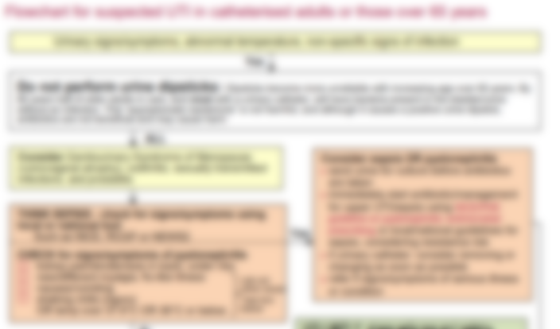
UKHSA UTI Diagnostic Tools: Older adults and those with a Urinary Catheter
Clinical Scenario
Urinary Tract Infection
www.rcgp.org.uk/TARGETantibiotics
Notes:
Presenter talk
The TARGET website also links to UTI quick reference diagnostic tool hosted on the UKHSA website.
This is a snapshot of the decision making algorithm for women over 65 years– last updated October 2022.
This flowchart currently combines recommendation for adults over 65 years and
I am going to walk you thorough the flowchart section by section…
Presenter notes
Go through each section of the flowchart and discuss the key points and decision making.
Highlight the links to the TARGET toolkit for patient information leaflets and the links to key NICE management guidance
Ensure you have checked for updates of the tool using the hyperlink below
Additional Information:
If questioned about age cut off:
Although the age of 65 years is used to represent the cut-off for risk of ASB, there is much discussion about weather or not different criteria should be used as the research that underpins the recommendation is quite old. UKHSA is currently working with University of Oxford to do a review of the data and see what evidence there is to move the cut-off for age, but we are continuing to recommend the age of 65 for now. For now the flowcharts recommend that clinician use discretion when using this cut off for women who are fit, healthy and living in the community, remembering that even in this group, urine dipsticks can have a high false negative result so diagnosis using symptomatic presentation is recommended.
Slide References
https://www.gov.uk/government/publications/urinary-tract-infection-diagnosis

Slide 15
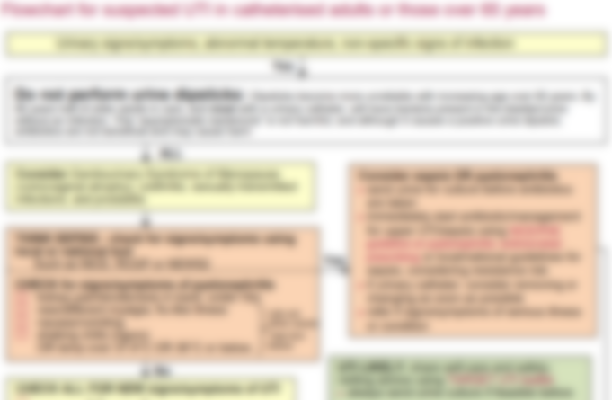
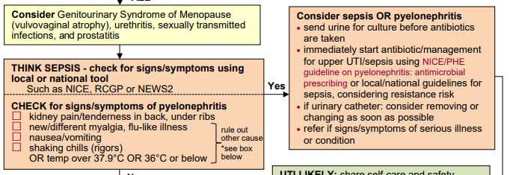
UKHSA UTI Diagnostic Tools: Older adults and those with a Urinary Catheter
Clinical Scenario
Urinary Tract Infection
www.rcgp.org.uk/TARGETantibiotics
Notes:
Presenter talk
Differential diagnosis and sepsis and pyelonephritis is ruled out in the same way for this group (go through briefly).
Another tool that you will see used more frequently in Care homes is the RESTORE 2 tool which is based on NEWs2 but modified for use in early detection in these settings.
Presenter notes
Go through each section of the flowchart and discuss the key points and decision making.
Clarify what deterioration or sepsis scoring tool is most frequently used for vulnerable individuals in care
Highlight the links to the TARGET toolkit for patient information leaflets and the links to key NICE management guidance
Ensure you have checked for updates of the tool using the hyperlink below
Slide References
https://www.gov.uk/government/publications/urinary-tract-infection-diagnosis

Slide 16
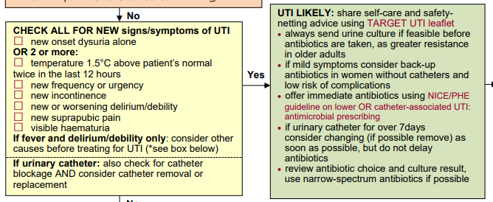
UKHSA UTI Diagnostic Tools: Older adults and those with a Urinary Catheter
Clinical Scenario
Urinary Tract Infection
www.rcgp.org.uk/TARGETantibiotics
Notes:
Presenter talk
Like women under 65 years, symptoms are key to diagnosing UTI in older adults.
The symptoms for UTI in older adults are slightly different than those for younger women based on findings from different studies.
Research targeting women at their homes in the community, shows that this menopausal and post menopausal women report an increase in symptoms like nocturia and incontinence when compared to pre menopausal women (Sanyaolu et al 2023).
A cluster RCT in 24 nursing homes in US/Canada conducted by Loeb et al in 2005.
12 care homes were allocated to a multifaceted intervention, and 12 allocated to usual care for 1yr
Diagnostic and treatment algorithm was implemented in the multifaceted intervention
Key symptoms identified were:
For those with urinary catheter: one or more of: costovertebral tenderness, rigors, new onset delirium and fever
For those without a urinary catheter: dysuria or two or more of fever, urgency, flank pain, incontinence, rigors, frequency, haematuria, and suprapubic pain
Fewer courses of antimicrobials were prescribed in the intervention nursing homes than in the non-intervention groups (weighted mean difference -0.49; 95% CI -0.93 to -0.06). There was no difference in hospitalisation or mortality
Presenter notes
Go through each section of the flowchart and discuss the key points and decision making.
Clarify what deterioration or sepsis scoring tool is most frequently used for vulnerable individuals in care
Highlight the links to the TARGET toolkit for patient information leaflets and the links to key NICE management guidance
Ensure you have checked for updates of the tool using the hyperlink below
Slide References
https://www.gov.uk/government/publications/urinary-tract-infection-diagnosis
Loeb M, et al. Effect of a multifaceted intervention on number of antimicrobial prescriptions for suspected urinary tract infections in residents of nursing homes: a cluster randomised controlled trial. BMJ. 2005 Sep; 331(7518):669.

Slide 17
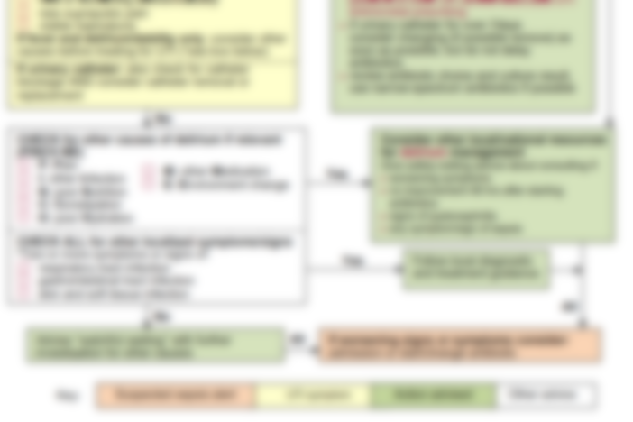
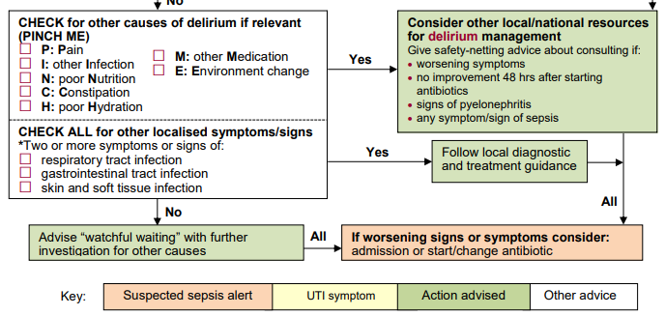
UKHSA UTI Diagnostic Tools: Older adults
Clinical Scenario
Urinary Tract Infection
www.rcgp.org.uk/TARGETantibiotics
Notes:
Presenter talk
Continue to talk through the slide….
Presenter notes
Go through each section of the flowchart and discuss the key points and decision making.
Highlight the links to the TARGET toolkit for patient information leaflets and the links to key NICE management guidance
Ensure you have checked for updates of the tool using the hyperlink below
Slide References
https://www.gov.uk/government/publications/urinary-tract-infection-diagnosis

Slide 18
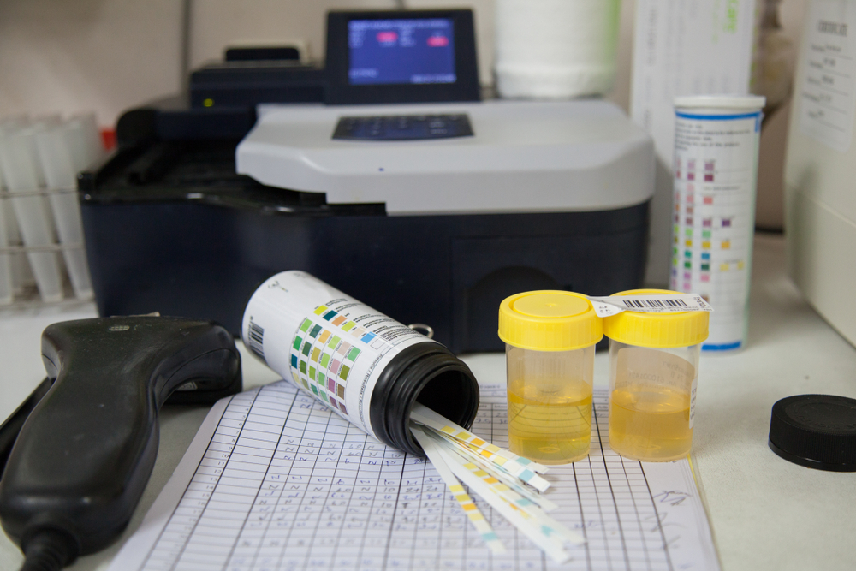
Why do we need to worry about our antibiotic use for UTI?
www.rcgp.org.uk/TARGETantibiotics

Slide 19
UTIs are linked to blood stream infections and resistance
Yearly estimated burden of E.coli resistant blood stream infections (BSIs) has reduced from 2017 but we need to keep momentum¹
E. coli bacteria are the most common cause of BSIs that are resistant to antibiotics¹
51% of E. coli blood stream infections are potentially linked to the urogenital tract²
After RTIs, UTIs are the most prescribed for infection in primary care³
www.rcgp.org.uk/TARGETantibiotics
1. UKHSA, ESPAUR Report, 2022
2. Abernethy et al. J. Hosp. Infect, 2017
3. Dolk et al. Journal of Antimicr Chem., 2018
Notes:
Presenter talk
Talk through the bullets
Presenter notes
You can find more information on the following slides which are hidden
Slide References
UKHSA 2022 ESPAUR Report
https://www.gov.uk/government/publications/english-surveillance-programme-antimicrobial-utilisation-and-resistance-espaur-report
Abernethy, J, Guy, R, Sheridan, EA et al. (5 more authors) (2017) Epidemiology of Escherichia coli bacteraemia in England: results of an enhanced sentinel surveillance programme. Journal of Hospital Infection, 95 (4). pp. 365-375. ISSN 0195-6701
https://eprints.whiterose.ac.uk/109639/
F Christiaan K Dolk, Koen B Pouwels, David R M Smith, Julie V Robotham, Timo Smieszek, Antibiotics in primary care in England: which antibiotics are prescribed and for which conditions?, Journal of Antimicrobial Chemotherapy, Volume 73, Issue suppl_2, February 2018, Pages ii2–ii10, https://doi.org/10.1093/jac/dkx504
https://academic.oup.com/jac/article/73/suppl_2/ii2/4841822

Slide 20
Antibiotic use for UTI has changed
Clinical Scenario
Urinary Tract Infection
Trimethoprim and Nitrofurantoin use across England
Nitrofurantoin
Trimethoprim
www.rcgp.org.uk/TARGETantibiotics
Data extracted from ePACT2
Notes:
Presenter talk
This is data from e-PACT 2 and shows trends in nitrofurantoin and trimethoprim use in the UK. It highlights the change that occurred when from December 2014 national prescribing guidance started to recommend nitrofurantoin as the first line antibiotic for women with suspected UTI
Presenter notes
Slide References
Data extracted from ePACT 2 in 2022
https://www.nhsbsa.nhs.uk/access-our-data-products/epact2

Slide 21
Antibiotic resistance in UTI can be reduced
Median number of dispensed antibiotic items/1000 registered practice population/year in South West of England 2013-2016
Clinical Scenario
Urinary Tract Infection
Guidance replaced Trimethoprim with Nitrofurantoin as first line choice – Dec 2014.
Relationship between antibiotic dispensing and resistance in following quarter:
Ciprofloxacin – Odds of resistance 0.982 (95% CI: 0.965 to 0.999)
Trimethoprim – Odds of resistance 0.992 (95% CI: 0.988 to 0.997)
Nitrofurantoin – Odds of resistance 0.999 (95% CI: 0.988 to 1.013)
Hammond et al. PLoS ONE (2020) :
e0232903.
www.rcgp.org.uk/TARGETantibiotics
Notes:
Presenter talk
A study by Hammond et al in 2020 looked at prescribing data from the South West of England from 2013 to 2016 ( 163 GP practices serving 1.5 million patients). The team used logistic regression to assess changes in resistance patters and the association with prescribing rate changes, controlling for confounding variables.
They found a fall in Trimethoprim use by 8% and a decrease in Ciprofloxacin use by 24.2% from 2013 - 2016. There was an increase in nitrofurantoin use by 7% over this period, but this was unsurprising as nitrofurantoin was changed to the first line choice in national guidance in 2014.
The odds of trimethoprim resistance and ciprofloxacin resistance were lower in the subsequent quarter as use declined. Increased nitrofurantoin dispensing was associated with reduced trimethoprim resistance with changes to nitrofurantoin resistance being non-significant.
Presenter notes
Study Aim:
To evaluate associations between changes in primary care dispensing and antimicrobial resistance in community-acquired urinary Escherichia coli infections.
Methods: Multilevel logistic regression modelling investigating relationships between primary care practice level antibiotic dispensing for approximately 1.5 million patients in South West England and resistance in 152,704 community-acquired urinary E. coli between 2013 and 2016. Relationships presented for within and subsequent quarter drug-bug pairs, adjusted for patient age, deprivation, and rurality.
Results: In line with national trends, overall antibiotic dispensing per 1000 registered patients fell 11%. Amoxicillin fell 14%, cefalexin 20%, ciprofloxacin 24%, co-amoxiclav 49% and trimethoprim 8%. Nitrofurantoin increased 7%. Antibiotic reductions were associated with reduced within quarter same-antibiotic resistance to: amoxicillin, ciprofloxacin and trimethoprim. Subsequent quarter reduced resistance was observed for trimethoprim and amoxicillin. Antibiotic dispensing reductions were associated with increased within and subsequent quarter resistance to cefalexin and co-amoxiclav. Increased nitrofurantoin dispensing was associated with reduced within and subsequent quarter trimethoprim resistance without affecting nitrofurantoin resistance.
Slide References
Hammond A, Stuijfzand B, Avison MB, Hay AD (2020) Antimicrobial resistance associations with national primary care antibiotic stewardship policy: Primary care-based, multilevel analytic study. PLoS ONE 15(5): e0232903
https://www.ncbi.nlm.nih.gov/pmc/articles/PMC7224529/pdf/pone.0232903.pdf

Slide 22
Antibiotic resistance in urine samples rises with age
UKHSA surveillance data – March 2024
Notes:
Presenter talk:
In 2022 there was a slight decrease in nitrofurantoin resistance reflected in national surveillance data, but otherwise resistance for trimethoprim and nitro. have been relatively consistent at around 30% and just under 2% resectively. This data also shows that resistance is proportionately higher in the older age groups, highlighting the risk for this group. Data on ciprofloxacin also shows a similar trend.
Presenter notes
This data does not represent the data for all patients presenting to you with acute uncomplicated UTI, as we know most GPs tend to only send urines to the laboratory from patients with recurrent UTI or persistent symptoms, but it certainly gives us some indication of the greater resistance in the elderly.
Slide information: This data comes from UKHSA surveillance reports. Please email targetantibiotics@ukhsa.gov.uk if you would like to update the information provided

Slide 23
Antibiotic resistance affects the recovery of patients with UTI
Clinical Scenario
Urinary Tract Infection
Clinical outcomes of uncomplicated UTIs in English GP treated with empirical trimethoprim
 | Patients with:
 | Resistant UTI | Susceptible UTI | P-value
Median time to symptom resolution (207) | 7 days | 4 days | 0.0002
Re-consultation in first week or less (317) | 17/44, 39% | 17/273, 6% | <0.0001
Further antibiotic in first week (317) | 16/44, 36% | 11/273, 4% | <0.0001
Still had bacteriuria at 1 month (132) | 8/19 42% | 23/113, 20% | 0.04
March 2024
www.rcgp.org.uk/TARGETantibiotics
McNulty et al. J. Antimicrob. Chemother. (2006) 58 (5): 1000-1008
Notes:
Presenter talk
So first what is the evidence that antibiotic resistance is important in your day to day practice?
Maybe you could consider when you last had a patient with UTI reconsult after treatment.
Pause see if there are nods or not
This is a prospective study of 497 women (18–70 years) with ≥ 2 UTI symptoms. It looked at clinical outcome in acute uncomplicated UTI in women treated with empirical trimethoprim.
Click for next part of the slide
Patients with a UTI resistant to the antibiotic in the left column took twice as long to become asymptomatic compared to those with a susceptible organism shown in blue.
Furthermore 40% of those with a resistant organism reconsulted in the first week, compared to only 6% with a susceptible organism.
In fact half of those patients who reconsulted in the first week had a resistant organism grown from their urine, and the majority of these had further antibiotics in that first week.
And at one month 42% of those patients with a resistant organism still had the same resistant bacteria in the urine, and this would have been much greater but 11 of these 19 patients had received a second antibiotic.
Presenter notes
McNulty et al. studied whether patients with an uncomplicated community-acquired urinary tract infection (UTI) and an isolate resistant to trimethoprim had worse clinical outcomes following empirical treatment with trimethoprim 200 mg twice daily for 3 days than did those with a susceptible isolate.
This was a prospective cohort study of clinical outcome where 497 women (18–70 years) presenting to general practitioner surgeries in Norwich and Gloucester with at least two symptoms of acute (<7 days) uncomplicated UTI were enrolled. Significant bacteriuria was defined as 104 cfu/mL from a mid-stream urine (MSU).
The results showed that of enrolled patients, 75% (334/448) had significant bacteriuria and trimethoprim resistance was present in 13.9% (44/317) of isolates. Patients with resistant isolates had a longer median time to symptom resolution (6 versus 3 days, P = 0.0005), greater reconsultation to the practice (39% versus 6% in first week, P < 0.0001), more subsequent antibiotics (36% versus 4% in first week, P < 0.0001) and higher rates of significant bacteriuria at 1 month (42% versus 20% with susceptible isolate, P = 0.04). Half of patients reconsulting in the first week had a resistant organism.
Slide References
McNulty CA, Richards J, Livermore DM, Little P, Charlett A, Freeman E, Harvey I, Thomas M. Clinical relevance of laboratory-reported antibiotic resistance in acute uncomplicated urinary tract infection in primary care. J Antimicrob Chemother. 2006 Nov;58(5):1000-8. doi: 10.1093/jac/dkl368. Epub 2006 Sep 23. PMID: 16998209.
https://academic.oup.com/jac/article-lookup/doi/10.1093/jac/dkl368

Slide 24
Antibiotic use in UTI increases risk of resistance
Clinical Scenario
Urinary Tract Infection
This Forest plots shows individual study and pooled odds ratio of increased risk of resistance
Antibiotic in last 6 months |  | Increased risk (Odds Ratio)
 | Antibiotic use decreases RESISTANCE |  | Antibiotic use increases RESISTANCE
Steinke | Any antibiotic |  |  | 1.36
Donnan | Trimethoprim |  |  | 1.67
Steinke | Trimethoprim |  |  | 3.95
Hillier | Amoxicillin |  |  | 1.83
Donnan | Any antibiotic |  |  | 1.65
Hillier | Trimethoprim |  |  | 2.57
Metlay | Sulpha / trim |  |  | 4.10
Pooled results 14,348 pts |  |  |  | 2.18
0.6
5
1
Longer duration and multiple courses associated with greater resistance
www.rcgp.org.uk/TARGETantibiotics
Costelloe C et al. BMJ (2010);
340:bmj.c2096
Notes:
Presenter talk
So we have shown that resistance is important and is increasing – but does our antibiotic use cause increased risk of antibiotic resistant infections in our patients?
This study goes some way to show that.
Costelloe et al. conducted a systematic review and meta-analysis examining previous antibiotic use and subsequent resistance. They included 5 studies of UTI with 14,348 patients in general practice.
Presenter click to bring in table
It found that antibiotic use in the past 6 months increased the risk of resistance two times (2.18).
This forest plot shows risk of having a resistant organism if patients have had an antibiotic in the last 6 months.
As you can see risk was increased in all the studies as the odds ratios (the blue squares) are to the right of the line with confidence intervals that do not overlap.
Presenter click to bring in text
Longer duration and multiple courses of antibiotics were associated with greater resistance.
What is important to note is that resistance to one antibiotic (for example amoxicillin or trimethoprim) can be linked to other resistance genes, so use of these antibiotics although considered narrower spectrum can increase resistance to other antibiotics too.
Presenter notes
The review included 24 studies; 22 involved patients with symptomatic infection and two involved healthy volunteers; 19 were observational studies (of which two were prospective) and five were randomised trials. In five studies of urinary tract bacteria (14 348 participants), the pooled odds ratio (OR) for resistance was 2.5 (95% confidence interval 2.1 to 2.9) within 2 months of antibiotic treatment and 1.33 (1.2 to 1.5) within 12 months. In seven studies of respiratory tract bacteria (2605 participants), pooled ORs were 2.4 (1.4 to 3.9) and 2.4 (1.3 to 4.5) for the same periods, respectively. Studies reporting the quantity of antibiotic prescribed found that longer duration and multiple courses were associated with higher rates of resistance. Studies comparing the potential for different antibiotics to induce resistance showed no consistent effects. Only one prospective study reported changes in resistance over a long period; pooled ORs fell from 12.2 (6.8 to 22.1) at 1 week to 6.1 (2.8 to 13.4) at 1 month, 3.6 (2.2 to 6.0) at 2 months, and 2.2 (1.3 to 3.6) at 6 months.
Therefore in conclusion, individuals prescribed an antibiotic in primary care for a respiratory or urinary infection have increased risk of developing bacterial resistance to that antibiotic. The effect is greatest in the month immediately after treatment but may persist for up to 12 months. This effect not only increases the population carriage of organisms resistant to first line antibiotics, but also creates the conditions for increased use of second line antibiotics in the community.
Slide References
Costelloe C, Metcalfe C, Lovering A, Mant D, Hay AD. Effect of antibiotic prescribing in primary care on antimicrobial resistance in individual patients: systematic review and meta-analysis. BMJ. 2010 May 18;340:c2096. doi: 10.1136/bmj.c2096. PMID: 20483949.
https://www.bmj.com/content/bmj/340/bmj.c2096.full.pdf

Slide 25
Risk of resistance persists for at least 12 months after your prescribing
Clinical Scenario
Urinary Tract Infection
Effect of antibiotic prescribing in primary care on antimicrobial resistance in individual patients: systematic review and meta-analysis
 | Increased risk of resistant organism
 | Antibiotic in past 2 months | Antibiotic in past 12 months
UTI 5 studies: n = 14,348 | 2.5 pooled odds of resistance | 1.33 pooled odds of resistance
www.rcgp.org.uk/TARGETantibiotics
Costello et al. BMJ. (2010) 340:c2096.
Notes:
Presenter talk
So how long does the risk of antibiotic resistance last after a course of antibiotics?
The metanalysis conducted by Costello et all in 2010 discussed on the previous slide showed a pooled odds ratio (OR) for resistance was 2.5 (95% confidence interval 2.1 to 2.9) within 2 months of antibiotic treatment and 1.33 (1.2 to 1.5) within 12 months. This indicates that risk of resistance is greatest in the first two months after an antibiotic as shown here for UTIs, but is still higher 12 months after antibiotic use for UTIs. Individuals prescribed an antibiotic in primary care for any infection have an increased risk of subsequently carrying resistant organisms – so that the next time they have an infection it may be with one of these antibiotic resistant organism. This will be particularly so for antibiotics that attain higher concentrations in the gut. And less so for those that only concentrate in the urine, or are inactive in the gut.
Presenter notes
Effect of antibiotic prescribing in primary care on antimicrobial resistance in individual patients: systematic review and meta-analysis
Costello et al 2010
The review included 24 studies; 22 involved patients with symptomatic infection and two involved healthy volunteers; 19 were observational studies (of which two were prospective) and five were randomised trials. In five studies of urinary tract bacteria (14 348 participants), the pooled odds ratio (OR) for resistance was 2.5 (95% confidence interval 2.1 to 2.9) within 2 months of antibiotic treatment and 1.33 (1.2 to 1.5) within 12 months. Studies reporting the quantity of antibiotic prescribed found that longer duration and multiple courses were associated with higher rates of resistance. Studies comparing the potential for different antibiotics to induce resistance showed no consistent effects. Only one prospective study reported changes in resistance over a long period; pooled ORs fell from 12.2 (6.8 to 22.1) at 1 week to 6.1 (2.8 to 13.4) at 1 month, 3.6 (2.2 to 6.0) at 2 months, and 2.2 (1.3 to 3.6) at 6 months.
This showed that individuals prescribed an antibiotic in primary care for a urinary infection have an increased risk of carrying resistant organisms – so that the next time they have an infection it is with a antibiotic resistant organism. The effect is greatest in the month immediately after treatment but may persist for up to 12 months. This effect not only increases the population carriage of organisms resistant to first line antibiotics, but also creates the conditions for increased use of second line antibiotics in the community.
Slide References
Costelloe C, Metcalfe C, Lovering A, Mant D, Hay AD. Effect of antibiotic prescribing in primary care on antimicrobial resistance in individual patients: systematic review and meta-analysis. BMJ. 2010 May 18;340:c2096. doi: 10.1136/bmj.c2096. PMID: 20483949.
https://www.bmj.com/content/bmj/340/bmj.c2096.full.pdf

Slide 26
UTI management and shared decision making
www.rcgp.org.uk/TARGETantibiotics

Slide 27
TARGET TYI-UTI leaflet
Outcome and plan can be personalised
Possible urinary symptoms & other things for GP & patient to consider
Self-care &
safety netting advice
Picture helps patients understand cause
How to prevent UTIs
Flow chart helps patient understand antibiotics and resistance
Recurrent UTI prevention
Notes:
Presenter talk
The Patient Urinary Tract Infection (UTI) Information leaflet has been designed to be used during consultation with women who have a suspected UTI
It is a useful tool for clinicians to use whether the patient needs an antibiotic prescription or not.
It explains the treatment decision pathway, and therefore is also helpful for less experienced staff.
It includes information on the types of UTI, which are often misunderstood by patients and health care staff, illness duration, self-care advice, prevention advice and advice on when to re-consult.
This leaflet was endorsed by NICE to use with the prescribing guidelines
TARGET leaflets have been formatted into html text so they are accessible using digital technology and screen readers.
The leaflet can also be linked to your computer clinical systems, for instance, accurx has embedded all of the TARGET HTML leaflets into their SMS services
I am now going to walk you through the various aspects of our leaflets for women under 65 years…..
Presenter notes
The animations will come up as you discuss different areas of the leaflet.

Slide 28
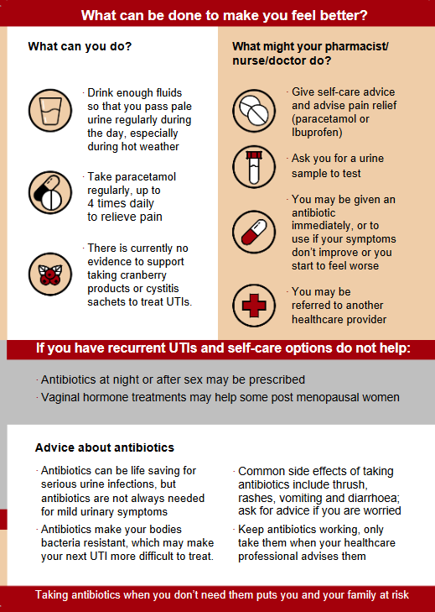
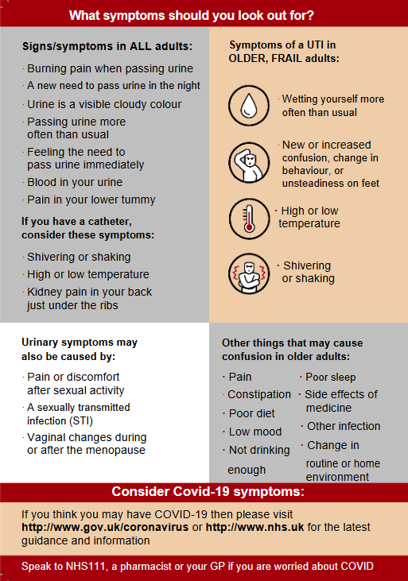
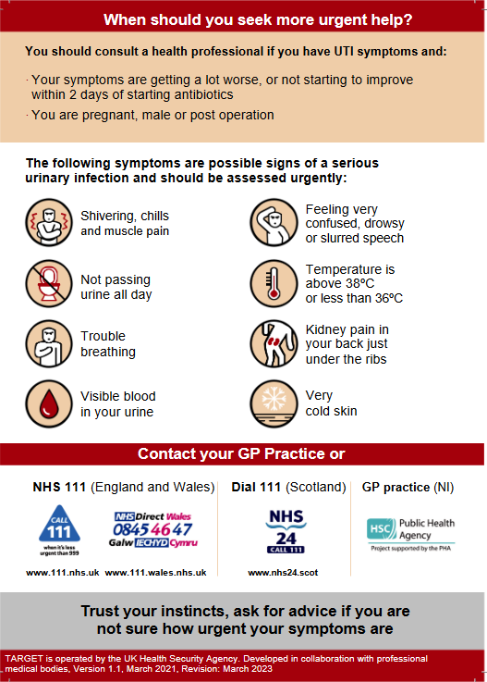
Clinical Scenario
Urinary Tract Infection
Notes:
Presenter talk
TARGET have a pictorial UTI patient information leaflet for UTI in adults (of all ages) that was published in March 2021
It covers the same information but in a format that is easier to read (larger text and graphics).
Presenter notes
Quickly quick through to bring up a different page of the combined pictorial leaflet
Reference
https://elearning.rcgp.org.uk/mod/book/view.php?id=12647&chapterid=443

Slide 29
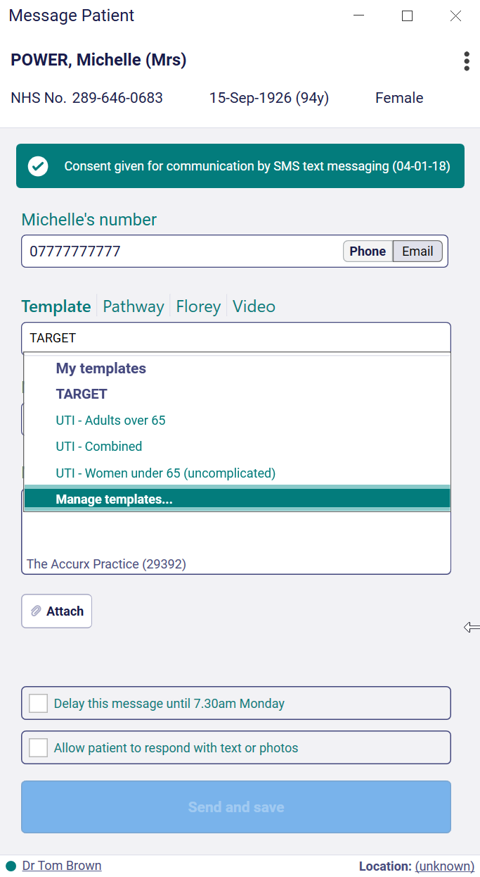
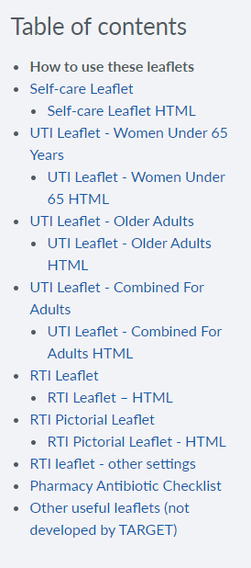
Web text - UTI Patient Information Leaflets
Clinical Scenario
Urinary Tract Infection
Notes:
Presenter talk
This is where you can access the HTML version of the UTI leaflets
As discussed previously, this format is easier for patients to access this information using digital technology.
It also enables you to SMS or email the information to your patients. This screenshot shows you where the UTI leaflets are embedded in the Accurx SMS templates.
Presenter notes
The animations will come up as you click

Slide 30
Non-antibiotic prevention and management
Always discuss risks and facilitate shared decision making!
NICE guideline for prevention of non-recurrent lower UTI:
no evidence was found to support or disprove use of cranberry products
recommend paracetamol (or ibuprofen if appropriate) and drinking enough fluid to avoid dehydration
NICE guideline for recurrent UTI prevention in non-pregnant women
lowest effective dose of vaginal oestrogen
some may wish to try D-mannose or other cranberry products
in 2022, NICE have reviewed the evidence for use of Methenamine Hippurate (Hiprex) and state that this may impact guidance
www.rcgp.org.uk/TARGETantibiotics
Notes:
Presenter talk:
While we are not going to go into detail regarding the UTI prevention, before we go into management we wanted to highlight non-antibiotic agents that can be used to prevent or manage UTIs.
NICE guidance for lower UTIs reviewed the effectiveness of cranberry products to support prevention or management so currently only include self care advice specific to paracetamol and hydration.
For recurrent UTI, the NICE evidence review highlighted the effectiveness of vaginal oestrogen for preventing recurrent UTIs and indicate it as a first line method for management in post menopausal women.
For self care NICE state that some women with recurrent UTI may wish to try D‑mannose if they are not pregnant (the evidence for D‑mannose was based on a study in which it was taken as 200 ml of 1% solution once daily in the evening). D‑mannose is a sugar that is available to buy as powder or tablets; it is not a medicine.
Although the benefit is uncertain, some women with recurrent UTI may wish to try cranberry products if they are not pregnant (evidence of benefit is uncertain and there is no evidence of benefit for older women). Some children and young people under 16 years with recurrent UTI may wish to try cranberry products with the advice of a paediatric specialist (evidence of benefit is uncertain).
From the NICE website - In 2022, NICE have reviewed the evidence for use of Methenamine Hippurate (Hiprex) and state that this may impact guidance. We don’t know when that will be or what the outcome of this will be but some trusts do include within protocols for recurrent UTI management.
More information:
The evidence review for cranberry products is based on 2 RCTs, (Wing et al. 2008 and Wing et al. 2015) in pregnant women. Both studies were conducted in healthy pregnant women, who otherwise had no indication or risk of asymptomatic bacteriuria or UTI. The included studies looked at cranberry capsules or cranberry juice drinks in pregnant women of less than 16 weeks gestation. The dose of proanthocyanidin within the capsules and juice drink, which is considered to be the active ingredient, was reported as equivalent as the same researchers conducted both studies (approximately 32-34 mg of proanthocyanidin).
One double blind RCT (Wing et al. 2008) assessed the efficacy of cranberry juice drink compared with placebo juice drink, when used to prevent UTI in healthy pregnant women. Wing et al. (2008) found no significant difference between the cranberry juice groups compared to the placebo group in the incidence of UTI or incidence of asymptomatic bacteriuria, incidence of pyelonephritis, preterm delivery <37 weeks, babies born with low birth weight, 1 min Apgar score <7, or admission to neonatal intensive care unit (NICU) (very low quality evidence).
One double blind RCT (Wing et al. 2015) assessed the safety and tolerability of cranberry capsules, when used to prevent UTI in healthy pregnant women. Wing et al. (2015) found that 25% of the participants had a history of UTI (p-value not reported). There was no significant difference in the number of babies born with a 1 min Apgar score, in those treated with cranberry capsules compared to placebo (1 RCT, n=33, 21.4% versus 0%; RR and 95% CI not stated, calculated by NICE as RR 9.33 95% 0.52 to 167.36; very low quality evidence).
There was no significant difference in preterm delivery (<37 weeks) rates, the number of babies born with low birth weight (< 2500g) or the number of admissions to a neonatal intensive care unit in those treated with cranberry capsules compared with placebo.
Overall, there were no significant differences in maternal or neonatal outcomes reported in both studies.
No systematic reviews or RCTs were identified that provided data on cranberry products for UTI in men, non-pregnant women and children.
References:
Urinary tract infection (recurrent): antimicrobial prescribing. NICE guideline [NG112] Published: 31 October 2018. https://www.nice.org.uk/guidance/ng112
Urinary tract infection (lower): antimicrobial prescribing, NICE guideline [NG109], Published: 31 October 2018
https://www.nice.org.uk/guidance/ng109
2022 exceptional surveillance of urinary tract infection (recurrent): antimicrobial prescribing (NICE guideline NG112)
https://www.nice.org.uk/guidance/ng112/resources/2022-exceptional-surveillance-of-urinary-tract-infection-recurrent-antimicrobial-prescribing-nice-guideline-ng112-11187931213/chapter/Surveillance-decision?tab=evidence

Slide 31
NICE antimicrobial prescribing guidance
Clinical Scenario
Urinary Tract Infection
www.rcgp.org.uk/TARGETantibiotics
Notes:
Presenter Talk
NICE hosts detailed prescribing guidance for women, men, and children with suspected lower UTI, prostatitis and pyelonephritis
It was developed in collaboration with multiple stakeholders and is summarised in decision tools linked to the main guidance
The NICE guidance for the management of lower urinary tract infections NICE suggest considering a back-up antibiotic prescription (to use if symptoms do not start to improve within 48 hours or worsen at any time) for women with lower UTI or an immediate antibiotic prescription for women with lower UTI who are not pregnant. Take account of:
the severity of symptoms
the risk of developing complications, which is higher in people with known or suspected structural or functional abnormality of the genitourinary tract or immunosuppression
the evidence for back-up antibiotic prescriptions, which was only in non-pregnant women with lower UTI where immediate antibiotic treatment was not considered necessary
previous urine culture and susceptibility results
previous antibiotic use, which may have led to resistant bacteria
preferences of the woman for antibiotic use.
Presenter Notes
References:
Urinary tract infection (lower): antimicrobial prescribing, NICE guideline [NG109], Published: 31 October 2018
https://www.nice.org.uk/guidance/ng109

Slide 32
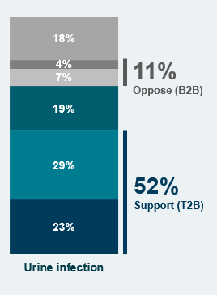
Back up prescribing for UTI is generally acceptable to patients – data from 2023
Clinical Scenario
Urinary Tract Infection
Do you support or oppose clinicians prescribing delayed/back-up antibiotic prescriptions for UTI?
54% of the population are in favour of delayed antibiotics
16% of patients who received a delayed prescription had a UTI
When asked about UTI, 52% of respondents were in favour of a delayed antibiotic
Consider back-up rather than immediate antibiotics –
but explain rationale, pain relief, and how to collect prescription
www.rcgp.org.uk/TARGETantibiotics
Source: Basis Research, AMR Survey
Base: All respondents (n=5390)
Notes:
Presenter Talk
This data comes from surveys that targets households asking about knowledge attitudes and practices specific to amicrobial use and the management of common infection. The research is conducted by a market research agency in Feb/March of each of the years indicated.
Findings from 2023 showed that:
About 54% of the public support the prescribing of delayed antibiotics, depending on the type of infection.
In the last 12 months, 7% of the people in the survey had received a delayed antibiotic prescription (n=370) and of these about 19% didn’t end up using them. Most commonly this was for a respiratory tract infection (cough, sore throat, ear infection etc…), but for 16% it was for UTI.
There is strongest support for delayed antibiotics in response to a urine infection (52% support), followed by an ear infection (49%) and a throat infection (47%).
Consider back-up rather than immediate antibiotics for UTIs using the guidance discussed on the previous slide – but make sure to explain rationale, pain relief, and how to collect prescription
Presenter Notes
This information comes from a study using a random sample of 5390 adults in England aged 18+. Data was collected using a 1 year recall period from May-June using an online survey that targeted households. Data was weighted to be representative of the population.
The key categories from bottom dark blue to the top grey are:
Strongly support, Tend to support, Neither support/oppose, Tend to oppose, Strongly oppose, Don’t know
References:
This data is currently being submitted for publication, please contact the t

Slide 33
NICE prescribing guidance for lower UTI – non-pregnant women
First choice:
Nitrofurantoin if eGFR] is 45 ml/minute or more: 100mg m/r BD (or if unavailable 50mg QDS)
Trimethoprim if low risk of resistance 200mg BD
Always safety net, and provide information on pain relief and self-care
If giving antibiotics send urine for culture & susceptibilities, if risk of resistance or over 65 years old
3
days
www.rcgp.org.uk/TARGETantibiotics
NICE, NG109, 2018
Notes:
Presenter Talk
For non-pregnant women aged 16 years and over Nice recommend:
Nitrofurantoin (if estimated glomerular filtration rate [eGFR] is 45 ml/minute or more):
100 mg modified-release twice a day (or, if unavailable, 50 mg four times a day) for 3 days
Trimethoprim (if there is a low risk of resistance):
200 mg twice a day for 3 days
You can use the patient information leaflet to discuss information on safety-netting and self care.
As seen previously, prevalence of resistance is higher in the older adult age groups, so it is recommended to send the urine for culture if you are prescribing antibiotics.
We will discuss risk factors that may mean you need to send the urine for culture on the next slide
References:
Urinary tract infection (lower): antimicrobial prescribing, NICE guideline [NG109], Published: 31 October 2018
https://www.nice.org.uk/guidance/ng109

Slide 34
Consider: Risk factors for resistance
Clinical Scenario
Urinary Tract Infection
Low risk of resistance:
younger women with acute UTI and no resistance risks
Risk factors for increased resistance include:
care home resident,
recurrent UTI (2 in 6 months; >3 in 12 months),
unresolving urinary symptoms,
hospitalisation for >7d in the last 6 months,
recent travel to a country with increased resistance,
previous UTI resistant to trimethoprim, cephalosporins, or quinolones.,
If risk of resistance: always safety net and send urine for culture & susceptibilities
www.rcgp.org.uk/TARGETantibiotics
Ben-Ami et al. Clin Infect Dis 2009
Malcom et al. JAC, 2017
Notes:
Presenter Talk:
Many studies have looked at risk factors for resistance. The most relevant one for the community setting, was undertaken in Scotland in 2016 using routine data. Results indicated that age, care home residence, and increasing comorbidity were significantly associated resistance after adjustment for other factors.
Other studies have looked at risk factors associated with UTIs due to Extended spectrum beta lactamase producing coliforms. Risk factors identified included: recent antibiotic use; residence in a long-term care facility; recent hospitalisation; aged 65 years or older; male sex.
Travel to a country with high resistance rates is also a very important risk factor, especially if that country has poor hygiene – for example South East Asia.
Presenter Notes:
Malcome et al. 2017: A surveillance study in Glasgow and Clyde CCG, aiming to use individual level linked data to characterise factors associated with antibiotic resistance in urine sample in 17,046 patients. All positive community urine samples from January 2012 to June 2015 were included and analysed. All cases were linked to national hospital activity data and patient-level community prescribing data. Risk factors associated with antibiotic susceptibility were assessed using multivariable multinomial logistic regression. Results indicated that age, care home residence, and increasing comorbidity were significantly associated with both categories of resistance after adjustment for other factors. Interestingly, there were no significant differences in repeat prescriptions within 42 days depending on whether patients were prescribed three (17.1%), five (16.8%), or seven days (17.3%) nitrofurantoin.
Ben-Ami et al. A survey paper, in which the authors identified significant risk factors through multivariate analysis. These risk factors included: recent antibiotic use; residence in a long-term care facility; recent hospitalisation; aged 65 years or older; male sex. The authors do note, however, that 34% of ESBL-producing isolates (115 of 336) were obtained from patients with no recent healthcare contact.
References:
William Malcolm, Eilidh Fletcher, Kimberley Kavanagh, Ashutosh Deshpande, Camilla Wiuff, Charis Marwick, Marion Bennie, Risk factors for resistance and MDR in community urine isolates: population-level analysis using the NHS Scotland Infection Intelligence Platform, Journal of Antimicrobial Chemotherapy, Volume 73, Issue 1, January 2018, Pages 223–230, https://doi.org/10.1093/jac/dkx363
https://academic.oup.com/jac/article/73/1/223/4430795?login=false
Ben-Ami R, Rodriguez-Bano J, Arslan H, Pitout JD, Quentin C, Calbo ES et al. A multinational survey of risk factors for infection with extended-spectrum beta-lactamase-producing enterobacteriaceae in non-hospitalized patients. Clin Infect Dis. 2009 Sep; 49(5):682-690. Available from: http://cid.oxfordjournals.org/content/49/5/682.full.pdf+html.

Slide 35
UTI and the link to blood stream infections
Estimate the prevalence of E.coli blood stream infections, which are resistant to co-amoxiclav last year in England.
0-10%
11-20%
21-30%
31-40%
Over 40%
41.4%
www.rcgp.org.uk/TARGETantibiotics
UKHSA ESPAUR 2023
Notes:
Presenter talk
We talked previously about how UTIs are linked to bloodstream infections in England. Who can remember the prevalence of co-amoxiclav resistance in England?
Presenter notes
The animations will pop up the question first and then click for the answer – you can see what the audience comes back with.
Slide References
UKHSA 2022 ESPAUR Report
https://www.gov.uk/government/publications/english-surveillance-programme-antimicrobial-utilisation-and-resistance-espaur-report

Slide 36
Reduced 3Cs to help reduce Clostridium difficile in the community
Clinical Scenario
Urinary Tract Infection
Reduce use of
Ciprofloxacin
Cephalosporins
Co-amoxiclav
Increase use of
Nitrofurantoin
Pivmecillinam
for UTI
Trimethoprim still good for UTI if there is a low risk of resistance
www.rcgp.org.uk/TARGETantibiotics
NICE, Evidence Summary, 2015
NICE, NG109, 2018
Notes:
Presenter talk:
Reducing the 3C antibiotics can help reduce the risk of Clostridium difficile for patients and communities
Remember that fluroquinolones like ciprofloxacin are not recommended if any other appropriate antibiotic can be used.
NICE recommendations for lower UTI management in non-pregnant women don’t recommend these broad spectrum antibiotics for first or second choice management.
Presenter notes:
Slide References
Clostridium difficile infection: risk with broad-spectrum antibiotics, Evidence summary [ESMPB1] Published: 17 March 2015
https://www.nice.org.uk/advice/esmpb1/chapter/key-points-from-the-evidence#estimated-impact-for-the-nhs

Slide 37
NICE prescribing guidance for lower UTI – non-pregnant women
Second choice:
Nitrofurantoin (if eGFR is 45 ml/minute or more, and it was not used as first-choice)
Pivmecillinam: 400 mg initial dose, then 200 mg three times a day for a total of 3 days
Fosfomycin: 3g single dose sachet in women
www.rcgp.org.uk/TARGETantibiotics
NICE, NG109, 2018
Notes:
Presenter talk:
Second choices (if no improvement in lower UTI symptoms on first choice taken for at least 48 hours, or when first choice is not suitable)
Nitrofurantoin (if eGFR is 45 ml/minute or more, and it was not used as first-choice):
100 mg modified-release twice a day (or, if unavailable, 50 mg four times a day) for 3 days
PLEASE NOTE: For Pivmecillinam and Fosfomycin there are regional and national variations in use and dose for UTI management. Please check your local guidelines and follow related recommendations.
NICE recommend for second choice after Nitrofurantoin:
Pivmecillinam (a penicillin):
400 mg initial dose, then 200 mg three times a day for a total of 3 days
Manufacture advises to avoid in pregnancy but should be appropriate for those who are breastfeeding.
Remember that pivmecillinam should not be prescribed to those with a true penicillin allergy, are hypersensitive to cephalosporins, have acute porphyria, have carnitine deficiency or concurrent treatment with valproic acid, valproate, or any other medication liberating pivalic acid due to increased risk of carnitine depletion, have gastrointestinal obstruction, or oesophageal strictures.
Drug interactions include: Methotrexate, anticoagulants, and valproate.
Fosfomycin: a phosphonic acid antibacterial, is active against a range of Gram-positive and Gram-negative bacteria
Give a 3 g single dose sachet
Don’t prescribe to women in severe renal insufficiency and use caution in pregnant/lactating women (manufacturer advises only if benefits outweigh risks).
Manufacturer advises granules should be taken on an empty stomach (about 2–3 hours before or after a meal), preferably before bedtime and after emptying the bladder. The granules should be dissolved into a glass of water and taken immediately.
References:
Urinary tract infection (lower): antimicrobial prescribing, NICE guideline [NG109], Published: 31 October 2018
https://www.nice.org.uk/guidance/ng109
Fosfomycin, NICE/British National Formulary. Accessed 4 March 2024. https://bnf.nice.org.uk/drugs/fosfomycin/
Urinary tract infection (lower) - women: Prescribing information. NICE/Clinical Knowledge Summaries. Last revised in December 2023. Accessed 4 March 2024. https://cks.nice.org.uk/topics/urinary-tract-infection-lower-women/prescribing-information/

Slide 38
NICE prescribing guidance - pyelonephritis
Clinical Scenario
Urinary Tract Infection
First choice for non-pregnant women and men aged 16 years and over
MHRA Jan 2024: Fluoroquinolones only prescribed when others inappropriate – Check NICE for updates regarding Cipro
First choice for pregnant women aged 12 years and over
www.rcgp.org.uk/TARGETantibiotics
NG111: pyelonephritis (acute): antimicrobial prescribing
Notes:
Presenter Talk
NICE also provide prescribing guidance for pyelonephritis (upper UTI). Choices for non-pregnant women, men and then pregnant women are summarised in these slides. The full guidance provides further choices for IV antibiotics
See BNF for appropriate use and dosing in specific populations, for example, hepatic impairment, renal impairment and breast-feeding, and administering intravenous antibiotics.
Check any previous urine culture, susceptibility and prescribing and choose antibiotics accordingly.
(Click for animation) The updated MHRA regulation about fluroquinolones needs to be considered before cipro is used but is an option in acute pyelonephritis which is a severe infection. NICE are currently reviewing guidance that includes fluoroquinolones.
Review intravenous antibiotics by 48 hours and consider stepping down to oral antibiotics.
Therapeutic drug monitoring and assessment of renal function is required (BNF, August 2018).
Slide Reference:
Pyelonephritis (acute): antimicrobial prescribing NICE guideline [NG111] Published: 31 October 2018
https://www.nice.org.uk/guidance/ng111/chapter/Recommendations
MHRA. Drug Safety Update: Fluoroquinolone antibiotics: must now only be prescribed when other commonly recommended antibiotics are inappropriate. Published 22 January 2024. Accessed 4 March 2024. https://www.gov.uk/drug-safety-update/fluoroquinolone-antibiotics-must-now-only-be-prescribed-when-other-commonly-recommended-antibiotics-are-inappropriate

Slide 39
What can you do to learn more about UTI using TARGET resources?
Clinical Scenario
Urinary Tract Infection
Rapid update quiz: This training quiz is for clinicians who manage patients with suspected UTI.
Recurrent UTI podcast
Encourage non-medical staff to watch this To Dip or Not To Dip training animation:
https://www.youtube.com/watch?v=rZ5T1Cz7DHQ
www.rcgp.org.uk/TARGETantibiotics
Notes:
Presenter Talk:
Here are some other resources that are available or linked to the TARGET toolkit that provide more information about UTI management.

Slide 40
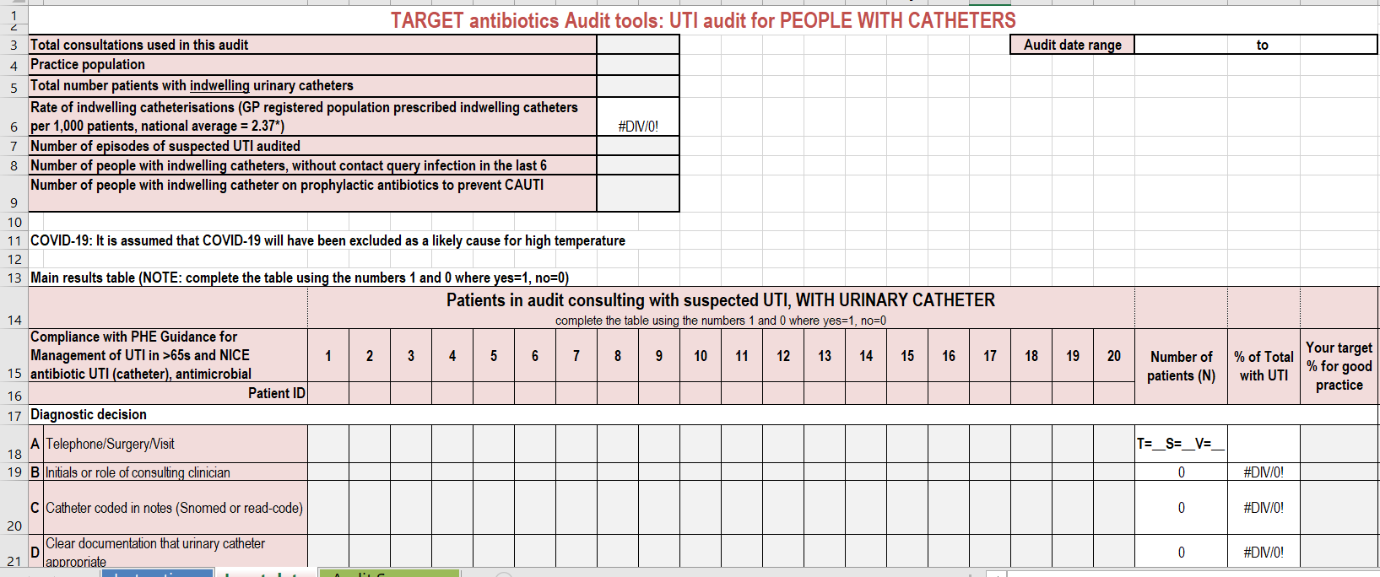
TARGET Audits: Urinary Tract infection (UTI)
Clinical Scenario
Urinary Tract Infection
The TARGET website has audit templates for:
Acute otitis media
UTI
Women under 65 years
Older adults
CAUTI
Sore Throat
Acute Cough
Otitis Externa
Acute Sinusitis
www.rcgp.org.uk/TARGETantibiotics
Notes:
Presenter Talk:
Have you done any personal or practice wide antibiotic audits in the last year?
This can really help you understand what antibiotics you and others in the practice are prescribing, and to whom, and why
The TARGET website has audit templates with appropriate guidance and Read codes to use for:
Otitis media, Sore Throat, acute cough, UTI Audits.
For UTIs – we have audits for lower UTIs in women under 65 years, older adults, and adults with urinary catheters.
These will also help you comply with your CPD and revalidation.
Slide Reference:
https://elearning.rcgp.org.uk/mod/book/view.php?id=12649

Slide 41
Routine data for UTI improvement
Presented by: Elizabeth Beech MBE Regional Antimicrobial Stewardship Lead South West Region

Slide 42
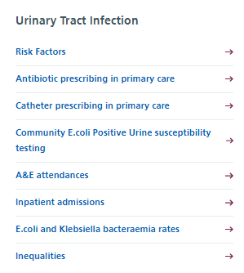
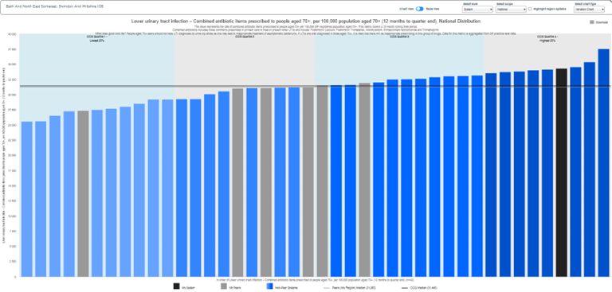
NHS England Model Health System AMR Dashboard - UTI
How to access?
Via Model Health System here registration required
Why use?
Improvement of the UTI pathway at an integrated care system level. Reports a wide variety of UTI related metrics based on routine NHS data. Includes metric reporting by gender
Good for:
System level improvement in a defined population known to have higher risk of antibiotic resistant UTI, and highest burden of Gram-negative blood stream infections (GNBSI). Reports population use of urinary catheters
Notes:
NHS Model Health System

Slide 43
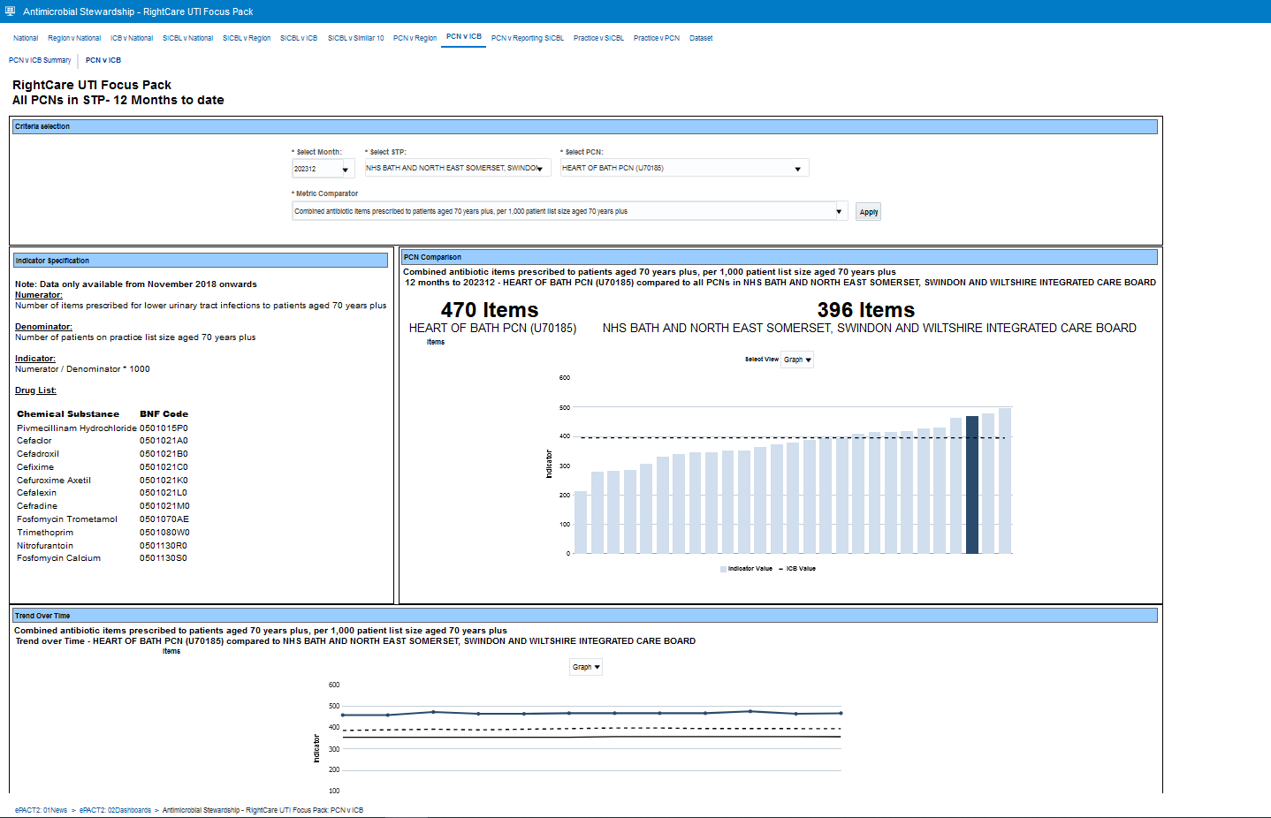
NHS BSA ePACT2 Antimicrobial Stewardship Dashboard RightCare UTI Focus Pack This dashboard is due to be replaced in 2024
How to access?
Via NHSBSA ePACT2 here registration required. RightCare UTI data packs via FutureNHS here
Why use?
Aligns to the primary care antibiotic prescribing metrics in use in RightCare UTI data pack which focus on improving the management of lower UTI in people aged 70+Y in primary care
Good for:
Improvement in a defined population known to have higher risk of antibiotic resistant UTI, and highest burden of Gram-negative blood stream infections (GNBSI).
Combined antibiotic items prescribed to patients aged 70 years plus per 1,000 patient list size aged 70 years plus for BSW PCN

Slide 44
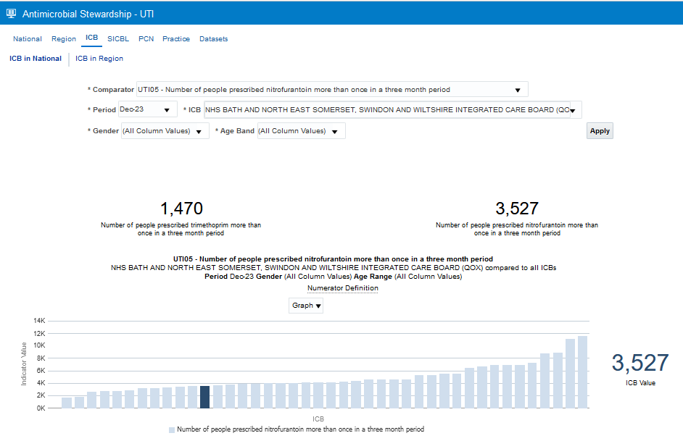
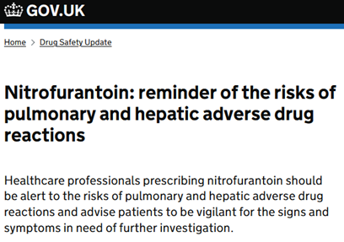
NHS BSA ePACT2 Antimicrobial Stewardship Dashboard UTI
Nearing publication and will report people metrics
How to access?
Via NHSBSA ePACT2 here registration required.
Why use?
Aligns to the primary care antibiotic prescribing metrics in use in Model Health System which focus on improving the management of lower UTI in people aged 70+Y in primary care
Good for:
Improvement in antibiotic management of LUTI in selected populations by age and gender. Includes population metric for urinary catheter use by age and gender.
Reports people counts for repeated nitrofurantoin and trimethoprim risks

Slide 45
Many thanks
Clinical Scenario
Urinary Tract Infection
Avril Tucker - Antimicrobial Pharmacist, NHS Wales
Catherine Hayes – PCIU, UKHSA
Dharini Shanmugabavan – RCGP
Donna Lecky – PCIU, UKHSA
Elizabeth Beech – Antimicrobial Stewardship Lead, NHS South West
Emily Cooper – Primary Care and Interventions Unit (PCIU), UKHSA
Joseph Besford – RCGP
Katherine Henderson – Lead Scientist for AMR/AMU, UKHSA
Kate Ellis – Senior Scientist for NIHR IPAP AMRP in UTI, UKHSA
Leigh Sanyaolu – GP and Researcher at Cardiff University
Liam Clayton – PCIU, UKHSA
Lizzie Richmond - RCGP
Naomi Fleming – Antimicrobial Stewardship Lead, NHS East of England
Philippa Moore – Consultant microbiologist, NHS Gloucestershire
Rebecca Guy – Principal Scientist - Epidemiology, UKHSA
The AMR team within UKHSA
www.rcgp.org.uk/TARGETantibiotics

Slide 46
Panel Discussion
Dr Philippa Moore
Consultant Medical Microbiologist, Gloucestershire Hosp. NHS Foundation Trust
Panellist/Speaker
Elizabeth Beech MBE
Regional Antimicrobial Stewardship Lead South West Region, NHS England
Panellist/Speaker
Naomi Fleming
Regional Antimicrobial Stewardship Lead East of England Region, NHS England
Panellist
Avril Tucker
Antimicrobial Pharmacist,
NHS Wales
Panellist
Dr Leigh Sanyaolu
General Practitioner and Doctoral Fellow at Cardiff University
Panellist

