Slide 1

Clinical Scenario:
Acute Cough

Slide 2

Acute cough clinical scenario
Consider the following details:
45 year old smoker with cough 1/52, green sputum
Temp 37.8°C
Several previous episodes of bronchitis and insists antibiotics ‘always help’
PEFR normal
Scattered course creps and wheeze, vesicular breath sounds, no focal crepitations
Poll/Show of hands - What would you do?
Notes:
Presenter notes
These cases are examples that can be printed out and discussed in pairs or groups, or with the group as a whole.
Allow the participants to discuss the case for 2 minutes and specifically ask several different people what they would do and /or prescribe.
It may be useful to also change the scenario slightly- how would this change if the patient was 81 years old and had been in hospital 6 months previously.
Please consider the following details then use the poll below to support a discussion session.
Poll - What would you do?:
A. Prescribe 5 days of doxycycline, with self care and safety netting advice
B. No antibiotic with self care and safety netting advice
C. Delayed antibiotic with self care and safety netting advice
D. Prescribe 5 days of amoxicillin, with self care and safety netting advice

Slide 3
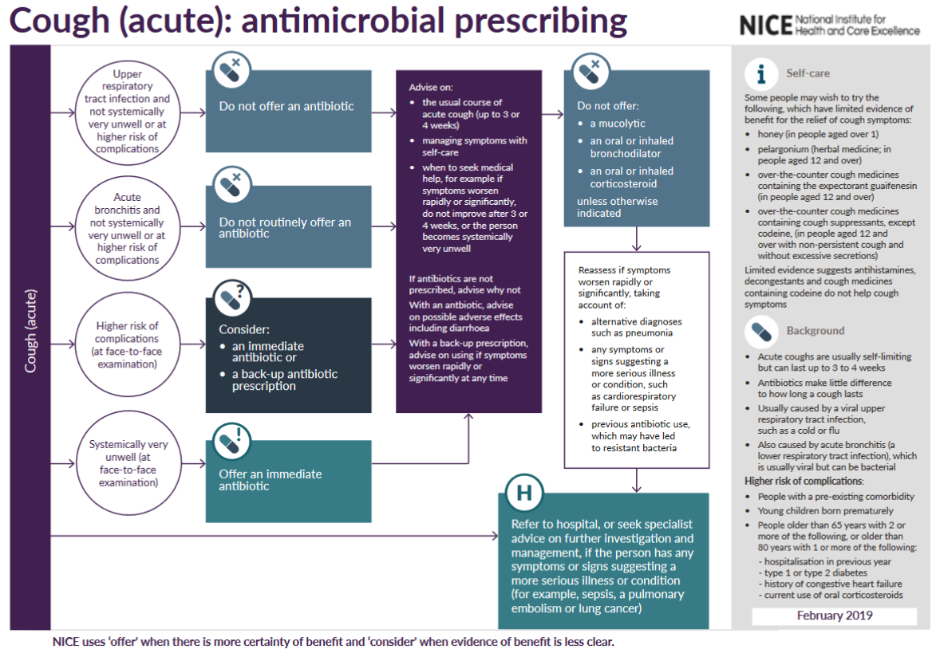
Acute cough antibiotic prescribing
(NICE 2019)
Notes:
Presenter talk
The TARGET website also links to the NICE national antibiotic guidance for acute cough, which is used by most ICBs to develop their local guidance. Please make sure to check your local guidance.
This is a snapshot of the visual summary of the Management of Infection Guidance for acute cough – last updated January 2022.
Speaker to click through the animations for each part of the guidance.
As you can see each section has information on what criteria is needed to indicate antibiotics should be prescribed. It also provides information on self care.
Presenter notes
We suggest you also refer to your local guidance.
Slide references
NICE (2019). Cough (acute): antimicrobial prescribing. Available at: https://www.nice.org.uk/guidance/ng120/evidence

Slide 4
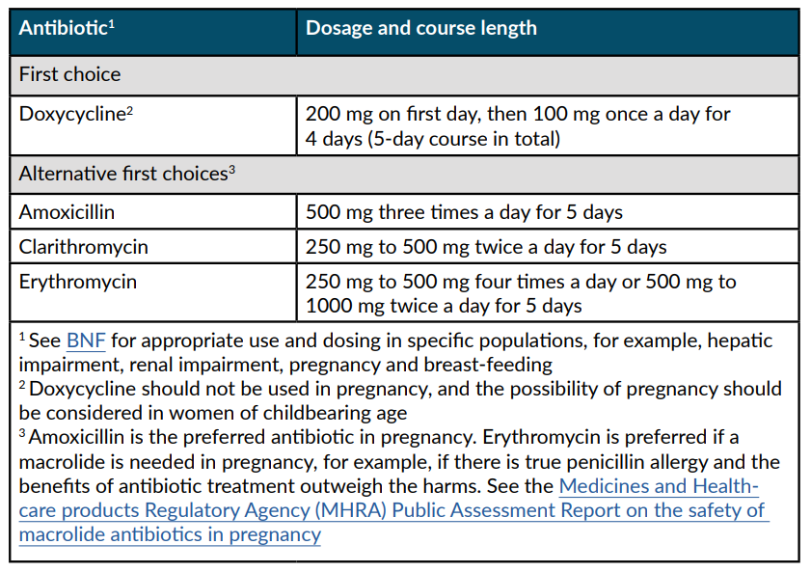
Acute cough antibiotic prescribing for adults
NICE antimicrobial prescribing guidance:
Choice of antibiotic for adults ages 18 years and over
(NICE 2019)
Notes:
Presenter talk
This is a screenshot of the treatment section of the NICE Management of Infection Guidance for acute cough and includes recommended first and second line antibiotics dose and duration. For acute cough, we suggest that antibiotics have little benefit if no co-morbidity. This NICE guidance also has an extensive rationale section which is really useful if you would like more information for yourself or the patient.
The guidance recommend doxycycline first line; with alternatives of amoxicillin, clarithromycin and erythromycin. Co-amoxiclav is not a recommended first line or second line alternative for acute cough (if pneumonia is not diagnosed).
Presenter notes
We suggest you also refer to your local guidance.
Slide references
NICE (2019). Cough (acute): antimicrobial prescribing. Available at: https://www.nice.org.uk/guidance/ng120/evidence

Slide 5
Acute cough clinical scenario: Feedback
45 year old smoker with cough 1/52, green sputum
Temp 37.8°C
Several previous episodes of bronchitis and insists antibiotics ‘always help’
PEFR normal
Scattered course creps and wheeze, vesicular breath sounds, no focal crepitations
Antibiotic little benefit as no co-morbidity
Consider no antibiotics OR if high risk of complications, 5 days back-up antibiotic prescription with safety netting
Share a leaflet with the patient e.g. TARGET RTI leaflet
Advise patient symptom resolution can take 3 weeks
If unclear, consider a point-of-care C‑reactive protein (CRP) test
(NICE 2019)
Notes:
Presenter talk
In this case a no, or back-up antibiotic prescription (5 day) strategy with safety netting advice using a patient leaflet (see TARGET) could be used as the symptoms do not suggest immediate antibiotic use is required. But the clinician needs to assess how ”ill” they consider the patient is.
NICE Guidance for Cough (acute) : antimicrobial prescribing suggests a no antibiotic or a delayed antibiotic prescribing strategy should be agreed for patients with acute URTI/bronchitis who is not at high risk of complications or systematically unwell. Patients should be advised that resolution of symptoms can take up to 3 weeks and that antibiotic therapy will make little difference to their symptoms and may result in side effects. Patients should also be advised to seek a clinical review if condition worsens or becomes prolonged.
If, after clinical assessment, it is unclear if antibiotics are needed for someone with a lower respiratory tract infection, consider a point-of-care C‑reactive protein (CRP) test to support clinical decision making
Presenter notes
The evidence – see references below:
In a European study of 3,000 primary care patients with acute cough across 13 countries, clinical outcome was similar whether antibiotics were given or not (1).
In an RCT of amoxicillin 1g tds vs placebo in 2061 patients 18yrs and over with acute LRTI when pneumonia was not suspected. New or worsening symptoms were significantly less common in amoxicillin (15.9%) than in the placebo group 19.3% (NNT30). Nausea, rash or diarrhoea were significantly more common in the amoxicillin group (number needed to harm 21). There was no increased benefit in those over 60 yrs (2). In this same patient series those with a history of significant co-morbidities experienced a significantly greater reduction in symptom severity between days 2 & 4. Those with a short prior illness <7days, or non smokers antibiotics provided a modest benefit (3).
NICE published guidelines in October 2023 to Suspected acute respiratory infection in over 16s: assessment at first presentation and initial management. These guidelines are to be used in conjunction with the This guideline should be read alongside NICE's antimicrobial prescribing guidelines on acute cough and acute sore throat. The guidelines state: If, after clinical assessment, it is unclear if antibiotics are needed for someone with a lower respiratory tract infection, consider a point-of-care C‑reactive protein (CRP) test to support clinical decision making and:
offer immediate antibiotics if the CRP level is more than 100 mg/litre
consider a back‑up antibiotic prescription if the CRP level is between 20 mg/litre and 100 mg/litre
do not routinely offer antibiotics if the CRP level is less than 20 mg/litre.
Slide references
Butler C C, Hood K, Verheij T, Little P, Melbye H, Nuttall J et al. Variation in antibiotic prescribing and its impact on recovery in patients with acute cough in primary care: prospective study in 13 countries BMJ 2009; 338 :b2242 doi:10.1136/bmj.b2242- https://www.bmj.com/content/bmj/338/bmj.b2242.full.pdf
2. Little P, Stuart B, Moore M, Coenen S, Butler CC, Godycki-Cwirko M, Mierzecki A, Chlabicz S, Torres A, Almirall J, Davies M, Schaberg T, Mölstad S, Blasi F, De Sutter A, Kersnik J, Hupkova H, Touboul P, Hood K, Mullee M, O'Reilly G, Brugman C, Goossens H, Verheij T; GRACE consortium. Amoxicillin for acute lower-respiratory-tract infection in primary care when pneumonia is not suspected: a 12-country, randomised, placebo-controlled trial. Lancet Infect Dis. 2013 Feb;13(2):123-9. doi: 10.1016/S1473-3099(12)70300-6. Epub 2012 Dec 19. PMID: 23265995.
https://www.ncbi.nlm.nih.gov/pmc/articles/PMC3905438/pdf/bjgpfeb2014-64-619-e75.pdf
3. Moore M, Stuart B, Coenen S, Butler CC, Goossens H, Verheij TJ, Little P; GRACE consortium. Amoxicillin for acute lower respiratory tract infection in primary care: subgroup analysis of potential high-risk groups. Br J Gen Pract. 2014 Feb;64(619):e75-80. doi: 10.3399/bjgp14X677121. Erratum in: Br J Gen Pract. 2014 Mar;64(620):126. PMID: 24567620; PMCID: PMC3905438.
https://bjgp.org/content/bjgp/64/619/e75.full.pdf
4. NICE Clinical Guidelines [CG237] Suspected acute respiratory infection in over 16s: assessment at first presentation and initial management. Published: 31 October 2023. Last updated: 16 November 2023. Accessed: December 2023. https://www.nice.org.uk/guidance/ng237
5. NICE (2019). Cough (acute): antimicrobial prescribing. Available at: https://www.nice.org.uk/guidance/ng120/evidence

Slide 6
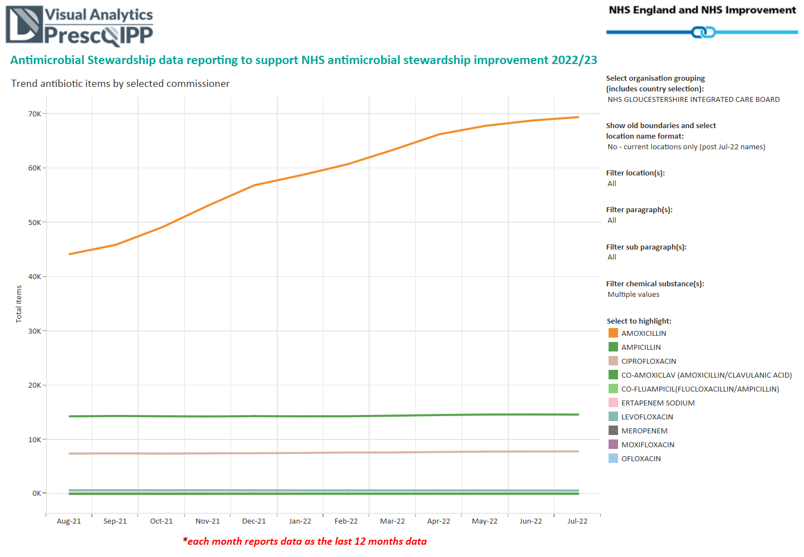
Prescribing: Your data (Glos)
July 2021 – July 2022
Notes:
Presenter talk
This line graph shows the trend in use of co-amoxiclav, cephalosporin and quinolone items in the past 12 months. As you can see there has been a sharp increase in the use of amoxicillin – likely a knock on effect from COVID-19, and can be seen across England.
The trend suggests that there is an opportunity for you to decrease your prescribing.
Presenter notes
To get graph
Go to https://www.prescqipp.info/our-resources/webkits/antimicrobial-stewardship/ams-visual-analytics-to-support-nhs-antimicrobial-stewardship-improvement-202223/
Select tab ‘Trend antibiotic items by selected commissioner’
On RHS menu select
Organisation grouping: the ICB of interest
Filter sub paragraph: broad-spectrum penicillins AND cephalosporins AND quinolines
Filter chemical substances: all 8 Cefs (cefaclor, cefadrixil, etc) / All 4 quinolines (cipro, levo, moxi, oflo) / Co-amoxiclav (amoxicillin/clavulanic acid)

Slide 7
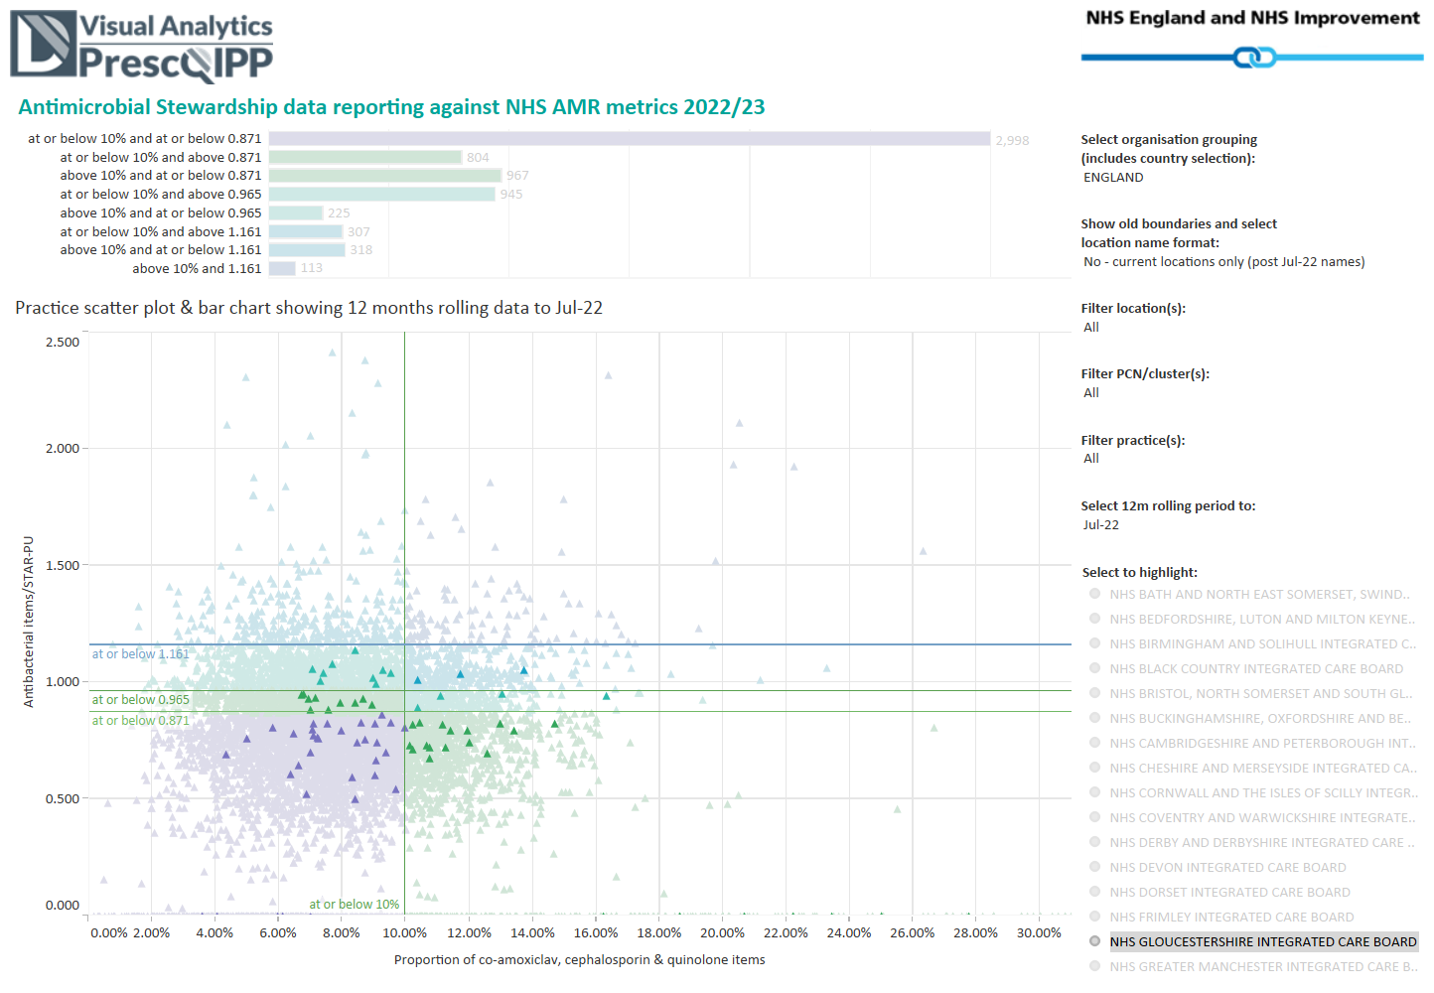
Prescribing: Your data (Glos)
July 2021 – July 2022
Notes:
Presenter talk
This scatter plot shows the variation in total number of antibiotic items on the vertical Y axis, and the % of the total that the co-amoxiclav, cephalosporin and quinolone items make up, on the horizontal X axis. As you can see there is a wide variation in use in total items across England, but also here locally in this ICB (seen in the darker dots). There is an even greater variation in the use of co-amoxiclav, cephalosporins and quinolones.
You are … [describe location on the chart]
The variation suggests that there is an opportunity for you to decrease your prescribing. Even if you are very low and can rightly feel proud about your practice prescribing – we still prescribe almost double that in the Netherlands.
Presenter notes
To get the graph
Once you have previous slide completed then select tab ‘practice scatter plot and bar chart’
Filter ‘select organisation grouping’ to ENGLAND
Filter ‘select to highlight’ to your ICB of interest

Slide 8
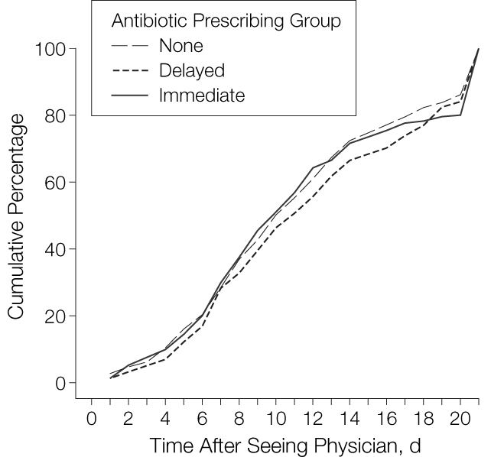
What is the evidence for back-up / delayed prescribing?
Duration of Cough After Physician Visit Until Patient Is Feeling Better
 | Patient satisfaction with treatment
No antibiotic (control Mean SD) | 130/181 (72)
Difference due to delayed antibiotic (95% CI) | 147/190 (77)
Difference due to Immediate antibiotics (95% CI) | 166/194 (86)
p-value | 0.005
(Little et al 2005, Spurling et al. 2017)
Notes:
Presenter talk
There has been much discussion about the use of giving delayed antibiotic prescriptions in acute uncomplicated infections, to reduce antibiotic use and reduce patient expectations. A 2017 Cochrane review has shown the benefits of this approach, without increasing complications in patients (1).
The study in the slide above assessed an information leaflet and antibiotic prescribing strategies for acute lower respiratory tract infection through a randomized controlled trial. Patients recruited by 37 physicians across Bristol and Southampton were randomised into immediate antibiotics, delayed antibiotics and no antibiotics groups. Of the 807 randomised participants, 272 were randomised to delayed antibiotics
The cough remained “a slight problem” for a mean of 11.7 days (in 25% the cough lasted 17 days), and moderately bad for a mean of 6.0 days. Compared with no offer of antibiotics, other prescribing strategies did not alter the primary outcomes.
There was no difference in recovery rates and high levels of satisfaction with all strategies. Overall, there were fewer re-attendances with cough following delayed prescribing and immediate antibiotics in the month after the physician visit compared to no antibiotics (mean attendances for delayed, 0.12; immediate, 0.11; and no antibiotics, 0.19; likelihood ratio [LR] test from Poisson regression, P=.04).
Authors concluded that No offer or a delayed offer of antibiotics for acute uncomplicated lower respiratory tract infection is acceptable, associated with little difference in symptom resolution, and is likely to considerably reduce antibiotic use and beliefs in the effectiveness of antibiotics.
Presenter further information
A Cochrane review of 11 studies has shown that delayed prescribing reduces antibiotic prescriptions without reducing satisfaction
Outcomes Risk with immediate antibiotics* Risk with delayed antibiotics* Relative effect (95% CI)
Antibiotic use:
delayed versus 930 per 1000 348 per 1000 OR 0.04
immediate antibiotics (286 to 401) (0.03 to 0.05)
Patient satisfaction:
delayed versus immediate 909 per 1000 866 per 1000 OR 0.65
Antibiotics (795 to 916) (0.39 to 1.10)
Reconsultation rate: 109 per 1000 113 per 1000 OR 1.04
delayed versus immediate (63 to 196) (0.55 to 1.98)
antibiotics
*Anticipated absolute effects* (95% CI)
Slide References
Spurling GK, et al. Cochrane Database Syst Rev https://www.ncbi.nlm.nih.gov/pmc/articles/PMC6372405/pdf/CD004417.pdf
Little P, Rumsby K, Kelly J, et al. Information leaflet and antibiotic prescribing strategies for acute lower respiratory tract infection: a randomized controlled trial. JAMA. 2005;293(24):3029-3035. doi:10.1001/jama.293.24.3029

Slide 9

Evidence: Risk of resistance persists for at least 12 months after prescribing antibiotics
Meta analysis of antibiotic resistance in individuals prescribed antibiotics in primary care RTI
7 studies of patients with RTI: n = 2,605
Increased risk of resistant organism
Antibiotic in past 2 months | Antibiotic in past 12 months
2.4 times | 2.4 times
(Costello et al. 2010)
Notes:
Presenter talk
Take a moment to think. Does your own antibiotic prescribing influence antibiotic resistance in your patients or community?
The risk of resistance is even greater in the first two months after an antibiotic as shown here for RTIs, but is still higher 12 months after antibiotic use for RTIs.
Individuals prescribed an antibiotic in primary care for a respiratory infection have an increased risk of subsequently carrying resistant organisms – so that the next time they have an infection it may be with one of these antibiotic resistant organism. So in conclusion, any antibiotic use increases our future risk of carrying resistant bacteria, even if it is amoxicillin, as this resistance gene is often linked to others like trimethoprim.
Presenter notes
The review referenced included 24 studies; 22 involved patients with symptomatic infection and two involved healthy volunteers; 19 were observational studies (of which two were prospective) and five were randomised trials. In five studies of urinary tract bacteria (14 348 participants), the pooled odds ratio (OR) for resistance was 2.5 (95% confidence interval 2.1 to 2.9) within 2 months of antibiotic treatment and 1.33 (1.2 to 1.5) within 12 months. In seven studies of respiratory tract bacteria (2605 participants), pooled ORs were 2.4 (1.4 to 3.9) and 2.4 (1.3 to 4.5) for the same periods, respectively. Studies reporting the quantity of antibiotic prescribed found that longer duration and multiple courses were associated with higher rates of resistance. Studies comparing the potential for different antibiotics to induce resistance showed no consistent effects. Only one prospective study reported changes in resistance over a long period; pooled ORs fell from 12.2 (6.8 to 22.1) at 1 week to 6.1 (2.8 to 13.4) at 1 month, 3.6 (2.2 to 6.0) at 2 months, and 2.2 (1.3 to 3.6) at 6 months.
Therefore in conclusion, individuals prescribed an antibiotic in primary care for a respiratory infection have an increased risk of carrying resistant organisms – so that the next time they have an infection it is with a antibiotic resistant organism. The effect is greatest in the month immediately after treatment but may persist for up to 12 months. This effect not only increases the population carriage of organisms resistant to first line antibiotics, but also creates the conditions for increased use of second line antibiotics in the community.
Slide references
Costelloe C, Metcalfe C, Lovering A, Mant D, Hay AD. Effect of antibiotic prescribing in primary care on antimicrobial resistance in individual patients: systematic review and meta-analysis. BMJ. 2010 May 18;340:c2096. doi: 10.1136/bmj.c2096. PMID: 20483949. https://pubmed.ncbi.nlm.nih.gov/20483949/ [Accessed 06 December 2023]

Slide 10
Evidence for CRP and communication in acute cough in general practice
Care for LRTI | Antibiotics prescribed
Usual care | 68%
Communication skills and leaflet | 33%
CRP to aid diagnosis | 39%
Both CRP & communication | 23%
I M P A C³ T
NICE: Patients with LRTI symptoms if diagnosis of pneumonia has not been made and it is not clear whether antibiotics are needed
C-reactive protein mg/litre | Management
Less than 20 | Do NOT routinely offer antibiotics
20 -100 | Consider delayed antibiotic prescription
Greater than 100 | Offer immediate antibiotics
(Cals 2009, NICE 2021/2023 )
Notes:
Presenter talk
The IMPACT study in the Netherlands showed that use of communication skills with GPs in which they shared information with patients halved antibiotic use. This supports the use of shared information and CRP when determining if antibiotics are necessary.
CRP alone was also very effective and the combination of both decreased antibiotic use the most.
Click to bring in information about NICE:
NICE conducted a systematic evidence review and metanalysis for POCT in primary care settings for ARTI in 2023. Evidence supports the use of POC CRP tests to assess adults with acute cough to help guide antibiotic management if pneumonia is suspected. NICE guidance continues to recommend that if it is unclear if antibiotics are needed for someone with a lower RTI, consider a point-of-care C-reactive protein (CRP) test to support clinical decision making.
According to NICE… walk people through the table
Slide References
Cals J W L, Butler C C, Hopstaken R M, Hood K, Dinant G. Effect of point of care testing for C reactive protein and training in communication skills on antibiotic use in lower respiratory tract infections: cluster randomised trial BMJ 2009; 338 :b1374 doi:10.1136/bmj.b1374
Antibiotic optimisation, resources for prescribers. University of Oxford. Accessed Dec 2023. https://www.antibioticoptimisation.co.uk/using-poc-crp-tests
NICE Clinical Guidelines [CG191] Pneumonia in adults: diagnosis and management. 2021. https://www.nice.org.uk/guidance/cg191
NICE Clinical Guidelines [CG237] Suspected acute respiratory infection in over 16s: assessment at first presentation and initial management. Published: 31 October 2023. Last updated: 16 November 2023. Accessed: December 2023. https://www.nice.org.uk/guidance/ng237

Slide 11
STARWAVe was developed to help predict future hospitalisation among children with cough
The seven symptoms and signs are:
Short duration of illness (≤3 days)
Parent reported fever in the previous 24 hours or temperature ≥37.8○C at presentation
Age <2 years
Clinician reported inter/subcostal recession
Clinician reported wheeze on auscultation
Current diagnosis of asthma
Parent reported moderate/severe vomiting in the previous 24 hours
S
T
A
R
W
A
V
(Blair et al 2023)
Notes:
Presenter talk
STARWAVe is a clinical scoring tool developed by researchers at University of Bristol to help predict possible hospitalisation among children who have presented to in-hours primary care with acute (≤28 days) cough and respiratory tract infection (RTI). Unlike some similar decision making algorithms, STARWAVe is not currently included in management guidance so please discus with your ICB medicines management leads before rolling it out as part of a practice wide intervention.
STARWAVe was developed in response to primary care clinicians saying they prescribe antibiotics “just in case” children’s illnesses deteriorate. However, as with all tools, use of STARWAVe should support, not replace, clinical judgement.
STARWAVe was used as part of a multi-faceted intervention to improve management of antibiotics for children presenting to primary care with acute cough and respiratory tract infection and was evaluated in a recent randomised controlled trial (CHICO), from Nov 2018 to Sept 2021. The trial period included COVID-19 pandemic, which changed how consultations occurred and rates of infection. Full trial results showed contradictory or non-significant findings. However, when a post hoc sensitivity analysis was conducted that excluded data after March 2020, the findings showed a reduced dispensing rate in the intervention arm (Adjusted rate ratio - 0.967 (95% CI: 0.946 to 0.989), p= 0.003). The findings also showed no difference in hospitalisations or emergency room visits between the intervention and control group.
The value of STARWAVe is to reduce clinical uncertainty when managing children with acute cough.
Children with 0-1 STARWAVe symptoms and signs (67% of all children): are at very low risk (around 1:320) of future admission and a ‘no’ antibiotic strategy should be considered for this group.
Children with 2-3 STARWAVe symptoms and signs (30% all children) who are at ‘normal’ risk of future admission (around 1:70). In keeping with NICE guidelines, a ‘no’ or ‘delayed’ antibiotic prescribing strategy should be considered.
Children with 4 or more STARWAVe symptoms and signs (3% of all children) should be closely monitored for signs of deterioration, with consideration given to proactively arranging same-day or next-day follow-up and prescribing an immediate antibiotic.
Presenter notes
STARWAVe development details are here: https://www.thelancet.com/journals/lanres/article/PIIS2213-2600(16)30223-5/fulltext
The intervention included the STARWAVEe algorithm embedded into GP systems and personalised printout recording decisions made at the consultation, covering common concerns and providing safety netting information, which was based on a leaflet co-designed with parents (Caring for children with cough).
https://www.bristol.ac.uk/media-library/sites/primaryhealthcare/documents/target/caring-for-children-with-cough-leaflet-print-ready.pdf
We found no difference in the rate of hospital admissions at 0.013 (0.010 to 0.018) and 0.015 (0.012 to 0.020) for the intervention and control arms, respectively. This translates into 13 or 15 admissions a year per 1000 children, and the rate ratio was 0.952 (0.905 to 1.003). As 1.003 lies below the 1.01 non-inferiority margin we set, the intervention was considered non-inferior. Pre-specified sensitivity analyses that incorporated hospital admissions with “missing diagnosis” did not change these results (supplementary table A). The seasonal winter peak of hospital admissions was absent during the pandemic (fig 2). The secondary outcome of emergency department attendance rates were 0.045 (0.038 to 0.054) and 0.044 (0.037 to 0.052) for the intervention and control arms, respectively. This translates into approximately 49 and 45 attendances a year per 1000 children; the rate ratio was 1.013 (0.980 to 1.047; P=0.44). Pre-specified sensitivity analyses that incorporated “missing diagnosis” admissions and emergency department attendances are shown in the supplementary material.
References
Blair P S, Young G, Clement C, Dixon P, Seume P, Ingram J et al. Multi-faceted intervention to improve management of antibiotics for children presenting to primary care with acute cough and respiratory tract infection (CHICO): efficient cluster randomised controlled trial BMJ 2023; 381 :e072488 doi:10.1136/bmj-2022-072488
Multi-faceted intervention to improve management of antibiotics for children presenting to primary care with acute cough and respiratory tract infection (CHICO): efficient cluster randomised controlled trial | The BMJ
Bristol University - Using STARWAVe in practice to predict hospitalisation. Available at: https://www.bristol.ac.uk/media-library/sites/primaryhealthcare/documents/target/Using%20STARWAVe%20evidence%20in%20practice%20(19.12.2023).pdf
[accessed 03.01.24]

Slide 12



The patient perspective: what do patients do when they have an RTI?
74% reported RTI in 2022- 23
55% self managed
(did not consult)
20% consulted
GP surgery
12% consulted
community pharmacy
Source: Basis Research, AMR Survey
Base: All respondents (n=5390), n varies by subgroup (min n=393)*
(AMR Public Perceptions survey 2023, Basis Research)
Notes:
Presenter talk
Data from an online survey of 5390 members of the public in 2023 (a nationally representative sample in England) shows that about ¾ of adults from the general population will say they had a respiratory tract infection in the last year. Of these 54% had a cold/runny nose and 47% a cough.
About ½ (53%) self managed without consulting any healthcare provider.
20% consulted a GP surgery and 12% and a community pharmacy/chemist.
Presenter notes
Slide references
UKHSA AMR Public Perceptions survey, Basis Research, December 2023 – Awaiting peer review and publication.

Slide 13
What did you expect from your contact or visit to the Doctor's surgery, for this most recent illness?
Vs What happened when you contacted or visited the Doctor's surgery [multiple choice question]
Patient expectations compared to reality
Significantly higher / lower vs. expectation
(AMR Public Perceptions survey 2023, Basis Research)
Notes:
Presenter talk
Patients were asked what they expected from contact or visit to the doctor's surgery and then what actually happened from the consultation.
The key take away is that although 40% expected to be prescribed antibiotics, there is a similar proportion expecting to be prescribed treatment to relieve the symptoms. Further more 30% are expecting to receive advice on whether antibiotics are needed.
Presenter notes
Slide references
UKHSA AMR Public Perceptions survey, Basis Research, December 2023 – Awaiting peer review and publication.

Slide 14
Patients generally trust the advice from their healthcare professional
3%
disagree
4%
disagree
6%
disagree
88%
Agree or strongly agree
78%
Agree or strongly agree
74%
Agree
Trust GP’s advice whether antibiotics are required
Trust nurses' advice whether
antibiotics
are required
Trust pharmacists' advice whether
antibiotics
are required
Source: Basis Research, AMR Survey
Base: All respondents (n=5390)
Notes:
Presenter talk:
This information is from an online survey of 5390 members of the public in 2023 (a nationally representative sample in England)
Respondents were asked if they trust “their GP’s/nurse's/pharmacist's advice as to whether they need antibiotics or not”
You can see looking at the light grey and red bars, that respondents generally trusted their healthcare providers advice about weather they needed antibiotics or not. This is slightly skewed towards the GPs but is still very high across professions.
References:
UKHSA AMR Public Perceptions survey, Basis Research, December 2023 – Awaiting peer review and publication.

Slide 15
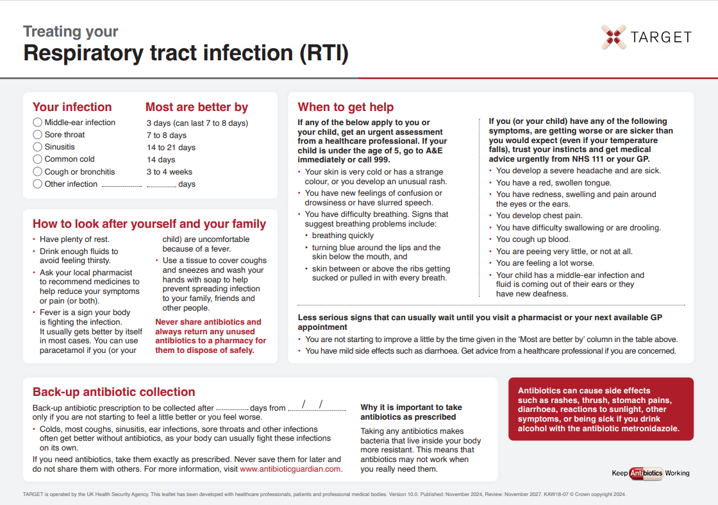
TARGET: Patient Information Leaflets
Treating Your Infection RTI Leaflet
Clinical Scenario
Acute Sore Throat
‘Most are better by’ section to help patients know when to (re) consult
Safety netting
Back-up prescription
Information about antibiotics & AMR
Read codes: Delayed:8CAk, Leaflet: 8OAN
www.rcgp.org.uk/TARGETantibiotics
Notes:
Presenter notes
It would be useful to print off a copies of this leaflet and take enough with you for each GP. They can be found at Leaflets to discuss with patients: How to use these leaflets (rcgp.org.uk)
Presenter talk
The TARGET patient information leaflets can be used to help give this advice in an evidence based format. The Treating Your Infection RTI leaflet has been developed through extensive feedback with patients and clinicians. It is designed to be shared with the patient and completed with them during the consultation. It aims facilitate the patient – clinician conversation, increase patient confidence to self-care, and to facilitate the use of back-up antibiotics. It also allows the patient to go away with something (not an antibiotic a prescription) and feel that they have been heard during the consultation, so ending the consultation on a positive note.
All leaflets are now available in HTML format and can be sent to patients via SMS. Templates are available on the accuRx platform.
Bring in ‘most get better by’ text box
The ‘usually lasts’ section allows patients to understand not only for this consultation but also others when they should consult. This section has consistently been seen as very useful by patients of all ages.
Bring in safety netting box
Whatever the infection, in this era of antibiotic resistance and with increasing numbers of elderly or vulnerable patients, it is extremely important to give some clear safety netting instructions. These are some that can be used and saved by patients.
Bring in back-up prescription box
The back-up prescription can reduce antibiotic prescribing by about 40%, and is extremely useful for particularly demanding patients or just before a weekend to reduce visits to out of hours services. These different options are given, so that the patient understands where to pick up the leaflet, a recent study by Little et al shows that either of the options leads to similar % of antibiotics being taken, but that giving the patients the prescription and advising them when to pick the antibiotic up –leads to slightly greater patient satisfaction.
Bring in information box
Although most patients know they shouldn’t take antibiotics for coughs and colds, far fewer know that sinusitis, ear infections and sore throats and many other infections get better on their own without antibiotics.
Likewise they know little about antibiotic resistance, so we should take every opportunity to educate them.
This final statement is important – as in January 2017 16% of patients given oral antibiotics in the last year reported having some left-overs, and this was 28% of 16-24 year olds. Of those with left-overs 30% kept them for future use just in case. So take the opportunity to stress not to share antibiotics, and to return left-overs to a pharmacy.
There is a READ code for delayed/ back-up antibiotics or leaflet given and if you Read code the infections featured the leaflet with EMIS and some other systems this leaflet will appear on your computer via the patient.co.uk system.
Extra notes for presenter: Most prescribers have access to many leaflets, both paper ones and ones that can be printed off their computer system or the web. However, not all information resources are based on the best available evidence or have been developed through rigorous processes. The TARGET Patient Information Leaflets have been developed through over months of literature searching, consultation, focus groups with patients and staff, drafting and revision.
Overview of the leaflet
To use this leaflet properly, it is important that clinicians use it as a tool to interact with patients, rather than just handing it to them as a ‘parting gift’. In order to communicate this effectively you must make sure that you are very familiar with its content. Please make sure that, in addition to completing this training, you take some time to thoroughly familiarise yourself with the leaflet before you start using it.
.

Slide 16
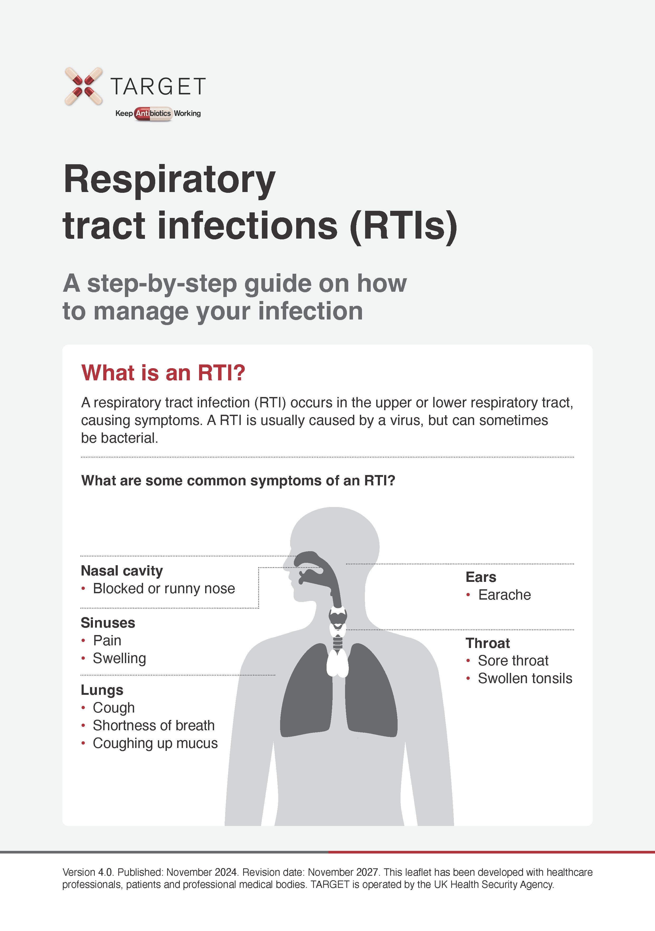
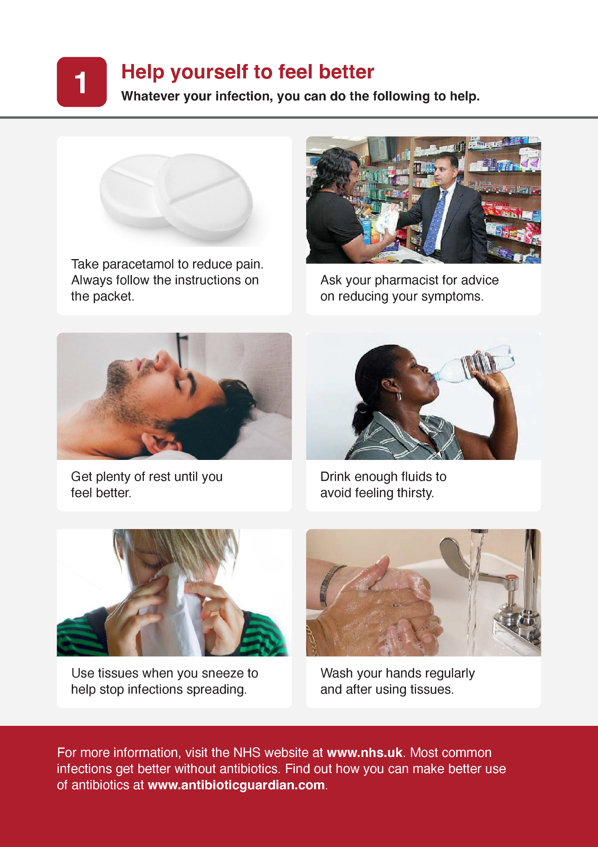
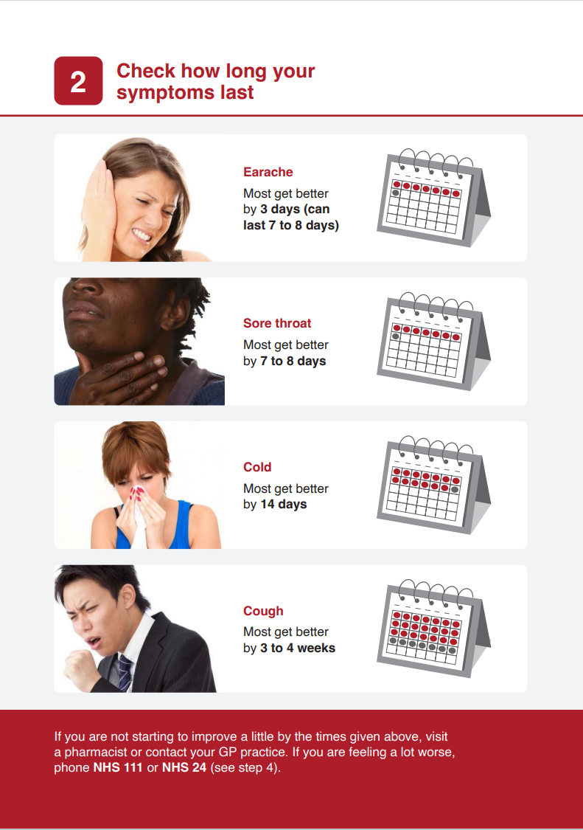
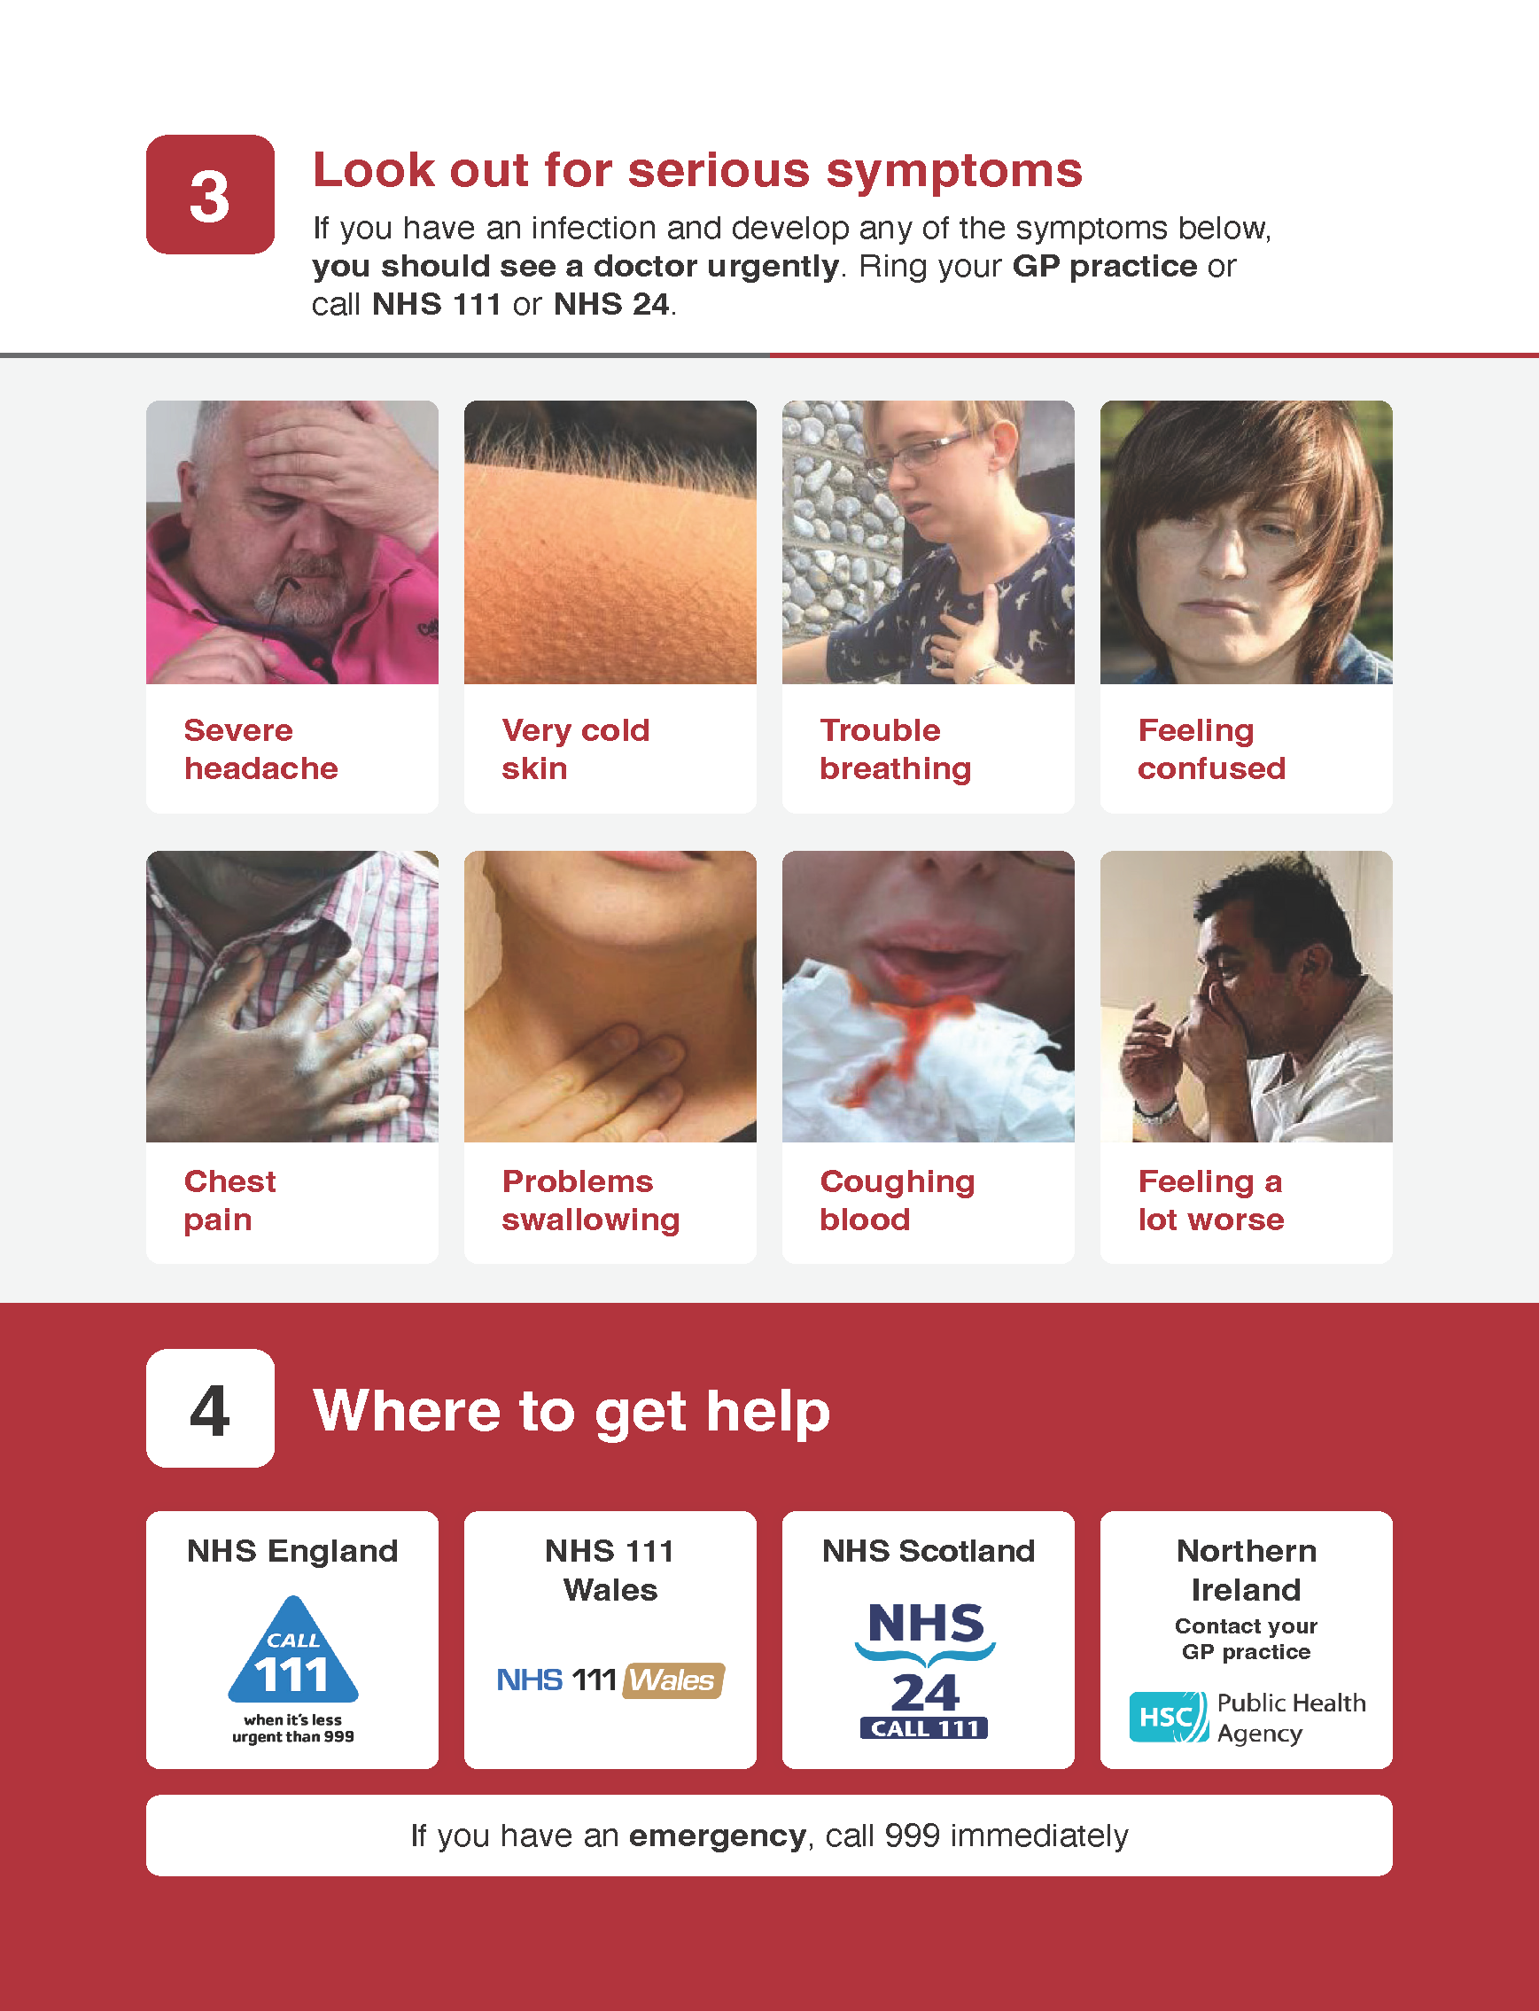
TARGET pictorial TYI leaflet
www.rcgp.org.uk/TARGETantibiotics
Notes:
Presenter talk
Teaching about antibiotic use and resistance is particularly challenging with lower ability groups. Lower participant ability often find the current self-care leaflets available on TARGET and patient.co.uk difficult to understand. In a pilot e-Bug course community users were not engaged by text based self-care leaflets. Initial discussions with community groups indicated that many do not know how long common infections usually last, what they can do to look after themselves and where or when to get appropriate help if their symptoms worsen. Therefore, this formed the basis of the aims of the pictorial leaflet; Managing Your Infection Leaflet: A step-by-step guide on how to manage your infection.
The aims of the pictorial leaflet for self-limiting respiratory tract infections are:
To increase the public understanding about the length of time symptoms of common infections usually last
To increase the public’s confidence on how to self-care appropriately for common infections
To increase public knowledge about what symptoms should prompt them to seek help from their GP practice or other health professional
To increase awareness about the importance of using tissues and handwashing to prevent the spread of infection
To increase the public’s trust in the pharmacists advice
The leaflet is found on the TARGET website next to the TARGET RTI leaflet.

Slide 17
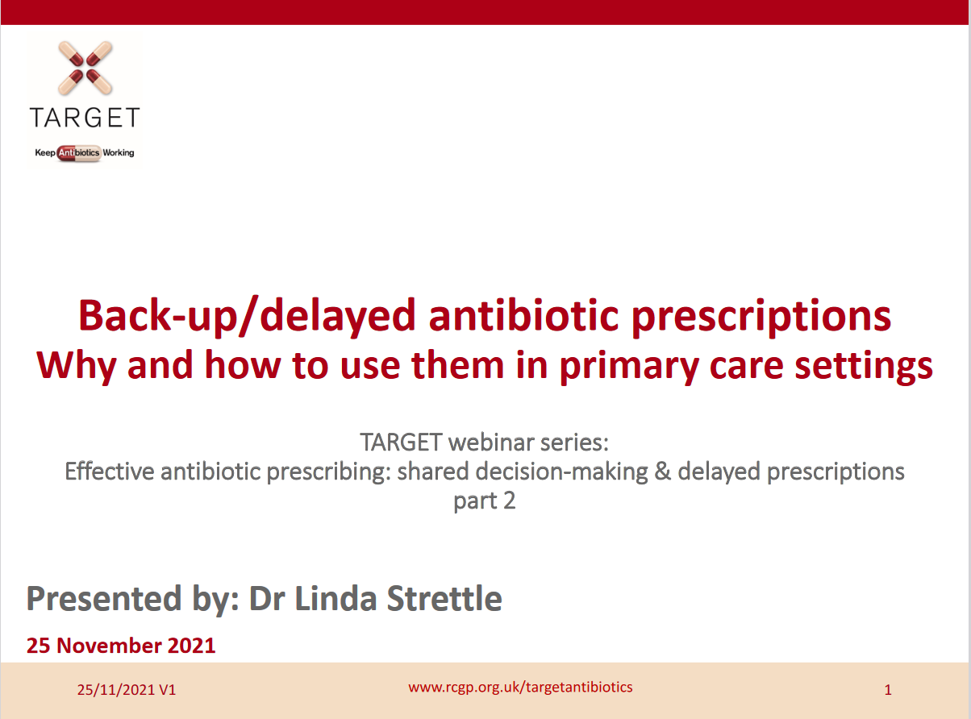

Back-up/delayed antibiotic prescriptions
www.rcgp.org.uk/TARGETantibiotics
Visit: www.rcgp.org.uk/TARGETantibiotics
Then: ‘learning resources for prescribers’ to access the recording and slide deck
Notes:
Presenter talk
We will briefly touch on back-up and delayed antibiotic prescriptions, but there is a previous TARGET webinar from 2021 you can access from the website which goes into depth on using these.

Slide 18
Prescribing can influence patients understanding and expectations
English RCT comparing treatment strategies for respiratory tract infection (n=889)
Delayed antibiotic
Delayed antibiotic
Little 2014, BMJ, Extracted from supplementary table 2
Notes:
Presenter Talk
This slide covers one study within a review conducted by Little et al in in 2014 focused on upper respiratory tract infections and included patients 889 patients over 3 years of age from 25 practices. Patients who were not judged to need an immediate antibiotic, were randomised into no antibiotic or delayed prescribing group (n=556).
There was no significant effect of antibiotic prescribing strategy on symptom severity or temperature. Higher levels of satisfaction were reported for the patient led and collection approaches, although the limited sample size for this outcome resulted in no significant differences overall (2.38, P=0.667). Those given antibiotics were more likely to believe that antibiotics were effective (click for arrow) despite immediate antibiotics having no significant effect on symptom severity or duration.
The back-up prescription is very useful to give to patients who have a high expectation for antibiotics, and can be given alongside the TARGET patient information leaflets.
Additional presenter notes
Additional information on delayed prescribing you can cover:
A 2017 Cochrane review found that symptoms for sore throat were only modestly improved by immediate antibiotics compared with delayed antibiotics (5 studies - Spurling 2017) also found no significant difference in patient satisfaction in delayed vs. immediate groups in studies focusing on respiratory tract infections (6 studies).
You can also include information about safety by covering the DESCARTE study:
A study of acute sore throat (the DESCARTE study – Little 2013) showed that complications in those who received immediate were similar to those receiving a back-up prescription even though 30% did not collect the prescription, and in the study complications were higher in the no antibiotic group. Thus giving more control to the patient does help prevent complications, but with a back-up antibiotic safety netting instructions are important.
Little 2014 study:
Health professionals decided in negotiation with patients whether immediate antibiotics were needed. Total of 889 patients, of these 333 (37%) were prescribed immediate antibiotics
If antibiotics were not needed, patients were randomised into four delayed prescribing groups (n=556, 63%):
Recontact for prescription (n=123)
Post-dated prescription (n=114)
Collection of the prescription (n=105)
Or patient led (the patient was given to use if needed) (n=106)
Immediate antibiotics given (n=333) symptoms documented (n=280)
For symptom severity, we saw no evidence of a significant interaction between antibiotic strategy and analgesia use
For the randomised no/delayed groups
There was no significant effect of strategy on symptoms severity, duration and small differences in temperature control.
Antibiotic use did not differ significantly between no/delayed prescribing strategies, with the lowest use reported in the no prescription group
Consultations in the following month were similar (RR: 2.97, P=0.563) and were not significantly different after the first month (RR: 4.11, P=0.391).
Belief in antibiotics was strong but not significantly different between no or delayed groups,
Inclusion of the non-randomised immediate prescription group
No significant effect of antibiotic prescribing strategy on symptom severity or temperature
Antibiotic use differed significantly with 97% of patients reporting antibiotic use in the immediate arm
More patients believed antibiotics were very effective despite immediate antibiotics having no significant effect on symptom severity or duration.
There was no significant difference in satisfaction rates across the groups
A 2017 Cochrane review of delayed prescriptions for respiratory infection found that:
A strategy of immediate antibiotics is more likely to confer the modest benefits of antibiotics on clinical outcomes such as symptoms for acute otitis media and sore throat than delayed antibiotics (moderate certainty evidence according to GRADE assessment).
Immediate antibiotics had similarly high levels of patient satisfaction to delayed antibiotics (91% versus 86% - moderate certainty evidence according to GRADE assessment).
Delayed antibiotics had higher levels of patient satisfaction than no antibiotics (87% versus 82% - moderate certainty evidence according to GRADE assessment).
Delayed antibiotic prescribing strategies achieved markedly lower rates of antibiotic use compared to immediate antibiotics (31% versus 93% - moderate certainty evidence according to GRADE assessment).
Requiring the patient to return for a prescription resulted in even lower antibiotic use (27%) than giving a prescription at the time of the consultation with instructions to fill the prescription if symptoms worsened (38%).
No antibiotics achieved lower rates still of antibiotic use compared to delayed antibiotics (14% versus 28%)- moderate certainty evidence according to GRADE assessment).
Slide References
Spurling GKP, Del Mar CB, Dooley L, Clark J, Askew DA. Delayed antibiotic prescriptions for respiratory infections. Cochrane Database of Systematic Reviews 2017, Issue 9. Art. No.: CD004417. DOI: 10.1002/14651858.CD004417.pub5. Accessed 23 January 2023.
Little P, Moore M, Kelly J, Williamson I, Leydon G, McDermott, L, Mullee M, Stuart B. Delayed antibiotic prescribing strategies for respiratory tract infections in primary care: pragmatic, factorial, randomised controlled trial. BMJ 2014;348.
Moore M, Little P, Rumsby K, Kelly J, Watson L, Warner G, Fahey T, Williamson I. Effect of antibiotic prescribing strategies and an information leaflet on longer-term reconsultation for acute lower respiratory tract infection. Br J Gen Pract. 2009 Oct;59(567):728-34. doi: 10.3399/bjgp09X472601. PMID: 19843421; PMCID: PMC2751917.
Little P, Stuart B, Hobbs FD, Butler CC, Hay AD, Campbell J, Delaney B, Broomfield S, Barratt P, Hood K, Everitt H, Mullee M, Williamson I, Mant D, Moore M; DESCARTE investigators. Predictors of suppurative complications for acute sore throat in primary care: prospective clinical cohort study. BMJ. 2013 Nov 25;347:f6867. doi: 10.1136/bmj.f6867. PMID: 24277339; PMCID: PMC3898431.
Little P, Stuart B, Hobbs FD, Butler CC, Hay AD, Delaney B, Campbell J, Broomfield S, Barratt P, Hood K, Everitt H, Mullee M, Williamson I, Mant D, Moore M; DESCARTE investigators. Antibiotic prescription strategies for acute sore throat: a prospective observational cohort study. Lancet Infect Dis. 2014 Mar;14(3):213-9. doi: 10.1016/S1473-3099(13)70294-9. Epub 2014 Jan 17. PMID: 24440616.

Slide 19
Public awareness of delayed/back up prescribing has increased but is still low
Awareness of delayed prescribing has increased
Base: All adults aged 18+ in England: 2022 (1663), 2021 (1676); 2020 (2052) :
(AMR Public Perceptions survey 2022)
Notes:
Presenter talk
When we look at the public survey data, on the publics awareness of delayed antibiotics we see an interesting picture building.
Take home message: Awareness of delayed prescribing has increased slightly in the last few years but almost 70% of the population are not aware of what a delayed prescription is.
Additional presenter notes
There seemed to be an increased awareness of delayed prescribing during the first year of the pandemic, with a significant increase in the percentage of people who said they were fully aware of what an antibiotic was (red/beige section) – and this remained constant in 2022. On the other hand, those who said they were not aware of delayed prescribing (light grey section) initially decreased in 2021 only to rise again tin 2022 – closer to pre-pandemic levels.
There were 1-2 I don’t know responses that account for the data discrepancy in each year.
Slide References
(1) Manuscript out for publication

Slide 20
Coding back-up antibiotic prescriptions
***Don’t forget to code your treatment choice***
READ codes (Emis, Vision) | SNOMED code (System One) | Definition
8OAN | 967191000000104 | Provision of Treating Your Infection self-care patient leaflet with back-up antibiotic prescription issued (procedure)
8CAk | 248041000000103 | Patient advised to delay filling of prescription (situation)
8BP0 | 417576009 | Deferred antibiotic therapy (situation)
n/a | 1065591000000109 | Delayed prescription given (situation)
Notes:
Speaker notes:
Don’t forget to code your treatment choice. Much of the evidence presented today use Read/Snomed codes to trawl the data, if you haven’t coded its makes it difficult for researchers to understand the benefit or not of any treatment.
The Read/Snomed codes for delayed prescriptions are outlined in this table and you can these slides will be freely available on the TARGET website following this presentation.

Slide 21
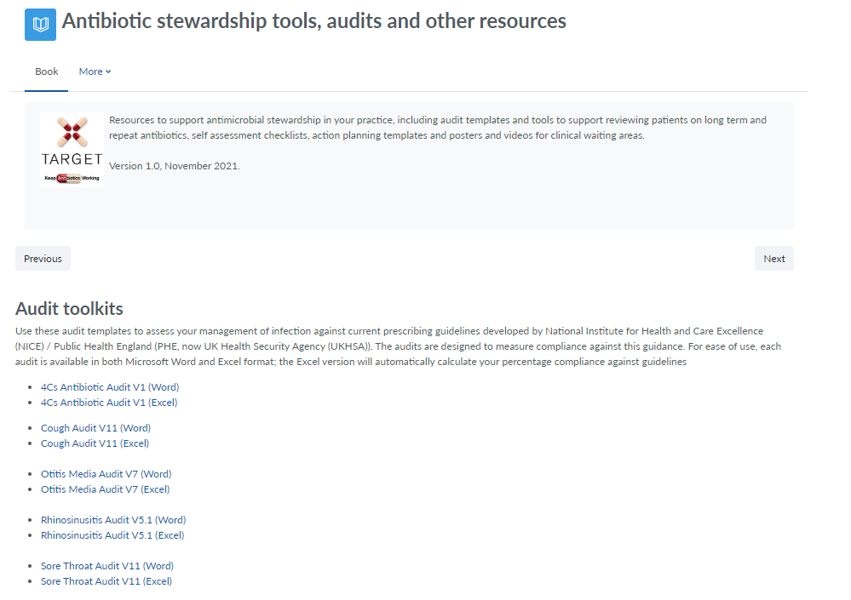
TARGET audit toolkits
    Acute otitis media
    UTI
    Acute sore throat
    Acute cough
    Otitis externa
    Acute rhinosinusitis
Excel templates auto calculates prescribing compliance for you!
Notes:
Presenter talk
Finally, how can you measure your or your practice’s compliance to NICE guidance for RTIs? TARGET have audit templates for a number of different infections under the section titled “Antibiotic stewardship tools, audits and other resources”
Audits adherence to NICE antimicrobial prescribing guidelines
MS Word and Excel
Includes step-by-step instructions
Calculates % adherence to guidelines
Summary report
Performance reflection questions
Allows to track performance
Slide reference
TARGET audits are available on the TARGET toolkit hub: https://elearning.rcgp.org.uk/course/view.php?id=553#section-0

Slide 22


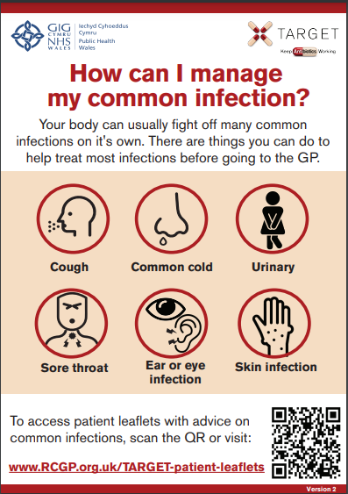
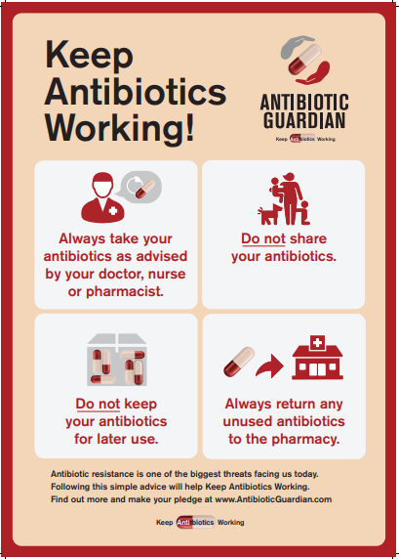
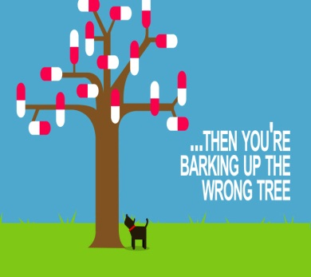
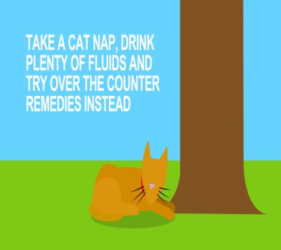

TARGET: Resources for clinical and waiting areas
Posters for Display
Clinical Scenario
Acute Sore Throat
Videos for patient waiting areas
www.rcgp.org.uk/TARGETantibiotics
Notes:
Presenter Talk
These posters and videos may make a difference to patient expectations about when to expect antibiotics, IF used in the waiting room where patients can see them and IF they have the time to digest the information. In 2014 25% of the general public surveyed remembered seeing the first poster and 95% of these correctly answered that antibiotics don’t help most coughs and colds. Used alone without any other strategies posters will make little difference to patients expectations for antibiotics, but they can be used to reduce expectations and can be used as a prompt for dialogue –
“you may have seen from the posters or videos in the waiting room that we in this practice encourage responsible antibiotic prescribing”
The videos were developed with patients and each animal cartoon video appealed to different people. A recent small survey of their use showed that those patients who saw them remembered the messages – however often the video sound was muted, chairs were pointing in the wrong direction or the video screen was off. If you intend to use them please don’t make this mistake.

Slide 23
Reflect on actions your practice can take to improve prescribing
Evidence
  Most patients with acute cough do not require antibiotics
  Reducing antibiotic prescribing can reduce consultations
  Patients trust you to give reassurance and advice
What actions can you agree with you team for this year?
Notes:
Presenter talk
To summarise
Most patients with acute cough do not require antibiotics
Reducing antibiotic prescribing can reduce consultations
Patients trust you to give reassurance and advice
What actions can we agree for this year?
Try to get to get participants to suggest some of the things that others have used in their practice – including the things on this list. The next slide details them
Use antibiotic guidance so consistent approach in practice – use the local or direct to the NICE guidance, and make sure used by all in the practice
Use NO, or back-up antibiotic and safety net – discuss how this could be done in their practice
Use the TARGET leaflet: discuss how they use leaflets and if they know about the TARGET leaflet
Consider CRP to guide in difficult cases or for clinicians with particularly high antibiotic use
Consider and audit of antibiotic use in acute cough using the resource on the RCGP website
Complete the free RCGP RTI clinical course

Slide 24
Clinical Scenario: Acute Cough
Action Planning next 12 months: Agree What, How, Who, When
Promote use of UKHSA/NICE or local antimicrobial / management of infection guidelines by all in practice
Consider use of CRP point of care testing when considering antibiotics and/or doubt the need for antibiotics (it is not recommended in all patients with acute cough - only in line with guidance when it is unclear if antibiotics are needed for someone with a lower respiratory tract infection)
Encourage use of TARGET Respiratory Tract infection (TYI-RTI) leaflet and share on clinical system.
Encourage consistent message from different staff and when patients re-attend.
Perform and encourage others to preform audit. Re-audit in 4 months - identify a date when you will repeat the audit.
Record actions required, especially when compliance with primary care guidance is less than 80%.
Reduce co-amoxiclav use.
Consider developing a target for antibiotic prescribing rate. e.g. 1 in 3 immediate, 1 in 3 delayed, 1 in 3 no antibiotic)
Make use of TARGET toolkit.
Notes:
Presenter notes
Here is a list of suggestions to add to any suggested by the audience
Use antibiotic guidance so consistent approach in practice – use the local or direct to NICE with rationale on the RCGP website, and make sure used by all in the practice
Use NO, or back-up antibiotic and safety net – discuss how this could be done in their practice
Use the TARGET leaflet: discuss how they use leaflets and if they know about the TARGET leaflet
Consider CRP to guide in difficult cases or for clinicians with particularly high antibiotic use
Consider and audit of antibiotic use in acute cough using the resource on the RCGP website
Complete the free RCGP RTI clinical course

