Slide 1
Clinical scenario: Acute rhinosinusitis
www.rcgp.org.uk/TARGETantibiotics

Slide 2
Clinical scenario: Acute Rhinosinusitis
35 year old non-smoker with nasal congestion and yellow nasal discharge for 11 days, mild right facial discomfort, sore throat and cough
Has had previous rhinosinusitis and feels that she usually needs antibiotics to treat her infection.
Temp 37.4°C, pulse 88, BP 142/88, right sided maxillary tenderness, mildly red throat, bilateral mildly red tympanic membranes and no lymphadenopathy.
www.rcgp.org.uk/TARGETantibiotics
Notes:
Presenter notes:
These cases are examples that can be printed out and discussed in pairs or groups, or with the group as a whole.
Allow the participants to discuss the case for 2 minutes and specifically ask several different people what they would do and /or prescribe.
It may be useful to also change the scenario slightly- how would this change if the patient was 81 years old and had been in hospital 6 months previously.

Slide 3
NG79: Sinusitis (acute):
antimicrobial prescribing.
www.rcgp.org.uk/TARGETantibiotics
Notes:
Presenter talk:
Management options are:
Continue with self-care with paracetamol or ibuprofen. There is little evidence that nasal saline or decongestants help, but people may wish to try them. There is no evidence to support the use of oral decongestants, anthihistamines, mucolytics or steam inhalation.
Consider high dose nasal corticosteroid for 14 days in adults and children aged over 12 years. E.g. mometazone 200mcg twice daily (unlicensed indication)
Consider antibiotic or delayed antibiotic for mild to moderate symptoms. Antibiotics make very little difference to symptom duration.
Offer immediate antibiotic to those who are systemically unwell, have symptoms and signs of a more serious illness or are at high risk of complications.
Consider referral to hospital if there is evidence of sepsis, intraorbital complications (oedema, cellulitis, displace eyeball, double vision or newly reduced visual acuity) or intracranail complications (severe frontal headache, swelling over frontal bone, signs of meningitis or focal neurological signs).
Presenter notes:
Evidence for:
Nasal saline: A systematic review of RCTs (King et al. 2015) found that nasal saline for 17 up to 28 days did not reduce the time to resolution of symptoms in adults (very low quality evidence). In the largest trial, in children aged 6 to 19 10 years, there were statistically significant reductions in nasal symptom scores, but these may not be clinically important (low quality evidence). Nasal saline irrigation is safe but may cause minor adverse effects, such as irritation (very low quality evidence). Nasal decongestants: A systematic review of RCTs (Smith et al. 2013) in children found no benefit for nasal decongestants compared with either placebo or mineral salts (low to very low quality evidence). No systematic reviews or RCTs of nasal decongestants in adults were identified. Nasal decongestants containing sympathomimetics can cause rebound 2 congestion and should not be used for longer than 7 days (BNF May 2017). Other interventions: No systematic reviews or RCTs of steam inhalation or applying warm face packs were identified. No systematic reviews or RCTs of paracetamol or ibuprofen were identified. However, these medicines have a well-established efficacy and safety profile for managing pain and fever. No systematic reviews or RCTs of oral decongestants, antihistamines, or mucolytics were identified.
Nasal corticosteroids: A systematic review of RCTs (Zalmanovici Trestioreanu et al. 2013) and 1 additional RCT (Keith at al. 2012) found that nasal corticosteroids (all doses assessed, with or without an antibiotic) for 14 to 21 days produced a statistically significant improvement in symptoms in adults and children aged 12 years and over compared with placebo (low to moderate quality). However, it is not clear whether these statistically significant 2 reductions in symptom scores are clinically important. The number needed to treat (NNT) was 15 for 1 additional person with acute sinusitis to have improved or resolved symptoms with nasal corticosteroids compared with placebo. Higher (twice daily) doses appeared to be more effective than 6 lower (once daily) doses.
In 1 RCT (Meltzer at al. 2005) which excluded people with suspected acute 8 bacterial sinusitis and compared nasal corticosteroids alone with antibiotics, there was a statistically significant reduction in symptoms with mometasone nasal spray 200 micrograms twice daily compared with mometasone nasal spray 200 micrograms once daily and compared with amoxicillin 500 mg three times daily for 10 days (low quality evidence). Systemic effects (mineralocorticoid and glucocorticoid) may occur with nasal corticosteroids, including a range of psychological or behavioural effects (particularly in children) (Drug Safety Update, September 2010). Adverse events for nasal corticosteroids in the studies were not significantly different from placebo (low to moderate quality evidence). The steroid burden of nasal corticosteroids needs to be considered in people already taking oral or inhaled corticosteroids (Ekins-Daukes et al. 20 2002), particularly systemic effects in children.
No antibiotic: Acute sinusitis is a self-limiting infection usually triggered by a viral infection, so most people will not benefit from an antibiotic. Only 0.5% to 2.2% of acute viral sinusitis becomes complicated by a 6 bacterial infection (International Consensus Statement on Allergy and 7 Rhinology: rhinosinusitis). The most common bacterial causes are Streptococcus pneumoniae, Haemophilus influenzae, Moraxella catarrhalis and Staphylococcus aureus (EPOS 2012 position paper). Complications of acute sinusitis are rare, with an incidence in large 11 epidemiological studies of 2.5 to 4.3 per million people per year. The most common complications are orbital, then intracranial, with osseous complications being least common (International Consensus Statement on 14 Allergy and Rhinology: rhinosinusitis). In a Dutch study (Hansen et al. 15 2012), severe complications were estimated to occur in 1:12,000 children 16 and 1:32,000 adults with acute sinusitis who were otherwise healthy.
Efficacy of antibiotics: Overall, evidence from 3 systematic reviews and meta-analyses of RCTs (Ahovuo-Saloranta et al. 2014, Falagas et al. 2008 and Rosenfeld et al. 20 2007) found the following. Antibiotics did not significantly increase the 21 proportion of adults with cure or improvement at 3 to 5 days follow-up 22 compared with placebo (low quality evidence). At longer durations of follow-up (approximately 7 to 15 days), there was a statistically significant difference in effectiveness for antibiotics compared with placebo, although the clinical difference in cure, improvement or clinical failure is small (low to 26 high quality evidence). This benefit was not maintained in the longer term (approximately 16 to 60 days follow-up) (low to very low-quality evidence). Where statistically significant benefits were seen for antibiotics compared with placebo, the NNT ranged between 7 and 20 depending on the outcomes considered, with little effect on the duration of illness. A meta-analysis of individual patient data (Young et al. 2008) found that the NNT was 15 for 1 additional person with acute sinusitis to be cured with antibiotics. Common clinical symptoms and signs could not confidently identify subgroups of people who may benefit from antibiotics, although people with purulent nasal discharge in the pharynx (observed by the doctor) had some prognostic value in identifying people who were more likely to benefit (NNT 8). Evidence from 2 systematic reviews (Cronin et al. 2013 and Falagas et al. 9 2008) in children was variable. In 1 systematic review, more children had symptom improvement at 10 to 14 days follow-up with antibiotics compared with placebo (NNT 8; low quality evidence). However, in the other systematic review, antibiotics did not significantly increase cure or improvement compared with placebo (low quality evidence).
Safety of antibiotics: Allergic reactions to penicillins occur in 1 to 10% of people and anaphylactic reactions occur in less than 0.05%. People with a history of atopic allergy (for example, asthma, eczema, and hay fever) are at a higher risk of anaphylactic reactions to penicillins. People with a history of immediate hypersensitivity to penicillins may also react to cephalosporins and other beta-lactam antibiotics (BNF May 2017). Antibiotic-associated diarrhoea is estimated to occur in 2 to 25% of people taking antibiotics, depending on the antibiotic used (NICE Clinical Knowledge Summary [CKS]: diarrhoea – antibiotic associated). Evidence from 3 systematic reviews (Falagas et al. 2008, Lemiengre et al. 25 2012 and Rosenfeld et al. 2007) found significantly more adverse events 26 with antibiotics compared with placebo (low to high quality evidence). The 27 number need to harm (NNH) ranged between 8 and 11 for all adverse effects, and was about 18 or 19 for diarrhoea. See the summaries of product characteristics for information on contraindications, cautions and adverse effects of individual medicines.
Presenter notes:
There are no major differences between different classes of antibiotics, so choice should be to minimise the risk of resistance. Consider a narrow spectrum antibitoic such as penicillin in the first instance and dosyxycline for adults and children over 12 years in those with penicillin allergy.
Evidence Choice of antibiotic: When an antibiotic is prescribed, penicillin V is considered to be the drug of choice first-line. This is considered appropriate as penicillin covers Streptococcus pneumoniae, the most common cause of acute sinusitis. Penicillin V does not cover Haemophilus influenzae, Neisseria catarrhalis, or Staphylococcus aureus, which are other less common causes of acute sinusitis. These organisms are not usually covered by amoxicillin either, which is currently the most common antibiotic prescribed for this condition. Moreover, in the systematic reviews cited, penicillin had similar efficacy as amoxicillin, and is also the first-line recommendation for sinusitis in Swedish guidance.
Overall, evidence from 2 systematic reviews and meta-analyses of RCTs in adults (Ahovuo-Saloranta et al. 2014 and Karageorgopoulos et al. 2008) did not suggest major differences in clinical effectiveness between classes of antibiotics, including penicillins, amoxicillin, cephalosporins, macrolides, tetracyclines, folate inhibitors and quinolones (very low to moderate quality 2 evidence). Some differences that were statistically significant were seen for some comparisons, for some end points at some time points only. Evidence from 1 systematic review in children (Smith 2013) found no significant differences between the antibiotics that were used in the studies (low to very low quality evidence). One systematic review in adults (Ahovuo-Saloranta et al. 2014) found significantly fewer drop-outs because of adverse effects in studies of cephalosporins (1.3%) or macrolides (2.1%), compared with co-amoxiclav (4.4% or 4.8%; high quality evidence). In a further systematic review (Karageorgopoulos et al. 2008), results varied for different safety outcomes, but overall there did not appear to be differences between quinolones and beta-lactam antibiotics (very low quality evidence). One systematic review in children (Smith 2013) found no significant differences in adverse events between classes of antibiotics (very low quality evidence).
Reference
https://www.nice.org.uk/guidance/ng79

Slide 4
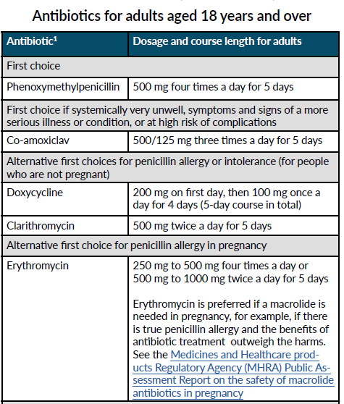
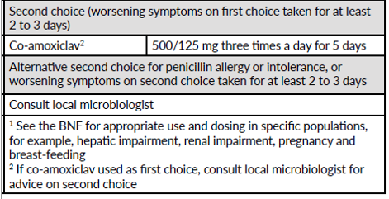
Acute Rhinosinusitis: NICE antimicrobial prescribing guidelines (NG79)
www.rcgp.org.uk/TARGETantibiotics
NG79: Sinusitis (acute):
antimicrobial prescribing.
Notes:
Presenter talk:
Walk users through the medication options.
Point out that co-amoxiclav is only used if patient very unwell, at high risk for complications or as second choice if no improvement 2-3 days after fist choice antibiotics.
Reference
https://www.nice.org.uk/guidance/ng79

Slide 5
Clinical Scenario: Acute Rhinosinusitis Feedback
35 year old non-smoker with nasal congestion and yellow nasal discharge for 11 days, mild right facial discomfort, sore throat and cough
Has had previous rhinosinusitis and feels that she usually needs antibiotics to treat her infection.
Temp 37.4°C, pulse 88, BP 142/88, right sided maxillary tenderness, mildly red throat, bilateral mildly red tympanic membranes and no lymphadenopathy.
Consider self-care, high dose nasal corticosteroids
Antibiotics make very little difference to symptom duration.
Consider antibiotic or delayed antibiotic for mild to moderate symptoms. Offer immediate antibiotic to those who are systemically unwell, have symptoms and signs of a more serious illness or are at high risk of complications.
Consider referral to hospital if there is evidence of complications
Share a leaflet with the patient – e.g. the TARGET leaflet
Notes:
Presenter talk:
In this case a no, or back-up antibiotic prescription (5 day) strategy with safety netting advice using a patient leaflet (see TARGET) could be used as the symptoms do not suggest immediate antibiotic use is required. But the clinician needs to assess how ”ill” he considers the patient is. Consider prescribing a high-dose nasal corticosteroid for 14 days for adults and children aged 12 years and over
Presenter notes:
For people presenting with symptoms for around 10 days or more with no improvement: Consider prescribing a high-dose nasal corticosteroid for 14 days for adults and children aged 12 years and over (mometasone 200 micrograms twice a day and fluticasone 110 micrograms twice a day (off-label). Consider no antibiotic prescription or a back-up antibiotic prescription taking account of evidence that antibiotics make little difference to how long symptoms last, or the proportion of people with improved symptoms; withholding antibiotics is unlikely to lead to complications; possible adverse effects, particularly diarrhoea and nausea; and factors that might make a bacterial cause more likely (see symptoms and signs).
NICE evidence comes from 3 systematic reviews and meta-analyses of RCTs (Ahovuo-Saloranta et al. 2014, Falagas et al. 2008 and Rosenfeld et al. 2007).
Antibiotics did not significantly increase the proportion of adults with cure or improvement at 3 to 5 days follow-up compared with placebo (this was very low quality evidence). At longer durations of follow-up (approximately 7 to 15 days), there was a statistically significant difference in effectiveness for antibiotics compared with placebo, although the clinical difference in cure, improvement or clinical failure is small (moderate quality evidence). This benefit was not maintained in the longer term (approximately 16 to 60 days follow‑up) (low to moderate quality evidence). Where statistically significant benefits were seen for antibiotics compared with placebo, the NNT ranged between 7 and 21 depending on the outcomes considered, with little effect on the duration of illness.

Slide 6
Inappropriate prescribing for Acute Rhinosinusitis
Condition | Consultations (n) | Proportion of consultations with a systemic antibiotic prescription (95% CI) | Ideal proportion of consultations resulting in systemic antibiotic prescriptions (IQR)16
Acute cough | 573 827 | 0.41 (0.41–0.41) | 0.10 (0.06–0.16)
Acute otitis media (age 2–18 years) | 39 513 | 0.88 (0.88–0.89) | 0.17 (0.08–0.30)
Acute rhinosinusitis | 74 359 | 0.88 (0.88–0.88) | 0.11 (0.05–0.18)
Acute sore throat | 386 971 | 0.59 (0.58–0.59) | 0.13 (0.07–0.22)
Big difference between actual and ideal prescribing for acute Rhinosinusitis in Primary Care
Considerable between-practice variation in prescribing proportions
Pouwels et al. JAC 2018 Feb; 73(Suppl 2): 19–26.
doi: 10.1093/jac/dkx502
Notes:
Presenter Talk
Why should we take a closer look at prescribing for Acute Rhinosinuitis? Research carried out in 2018 hihhlighted the discrepancy between prescribing and ideal prescribing for various conditions. This table shows only of a few f the conditions looked at. To enable quantification of inappropriate (defined here as clinically unnecessary) antibiotic prescribing in England, the researchers evaluated antibiotic prescribing proportions and compared with the results of their recent expert elicitation and/or the results of the European Surveillance of Antimicrobial Consumption (ESAC) expert elicitation to identify the potential for reductions in antibiotic prescribing. You can see that 88% of Acute Rhinosinusitis consultations resulted in an antibiotic prescription when the ideal prescribing proportion was 11%. Researchers however were unable to identify what proportion of these prescriptions were for delayed antibiotics.
Reference
Actual versus ‘ideal’ antibiotic prescribing for common conditions in English primary care - PMC (nih.gov)
J Antimicrob Chemother. 2018 Feb; 73(Suppl 2): 19–26.
Published online 2018 Feb 27. doi: 10.1093/jac/dkx502
PMCID: PMC5890776
PMID: 29490060
Actual versus ‘ideal’ antibiotic prescribing for common conditions in English primary care
Koen B Pouwels,^{1,2,3} F Christiaan K Dolk,^{1,2} David R M Smith,¹ Julie V Robotham,¹ and Timo Smieszek^{1,3}

Slide 7
Awareness of delayed/back up prescribing has increased but is still low
Y2 COVID-19
Y1 COVID-19
Pre COVID-19
Awareness of delayed prescribing has increased
Base: All adults aged 18+ in England: 2022 (1663), 2021 (1676); 2020 (2052) :
Notes:
Presenter talk
Throughout the COVID pandemic the UKHSA Primary Care and Interventions Unit carried out an annual survey of the general public’s health seeking behaviours and attitudes and behaviours towards antibiotics facilitated by Ipsos mori marketing research. All data was collected in Feb/Mar of years highlighted in this figure and respondents were asked about their behaviour in the previous 12 months – therefore 2020 respondents were asked about their behaviour in the 12 months BEFORE the first English national lockdown.
When we look at the publics awareness of delayed antibiotics we see an interesting picture building. There seemed to be an increased awareness of delayed prescribing during the first year of the pandemic, with a significant increase in the percentage of people who said they were fully aware of what an antibiotic was (darkest blue section) – and this remained constant in 2022. On the other hand, those who said they were not aware of delayed prescribing (lighter blue section) initially decreased in 2021 only to rise again tin 2022 – but to pre pandemic levels.
Take home message: Awareness of delayed prescribing has increased but is starting to decrease – almost 70% of the population are not aware of what a delayed prescription is.
Slide References
(1) Manuscript out for publication

Slide 8
How acceptable did you find being given the delayed / back-up antibiotic prescription?
% acceptable
Base: All adults aged 18+ in England who in the last 12 months have been given a delayed or back-up antibiotic prescription : 2022 (47); 2021 (46); 2020 (82) :
Small base sizes
Notes:
Of those who were offered a delated antibiotic – note small base size – acceptance was high!
Overall, around half of people given a delayed prescription (55%) had started taking the antibiotics; this was 41% in 2021 (although the small base sizes mean this difference is not significant).
In the 2022 survey for the first time a distinction has been made between whether they started taking the antibiotics immediately, or after a few days. A quarter (24%) had started taking them immediately, and around one-third (31%) had started taking them a few days later.

Slide 9
Back-up antibiotic prescriptions - How?
***Don’t forget to code your treatment choice***
READ codes (Emis, Vision) | SNOMED code (System One) | Definition
8OAN | 967191000000104 | Provision of Treating Your Infection self-care patient leaflet with back-up antibiotic prescription issued (procedure)
8CAk | 248041000000103 | Patient advised to delay filling of prescription (situation)
8BP0 | 417576009 | Deferred antibiotic therapy (situation)
n/a | 1065591000000109 | Delayed prescription given (situation)
Notes:
Presenter Talk
Don’t forget to code your treatment choice. Much of the evidence presented today use Read/Snomed codes to trawl the data, if you haven’t coded its makes it difficult for researchers to understand the benefit or not of any treatment. It also helps if you want to look back and audit your prescribing.

Slide 10
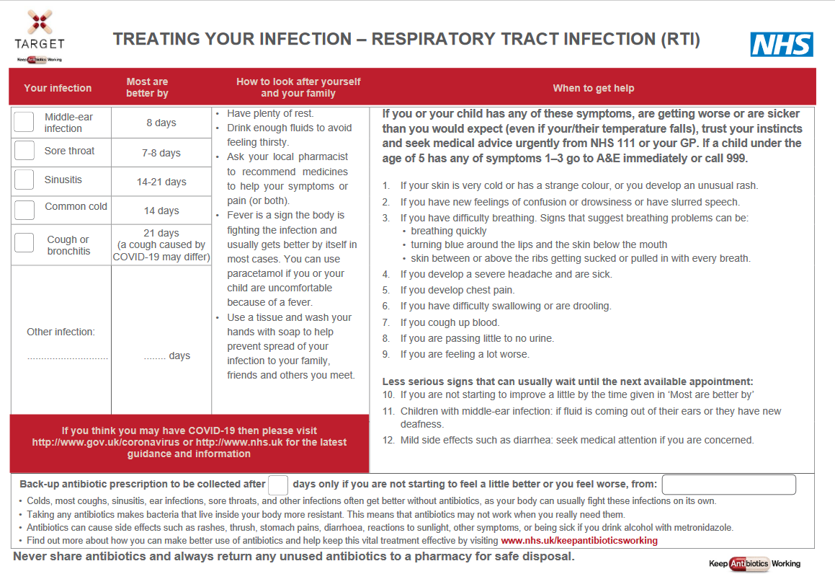
TARGET: Treating Your Infection RTI Leaflet
‘Most are better by’ section to help patients know when to (re) consult
Safety netting
Covid-19 Warning
Back-up prescription
Information about antibiotics & AMR
www.rcgp.org.uk/TARGETantibiotics
Notes:
Presenter notes:
It would be useful to print off a copies of this leaflet and take enough with you for each GP. They can be found at
http://www.rcgp.org.uk/clinical-and-research/target-antibiotics-toolkit/~/media/Files/CIRC/TARGET/Patient-Antibiotic-leaflet.ashx
Presenter talk:
The treating your infection leaflet has been developed through extensive feedback with patients and clinicians over the last 2 years. It is designed to be shared with the patient and completed with them during the consultation. Its aim is to increase the patients confidence to self-care, and to facilitate the use of back-up antibiotics, but it also allows the patients to go away with something, so ending the consultation on a positive note.
Bring in personalised text box
All sections can be personalised and added to by the GP. And it is important to share it with the patient and add extra infections , self-care instructions in the third column and alarm symptoms in the fourth column that may be required.
Bring in ‘most get better by’ text box
The ‘usually lasts’ section allows patients to understand not only for this consultation but also others when they should consult. This section has consistently been seen as very useful by patients of all ages.
Bring in safety netting box
Whatever the infection, in this era of antibiotic resistance and with increasing numbers of elderly or vulnerable patients, it is extremely important to give some clear safety netting instructions. These are some that can be used and saved by patients.
Bring in back-up prescription box
The back-up prescription can reduce antibiotic prescribing by about 40%, and is extremely useful for particularly demanding patients or just before a weekend to reduce visits to out of hours services. These different options are given, so that the patient understands where to pick up the leaflet, a recent study by Little et al shows that either of the options leads to similar % of antibiotics being taken, but that giving the patients the prescription and advising them when to pick the antibiotic up –leads to slightly greater patient satisfaction.
Bring in information box
Although most patients know they shouldn’t take antibiotics for coughs and colds, far fewer know that sinusitis, ear infections and sore throats and many other infections get better on their own without antibiotics.
Likewise they know little about antibiotic resistance, so we should take every opportunity to educate them.
This final statement is important – as in January 2017 16% of patients given oral antibiotics in the last year reported having some left-overs, and this was 28% of 16-24 year olds. Of those with left-overs 30% kept them for future use just in case. So take the opportunity to stress not to share antibiotics, and to return left-overs to a pharmacy.
There is a READ code for delayed/ back-up antibiotics or leaflet given and if you Read code the infections featured the leaflet with EMIS and some other systems this leaflet will appear on your computer via the patient.co.uk system.
Extra notes for presenter: Most prescribers have access to many leaflets, both paper ones and ones that can be printed off their computer system or the web. However, not all information resources are based on the best available evidence or have been developed through rigorous processes. The Antibiotic Information Leaflet has been developed through over 24 months of literature searching, consultation, focus groups with patients and staff, drafting and revision.
Overview of the leaflet
To use this leaflet properly, it is important that clinicians use it as a tool to interact with patients, rather than just handing it to them as a ‘parting gift’. In order to communicate this effectively you must make sure that you are very familiar with its content. Please make sure that, in addition to completing this training, you take some time to thoroughly familiarise yourself with the leaflet before you start using it.
.

Slide 11
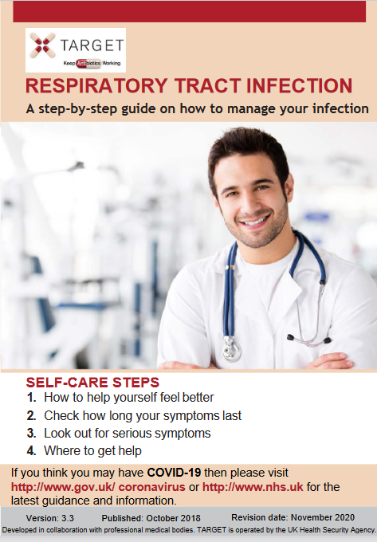
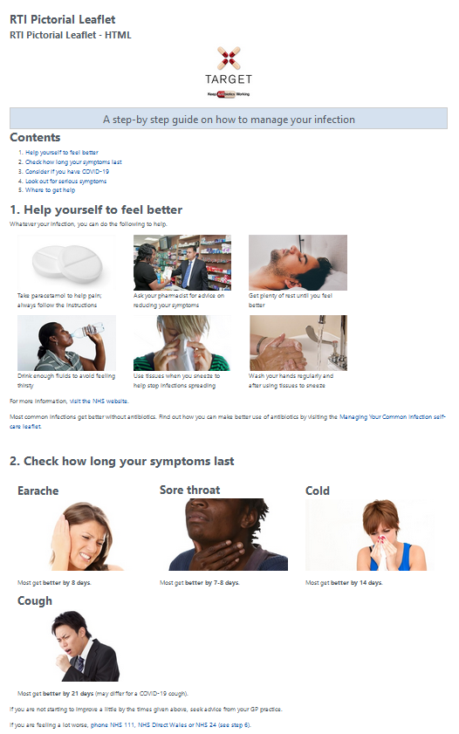
TARGET: Treating Your Infection RTI Leaflet
Pictorial leaflet
Digital leaflets
Notes:
The target RTI leaflets are available in a pictorial word/pdf version that can be printed off and used in a consultation
The standard and pictorial versions of the leaflets are also available in HTLM and can be embedded in GP system SMS templates so they can be texted or emailed after a consultation.

Slide 12
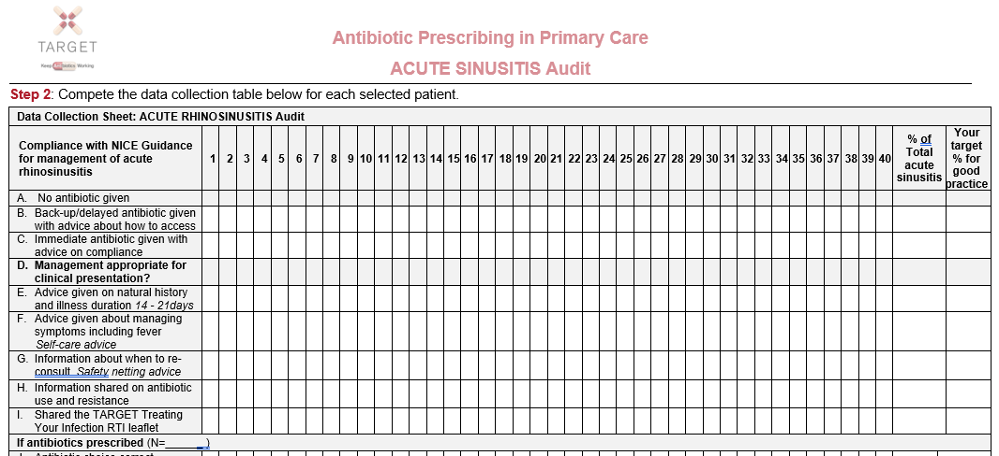
TARGET: Could your practice do an audit this year?
The TARGET website has audit templates for:
Acute otitis media
UTI
Sore Throat
Acute Cough
Otitis Externa
Acute Rhinosinusitis
Excel template auto calculates prescribing compliance for you!
Notes:
Presenter notes:
Have you done any personal or practice wide antibiotic audits in the last year?
The self-assessment check list suggests
a biannual practice wide antibiotic audit
You keep a personal action plan following audits.
Read coding facilitates audits
The TARGET website has audit templates with appropriate guidance and Read codes to use for:
Otitis media, sore throat, acute cough, UTI, otitis externa, acute rhinosinusitis.
These will also help you comply with your CPD and revalidation.

Slide 13
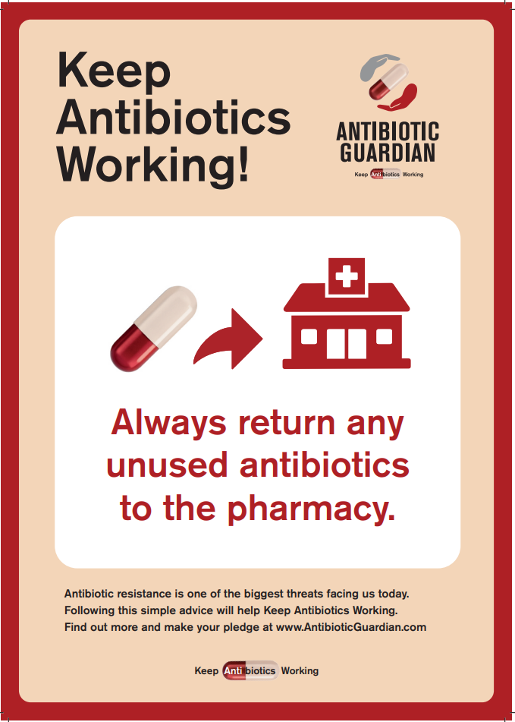
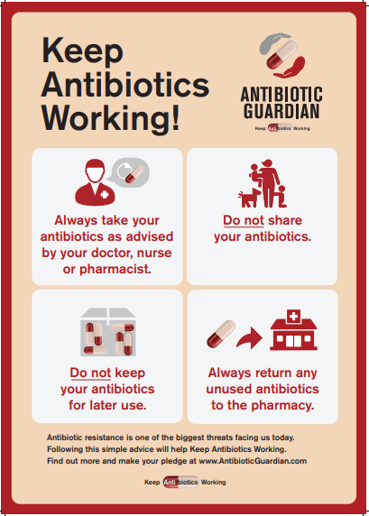
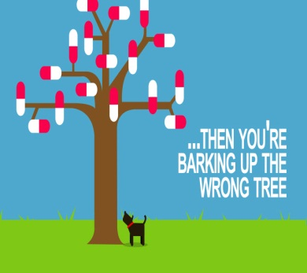
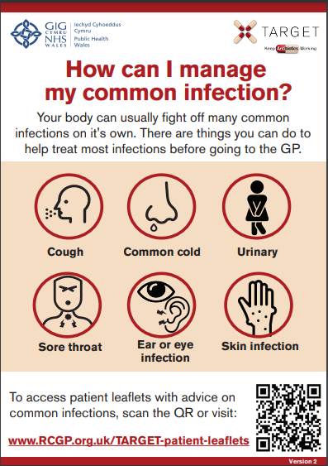
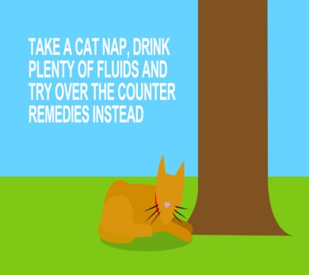
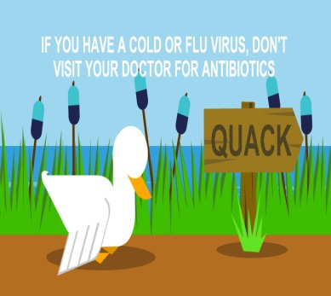
TARGET: Additional supportive tools
Posters for Display
Videos for patient waiting areas
Notes:
Presenter talk/notes:
These posters and videos may make a difference to patient expectations about when to expect antibiotics, IF used in the waiting room where patients can see them and IF they have the time to digest the information. In 2014 25% of the general public surveyed remembered seeing the first poster and 95% of these correctly answered that antibiotics don’t help most coughs and colds. Used alone without any other strategies posters will make little difference to patients expectations for antibiotics, but they can be used to reduce expectations and can be used as a prompt for dialogue –
“you may have seen from the posters or videos in the waiting room that we in this practice encourage responsible antibiotic prescribing”
The videos were developed with patients and each animal cartoon video appealed to different people. A recent small survey of their use showed that those patients who saw them remembered the messages – however often the video sound was muted, chairs were pointing in the wrong direction or the video screen was off. If you intend to use them please don’t make this mistake.

Slide 14
Clinical scenario: Acute Rhinosinusitis
Action plan ideas for next 12 months: What, How, Who , When
Promote use of local antimicrobial or NICE antimicrobial prescribing guidance by all in practice
Make use of TARGET toolkit.
Encourage use of TARGET Treating Your Infection – Respiratory Tract infection (TYI-RTI) leaflet.
Share TARGET TYI-RTI leaflet on clinical system.
Encourage consistent message from different staff and when patients re-attend.
Encourage an audit of self-care, safety netting & antibiotic advice
Re-audit in 4 months - identify a date when you will repeat the audit.
Record actions required, especially when compliance with primary care guidance is less than 80%.
Consider developing a target for antibiotic prescribing rate.
www.rcgp.org.uk/TARGETantibiotics
Notes:
Presenter notes:
Developing an action plan with who will be responsible is important, as otherwise good intentions may not be converted into action

