Slide 1
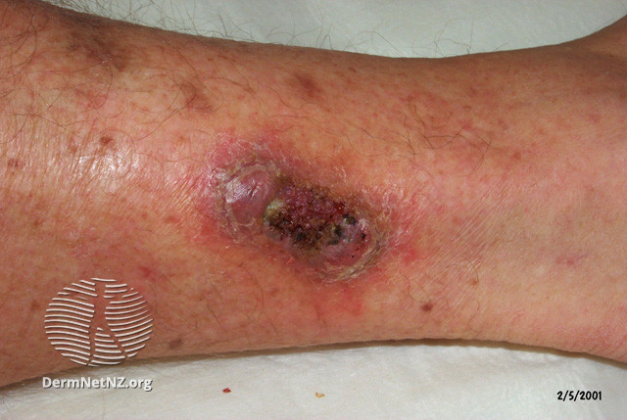
Clinical Scenario:
Leg ulcer
Notes:
Presenter Notes:
These cases are examples that can be printed out and discussed in pairs or groups, or with the group as a whole.
Allow the participants to discuss the case for 2 minutes and specifically ask several different people what they would do and /or prescribe.
Slide References
(1) Image: Uninfected ulcer [Available from: https://dermnetnz.org/topics/leg-ulcer-images]

Slide 2
Clinical scenario
74 year old lady
Seen by the district nurse, who requests antibiotics
Leg ulcer at routine dressing, greenish discharge and characteristic odour
No other signs or symptoms
PMHx: Osteoarthritis, hypertension
What do you do?
Notes:
Presenter Notes
Ask the audience to consider the attached clinical scenario and possible treatment options
PMHx – past medical history
Slide References
(1) Image: Leg ulcer [Available from: https://www.shutterstock.com/image-photo/leg-ulcer-secondary-cellulitis-preceeded-by-1106340626]

Slide 3
Clinical scenario
What are your treatment recommendations?
Commence oral antibiotics immediately
Send swab sample and arrange review with results
Consider referral for IV antibiotics
Dress wound and arrange clinical follow up
The patient should be advised to monitor for redness or swelling, and any systemic upset and to contact for sooner follow up if this occurs.
Notes:
This slide is animated, the correct answer will appear on the mouse click
Presenter Talk
The correct answer is option 4 – the patient should be advised to monitor for redness or swelling, and any systemic upset and to contact for sooner follow up if this occurs.
According to Clinical Knowledge summaries (1) ideally, people with uncomplicated ulcers should be reviewed at least weekly for the first 2 weeks after initiation of primary care treatment. If the ulcer is healing, this period can be extended depending on clinical judgement.
According to NICE (2), if you are treating an infected leg ulcer you should give advice to seek medical help if symptoms or signs of the infection worsen rapidly or significantly at any time, or do not start to improve within 2 to 3 days of starting treatment.
So why do some leg ulcers not require antibiotic treatment?
Presenter Notes
Discussion points:
Will you decline to prescribe if no documented signs/symptoms of infection?
Dressings – different dressings will alter the surface of an ulcer.
Antibiotics aim to target the deeper bacteria i.e. stop the ulcer getting deeper larger and more painful . A spreading cellulitis associated with an ulcer is most likely to be caused by staph & strep
No robust evidence has been identified to support the superiority of any dressing type over another for any type of leg wounds. Therefore, simple low-adherent dressings with sufficient absorbency are recommended as first line care but this recommendation does not replace clinical judgement and decision making in relation to the needs of the individual patient
Often cannot distinguish those patients who may benefit from silver or honey dressings although can be considered if standard dressings not leading to healing with other factors taken into account (elevation, control oedema and diabetes etc).
Slide references
(1) NICE Clinical Knowledge Summaries. Scenario: Venous leg ulcers. Available at: https://cks.nice.org.uk/topics/leg-ulcer-venous/management/venous-leg-ulcers/#follow-up
(2) NICE Cellulitis and erysipelas: antimicrobial prescribing. NICE guideline [NG141]. Available at: https://www.nice.org.uk/guidance/ng141/chapter/Recommendations#choice-of-antibiotic-prophylaxis

Slide 4
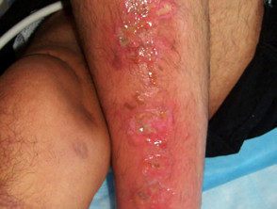
Few leg ulcers are clinically infected
Uninfected ulcer
(minimal surrounding erythema)
Infected ulcer
DermNetNZ.org
Important to manage underlying conditions to promote healing
(E.g. venous insufficiency, oedema)
Only treat if symptoms / signs of infection:
Increased pain, fever, redness or swelling spreading beyond ulcer, localised warmth
Notes:
Presenter Talk
An important note is few leg ulcers are clinically infected, most are colonised. - Abx don’t promote healing if not clinically infected - Systemic antibiotics will not get to the surface of an ulcer as there is no mechanism for delivery into slough – antibiotics deal with bacteria invading into normal tissue that cause the ulcer to deepen, enlarge, produce inflammation etc
There is a need to treat underlying condition e.g. venous insufficiency & oedema
Optional:
Pseudomonas commonly causes colonisation – it has a characteristic fresh cut grass odour and a typical blue-green colour. Widespread in soil water /moist environments and hospital patients may be colonised at moist sites, such as ulcers
It tends to have a low virulence unless the host is compromised
Tends to be mild but HAI is more severe.
The clinical scenario example had this greenish discharge/characteristic smell however as pseudomonas is more commonly a coloniser - antibiotics will not promote healing if the wound is not clinically infected.
Presenter Notes
Many causes: There are various types of ulcers with different aetiology: pressure sores, diabetic foot ulcers, venous leg ulcers, arterial ulcers, autoimmune conditions such as pemphigus/pemphigoid. All ulcers are invariably colonised by a polymicrobial flora.
Ankle brachial pulse index (ABPI) (1)
Between 0.8 and 1.3 suggests no evidence of significant arterial disease .Compression may be safely applied in most people.
Greater than 1.3 may suggest the presence of arterial calcification, such as in some people with diabetes, rheumatoid arthritis, systemic vasculitis, atherosclerotic disease, and advanced chronic renal failure. For values above 1.5, the vessels are likely to be incompressible, and the result cannot be relied on to guide clinical decisions. Care must be taken in interpreting ABPI results in people with these conditions, as they may be misleadingly high [CKS]
Refer/specialist advice if more serious illness eg sepsis , necrotising fasciitis osteomyelitis consider if not responding to abx
Slide references
NICE. How should I interpret ankle brachial pressure index (ABPI) results? 2021. [Available from: https://cks.nice.org.uk/topics/leg-ulcer-venous/diagnosis/interpretation-of-abpi/]
Image: Uninfected ulcer [Available from: https://dermnetnz.org/topics/leg-ulcer-images]
Image: Infected ulcer [Available from: https://dermnetnz.org/topics/leg-ulcer-images]

Slide 5
Do not swab leg ulcer at initial presentation
Initial presentation: Do not swab initially (non-diabetic people)
Worsening or not improving: Consider swab (after cleaning) if symptoms or signs of the infection
HOW to…
When swabs taken from infected ulcers, they should be taken after cleansing and debridement
Notes:
Presenter talk
Advice is not to swab at initial presentation, however, if patient returns with leg ulcer that is not improving or worsening then consider a swab.
UK standards for microbiology investigations state that when swabs taken from infected ulcers, they should be taken after cleansing and debridement. If this is not done, the swab may detect bacteria from overlying polymicrobial slough (including pseudomonas), rather than the invasive causative organism invading normal tissue.
This will give false indication of infection and therefore lead to inappropriate antimicrobial prescribing.
However, GPs often receive swab results taken by others. In this case it is important to use clinical examination to assess if infected or not. Despite receiving a positive swab result.
Key message is to remember to look for signs of infection before prescribing
Slide references
(1) NICE. Scenario: Venous leg ulcers, 2021. [Available from: https://cks.nice.org.uk/topics/leg-ulcer-venous/management/venous-leg-ulcers/]

Slide 6
When to consider antibiotics for leg ulcers
Offer an antibiotic for adults when there are symptoms or signs of infection (e.g. redness or swelling spreading beyond the ulcer, localised warmth, increased pain or fever).
When choosing antibiotics, consider:
Severity of symptoms or signs
Risk of developing complications
Previous antibiotic use
First line, as cellulitis flucloxacillin 500mg – 1g qds 7 days because usually Staphylococcus aureus (Penicillin allergy: clarithromycin or doxycycline)
It will take some time for a leg ulcer infection to resolve
Not expected until after antibiotic course completed
However, advise to seek medical help if condition worsens at any time, or does not start to improve within 2-3 days of starting treatment.
Notes:
Presenter Talk
Antibiotics aim to target the deeper bacteria i.e. stop the ulcer getting deeper larger and more painful. A spreading cellulitis associated with an ulcer is most likely to be caused by staph & strep – therefore treat with flucloxacillin (500mg to 1g for 7 days)
Give advice to seek medical help if symptoms or signs of infection:
• worsen rapidly or significantly at any time, or
• do not start to improve within 2 to 3 days of starting treatment
Be aware that it will take some time for a leg ulcer infection to resolve, with full resolution not expected until after the antibiotic course is completed. [NG152] -and therefore a further course of antibiotics may not be needed
Presenter Notes
It is worth noting fluclox 500mg/1g is not going to be adequate for very extensive cellulitis and IVs may be needed– refer to the NICE guidance for severe infection.
Further information - Very long standing ulcers that have failed to heal on treatment, might need to consider whether any underlying osteomyelitis
Slide References
(1) NICE. Leg ulcer infection: antimicrobial prescribing [NG152], 2020. [Available from: https://www.nice.org.uk/guidance/ng152]

Slide 7
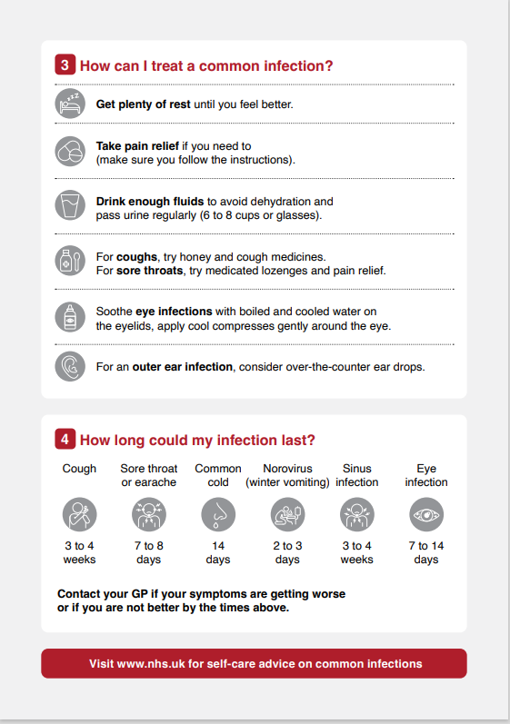
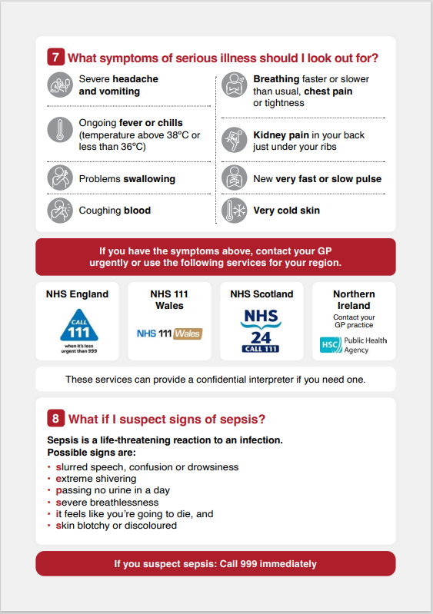
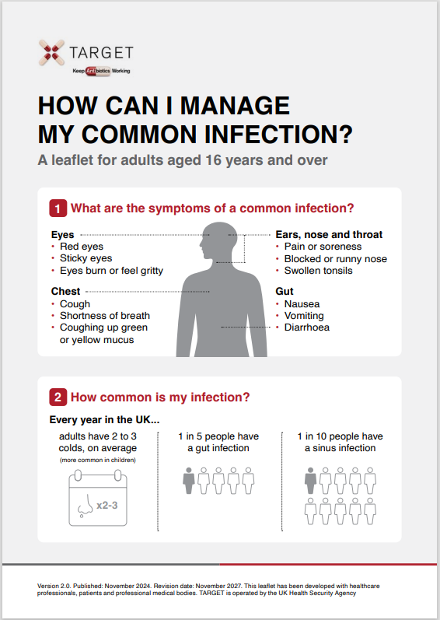
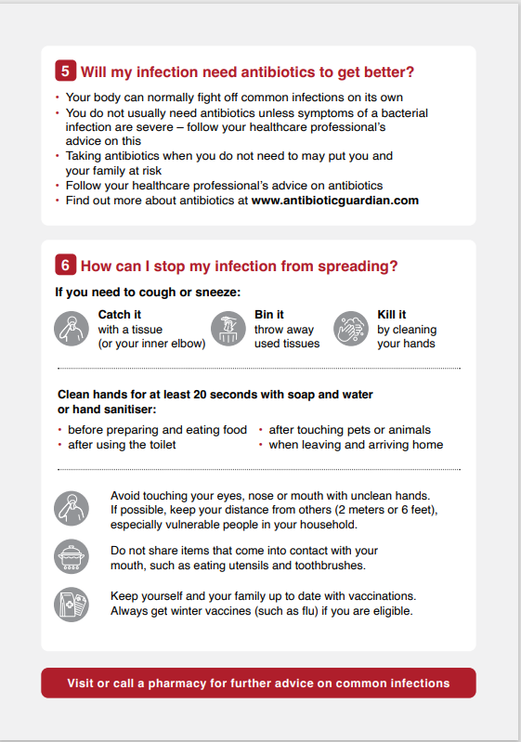
TARGET Self-care leaflet
Notes:
Presenter Notes
The Managing Your Common Infection (self-care) leaflet can be used as a tool for the public and communities to increase awareness and change behaviour around antibiotic use by increasing individuals’ confidence and knowledge on how to self-care for their own infections and subsequently reducing inappropriate antibiotic use.
What are the aims of the Managing Your Common Infection leaflet?
The leaflet aims to give information, in line with NICE 63 guidance on:
Increase awareness and change behaviour around hygiene, self-care and subsequently antibiotic use
The natural course of self-limiting infections
How people can self-care
Explicit advice when to seek medical help
Simple advice to wash their hands to reduce the spread of infection
The leaflet is found on the TARGET website in “Leaflets to discuss with patients”

Slide 8
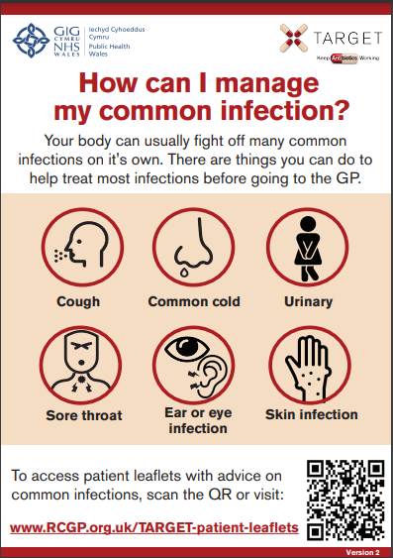
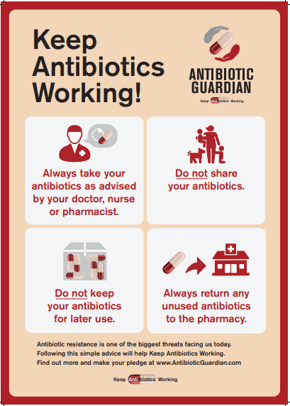
TARGET: Resources for clinical and waiting areas
Videos for patient waiting areas
Notes:
Presenter Talk
These posters and videos may make a difference to patient expectations about when to expect antibiotics, IF used in the waiting room where patients can see them and IF they have the time to digest the information. In 2014 25% of the general public surveyed remembered seeing the first poster and 95% of these correctly answered that antibiotics don’t help most coughs and colds. Used alone without any other strategies posters will make little difference to patients expectations for antibiotics, but they can be used to reduce expectations and can be used as a prompt for dialogue – “you may have seen from the posters or videos in the waiting room that we in this practice encourage responsible antibiotic prescribing”
The videos were developed with patients and each animal cartoon video appealed to different people. A recent small survey of their use showed that those patients who saw them remembered the messages – however often the video sound was muted, chairs were pointing in the wrong direction or the video screen was off. If you intend to use them please don’t make this mistake.

Slide 9
Reduce Antibiotic Prescribing
Makes difference to resistance in your patients
Reducing antibiotic prescribing in your practice
Helps to reduce future consultations
Helps to slow future antibiotic resistance
Increase patient
self-care
Notes:
Presenter Talk:
I hope you agree that the evidence suggests that by improving the antibiotic prescribing in your practice – you can:
Make a difference to the care of individual patients.
Help to slow the development of future resistance in our community.
AND as a bonus help to increase patient self-care and reduce future consultations for self-limiting infections.

Slide 10
How can we fit together the evidence and change behaviour during consultation with our patients to improve antibiotic prescribing?
Possible solution for you
Practice
GP
Evidence
Patient
Use the TARGET antibiotics toolkit
Notes:
Presenter Notes:
So how can we fit all of this evidence together and change behaviour within the practice consultation with our patients to improve prescribing?

Slide 11
How could your practice improve antibiotic prescriptions for leg ulcers
✓ Few leg ulcers are clinically infected, most are colonised
✓ Important to manage underlying conditions to promote healing
✓ Initial presentation: Do not swab, even if it might be infected
! Antibiotics do not promote healing when not clinically infected
Rx Cellulitis flucloxacillin 500mg/1g qds 7 days
Notes:
Presenter Talk
To summarise the key points:
- Few leg ulcers are clinically infected, most are colonised
- Important to manage underlying conditions to promote healing
- During initial presentation, NICE advices that you do not swab, even if it might be infected
Our take-home point is - Antibiotics do not promote healing when not clinically infected
And when a leg ulcer is infected treat with Cellulitis flucloxacillin 500mg to 1g qds 7 days

Slide 12
Clinical Scenario Leg ulcer Action Planning next 12 months
Agree actions, who, when and how:
Promote use of UKHSA/NICE or local antimicrobial / management of infection guidelines by all in practice
Undertake an audit of antibiotics for leg ulcers, such as flucloxacillin and co-amoxiclav
Encourage use of TARGET Managing Your Common Infection (self-care) leaflet and share on clinical system.
Encourage consistent message from different staff and when patients re-attend.
Make use of TARGET toolkit.
Notes:
Presenter Notes
Here is a list of suggestions for action planning. You may wish to add any suggested by the audience

