Slide 1

Clinical Scenario:
Urinary Tract Infection (UTI)
Last review: Feb 2023
Next review: Feb 2026
www.rcgp.org.uk/TARGETantibiotics

Slide 2
Clinical Scenario: UTI – women under 65 years
Please consider the following details:
35 year old
Strong smelling urine
Dysuria over 2 days
Frequency
Recent laparoscopy and removal endometriosis
Had trimethoprim in the past month for suspected UTI post operation
What should you ask?
Last review: Feb 2023
Next review: Feb 2026
www.rcgp.org.uk/TARGETantibiotics
Notes:
Presenter talk
Prompts for what more should be asked:
Find out more about the symptom severity and duration,
Other urinary symptoms nocturia, haematuria,
Other non-UTI symptoms – vaginal discharge, other GU symptoms, relationship to intercourse and sexual contacts,
Any symptoms of pyelonephritis – loin pain, rigors, fever.
Other risk factors for antibiotic resistance or infection: hospitalisation details, perioperative complications, other antibiotics.
Travel to country with high antibiotic resistance rates.
Presenter Notes
These cases are examples that can be printed out and discussed in pairs or groups, or with the group as a whole.
Allow the participants to discuss the case for 2 minutes and specifically ask several different people what they would do and /or prescribe.
There is another scenario later in the slide deck focusing on older adults which you could use as well as or instead of the one for women under 65 years

Slide 3
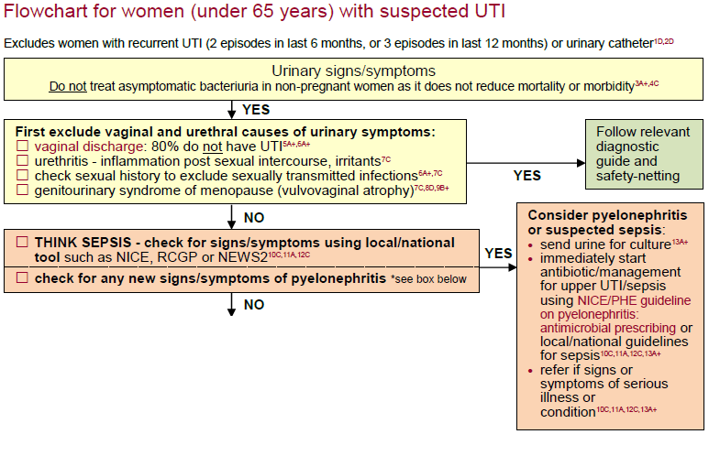
UKHSA UTI Diagnostic Tool:
Next slide
Last review: Feb 2023
Next review: Feb 2026
www.rcgp.org.uk/TARGETantibiotics
Diagnosis of urinary tract infections: quick reference guide for primary care, UKHSA, October 2020
Notes:
Presenter talk
The TARGET website also links to UTI quick reference diagnostic tool hosted on the UKHSA website.
This is a snapshot of the decision making algorithm for women under 65 years– last updated October 2022.
I am going to walk you thorough the flowchart section by section…
Presenter notes
Go through each section of the flowchart and discuss the key points and decision making.
Highlight the links to the TARGET toolkit for patient information leaflets and the links to key NICE management guidance
See next slide for evidence underpinning guidance
Ensure you have checked for updates of the tool using the hyperlink below
See notes on next slide if you want to talk about the evidence underpinning the recommendations
Slide References
https://www.gov.uk/government/publications/urinary-tract-infection-diagnosis

Slide 4
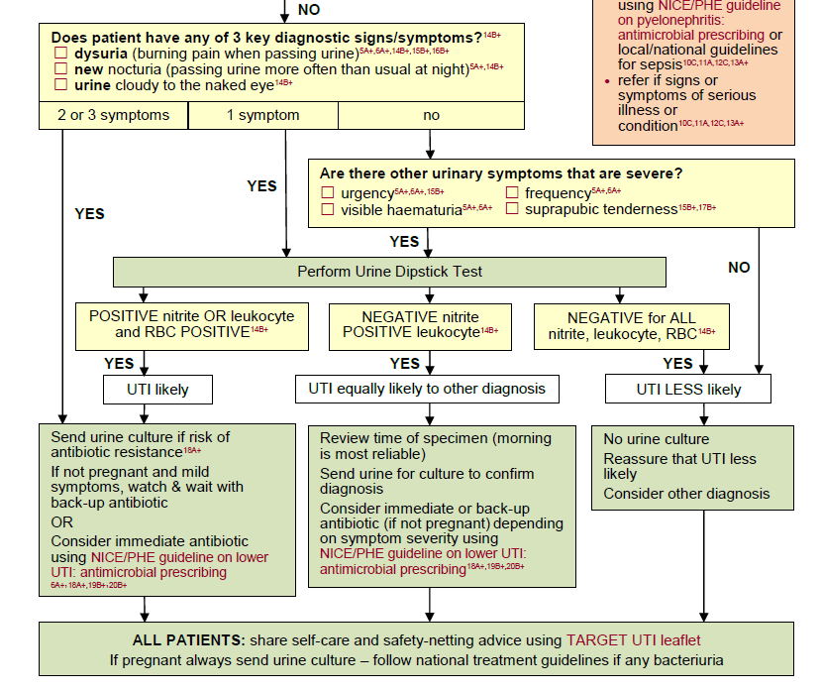
UKHSA UTI Diagnostic Tool:
Last review: Feb 2023
Next review: Feb 2026
www.rcgp.org.uk/TARGETantibiotics
Notes:
Presenter talk
Continue to walk the users through the flowchart….
If you want to provide more evidence about the signs and symptoms that are included in the flowchart you can refer to these publications:
The three key symptoms were based on a validation study using clinical scores and urine dipsticks conducted by Little et al in 2010
Included 434 women with at least 2 urinary symptoms of UTI and no vaginal discharge (62 different practices in England)
PPV strong for clinical symptoms of dysuria, nocturia or cloudy urine and dipsticks but poor negative predictive values
Dipsticks performed slightly better but NPVs also low
Findings showed that patients with suspected UTI who have dysuria, nocturia (any severity), and cloudy urine probably do have UTI
But we need to be cautious about excluding patients based on the absence of these features or negative dipstick results
Other symptoms and the use of dipsticks was included based on other reviews:
In a review of 9 studies by Bent et al (2002)¹
Dysuria, frequency, haematuria, costovertebral angle tenderness and back pain were predictive of UTI - dipstick useful if woman is symptomatic
Highlight need to rule out vaginal infection/irritation
Giesen et al (2010) identified 16 studies (3,711) patients²
Identified dysuria, frequency, haematuria, nocturia, and urgency as predictive
Combining positive dipstick test results, particularly tests for nitrites, with symptoms increases post-test probability
Diagnostic accuracy varied between studies and difficult to standardize symptoms/signs
Presenter notes
Go through each section of the flowchart and discuss the key points and decision making.
Highlight the links to the TARGET toolkit for patient information leaflets and the links to key NICE management guidance
Ensure you have checked for updates of the tool using the hyperlink below
You can use the points above if you would like to provide more evidence behind the symptoms used.
Slide References
https://www.gov.uk/government/publications/urinary-tract-infection-diagnosis
Little, P., et al. Validating the prediction of lower urinary tract infection in primary care: sensitivity and specificity of urinary dipsticks and clinical scores in women. Br J Gen Pract. 2010; 60(576): 495-500. Available from: www.ncbi.nlm.nih.gov/pmc/articles/PMC2894378/
Bent S, Nallamothu BK, Simel DL, Fihn SD, Saint S. Does this woman have an acute uncomplicated urinary tract infection? JAMA. 2002 May;287(20):2701-2710. Available from: www.ncbi.nlm.nih.gov/pubmed/12020306
Giesen, L. G. et al. Predicting acute uncomplicated urinary tract infection in women: a systematic review of the diagnostic accuracy of symptoms and signs. BMC Family Practice. 2010;11(78). Available from: www.ncbi.nlm.nih.gov/pubmed/20969801

Slide 5

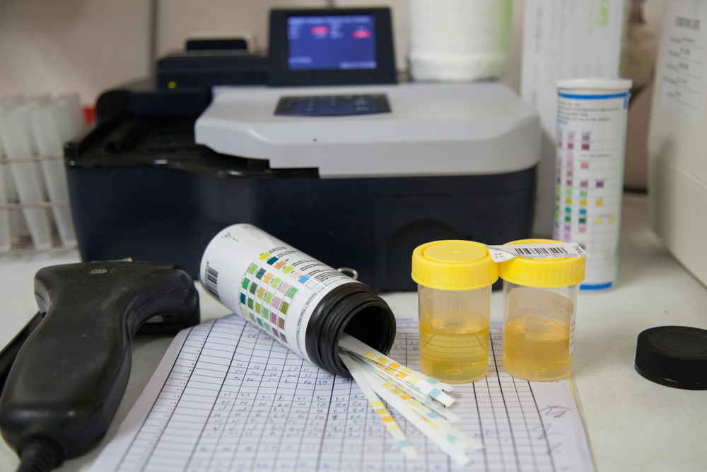
Why do we need to worry about our antibiotic use for UTI?
Last review: Feb 2023
Next review: Feb 2026
www.rcgp.org.uk/TARGETantibiotics

Slide 6
UTIs are linked to blood stream infections and resistance
Yearly estimated burden of E.coli resistant blood stream infections (BSIs) has reduced from 2017 but we need to keep momentum¹
E. coli bacteria are the most common cause of BSIs that are resistant to antibiotics¹
51% of E. coli blood stream infections are linked to the urogenital tract²
After RTIs, UTIs are the most prescribed for infection in primary care³
Last review: Feb 2023
Next review: Feb 2026
www.rcgp.org.uk/TARGETantibiotics
1. UKHSA, ESPAUR Report, 2022
2. Abernethy et al. J. Hosp. Infect, 2017
3. Dolk et al. Journal of Antimicr Chem., 2018
Notes:
This slide summarises the information in the slides below. You can use it if you are trying to cut back on information being presented or present the following slides with graphs if you have more time.
Presenter talk
Talk through the bullets
Presenter notes
You can find more information on the following slides which are hidden
Slide References
UKHSA 2022 ESPAUR Report
https://www.gov.uk/government/publications/english-surveillance-programme-antimicrobial-utilisation-and-resistance-espaur-report
Abernethy, J, Guy, R, Sheridan, EA et al. (5 more authors) (2017) Epidemiology of Escherichia coli bacteraemia in England: results of an enhanced sentinel surveillance programme. Journal of Hospital Infection, 95 (4). pp. 365-375. ISSN 0195-6701
https://eprints.whiterose.ac.uk/109639/
F Christiaan K Dolk, Koen B Pouwels, David R M Smith, Julie V Robotham, Timo Smieszek, Antibiotics in primary care in England: which antibiotics are prescribed and for which conditions?, Journal of Antimicrobial Chemotherapy, Volume 73, Issue suppl_2, February 2018, Pages ii2–ii10, https://doi.org/10.1093/jac/dkx504
https://academic.oup.com/jac/article/73/suppl_2/ii2/4841822

Slide 7

UTI and the link to blood stream infections
UTIs contribute the highest number of deaths in people with E. coli blood stream infection^{1,2}
Around half of E. coli blood stream infections occur in people over 75 years of age¹
51% of E. coli blood stream infections are linked to the urogenital tract^{1,2}
  Urinary catheters
  Women
  Having a UTI in previous month
Last review: Feb 2023
Next review: Feb 2026
www.rcgp.org.uk/TARGETantibiotics
1. Abernethy et al. J. Hosp. Infect. (2017).
2. Abernethy et al. Clin. Microbiol. Infect. (2015).
Notes:
Presenter talk
Here are some facts and figures surrounding the issue of E. coli blood stream infections and UTIs
UTIs contribute the highest number of deaths when comparing 30 days all-cause mortality in people with E. coli blood stream infections
Around half of E. coli blood stream infections occur in people over 75 years of age
51% of E. coli blood stream infections are linked to the urogenital tract
Risk factors for ECBSI linked to the urogenital tract include urinary catheter, women, having a UTI managed in previous month
Presenter notes
This and the following slides provide background information specific to UTIs, blood stream infections, and resistance. You may want to only include some depending on the amount of time you have to present.
Slide References
Abernethy, J, Guy, R, Sheridan, EA et al. (5 more authors) (2017) Epidemiology of Escherichia coli bacteraemia in England: results of an enhanced sentinel surveillance programme. Journal of Hospital Infection, 95 (4). pp. 365-375. ISSN 0195-6701
https://eprints.whiterose.ac.uk/109639/
Abernethy JK, Johnson AP, Guy R, Hinton N, Sheridan EA, Hope RJ. Thirty day all-cause mortality in patients with Escherichia coli bacteraemia in England. Clin Microbiol Infect. 2015 Mar;21(3):251.e1-8. doi: 10.1016/j.cmi.2015.01.001. Epub 2015 Jan 14. PMID: 25698659.
https://linkinghub.elsevier.com/retrieve/pii/S1198-743X(15)00173-1

Slide 8
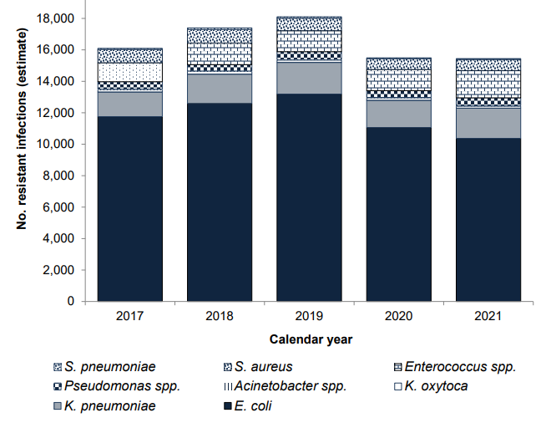
E. coli bacteria are the most common cause of antibiotic resistant blood stream infections
Yearly estimated burden of antibiotic resistant blood stream infections:
England:
2017-2021
Last review: Feb 2023
Next review: Feb 2026
www.rcgp.org.uk/TARGETantibiotics
UKHSA ESPAUR 2022
Notes:
Presenter talk
As shown in the graph E. coli bacteria are the most common cause of blood stream infections that are resistant to antibiotics
Presenter notes
The size of each coloured bar represents the number of each of these bacterial infections that are resistant to antibiotics
As you can see the dark blue bar is the biggest by far, this represents e. coli, which are the most common cause of antibiotic resistant blood stream infections
Slide References
UKHSA 2022 ESPAUR Report
https://www.gov.uk/government/publications/english-surveillance-programme-antimicrobial-utilisation-and-resistance-espaur-report

Slide 9
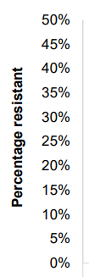
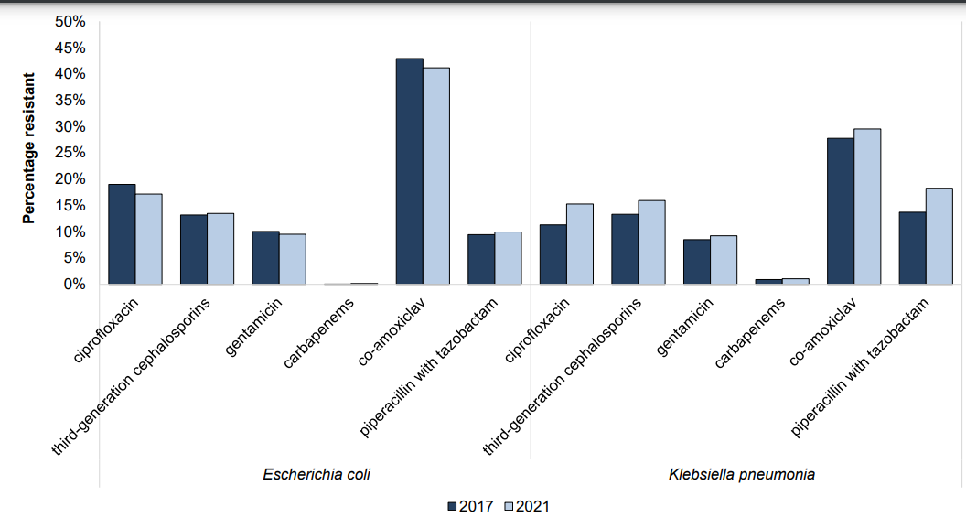
E.coli BSIs are improving but we need to keep momentum
Resistance in E. coli and K. pneumoniae bacteraemia, 2017 and 2021, England
Last review: Feb 2023
Next review: Feb 2026
www.rcgp.org.uk/TARGETantibiotics
UKHSA ESPAUR 2022
Notes:
Presenter talk
This graph shows trends in resistance to key antibiotics in E. coli and K. pneumoniae bacteraemia, between 2017 and 2021, England
Decreases in resistance to co-amoxiclav (42.9% to 41.2%, p<0.05) were detected in E. coli blood isolates between 2017 and 2021, but we will need to keep this momentum in the post-Covid context
Presenter notes
Between 2017 and 2021, small but statistically significant decreases in resistance to ciprofloxacin (from 19.0% to 17.2%, p<0.05) and co-amoxiclav (42.9% to 41.2%, p<0.05) were detected in E. coli blood isolates
Slide References
UKHSA 2022 ESPAUR Report
https://www.gov.uk/government/publications/english-surveillance-programme-antimicrobial-utilisation-and-resistance-espaur-report

Slide 10

Antibiotic resistance affects the recovery of patients with UTI
Clinical Scenario
Urinary Tract Infection
Clinical outcomes of uncomplicated UTIs in English GP treated with empirical trimethoprim.
 | Patients with:
 | Resistant UTI | Susceptible UTI | P-value
Median time to symptom resolution (207) | 7 days | 4 days | 0.0002
Re-consultation in first week or less (317) | 17/44, 39% | 17/273, 6% | <0.0001
Further antibiotic in first week (317) | 16/44, 36% | 11/273, 4% | <0.0001
Still had bacteriuria at 1 month (132) | 8/19 42% | 23/113, 20% | 0.04
Last review: Feb 2023
Next review: Feb 2026
www.rcgp.org.uk/TARGETantibiotics
McNulty et al. J. Antimicrob. Chemother. (2006) 58 (5): 1000-1008
Notes:
Presenter talk
So first what is the evidence that antibiotic resistance is important in your day to day practice?
Maybe you could consider when you last had a patient with UTI reconsult after treatment.
Pause see if there are nods or not
This is a prospective study of 497 women (18–70 years) with ≥ 2 UTI symptoms. It looked at clinical outcome in acute uncomplicated UTI in women treated with empirical trimethoprim.
Click for next part of the slide
Patients with a UTI resistant to the antibiotic in the left column took twice as long to become asymptomatic compared to those with a susceptible organism shown in blue.
Furthermore 40% of those with a resistant organism reconsulted in the first week, compared to only 6% with a susceptible organism.
In fact half of those patients who reconsulted in the first week had a resistant organism grown from their urine, and the majority of these had further antibiotics in that first week.
And at one month 42% of those patients with a resistant organism still had the same resistant bacteria in the urine, and this would have been much greater but 11 of these 19 patients had received a second antibiotic.
Presenter notes
McNulty et al. studied whether patients with an uncomplicated community-acquired urinary tract infection (UTI) and an isolate resistant to trimethoprim had worse clinical outcomes following empirical treatment with trimethoprim 200 mg twice daily for 3 days than did those with a susceptible isolate.
This was a prospective cohort study of clinical outcome where 497 women (18–70 years) presenting to general practitioner surgeries in Norwich and Gloucester with at least two symptoms of acute (<7 days) uncomplicated UTI were enrolled. Significant bacteriuria was defined as 104 cfu/mL from a mid-stream urine (MSU).
The results showed that of enrolled patients, 75% (334/448) had significant bacteriuria and trimethoprim resistance was present in 13.9% (44/317) of isolates. Patients with resistant isolates had a longer median time to symptom resolution (6 versus 3 days, P = 0.0005), greater reconsultation to the practice (39% versus 6% in first week, P < 0.0001), more subsequent antibiotics (36% versus 4% in first week, P < 0.0001) and higher rates of significant bacteriuria at 1 month (42% versus 20% with susceptible isolate, P = 0.04). Half of patients reconsulting in the first week had a resistant organism.
Slide References
McNulty CA, Richards J, Livermore DM, Little P, Charlett A, Freeman E, Harvey I, Thomas M. Clinical relevance of laboratory-reported antibiotic resistance in acute uncomplicated urinary tract infection in primary care. J Antimicrob Chemother. 2006 Nov;58(5):1000-8. doi: 10.1093/jac/dkl368. Epub 2006 Sep 23. PMID: 16998209.
https://academic.oup.com/jac/article-lookup/doi/10.1093/jac/dkl368

Slide 11
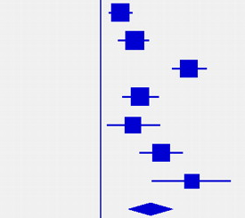
Antibiotic use in UTI increases risk of resistance
Clinical Scenario
Urinary Tract Infection
This Forest plots shows individual study and pooled odds ratio of increased risk of resistance
Antibiotic in last 6 months |  | Increased risk (Odds Ratio)
 | Antibiotic use decreases RESISTANCE |  | Antibiotic use increases RESISTANCE
Steinke | Any antibiotic |  |  | 1.36
Donnan | Trimethoprim |  |  | 1.67
Steinke | Trimethoprim |  |  | 3.95
Hillier | Amoxicillin |  |  | 1.83
Donnan | Any antibiotic |  |  | 1.65
Hillier | Trimethoprim |  |  | 2.57
Metlay | Sulpha / trim |  |  | 4.10
Pooled results 14,348 pts |  |  |  | 2.18
0.6
5
1
Longer duration and multiple courses associated with greater resistance
Last review: Feb 2023
Next review: Feb 2026
www.rcgp.org.uk/TARGETantibiotics
Costelloe C et al. BMJ (2010);
340:bmj.c2096
Notes:
Presenter talk
So we have shown that resistance is important and is increasing – but does our antibiotic use cause increased risk of antibiotic resistant infections in our patients?
This study goes some way to show that.
Costelloe et al. conducted a systematic review and meta-analysis examining previous antibiotic use and subsequent resistance. They included 5 studies of UTI with 14,348 patients in general practice.
Presenter click to bring in table
It found that antibiotic use in the past 6 months increased the risk of resistance two times (2.18).
This forest plot shows risk of having a resistant organism if patients have had an antibiotic in the last 6 months.
As you can see risk was increased in all the studies as the odds ratios (the blue squares) are to the right of the line with confidence intervals that do not overlap.
Presenter click to bring in text
Longer duration and multiple courses of antibiotics were associated with greater resistance.
What is important to note is that resistance to one antibiotic (for example amoxicillin or trimethoprim) can be linked to other resistance genes, so use of these antibiotics although considered narrower spectrum can increase resistance to other antibiotics too.
Presenter notes
The review included 24 studies; 22 involved patients with symptomatic infection and two involved healthy volunteers; 19 were observational studies (of which two were prospective) and five were randomised trials. In five studies of urinary tract bacteria (14 348 participants), the pooled odds ratio (OR) for resistance was 2.5 (95% confidence interval 2.1 to 2.9) within 2 months of antibiotic treatment and 1.33 (1.2 to 1.5) within 12 months. In seven studies of respiratory tract bacteria (2605 participants), pooled ORs were 2.4 (1.4 to 3.9) and 2.4 (1.3 to 4.5) for the same periods, respectively. Studies reporting the quantity of antibiotic prescribed found that longer duration and multiple courses were associated with higher rates of resistance. Studies comparing the potential for different antibiotics to induce resistance showed no consistent effects. Only one prospective study reported changes in resistance over a long period; pooled ORs fell from 12.2 (6.8 to 22.1) at 1 week to 6.1 (2.8 to 13.4) at 1 month, 3.6 (2.2 to 6.0) at 2 months, and 2.2 (1.3 to 3.6) at 6 months.
Therefore in conclusion, individuals prescribed an antibiotic in primary care for a respiratory or urinary infection have increased risk of developing bacterial resistance to that antibiotic. The effect is greatest in the month immediately after treatment but may persist for up to 12 months. This effect not only increases the population carriage of organisms resistant to first line antibiotics, but also creates the conditions for increased use of second line antibiotics in the community.
Slide References
Costelloe C, Metcalfe C, Lovering A, Mant D, Hay AD. Effect of antibiotic prescribing in primary care on antimicrobial resistance in individual patients: systematic review and meta-analysis. BMJ. 2010 May 18;340:c2096. doi: 10.1136/bmj.c2096. PMID: 20483949.
https://www.bmj.com/content/bmj/340/bmj.c2096.full.pdf

Slide 12
Risk of resistance persists for at least 12 months after your prescribing
Clinical Scenario
Urinary Tract Infection
Effect of antibiotic prescribing in primary care on antimicrobial resistance in individual patients: systematic review and meta-analysis
 | Increased risk of resistant organism
 | Antibiotic in past 2 months | Antibiotic in past 12 months
UTI 5 studies: n = 14,348 | 2.5 pooled odds of resistance | 1.33 pooled odds of resistance
Last review: Feb 2023
Next review: Feb 2026
www.rcgp.org.uk/TARGETantibiotics
Costello et al. BMJ. (2010) 340:c2096.
Notes:
Presenter talk
So how long does the risk of antibiotic resistance last after a course of antibiotics?
The metanalysis conducted by Costello et all in 2010 discussed on the previous slide showed a pooled odds ratio (OR) for resistance was 2.5 (95% confidence interval 2.1 to 2.9) within 2 months of antibiotic treatment and 1.33 (1.2 to 1.5) within 12 months. This indicates that risk of resistance is greatest in the first two months after an antibiotic as shown here for UTIs, but is still higher 12 months after antibiotic use for UTIs. Individuals prescribed an antibiotic in primary care for any infection have an increased risk of subsequently carrying resistant organisms – so that the next time they have an infection it may be with one of these antibiotic resistant organism. This will be particularly so for antibiotics that attain higher concentrations in the gut. And less so for those that only concentrate in the urine, or are inactive in the gut.
Presenter notes
Effect of antibiotic prescribing in primary care on antimicrobial resistance in individual patients: systematic review and meta-analysis
Costello et al 2010
The review included 24 studies; 22 involved patients with symptomatic infection and two involved healthy volunteers; 19 were observational studies (of which two were prospective) and five were randomised trials. In five studies of urinary tract bacteria (14 348 participants), the pooled odds ratio (OR) for resistance was 2.5 (95% confidence interval 2.1 to 2.9) within 2 months of antibiotic treatment and 1.33 (1.2 to 1.5) within 12 months. Studies reporting the quantity of antibiotic prescribed found that longer duration and multiple courses were associated with higher rates of resistance. Studies comparing the potential for different antibiotics to induce resistance showed no consistent effects. Only one prospective study reported changes in resistance over a long period; pooled ORs fell from 12.2 (6.8 to 22.1) at 1 week to 6.1 (2.8 to 13.4) at 1 month, 3.6 (2.2 to 6.0) at 2 months, and 2.2 (1.3 to 3.6) at 6 months.
This showed that individuals prescribed an antibiotic in primary care for a urinary infection have an increased risk of carrying resistant organisms – so that the next time they have an infection it is with a antibiotic resistant organism. The effect is greatest in the month immediately after treatment but may persist for up to 12 months. This effect not only increases the population carriage of organisms resistant to first line antibiotics, but also creates the conditions for increased use of second line antibiotics in the community.
Slide References
Costelloe C, Metcalfe C, Lovering A, Mant D, Hay AD. Effect of antibiotic prescribing in primary care on antimicrobial resistance in individual patients: systematic review and meta-analysis. BMJ. 2010 May 18;340:c2096. doi: 10.1136/bmj.c2096. PMID: 20483949.
https://www.bmj.com/content/bmj/340/bmj.c2096.full.pdf

Slide 13
Antibiotic use is changing
Clinical Scenario
Urinary Tract Infection
Trimethoprim and Nitrofurantoin use across England
Nitrofurantoin
Trimethoprim
Last review: Feb 2023
Next review: Feb 2026
www.rcgp.org.uk/TARGETantibiotics
Data extracted from ePACT2
Notes:
Presenter talk
From December 2014 national prescribing guidance changed to recommend nitrofurantoin as the first line antibiotic for women with suspected UTI
Presenter notes
Slide References
Data extracted from ePACT 2 in 2022
https://www.nhsbsa.nhs.uk/access-our-data-products/epact2

Slide 14
Antibiotic resistance in UTI can be reduced
Median number of dispensed antibiotic items/1000 registered practice population/year in South West of England 2013-2016
Clinical Scenario
Urinary Tract Infection
Guidance replaced Trimethoprim with Nitrofurantoin as first line choice – Dec 2014.
Relationship between antibiotic dispensing and resistance in following quarter:
Ciprofloxacin – Odds of resistance 0.982 (95% CI: 0.965 to 0.999)
Trimethoprim – Odds of resistance 0.992 (95% CI: 0.988 to 0.997)
Nitrofurantoin – Odds of resistance 0.999 (95% CI: 0.988 to 1.013)
Hammond et al. PLoS ONE (2020) :
e0232903.
Last review: Feb 2023
Next review: Feb 2026
www.rcgp.org.uk/TARGETantibiotics
Notes:
Presenter talk
A study by Hammond et al in 2020 looked at prescribing data from the South West of England from 2013 to 2016 ( 163 GP practices serving 1.5 million patients). The team used logistic regression to assess changes in resistance patters and the association with prescribing rate changes, controlling for confounding variables.
They found a fall in Trimethoprim use by 8% and a decrease in Ciprofloxacin use by 24.2% from 2013 - 2016. There was an increase in nitrofurantoin use by 7% over this period, but this was unsurprising as nitrofurantoin was changed to the first line choice in national guidance in 2014.
The odds of trimethoprim resistance and ciprofloxacin resistance were lower in the subsequent quarter as use declined. Increased nitrofurantoin dispensing was associated with reduced trimethoprim resistance with changes to nitrofurantoin resistance being non-significant.
Presenter notes
Study Aim:
To evaluate associations between changes in primary care dispensing and antimicrobial resistance in community-acquired urinary Escherichia coli infections.
Methods: Multilevel logistic regression modelling investigating relationships between primary care practice level antibiotic dispensing for approximately 1.5 million patients in South West England and resistance in 152,704 community-acquired urinary E. coli between 2013 and 2016. Relationships presented for within and subsequent quarter drug-bug pairs, adjusted for patient age, deprivation, and rurality.
Results: In line with national trends, overall antibiotic dispensing per 1000 registered patients fell 11%. Amoxicillin fell 14%, cefalexin 20%, ciprofloxacin 24%, co-amoxiclav 49% and trimethoprim 8%. Nitrofurantoin increased 7%. Antibiotic reductions were associated with reduced within quarter same-antibiotic resistance to: amoxicillin, ciprofloxacin and trimethoprim. Subsequent quarter reduced resistance was observed for trimethoprim and amoxicillin. Antibiotic dispensing reductions were associated with increased within and subsequent quarter resistance to cefalexin and co-amoxiclav. Increased nitrofurantoin dispensing was associated with reduced within and subsequent quarter trimethoprim resistance without affecting nitrofurantoin resistance.
Slide References
Hammond A, Stuijfzand B, Avison MB, Hay AD (2020) Antimicrobial resistance associations with national primary care antibiotic stewardship policy: Primary care-based, multilevel analytic study. PLoS ONE 15(5): e0232903
https://www.ncbi.nlm.nih.gov/pmc/articles/PMC7224529/pdf/pone.0232903.pdf

Slide 15
Antibiotic resistance to Trimethoprim
Clinical Scenario
Urinary Tract Infection
*2023 data: January to June only
Last review: Feb 2023
Next review: Feb 2026
www.rcgp.org.uk/TARGETantibiotics
Mandatory surveillance data from UKHSA
Notes:
Presenter talk:
The trend from the previous slide is also reflected in national surveillance data. This data also shows that resistance is proportionately higher in the older age groups, highlighting the risk for this group
Presenter notes
This data does not represent the data for all patients presenting to you with acute uncomplicated UTI, as we know most GPs tend to only send urines to the laboratory from patients with recurrent UTI or persistent symptoms, but it certainly gives us some indication of the greater resistance in the elderly.
Slide information: This data comes from UKHSA surveillance reports. Please email targetantibiotics@ukhsa.gov.uk if you would like to update the information provided

Slide 16
Antibiotic resistance to Nitrofurantoin
Clinical Scenario
Urinary Tract Infection
*2023 data: January to June only
Last review: Feb 2023
Next review: Feb 2026
www.rcgp.org.uk/TARGETantibiotics
Mandatory surveillance data from UKHSA
Notes:
Presenter talk:
The very slight increase in nitrofurantoin resistance is also reflected in national surveillance data. This data also shows that resistance is proportionately higher in the older age groups, highlighting the risk for this group
Presenter notes
This data does not represent the data for all patients presenting to you with acute uncomplicated UTI, as we know most GPs tend to only send urines to the laboratory from patients with recurrent UTI or persistent symptoms, but it certainly gives us some indication of the greater resistance in the elderly.
Slide information: This data comes from UKHSA surveillance reports. Please email targetantibiotics@ukhsa.gov.uk if you would like to update the information provided

Slide 17
Antibiotic resistance to Ciprofloxacin
Clinical Scenario
Urinary Tract Infection
*2023 data: January to June only
Last review: Feb 2023
Next review: Feb 2026
www.rcgp.org.uk/TARGETantibiotics
Mandatory surveillance data from UKHSA
Notes:
Presenter talk:
The same trend is evident for Ciprofloxacin
Presenter notes
This data does not represent the data for all patients presenting to you with acute uncomplicated UTI, as we know most GPs tend to only send urines to the laboratory from patients with recurrent UTI or persistent symptoms, but it certainly gives us some indication of the greater resistance in the elderly.
Slide information: This data comes from UKHSA surveillance reports. Please email targetantibiotics@ukhsa.gov.uk if you would like to update the information provided

Slide 18
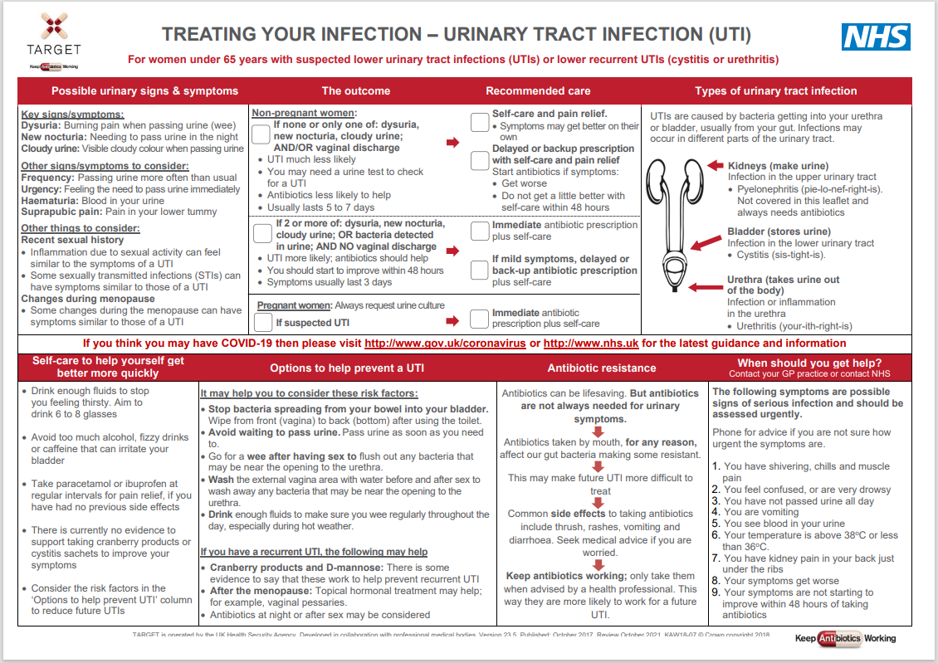
TARGET TYI-UTI leaflet
Outcome and plan can be personalised
Possible urinary symptoms & other things for GP & patient to consider
Picture helps patients understand cause
How to prevent UTIs
Flow chart helps patient understand antibiotics and resistance
Self-care &
safety netting advice
Notes:
Presenter talk
The Patient Urinary Tract Infection (UTI) Information leaflet has been designed to be used during consultation with women who have a suspected UTI
It is a useful tool for clinicians to use whether the patient needs an antibiotic prescription or not.
It explains the treatment decision pathway, and therefore is also helpful for less experienced staff.
It includes information on the types of UTI, which are often misunderstood by patients and health care staff, illness duration, self-care advice, prevention advice and advice on when to re-consult.
This leaflet was endorsed by NICE to use with the prescribing guidelines
TARGET leaflets have been formatted into html text so they are accessible using digital technology and screen readers.
The leaflet can also be linked to your computer clinical systems, for instance, accurx has embedded all of the TARGET HTML leaflets into their SMS services
I am now going to walk you through the various aspects of our leaflets for women under 65 years…..
Presenter notes
The animations will come up as you discuss different areas of the leaflet.

Slide 19
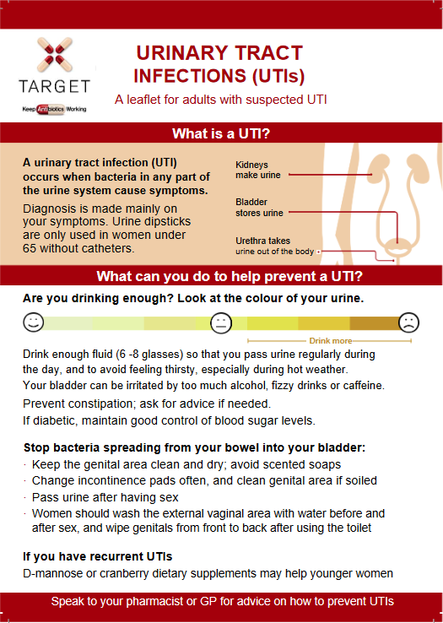
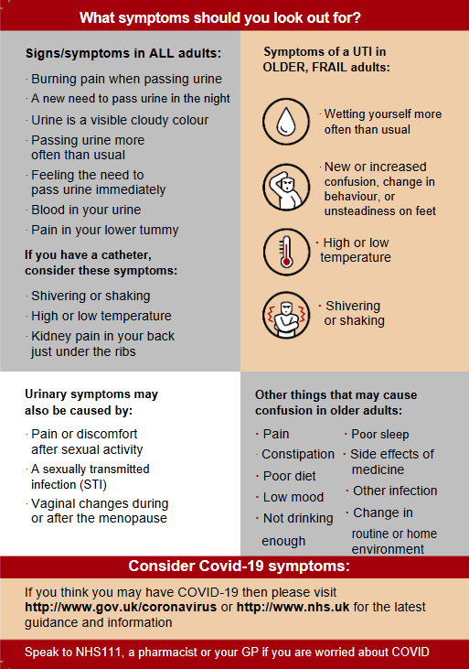
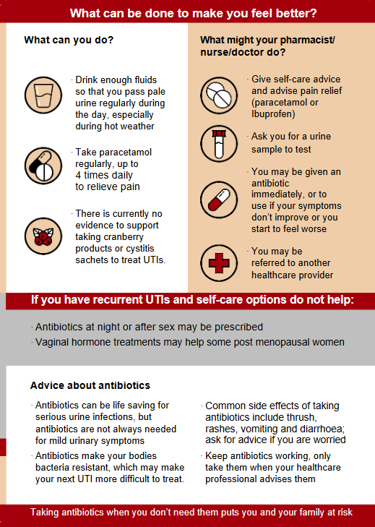
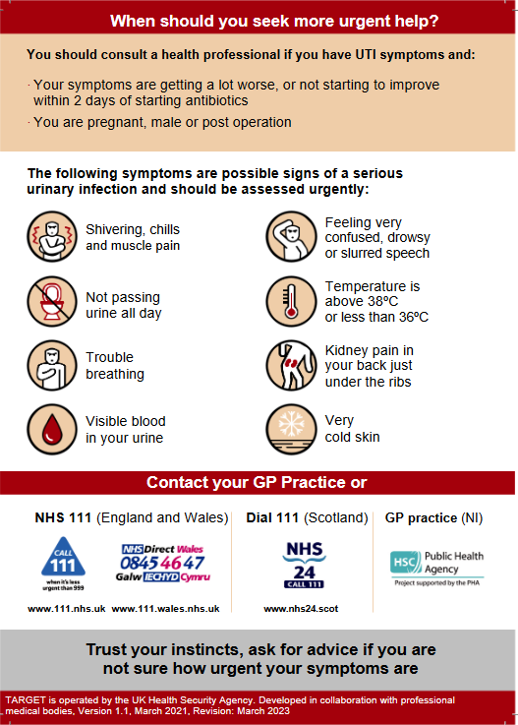
TARGET Pictorial Leaflet
Clinical Scenario
Urinary Tract Infection
Notes:
Presenter talk
TARGET have a pictorial UTI patient information leaflet for UTI in adults (of all ages) that was published in March 2021
It covers the same information but in a format that is easier to read (larger text and graphics).
Presenter notes
Quickly quick through to bring up a different page of the combined pictorial leaflet
Reference
https://elearning.rcgp.org.uk/mod/book/view.php?id=12647&chapterid=443

Slide 20
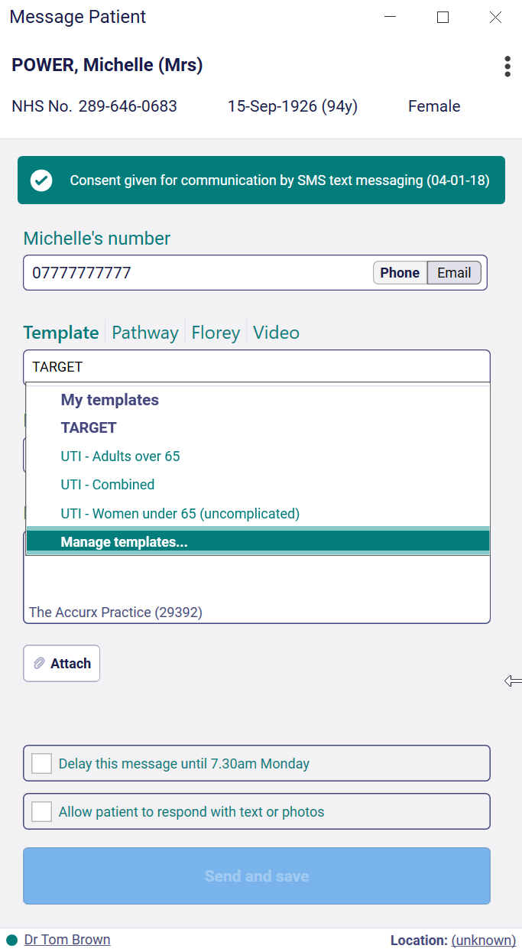

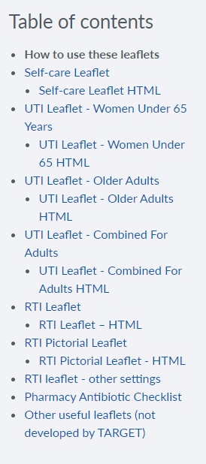
Web text - UTI Patient Information Leaflets
Clinical Scenario
Urinary Tract Infection
Notes:
Presenter talk
This is where you can access the HTML version of the UTI leaflets
As discussed previously, this format is easier for patients to access this information using digital technology.
It also enables you to SMS or email the information to your patients. This screenshot shows you where the UTI leaflets are embedded in the Accurx SMS templates.
Presenter notes
The animations will come up as you click

Slide 21
Clinical scenario: UTI Older adults
Clinical Scenario
Urinary Tract Infection
Please consider the following details:-
80 year old resident in nursing home
Strong smelling urine, but clear looking
Increasing confusion over 2 days
No history of fever, temp 37.4°C.
Has had antibiotics in past for suspected UTI
What should you ask?
Who would do a dipstick?
Last review: Feb 2023
Next review: Feb 2026
www.rcgp.org.uk/TARGETantibiotics
Notes:
Presenter talk
Note that you should assess for signs of sepsis or pyelonephritis
Prompts for what more should be asked:
other symptoms suggesting another infection
new or worsening urgency/incontinence, frequency
suprapubic pain or flank or loin tenderness
gross haematuria
Why was she given previous antibiotics, and what were they and for how long
Hydration
Presenter Notes
These cases are examples that can be printed out and discussed in pairs or groups, or with the group as a whole.
Allow the participants to discuss the case for 2 minutes and specifically ask several different people what they would do and /or prescribe.
There is another scenario later in the slide deck focusing on older adults which you could use as well as or instead of the one for women under 65 years
See next slide for these factors below written out

Slide 22
Clinical scenario: UTI Older adults
Clinical Scenario
Urinary Tract Infection
80 year old resident in nursing home
Strong smelling urine, but clear looking
Increasing confusion over 2 days
No history of fever, temp 37.4°C.
Has had antibiotics in past for suspected UTI
What do you think a urine dipstick result will be?
1. Positive for all
+ Nitrite
+ Leukocyte
+ RBC
2. Positive nitrite, negative leukocyte and RBC positive
+ Nitrite
- Leukocyte
+ RBC
3. Positive nitrite, positive leukocyte and RBC negative
+ Nitrite
+ Leukocyte
- RBC
4. Negative for all
- Nitrite
- Leukocyte
RBC
Last review: Feb 2023
Next review: Feb 2026
www.rcgp.org.uk/TARGETantibiotics
Notes:
Presenter Talk:
The treatment of UTI in older people should follow the same principles as in younger patients and should be based on whether the infection is uncomplicated or whether there is evidence of pyelonephritis or bacteraemia.
Empirical diagnosis of UTI in delirium: For residents who do not have an indwelling catheter, minimum criteria for initiating antibiotics included acute dysuria alone or fever (>37.9ºC or 1.5ºC increase above baseline temperature) and at least one of the following: new or worsening urgency/incontinence, frequency, signs of irritation of the urinary tract such as suprapubic pain or flank or loin tenderness, or gross haematuria [Loeb et al 2005].
A positive urine culture or dipstick test will not differentiate between UTI or asymptomatic bacteriuria, and there is no robust evidence for the use of leucocyte esterase or nitrite by urine dipstick testing in women aged 65 years and above in long-term care facilities or in frail elderly people requiring assisted living services (SIGN 160).
Patients with asymptomatic bacteriuria may also have white blood cells in the urine, as the immune system does not differentiate between asymptomatic carriage and infection.
UTI should be considered if there are signs of septicaemia and generalized illness: nausea, vomiting, rigors, new or increasing malaise and confusion, tachycardia, tachypnoea, poor peripheral circulation, reduced urine output, low blood pressure.
For patients with recent hospitalisation or antibiotics or operation, consideration should be given to the prescription of pivmecillinam, co-amoxiclav or ciprofloxacin over trimethoprim, but if these are prescribed always safety net and send a urine specimen for culture and susceptibility, so that treatment can be modified on receipt of the culture result.
Presenter Notes:
A systematic literature review covering quantitative primary studies that assess the urine dipstick as a tool in diagnosing urinary tract infection in older adults was conducted by Eriksen and Bing-Jonsson and published in 2015 (42) [2a-]. The review summarised 6 studies that looked at urine dipstick use, and the correlation to positive urine culture. The authors found there was a PPV of leukocytes and nitrites on a urine dipstick ranging from 31% to 93% and an NPV ranging from 49% to 100%. The authors conclude that dipsticks are more useful for ruling out a positive urine culture (than in) but summarise a number of limitations that clinicians need to be aware of and highlight reasons why dipsticks may give a false positive or negative in this group.
An observational study conducted by Ducharme and others in 2007, looked at the use of urine dipsticks to identify patients with a positive urine culture in 2 cohorts (43) [2b]. Each cohort included 100 patients aged 65 years presenting in an emergency department with no UTI symptoms (non-infectious/systemic complaints) or non-specific UTI symptoms (acute confusion, weakness or fever without focal symptoms). Patients with common UTI symptoms were excluded. A positive dipstick was determined by any leukocyte-esterase or nitrite or both and a positive culture; any single organism count greater than 10⁵ CFU/mL in midstream specimens and greater than 10² CFU/mL in specimens collected by catheterization. The non-infectious and non-specific infection groups had similar PPVs (31% and 37% respectively) and NPVs (93% and 92% respectively). Because dipstick results were negative and there were no localizing urinary symptoms, 5 patients presenting in the ED with positive cultures and non-specific signs of infection had a UTI excluded from diagnosis. The authors highlight that though dipsticks performed better at ruling out a positive culture, they were not completely dependable.
Although urine dipsticks seem to be better at ruling out a positive urine culture than ruling one in for older adults, there is a wide variation in estimates across studies and potential risk if a positive culture (or a UTI) is ruled out incorrectly for vulnerable patients with non-specific signs of infection. For this reason, this quick reference tool does not recommend their use to rule in a UTI or to rule out a UTI in older adult groups.
References:
Loeb, M., Brazil, K., Lohfeld, L., McGeer, A., Simor, A., Stevenson, K., . . . Walter, S. D. (2005). Effect of a multifaceted intervention on number of antimicrobial prescriptions for suspected urinary tract infections in residents of nursing homes: cluster randomised controlled trial. BMJ, 331(7518), 669.
SIGN 160. Management of suspected bacterial lower urinary tract infection in adult women. Sept 2020
https://www.sign.ac.uk/media/1766/sign-160-uti-0-1_web-version.pdf
42. Eriksen SV and Bing-Jonsson PC. ‘Can we trust urine dipsticks?’ Norwegian Journal of Clinical Nursing/Sykepleien Forskning 2017: volume 1: pages 1 to 14
43. Ducharme J, Neilson S and Ginn JL. ‘Can urine cultures and reagent test strips be used to diagnose urinary tract infection in elderly emergency department patients without focal urinary symptoms?’ Canadian Journal of Emergency Medicine 2007: volume 9, issue 2, pages 87 to 92

Slide 23
Clinical scenario: UTI Older adults
Clinical Scenario
Urinary Tract Infection
80 year old resident in nursing home
Strong smelling urine, but clear looking
Increasing confusion over 2 days
No history of fever, temp 37.4°C.
Has had antibiotics in past for suspected UTI
  Ask about
  Signs or symptoms of sepsis or pyelonephritis
  New or worsening UTI symptoms: dysuria, urgency, incontinence, frequency
  Suprapubic pain
  Visible haematuria
  Other symptoms suggesting another infection
  What were previous antibiotics and duration
  Other causes of delirium
  Risk factors: Urinary Catheterisation, hospitalisation, operations
Last review: Feb 2023
Next review: Feb 2026
www.rcgp.org.uk/TARGETantibiotics
Notes:
Presenter talk
Presenter Notes
Use this as part of your recap on the points to be asked about discussion – highlight anything that wasn’t mentioned

Slide 24
Clinical scenario: UTI Older adults
Clinical Scenario
Urinary Tract Infection
Please consider the following details:
80 year old resident in nursing home
No confusion/delirium
New dysuria
New incontinence
Temperature 37.5°C
Received antibiotics previously for suspected UTI
How would you manage this patient?
What antibiotic would you use to treat this patient, if any?
Last review: Feb 2023
Next review: Feb 2026
www.rcgp.org.uk/TARGETantibiotics
Notes:
Presenter talk
After the discussion go through the following slides that use the UKHSA and TARGET tools to talk through management and patient information.
Presenter Notes
These cases are examples that can be printed out and discussed in pairs or groups, or with the group as a whole.
Allow the participants to discuss the case for 2 minutes and specifically ask several different people what they would do and /or prescribe.
There is another scenario later in the slide deck focusing on older adults which you could use as well as or instead of the one for women under 65 years
See next slide for these factors below written out

Slide 25
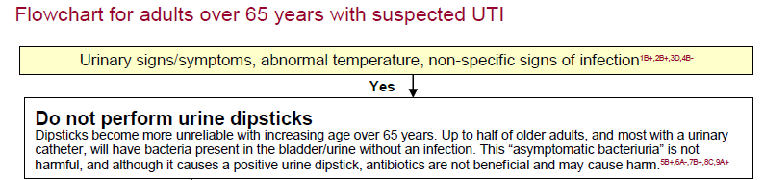
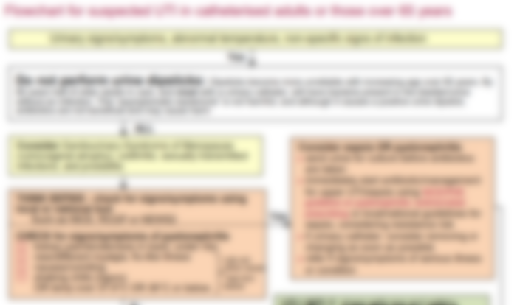
UKHSA UTI Diagnostic Tool: Diagnostic Flowchart
Clinical Scenario
Urinary Tract Infection
Last review: Feb 2023
Next review: Feb 2026
www.rcgp.org.uk/TARGETantibiotics
Notes:
Presenter talk
The TARGET website also links to UTI quick reference diagnostic tool hosted on the UKHSA website.
This is a snapshot of the decision making algorithm for women over 65 years– last updated October 2022.
I am going to walk you thorough the flowchart section by section…
Presenter notes
Go through each section of the flowchart and discuss the key points and decision making.
Highlight the links to the TARGET toolkit for patient information leaflets and the links to key NICE management guidance
Ensure you have checked for updates of the tool using the hyperlink below
Slide References
https://www.gov.uk/government/publications/urinary-tract-infection-diagnosis

Slide 26
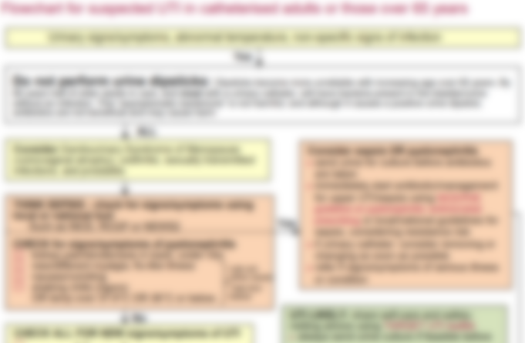
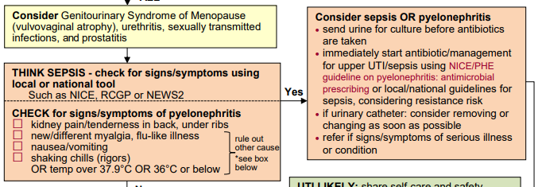
UKHSA UTI Diagnostic Tool: Diagnostic Flowchart
Clinical Scenario
Urinary Tract Infection
Last review: Feb 2023
Next review: Feb 2026
www.rcgp.org.uk/TARGETantibiotics
Notes:
Presenter talk
Continue to go through the flowchart.
Differential diagnosis and sepsis and pyelonephritis is ruled out in the same way for this group (go through briefly).
Another tool that you will see used more frequently in Care homes is the RESTORE 2 tool which is based on NEWs2 but modified for use in early detection in these settings.
Presenter notes
Go through each section of the flowchart and discuss the key points and decision making.
Clarify what deterioration or sepsis scoring tool is most frequently used for vulnerable individuals in care
Highlight the links to the TARGET toolkit for patient information leaflets and the links to key NICE management guidance
Ensure you have checked for updates of the tool using the hyperlink below
Slide References
https://www.gov.uk/government/publications/urinary-tract-infection-diagnosis

Slide 27
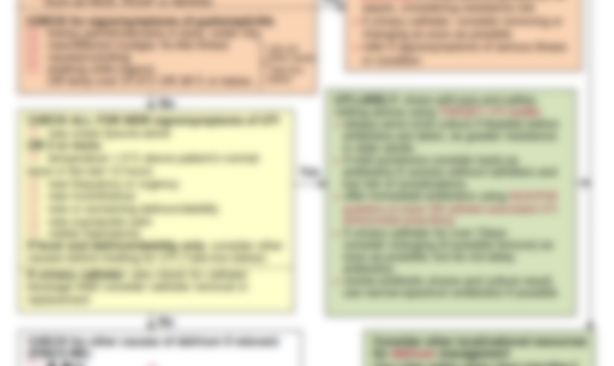
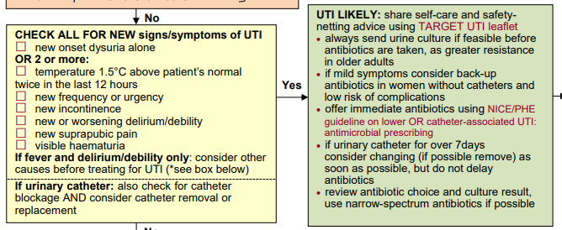
UKHSA UTI Diagnostic Tool: Diagnostic Flowchart
Clinical Scenario
Urinary Tract Infection
Last review: Feb 2023
Next review: Feb 2026
www.rcgp.org.uk/TARGETantibiotics
Notes:
Presenter talk
Continue to go through the flowchart.
Like women under 65 years, symptoms are key to diagnosing UTI in older adults.
The symptoms for UTI in older adults are slightly different than those for younger women based on findings from different studies.
Research targeting women at their homes in the community, shows that this menopausal and post menopausal women report an increase in symptoms like nocturia and incontinence when compared to pre menopausal women (Sanyaolu et al 2023).
If you want to provide more evidence specific to the symptoms used you can use the points below:
The symptoms used to determine UTI were based on a cluster RCT in 24 nursing homes in US/Canada conducted by Loeb et al in 2005.
12 care homes were allocated to a multifaceted intervention, and 12 allocated to usual care for 1yr
Diagnostic and treatment algorithm was implemented in the multifaceted intervention
Key symptoms identified were:
For those with urinary catheter: one or more of: costovertebral tenderness, rigors, new onset delirium and fever
For those without a urinary catheter: dysuria or two or more of fever, urgency, flank pain, incontinence, rigors, frequency, haematuria, and suprapubic pain
Fewer courses of antimicrobials were prescribed in the intervention nursing homes than in the non-intervention groups (weighted mean difference -0.49; 95% CI -0.93 to -0.06). There was no difference in hospitalisation or mortality
Presenter notes
Go through each section of the flowchart and discuss the key points and decision making.
Clarify what deterioration or sepsis scoring tool is most frequently used for vulnerable individuals in care
Highlight the links to the TARGET toolkit for patient information leaflets and the links to key NICE management guidance
Ensure you have checked for updates of the tool using the hyperlink below
Slide References
https://www.gov.uk/government/publications/urinary-tract-infection-diagnosis
Loeb M, et al. Effect of a multifaceted intervention on number of antimicrobial prescriptions for suspected urinary tract infections in residents of nursing homes: a cluster randomised controlled trial. BMJ. 2005 Sep; 331(7518):669.
Sanyaolu, L.N.; Cooper, E.; Read, B.; Ahmed, H.; Lecky, D.M. Impact of Menopausal Status and Recurrent UTIs on Symptoms, Severity, and Daily Life: Findings from an Online Survey of Women Reporting a Recent UTI. Antibiotics 2023, 12, 1150. https://doi.org/10.3390/antibiotics12071150

Slide 28
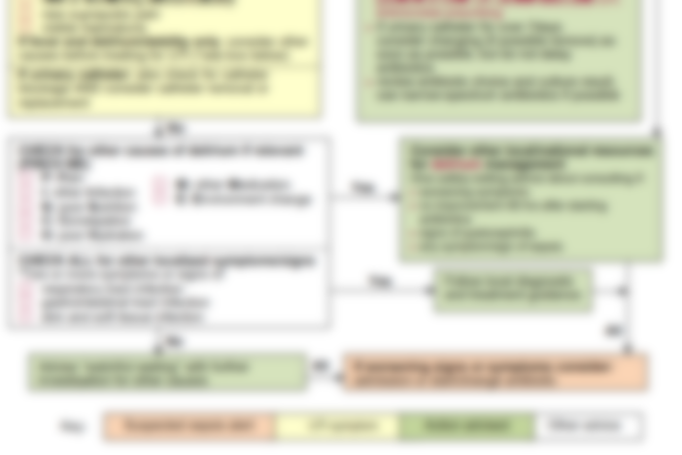
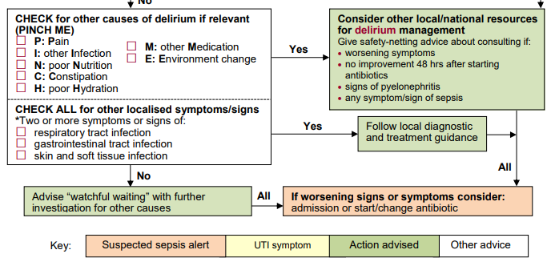
UKHSA UTI Diagnostic Tool: Diagnostic Flowchart
Clinical Scenario
Urinary Tract Infection
Last review: Feb 2023
Next review: Feb 2026
www.rcgp.org.uk/TARGETantibiotics
Notes:
Presenter talk
Continue to talk through the slide….
Presenter notes
Go through each section of the flowchart and discuss the key points and decision making.
Highlight the links to the TARGET toolkit for patient information leaflets and the links to key NICE management guidance
Ensure you have checked for updates of the tool using the hyperlink below
Slide References
https://www.gov.uk/government/publications/urinary-tract-infection-diagnosis

Slide 29
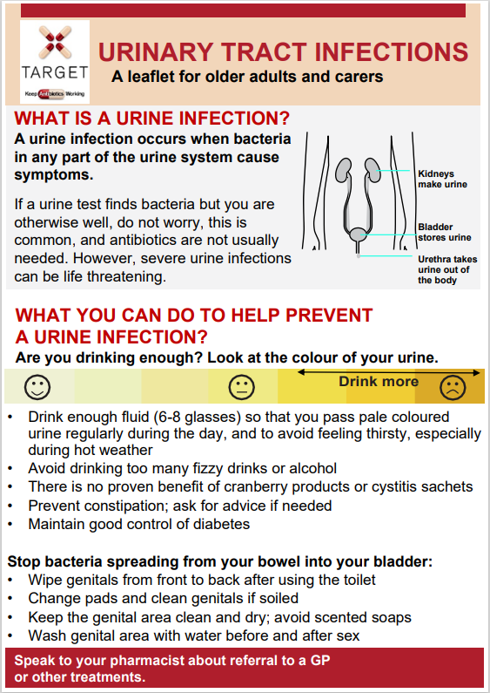
TARGET: UTI Patient Information Leaflet for Older Adults
There is a need to communicate consistently across the care pathway using appropriate tools for the audience
Clinical Scenario
Urinary Tract Infection
  Improve understanding of dipsticks and asymptomatic bacteriuria
Hydration is important – but what else can we do to prevent urinary tract infections?
Last review: Feb 2023
Next review: Feb 2026
www.rcgp.org.uk/TARGETantibiotics
Notes:
Presenter talk
The Patient Urinary Tract Infection (UTI) Information leaflet has been designed to be used during consultation with adults over the age of 65 years who have a suspected UTI
It is a useful tool for clinicians to use whether the patient needs an antibiotic prescription or not and can be used as a tool to discuss management with patients, family members, and caregivers.
It explains the treatment decision pathway, and therefore is also helpful for less experienced staff.
It includes information on the types of UTI, which are often misunderstood by patients and health care staff, illness duration, self-care advice, prevention advice and advice on when to re-consult.
This leaflet was endorsed by NICE to use with the prescribing guidelines
TARGET leaflets have been formatted into html text so they are accessible using digital technology and screen readers.
The leaflet can also be linked to your computer clinical systems, for instance, accurx has embedded all of the TARGET HTML leaflets into their SMS services
I am now going to walk you through the various aspects of our leaflets for adults over 65 years…..
Presenter notes
Various aspects of the leaflet will be highlighted so you can go through and read the points

Slide 30
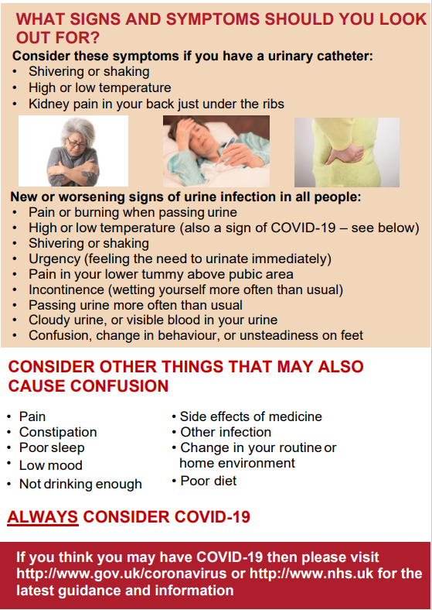
TARGET: UTI Patient Information Leaflet for Older Adults
Clinical Scenario
Urinary Tract Infection
Clarification of what signs to look out for – e.g. not everyone knew that a low temperature could indicate infection
Delirium is a symptom of a UTI but can also be related to other things
Simplified wording for PINCH ME
Last review: Feb 2023
Next review: Feb 2026
www.rcgp.org.uk/TARGETantibiotics

Slide 31

TARGET: UTI Patient Information Leaflet for Older Adults
Clinical Scenario
Urinary Tract Infection
Self-care advice
What the patient/carer can expect in a consultation
Side effects of antibiotics and AMR
Last review: Feb 2023
Next review: Feb 2026
www.rcgp.org.uk/TARGETantibiotics

Slide 32
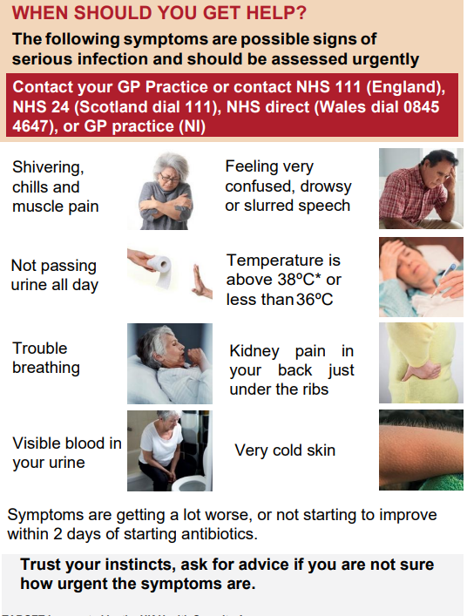
TARGET: UTI Patient Information Leaflet for Older Adults
Clinical Scenario
Urinary Tract Infection
Safety netting information – some carers did not know that UTIs can cause sepsis
Last review: Feb 2023
Next review: Feb 2026
www.rcgp.org.uk/TARGETantibiotics

Slide 33
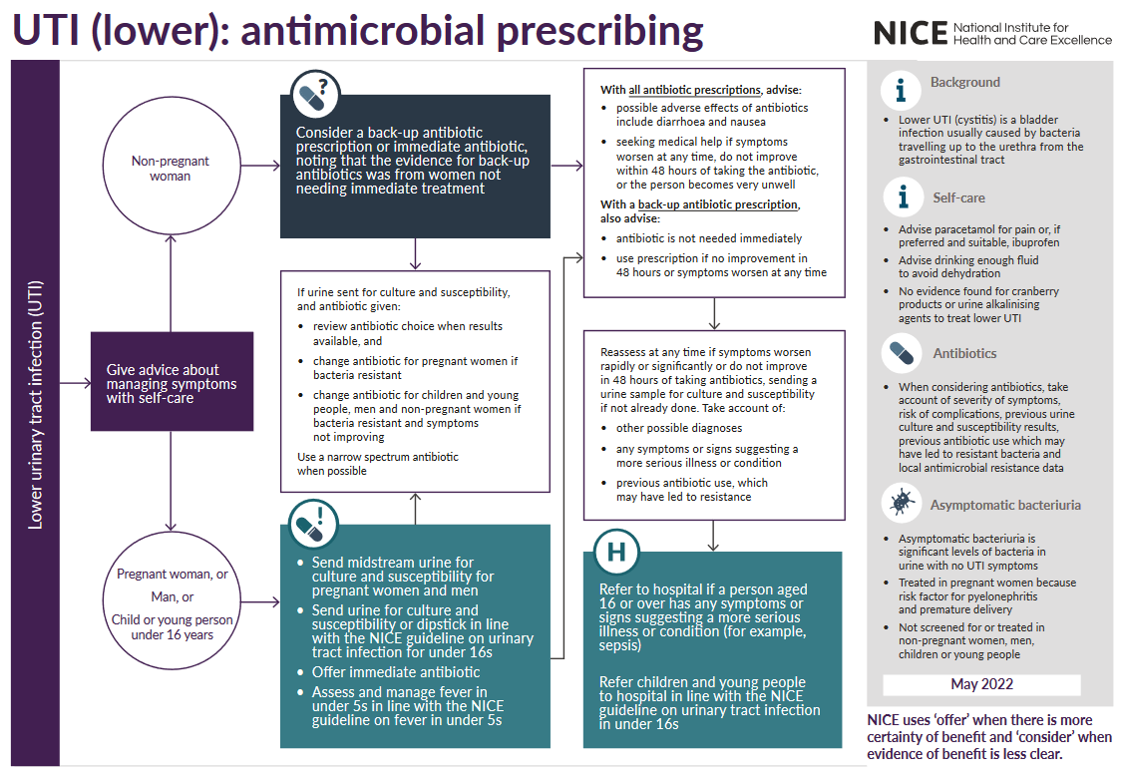
NICE antimicrobial prescribing guidance
Clinical Scenario
Urinary Tract Infection
Last review: Feb 2023
Next review: Feb 2026
www.rcgp.org.uk/TARGETantibiotics
Notes:
Presenter Talk
NICE hosts detailed prescribing guidance for women, men, and children with suspected lower UTI, prostatitis and pyelonephritis
It was developed in collaboration with multiple stakeholders and is summarised in decision tools linked to the main guidance
The NICE guidance for the management of lower urinary tract infections NICE suggest considering a back-up antibiotic prescription (to use if symptoms do not start to improve within 48 hours or worsen at any time) for women with lower UTI or an immediate antibiotic prescription for women with lower UTI who are not pregnant. Take account of:
the severity of symptoms
the risk of developing complications, which is higher in people with known or suspected structural or functional abnormality of the genitourinary tract or immunosuppression
the evidence for back-up antibiotic prescriptions, which was only in non-pregnant women with lower UTI where immediate antibiotic treatment was not considered necessary
previous urine culture and susceptibility results
previous antibiotic use, which may have led to resistant bacteria
preferences of the woman for antibiotic use.
Presenter Notes
References:
Urinary tract infection (lower): antimicrobial prescribing, NICE guideline [NG109], Published: 31 October 2018
https://www.nice.org.uk/guidance/ng109

Slide 34
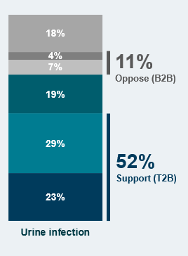


Back up prescribing for UTI is generally acceptable to patients – data from 2023
Clinical Scenario
Urinary Tract Infection
Do you support or oppose clinicians prescribing delayed/back-up antibiotic prescriptions for UTI?
54% of the population are in favour of delayed antibiotics
16% of patients who received a delayed prescription had a UTI
When asked about UTI, 52% of respondents were in favour of a delayed antibiotic
Consider back-up rather than immediate antibiotics –
but explain rationale, pain relief, and how to collect prescription
www.rcgp.org.uk/TARGETantibiotics
Source: Basis Research, AMR Survey
Base: All respondents (n=5390)
Notes:
Presenter Talk
This data comes from surveys that targets households asking about knowledge attitudes and practices specific to amicrobial use and the management of common infection. The research is conducted by a market research agency in Feb/March of each of the years indicated.
Findings from 2023 showed that:
About 54% of the public support the prescribing of delayed antibiotics, depending on the type of infection.
In the last 12 months, 7% of the people in the survey had received a delayed antibiotic prescription (n=370) and of these about 19% didn’t end up using them. Most commonly this was for a respiratory tract infection (cough, sore throat, ear infection etc…), but for 16% it was for UTI.
There is strongest support for delayed antibiotics in response to a urine infection (52% support), followed by an ear infection (49%) and a throat infection (47%).
Consider back-up rather than immediate antibiotics for UTIs using the guidance discussed on the previous slide – but make sure to explain rationale, pain relief, and how to collect prescription
Presenter Notes
This information comes from a study using a random sample of 5390 adults in England aged 18+. Data was collected using a 1 year recall period from May-June using an online survey that targeted households. Data was weighted to be representative of the population.
The key categories from bottom dark blue to the top grey are:
Strongly support, Tend to support, Neither support/oppose, Tend to oppose, Strongly oppose, Don’t know
References:
This data is currently being submitted for publication, please contact the t

Slide 35
NICE prescribing guidance for lower UTI – non-pregnant women
First choice:
Nitrofurantoin if eGFR] is 45 ml/minute or more: 100mg m/r BD (or if unavailable 50mg QDS)
Trimethoprim if low risk of resistance 200mg BD
Always safety net, and provide information on pain relief and self-care
If giving antibiotics send urine for culture & susceptibilities, if risk of resistance or over 65 years old
3
days
Last review: Feb 2023
Next review: Feb 2026
www.rcgp.org.uk/TARGETantibiotics
NICE, NG109, 2018
Notes:
Presenter Talk
For non-pregnant women aged 16 years and over Nice recommend:
Nitrofurantoin (if estimated glomerular filtration rate [eGFR] is 45 ml/minute or more):
100 mg modified-release twice a day (or, if unavailable, 50 mg four times a day) for 3 days
Trimethoprim (if there is a low risk of resistance):
200 mg twice a day for 3 days
You can use the patient information leaflet to discuss information on safety-netting and self care.
As seen previously, prevalence of resistance is higher in the older adult age groups, so it is recommended to send the urine for culture if you are prescribing antibiotics.
We will discuss risk factors that may mean you need to send the urine for culture on the next slide
References:
Urinary tract infection (lower): antimicrobial prescribing, NICE guideline [NG109], Published: 31 October 2018
https://www.nice.org.uk/guidance/ng109

Slide 36
Consider: Risk factors for resistance
Clinical Scenario
Urinary Tract Infection
Low risk of resistance:
younger women with acute UTI and no resistance risks
Risk factors for increased resistance include:
care home resident,
recurrent UTI (2 in 6 months; >3 in 12 months),
unresolving urinary symptoms,
hospitalisation for >7d in the last 6 months,
recent travel to a country with increased resistance,
previous UTI resistant to trimethoprim, cephalosporins, or quinolones.,
If risk of resistance: always safety net and send urine for culture & susceptibilities
Last review: Feb 2023
Next review: Feb 2026
www.rcgp.org.uk/TARGETantibiotics
Ben-Ami et al. Clin Infect Dis 2009
Malcom et al. JAC, 2017
Notes:
Presenter Talk:
Many studies have looked at risk factors for resistance. The most relevant one for the community setting, was undertaken in Scotland in 2016 using routine data. Results indicated that age, care home residence, and increasing comorbidity were significantly associated resistance after adjustment for other factors.
Other studies have looked at risk factors associated with UTIs due to Extended spectrum beta lactamase producing coliforms. Risk factors identified included: recent antibiotic use; residence in a long-term care facility; recent hospitalisation; aged 65 years or older; male sex.
Travel to a country with high resistance rates is also a very important risk factor, especially if that country has poor hygiene – for example South East Asia.
Presenter Notes:
Malcome et al. 2017: A surveillance study in Glasgow and Clyde CCG, aiming to use individual level linked data to characterise factors associated with antibiotic resistance in urine sample in 17,046 patients. All positive community urine samples from January 2012 to June 2015 were included and analysed. All cases were linked to national hospital activity data and patient-level community prescribing data. Risk factors associated with antibiotic susceptibility were assessed using multivariable multinomial logistic regression. Results indicated that age, care home residence, and increasing comorbidity were significantly associated with both categories of resistance after adjustment for other factors. Interestingly, there were no significant differences in repeat prescriptions within 42 days depending on whether patients were prescribed three (17.1%), five (16.8%), or seven days (17.3%) nitrofurantoin.
Ben-Ami et al. A survey paper, in which the authors identified significant risk factors through multivariate analysis. These risk factors included: recent antibiotic use; residence in a long-term care facility; recent hospitalisation; aged 65 years or older; male sex. The authors do note, however, that 34% of ESBL-producing isolates (115 of 336) were obtained from patients with no recent healthcare contact.
References:
William Malcolm, Eilidh Fletcher, Kimberley Kavanagh, Ashutosh Deshpande, Camilla Wiuff, Charis Marwick, Marion Bennie, Risk factors for resistance and MDR in community urine isolates: population-level analysis using the NHS Scotland Infection Intelligence Platform, Journal of Antimicrobial Chemotherapy, Volume 73, Issue 1, January 2018, Pages 223–230, https://doi.org/10.1093/jac/dkx363
https://academic.oup.com/jac/article/73/1/223/4430795?login=false
Ben-Ami R, Rodriguez-Bano J, Arslan H, Pitout JD, Quentin C, Calbo ES et al. A multinational survey of risk factors for infection with extended-spectrum beta-lactamase-producing enterobacteriaceae in non-hospitalized patients. Clin Infect Dis. 2009 Sep; 49(5):682-690. Available from: http://cid.oxfordjournals.org/content/49/5/682.full.pdf+html.

Slide 37
UTI and the link to blood stream infections
Estimate the prevalence of E.coli blood stream infections, which are resistant to co-amoxiclav
0-10%
11-20%
21-30%
31-40%
Over 40%
41.4%
Last review: Feb 2023
Next review: Feb 2026
www.rcgp.org.uk/TARGETantibiotics
UKHSA ESPAUR 2022
Notes:
Presenter talk
We talked previously about how UTIs are linked to bloodstream infections in England. Who can remember the prevalence of co-amoxiclav resistance in England?
Presenter notes
The animations will pop up the question and answer first – you can see what the audience comes back with.
Slide References
UKHSA 2022 ESPAUR Report
https://www.gov.uk/government/publications/english-surveillance-programme-antimicrobial-utilisation-and-resistance-espaur-report

Slide 38
Reduced 3Cs to help reduce Clostridium difficile in the community
Clinical Scenario
Urinary Tract Infection
Reduce use of
Ciprofloxacin
Cephalosporins
Co-amoxiclav
Increase use of
Nitrofurantoin
Pivmecillinam
for UTI
Trimethoprim still good for UTI if there is a low risk of resistance
Last review: Feb 2023
Next review: Feb 2026
www.rcgp.org.uk/TARGETantibiotics
NICE, Evidence Summary, 2015
NICE, NG109, 2018
Notes:
Presenter talk:
Reducing the 3C antibiotics can help reduce the risk of Clostridium difficile for patients and communities
NICE recommendations for lower UTI management in non-pregnant women don’t recommend these broad spectrum antibiotics for first or second choice management.
Presenter notes:
Slide References
Clostridium difficile infection: risk with broad-spectrum antibiotics, Evidence summary [ESMPB1] Published: 17 March 2015
https://www.nice.org.uk/advice/esmpb1/chapter/key-points-from-the-evidence#estimated-impact-for-the-nhs

Slide 39
NICE prescribing guidance for lower UTI – non-pregnant women
Second choice:
Nitrofurantoin (if eGFR is 45 ml/minute or more, and it was not used as first-choice)
Pivmecillinam: 400 mg initial dose, then 200 mg three times a day for a total of 3 days
Fosfomycin: 3g single dose sachet in women
Last review: Feb 2023
Next review: Feb 2026
www.rcgp.org.uk/TARGETantibiotics
NICE, NG109, 2018
Notes:
Presenter talk:
Second choices (if no improvement in lower UTI symptoms on first choice taken for at least 48 hours, or when first choice is not suitable)
Nitrofurantoin (if eGFR is 45 ml/minute or more, and it was not used as first-choice):
100 mg modified-release twice a day (or, if unavailable, 50 mg four times a day) for 3 days
PLEASE NOTE: For Pivmecillinam and Fosfomycin there are regional and national variations in use and dose for UTI management. Please check your local guidelines and follow related recommendations.
NICE recommend for second choice after Nitrofurantoin:
Pivmecillinam (a penicillin):
400 mg initial dose, then 200 mg three times a day for a total of 3 days
Manufacture advises to avoid in pregnancy but should be appropriate for those who are breastfeeding.
Remember that pivmecillinam should not be prescribed to those with a true penicillin allergy, are hypersensitive to cephalosporins, have acute porphyria, have carnitine deficiency or concurrent treatment with valproic acid, valproate, or any other medication liberating pivalic acid due to increased risk of carnitine depletion, have gastrointestinal obstruction, or oesophageal strictures.
Drug interactions include: Methotrexate, anticoagulants, and valproate.
Fosfomycin: a phosphonic acid antibacterial, is active against a range of Gram-positive and Gram-negative bacteria
Give a 3 g single dose sachet
Don’t prescribe to women in severe renal insufficiency and use caution in pregnant/lactating women (manufacturer advises only if benefits outweigh risks).
Manufacturer advises granules should be taken on an empty stomach (about 2–3 hours before or after a meal), preferably before bedtime and after emptying the bladder. The granules should be dissolved into a glass of water and taken immediately.
References:
Urinary tract infection (lower): antimicrobial prescribing, NICE guideline [NG109], Published: 31 October 2018
https://www.nice.org.uk/guidance/ng109
Fosfomycin, NICE/British National Formulary. Accessed 4 March 2024. https://bnf.nice.org.uk/drugs/fosfomycin/
Urinary tract infection (lower) - women: Prescribing information. NICE/Clinical Knowledge Summaries. Last revised in December 2023. Accessed 4 March 2024. https://cks.nice.org.uk/topics/urinary-tract-infection-lower-women/prescribing-information/

Slide 40
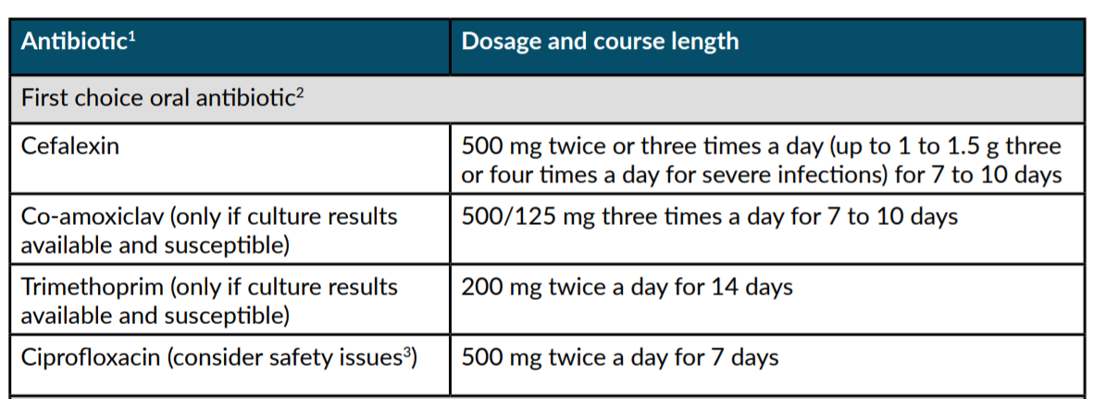
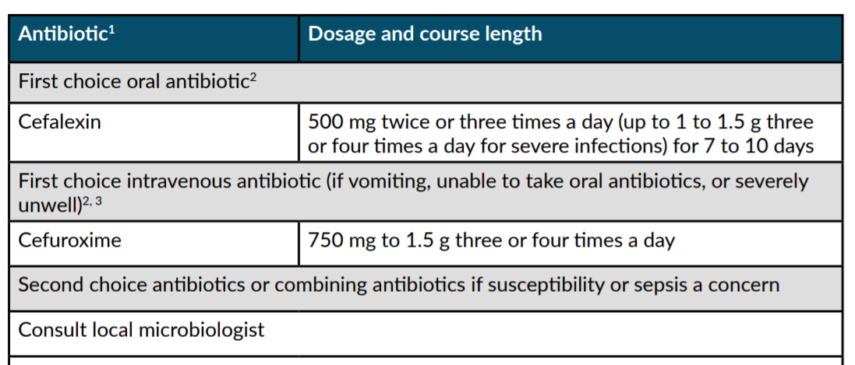
NICE prescribing guidance - pyelonephritis
Clinical Scenario
Urinary Tract Infection
First choice for non-pregnant women and men aged 16 years and over
MHRA Jan 2024: Fluoroquinolones only prescribed when others inappropriate – Check NICE for updates regarding Cipro
First choice for pregnant women aged 12 years and over
www.rcgp.org.uk/TARGETantibiotics
NG111: pyelonephritis (acute): antimicrobial prescribing
Notes:
Presenter Talk
NICE also provide prescribing guidance for pyelonephritis (upper UTI). Choices for non-pregnant women, men and then pregnant women are summarised in these slides. The full guidance provides further choices for IV antibiotics
See BNF for appropriate use and dosing in specific populations, for example, hepatic impairment, renal impairment and breast-feeding, and administering intravenous antibiotics.
Check any previous urine culture, susceptibility and prescribing and choose antibiotics accordingly.
(Click for animation) The updated MHRA regulation about fluroquinolones needs to be considered before cipro is used but is an option in acute pyelonephritis which is a severe infection. NICE are currently reviewing guidance that includes fluoroquinolones.
Review intravenous antibiotics by 48 hours and consider stepping down to oral antibiotics.
Therapeutic drug monitoring and assessment of renal function is required (BNF, August 2018).
Slide Reference:
Pyelonephritis (acute): antimicrobial prescribing NICE guideline [NG111] Published: 31 October 2018
https://www.nice.org.uk/guidance/ng111/chapter/Recommendations
MHRA. Drug Safety Update: Fluoroquinolone antibiotics: must now only be prescribed when other commonly recommended antibiotics are inappropriate. Published 22 January 2024. Accessed 4 March 2024. https://www.gov.uk/drug-safety-update/fluoroquinolone-antibiotics-must-now-only-be-prescribed-when-other-commonly-recommended-antibiotics-are-inappropriate

Slide 41
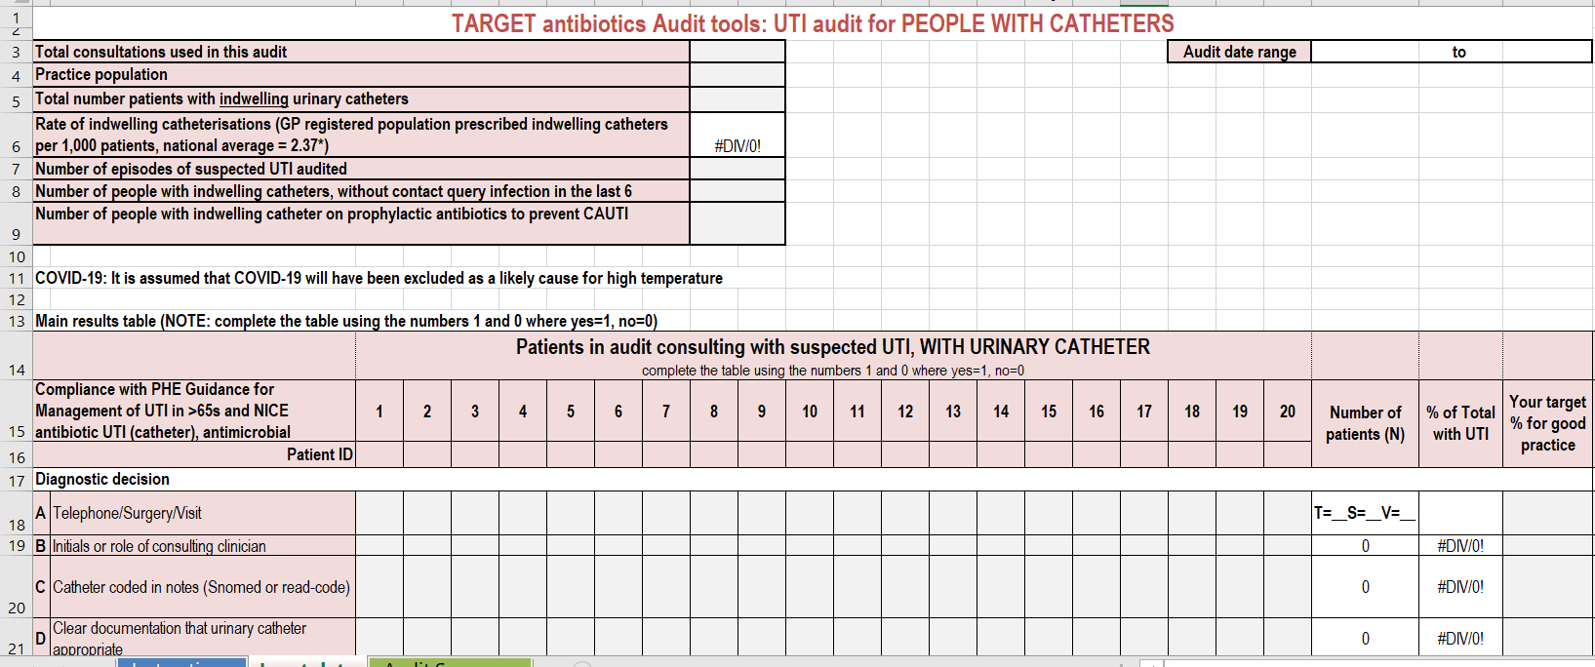
TARGET: Urinary Tract infection (UTI)
Clinical Scenario
Urinary Tract Infection
The TARGET website has audit templates for:
    Acute otitis media
    UTI
      Women under 65 years
      Older adults
      CAUTI
    Sore Throat
    Acute Cough
    Otitis Externa
    Acute Rhinosinusitis
Last review: Feb 2023
Next review: Feb 2026
www.rcgp.org.uk/TARGETantibiotics
Notes:
Presenter Talk:
Have you done any personal or practice wide antibiotic audits in the last year?
This can really help you understand what antibiotics you and others in the practice are prescribing, and to whom, and why
The TARGET website has audit templates with appropriate guidance and Read codes to use for:
Otitis media, Sore Throat, acute cough, UTI Audits.
For UTIs – we have audits for lower UTIs in women under 65 years, older adults, and adults with urinary catheters.
These will also help you comply with your CPD and revalidation.
Slide Reference:
https://elearning.rcgp.org.uk/mod/book/view.php?id=12649

Slide 42
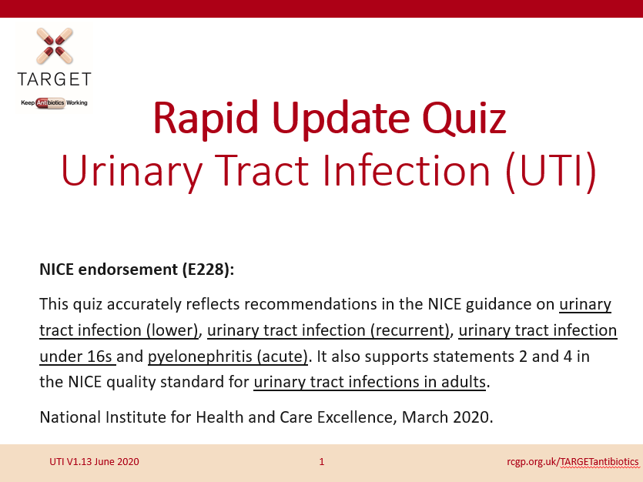

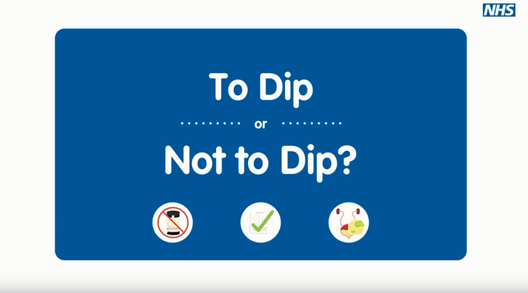
What can you do to learn more about UTI using TARGET resources?
Clinical Scenario
Urinary Tract Infection
Rapid update quiz: This training quiz is for clinicians who manage patients with suspected UTI.
Recurrent UTI podcast
Encourage non-medical staff to watch this To Dip or Not To Dip training animation:
https://www.youtube.com/watch?v=rZ5T1Cz7DHQ
Last review: Feb 2023
Next review: Feb 2026
www.rcgp.org.uk/TARGETantibiotics
Notes:
Presenter Talk:
Here are some other resources that are available or linked to the TARGET toolkit that provide more information about UTI management.

Slide 43
In summary
Makes difference to resistance in your patients
Clinical Scenario
Urinary Tract Infection
Reducing antibiotic prescribing in your practice
Helps to reduce future consultations
Helps to slow future antibiotic resistance
Increase patient
self-care
Last review: Feb 2023
Next review: Feb 2026
www.rcgp.org.uk/TARGETantibiotics
Notes:
Presenter notes:
Thus in summary, I hope you agree that the evidence suggests that by improving the antibiotic prescribing in your practice – you can:
Make a difference to the care of individual patients.
Help to slow the development of future resistance in our community.
AND as a bonus help to increase patient self-care and reduce future consultations for self-limiting infections.

Slide 44
How can we fit together the evidence and change behaviour during consultation with our patients to improve antibiotic prescribing?
Possible solution for you
Clinical Scenario
Urinary Tract Infection
Practice
GP
Evidence
Patient
Use the TARGET antibiotics toolkit
Last review: Feb 2023
Next review: Feb 2026
www.rcgp.org.uk/TARGETantibiotics
Notes:
Presenter notes:
So how can we fit all of this evidence together and change behaviour within the practice consultation with our patients to improve prescribing?

Slide 45
Actions
What can and will you do?
Clinical Scenario
Urinary Tract Infection
Last review: Feb 2023
Next review: Feb 2026
www.rcgp.org.uk/TARGETantibiotics
Notes:
Presenter notes:
So what can and will you as an individual and as a practice do to help?
Please can we discuss a plan?
Need to discuss a plan with each practice
They are all evidence based
Get them to do the planning – so moves on within the practice
Get them to prioritise
Get them to plan review with audit.
Identify a person to take forward
Find the individual with computer interest and get them to help with a computer reminder linking to the TARGET patient shared information.
Action plan, timescale, review date
1 year plan – as a lot going on and can’t do it all now
Need to show them the scale of change which can be attained

Slide 46
How could your practice improve antibiotic prescriptions for UTI?
Clinical Scenario
Urinary Tract Infection
Agree antibiotic choice in line with local guidance
Agree diagnostic tests in line with UTI Diagnostic Tool
Consider a non UTI cause in post-menopausal women
Remember inflammation due to sexual activity can cause urinary symptoms due to mild urethritis
Consider back-up prescription in those with mild symptoms
Always do safety netting especially in the elderly
Use the TARGET UTI patient leaflet during consultations
Use computer reminders for leaflets & back-up prescriptions
Do a UTI audit
Do RCGP Management of UTI free online course
Use stand-by rather than daily prophylaxis for recurrent UTI and review 6 monthly for need
Do not use dipsticks in elderly patients
Last review: Feb 2023
Next review: Feb 2026
www.rcgp.org.uk/TARGETantibiotics
Notes:
Presenter notes:

