Slide 1

Clinical Scenario:
Acute Sore Throat
Last review: Feb 2023
Next review: Feb 2026
Notes:
Presenter Notes
This clinical scenario of acute sore throat, can be used instead of the acute cough scenario, if you wish to increase awareness of the FeverPAIN score recommended in NICE guidance, specifically Target prescribing for this condition or undertake an audit in this area, or of course all of the above!
The case can be just put up on the projector or printed out and discussed in pairs or groups, or with the group as a whole.
Allow the participants to discuss the case for 2 minutes and specifically ask several different people what they would do and /or prescribe.

Slide 2
Clinical Scenario:
Acute Sore Throat
Consider the following details:
18 year old girl
4/7 days sore throat, “high” fever last night, tiredness, cough
Difficulty swallowing
Temp 37.5°C
Slough on swollen tonsils, palatal petechiae
Cervical and axillary lymphadenopathy
‘Antibiotics helped’ for tonsils last year
Last review: Feb 2023
Next review: Feb 2026
Notes:
Presenter notes
These cases are examples that can be printed out and discussed in pairs or groups, or with the group as a whole.
Allow the participants to discuss the case for 2 minutes and specifically ask several different people what they would do and /or prescribe.
If you wish to increase awareness of the FeverPAIN score recommended in NICE guidance, specifically target prescribing for this condition or undertake an audit in this area, or of course all of the above!
The case can be just put up on the projector or printed out and discussed in pairs or groups, or with the group as a whole.
When you put up the scenario, ask the group to discuss what will determine their decision to prescribe in this case , and other cases. Do they use any scoring system? And if so what? And can they see any advantages to one scoring system over another.

Slide 3
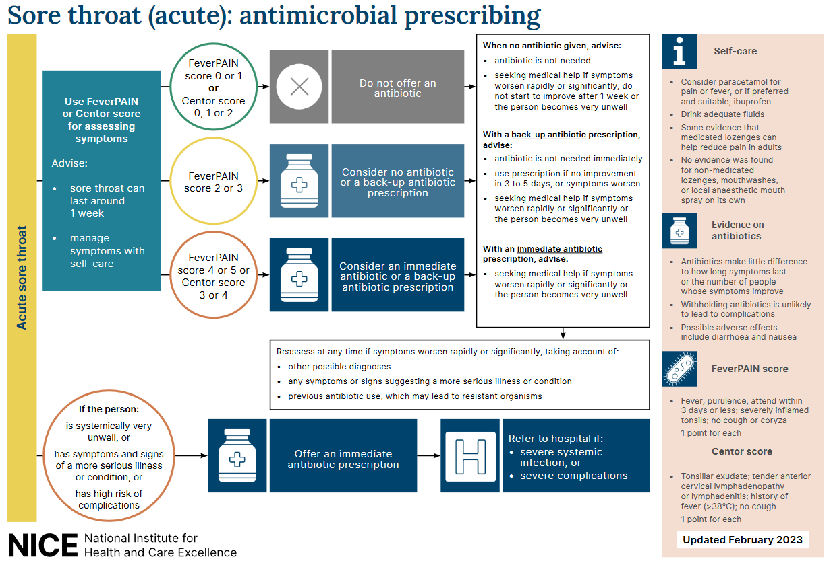
Sore throat: antimicrobial prescribing
Last review: Feb 2023
Next review: Feb 2026
NICE: Sore throat (acute) in adults: antimicrobial prescribing [NG84]
Notes:
Presenter notes:
This is an overview of the NICE guidelines that recommend the use of clinical scoring systems. Lets have a look at the scoring systems in a bit more detail
Slide reference:
Sore throat (acute): antimicrobial prescribing
NICE guideline [NG84] Published: 26 January 2018
https://www.nice.org.uk/guidance/ng84

Slide 4
Clinical scoring systems
Centor criteria
(scores 0-4)
Tonsillar exudate
Tender anterior cervical lymphadenopathy or lymphadenitis
History of fever (over 38 degrees Celsius)
Absence of cough
FeverPAIN criteria
(scores 0-5)
Fever (in last 24 hours)
Purulence (pus on tonsils)
Attend rapidly (within 3 days of symptom onset)
(severely) Inflamed tonsils
No cough or coryza (inflammation of mucus membranes in the nose)
Last review: Feb 2023
Next review: Feb 2026
NICE: Sore throat (acute) in adults: antimicrobial prescribing [NG84]
Notes:
Presenter talk
NICE suggest that clinicians should use either the Fever PAIN or CENTOR score to help decide on the management of adult acute sore throat. Many of you will be familiar with one or both of these clinical scoring tools.
Centor has been around since 1981 and was developed to predict the probability of the presence of Streptococcus pyogenes or group A β haemolytic Streptococcus (GABHS) in a throat swab culture.
Centor criteria
Tonsillar exudate
Tender anterior cervical lymphadenopathy or lymphadenitis
History of fever (over 38 degrees Celsius)
Absence of cough
Each of the Centor criteria score 1 point (maximum score of 4). A score of 0, 1 or 2 is thought to be associated with a 3 to 17% likelihood of isolating streptococcus. A score of 3 or 4 is thought to be associated with a 32 to 56% likelihood of isolating streptococcus.
The FeverPAIN score was developed with over 500 UK general practice patients, and then tested in a further cohort of over 600 patients, so the findings of the study are really robust.
The score was not just used to predict Group A strep sore throats like the Centor score, but also other streptococcal sore throats such as C, G.
Each of the FeverPAIN criteria score 1 point (maximum score of 5). A score of 0 or 1 is thought to be associated with a 13 to 18% likelihood of isolating streptococcus. A score of 2 or 3 is thought to be associated with a 34 to 40% likelihood of isolating streptococcus. A score of 4 or 5 is thought to be associated with a 62 to 65% likelihood of isolating streptococcus (NG84).
Fever (during previous 24 hours)
Purulence (pus on tonsils)
Attend rapidly (within 3 days after onset of symptoms)
Severely Inflamed tonsils
No cough or coryza (inflammation of mucus membranes in the nose
You can link to a scoring system at https://ctu1.phc.ox.ac.uk/feverpain/index.php
Whilst both scoring systems are very similar, the Fever PAIN score found that cervical lymphadenopathy was not predictive of streptococcal sore throat, and this may not surprise us as this occurs also in viral sore throats, so does not help to differentiate the two.
Presenter Notes
See NG 84 for more details
Slide references
Centor R, Witherspoon J, Dalton H, et al. The diagnosis of strep throat in adults in the emergency room. Med Decis Making 1981;1:239–46
Little P, Moore M, Hobbs FDR, et al. BMJ Open 2013, 2013;3:e003943. doi:10.1136/bmjopen-2013-003943
***Centor however was specifically developed for adults, so in 2004 McIsaac and team developed modified criteria, which add the age of the patient (+1 if age 3–14, 0 if age 15–44 and -1 if age ≥45), taking into account the fact that GABHS is more prevalent in the age group of 5–15 years. Still, several studies have shown that neither signs and symptoms, nor signs and symptoms combined as prediction rules, were reliable to distinguish between GABHS and non-GABHS pharyngitis.

Slide 5
Clinical Scenario: Acute Sore Throat Feedback FeverPAIN
18 year old girl
4/7 days sore throat, “high” fever last night, tiredness, cough. difficulty swallowing
Temp 37.5°C
Slough on swollen tonsils, palatal petechiae
Cervical and axillary lymphadenopathy
‘Antibiotics helped’ for tonsils last year
FeverPAIN is a five-item score based on Fever, Purulence, Attend rapidly (3 days or less), severely Inflamed tonsils and No cough or coryza
FeverPAIN score 0-1: only 13-18% have streptococcus, close to background carriage. NO antibiotic strategy appropriate with discussion
FeverPAIN score 2-3: 34-40% have streptococcus. A back-up/ delayed antibiotic is appropriate with discussion
Fever PAIN score of >4: 62-65% have streptococcus, consider immediate antibiotic if symptoms are severe, or a short delayed prescribing strategy may be appropriate (48 hours)
Patient above scores 3
Last review: Feb 2023
Next review: Feb 2026
NICE: Sore throat (acute) in adults: antimicrobial prescribing [NG84]
Notes:
Presenter talk
So lets take a look at using the FeverPAIN score in adults (note for presenter: double check guidance in children (see slide 8)
The Fever PAIN score gives the likelihood of having a streptococcal sore throat, which can be discussed with the patient.
So the FeverPAIN is a five-item score based on Fever (during previous 24 hours), Purulence (pus on tonsils), Attend rapidly (within 3 days after onset of symptoms), Severely Inflamed tonsils, No cough or coryza (inflammation of mucus membranes in the nose)
(FeverPAIN)
You can link to a scoring system at https://ctu1.phc.ox.ac.uk/feverpain/index.php
Bring in scoring and what they represent – each bullet will come in on a separate mouse click.
If the FeverPAIN score is 0 or 1 then the likelihood of a patient having a streptococcus in their throat is 13-18% which is close to the background carriage of streptococci, and therefore antibiotics are not warranted.
This patient has 3 of the 5 FeverPAIN criteria (fever in last 24 hours, purulence, and severe inflammation) – and therefore has a 34-40% likelihood of a beta haemolytic streptococcus. She could warrant a back-up/delayed antibiotic and this needs to be discussed with the patient.
If the Fever PAIN score is >4: there is a 62-65% of having a streptococcus, therefore consider an immediate antibiotic if symptoms are severe, or a short delayed prescribing strategy may be appropriate if symptoms are not severe and the patient is happy to wait and see how their symptoms progress. (48 hour)
In this case our patient has a FEVERPAIN score of 3 suggesting bask-up/delayed antibiotics.
It may be worth discussing some slightly different scenarios, and what factors makes a clinician more likely to prescribe – and if this is a correct approach.
Presenter additional background information
References for FeverPAIN score development and testing
Little P, Moore M, Hobbs FDR, et al. BMJ Open 2013, 2013;3:e003943. doi:10.1136/bmjopen-2013-003943
ABSTRACT: Objective: To assess the association between features of acute sore throat and the growth of streptococci from culturing a throat swab. Design: Diagnostic cohort. Setting: UK general practices.
Participants: Patients aged 5 or over presenting with an acute sore throat. Patients were recruited for a second cohort (cohort 2, n=517) consecutively after the first (cohort 1, n=606) from similar practices. Main outcome: Predictors of the presence of Lancefield A/C/G streptococci. Results: Variables significant in multivariate analysis in both cohorts were rapid attendance ( prior duration 3 days or less; multivariate adjusted OR 1.92 cohort, 1.67 cohort 2); fever in the last 24 h (1.69, 2.40); and doctor assessment of severity (severely inflamed pharynx/ tonsils (2.28, 2.29)). The absence of coryza or cough and purulent tonsils were significant in univariate analysis in both cohorts and in multivariate analysis in one cohort.
A five-item score was suggested based on Fever, Purulence, Attend rapidly (3 days or less), severely Inflamed tonsils and No cough or coryza (FeverPAIN) had moderate predictive value (bootstrapped area under the ROC curve 0.73 cohort 1, 0.71 cohort 2) and identified a substantial number of participants at low risk of streptococcal infection (38% in cohort 1, 36% in cohort 2 scored ≤1, associated with a streptococcal percentage of 13% and 18%, respectively). A Centor score of ≤1 identified 23% and 26% of participants with streptococcal percentages of 10% and 28%, respectively
This score was further tested in an RCT: Little P, Hobbs FDR, Moore M. et al. Clinical score and rapid antigen detection test to guide antibiotic use for sore throats: randomised controlled trial of PRISM (primary care streptococcal management). 2013. BMJ. Available from: http://www.bmj.com/content/347/bmj.f5806.
Rationale: A multicentre randomised controlled trial in UK general practices designed to determine the effect of clinical scores that predict streptococcal infection or rapid streptococcal antigen detection tests compared with delayed antibiotic prescribing in patients aged >3 with acute sore throat.
This study compared three strategies for limiting or targeting antibiotic using a validated FeverPAIN score in 631 patients with sore throat: they compared delayed antibiotic prescribing, the use of a clinical score designed to identify streptococcal infection, and the targeted use of rapid antigen tests according to the clinical score. Findings suggest that across a range of practitioners and practices, use of either the simple FeverPAIN clinical score or the clinical FeverPAIN score with a rapid antigen test is likely to moderately improve symptom control and reduce antibiotic use; the addition of the Rapid antigen test to the FeverPAIN score gave no clear advantages compared with use of the FeverPAIN score alone. Use of antibiotics in the clinical score group (60/161) was 29% lower (adjusted risk ratio 0.71, 95% confidence interval 0.50 to 0.95; P=0.02) and in the antigen test group (58/164) was 27% lower (0.73, 0.52 to 0.98; P=0.03). There were no significant differences in complications or reconsultations. The authors therefore suggest the use of the following scoring system and clinical management: With a low FeverPAIN score of 0-1: only 13-18% have streptococcus, close to background carriage and therefore a no antibiotic strategy is appropriate with discussion. With a FeverPAIN score of 2-3: 34-40% have streptococcus, therefore a back-up/delayed antibiotic is appropriate with discussion. With a FeverPAIN score of >4: 62-65% have streptococcus, therefore consider immediate antibiotic if symptoms are severe or a short 48 hour delayed antibiotic prescribing strategy may also be appropriate after agreement with the patient and safety netting advice.
If a patient is unwell with a Centor score of 3-or-4 then the chance of developing Quinsy is 1:60.

Slide 6
Clinical Scenario: Acute Sore Throat Feedback CENTOR
18 year old girl
4/7 days sore throat, “high” fever last night, tiredness, cough, difficulty swallowing
Temp 37.5°C
Slough on swollen tonsils, palatal petechiae
Cervical and axillary lymphadenopathy
‘Antibiotics helped’ for tonsils last year
Centor Criteria: History of fever; absence of cough; tender anterior cervical lymphadenopathy and tonsillar exudates.
Centor score 0-2: has a high negative predictive value (80%) and indicates low chance of Group A Beta Haemolytic Streptococci
Centor score 3 or 4: suggests the chance of GABHS is 40%.
If a patient is unwell with a Centor score of 3-or-4 then the chance of developing Quinsy is 1:60.
Patient scores Centor criteria 3
Last review: Feb 2023
Next review: Feb 2026
NICE: Sore throat (acute) in adults: antimicrobial prescribing [NG84]
Notes:
Presenter talk
Lets have a look at the same scenario but using the Centor score.
As we saw before the Centor scoring system is very similar but includes lymphadenopathy which this patient has – giving a score of 3, and suggesting an immediate or back-up antibiotic.
Centor Criteria: History of fever; absence of cough; tender anterior cervical lymphadenopathy and tonsillar exudates. A low Centor score (0-2) has a high negative predictive value (80%) and indicates low chance of Group A Beta Haemolytic Streptococci (GABHS). A Centor score of 3-or-4 suggests the chance of GABHS is 40%. If a patient is unwell with a Centor score of 3-or-4 then the chance of developing Quinsy is 1:60.
This patient has 3 of the 4 Centor criteria (because they have a history of fever, lymphadenopathy, and exudate) – and is therefore more likely to have a group A beta haemolytic Streptococcus. She could warrant an immediate or back-up/delayed antibiotic – however the benefit with immediate antibiotics may still be quite small and needs to be discussed with the patient. Centor leads to more prescribing than Fever PAIN
It may be worth discussing some slightly different scenarios, and what factors makes a clinician more likely to prescribe – and if this is a correct approach.
Slide reference
Centor RM, Whitherspoon JM, Dalton HP, Brody CE, Link K. The diagnosis of strep throat in adults in the emergency room. Med Decision Making 1981;1:239-46.
Studies that back up the use of Centor
Aalbers J, O'Brien KK, Chan WS, Falk GA, Teljeur C, Dimitrov BD, and Fahey T (2011) Predicting streptococcal pharyngitis in adults in primary care: a systematic review of the diagnostic accuracy of symptoms and signs and validation of the Centor score. BMC Medicine, 9:67.
https://www.ncbi.nlm.nih.gov/pmc/articles/PMC3127779/pdf/1741-7015-9-67.pdf
Fine AM, Nizet V, and Mandl KD (2012) Large-scale validation of the Centor and McIsaac scores to predict group A streptococcal pharyngitis. Arch Intern Med, 172(11):847-852.
https://jamanetwork.com/journals/jamainternalmedicine/article-abstract/1157417
Hassan MF, Eida MM, Metwally LA, and Mahmoud HA (2015) Evaluation of Appropriateness of Antibiotic Use and Validation of the Mclsaac-Modified Centor Score for Group A Beta Hemolytic Streptococcal Acute Pharyngitis in Suez Canal Area. Suez Canal University Medical Journal, 18(2):117-124.
https://journals.ekb.eg/article_45612_a3c5f8106208278c29773deb5a076b0e.pdf

Slide 7
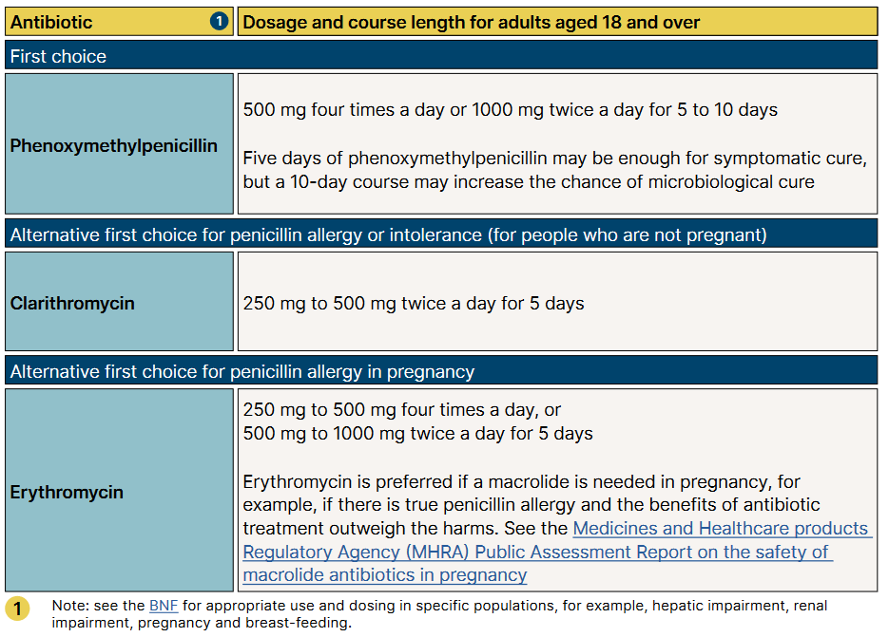
NICE antimicrobial prescribing guidelines for acute sore throat in adults
Last review: Feb 2023
Next review: Feb 2026
NICE: Sore throat (acute) in adults: antimicrobial prescribing [NG84]
Notes:
Presenter notes
We suggest you take your local antibiotic guidance with you – and show them the sore throat section, and your local recommendations. You may wish to edit the above slide if there are any major differences.
Presenter talk
So we have managed this case in line with National NICE guidance. This is a snapshot of the aims and principles of treatment section of the Antibiotic Prescribing Implementation Tool for acute sore throat. As you can see each section has links to other guidance, comments on when antibiotics should be used, recommended first and second line antibiotics dose and duration.
The guidance recommends oral penicillin V for AST as first line
Presenter please tell the participants where to find your local guidance and how locums can get extra copies if needed.

Slide 8
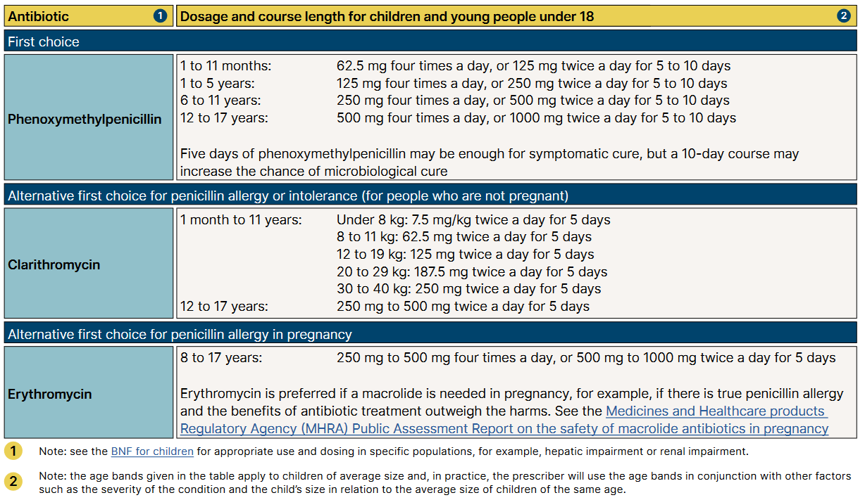
NICE antimicrobial prescribing guidelines for acute sore throat in children
NICE: Sore throat (acute) in adults: antimicrobial prescribing [NG84]
Notes:
Presenter notes
We suggest you take your local antibiotic guidance with you – and show them the sore throat section, and your local recommendations. You may wish to edit the above slide if there are any major differences.
Presenter talk
So we have managed this case in line with National NICE guidance. This is a snapshot of the aims and principles of treatment section of the Antibiotic Prescribing Implementation Tool for acute sore throat. As you can see each section has links to other guidance, comments on when antibiotics should be used, recommended first and second line antibiotics dose and duration.
The guidance recommends oral penicillin V for AST as first line
Presenter please tell the participants where to find your local guidance and how locums can get extra copies if needed.

Slide 9
Prescribing can influence patients understanding and expectations
English RCT comparing treatment strategies for respiratory tract infection (n=889)
Last review: Feb 2023
Next review: Feb 2026
Little 2014, BMJ, Extracted from supplementary table 2
Notes:
Presenter Talk
There has been much discussion about the use of giving delayed antibiotic prescriptions in acute uncomplicated infections, to reduce antibiotic use and reduce patient expectations
This slide covers one study within that review conducted by Little et al in in 2014 focused on upper respiratory tract infections and included patients 889 patients over 3 years of age from 25 practices. Patients who were not judged to need an immediate antibiotic, were randomised into no antibiotic or delayed prescribing group (n=556).
There was no significant effect of antibiotic prescribing strategy on symptom severity or temperature. Higher levels of satisfaction were reported for the patient led and collection approaches, although the limited sample size for this outcome resulted in no significant differences overall (2.38, P=0.667). Those given antibiotics were more likely to believe that antibiotics were effective (click for arrow) despite immediate antibiotics having no significant effect on symptom severity or duration.
The back-up prescription is very useful to give to patients who have a high expectation for antibiotics, and can be given using the patient leaflet I will show you.
Presenter notes
Additional information on delayed prescribing you can cover:
A 2017 Cochrane review found that symptoms for sore throat were only modestly improved by immediate antibiotics compared with delayed antibiotics (5 studies - Spurling 2017) also found no significant difference in patient satisfaction in delayed vs. immediate groups in studies focusing on respiratory tract infections (6 studies).
You can also include information about safety by covering the DESCARTE study:
A study of acute sore throat (the DESCARTE study – Little 2013) showed that complications in those who received immediate were similar to those receiving a back-up prescription even though 30% did not collect the prescription, and in the study complications were higher in the no antibiotic group. Thus giving more control to the patient does help prevent complications, but with a back-up antibiotic safety netting instructions are important.
Little 2014 study:
Health professionals decided in negotiation with patients whether immediate antibiotics were needed. Total of 889 patients, of these 333 (37%) were prescribed immediate antibiotics
If antibiotics were not needed, patients were randomised into four delayed prescribing groups (n=556, 63%):
Recontact for prescription (n=123)
Post-dated prescription (n=114)
Collection of the prescription (n=105)
Or patient led (the patient was given to use if needed) (n=106)
Immediate antibiotics given (n=333) symptoms documented (n=280)
For symptom severity, we saw no evidence of a significant interaction between antibiotic strategy and analgesia use
For the randomised no/delayed groups
There was no significant effect of strategy on symptoms severity, duration and small differences in temperature control.
Antibiotic use did not differ significantly between no/delayed prescribing strategies, with the lowest use reported in the no prescription group
Consultations in the following month were similar (RR: 2.97, P=0.563) and were not significantly different after the first month (RR: 4.11, P=0.391).
Belief in antibiotics was strong but not significantly different between no or delayed groups,
Inclusion of the non-randomised immediate prescription group
No significant effect of antibiotic prescribing strategy on symptom severity or temperature
Antibiotic use differed significantly with 97% of patients reporting antibiotic use in the immediate arm
More patients believed antibiotics were very effective despite immediate antibiotics having no significant effect on symptom severity or duration.
There was no significant difference in satisfaction rates across the groups
A 2017 Cochrane review of delayed prescriptions for respiratory infection found that:
A strategy of immediate antibiotics is more likely to confer the modest benefits of antibiotics on clinical outcomes such as symptoms for acute otitis media and sore throat than delayed antibiotics (moderate certainty evidence according to GRADE assessment).
Immediate antibiotics had similarly high levels of patient satisfaction to delayed antibiotics (91% versus 86% - moderate certainty evidence according to GRADE assessment).
Delayed antibiotics had higher levels of patient satisfaction than no antibiotics (87% versus 82% - moderate certainty evidence according to GRADE assessment).
Delayed antibiotic prescribing strategies achieved markedly lower rates of antibiotic use compared to immediate antibiotics (31% versus 93% - moderate certainty evidence according to GRADE assessment).
Requiring the patient to return for a prescription resulted in even lower antibiotic use (27%) than giving a prescription at the time of the consultation with instructions to fill the prescription if symptoms worsened (38%).
No antibiotics achieved lower rates still of antibiotic use compared to delayed antibiotics (14% versus 28%)- moderate certainty evidence according to GRADE assessment).
Slide References
Spurling GKP, Del Mar CB, Dooley L, Clark J, Askew DA. Delayed antibiotic prescriptions for respiratory infections. Cochrane Database of Systematic Reviews 2017, Issue 9. Art. No.: CD004417. DOI: 10.1002/14651858.CD004417.pub5. Accessed 23 January 2023.
Little P, Moore M, Kelly J, Williamson I, Leydon G, McDermott, L, Mullee M, Stuart B. Delayed antibiotic prescribing strategies for respiratory tract infections in primary care: pragmatic, factorial, randomised controlled trial. BMJ 2014;348.
Moore M, Little P, Rumsby K, Kelly J, Watson L, Warner G, Fahey T, Williamson I. Effect of antibiotic prescribing strategies and an information leaflet on longer-term reconsultation for acute lower respiratory tract infection. Br J Gen Pract. 2009 Oct;59(567):728-34. doi: 10.3399/bjgp09X472601. PMID: 19843421; PMCID: PMC2751917.
Little P, Stuart B, Hobbs FD, Butler CC, Hay AD, Campbell J, Delaney B, Broomfield S, Barratt P, Hood K, Everitt H, Mullee M, Williamson I, Mant D, Moore M; DESCARTE investigators. Predictors of suppurative complications for acute sore throat in primary care: prospective clinical cohort study. BMJ. 2013 Nov 25;347:f6867. doi: 10.1136/bmj.f6867. PMID: 24277339; PMCID: PMC3898431.
Little P, Stuart B, Hobbs FD, Butler CC, Hay AD, Delaney B, Campbell J, Broomfield S, Barratt P, Hood K, Everitt H, Mullee M, Williamson I, Mant D, Moore M; DESCARTE investigators. Antibiotic prescription strategies for acute sore throat: a prospective observational cohort study. Lancet Infect Dis. 2014 Mar;14(3):213-9. doi: 10.1016/S1473-3099(13)70294-9. Epub 2014 Jan 17. PMID: 24440616.

Slide 10
Awareness of delayed/back up prescribing has increased but is still low
Y2 COVID-19
Y1 COVID-19
Pre COVID-19
Awareness of delayed prescribing has increased
Last review: Feb 2023
Next review: Feb 2026
Base: All adults aged 18+ in England: 2022 (1663), 2021 (1676); 2020 (2052) :
Notes:
Presenter talk
Throughout the COVID pandemic the UKHSA Primary Care and Interventions Unit carried out an annual survey of the general public’s health seeking behaviours and attitudes and behaviours towards antibiotics facilitated by Ipsos mori marketing research. All data was collected in Feb/Mar of years highlighted in this figure and respondents were asked about their behaviour in the previous 12 months – therefore 2020 respondents were asked about their behaviour in the 12 months BEFORE the first English national lockdown.
When we look at the publics awareness of delayed antibiotics we see an interesting picture building. There seemed to be an increased awareness of delayed prescribing during the first year of the pandemic, with a significant increase in the percentage of people who said they were fully aware of what an antibiotic was (darkest blue section) – and this remained constant in 2022. On the other hand, those who said they were not aware of delayed prescribing (lighter blue section) initially decreased in 2021 only to rise again tin 2022 – but to pre pandemic levels.
Take home message: Awareness of delayed prescribing has increased but is starting to decrease – almost 70% of the population are not aware of what a delayed prescription is.
Slide References
(1) Manuscript out for publication

Slide 11
Around half of members of the public support the prescription of delayed antibiotics for a variety of different infections
Support of delayed antibiotic prescription
Don’t know
Strongly oppose
12%
Oppose
11%
Oppose
11%
Oppose
Tend to oppose
Neither support nor oppose
Tend to support
52%
Support
47%
Support
49%
Support
Strongly support
Base: All respondents (n=5390), adults 18+ in England
Last review: Feb 2023
Next review: Feb 2026
(AMR Public Perceptions survey 2023, Basis Research)
Notes:
Presenter talk
Data from an online survey of 5390 members of the public in 2023 (a nationally representative sample in England) by UKHSA Primary Care and Interventions Unit, facilitated by Basis Research.
When asked about their support or opposition of delayed prescribing for throat, ear and urine infections around half tend to or strongly support, and 11 – 12% oppose. Many answer that they don’t know or that they neither support nor oppose, again suggesting that more awareness is needed.
There is advice on communication around delayed antibiotic prescription in the TARGET toolkit in the ‘Discussing antibiotics with patients’ section
Slide References
(1) UKHSA AMR Public Perceptions survey, Basis Research, December 2023 – Awaiting peer review and publication.

Slide 12
The Patient Perspective:
Expectation vs reality
What did you expect from your contact or visit to the Doctor's surgery, for this most recent illness? Vs What happened when you contacted or visited the Doctor's surgery [multiple choice question]
Significantly higher / lower vs. expectation
Last review: Feb 2023
Next review: Feb 2026
www.rcgp.org.uk/TARGETantibiotics
(AMR Public Perceptions survey 2023, Basis Research)
Notes:
Presenter talk
In the same survey as the previous slide (UKHSA Basis research, 2023), patients were asked what they expected from contact or visit to the doctor's surgery and then what actually happened from the consultation.
The key take away is that although 40% expected to be prescribed antibiotics, there is a similar proportion expecting to be prescribed treatment to relieve the symptoms. Further more 30% are expecting to receive advice on whether antibiotics are needed.
Slide References
(1) UKHSA AMR Public Perceptions survey, Basis Research, December 2023 – Awaiting peer review and publication.

Slide 13
How to give back-up/delayed antibiotics?
889 UK GP patients > 3 years with acute respiratory tract infection
Last review: Feb 2023
Next review: Feb 2026
Little BMJ 2014
Notes:
Presenter Talk
Which way should we give back-up antibiotics?
This 2014 trial by Little et al in UK general practice indicates it doesn’t really matter. Patients judged not to need immediate antibiotics were randomised to undergo four strategies of delayed prescription: recontact for a prescription, post-dated prescription, collection of the prescription, and be given the prescription (patient led). During the trial, a strategy of no antibiotic prescription was added as another randomised comparison. Patients had similar symptom severity scores. Each of the strategies resulted in similar antibiotic use, belief in antibiotics and satisfaction, although patient led pick up had slightly greater satisfaction and use and less belief – but neither were significant.
That being said UK STEP UP team examined Public preferences for delayed or immediate antibiotic prescriptions in UK primary care using A choice experiment. Their findings suggest that prescribing choices for sore throat may need additional explanation to ensure patient acceptance, and parents in particular may benefit from reassurance about the usual duration of these illnesses.
So do what works for your practice, your way of working and of course the day of the week.
Slide References
Paul Little, Michael Moore, Jo Kelly, et al Delayed antibiotic prescribing strategies for respiratory tract infections in primary care: pragmatic, factorial, randomised controlled trial. BMJ 2014; 348 doi: https://doi.org/10.1136/bmj.g1606
Morrell L, et al; STEPUP team. Public preferences for delayed or immediate antibiotic prescriptions in UK primary care: A choice experiment. PLoS Med. 2021 Aug 30;18(8):e1003737. doi: 10.1371/journal.pmed.1003737. PMID: 34460825; PMCID: PMC8439451.

Slide 14
Back-up antibiotic prescriptions - How?
***Don’t forget to code your treatment choice***
READ codes (Emis, Vision) | SNOMED code (System One) | Definition
8OAN | 967191000000104 | Provision of Treating Your Infection self-care patient leaflet with back-up antibiotic prescription issued (procedure)
8CAk | 248041000000103 | Patient advised to delay filling of prescription (situation)
8BP0 | 417576009 | Deferred antibiotic therapy (situation)
n/a | 1065591000000109 | Delayed prescription given (situation)
Last review: Feb 2023
Next review: Feb 2026
Notes:
Presenter Talk
Don’t forget to code your treatment choice. Much of the evidence presented today use Read/Snomed codes to trawl the data, if you haven’t coded its makes it difficult for researchers to understand the benefit or not of any treatment. It also helps if you want to look back and audit your prescribing.

Slide 15
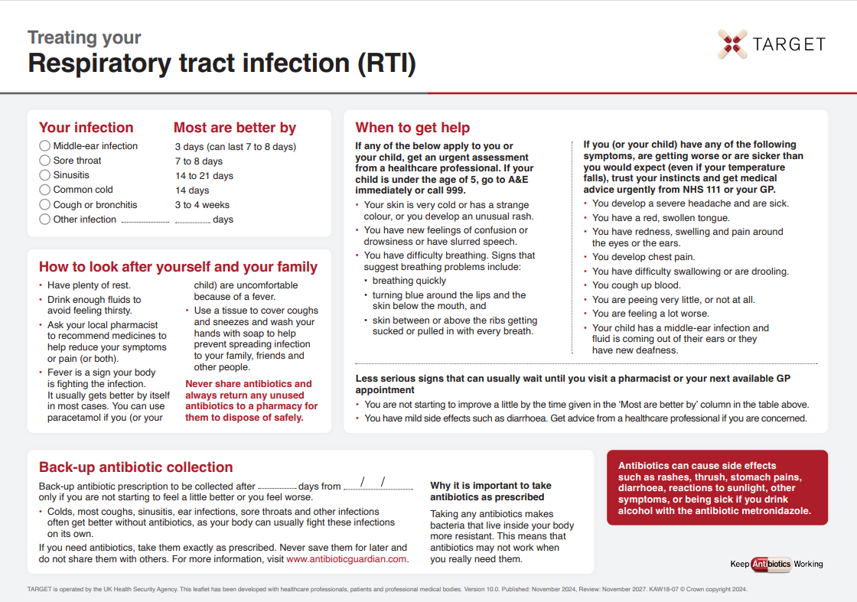
TARGET: Patient Information Leaflets
‘Most are better by’ section to help patients know when to (re) consult
Safety netting
Back-up prescription
Information about antibiotics & AMR
Last review: Feb 2023
Next review: Feb 2026
Notes:
Presenter notes
It would be useful to print off a copies of this leaflet and take enough with you for each GP. They can be found at
Leaflets to discuss with patients: How to use these leaflets (rcgp.org.uk)
Presenter Talk
It can be difficult having the to prescribe or not to prescribe discussion with patient. The treating your infection leaflet has been developed through extensive feedback with patients and clinicians over the last 2 years. It is designed to be shared with the patient and completed with them during the consultation. Its aim is to increase the patients confidence to self-care, and to facilitate the use of back-up antibiotics, but it also allows the patients to go away with something, so ending the consultation on a positive note.
All leaflets are now available in HTML format and can be sent to patients via SMS using AccuRx
Bring in ‘most get better by’ text box
The ‘usually lasts’ section allows patients to understand not only for this consultation but also others when they should consult. This section has consistently been seen as very useful by patients of all ages.
Bring in safety netting box
Whatever the infection, in this era of antibiotic resistance and with increasing numbers of elderly or vulnerable patients, it is extremely important to give some clear safety netting instructions. These are some that can be used and saved by patients.
Bring in COVID-19 box
There is information on where patients can go for more information if they are concerned about COVID-19
Bring in back-up prescription box
The back-up prescription can reduce antibiotic prescribing by about 40%, and is extremely useful for particularly demanding patients or just before a weekend to reduce visits to out of hours services. These different options are given, so that the patient understands where to pick up the leaflet, a recent study by Little et al shows that either of the options leads to similar % of antibiotics being taken, but that giving the patients the prescription and advising them when to pick the antibiotic up –leads to slightly greater patient satisfaction.
Bring in information box
Although most patients know they shouldn’t take antibiotics for coughs and colds, far fewer know that sinusitis, ear infections and sore throats and many other infections get better on their own without antibiotics.
Likewise they know little about antibiotic resistance, so we should take every opportunity to educate them.
This final statement is important – as in January 2017 16% of patients given oral antibiotics in the last year reported having some left-overs, and this was 28% of 16-24 year olds. Of those with left-overs 30% kept them for future use just in case. So take the opportunity to stress not to share antibiotics, and to return left-overs to a pharmacy.
There is a READ code for delayed/ back-up antibiotics or leaflet given and if you Read code the infections featured the leaflet with EMIS and some other systems this leaflet will appear on your computer via the patient.co.uk system.
Extra notes for presenter:
Most prescribers have access to many leaflets, both paper ones and ones that can be printed off their computer system or the web. However, not all information resources are based on the best available evidence or have been developed through rigorous processes. The Antibiotic Information Leaflet has been developed through over 24 months of literature searching, consultation, focus groups with patients and staff, drafting and revision.
Overview of the leaflet
To use this leaflet properly, it is important that clinicians use it as a tool to interact with patients, rather than just handing it to them as a ‘parting gift’. In order to communicate this effectively you must make sure that you are very familiar with its content. Please make sure that, in addition to completing this training, you take some time to thoroughly familiarise yourself with the leaflet before you start using it.
.

Slide 16
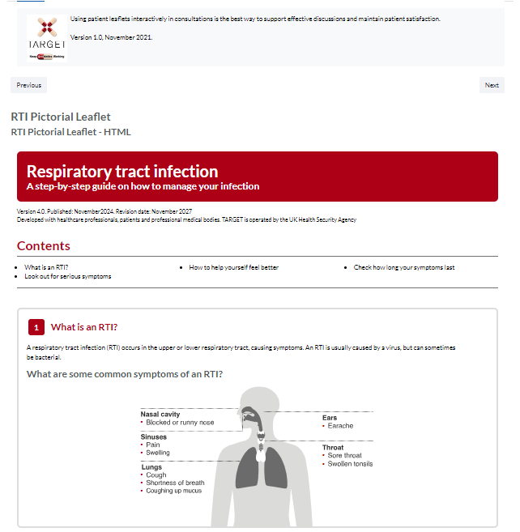
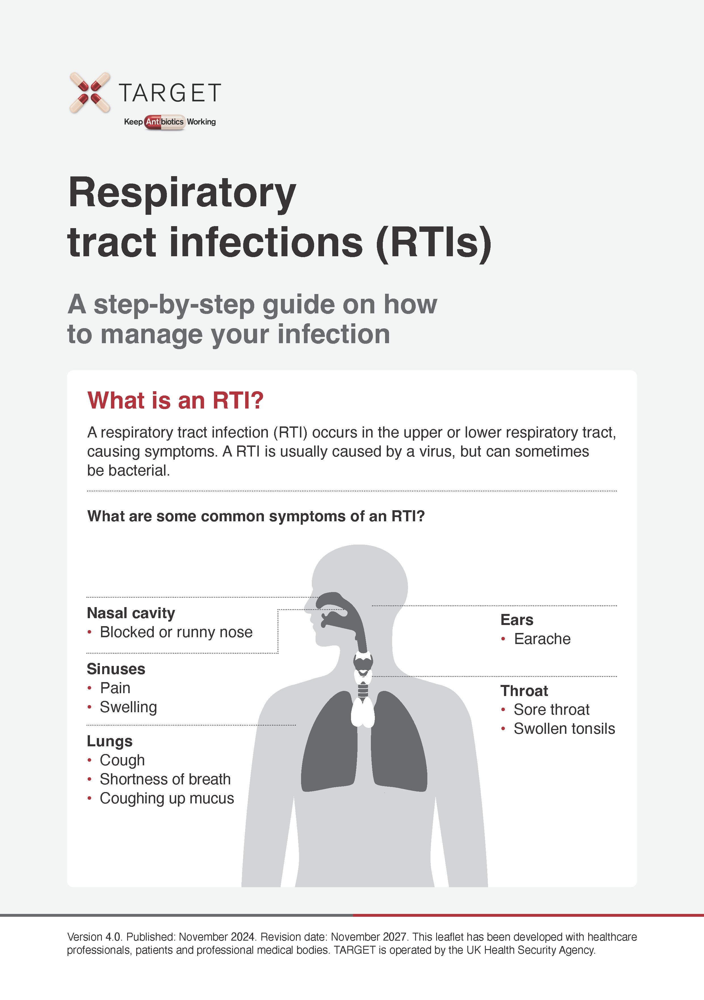
TARGET: Treating Your Infection RTI Leaflet
Pictorial leaflet
Digital leaflets
Notes:
The target RTI leaflets are available in a pictorial word/pdf version that can be printed off and used in a consultation
The standard and pictorial versions of the leaflets are also available in HTLM and can be embedded in GP system SMS templates so they can be texted or emailed after a consultation.

Slide 17

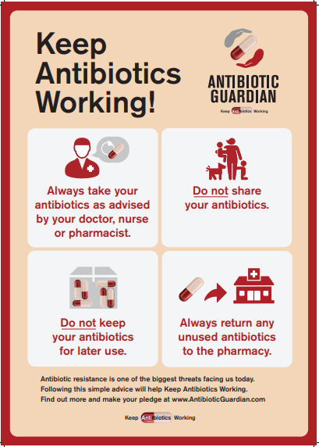
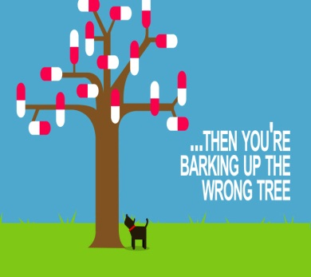
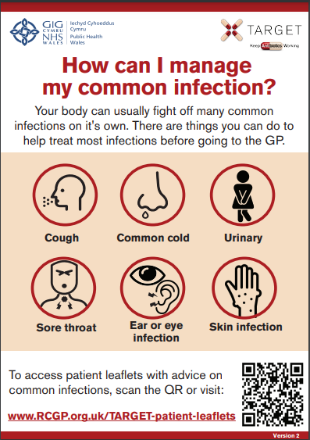
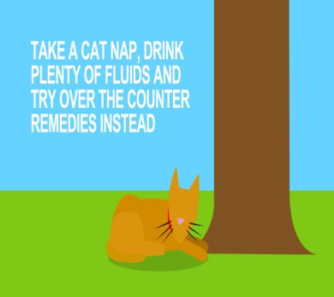

TARGET: Additional supportive tools
Posters for Display
Videos for patient waiting areas
Last review: Feb 2023
Next review: Feb 2026
Notes:
Presenter notes:
These posters and videos may make a difference to patient expectations about when to expect antibiotics, IF used in the waiting room where patients can see them and IF they have the time to digest the information. In 2014 25% of the general public surveyed remembered seeing the first poster and 95% of these correctly answered that antibiotics don’t help most coughs and colds. Used alone without any other strategies posters will make little difference to patients expectations for antibiotics, but they can be used to reduce expectations and can be used as a prompt for dialogue –
“you may have seen from the posters or videos in the waiting room that we in this practice encourage responsible antibiotic prescribing”
The videos were developed with patients and each animal cartoon video appealed to different people. A recent small survey of their use showed that those patients who saw them remembered the messages – however often the video sound was muted, chairs were pointing in the wrong direction or the video screen was off. If you intend to use them please don’t make this mistake.

Slide 18
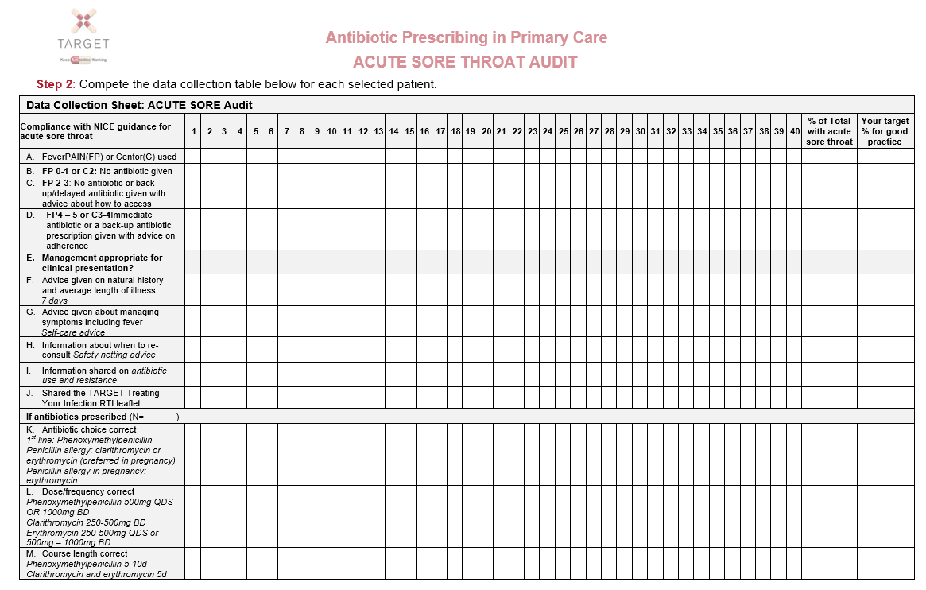
TARGET: Audits
Could your practice commit to doing an audit this year?
The TARGET website has audit templates for :
    Acute Sore Throat
    UTI
    Acute cough
    Acute otitis media
    Otitis externa
    Acute rhinosinusitis
Excel template auto calculates prescribing compliance for you!
Last review: Feb 2023
Next review: Feb 2026
Notes:
Presenter Talk
Have you done any personal or practice wide antibiotic audits in the last year?
The self-assessment check list suggests
a biannual practice wide antibiotic audit
You keep a personal action plan following audits.
Read coding facilitates audits
The TARGET website has audit templates with appropriate guidance and Read codes to use for:
Otitis media, sore throat, acute cough, UTI, otitis externa, acute rhinosinusitis.
These will also help you comply with your CPD and revalidation.

Slide 19


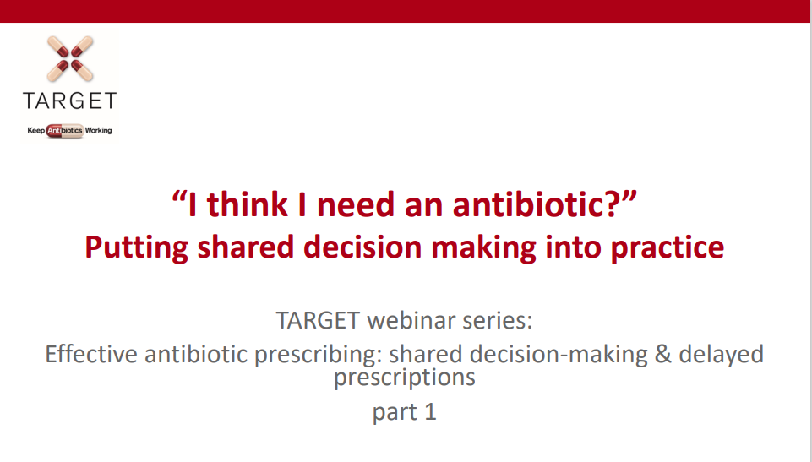
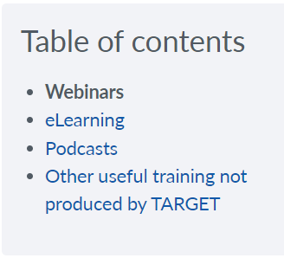
TARGET: Learning Resources
Last review: Feb 2023
Next review: Feb 2026
Notes:
Presenter notes:
These are examples of the training resources available on the TARGET antibiotics website.
You can find recordings and slides of previous TARGET and RCGP webinars in the ‘Learning resources for prescribers section’.
Many of the most recent TARGET webinars are specific to antibiotic use for RTI and UTIs and also covering topics like delayed prescribing and remote consultations.

Slide 20

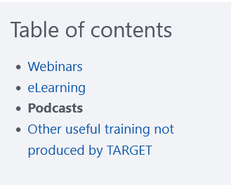
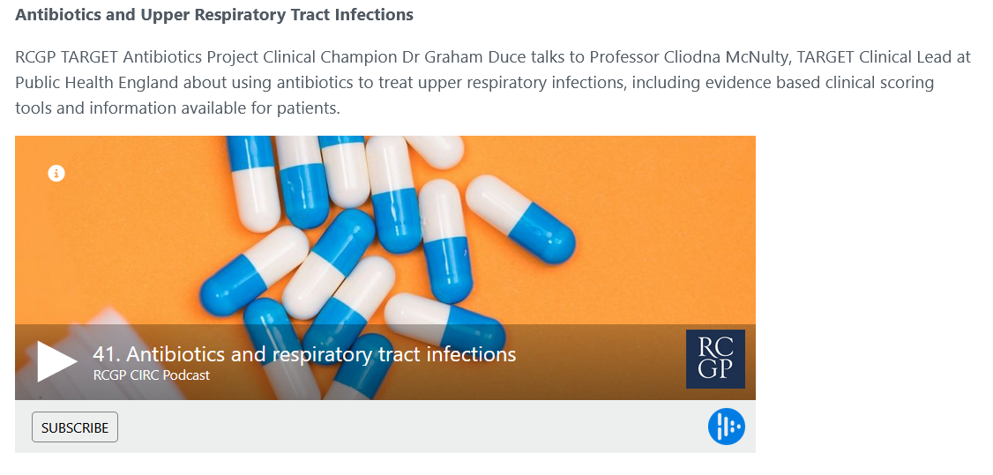
TARGET: Learning Resources
Podcasts
Last review: Feb 2023
Next review: Feb 2026
Notes:
Presenter Talk
These are examples of the training resources available on the TARGET antibiotics website.
Check out these podcasts to learn more about resistance and management for Upper respiratory tract infections.

Slide 21
Action Planning
Action planning for next 12 months: Agree What, How, Who, When
Familiarise staff with, and use FeverPAIN/Centor score
Use TARGET RTI patient leaflet in consultations
Use coded back-up/ delayed antibiotic prescribing when indicated
Set up computer reminders for leaflets and back-up antibiotics
Use delayed date on electronic prescription
Agree who will put up posters/videos in the surgery
Complete an audit of management of acute sore throat
Last review: Feb 2023
Next review: Feb 2026
Notes:
Presenter notes:
Developing a definite action plan with responsibilities will help to reduce antibiotic use in acute sore throat.
Here are some of the ideas – but how they will be taken forward needs to be discussed – this will depend on local guidance, computer clinical systems, etc
Use the Centor or Fever pain scoring system to see whom they could delay antibiotics safely in
Use the TARGET leaflets to encourage self-care
Use back-up/ delayed antibiotic prescribing: How do they want to do this? - can they issue a Electronic Prescribing System token, which allows you to print off the prescription to be picked up later from the surgery; post date the prescription for at least 24 hours. Arrange for them to not pick it up from the pharmacy for at least 24 hours.
Set up computer reminders for leaflets and back-up antibiotics – who can do this? Available on EMIS and SystmOne
Use electronic prescribing “token” and get patient to pick up later from the surgery

