Slide 1
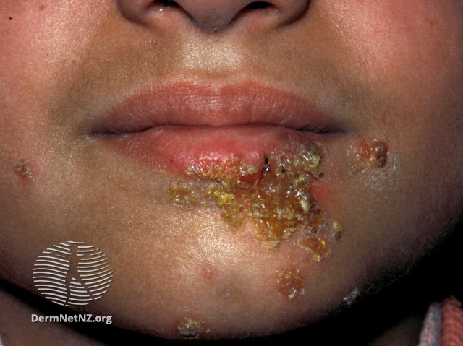
Clinical Scenario:
Impetigo
Notes:
Presenter Notes:
These cases are examples that can be printed out and discussed in pairs or groups, or with the group as a whole.
Allow the participants to discuss the case for 2 minutes and specifically ask several different people what they would do and /or prescribe.
Slide References
(1) - Image: Impetigo [Available from: https://dermnetnz.org/images/impetigo-images]

Slide 2
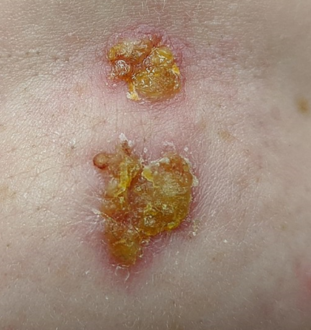
Clinical Scenario
Video call with parent:
5year old daughter
Spot on her cheek over 3 days, 50p sized area
Several other yellow crusty lesions; other spots under chin
Otherwise well, no allergies.
You diagnose impetigo (non-bullous)
James Heilman, MD
Notes:
Presenter Notes
These cases are examples that can be printed out and discussed in pairs or groups, or with the group as a whole.
Allow the participants to discuss the case for 2 minutes and specifically ask several different people what they would do and /or prescribe.
It may be useful to also change the scenario slightly- how would this change if the patient had wide-spread or bullous impetigo?
Slide References
Image: Non-bullous impetigo - James Heilman MD – Creative commons

Slide 3
Clinical Scenario
What are your treatment recommendations?
Clarithromycin (oral)
Antiseptic or hydrogen peroxide cream
Flucloxacillin
Fusidic 2% cream
TIP: if antiseptic/ hydrogen peroxide not used this time,
can suggest at onset if future lesions
Notes:
This slide is animated, the correct answer will appear on the mouse click, and click again to reveal useful tip/information.
Presenter Talk
There are two correct answers here: you could prescribe Hydrogen peroxide cream or Fusidic acid 2%.
The consideration of hydrogen peroxide is one of the biggest changes in the NICE guidance. In the next few slides we will look at the prescribing guidance in more depth and why hydrogen peroxide is now recommended (for localised non-bullous impetigo).

Slide 4
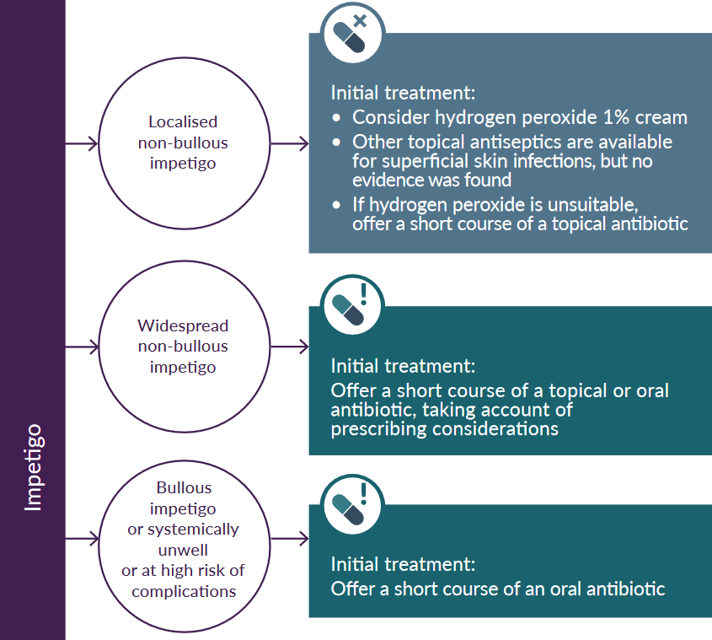
NICE Prescribing Guidelines
NG153: Impetigo: antimicrobial prescribing
Notes:
Presenter Talk
Lets first look at the NICE prescribing guidance, the first scenario highlighted with the red circle is for localised non-bullous impetigo (the same as the clinical scenario example). The guidance states to consider hydrogen peroxide or if this is unsuitable then a topical antibiotic (e.g. Fusidic 2% cream).
Hydrogen peroxide has not previously been widely used therefore the next slide will look at the evidence and practical implications.
Presenter Notes
One important note is this is a ‘consider recommendation’ (1): (NICE terminology, not as strong as “offer” see below for further info)
Further information – guideline wording
1.1.12 Consider hydrogen peroxide 1% cream for people with localised non-bullous impetigo who are not systemically unwell or at high risk of complications. Although other topical antiseptics are available for treating superficial skin infections, no evidence was found for using them to treat impetigo.
1.1.3 If hydrogen peroxide 1% cream is unsuitable, offer a short course of a topical antibiotic for people with localised non-bullous impetigo who are not systemically unwell or at high risk of complications [NICE NG153]
Further information - NICE terminology
(It is not mandatory to apply NICE recommendations, - the guideline does not override the responsibility to make decisions appropriate to the circumstances of the individual, in consultation with them and their families and carers or guardian)
Slide References
(1) NICE. Impetigo: antimicrobial prescribing [NG153], 2020. [Available from: https://www.nice.org.uk/guidance/ng153]

Slide 5
Evidence for Hydrogen peroxide use?
Topical fusidic acid 2% vs. Hydrogen peroxide cream 1% (both bd-tds for up to 21 days)
No significant difference for cure or improvement (S Koning, 2012)
Hydrogen peroxide does not lead to antimicrobial resistance
11.4% of MSSA and 22.4% of MRSA resistant to fusidic acid in 2022 (ESPAUR)
Other topical antiseptics - no studies found
Advice
Available OTC [Crystacide]
“should be prescribed on NHS ..due to high retail price”
Dry film will appear on the skin after application, can be washed off with water
Avoid contact with the eyes.
Do not use on large or deep wounds.
Do not apply to healthy skin.
Can bleach fabric
https://www.prescqipp.info/our-resources/webkits/hot-topics/
Notes:
Presenter Talk
A 2012 Cochrane Review assessed the effects of treatments for impetigo (2).
Findings highlighted that topical antibiotics were as effective as oral antibiotics for the treatment of impetigo, and that topical fusidic acid (2% twice to three times a day for up to 21 days) was not significantly different to hydrogen peroxide cream (1% twice to three times a day for up to 21 days) in children with impetigo for cure or improvement (follow-up not reported; 1 RCT, n=256, 82.0% versus 71.9%, RR 1.14, 95% CI 1.00 to 1.31; moderate quality evidence).
Nor was there any significant difference in the number of children experiencing adverse events leading to withdrawal (1 RCT, n=256, 2.3% versus 0%, RR 7.00, 95% CI 0.37 to 134.16; low quality evidence) or the number of children with mild side effects (1 RCT, n=256, 7.0% versus 10.2%, RR 0.69, 95% CI 0.31 to 1.56; low quality evidence).
It is important to highlight here that hydrogen peroxide does not lead to antibiotic resistance. The ESPAUR report 2021-2022 highlights percentage of MSSA resistant to fusidic acid as 11.2% and MRSA as 23.1% (3)
Presenter notes
The alternative topical antibiotic if resistance to fusidic acid suspected or confirmed is mupirocin
When deciding which to prescribe, some practicalities to consider are (4):
Does hydrogen peroxide bleach skin? “Whilst hydrogen peroxide can bleach darker hair and skin. The NICE committee noted that there were no warnings in the BNF or BNFC regarding skin bleaching for hydrogen peroxide. They agreed that this wasn’t likely at a 1% concentration”
Avoiding contact with eyes – hydrogen peroxide may be less appropriate choice for toddlers & v young children who may be more likely to rub into eyes
Other topical antiseptics are available for superficial skin infections, but no evidence was found for using these on impetigo.
Reasonable to encourage antiseptic or Hydrogen peroxide at onset if future lesions
Hydrogen peroxide: approx £11-14 ; NHS cost £8.07/25g (generics may become available) Fucidin cream NHS tariff £2.74 /15g
Slide References
Prescqipp. Hot Topics: Hydrogen peroxide 1% cream for impetigo. [Available from: https://www.prescqipp.info/umbraco/surface/authorisedmediasurface/index?url=%2fmedia%2f4701%2fhydrogen-peroxide-1-cream-for-impetigo-21.pdf
Koning S, van der Sande R, Verhagen AP, van Suijlekom-Smit LW, Morris AD, Butler CC, Berger M, van der Wouden JC. Interventions for impetigo. Cochrane Database Syst Rev. 2012 Jan 18;1(1):CD003261. doi: 10.1002/14651858.CD003261.pub3. PMID: 22258953; PMCID: PMC7025440.
UK Health Security Agency. English surveillance programme for antimicrobial utilisation and resistance (ESPAUR) Report 2022 to 2023.
https://www.gov.uk/government/publications/english-surveillance-programme-antimicrobialutilisation-and-resistance-espaur-report London: UK Health Security Agency, November 2023
(4) NICE. Impetigo: antimicrobial prescribing [NG153], 2020. [Available from: https://www.nice.org.uk/guidance/ng153]

Slide 6
Bullous Impetigo
NG153: Impetigo: antimicrobial prescribing
Notes:
Presenter Talk
Now on to the other types of impetigo:
To focus on the bottom circle: This is for bullous impetigo in people who are systemically unwell or at high risk of complications. The guidance here is to offer oral (or admit) as with all the common infection prescribing guidelines.
Now lets look at the prescribing considerations: next slide
Slide references
(1) NICE. Impetigo: antimicrobial prescribing [NG153], 2020. [Available from: https://www.nice.org.uk/guidance/ng153]

Slide 7
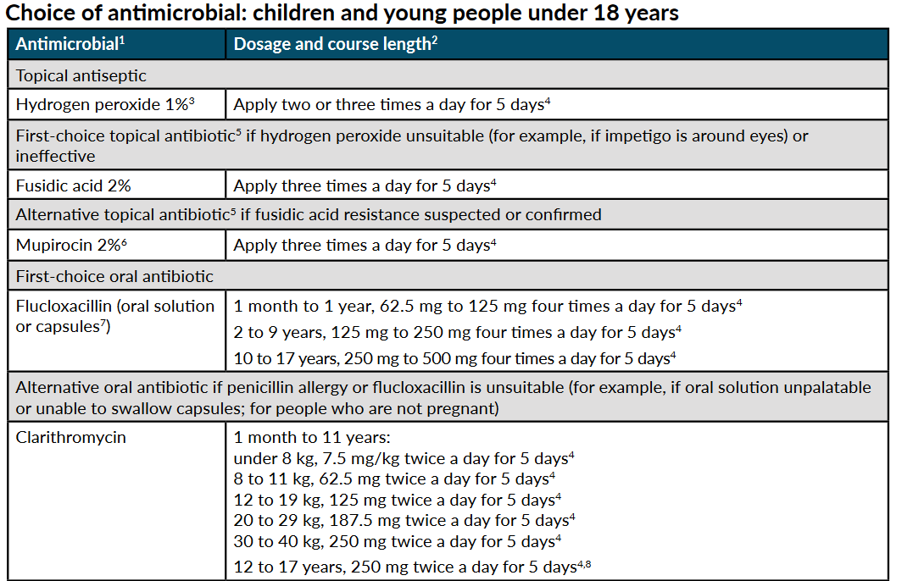
Impetigo NICE summary table
5 days
Frequent recurrence
Send a skin swab
Consider nasal swab & treatment for suppression.
(NICE NG 153, 2020)
Notes:
Presenter Talk
This slide contains the NICE guidance summary table. We can see here the first line oral antibiotic is flucloxacillin for 5 days and the alternative antibiotic is clarithromycin if penicillin allergy.
Often children are not keen on the taste of flucloxacillin suspension. If child refuses to take then can follow NICE guidance for “if flucloxacillin is unsuitable” and offer clarithromycin
Note on the slide what to do if frequent recurrence of impetigo.
We don’t go into detail on suppression or decolonisation here but further information can be found on CKS - https://cks.nice.org.uk/topics/boils-carbuncles-staphylococcal-carriage/
Presenter Notes
NICE Summary table of treatment choice.
5-day course is appropriate for most, can be increased to 7 days based on clinical judgement, depending on the severity and number of lesions
Slide References
(1) NICE (2020). "Impetigo: antimicrobial prescribing [NG153]." from https://www.nice.org.uk/guidance/ng153

Slide 8
Widespread non-bullous
NG153: Impetigo: antimicrobial prescribing
Notes:
Presenter Talk
The final type of impetigo is widespread non-bullous impetigo (middle circle). Notice the guidelines here say topical or oral antibiotic – NOT dual topical+oral
This is an important decision, that requires consideration. So how do we make the choice?
Slide References
(1) NICE. Impetigo: antimicrobial prescribing [NG153], 2020. [Available from: https://www.nice.org.uk/guidance/ng153]

Slide 9
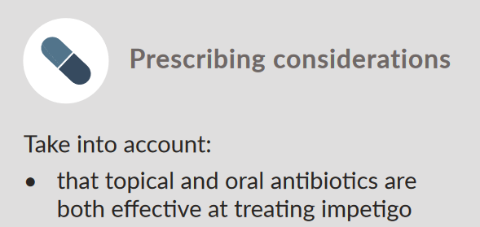



Widespread non-bullous
Topical or oral?
=
1. Consider the evidence
No statistically significant difference in effectiveness
2. Patient preference?
Topical likely less to cause side-effects
3. Effective administration?
Topical straightforward application for localised infection
AMR can develop rapidly with extended or repeated topical antibiotic
Notes:
This slide is animated, click to make red AMR text appear
Presenter talk
First we consider the evidence of the effectiveness of topical vs oral. And as previously stated, the 2012 Cochrane review highlighted no difference in outcomes between topical vs oral antibiotics.
Therefore we can factor in patient preference/side effects and the effective administration of topical antibiotics for a localised infection.
It is important to consider that AMR can develop rapidly with extended or repeated topical antibiotic – consider what the patient has been given previously
Presenter notes
Patient preference: Topical likely to cause fewer side effects, application usually straightforward for localised impetigo
Palatability & frequent dosing oral antibiotic liquids can be challenging .Paediatrician reported young children (e.g.6yrs) able to swallow tablets. Resources to support tablet swallowing https://www.medicinesforchildren.org.uk/advice-guides/general-advice-for-medicines/helping-your-child-to-swallow-tablets/ (e.g. turning head to side, not backwards)
Evidence impetigo topical vs oral effectiveness
Based on SR & MA Koning et al 2012 (1), a number of analyses found no statistically significant differences in clinical effectiveness (outcome - cure or improvement) but a large analysis was topical mupirocin vs oral erythromycin adults & children 10RCTs N=581 mod quality evidence. Another was Fucidin vs erythromycin babies lower quality evidence
ER evidence for route of administration of antibiotics for impetigo comes from 1 systematic review and meta-analysis (Koning et al. 2012), and 2 RCTs Al-Samman et al. 2014 (n=52) [IM Cef] (2) and Bowen et al. 2014 (non-inferiority trial; n=508)[cotrim vs IM.] (3).
Slide References
Koning S, van der Sande R, Verhagen AP, van Suijlekom-Smit LW, Morris AD, Butler CC, Berger M, van der Wouden JC. Interventions for impetigo. Cochrane Database Syst Rev. 2012 Jan 18;1(1):CD003261. doi: 10.1002/14651858.CD003261.pub3. PMID: 22258953; PMCID: PMC7025440.
Al-Samman, Dina K. Comparison of single-dose ceftriaxone versus seven days cefadroxil in addition to fucidic acid cream as adjuvant therapy for the treatment of children with impetigo. Pharmacie Globale. 2013;4(9).
Bowen AC, Tong SY, Andrews RM, O'Meara IM, McDonald MI, Chatfield MD, et al. Short-course oral co-trimoxazole versus intramuscular benzathine benzylpenicillin for impetigo in a highly endemic region: an open-label, randomised, controlled, non-inferiority trial. Lancet. 2014;13-19(9960):2132-40.

Slide 10
Impetigo NICE summary table
5 days
Frequent recurrence
Send a skin swab
Consider nasal swab & treatment for suppression.
(NICE NG 153, 2020)
Notes:
Presenter Talk
For widespread non-bullous impetigo, topical antibiotics include fusidic acid 2% for 5 days or mupirocin 2% if resistance to fusidic acid is suspected/confirmed
Presenter Notes
NICE Summary table of treatment choice.
5 days topical & oral . 5-day course is appropriate for most, can be increased to 7 days based on clinical judgement, depending on the severity and number of lesions
Do not offer combination topical+oral
Slide References
(1) NICE. Impetigo: antimicrobial prescribing [NG153], 2020. [Available from: https://www.nice.org.uk/guidance/ng153]

Slide 11

Infection control advice
Hygiene considerations
Wash affected areas with soap and water:
  Wash hands regularly particular after touching a patch of impetigo
  Avoid scratching affected areas
  Avoids sharing towels
  Clean potentially contaminated toys and play equipment. [CKS]
  Exclusion Criteria
  Children should be excluded from school nursery or childcare until:
  lesions are crusted and healed
  or
  48 hours after commencing antibiotic treatment [PHE]
  Food handlers are required by law to inform employers immediately if they have impetigo [CKS]
Direct patients to https://www.nhs.uk/conditions/impetigo/ for self care advice
Notes:
Presenter Talk
One thing to take particular care with is the highly infectious nature of impetigo. It is spread by direct contact with discharges from the scabs of an infected person and the bacteria invade skin through minor abrasions and then spread to other sites by scratching. Infection is spread mainly on hands, but indirect spread via toys, clothing, equipment and the environment may occur.
Because of this there is specific infection control advice. This is highlighted on the slide. For healthcare workers there should be caution especially if working with v vulnerable/ immunocompromised people. And food handlers are to report to employers immediately, according to law.
Presenter Notes
The exclusion advice will increase the enthusiasm for antibiotics vs antiseptic. Oral /topical antibiotic is not specified by UKHSA. UKHSA is not expected to alter this guidance.
Slide References
(1) UKHSA. Health protection in children and young people settings, including education 2023 [Available from: https://www.gov.uk/government/publications/health-protection-in-schools-and-other-childcare-facilities#impetigo.

Slide 12
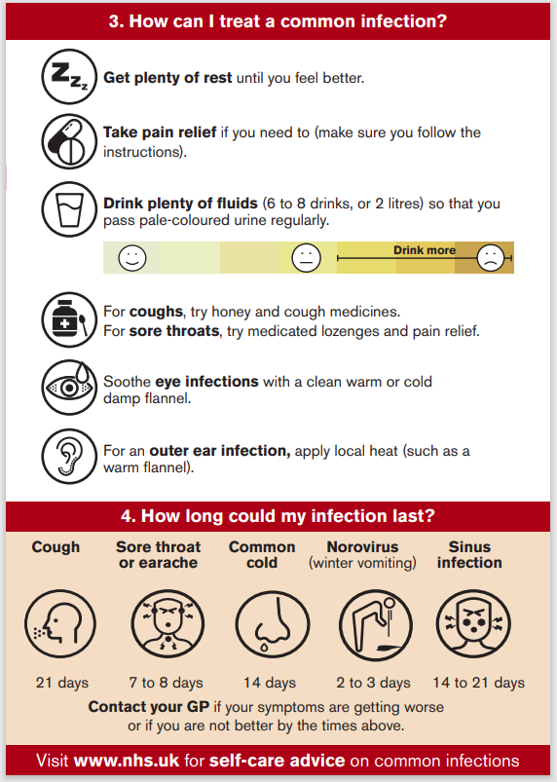
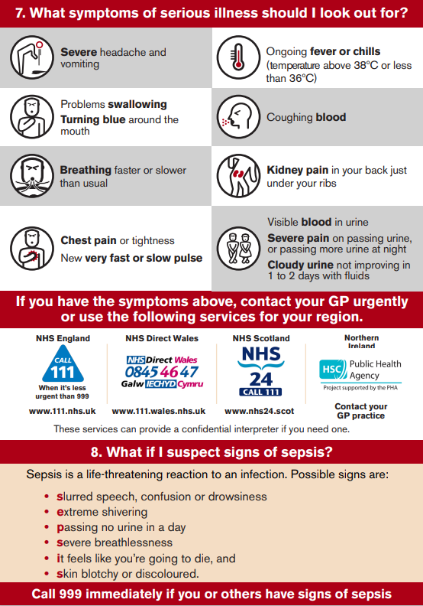
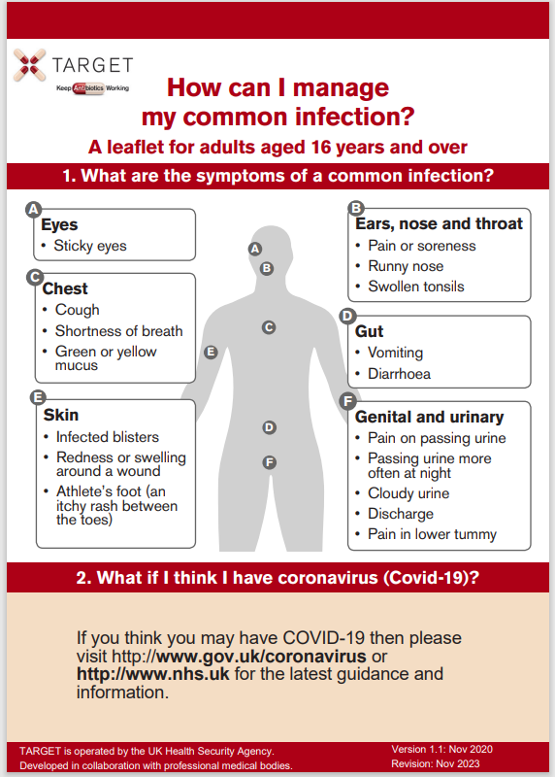
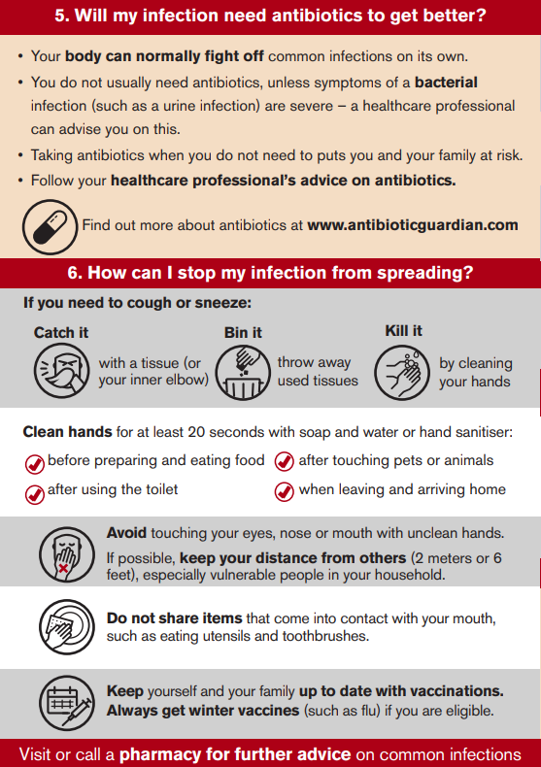
TARGET Self-care leaflet
Notes:
Presenter Notes
The Managing Your Common Infection (self-care) leaflet can be used as a tool for the public and communities to increase awareness and change behaviour around antibiotic use by increasing individuals’ confidence and knowledge on how to self-care for their own infections and subsequently reducing inappropriate antibiotic use.
What are the aims of the Managing Your Common Infection leaflet?
The leaflet aims to give information, in line with NICE 63 guidance on:
Increase awareness and change behaviour around hygiene, self-care and subsequently antibiotic use
The natural course of self-limiting infections
How people can self-care
Explicit advice when to seek medical help
Simple advice to wash their hands to reduce the spread of infection
The leaflet is found on the TARGET website in “Leaflets to discuss with patients”

Slide 13

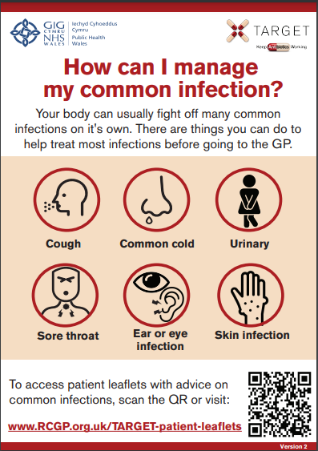
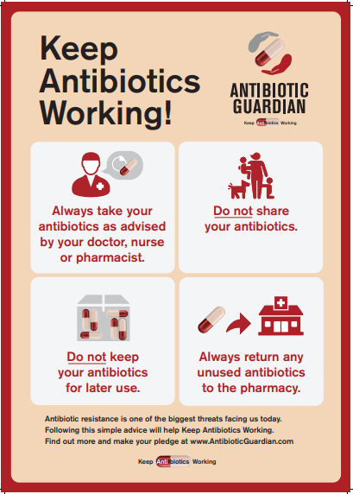



TARGET: Resources for clinical and waiting areas
Videos for patient waiting areas
Notes:
Presenter Talk
These posters and videos may make a difference to patient expectations about when to expect antibiotics, IF used in the waiting room where patients can see them and IF they have the time to digest the information. In 2014 25% of the general public surveyed remembered seeing the first poster and 95% of these correctly answered that antibiotics don’t help most coughs and colds. Used alone without any other strategies posters will make little difference to patients expectations for antibiotics, but they can be used to reduce expectations and can be used as a prompt for dialogue –
“you may have seen from the posters or videos in the waiting room that we in this practice encourage responsible antibiotic prescribing”
The videos were developed with patients and each animal cartoon video appealed to different people. A recent small survey of their use showed that those patients who saw them remembered the messages – however often the video sound was muted, chairs were pointing in the wrong direction or the video screen was off. If you intend to use them please don’t make this mistake.

Slide 14
Reduce Antibiotic Prescribing
Makes difference to resistance in your patients
Reducing antibiotic prescribing in your practice
Helps to reduce future consultations
Helps to slow future antibiotic resistance
Increase patient
self-care
Notes:
Presenter Talk:
I hope you agree that the evidence suggests that by improving the antibiotic prescribing in your practice – you can:
Make a difference to the care of individual patients.
Help to slow the development of future resistance in our community.
AND as a bonus help to increase patient self-care and reduce future consultations for self-limiting infections.

Slide 15
How can we fit together the evidence and change behaviour during consultation with our patients to improve antibiotic prescribing?
Possible solution for you
Practice
GP
Evidence
Patient
Use the TARGET antibiotics toolkit
Notes:
Presenter Notes:
So how can we fit all of this evidence together and change behaviour within the practice consultation with our patients to improve prescribing?

Slide 16
How could your practice improve antibiotic prescriptions for impetigo
✓ Evidence supportive of topical antiseptic / hydrogen peroxide
✓ Antibiotic effectiveness: topical = oral
✓ Avoid extended or repeated use of topical antibiotics – risk resistance
! For Bullous impetigo – offer oral antibiotic
Rx Treatment course 5 days for most
Important to remember infection control and self-care advice!
Notes:
Presenter Talk
To summarise the key points:
Evidence suggests no significant difference in use of hydrogen peroxide over topical antibiotics
The evidence also highlighted that topical antibiotics were as effective as oral antibiotics for the treatment of impetigo
Repeated use of topical antibiotics can lead to antimicrobial resistance
Offer an oral antibiotic for bullous impetigo
And most treatment course last 5 days for impetigo

Slide 17
Clinical Scenario Impetigo
Action Planning next 12 months
Agree actions, who, when and how:
Promote use of UKHSA/NICE or local antimicrobial / management of infection guidelines by all in practice
Undertake an audit of antibiotics for impetigo such as fusidic acid, mupirocin and flucloxacillin
Encourage use of TARGET Managing Your Common Infection (self-care) leaflet and share on clinical system.
Encourage consistent message from all staff and when patients re-attend.
Make use of TARGET toolkit.
Notes:
Presenter Notes
Here is a list of suggestions for action planning. You may wish to add any suggested by the audience

