Slide 1
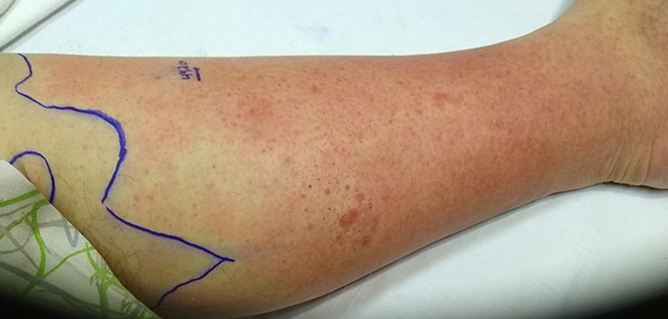
Clinical Scenario:
Cellulitis
Notes:
Presenter Notes:
These cases are examples that can be printed out and discussed in pairs or groups, or with the group as a whole.
Allow the participants to discuss the case for 2 minutes and specifically ask several different people what they would do and /or prescribe.
Slide References
(1) Image: Cellulitis – picture obtained with patient consent

Slide 2
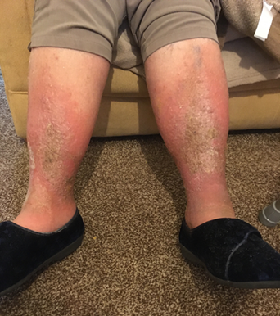
Clinical scenario 1
77 year old lady, contacted by carer:
Has inflamed, painful, swollen lower legs, out of sorts and not eating much
Says had tablets 3 months ago for this
PMHx Hypertension, osteoarthritis
Penicillin allergy
No thermometer but doesn’t feel feverish, no shivers, aches or sweats
Has a BP monitor & agrees to check obs: Pulse 98/min , BP 146/73
People with dark skin tones may present with painful swollen legs with change in colour and altered texture
Notes:
Presenter Notes
Ask the audience to consider the attached clinical scenario and possible treatment options
Note on dark skin tones, language used for cellulitis such as “redness” is not always applicable
Slide References
(1) Image: Cellulitis mimic – picture obtained with patient consent

Slide 3
Clinical scenario 1
What do you do at this point?
Prescribe clarithromycin
Prescribe co-amoxiclav
Prescribe doxycycline
None of the above
What else might it be? Chronic conditions, usually bilateral: Varicose eczema/venous insufficiency, lipodermatosclerosis lymphoedema
Heart failure
(amlodipine, felodipine)
Notes:
Answer revealed through animation, and click again for discussion point
Presenter Talk
To summarise, the question is for a 77yr-old, red painful swollen lower legs, malaise, obs normal
The answer is “None of the above” - no antibiotics at this point as uncertain diagnosis
Bilateral cellulitis is unlikely
Need further information to diagnosis
Presenter Notes
Differential Diagnosis:
Unilateral swelling – DVT, Bakers cyst , thrombophlebitis
Chronic usually bilateral but if worse on one side, it may be difficult to exclude superimposed cellulitis (if it was cellulitis doxy or clarithro ok )
Slide References
(1) Image: Cellulitis mimic – picture obtained with patient consent

Slide 4
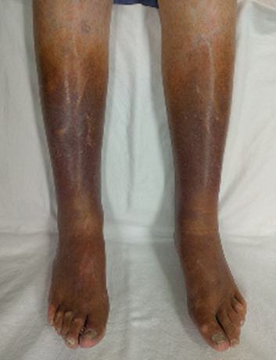
Conditions misidentified as cellulitis Venous eczema and lipodermatosclerosis
Venous skin changes can be caused by:
Venous insufficiency: due to venous valve incompetence or impaired calf muscle pump
Deep vein thrombosis: Can have unilateral presentation and be related to venous insufficiency
venous insufficiency
Examination, varying severity:
Hyperpigmentation (haemosiderin)
Venous eczema red, itchy, flaky, +/- pain, blisters, swelling
Lipodermatosclerosis from chronic inflammation and fibrosis:
Acute lipodermatosclerosis (sclerosing panniculitis) - painful inflammation above ankles
Chronic lipodermatosclerosis painful, hardened, tight, 'inverted champagne bottle
Advice:
Keep active, weight loss, leg elevation, emollient
Compression stockings (after ABPI)
Acute flares – topical corticosteroid
Notes:
This slide is animated, click for information on varying severity and click again for advice
Presenter Talk
This slide highlights conditions often misidentified for cellulitis
Self care is important and advice includes elevation, keep physically active , weight loss if high BMI
And do not use compression stocking if active cellulitis (1)
Presenter Notes
NHS website info excellent (2)
CKS varicose eczema/lipodermato (3)
DVT (4)
Venous insufficiency
Risks: Immobility, obesity, VVs, previous DVT
Symptoms: heaviness, aching, swelling, and itching, typically worse at end of day, relieved by leg elevation
DVT
Risks –previous DVT, cancer, >60yr old, obesity,
Symptoms: Unilateral localised pain, tenderness, skin changes, which include oedema, redness, and warmth, and vein distension.
Slide References
National Wound Care Strategy Programme. Recommendations for Lower Limb Ulcers. 2020. [Available from: https://www.nationalwoundcarestrategy.net/wp-content/uploads/2021/04/Lower-Limb-Recommendations-WEB-25Feb21.pdf]
NHS. Varicose eczema 2019 [Available from: https://www.nhs.uk/conditions/varicose-eczema/.
NICE CKS. Venous eczema and lipodermatosclerosis 2022 [Available from: https://cks.nice.org.uk/topics/venous-eczema-lipodermatosclerosis/.
NICE CKS. Deep vein thrombosis 2022 [Available from: https://cks.nice.org.uk/topics/deep-vein-thrombosis/.
Image: Cellulitis mimic – picture obtained with patient consent
Image: Venous Insufficiency - James Heilman MD – Creative commons

Slide 5
Clinical scenario 2
83-year old male:
A warm red swollen and painful left lower leg, and now covers a 15cm area
You notice a small abrasion on the side of his foot (he remembers he had knocked it in the garden)
O/E Temp 37.7
PMHx: Ischemic heart disease, atrial fibrillation, hypertension
Notes:
Presenter Notes
Ask the audience to consider the attached clinical scenario and possible treatment options
Slide References
(1) Image: Cellulitis – picture obtained with patient consent

Slide 6
Clinical scenario 2
Clinical scenario answer
5-7 days recommended
A longer course (up to 14 days in total) may be needed based on clinical assessment.
Skin takes time to return to normal, full resolution at 5 - 7 days is not expected.
What antibiotic course length would you give?
5 days
7 days
10 days
14 days
Notes:
This slide is animated, click to reveal answer, and click again for further information
Presenter Talk
We have established that an antibiotic will be prescribed but what course length would be appropriate?
(In this case study the patient is not diabetic)
The answer is either 5 or 7 days. However a longer course may be recommended based on clinical assessment.
Presenter Notes
Evidence for cellulitis course length, 5 – 7 days
NICE reviewed the evidence for Antibiotic course length in adults with cellulitis or erysipelas in their antimicrobial prescribing guideline NG141. The evidence for antibiotic course length in adults with cellulitis comes from 1 systematic review (Hanretty et al 2018) and 1 systematic review and meta-analysis (Kilburn et al 2010).
Slide References
(1) NICE. Cellulitis and erysipelas: antimicrobial prescribing NG141 2019 [Available from: https://www.nice.org.uk/guidance/ng141.]
(2) Hanretty, A.M. and Gallagher, J.C. (2018), Shortened Courses of Antibiotics for Bacterial Infections: A Systematic Review of Randomized Controlled Trials. Pharmacotherapy, 38: 674-687.
(3) Kilburn SA, Featherstone P, Higgins B, Brindle R. Interventions for cellulitis and erysipelas. Cochrane Database Syst Rev. 2010;2010(6):Cd004299.

Slide 7
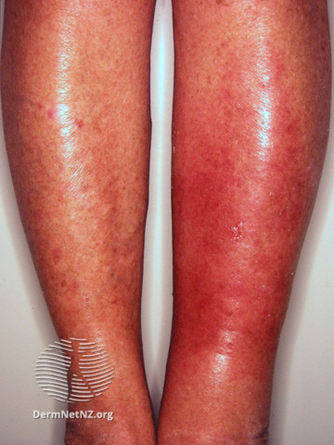
Diagnosis and risk factors
Usually unilateral. Bilateral leg cellulitis is rare.
Acute onset: red, painful, hot, swollen, and tender skin, that spreads rapidly, fever & malaise
Check for skin break/organism entry site e.g. wound/trauma, macerated skin, fungal skin infection, concomitant skin disorder
Other Risk factors & comorbidities which may complicate or delay resolution of infection:
Oedema, venous insufficiency, obesity
Diabetes
Peripheral vascular disease
Immunosuppression
See CKS for further information
Notes:
Presenter Talk
This slide is to help highlight signs and symptoms of cellulitis to aid with diagnosis and therefore appropriate antibiotic prescribing.
Also to highlight risk factors that may complicate the infection
Presenter Notes
NICE doesn’t stratify treatment according to severity. (1)
Class I — there are no signs of systemic toxicity and the person has no uncontrolled comorbidities.
Class II — the person is either systemically unwell or systemically well but with a comorbidity (for example peripheral arterial disease, chronic venous insufficiency, or morbid obesity) which may complicate or delay resolution of infection
Class III — the person has significant systemic upset, such as acute confusion, tachycardia, tachypnoea, hypotension, or unstable comorbidities that may interfere with a response to treatment, or a limb-threatening infection due to vascular compromise.
Class IV — the person has sepsis or a severe life-threatening infection, such as necrotizing fasciitis
Consider underlying comorbidities (such as diabetes mellitus) that predispose to infection
Slide References
NICE CKS. Cellulitis - acute 2023 [Available from: https://cks.nice.org.uk/topics/cellulitis-acute/.]
Image: Cellulitis [Available from: https://dermnetnz.org/image-catalogue/bacterial-skin-infection-images?stage=Live]

Slide 8
Acute complications
Necrotizing fasciitis:
Destructive, severe, rapidly progressive soft tissue infection
Involves the deep subcutaneous tissues and fascia (and occasionally muscles), which is characterized by extensive necrosis and gangrene of the skin and underlying structures.
Early symptoms – intense pain out of proportion to skin damage
Group A streptococcus is a major causative agent in Type II necrotizing fasciitis.
Rapid progression, skin discolouration , crepitus, bulla, gangrene
Refer – IV antibiotics & surgical
Myositis: inflammation of muscle due to infection.
Sepsis (potentially fatal).
Subcutaneous abscesses.
Post-streptococcal nephritis
Notes:
Presenter Talk
Here we highlight a range of acute complications of cellulitis
Slide References
NICE. Cellulitis - acute 2023 [Available from: https://cks.nice.org.uk/topics/cellulitis-acute/.]
CDC. Type II Necrotizing Fasciitis 2022 [Available from: https://www.cdc.gov/groupastrep/diseases-hcp/necrotizing-fasciitis.html#:~:text=Necrotizing%20fasciitis%20can%20affect%20any,accompanied%20by%20the%20following%20signs%3A&text=The%20pain%20experience%20by%20the,of%20the%20local%20skin%20infection.

Slide 9
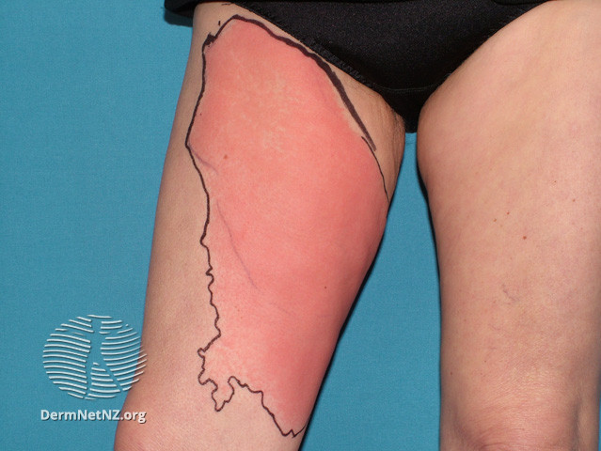
Cellulitis Management
Most common causative pathogens Streptococcus pyogenes and Staphylococcus aureus, therefore flucloxacillin first line
Consider swab if skin broken,
+ risk of uncommon pathogen.
Penetrating injury,
Exposure to water-borne organisms
Infection acquired outside UK
Consider marking extent with single-use surgical marker pen
Manage underlying conditions E.g. diabetes, venous insufficiency eczema and oedema
(calcium channel blockers)
Notes:
Presenter Talk
For management of cellulitis you can (1):
Consider swabbing if there is evidence of a penetrating injury and risk of exposure to an uncommon pathogen (water-borne or infection acquired outside of UK)
Use a surgical pen to mark the outline of the extent of infection for future comparison
Manage underlying conditions
Presenter Notes
Less common organisms include: beta haemolytic streps inc G (which can also cause necrotizing fasciitis), C occas and B, Streptococcus pneumoniae, Haemophilus influenzae, Gram negative bacilli and anaerobes
Risk for atypical organisms (2):
profound immunosuppression
animal or human bites
intravenous drug use (including skin-popping
sea or freshwater exposure (to broken skin) including pools and spas
exposure to animals, fish, or reptiles
Slide References
NICE. Cellulitis - acute 2023 [Available from: https://cks.nice.org.uk/topics/cellulitis-acute/.
Sullivan T, de Barra E. Diagnosis and management of cellulitis. Clinical Medicine. 2018;18(2):160-3.
Image: Cellulitis {Available from: https://dermnetnz.org/topics/cellulitis]

Slide 10
Cellulitis NICE summary table
(NICE NG 141, 2019)
Notes:
Presenter Talk
Here we have the NICE summary table for cellulitis antimicrobial prescribing
As previously discussed Flucloxacillin (500mg to 1g 5-7 days) is the first choice antibiotic.
But alternative first choice antibiotics if penicillin allergy include clarithromycin, erythromycin and also doxycycline
If infection is near the eyes or nose there are different recommendations with first choice as co-amoxiclav or clarithromycin with metronidazole if penicillin allergy.
Presenter Notes
Guideline rationale : “oral antibiotics should be used in preference to intravenous antibiotics where possible. Intravenous antibiotics should only
be used for people who are severely ill, unable to tolerate oral treatment, or where oral treatment would not provide adequate coverage or tissue penetration”
Remember to check the BNF for considerations if someone has renal/hepatic impairment. And consider prescribing differences for obese patients.
Slide References
NICE. Cellulitis and erysipelas: antimicrobial prescribing NG141 2019 [Available from: https://www.nice.org.uk/guidance/ng141.]

Slide 11
Safety netting advice
Advice & reassessment:
• Skin will take time to return to normal after finishing the antibiotics
• Seek medical help/reassess if:
Worsen rapidly or significantly at any time,
Or do not start to improve in 2 to 3 days
The person is very unwell, has severe pain, or redness or swelling
Admit if they have any symptoms or signs suggesting a more serious illness or condition, such as orbital cellulitis, osteomyelitis, septic arthritis, necrotising fasciitis or sepsis.
Notes:
Presenter Talk
This slide contains some safety netting advice to help with management.

Slide 12
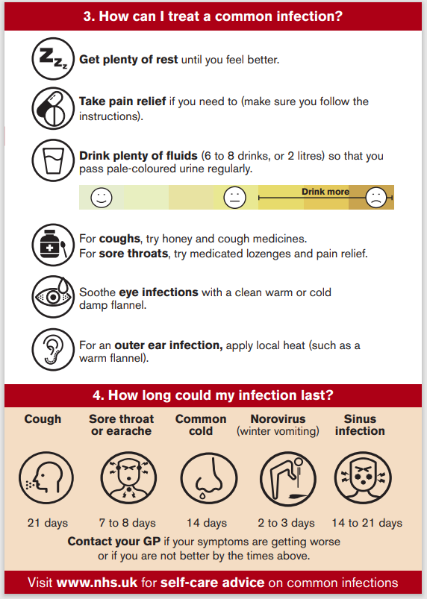
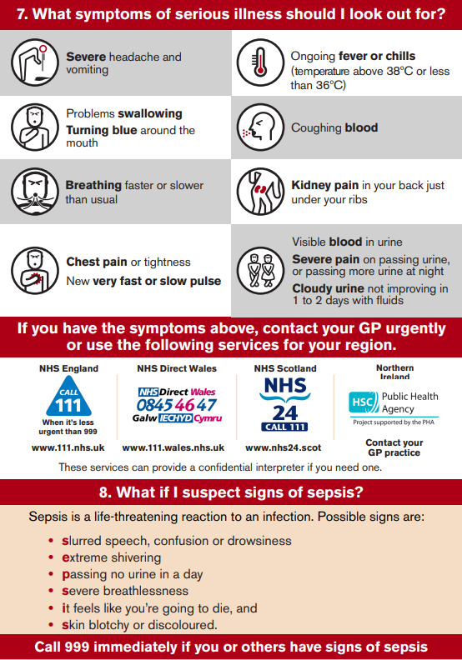
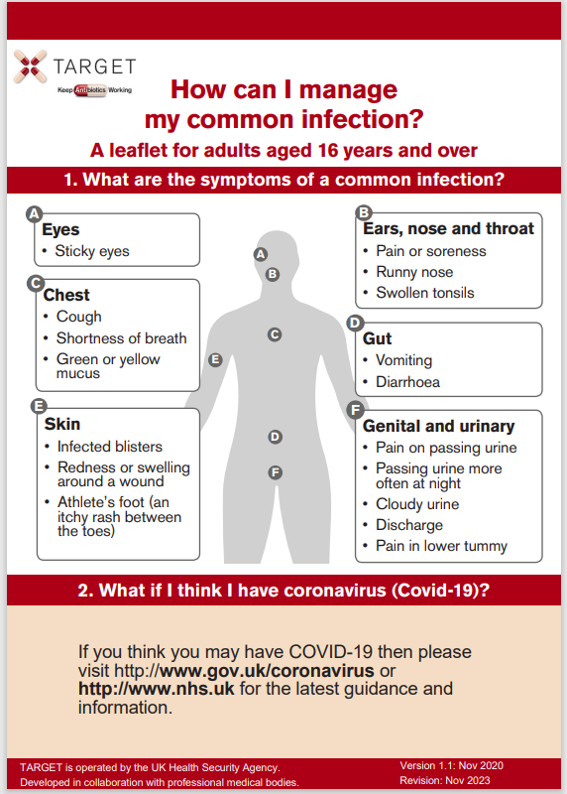
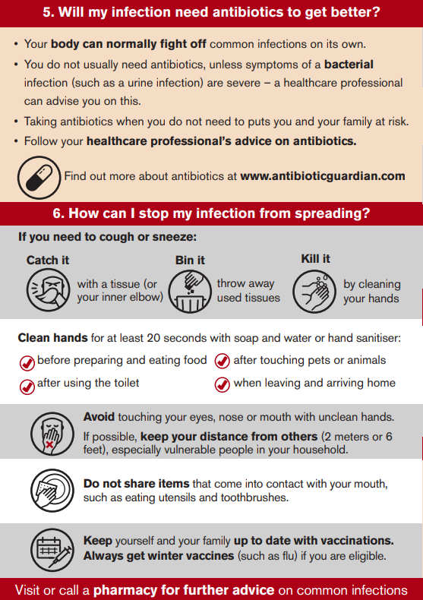
TARGET Self-care leaflet
Notes:
Presenter Notes
The Managing Your Common Infection (self-care) leaflet can be used as a tool for the public and communities to increase awareness and change behaviour around antibiotic use by increasing individuals’ confidence and knowledge on how to self-care for their own infections and subsequently reducing inappropriate antibiotic use.
What are the aims of the Managing Your Common Infection leaflet?
The leaflet aims to give information, in line with NICE 63 guidance on:
Increase awareness and change behaviour around hygiene, self-care and subsequently antibiotic use
The natural course of self-limiting infections
How people can self-care
Explicit advice when to seek medical help
Simple advice to wash their hands to reduce the spread of infection
The leaflet is found on the TARGET website in “Leaflets to discuss with patients”

Slide 13
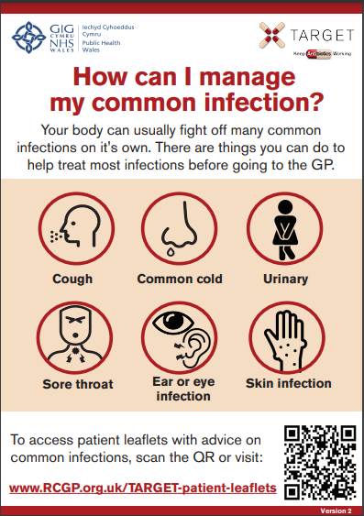
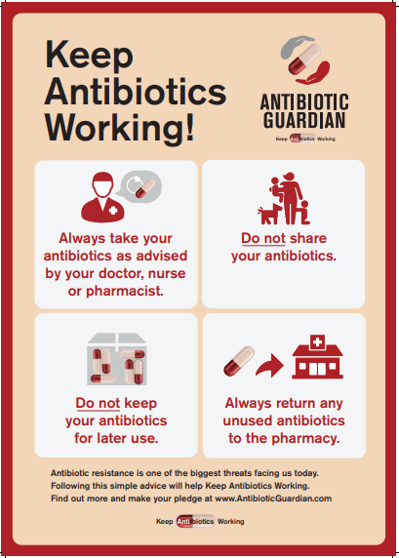
TARGET: Resources for clinical and waiting areas
Videos for patient waiting areas
Notes:
Presenter Talk
These posters and videos may make a difference to patient expectations about when to expect antibiotics, IF used in the waiting room where patients can see them and IF they have the time to digest the information. In 2014 25% of the general public surveyed remembered seeing the first poster and 95% of these correctly answered that antibiotics don’t help most coughs and colds. Used alone without any other strategies posters will make little difference to patients expectations for antibiotics, but they can be used to reduce expectations and can be used as a prompt for dialogue – “you may have seen from the posters or videos in the waiting room that we in this practice encourage responsible antibiotic prescribing”
The videos were developed with patients and each animal cartoon video appealed to different people. A recent small survey of their use showed that those patients who saw them remembered the messages – however often the video sound was muted, chairs were pointing in the wrong direction or the video screen was off. If you intend to use them please don’t make this mistake.

Slide 14
Reduce Antibiotic Prescribing
Makes difference to resistance in your patients
Reducing antibiotic prescribing in your practice
Helps to reduce future consultations
Helps to slow future antibiotic resistance
Increase patient
self-care
Notes:
Presenter Talk:
I hope you agree that the evidence suggests that by improving the antibiotic prescribing in your practice – you can:
Make a difference to the care of individual patients.
Help to slow the development of future resistance in our community.
AND as a bonus help to increase patient self-care and reduce future consultations for self-limiting infections.

Slide 15
How can we fit together the evidence and change behaviour during consultation with our patients to improve antibiotic prescribing?
Possible solution for you
Practice
GP
Evidence
Patient
Use the TARGET antibiotics toolkit
Notes:
Presenter Notes:
So how can we fit all of this evidence together and change behaviour within the practice consultation with our patients to improve prescribing?

Slide 16
How could your practice improve antibiotic prescriptions for cellulitis
✓ Exclude other causes of skin redness & oedema
✓ Look for site of entry e.g. skin break
✓ Usually affects one limb, bilateral cellulitis is rare
! Manage underlying conditions
Rx First line - flucloxacillin (500mg/1g), 4 times a day, 5-7 days (up to 14 days)
Give prevention advice and advise that skin takes some time to return to normal after antibiotics finished
Notes:
Presenter Talk
To summarise the key points:
- Exclude other causes of skin redness & oedema
- Look for site of entry e.g. skin break
- Usually affects one limb, bilateral cellulitis is rare
- It is important to manage underlying conditions
- And the first line antibiotic is flucloxacillin (500mg/1g), 4 times a day, 5-7 days (up to 14 days)
Presenter Notes
Possible discussion points:
In your experience do people get repeated courses of antibiotic for cellulitis
Study BJGP by Teasdale (1) found approx. 2/3 people surveyed reported receiving no information about cause or prevention of recurrence. (also important to name condition)
Slide References
Teasdale E, Lalonde A, Muller I, Chalmers J, Smart P, Hooper J, et al. Patients’ understanding of cellulitis and their information needs: a mixed-methods study in primary and secondary care. British Journal of General Practice. 2019;69(681):e279-e86.
Image: Cellulitis {Available from: https://dermnetnz.org/topics/cellulitis]

Slide 17
Clinical Scenario Cellulitis Action Planning next 12 months
Agree actions, who, when and how:
Promote use of UKHSA/NICE or local antimicrobial / management of infection guidelines by all in practice
Undertake an audit of antibiotics for cellulitis such as flucloxacillin and co-amoxiclav
Encourage use of TARGET Managing Your Common Infection (self-care) leaflet and share on clinical system.
Encourage consistent message from different staff and when patients re-attend.
Make use of TARGET toolkit.
Notes:
Presenter Notes
Here is a list of suggestions for action planning. You may wish to add any suggested by the audience

