Slide 1
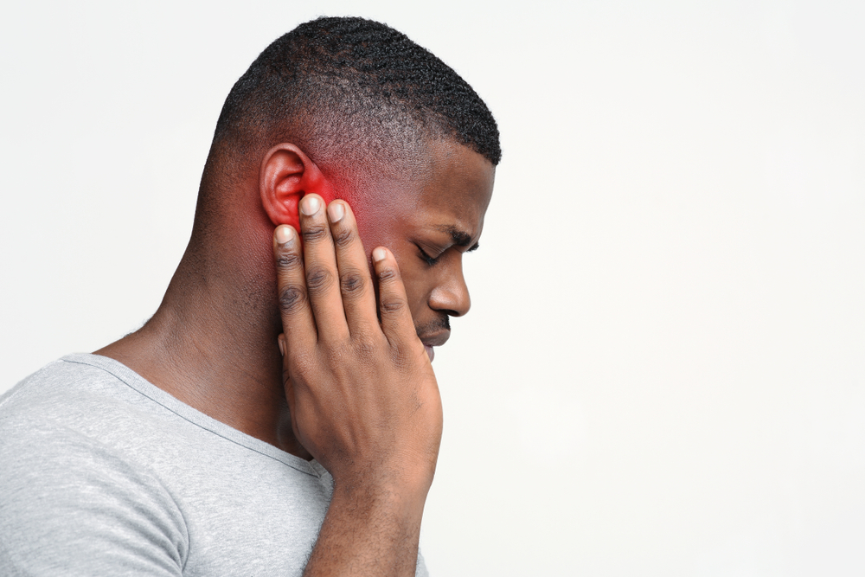
Clinical scenario:
Acute Otitis Media
Clinical Scenario
Acute Otitis Media
www.rcgp.org.uk/TARGETantibiotics

Slide 2

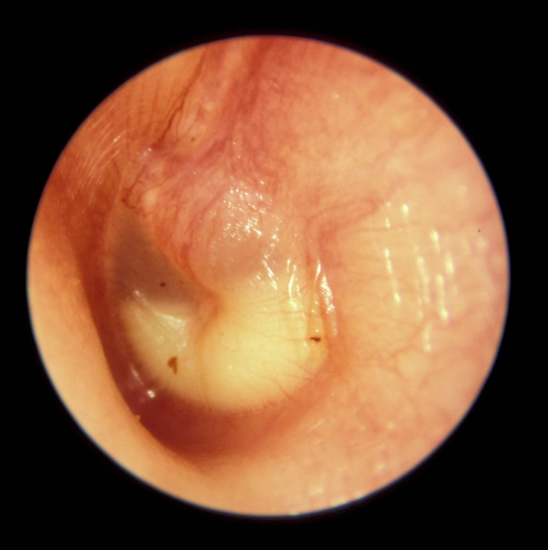
Clinical scenario:
Acute Otitis Media
Clinical Scenario
Acute Otitis Media
Consider the following details:
5 year old boy screaming with pain in left ear.
No history of fever, temp 37.4°C.
Not vomiting.
Paracetamol helps but pain returns before next dose due.
Had AOM this time last year.
Right ear drum bulging and red.
Had antibiotics last time and mother very keen to have antibiotics again.
www.rcgp.org.uk/TARGETantibiotics
Notes:
These cases are examples that can be printed out and discussed in pairs or groups, or with the group as a whole.
Presenter talk/notes:
So what about this case of AOM?
What does the evidence show? Most importantly 60% of AOM resolve in 24 h without antibiotics,
Furthermore antibiotics only reduce pain at 2 days when most would have already resolved with Number Needed To Treat (NNT) of 15
Antibiotics do not prevent deafness
Consider 2 or 3-day delayed or immediate antibiotics for pain relief if:
<2 years AND bilateral AOM (NNT4) or bulging membrane & ≥ 4 marked symptoms
All ages with otorrhoea NNT3
Therefore in this situation antibiotics are unlikely to be beneficial
Evidence
Rovers MM, Glasziou P, Appleman CL, Burke P, McCormick DP, Damoiseaux RA, Little P, Le Saux N, Hoes AW. Predictors of pain and/or fever at 3 to 7 days for children with acute otitis media not treated initially with antibiotics: a meta-analysis of individual patient data. Pediatrics 2007;119(3):579-85
RATIONALE: The risk of prolonged illness was 2 times higher for children <2years with bilateral AOM than for children with unilateral AOM. For this sub-group parents should be advised that symptoms may persist for up to 7 days, and they should optimise analgesia use.
The protective immunity against infections with encapsulated bacteria, such as the species that cause AOM, depends on the ability to produce specific antibodies against bacterial capsular polysaccharides, which is inadequate until 2 years of age. The anatomic features of the eustachian tubes and the nasopharynx also differ with age. Consequently, children under 2 years of age seem to be more susceptible to AOM.

Slide 3
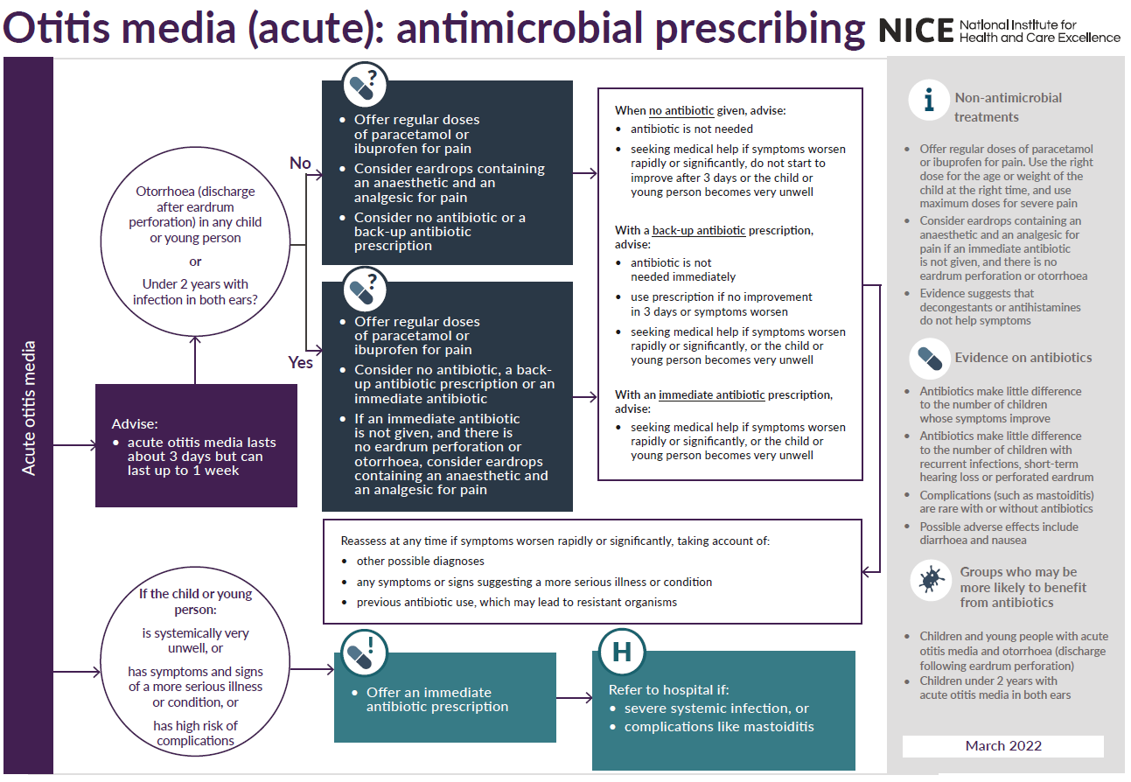
Clinical Scenario
Acute Otitis Media
www.rcgp.org.uk/TARGETantibiotics
NG91: Otitis Media (acute): antimicrobial prescribing
Notes:
Presenter notes:
This is an example of the NICE antimicrobial prescribing guidance. Please check to see if there are local modifications that have been made through your ICB
OM resolves in 60% in 24 h without antibiotics, which only reduce pain at 2 days (NNT15) and does not prevent deafness
If systemically very unwell, has signs and symptoms of a serious illness or high risk of complications – offer an immediate antibiotic or refer to hospital (click once to bring in larger font and again to get rid of larger font)
Consider 2 or 3-day delayed or immediate antibiotics for pain relief if: (click once to bring in larger font and again to get rid of larger font)
<2 years AND bilateral AOM
OR
Otorrhoea (discharge from eardrum) in any child our young person
(NEW) Consider Phenazone 40 mg/g with lidocaine 10 mg/g drops if immediate antibiotic is not given and there is no ear drum perforation or otorrhoea
If providing no antibiotic or back up prescription advise to seek medical help (or take back-up prescription) if no improvement in 3 days.
Advise to seek medical help if child/young person becomes very unwell.
Notes/References:
Optimise analgesia:
Little P, Gould C, Williamson I, Moore M, Warner G, Dunleavey J. Pragmatic randomised controlled trial of two prescribing strategies for childhood acute otitis media. BMJ. 2001 Feb; 322(7282):336-342. Available from: http://www.ncbi.nlm.nih.gov/pmc/articles/PMC26576/.
RATIONALE: A randomised controlled trial of 315 children aged between six months and ten years presenting with acute otitis media. Two important observations were noted: parents tend to underestimate the amount of analgesia they have administered, and when recommending a no antibiotic strategy, it is all the more important to optimise analgesia.
Little effect of antibiotics:
Venekamp RP, Sanders S, Glasziou PP, Del Mar CB, Rovers MM. Antibiotics for acute otitis media in children. Cochrane Database Syst Rev. 2015;23:1-85. http://onlinelibrary.wiley.com/doi/10.1002/14651858.CD000219.pub4/epdf.
A systematic review, revealing that antibiotics have no early effect on pain, a slight effect on pain in the days following, and only a modest effect on the number of children with tympanic perforations, contralateral otitis episodes, and abnormal tympanometry findings (at two to four weeks, and six to eight weeks) compared with placebo in children with acute otitis media. In high-income countries, most cases of acute otitis media spontaneously remit without complications. The authors conclude that the benefits of antibiotics must be weighed against the possible harms, eg for every 14 children treated with antibiotics, one child had an adverse event (vomiting; diarrhoea; rash) that would not have occurred if antibiotics not given.
Why under 2 years? The protective immunity against infections with encapsulated bacteria, such as the species that cause AOM, depends on the ability to produce specific antibodies against bacterial capsular polysaccharides, which is inadequate until 2 years of age. The anatomic features of the eustachian tubes and the nasopharynx also differ with age. Consequently, children under 2 years of age seem to be more susceptible to AOM.
The evidence for treating those with more severe symptoms comes from: Rovers MM, Glasziou P, Appleman CL, Burke P, McCormick DP, Damoiseaux RA, Little P, Le Saux N, Hoes AW. Predictors of pain and/or fever at 3 to 7 days for children with acute otitis media not treated initially with antibiotics: a meta-analysis of individual patient data. Pediatrics 2007;119:579-85 RATIONALE: The risk of prolonged illness was 2 times higher for children <2years with bilateral AOM than for children with unilateral AOM. For this sub-group parents should be advised that symptoms may persist for up to 7 days, and they should optimise analgesia use.

Slide 4
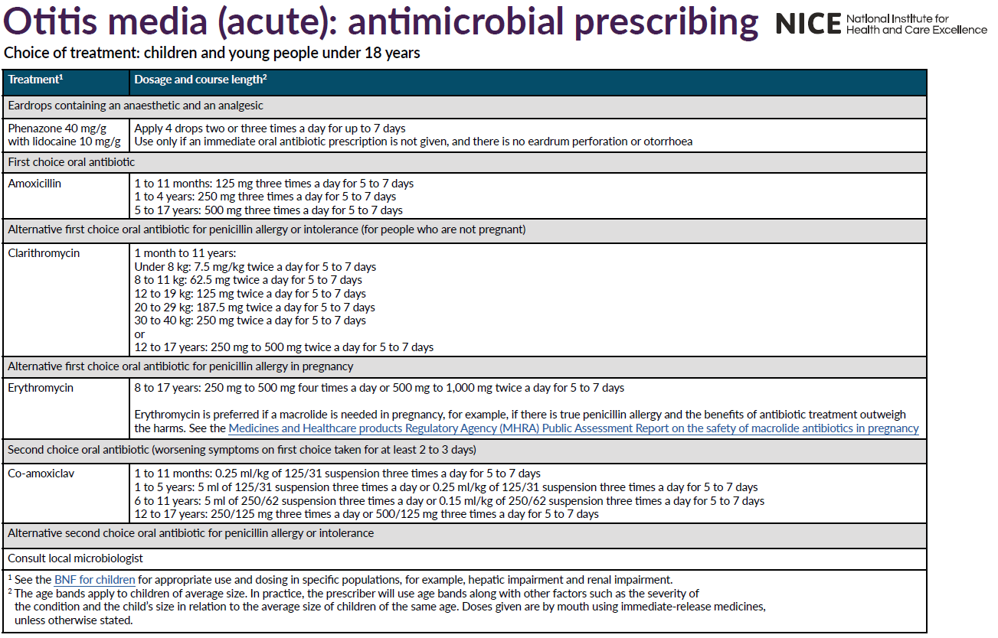
NG91: Otitis Media (acute): antimicrobial prescribing
Clinical Scenario
Acute Otitis Media
Notes:
Presenter talk:
Refer to the different prescribing options in the NICE guidance.
NEW: Phenazone/Lidocaine drops – only if antibiotics not given and there is no eardrum perforation or otorrhea
First line: Amoxicillin
Alternative if PCN allergy or intolerance (if not pregnant): clarithromycin
If PCN allergy and pregnant: Erythromycin
Save Co-amoxiclav for second choice oral if worsening symptoms after first choice taken for at least 2-3 days

Slide 5
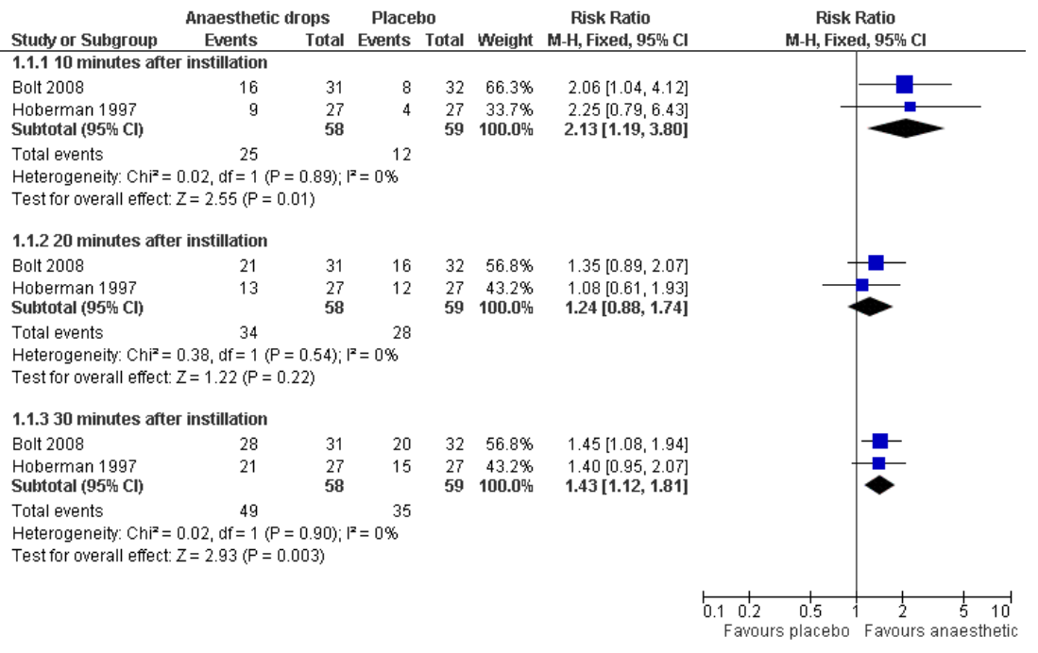
Topical analgesia for acute otitis media
Clinical Scenario
Acute Otitis Media
Anaesthetic versus placebo showed 50%/30% reduction in ear pain 10/30 min after administration
Foxlee et al. Cochrane. (2006) CD005657
Notes:
Presenter talk (only include if additional information useful to target audience):
Acute Otitis media prescribing guidance was updated by NICE in March 2022 as a licensed preparation of ear drops containing an anaesthetic and an analgesic is now available in the UK.
Guidance allows for the provision of anaesthetic drops with back-up prescription and if no ear drum perforation/otorrhoea.
Meta-analysis of five trials (391 participants); two compared anaesthetic drops to placebo (inactive) drops; and three compared anaesthetic drops to herbal ear drops.
Findings in this forest plot show (click for animation) the statistically significant difference in the proportion of children achieving a 50% reduction in pain in favour of anaesthetic drops 10 minutes after instillation (risk ratio (RR) 2.13, 95% confidence interval (CI) 1.19 to3.80) and 30 minutes after instillation (RR 1.43, 95% CI 1.12 to 1.81) on the day AOM was diagnosed.
Data indicates that analgesic ear drops may be helpful in treating the pain associated with AOM in children. Ear pain diminishes rapidly for most sufferers and itis likely that the concomitant administration of oral analgesics aids this process. Nevertheless, this review indicates that topical analgesia offers an effective and accessible treatment option for children with AOM.
Reference:
Foxlee R, Johansson AC, Wejfalk J, Dooley L, Del Mar CB. Topical analgesia for acute otitis media. Cochrane Database of Systematic Reviews 2006, Issue 3. Art. No.: CD005657. DOI: 10.1002/14651858.CD005657.pub2.
https://www.ncbi.nlm.nih.gov/pmc/articles/PMC9006341/pdf/CD005657.pdf

Slide 6
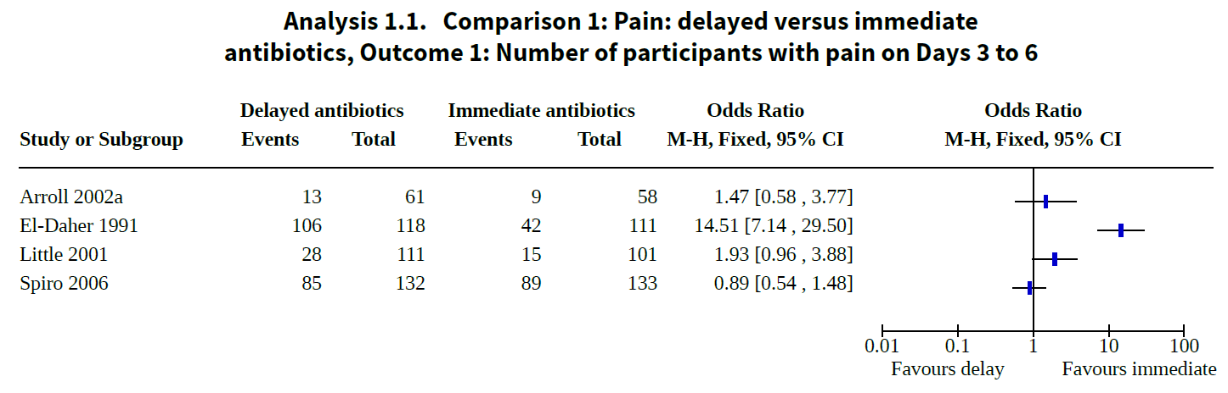
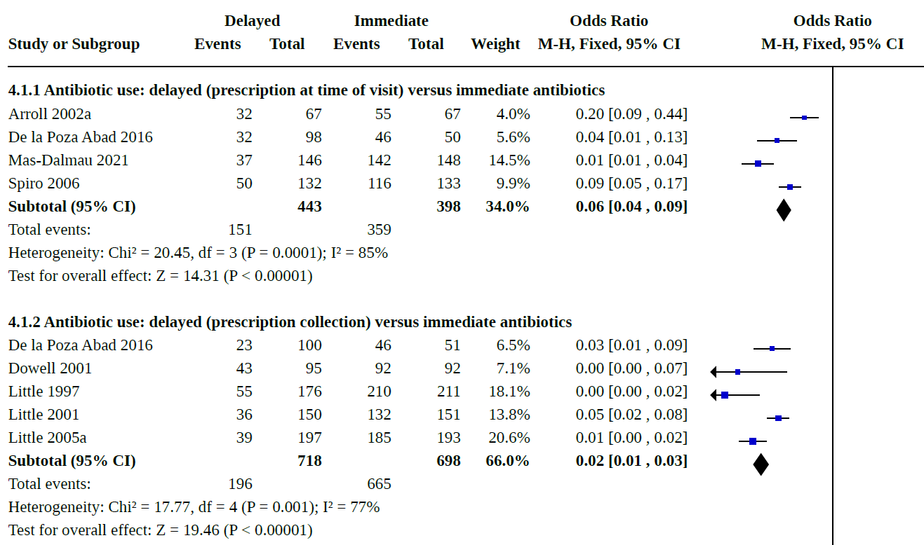
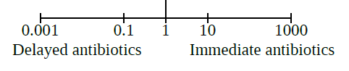
Resolution of symptoms and antibiotic use when comparing immediate vs delayed antibiotic for AOM
Venekamp et al (2015): No significant difference in pain at 3-7 days, membrane perforation or recurrence
Spurling et al. Cochrane (2017) CD004417
Venekamp et al. Cochrane (2015) CD000219
Notes:
Presenter Notes:
NICE recommendations for delayed prescribing for AOM is based on evidence from 2 reviews (Spurling et al 2017 and Venekamp et al 2015)
Presenter Talk:
The first two graphs are from the Spurling review.
According to a study conducted by Little et al in 2001, on average symptoms of AOM resolved after 3 days
Three RCTs were included in a review done by Spurling et al. (2017) which compared back-up antibiotics with no antibiotic prescription and immediate antibiotics for acute otitis media (click for animation).
In figure 1.1 we can see where two studies showed no significant differences between back up and immediate antibiotics for the outcomes of pain on day 3 (OR 1.93, 95% CI 0.96 to 3.88), days 4 to 6 (0.89, 95% CI 0.54 to 1.48)
In figure 4.1 we see the findings from a study in this review also found significantly lower antibiotic use with back-up antibiotics compared with immediate antibiotics, (click for next animation) both when the back-up prescription was given at the time of consultation (Spiro 2006 - OR 0.09, 95% CI 0.05 to 0.17) and when the prescription had to be collected at a separate visit (OR 0.05, 95% CI 0.02 to 0.08).
This review did find significantly more OTC pain relief used with back-up antibiotics compared with immediate antibiotics. ( About ½ a spoonful more per day)
Another review by Venekamp et al (2015) also found no significant difference between antibiotic vs. watchful waiting/delayed prescribing for pain at 3-7 or 11-14 days. There were also no significant differences between groups for abnormal tympanometry at 4 weeks, tympanic membrane perforation, recurrence of acute otitis media or parent-reported ear pain episodes at 1 year after randomisation (very low to moderate quality evidence).
Additional information:
Spurling et al. also found that there was no significant difference between groups in re-consultation rates. However, patient satisfaction was significantly lower with back-up antibiotics when participants had to return for a prescription, compared with immediate antibiotics (OR 0.32, 95%CI 0.16 to 0.65). Highlighting the need to explain the use and rationale behind the use of delayed antibiotics to patients.
References:
Little P, Gould C, Williamson I, Moore M, Warner G, Dunleavey J. Pragmatic randomised controlled trial of two prescribing strategies for childhood acute otitis media. BMJ. 2001 Feb 10;322(7282):336-42. doi: 10.1136/bmj.322.7282.336. PMID: 11159657; PMCID: PMC26576.
https://www.ncbi.nlm.nih.gov/pmc/articles/PMC26576/pdf/336.pdf
Spurling GKP, Del Mar CB, Dooley L, Clark J, Askew DA. Delayed antibiotic prescriptions for respiratory infections. Cochrane Database of Systematic Reviews 2017, Issue 9. Art. No.: CD00441
https://www.cochranelibrary.com/cdsr/doi/10.1002/14651858.CD004417.pub5/epdf/full
Venekamp RP, Sanders SL, Glasziou PP, Del Mar CB, Rovers MM. Antibiotics for acute otitis media in children. Cochrane Database Syst Rev. 2015 Jun 23;2015(6):CD000219. doi: 10.1002/14651858.CD000219.pub4. PMID: 26099233; PMCID: PMC7043305.
https://www.cochranelibrary.com/cdsr/doi/10.1002/14651858.CD000219.pub4/full

Slide 7
Perceptions towards antibiotics remain relatively unchanged
% true
Antibiotics work for ….
2022 | 2021 | 2020
78% | 80% | 68%
16% | 14% | -
24% | 28% | -
= significantly higher/lower than previous year
Base: All adults aged 18+ in England: 2022 (1663), 2021 (1676); 2020 (2052) :
Notes:
Presenter talk:
Throughout the COVID pandemic the UKHSA Primary Care and Interventions Unit carried out an annual survey of the general public’s health seeking behaviours and attitudes and behaviours towards antibiotics facilitated by Ipsos mori marketing research. All data was collected in Feb/Mar of years highlighted in this figure and respondents were asked about their behaviour in the previous 12 months – therefore 2020 respondents were asked about their behaviour in the 12 months BEFORE the first English national lockdown.
Data from 2022 indicates that perceptions towards the usefulness of antibiotics remain relatively unchanged
This slide shows us data from participants response to whether they agreed or disagreed with several statements about antibiotic use and their effectiveness for different conditions.
Most participants agree that antibiotics work for the majority of infections related to the ear (78%) which is a similar figures to those seen in 2021, but significantly higher than in 2020.
The finding on this slide showcase the large gap in public perceptions about antibiotic use for ear infections compared to Cold/Flu/COVID, highlighting the scope for improvement.
Slide References
(1) Manuscript out for publication

Slide 8
Awareness of delayed/back up prescribing has increased but is still low
Clinical Scenario
Acute Otitis Media
Y2 COVID-19
Y1 COVID-19
Pre COVID-19
Awareness of delayed prescribing has increased
Last review: Feb 2023
Next review: Feb 2026
Base: All adults aged 18+ in England: 2022 (1663), 2021 (1676); 2020 (2052) :
Notes:
Presenter talk
When we look at the publics awareness of delayed antibiotics we see an interesting picture building. There seemed to be an increased awareness of delayed prescribing during the first year of the pandemic, with a significant increase in the percentage of people who said they were fully aware of what an antibiotic was (darkest blue section) – and this remained constant in 2022. On the other hand, those who said they were not aware of delayed prescribing (lighter blue section) initially decreased in 2021 only to rise again tin 2022 – but to pre pandemic levels.
Take home message: Awareness of delayed prescribing has increased but is starting to decrease – almost 70% of the population are not aware of what a delayed prescription is.
Slide References
(1) Manuscript out for publication

Slide 9
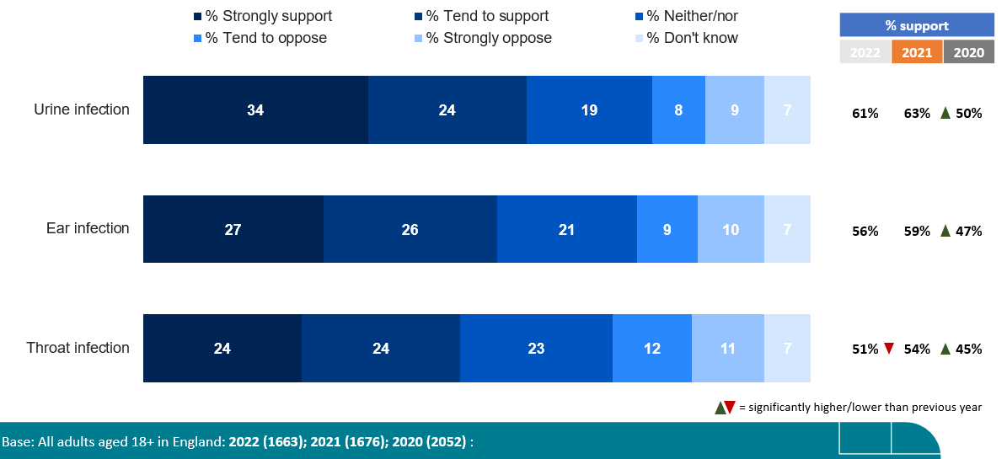

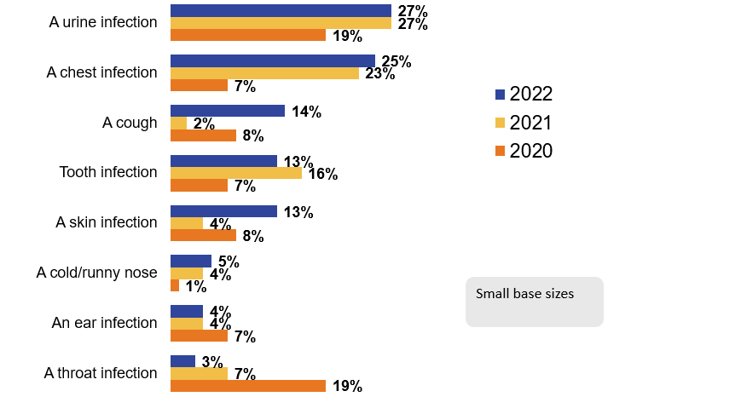
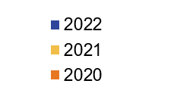
Public acceptance for delayed/back up prescribing is increasing
Clinical Scenario
Acute Otitis Media
Attitudes towards delayed antibiotics for ear infection
= significantly higher/lower than previous year
Use of delayed antibiotics – 3% of population*
*SMALL BASE: All adults aged 18+ in England who in the last 12 months have been given a delayed or back-up antibiotic prescription : 2022 (47); 2021 (46); 2020 (82) :
Last review: Feb 2023
Next review: Feb 2026
Base: All adults aged 18+ in England: 2022 (1663), 2021 (1676); 2020 (2052); 2017 (1691)
Notes:
Presenter talk
In the same study, when we look at public attitudes towards delayed prescribing for otitis media and we see that more of the public are in favour of a delayed script for a otitis media than in 2020 so acceptance has increased (56/59% in 22/21 compared to 47% in 2020)
In contrast, In the 2022, only 4% of the population (out of 47 people in the survey) actually received a delayed antibiotic prescription for otitis media, the same proportion as in 2021. What is perhaps unsurprising, is that the numbers of delayed scripts for sore throats decreased during COVID – possibly because sore throat consultations also reduced.
This showed that for acute otitis media, the public are generally in favour of delayed prescribing but that rates have gone down – indicating it could be used more in primary care settings
Slide References
(1) Manuscript out for publication

Slide 10
How to give back-up/delayed antibiotics?
889 UK GP patients > 3 years with acute respiratory tract infection
Last review: Feb 2023
Next review: Feb 2026
Little BMJ 2014
Notes:
Presenter Talk
Which way should we give back-up antibiotics?
This 2014 trial by Little et al in UK general practice indicates it doesn’t really matter. Patients judged not to need immediate antibiotics were randomised to undergo four strategies of delayed prescription: recontact for a prescription, post-dated prescription, collection of the prescription, and be given the prescription (patient led). During the trial, a strategy of no antibiotic prescription was added as another randomised comparison. Patients had similar symptom severity scores. Each of the strategies resulted in similar antibiotic use, belief in antibiotics and satisfaction, although patient led pick up had slightly greater satisfaction and use and less belief – but neither were significant.
That being said UK STEP UP team examined Public preferences for delayed or immediate antibiotic prescriptions in UK primary care using A choice experiment. Their findings suggest that prescribing choices for sore throat may need additional explanation to ensure patient acceptance, and parents in particular may benefit from reassurance about the usual duration of these illnesses.
So do what works for your practice, your way of working and of course the day of the week.
Slide References
Paul Little, Michael Moore, Jo Kelly, et al Delayed antibiotic prescribing strategies for respiratory tract infections in primary care: pragmatic, factorial, randomised controlled trial. BMJ 2014; 348 doi: https://doi.org/10.1136/bmj.g1606
Morrell L, et al; STEPUP team. Public preferences for delayed or immediate antibiotic prescriptions in UK primary care: A choice experiment. PLoS Med. 2021 Aug 30;18(8):e1003737. doi: 10.1371/journal.pmed.1003737. PMID: 34460825; PMCID: PMC8439451.

Slide 11
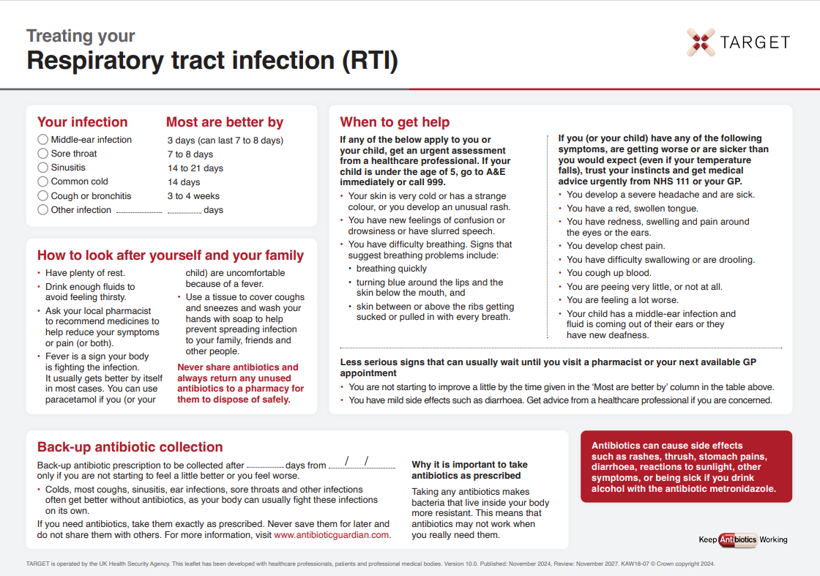
TARGET: Treating Your Infection RTI Leaflet
Clinical Scenario
Acute Otitis Media
‘Most are better by’ section to help patients know when to (re) consult
Safety netting
Back-up prescription
Information about antibiotics & AMR
www.rcgp.org.uk/TARGETantibiotics
Notes:
Presenter notes:
It would be useful to print off a copies of this leaflet and take enough with you for each GP. They can be found at
http://www.rcgp.org.uk/clinical-and-research/target-antibiotics-toolkit/~/media/Files/CIRC/TARGET/Patient-Antibiotic-leaflet.ashx
Presenter talk:
The treating your infection leaflet has been developed through extensive feedback with patients and clinicians over the last 2 years. It is designed to be shared with the patient and completed with them during the consultation. Its aim is to increase the patients confidence to self-care, and to facilitate the use of back-up antibiotics, but it also allows the patients to go away with something, so ending the consultation on a positive note.
Bring in personalised text box
All sections can be personalised and added to by the GP. And it is important to share it with the patient and add extra infections , self-care instructions in the third column and alarm symptoms in the fourth column that may be required.
Bring in ‘most get better by’ text box
The ‘usually lasts’ section allows patients to understand not only for this consultation but also others when they should consult. This section has consistently been seen as very useful by patients of all ages.
Bring in safety netting box
Whatever the infection, in this era of antibiotic resistance and with increasing numbers of elderly or vulnerable patients, it is extremely important to give some clear safety netting instructions. These are some that can be used and saved by patients.
Bring in back-up prescription box
The back-up prescription can reduce antibiotic prescribing by about 40%, and is extremely useful for particularly demanding patients or just before a weekend to reduce visits to out of hours services. These different options are given, so that the patient understands where to pick up the leaflet, a recent study by Little et al shows that either of the options leads to similar % of antibiotics being taken, but that giving the patients the prescription and advising them when to pick the antibiotic up –leads to slightly greater patient satisfaction.
Bring in information box
Although most patients know they shouldn’t take antibiotics for coughs and colds, far fewer know that sinusitis, ear infections and sore throats and many other infections get better on their own without antibiotics.
Likewise they know little about antibiotic resistance, so we should take every opportunity to educate them.
This final statement is important – as in January 2017 16% of patients given oral antibiotics in the last year reported having some left-overs, and this was 28% of 16-24 year olds. Of those with left-overs 30% kept them for future use just in case. So take the opportunity to stress not to share antibiotics, and to return left-overs to a pharmacy.
There is a READ code for delayed/ back-up antibiotics or leaflet given and if you Read code the infections featured the leaflet with EMIS and some other systems this leaflet will appear on your computer via the patient.co.uk system.
Extra notes for presenter: Most prescribers have access to many leaflets, both paper ones and ones that can be printed off their computer system or the web. However, not all information resources are based on the best available evidence or have been developed through rigorous processes. The Antibiotic Information Leaflet has been developed through over 24 months of literature searching, consultation, focus groups with patients and staff, drafting and revision.
Overview of the leaflet
To use this leaflet properly, it is important that clinicians use it as a tool to interact with patients, rather than just handing it to them as a ‘parting gift’. In order to communicate this effectively you must make sure that you are very familiar with its content. Please make sure that, in addition to completing this training, you take some time to thoroughly familiarise yourself with the leaflet before you start using it.
.

Slide 12
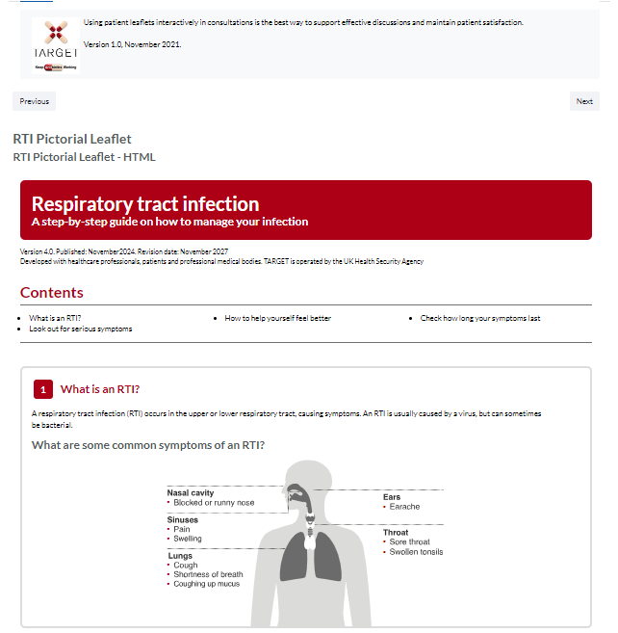
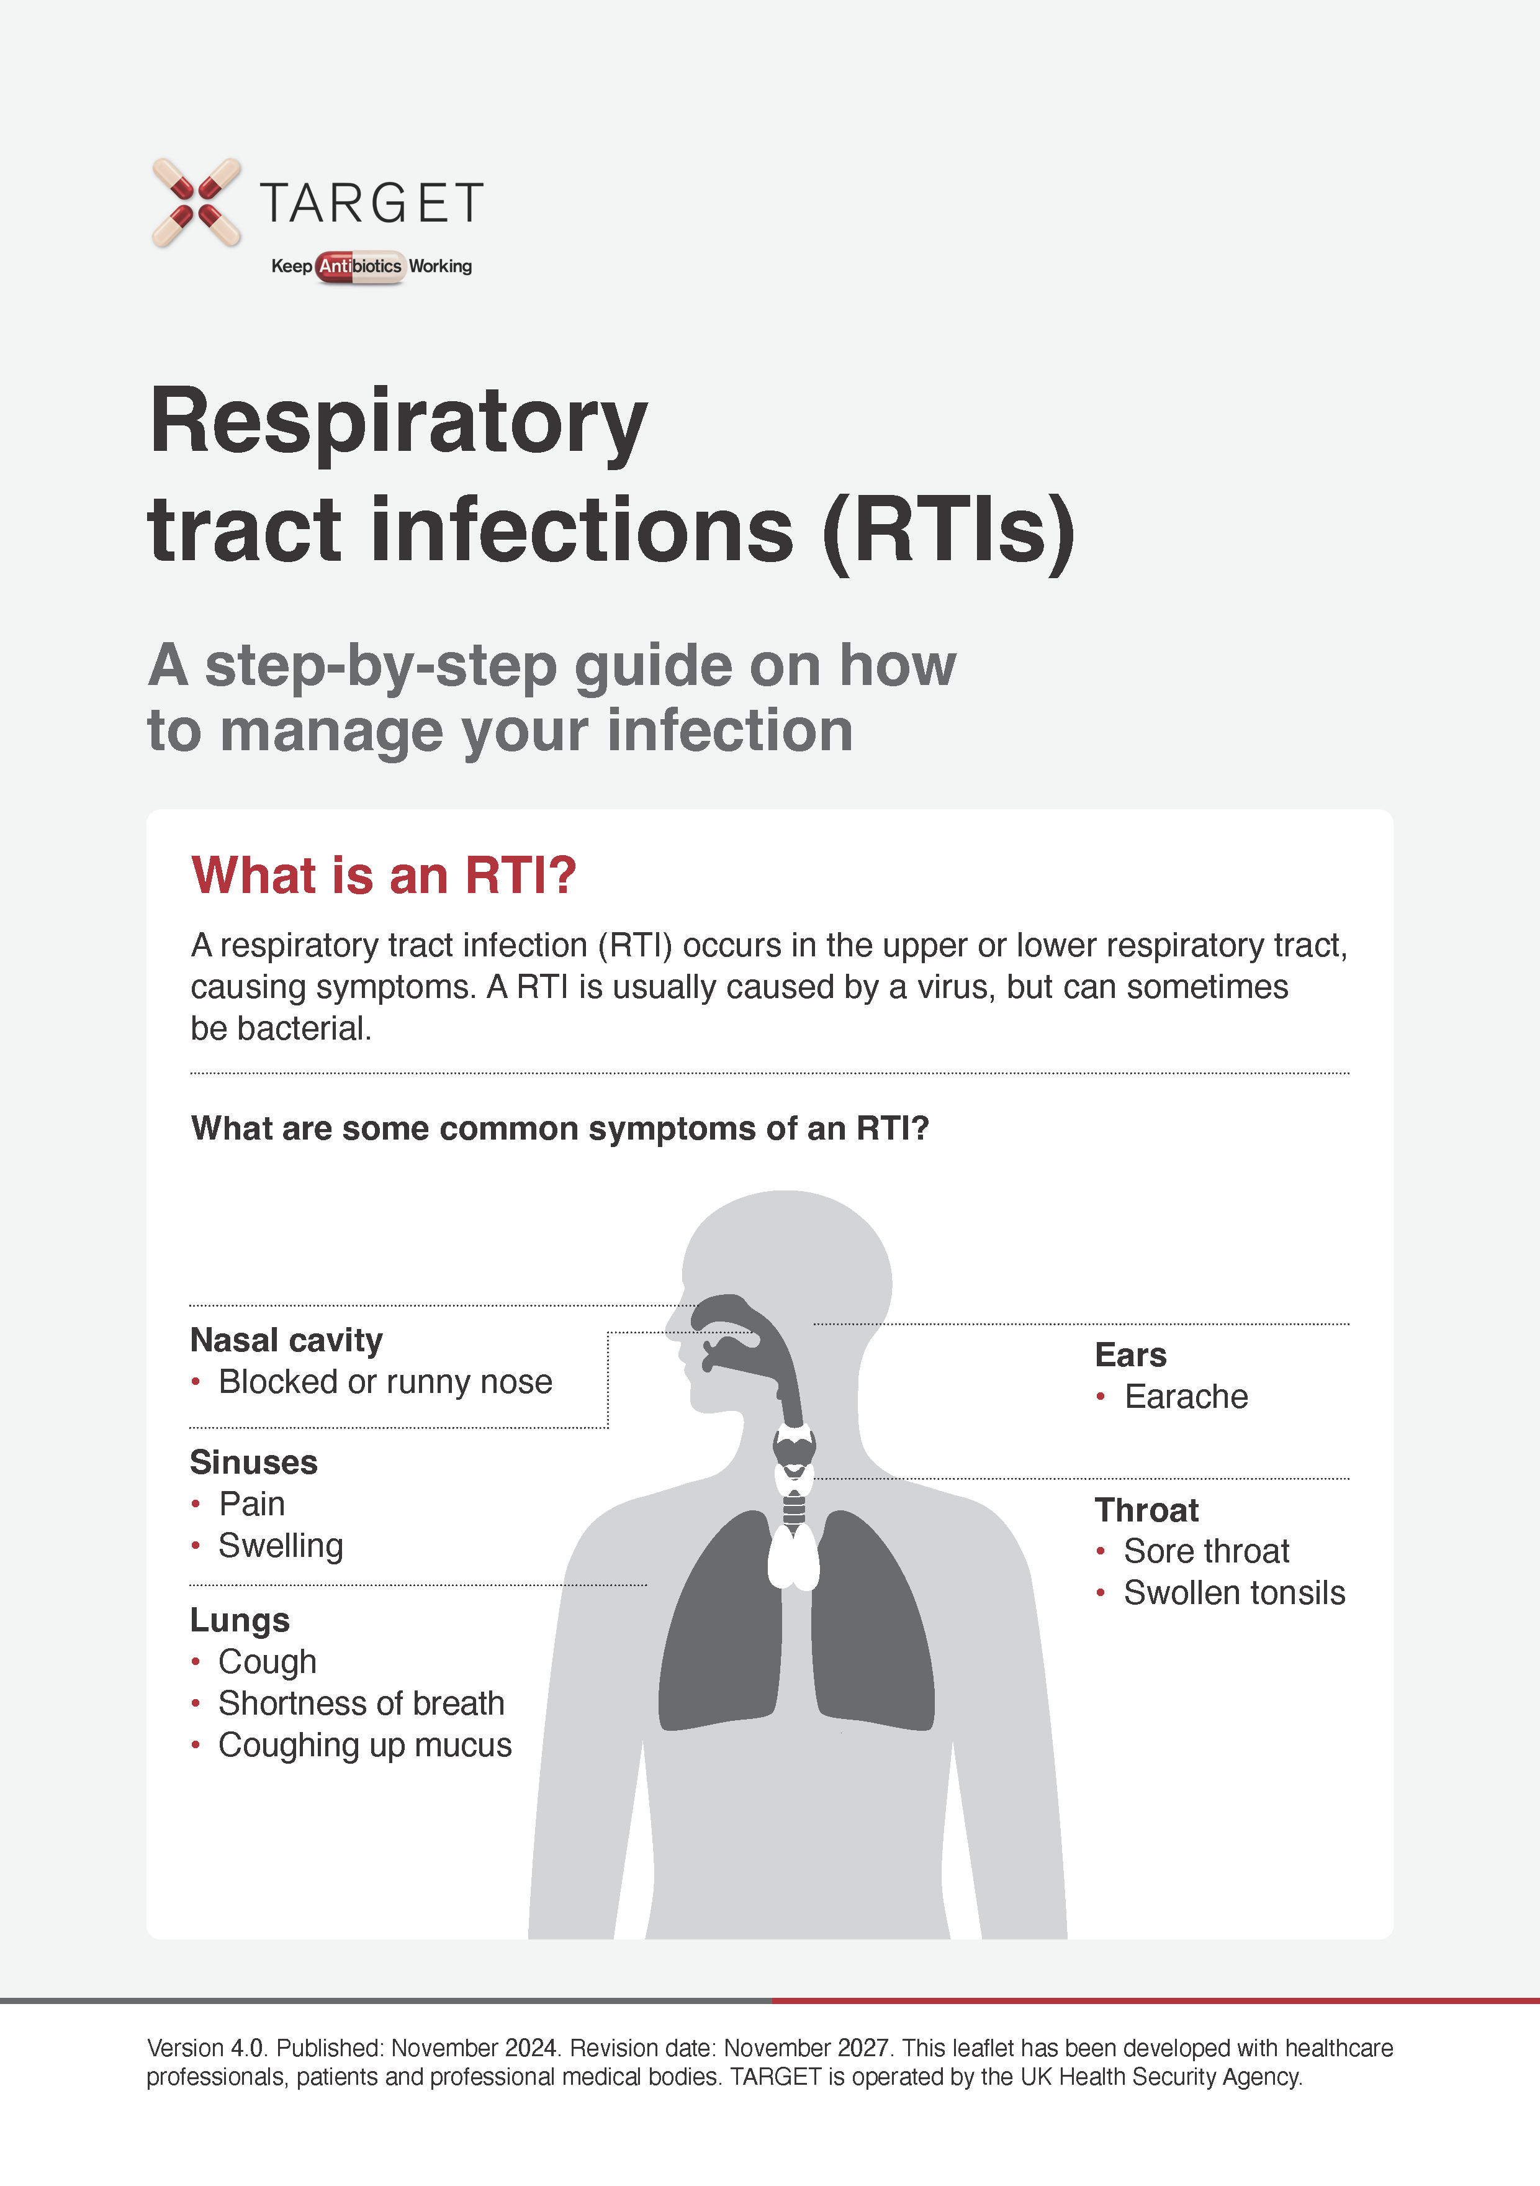
TARGET: Treating Your Infection RTI Leaflet
Pictorial leaflet
Digital leaflets
Clinical Scenario
Acute Otitis Media
Notes:
The target RTI leaflets are available in a pictorial word/pdf version that can be printed off and used in a consultation
The standard and pictorial versions of the leaflets are also available in HTLM and can be embedded in GP system SMS templates so they can be texted or emailed after a consultation.

Slide 13
Back-up antibiotic prescriptions - How?
Clinical Scenario
Acute Otitis Media
***Don’t forget to code your treatment choice***
READ codes (Emis, Vision) | SNOMED code (System One) | Definition
8OAN | 967191000000104 | Provision of Treating Your Infection self-care patient leaflet with back-up antibiotic prescription issued (procedure)
8CAk | 248041000000103 | Patient advised to delay filling of prescription (situation)
8BP0 | 417576009 | Deferred antibiotic therapy (situation)
n/a | 1065591000000109 | Delayed prescription given (situation)
Last review: Feb 2023
Next review: Feb 2026
Notes:
Presenter Talk
Don’t forget to code your treatment choice. Much of the evidence presented today use Read/Snomed codes to trawl the data, if you haven’t coded its makes it difficult for researchers to understand the benefit or not of any treatment. It also helps if you want to look back and audit your prescribing.

Slide 14
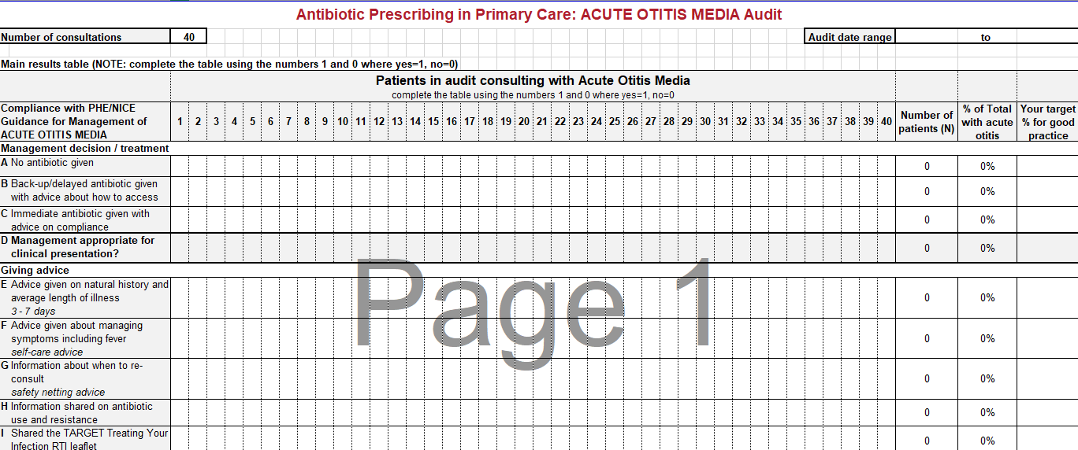
TARGET: Otitis Media Audit
The TARGET website has audit templates for:
    Acute otitis media
    UTI
    Sore Throat
Clinical Scenario
Acute Otitis Media
    Acute Cough
    Otitis Externa
    Acute Rhinosinusitis
www.rcgp.org.uk/TARGETantibiotics
Notes:
Presenter talk/notes:
Have you done any personal or practice wide antibiotic audits in the last year?
The self-assessment check list suggests
a biannual practice wide antibiotic audit
You keep a personal action plan following audits.
Read coding facilitates audits
The TARGET website has audit templates with appropriate guidance and Read codes to use for:
Otitis media, sore throat, acute cough, UTI, otitis externa, acute rhinosinusitis.
These will also help you comply with your CPD and revalidation.

Slide 15

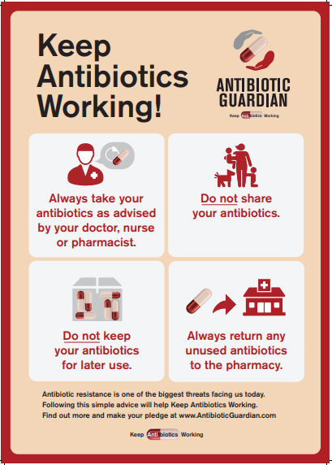
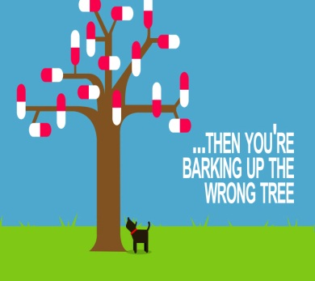
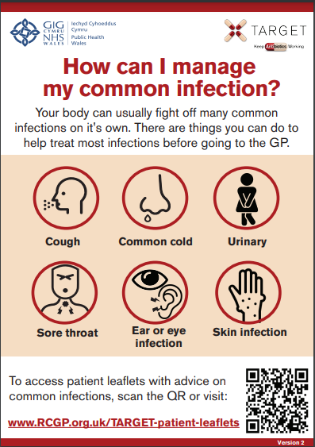
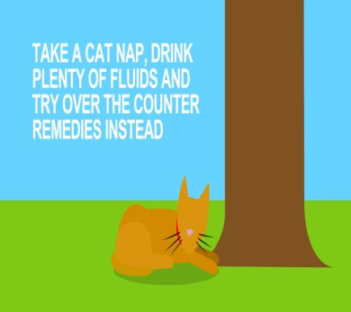

TARGET: Additional supportive tools
Posters for Display
Videos for patient waiting areas
Clinical Scenario
Acute Otitis Media
Last review: Feb 2023
Next review: Feb 2026
Notes:
Presenter talk/notes:
These posters and videos may make a difference to patient expectations about when to expect antibiotics, IF used in the waiting room where patients can see them and IF they have the time to digest the information. In 2014 25% of the general public surveyed remembered seeing the first poster and 95% of these correctly answered that antibiotics don’t help most coughs and colds. Used alone without any other strategies posters will make little difference to patients expectations for antibiotics, but they can be used to reduce expectations and can be used as a prompt for dialogue –
“you may have seen from the posters or videos in the waiting room that we in this practice encourage responsible antibiotic prescribing”
The videos were developed with patients and each animal cartoon video appealed to different people. A recent small survey of their use showed that those patients who saw them remembered the messages – however often the video sound was muted, chairs were pointing in the wrong direction or the video screen was off. If you intend to use them please don’t make this mistake.

Slide 16
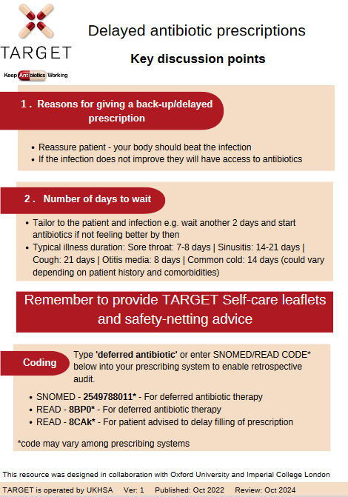
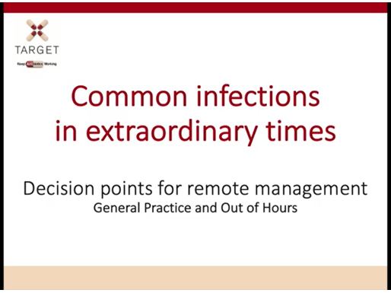
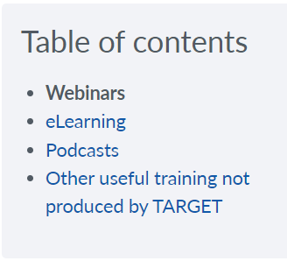
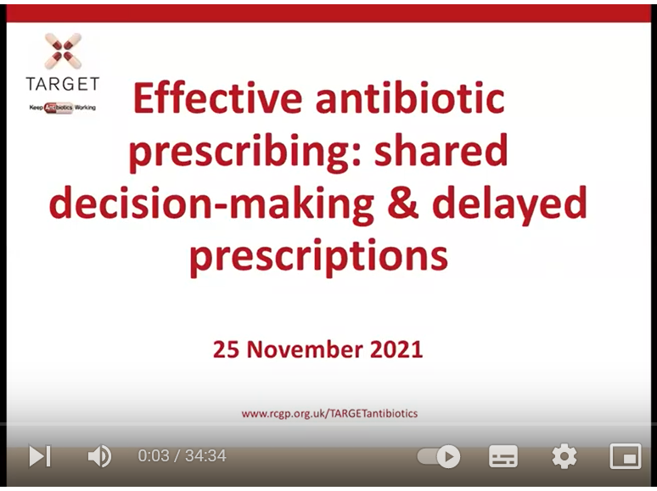
TARGET: Learning Resources
Clinical Scenario
Acute Otitis Media
Last review: Feb 2023
Next review: Feb 2026
Notes:
Presenter notes:
These are examples of the training resources available on the TARGET antibiotics website.
Many of the most recent TARGET webinars are specific to antibiotic use covering topics like delayed prescribing and remote consultations

Slide 17
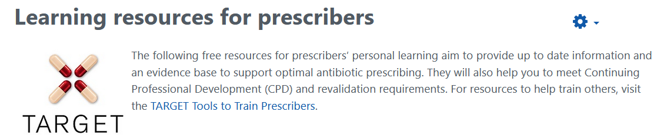
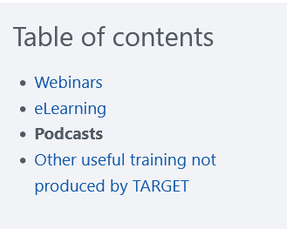
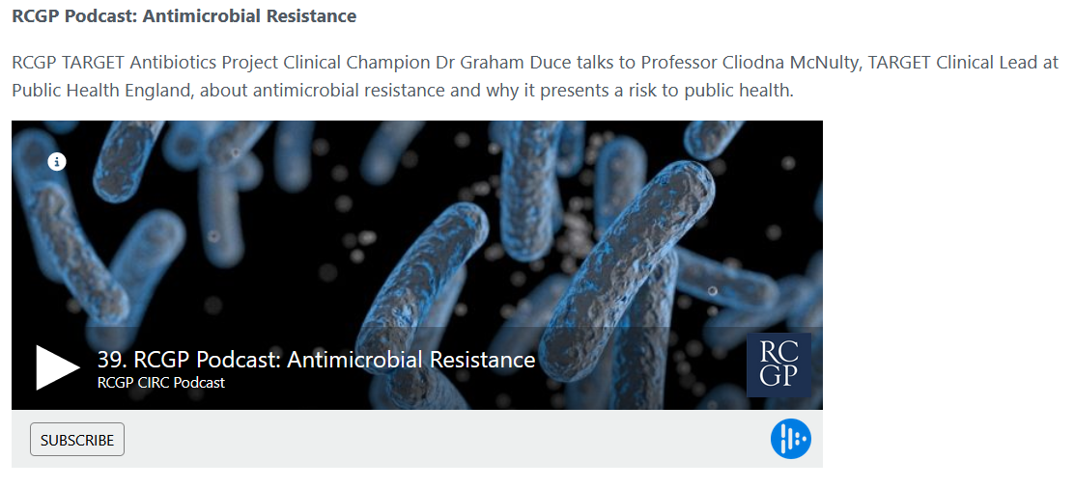
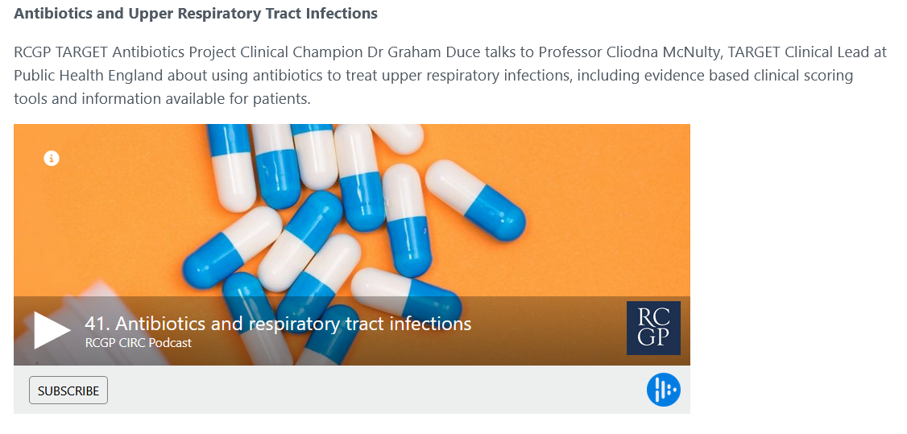
TARGET: Learning Resources
Clinical Scenario
Acute Otitis Media
www.rcgp.org.uk/TARGETantibiotics
Notes:
Presenter talk:
These are examples of the training resources available on the TARGET antibiotics website.
Check out these podcasts to learn more about resistance and management for Upper respiratory tract infections.

Slide 18

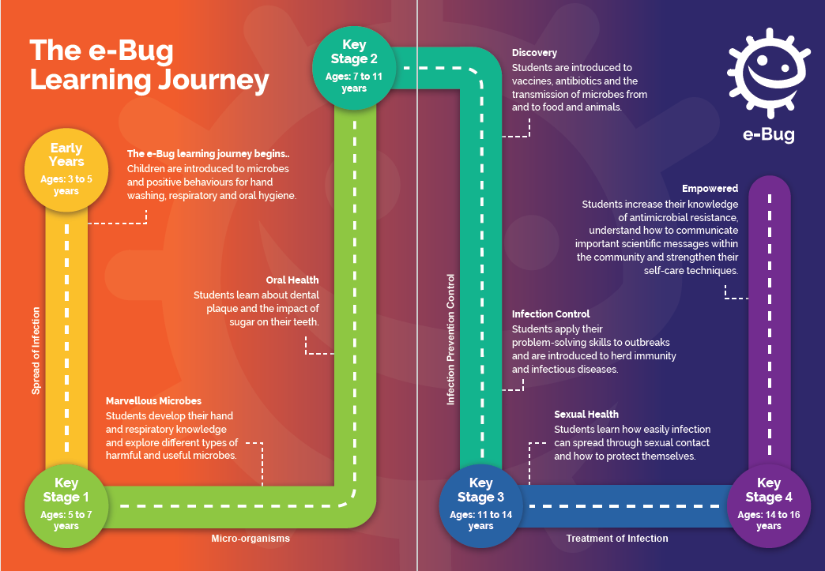
E-Bug: resources for schools and community groups
Clinical Scenario
Acute Otitis Media
www.rcgp.org.uk/TARGETantibiotics
Notes:
Presenter talk:
e-Bug is an international programme that aims to educate children and young people on the spread of infection and use of antimicrobials. The respiratory hygiene topic supports students to understand how to limit the spread of microbes when coughing and sneezing and why this is important, and the hand hygiene topic teaches students about good hand washing behaviours to remove the microbes that build up on the hands and why failing to do so can cause infection.
Promoting positive behaviour change amongst children and young people can help to ensure that we are educating appropriate use of antimicrobials to the users and prescribers of the future.

Slide 19
Action Planning
Clinical Scenario
Acute Otitis Media
Action planning for next 12 months: Agree What, How, Who, When
Promote use of local antimicrobial or NICE antimicrobial prescribing guidance by all in practice
Agree criteria for prescribing, so parents do not return to a different clinician
Use the children’s Healthier Together website (if available) or TARGET TYI-RTI leaflet
Use back-up / delayed prescribing. Use delayed date on electronic prescription
Set up computer reminders for leaflets and back-up antibiotics
Do an audit of self-care, safety netting & antibiotic advice
Re-audit in 4 months - identify a date when you will repeat the audit.
www.rcgp.org.uk/TARGETantibiotics
Notes:
Presenter notes:
Developing an action plan with who will be responsible is important, as otherwise good intentions may not be converted into action
Agree criteria for prescribing, so parents do not return to a different clinician
Use the children’s Healthier Together website (if available) or TARGET TYI-RTI leaflet
Use back-up / delayed prescribing
Set up computer reminders for leaflets and back-up antibiotics
Use delayed date on electronic prescription
Do an audit of self-care, safety netting & antibiotic advice
Complete TARGET webinar on managing children with infections

