Slide 1
TARGET Antibiotics
“There are few public health issues of potentially greater importance for society than antibiotic resistance”
2013 CMO Prof Dame Sally Davies
www.rcgp.org.uk/TARGETantibiotics
Notes:
1. The top part of this notes section is for presenters to use during the workshop, and can be used verbatim or paraphrased.
Extra notes below contain extra background information about the evidence base for the information on the slides and details about the references quoted, or how to obtain particular information or resources.
Underlined notes are instructions.
If you want to use the voice over at any time please make sure your laptop or PC has functional speakers and they are not on mute.
While you are waiting for staff to arrive it is really useful to get them to think about their current antibiotic prescribing practice by
getting them to complete the self-assessment checklist available at Antibiotic stewardship tools, audits and posters: Self-assessment checklist (rcgp.org.uk) (see slide 2)
Giving them the TARGET patient leaflet to look at (available at Leaflets to discuss with patients: How to use these leaflets (rcgp.org.uk) )
Print out and ask the group to consider and chat about some of the case studies in the presentation.
Lets begin!
Slide one presenter notes:
Although this quote from Dame Sally Davies is now 9 years old, it is still as relevant today and it was in 2013. U. Next slide.

Slide 2
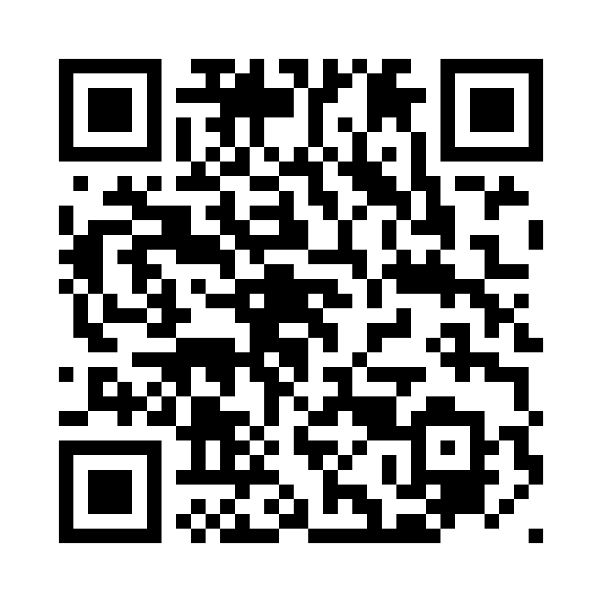
Pre-session survey (5 minutes)
In order to receive your certificate of attendance please:
Complete the pre-evaluation section of the survey at the start of the session
Send yourself the link to rejoin so you can log back into the survey to complete the post-session questions at the end of the training
https://surveys.ukhsa.gov.uk/s/izb5vf

Slide 3
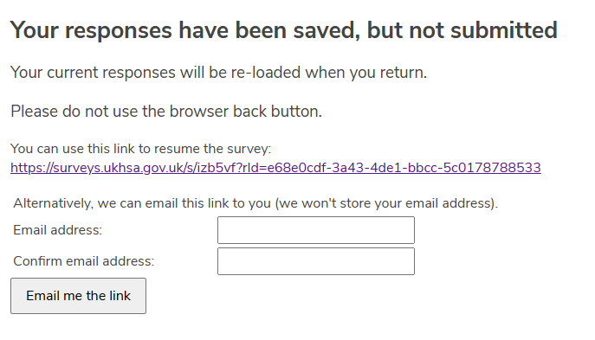
Pre-session survey (5 minutes)
Use an email address that you can access during the training!
The UNIQUE resume link will be sent to that inbox.
Notes:
Note for trainer – they will need the unique link to complete the post session survey.

Slide 4
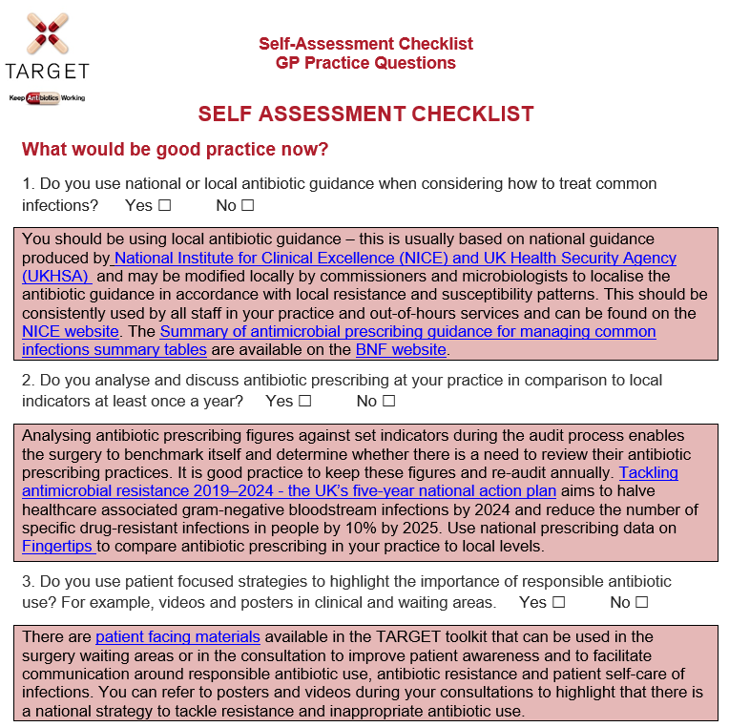
Self Assessment Checklist to complete whilst waiting for whole team
www.rcgp.org.uk/TARGETantibiotics
Notes:
Presenter notes:
We suggest you send this to practice staff before the event or give it out as soon as you arrive – while you are waiting for all staff to gather. Go through self-assessment check list with the staff, this acts as a very good ice breaker and can be referred back to during the session.
The Primary Care Self Assessment tool is a tool for you to decide and measure how far you are along the road to optimising antibiotic prescribing in your practice. It highlights the different strategies you can use and how you can find resources to support these strategies. This tool is a guide to providing strategies that may help to optimise antibiotic prescribing in primary care.
There is also a separate part for commissioners which it would be useful for trainers to access and complete to see how well their local area is doing.
Presenter notes – we suggest at this point you get them to have a quick look to see how many of the strategies they are using to optimise antibiotic prescribing in their practice. Make sure you are familiar with the local antibiotic guidance and how they can access it, how you can help with audits, and Read codes. Encourage the practice to identify a lead for prescribing, and if possible book another visit to go over their progress with local indicators of antibiotic prescribing and their use of the resources.
Encourage the practice again to use leaflets and posters and if possible put some antibiotic posters up while you are there.
Are the laboratory protocols for reporting antibiotic susceptibility in line with local antibiotic guidance.

Slide 5
Workshop agenda
Context and background of antimicrobial resistance
Improving our antibiotic prescribing
  Strategies and resources
  Evidence for using the TARGET resources
  Clinical scenarios
The link between antibiotic prescribing and resistance in your patients
Benefits of reducing antibiotic prescribing on AMR and on patient consultations
www.rcgp.org.uk/TARGETantibiotics
Notes:
Presenter notes:
The aims of this workshop are to discuss with you, using clinical scenarios, the need for optimising antibiotic prescribing, by showing you the:
evidence that there is a link between antibiotic prescribing and resistance in GP patients
how reducing antibiotic prescribing can not only reduce antibiotic resistance, but also patients’ future expectations for an antibiotic and a consultation.
We will also discuss and share materials and strategies (and the evidence behind them) that can help us together with our hospital and veterinary colleagues improve our antibiotic prescribing

Slide 6
Workshop Outcomes
By the end of this workshop you should have a clear understanding of…
The consequences of antimicrobial resistance and the role we all play in contributing to, and addressing AMR
The TARGET toolkit and how it can support you - where to find it and how to use it
What you, and your practice, can do to help tackle AMR safely and responsibly
The value of using appropriate SNOMED/Read codes
www.rcgp.org.uk/TARGETantibiotics
Notes:
Presenter notes:
By the end of the workshop today you should have a clear understanding of;
The consequences of antimicrobial resistance and the role we all play in contributing to, and addressing AMR
The TARGET toolkit and how it can support you - where to find it and how to use it
What you, and your practice, can do to help tackle AMR safely and responsibly
The value of using appropriate SNOMED/Read codes
And have started to think about/create an action plan of how you can implement changes in your practice to help tackle AMR

Slide 7
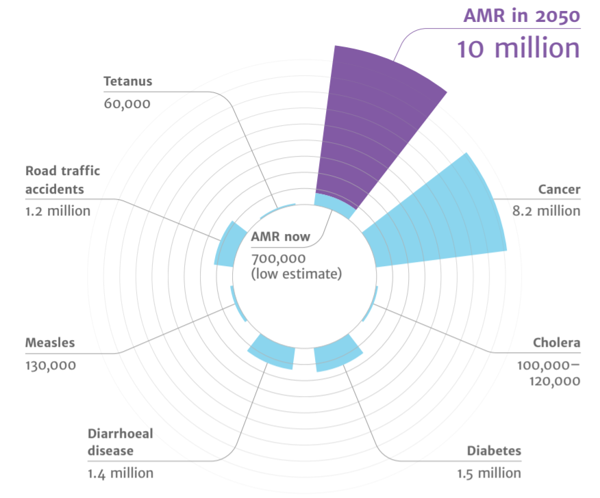
Deaths attributable to AMR each year
Context
AMR
2050
Diabetes
and cancer
combined
AMR in 2050
10 million
Tetanus
60,000
10,000,000
Road traffic accidents
1.2 million
9,700,000
Cancer
8.2 million
AMR now
700,000
(low estimate)
Cholera
100,00 – 120,000
Measles
130,000
Diarrhoeal disease
1.4 million
Diabetes
1.5 million
(O ’Neill, 2015)
Notes:
There is much information out there about the threat and consequences of antimicrobial resistance but lets just put that into context. A recent UN report (April 2019) highlighted that by 2050, AMR could kill 10 million people per year, in its worst-case scenario.
https://amr-review.org/sites/default/files/Antimicrobials%20in%20agriculture%20and%20the%20environment%20-%20Reducing%20unnecessary%20use%20and%20waste.pdf

Slide 8

The Iceberg of Gram Negative Resistance
Carbapenemases<2%
ESBL
Some resistance
Sensitive
www.rcgp.org.uk/TARGETantibiotics
Notes:
Presenter notes:
On a daily basis we see the results of multi resistant infections, but they are only the the tip of the iceberg; there is much resistance hidden within the community setting.
7% of the general population in England in a 2014 stool collection survey carried Extended beta lactamase producing E.coli in their gut
And we are seeing this across the globe, “Pakistani authorities recently reported a new strain of typhoid, which was resistant to the last affordable oral antibiotic in the area”. Prof Claire Chandler, LSHTM
And you all know from your daily practice that antibiotic resistance in UTIs is increasing to trimethoprim, even though these organisms may not be multiresistant

Slide 9
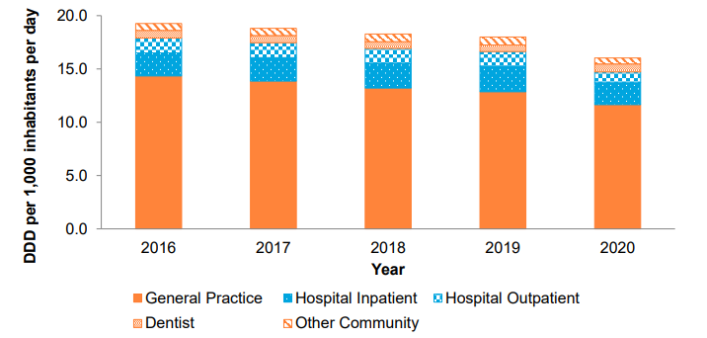
UK prescribing: 72.7% of antibiotics are prescribed in the community
ESPAUR Report 2021
(ESPAUR Report, 2021)
Notes:
What does that mean for us in general practice?
Interviews with GPs indicate that:
GPs recognise the wider importance of resistance
But they don’t really think that it is a problem in their own practice
And they believe that hospitals and other prescribers such as vets are as important or more important contributors to resistance.
However this data shows that 72.7% of antibiotics are prescribed in the community and therefore GP staff hold much of the responsibility for rising use and antibiotic resistance.
However this doesn’t mean that the other groups antibiotic prescribing is not important. In deed it is and that is why there is the Start Smart Then Focus strategy in hospitals, a campaign with dentists with posters saying “antibiotics do not cure toothache,” and a strategy to improve antibiotic prescribing in animals.
The good news is that in 2015 we saw the first fall in antibiotic use in general practice for some years and this trend has continued.
https://webarchive.nationalarchives.gov.uk/ukgwa/20211124171706/https://www.gov.uk/government/publications/english-surveillance-programme-antimicrobial-utilisation-and-resistance-espaur-report

Slide 10
Europe Prescribing:
Total consumption (community and hospital sector) of antibacterials for systemic use by country, EU/EEA and the United Kingdom, 2020 (expressed as DDD per 1 000 inhabitants per day)
DDD per 1000 inhabitants per day (2019)
© ECDC
www.rcgp.org.uk/TARGETantibiotics
Notes:
Presenter notes: However we still have some way to go compared to some other European countries. Although as this slide shows in comparison to other European countries in 2019 we prescribe much less than Greece, in the community we do prescribe twice as much as the Netherlands which has a similar population to us. I suggest therefore that there is an opportunity to reduce our community antibiotic prescribing. The differences are partially due to cultural norms in the UK compared to other Northern EU countries who prescribe less for respiratory tract infections.
Extra presenter notes: The EU expresses community antibiotic consumption in Defined Daily Doses per 1 000 inhabitants and per day, which is slightly different to the ADQs used in the UK. Each bar refers to a specific country while the colours indicate the recorded consumption of the different antibiotic classes in that country.
Total community antibiotic consumption ranged from 11 DDD per 1 000 inhabitants and per day in Netherlands to 37 DDD per 1,000 inhabitants and per day in Greece. As in previous years, antibiotics of the penicillin class were the most frequently used antibiotics in all countries .
The UK still prescribes more than any of our northern European colleagues. DDDs (or if we used ADQs) is influenced by antibiotic dose, so as clinicians use of amoxicillin increases from 250 to 500mg routinely, the ADQs and DDDs increase, even if the number of items remains the same.

Slide 11
Practice bar charts
Antibacterial items/STAR-PU
12 months rolling data to Jul-22
Your Practice
Glos ICB 12m
ENGLAND
www.rcgp.org.uk/TARGETantibiotics
Notes:
Now let’s take a closer look at prescribing in our [insert name] ICB.
This graph shows antibacterial items/star-PU and conveniently colour codes practices into at or below
0.871 (blue) = appropriate prescribing of antibiotics in primary care
0.965 (orange) = NHS target
1.161 (grey) = antibiotic items per STAR-PU are equal to or below England 2013/14 mean performance

Slide 12
Practice bar charts prop of co-amoxiclav, cephalosporin & quinolone
12 months rolling data to Jul-22
Your Practice
ENGLAND
Glos ICB 12m
www.rcgp.org.uk/TARGETantibiotics
Notes:
Reduction in the proportion of broad spectrum antibiotics cephalosporins, quinolones & co-amoxiclav by 10%

Slide 13
Antibiotic prescribing in Primary Care vs European Targets
Condition/syndrome | Actual prescription (THIN data) | Ideal prescription: UKHSA EE median (IQ range) | Ideal prescription: ESAC EE acceptable range
Acute cough | 40% | 10% (6 – 16%)
Acute bronchitis | 92% | 13% (6 – 22%) | 0 – 30 %
Acute sore throat | 60% | 13% (7 – 22%) | 0 – 20% (tonsillitis)
Acute rhinosinusitis | 92% | 11% (5 – 18%) | 0 – 20%
Acute otitis media 6mo – 2yr 2yr – 18yr | 96% 94% | 19% (9 – 33%) 17% (8 – 30%) | 0 – 20%
URTI | 19% |  | 0 – 20%
UTI | 94% | 75% (61 – 86%) | 80 – 100%
J Antimicrob Chemother. 2018 Feb 1;73(suppl_2)
www.rcgp.org.uk/TARGETantibiotics
Notes:
So where are we at the moment compared to where we want to get. There has been some good news about primary care antibiotic prescribing. Between 2016 to 2019, antibiotic consumption reduced by 6.6%, with a further decrease of 10.9% between 2019 to 2020.
These studies show that GPs still prescribe antibiotics in more than half of all respiratory infections. Targets set by the European Surveillance on Antimicrobial Consumption suggest we still have a long way to go and that we need to reduce prescribing by 2/3rds.
1. http://bmjopen.bmj.com/content/4/10/e006245.ful
2. http://qualitysafety.bmj.com/content/early/2011/03/21/bmjqs.2010.049049.abstract
Slide table shows: Percentage of patients prescribed antibiotics (THIN) and the percentages that experts believe are appropriate (results from PHE expert elicitation (EE) work and EE by ESAC). Conditions in bold show the greatest discrepancy between expert opinion and actual prescribing proportions.

Slide 14
Why do GP staff prescribe antibiotics?
Relief of symptoms
Worry about complications/more serious illness
Patient pressure
www.rcgp.org.uk/TARGETantibiotics
Notes:
Presenter notes:
So, how do we change antibiotic prescribing? Lets go back to the fundamentals of practice. Why do we prescribe? We prescribe mainly for 3 reasons.
Firstly, we want to help our patients to get better. We want to relieve their symptoms and we believe that antibiotics will help.
Secondly, we prescribe because we worry that if we don’t patients may develop complications or more serious illness.
We also prescribe because we think patients expect a prescription, usually antibiotics. Let’s take a look at these three reasons for prescribing and examine the evidence supporting each of these reasons.

Slide 15
Symptom benefit from antibiotics
 | Total Duration untreated | Beneficial effect from antibiotics | NNT for one additional patient to benefit | NNT for one additional adverse effect
Otitis media | 4 -12 days | 8-12 hours | 18 | 9
Sore throat | 8 days | 12-18 hours | 6-20 | 15
Sinusitis | 12-15 days | 24 hours | 18 | 8
Bronchitis | 20-22 days | 11-24 hours | 10-22 | 24
And how do we communicate this information to patients?
Cochrane reviews Otitis media: Venekamp et al (2015); Sore throat: Spinks et al. 2013; Sinusitis: Leminengre M et al. (2012); bronchitis: Smith et al. (2017)
Notes:
Presenter notes:
How useful are antibiotics for common respiratory tract infections? This table includes much of the research on what we know about common respiratory tract infections, how long the symptoms usually last, and how much patients benefit from taking antibiotics. As you can see from the circled column, antibiotics reduce symptoms for between 8 and 24 hours. So at best about 12 hours in otitis media, an illness that lasts for 4 to 8 days; taking a look at the NNT Benefit and NNT Harm columns – 18 patients with OM need to be treated with antibiotics for one patient to benefit, but for 9 patients receiving antibiotics one will experience an adverse effect. For bronchitis, an illness that lasts for about three weeks, the reduction in days with cough was less than half a day and the reduction in days feeling ill was just over half a day with antibiotics.
Any benefit that our patients achieve from antibiotics is tiny and the numbers needed to treat to achieve one satisfactory earlier resolution needs to be weighed against the one in 10 chance of causing side effects such as diarrhoea, vomiting, rash, allergic reaction (1 in 15) or the risk of carrying a resistance bacteria. So, unless symptoms are particularly severe, there is no reason for using antibiotics in the majority of patients presenting with respiratory symptoms because they do not help.
Evidence
This evidence is all outlined in the PHE antibiotic guidelines and NICE CG69, but most recent systematic reviews include:
Otitis media
Venekamp et al (2015) Antibiotics for acute middle ear infection (acute otitis media). Cochrane
http://www.cochrane.org/CD000219/ARI_antibiotics-for-acute-middle-ear-infection-acute-otitis-media-in-children
This systematic review included 13 RCTs involving 3401 children with otitis media (3938 episodes). Pain was not reduced by antibiotics at 24 hours. A third fewer had residual pain at 2-3 days (at which point pain levels are usually substantially reduced) and NNT for an additional beneficial outcome was 20. Antibiotics reduced the number of Tympanic Membrane perforations, but NNT for Benefit is 33. Severe complications were rare and did not differ between children given antibiotics and those given placebo. Antibiotics are most beneficial for children aged <2 yrs with bilateral AOM (NNTB 4) or with both AOM and discharge (NNTB 3). Immediate antibiotics were associated with a substantial increased risk of vomiting, diarrhoea or rash compared with no treatment (NNTH9).
Sore throat
Spinks A et al. (2013) Antibiotics for sore throat. Cochrane
http://onlinelibrary.wiley.com/doi/10.1002/14651858.CD000023.pub4/pdf/abstract
27 RCTs of antibiotics for sore throat vs placebo including 12 835 cases. Antibiotics were most beneficial if given at day three if throat swabs were positive for streptococcus (NNTB 6) compared to NNTB at day 7 of 21. Antibiotics reduced duration of symptoms by 16 hours on average. 90% resolve in 7 days. Advantages may be greater in low income countries (possibly recent travelers from these countries – personal communication Dr L Hendricks) where the risk of rheumatic fever is higher. NNTH is 15.
Little P et al (2013) – 2 studies within the PRISM trial used a Clinical score compared to rapid antigen detection test to guide antibiotic use for sore throats. The RCT using clinical scores to predict streptococcal infection in patients and found that the use of FeverPAIN is likely to moderately improve symptom control and reduce antibiotic use. PHE and NICE guidance suggests Consider immediate antibiotics if symptoms severe or a short 48 hour back-up strategy may be appropriate, when the FeverPAIN score is 4 or over. Consider back-up or no antibiotic if score 2-3.
https://www.bmj.com/content/bmj/347/bmj.f5806.full.pdf
Sinusitis
Leminengre M et al. (2012) Antibiotics for clinically diagnosed acute rhinosinusitis in adults. Cochrane.
http://onlinelibrary.wiley.com/doi/10.1002/14651858.CD006089.pub4/pdf/abstract
10 RCTs of antibiotics vs placebo including 2450 participants. Irrespective of treatment group 47% of patients were cured after 1 week, 71% after 14 days. 18 patients need to be treated for a faster cure rate between 7 and 14 days. If several of: purulent nasal discharge; severe localised unilateral pain; fever; marked deterioration after initial milder phase, patients were more likely to benefit from antibiotics, when PHE and NICE recommend a back-up antibiotic. One disease related complication (brain abscess) occurred in patient treated with antibiotics, but complications are rare.
Bronchitis/LRTI (without pneumonia)
Smith S et al. (2017) Antibiotic treatment of people with clinical diagnosis of acute bronchitis. Cochrane
http://www.cochrane.org/CD000245/ARI_antibiotic-treatment-people-clinical-diagnosis-acute-bronchitis
17 trials with 5099 participants were included. The number needed to treat for one additional beneficial outcome was 22 (NNTB 22). The reduction in days with cough was 0.46 days and days feeling ill was 0.64 days (CI 1.16-0.13). NNT for an additional adverse effect was 24.

Slide 16
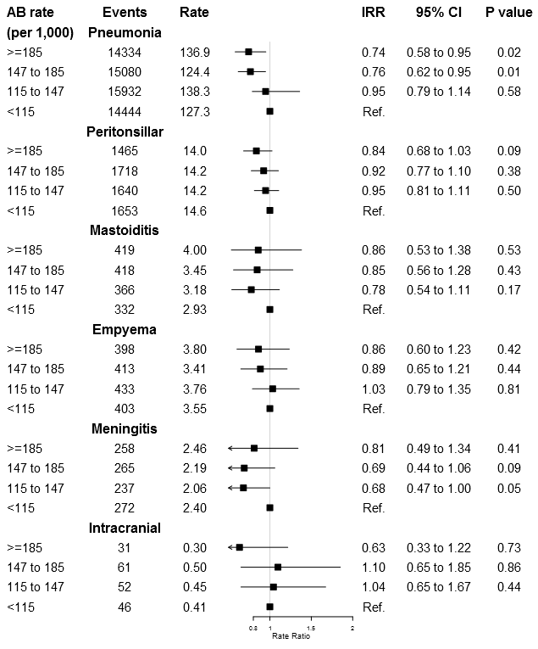
Complications with lower antibiotic use:
High vs low prescribing practices
In a practice of 7,000,
a 10% reduction in antibiotic prescribing for RTI might expect:
  1 additional peritonsilar abscess each 10 years
  1 additional pneumonia each year
BMJ 2016 Gulliford http://www.bmj.com/content/354/bmj.i4245
www.rcgp.org.uk/TARGETantibiotics
Notes:
Presenter notes:
Now lets look at complications. If we prescribe less do we see more complications? The short answer, perhaps, but hardly any. In a practice of 7000 patients, a 10% reduction in antibiotic prescribing for RTI may result in 1 additional pneumonia each year and 1 additional peritonsilar abscess every 10 years.
This study stratified practices by their antibiotic prescribing rates into four quartiles. (>185, 147-185, 115-147 and less than 115 antibiotic prescriptions per 1000 patients. They then looked at infection related complications – pneumonia, peritonsillar abscess, mastoiditis, empyema, meningitis and intracranial abscess.
There was no significant reduction in peritonsilar abscess, mastoiditis, empyema, or intracranial abscess, in practices where antibiotics were given much more often, as you can see the confidence intervals cross one and the p values are over 0.05. Although the slight increase in peritonsilar abscess they suggested would result in one additional peritonsilar abscess every 10 years.
There was a significant reduction in pneumonia, indicating that this equated to one additional pneumonia per year. This indicates that we need to be careful in this area – and consider the age and risk of patients with suspected pneumonia, and consider using CRP too.

Slide 17
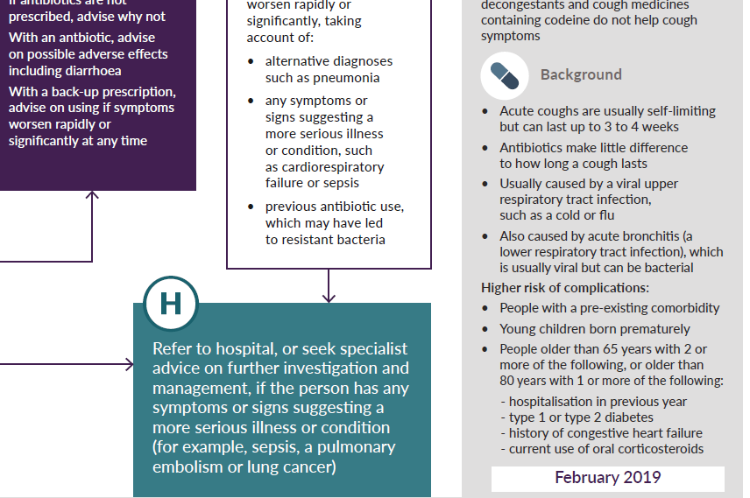
Antibiotics and complications
Serious complications rare after URTI
Sore throat and otitis media NNT>4000
Pneumonia more common after LRTI
  >65 years: NNT 39
  < 65 years: NNT >100
  Highlighted in NICE/PHE summary tables
www.rcgp.org.uk/TARGETantibiotics
Notes:
Presenter notes:
Serious complications are rare after URTI, sore throats and otitis media. There are some patient groups at slightly higher risk of complications after LRTI or bronchitis and the current guidelines target prescribing for those at highest risk, for example in those aged 65 or older with 2 or more of: recent hospitalisation, diabetes, CCF or recent steroid use. and even then you still have to treat a number of patients for one to benefit.

Slide 18
INSERT CLINCIAL SCENARIO SLIDES HERE
www.rcgp.org.uk/TARGETantibiotics

Slide 19
Reducing complication risk
Empowering clinicians to give
Careful clinical assessment, including targeting treatment to those most at risk (clinical tools)
Back-up / delayed antibiotics
Safety netting including patient information leaflets
www.rcgp.org.uk/TARGETantibiotics
Notes:
Presenter notes:
So most of the really large systematic reviews show that complications are rare. With careful clinical assessment to rule out more serious illness such as pneumonia or sepsis and the use of clinical tools, we can target treatment to those most at risk of complications. We have already discussed identifying those at greater risk of pneumonia.
The FeverPAIN tool (see sore throat case study) is another example of clinical tools that help to target care. If we are unsure what to do or for patients who really want antibiotics we can use delayed or back up prescriptions. The PRISM trial shows that a back up prescriptions for sore throat helps to reduce complication rates.
We need to provide clear advice around duration of illness and what symptoms or signs may mean that urgent care is needed. These can be reinforced by using patient information leaflets available on the TARGET toolkit, and we will show these later.

Slide 20

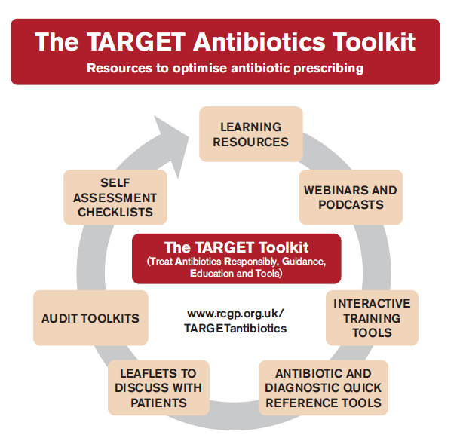
TARGET toolkit
www.rcgp.org.uk/TARGETantibiotics
Notes:
What is TARGET?
Developed by the UK Health Security Agency (UKHSA), the Royal College of General Practitioners (RCGP) and the Antimicrobial Stewardship in Primary Care (ASPIC) Group, TARGET is the central resource to help primary care healthcare professionals and commissioning organisations improve antibiotic prescribing. Using the TARGET Antibiotics Toolkit resources will also enable primary care organisations to demonstrate compliance with the Health and Social Care Act 2008: Code of Practice on the prevention and control of infections and related guidance.
Who is the toolkit for and how can it be used?
To get maximum effect regarding antibiotic use, all or as many as possible of the resources should be used with action planning by those involved in antimicrobial stewardship activities such as those from clinical commissioning groups (CCGs) and primary care networks (PCN), prescribers working in primary care, and those involved in training prescribers around infection management. Collectively, the TARGET resources will support practices in planning, implementing and reviewing activity in delivering quality improvement programmes relating to antimicrobial stewardship. A recent rigorous RCT evaluation in routine general practice showed that a one hour TARGET workshop given by local GPs, microbiologists or medicine managers, combined with demonstrating the resources, significantly reduced antibiotic use.
It is essential to plan and monitor implementation of the TARGET Antibiotics Toolkit appropriately and this is best achieved by developing a local antibiotic action plan, either for your CCG or your practice. It is important that this plan is developed using a whole team approach so that everyone who is involved in communication and prescribing around antibiotics has had the opportunity to contribute.
Each CCG, PCN and Practice has different prescribing pressures and priorities. It is therefore also important that prescribers take ownership of the planning process as well as the adaptation and implementation of resources at a local level. Before beginning the planning process we recommend you appoint a local antibiotic champion from within the CCG or the practice. This could be a prescribing lead, GP with a specialist interest in infection management, nurse practitioner, clinical pharmacist, or any other person who can be responsible for antimicrobial stewardship in your practice, your PCN or CCG. This is someone who has responsibility for leading on all issues relating to antibiotics and leads the development and implementation of the antibiotic action plan.
In order to maximise effectiveness of the TARGET resources, users should plan, monitor and review the implementation as part of a cyclical process as follows:

Slide 21
In summary
Reducing antibiotic prescribing in your practice
Makes difference to resistance in your patients
Helps to slow future antibiotic resistance
Increase patient self-care
Helps to reduce future consulta-tions
www.rcgp.org.uk/TARGETantibiotics
Notes:
Presenter notes:
Thus in summary, I hope you agree that the evidence suggests that by improving the antibiotic prescribing in your practice – you can:
Make a difference to the care of individual patients.
Help to slow the development of future resistance in our community.
AND as a bonus help to increase patient self-care and reduce future consultations for self-limiting infections.

Slide 22
How can we fit together the evidence and change behaviour during consultation with our patients to improve antibiotic prescribing?
Possible solution for you
Practice
GP
Evidence
Patient
Use the TARGET antibiotics toolkit
Notes:
Presenter notes:
So how can we fit all of this evidence together and change behaviour within the practice consultation with our patients to improve prescribing?

Slide 23
Actions
What can and will you do?
www.rcgp.org.uk/TARGETantibiotics
Notes:
Presenter notes:
So what can and will you as an individual and as a practice do to help?
Please can we discuss a plan?
Need to discuss a plan with each practice
They are all evidence based
Get them to do the planning – so moves on within the practice
Get them to prioritise
Get them to plan review with audit.
Identify a person to take forward
Find the individual with computer interest and get them to help with a computer reminder linking to the TARGET patient shared information.
Action plan, timescale, review date
1 year plan – as a lot going on and can’t do it all now
Need to show them the scale of change which can be attained

Slide 24
Action planning:
Developing priorities, for you now
Aim: improve antibiotic use and halve E.coli bacteraemia
HOW?
Take a WHOLE PRACTICE APPROACH
Use Fingertips or PrescQipp to monitor usage
Use the leaflets to reduce patient expectations
Develop computer prompt to increase use of leaflet
Use back-up/delayed prescribing (the leaflet will help)
Refer to the posters to introduce antibiotics
Make sure everyone has access to antibiotic guidance
Use SNOMED/Read codes for consultations
Do an antibiotic audit with action planning
Decide now who will be responsible for each action
Notes:
Presenter notes:
The DH would like to encourage you to get back to the prescribing levels of 2010.
This will help as I said to reduce Clostridium locally (and is a priority for many CCGs), and help control antibiotic resistance rates.
Ask them what they are going to do: then bring up the list of things other practices have done. And see which ones they will agree to
Use the leaflets to reduce patient expectations
Develop computer prompt or use patient.co.uk to increase use of leaflet
Use back-up/delayed prescribing (the leaflet will help)
Refer to the posters to introduce antibiotics
Make sure everyone including locums and trainees and nurses have access to antibiotic guidance
Do an antibiotic audit
Give an individual responsibility of taking these forward

Slide 25
Workshop Outcomes
By the end of this workshop you should have a clear understanding of…
The consequences of antimicrobial resistance and the role we all play in contributing to, and addressing AMR
The TARGET toolkit and how it can support you - where to find it and how to use it
What you, and your practice, can do to help tackle AMR safely and responsibly
The value of using appropriate SNOMED/Read codes
www.rcgp.org.uk/TARGETantibiotics
Notes:
Presenter notes:
By the end of the workshop today you should have a clear understanding of;
The consequences of antimicrobial resistance and the role we all play in contributing to, and addressing AMR
The TARGET toolkit and how it can support you - where to find it and how to use it
What you, and your practice, can do to help tackle AMR safely and responsibly
The value of using appropriate SNOMED/Read codes
And have started to think about/create an action plan of how you can implement changes in your practice to help tackle AMR

Slide 26
Post-session survey
Please log back in and complete the post-session section of the feedback survey using the link sent to your email
If your browser remains opened, you can use the UNIQUE link presented on your page

