Slide 1
Rapid Update Quiz
Urinary Tract Infection (UTI)
NICE endorsement (E228):
This quiz accurately reflects recommendations in the NICE guidance on urinary tract infection (lower), urinary tract infection (recurrent), urinary tract infection under 16s and pyelonephritis (acute). It also supports statements 2 and 4 in the NICE quality standard for urinary tract infections in adults.
National Institute for Health and Care Excellence, March 2020.

Slide 2
UTI Rapid Update Quiz
Who is this quiz for? Prescribers and health professionals managing people with suspected UTI
Why do this quiz? To highlight key points and NICE recommendations which are a change to current practice.
Quiz notes: Extra information to explain the answers & rationale can be found in the notes section of each slide
Source: Guidance NICE/PHE
Notes:
Author: Common Infections working group (see acknowledgements)
Presenting tip Once people have had a go at the quiz, it can be useful to share printed versions of the visual summaries
See individual guidelines (lower UTI; acute pyelonephritis; recurrent UTI; catheter-associated UTI) and evidence reviews for a comprehensive information
NICE guidance is prepared for the National Health Service in England. All NICE guidance is subject to regular review and may be updated or withdrawn. NICE accepts no responsibility for the use of its content in this product/publication.’
Information relating to NICE products was accurate at the time of publication July 2019
© NICE All rights reserved. Subject to Notice of rights :
Urinary tract infection (lower): antimicrobial prescribing NICE guideline [NG109]Published date: October 2018 https://www.nice.org.uk/guidance/ng109
Pyelonephritis (acute): antimicrobial prescribing NICE guideline [NG111]Published date: October 2018 https://www.nice.org.uk/guidance/ng111
Urinary tract infection (recurrent): antimicrobial prescribing NICE guideline [NG112]Published date: October 2018 https://www.nice.org.uk/guidance/ng112
Urinary tract infection (catheter-associated): antimicrobial prescribing NICE guideline [NG113]Published date: November 2018 https://www.nice.org.uk/guidance/ng113
Endorsement statement (E228)
UTI Rapid Update Quiz
This quiz accurately reflects recommendations in the NICE guidance on urinary tract infection (lower), urinary tract infection (recurrent), urinary tract infection in under 16s and pyelonephritis (acute). It also supports statements 2 and 4 in the NICE quality standard for urinary tract infections in adults.
National Institute for Health and Care Excellence
March 2020

Slide 3
Question 1
Estimate the rate of E.coli blood stream infections, which are resistant to co-amoxiclav
0-10%
11-20%
21-30%
31-40%
Over 40%

Slide 4
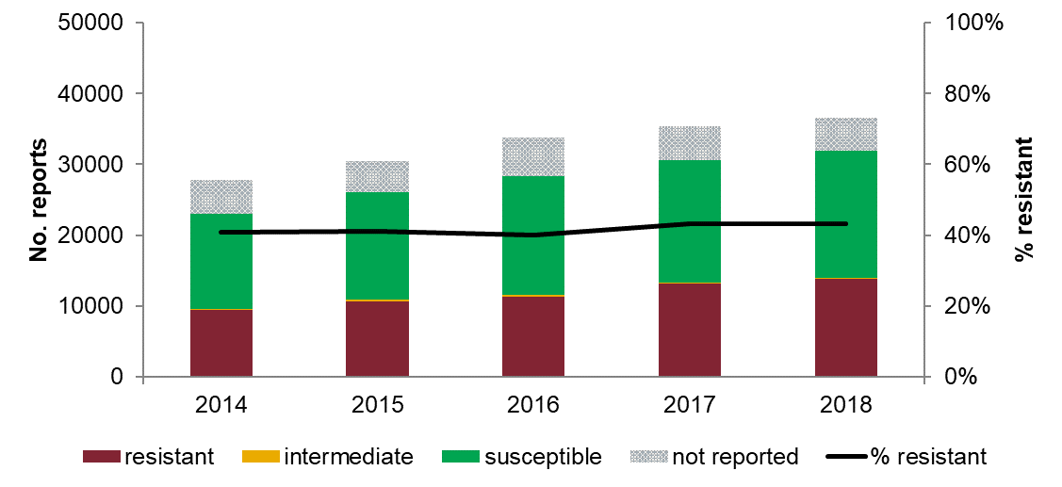
Q1: Answer & Rationale
Estimate the rate of E.coli blood stream infections, which are resistant to co-amoxiclav
0-10%
11-20%
21-30%
31-40%
Over 40%
E. coli isolates from blood resistant to co-amoxiclav, England, 2014-2018
43%
Public Health England (PHE). (2018). Antimicrobial resistance quarterly surveillance: March 2018.
Notes:
E. coli isolates from blood resistant to co-amoxiclav, England 2014-2018 43%
E.Coli Resistance Lab-MSU 20 % (varies by area 10.8 - 30.7%)
Nationally for England, resistance of E. coli (the main causative organism of acute pyelonephritis) in laboratory-processed urine specimens to the following antibiotics is:
cefalexin: 9.9% (varies by area from 8.1 to 11.4%)
ciprofloxacin: 10.6% (varies by area from 7.8 to 13.7%)
co-amoxiclav: 19.8% (varies by area from 10.8 to 30.7%)
trimethoprim: 30.3% (varies by area from 27.1 to 33.4%).
(Public Health England. Antimicrobial resistance quarterly surveillance: March: March 2018)

Slide 5
Q1: Rationale
Increasing burden of infection and antibiotic-resistant infection 2014-2018
Notes:
Slide = English Surveillance Programme for Antimicrobial Utilisation and Resistance (ESPAUR) 2019
According to ESPAUR 2018: “burden of antibiotic-resistant bloodstream infections is particularly marked for those caused by Enterobacteriaceae, particularly E. coli, as they are the infections with the highest incidence, comprising 84.4% of the total.”

Slide 6
Question 2
When should asymptomatic bacteriuria be treated?
Select all that apply
Prior to orthopaedic operation
People with indwelling urinary catheters
Children
Pregnancy
None of the above
rcgp.org.uk/TARGETantibiotics
Notes:
Encourage discussion of the answers for each question before moving onto the answer slides

Slide 7
Q2
Managing asymptomatic bacteriuria
Be aware that asymptomatic bacteriuria:
is significant levels of bacteria in urine, no symptoms of UTI
is not routinely screened for, or treated, in women who are not pregnant, men, young people and children
is routinely screened for, and treated with antibiotics, in pregnant women because it is a risk factor for pyelonephritis and premature delivery [NG109].
Notes:
Urinary tract infection (lower): antimicrobial prescribing (NG109) Rec 1.2 Managing asymptomatic bacteriuria

Slide 8
Q2: Answer
When should asymptomatic bacteriuria be treated?
Select all that apply
a) Prior to orthopaedic operation | No
b) People with indwelling urinary catheters | No
c) Children | No
d) Pregnancy | Yes
e) None of the above | No
rcgp.org.uk/TARGETantibiotics
Notes:
Urinary tract infection (catheter associated):Be aware that:
a catheter-associated urinary tract infection (UTI) is a symptomatic infection of the bladder or kidneys in a person with a urinary catheter the longer a catheter is in place, the more likely bacteria will be found in the urine; after 1 month nearly all people have bacteriuria [NG113 1.1.1]
NICE QS 90
Quality statement: Healthcare professionals do not use dipstick testing to diagnose urinary tract infections in adults with urinary catheters
Resource: QI-UTI mini audit available https://www.nice.org.uk/guidance/ng113/resources
Routine preoperative tests for elective surgery (NG45)
1.7 Urine tests
1.7.1 Do not routinely offer urine dipstick tests before surgery.
1.7.2 Consider microscopy and culture of midstream urine sample before surgery if
The presence of a urinary tract infection would influence the decision to operate.
Urinary tract infection (lower): antimicrobial prescribing (NG109)
Evidence review background states Asymptomatic bacteriuria is not an infection but a commensal colonisation, which should not be treated and therefore should not be screened for, except if it is considered a risk factor in clearly defined situations, such as in pregnant women and prior to urological procedures breaching the mucosa (European Association of Urology guidelines on urological infections 2017).

Slide 9
Question 3
Which of the following would NOT be suitable to treat pyelonephritis?
Select all that apply
Trimethoprim (known sensitivity)
Cefalexin
Nitrofurantoin
Fosfomycin
Pivmecillinam

Slide 10
Q3: Answer & Rationale
Which of the following would NOT be suitable to treat pyelonephritis?
Select all that apply
Trimethoprim (known sensitivity)
Cefalexin
Nitrofurantoin
Fosfomycin
Pivmecillinam
Antibiotics that don't achieve adequate levels in renal tissue e.g. nitrofurantoin, fosfomycin & pivmecillinam, are to be avoided [NG111].

Slide 11
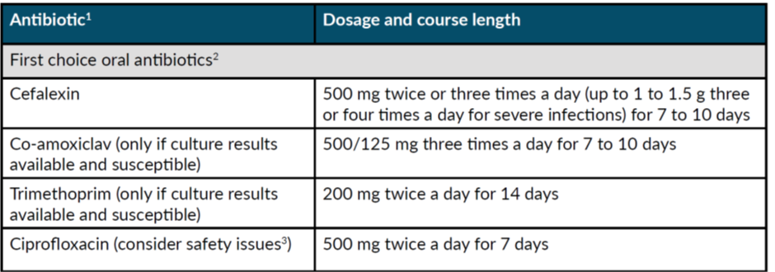
Q3: Rationale
Pyelonephritis (acute): antimicrobial prescribing
Non-pregnant women & men
Antibiotics that don't achieve adequate levels in renal tissue e.g. nitrofurantoin, fosfomycin & pivmecillinam, are to be avoided [NG111].
Notes:
Cefalexin – suitable for women, men , pregnancy & children
Footnote 3 Ciprofloxacin
See MHRA advice for restrictions and precautions for using fluoroquinolone antibiotics due to very rare reports of disabling and potentially long-lasting or irreversible side effects affecting musculoskeletal and nervous systems. Warnings include: stopping treatment at first signs of a serious adverse reaction (such as tendonitis), prescribing with special caution in people over 60 years and avoiding coadministration with a corticosteroid (March 2019).
Footnote 2 Check any previous urine culture and susceptibility results and antibiotic prescribing and choose antibiotics accordingly.
For full guidance see https://www.nice.org.uk/guidance/ng111 and BNF

Slide 12
Question 4
Sarah 29yrs has an appointment to review her cystitis symptoms which didn’t get better with nitrofurantoin prescribed 5 days ago.
No vaginal discharge. | Dipstick test shows nitrite & blood.
Has penicillin allergy, trimethoprim prescribed 2 months ago. | You suspect persisting lower UTI & agree to treat immediately.
What do you do? Vote for all that apply
a) Send MSU | b) Prescribe trimethoprim
c) Prescribe cefalexin | d) Prescribe fosfomycin
e) Prescribe pivmecillinam
rcgp.org.uk/TARGETantibiotics

Slide 13
Q4: Answer & Rationale
Sarah 29yrs has an appointment to review her cystitis symptoms which didn’t get better with nitrofurantoin prescribed 5 days ago.
No vaginal discharge. | Dipstick test shows nitrite & blood.
Has penicillin allergy, trimethoprim prescribed 2 mths ago. | You suspect persisting lower UTI & agree to treat immediately.
a) Send MSU: Yes, always following initial treatment failure [QS90]
If symptoms & signs are mild you may suggest awaiting culture before prescribing.
13
Notes:
Urinary tract infections in adults (QS90)
Statement 4 Adults with a urinary tract infection not responding to initial antibiotic treatment have a urine culture.
Urinary tract infection (lower): antimicrobial prescribing (NG109)
1.1.4 If a urine sample has been sent for culture and susceptibility testing and an antibiotic prescription has been given:
review the choice of antibiotic when microbiological results are available, and
change the antibiotic according to susceptibility results if bacteria are resistant and symptoms are not already improving, using a narrow-spectrum antibiotic wherever possible
If symptoms & signs are mild you may suggest awaiting culture before prescribing.
NG109 Committee discussion: Decisions around prescribing strategies should be individualised, taking account of the severity of symptoms, the risk of developing complications or having treatment failure, and preference for back-up or immediate antibiotics, or awaiting the results of urine culture.

Slide 14
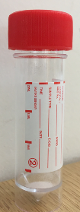
Q4: Answer & Rationale
Suspected UTI: when to send a urine sample?
Send MSU includes:
All men Pregnant women | Suspected acute pyelonephritis or sepsis
Children if unexplained temp >38, Symptoms & signs suggestive of UTI Women who present with atypical symptoms | Treatment failure, symptoms worsen or do not improve Recurrent UTI or high risk of resistance
Change antibiotic according to susceptibility results if bacteria are resistant & symptoms are not already improving, using a narrow-spectrum antibiotic where possible [NG109].
14
Notes:
NICE CG54<16yrs
National Institute for Health and Care Excellence (NICE). (2007). Urinary tract infection in under 16s: diagnosis and management. Clinical guideline [CG54]. www.nice.org.uk/Guidance/CG54/
1.1 Diagnosis
1.1.1 Symptoms and signs
1.1.1.1Infants and children presenting with unexplained fever of 38°C or higher should have a urine sample tested within 24 hours. [2007]
1.1.1.2Infants and children with an alternative site of infection should not have a urine sample tested. When infants and children with an alternative site of infection remain unwell, urine testing should be considered after 24 hours at the latest. [2007]
1.1.1.3Infants and children with symptoms and signs suggestive of urinary tract infection (UTI) should have a urine sample tested for infection. Table 1 is a guide to the symptoms and signs that infants and children present with. [2007]
Reassessment
1.1.15 Reassess if symptoms worsen rapidly or significantly at any time, or do not start to improve within 48 hours of taking the antibiotic, taking account of:
other possible diagnoses
any symptoms or signs suggesting a more serious illness or condition, such as pyelonephritis
previous antibiotic use, which may have led to resistant bacteria.
Send a urine sample for culture and susceptibility testing if this has not already been done and review treatment when results are available (see recommendations 1.1.4, 1.1.7, 1.1.8 and 1.1.12).

Slide 15
Q4: Answer & Rationale
Sarah 29yrs has an appointment to review her cystitis symptoms which didn’t get better with nitrofurantoin prescribed 5 days ago.
No vaginal discharge. | Dipstick test shows nitrite & blood.
Has penicillin allergy, trimethoprim prescribed 2 mths ago. | You suspect persisting lower UTI & agree to treat immediately.
Send MSU: Yes, always following initial treatment failure [QS90]
Prescribe trimethoprim: No, high risk of resistance if issued less than 3 months ago
Prescribe cefalexin: Preferably not, not recommended uncomplicated lower UTI, reserve e.g. for pyelonephritis
Prescribe Fosfomycin: Yes, this is an option (NICE/PHE 2nd line)
Prescribe pivmecillinam: No, it is a penicillin & she is allergic
15
National Institute for Health and Care Excellence (NICE). (2018). Pyelonephritis (acute): antimicrobial prescribing [NG111]. www.nice.org.uk/guidance/ng111/
Notes:
Rationale trimethoprim, fosfomycin, pivmecillinam - see next slide
Rationale cefalexin – Not recommended uncomplicated lower UTI, reserve e.g. for pyelonephritis. See NICE Pyelonephritis NG111 & slide 10

Slide 16
Q4: Rationale
UTI (lower): trimethoprim resistance
Lower risk:
not used past 3 months
previous MSU sensitive (& not used)
younger people where
local resistance is low
Non-pregnant women aged 16 and over
Higher risk:
recent use
older people in residential facilities
DOSING
16
National Institute for Health and Care Excellence (NICE). (2018). Urinary tract infection (lower): antimicrobial prescribing [NG109]. www.nice.org.uk/guidance/ng109/
Notes:
Speaker notes: Note previous NHSE policy of nitrofurantoin first line. Trimethoprim may be appropriate first line if low risk of resistance
NICE UTI (lower) Prescribing table NG 109
Footnote 5 A lower risk of resistance may be more likely if not used in the past 3 months, previous urine culture suggests susceptibility (but this was not used), and in younger people in areas where local epidemiology data suggest resistance is low. A higher risk of resistance may be more likely with recent use and in older people in residential facilities.
Footnote 6 If there are symptoms of pyelonephritis or the person has a complicated UTI (associated with a structural or functional abnormality, or underlying disease, which increases the risk of a more serious outcome or treatment failure)
See the recommendations on choice of antibiotic in the NICE guideline on pyelonephritis (acute): antimicrobial prescribing. NG111
Footnotes
3- Check any previous urine culture and susceptibility results and antibiotic prescribing and choose antibiotics accordingly.
4- May be used with caution if eGFR 30-44 ml/minute to treat uncomplicated lower UTI caused by suspected or proven multidrug resistant bacteria and only if potential benefit outweighs risk (BNF, August 2018).
For full guidance see https://www.nice.org.uk/guidance/ng109 and BNF
Dosing – Prescribers may not be aware of the dosing regime for pivmecillinam

Slide 17
Q4: Rationale
UTI (lower): duration of treatment
3 days:
Women (non-pregnant),
if uncomplicated
Non-pregnant women aged 16 and over
Complicated includes:
structural/functional abnormality
underlying disease, which increases risk of more serious outcome/ treatment failure
*See pyelonephritis guideline
17
National Institute for Health and Care Excellence (NICE). (2018). Urinary tract infection (lower): antimicrobial prescribing [NG109]. www.nice.org.uk/guidance/ng109/
Notes:
Evidence based largely on Systematic review Milo et al. 2005 involved 32 RCTs n=9,605 with proven UTI, [largely quinolones betalactams & cotrimoxazole]
Participant exclusions - symptoms or signs of an upper UTI (costovertebral pain or tenderness, fever, or positive blood cultures).
NICE evidence review https://www.nice.org.uk/guidance/ng109/evidence
Footnotes
6- If there are symptoms of pyelonephritis or the person has a complicated UTI (associated with a structural or functional abnormality, or underlying disease, which increases the risk of a more serious outcome or treatment failure), see the recommendations on choice of antibiotic in the NICE antimicrobial prescribing guideline on acute pyelonephritis
7 days: Men, pregnant women,
Pyelonephritis 7+ days depending on the antibiotic . See slide 10 & pyelonephritis guideline for choice & duration pyelonephritis or complicated UTI

Slide 18
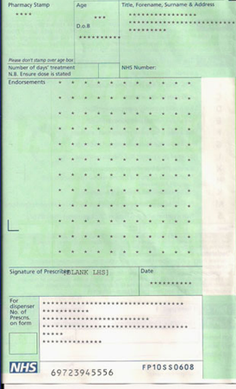
Question 5
Recurrent UTI: review of prophylactic antibiotics
Ms S is 59yrs attends for medication review. She has been taking antibiotics for 15 months for recurrent UTIs*.
What do you want to consider during the review?
*Recurrent UTI in adults = 2+ last 6 months
or 3+ last 12 months
18
Notes:
Recurrent UTI in adults = 2+ last 6 months or 3+last 12 months
European Association of Urology [EAU] guidelines on urological infections 2017.

Slide 19
Q5: Answer & Rationale
Recurrent UTI: review of prophylactic antibiotics
Ms S is 59yrs attends for medication review. She has been taking antibiotics for 15 months for recurrent UTIs.
Considerations:
Has she had investigation for underlying cause?
Discussing whether to continue, stop or change antibiotic
Any breakthrough (acute) UTIs?
Reminders about self care, behavioural & personal hygiene measures
Recent MSU – does this alter prophylactic choice?
19
rcgp.org.uk/TARGETantibiotics
Notes:
1.1.11 When a trial of daily antibiotic prophylaxis is given, give advice about:
the risk of resistance with long-term antibiotics, which means they may be less effective in the future
possible adverse effects of long-term antibiotics
returning for review within 6 months
seeking medical help if there are symptoms of an acute UTI. [UTI (recurrent) NG112]

Slide 20
Q5: Answer & Rationale
Recurrent UTI: review of prophylactic antibiotics
1.1.16 Review antibiotic prophylaxis for recurrent UTI at least every 6 months.
Has she had investigation for underlying cause? Referral criteria?
Discussing whether to continue, stop or change antibiotic incl. risk of resistance?
Any breakthrough (acute) UTIs?
Reminders* about self care, behavioural & personal hygiene measures
Recent MSU – does this alter prophylactic choice?
If antibiotic prophylaxis is stopped, ensure that people have rapid access to treatment if they have an acute UTI.
*What advice?
20
National Institute for Health and Care Excellence (NICE). Urinary tract infection (recurrent): antimicrobial prescribing [NG112]. www.nice.org.uk/guidance/ng112
Notes:
1.1.11 When a trial of daily antibiotic prophylaxis is given, give advice about:
the risk of resistance with long-term antibiotics, which means they may be less effective in the future
possible adverse effects of long-term antibiotics
returning for review within 6 months
seeking medical help if there are symptoms of an acute UTI.
1.1.16 Review antibiotic prophylaxis for recurrent UTI at least every 6 months, with
the review to include:
assessing the success of prophylaxis
discussion of continuing, stopping or changing prophylaxis (taking into account the
person's preferences for antibiotic use and the risk of antimicrobial resistance)
a reminder about behavioural and personal hygiene measures and self-care treatments
(see the recommendations on self-care).
If antibiotic prophylaxis is stopped, ensure that people have rapid access to treatment
Referral information – see next slide

Slide 21
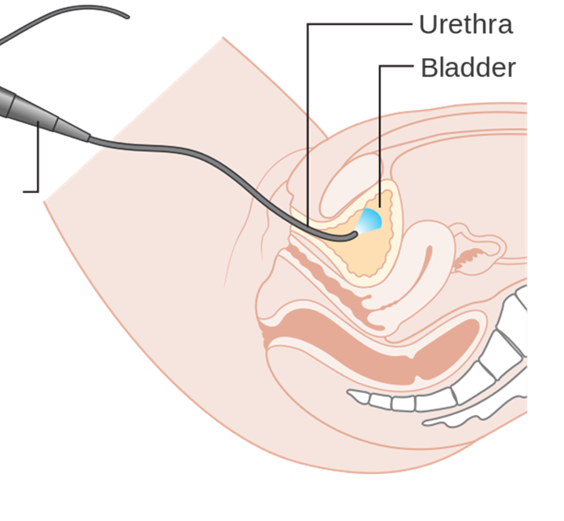
Q5: Rationale
Recurrent UTI: review of prophylactic antibiotics
Seek specialist advice for:
men 16+ yrs | pregnant women
recurrent upper UTI | under 16 yrs see CG54
recurrent lower UTI, cause unknown | suspected cancer
Suspected cancer [NG12]
45yrs+: | unexplained visible haematuria, no UTI visible haematuria recurs after successful treatment UTI
60yrs+: | unexplained non-visible haematuria & either dysuria or raised WCC (blood)
60yrs+: | (non-urgent) recurrent or persistent unexplained UTI
21
National Institute for Health and Care Excellence (NICE). Urinary tract infection (recurrent): antimicrobial prescribing [NG112 1.1.4]. www.nice.org.uk/guidance/ng112
Notes:
Urinary tract infection (recurrent): antimicrobial prescribing (NG112)
1.1.4 Refer or seek specialist advice on further investigation and management for:
men aged 16 years and over
people with recurrent upper UTI
people with recurrent lower UTI when the underlying cause is unknown
pregnant women
children and young people under 16 years in line with the NICE guideline on urinary
tract infection in under 16s
people with suspected cancer in line with the NICE guideline on suspected cancer: recognition and referral.
Suspected cancer: recognition and referral (NG12)
Bladder cancer
1.6.4 Refer people using a suspected cancer pathway referral (for an appointment within 2 weeks) for bladder cancer if they are: aged 45 and over and have: unexplained visible haematuria without urinary tract infection or visible haematuria that persists or recurs after successful treatment of urinary tract infection, or aged 60 and over and have unexplained non-visible haematuria and either dysuria or a raised white cell count on a blood test. [new 2015]
1.6.5 Consider non-urgent referral for bladder cancer in people aged 60 and over with recurrent or persistent unexplained urinary tract infection. [new 2015] Renal cancer 1.6.6 Refer people using a suspected cancer pathway referral (for an appointment within 2 weeks) for renal cancer if they are aged 45 and over and have: unexplained visible haematuria without urinary tract infection or visible haematuria that persists or recurs after successful treatment of urinary tract infection. [new 2015]

Slide 22
Patient ‘Treating Your Infection’ UTI leaflet
For women with suspected lower UTI
For women under 65 with suspected lower UTI or lower recurrent UTI
Wipe from front (vagina) to back (bottom).
Avoid waiting to pass urine.
Wee after having sex.
Wash the external vagina area with water before and after sex.
Drink enough fluids to make sure you wee regularly.
22
rcgp.org.uk/TARGETantibiotics
Notes:
Speaker note – clarify that the audience will not be able to read the detail of the chart. Consider handing out hard copies, advising search for “RCGP TARGET UTI leaflet” or providing the link below
It may help you to consider these risk factors:
Stop bacteria spreading from your bowel into your bladder. Wipe from front (vagina) to back (bottom) after using the toilet.
Avoid waiting to pass urine. Pass urine as soon as you need a wee.
Go for a wee after having sex to flush out any bacteria that may be near the opening to the urethra
1. Possible urinary symptoms & other things for GP & patient to consider
2. Outcome and plan can be personalised
3. Flow chart helps patient understand antibiotics and resistance
Presenter notes:
The Patient Urinary Tract Infection (UTI) Information leaflet has been designed to be used during consultation with women who have a suspected UTI
It is a useful tool for clinicians to use whether the patient needs an antibiotic prescription or not.
It explains the treatment decision pathway, and therefore is also helpful for less experienced staff.
It includes information on the types of UTI, which are often misunderstood by patients and health care staff, illness duration, self-care advice, prevention advice and advice on when to re-consult.
Use of this leaflet has been approved by PHE, RCGP, NHS Wales, Scottish UTI Network (SUTIN), RPS and BIA.
The leaflet can also be linked to your computer clinical systems
https://www.rcgp.org.uk/clinical-and-research/resources/toolkits/amr/target-antibiotics-toolkit/uti-resource-suite.aspx

Slide 23
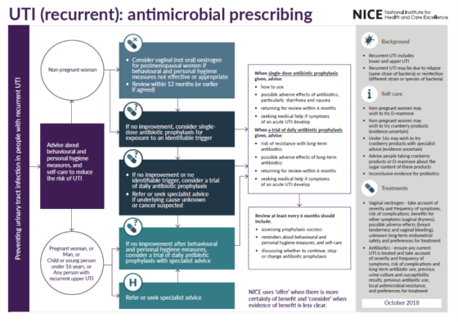
Recurrent UTI: antimicrobial prescribing
Vaginal (not oral) oestrogen
Single dose antibiotic prophylaxis for identifiable trigger
Underlying cause?
If no improvement after behavioural & personal hygiene measures consider trial of daily prophylaxis with specialist advice
23
National Institute for Health and Care Excellence (NICE). Urinary tract infection (recurrent): antimicrobial prescribing [NG112]. www.nice.org.uk/guidance/ng112
Notes:
Oestrogen
1.1.5 Consider the lowest effective dose of vaginal oestrogen [1] (for example, estriol cream) for postmenopausal women
with recurrent UTI if behavioural and personal hygiene measures alone are not effective or not appropriate. Discuss
the following with the woman to ensure shared decision-making:
the severity and frequency of previous symptoms
the risk of developing complications from recurrent UTIs
the possible benefits of treatment, including for other related symptoms, such as vaginal dryness NNT=3
the possible adverse effects such as breast tenderness and vaginal bleeding (which should be reported because it may require investigation) NNH=5
the uncertainty of endometrial safety with long-term or repeated use
preferences of the woman for treatment with vaginal oestrogen.
Review treatment within 12 months, or earlier if agreed with the woman.
1.1.6 Do not offer oral oestrogens (hormone replacement therapy) specifically to
reduce the risk of recurrent UTI in postmenopausal women
[Urinary tract infection (recurrent): antimicrobial prescribing (NG112)]

Slide 24
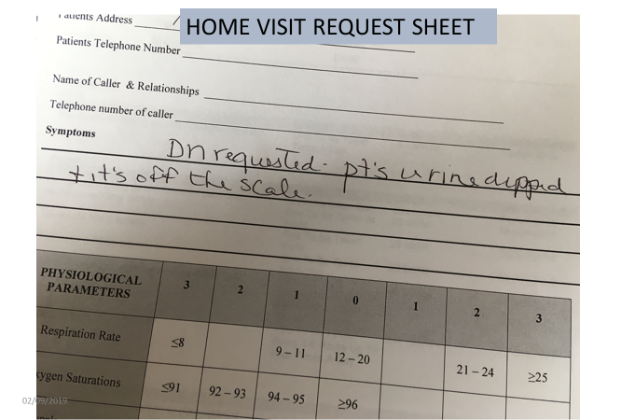
What do you want to ask?
24
rcgp.org.uk/TARGETantibiotics
Notes:
Home visit request sheet, D/N request . Patient’s urine dipped and it’s off the scale”
87 yr.-old man has moderate cognitive impairment, & history of benign prostatic hypertrophy, a long-term indwelling catheter, (on urologist advise) The D/N request a home visit because he is more confused than normal .

Slide 25
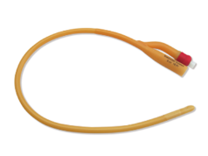
Catheter UTI
87 yr-old man, cognitive impairment, long-term indwelling catheter. HV request, more confused, +ve dip
Fever?
Pelvic discomfort, flank pain?
Confusion: Duration & details, other causes?
PINCH ME (next slide)
Why dipped?
25
rcgp.org.uk/TARGETantibiotics

Slide 26
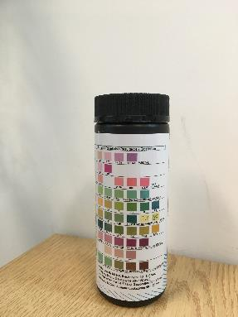

UTI in adults
Healthcare professionals do not use dipstick testing to diagnose UTIs in adults with urinary catheters [QS90].
The patient's clinical need for catheterisation should be reviewed regularly and the urinary catheter removed as soon as possible [CG139].
26
NICE. (2015). UTI in adults [QS90].
NICE. (2012). Healthcare-associated infections: prevention and control in primary and community care [CG139].
Notes:
Statement 2. Healthcare professionals do not use dipstick testing to diagnose UTIs in adults with urinary catheters. [QS90]

Slide 27
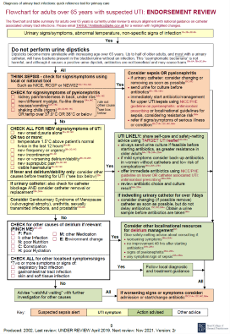
PINCH ME
Check for other causes of delirium if relevant
Flowchart for adults over 65 with suspected UTI
P: Pain
I: other Infection
N: poor Nutrition
C: Constipation
H: poor Hydration
M: other Medication
E: Environment change
27
Public Health England (PHE). (2019). Flowchart for adults over 65 years with suspected UTI. www.rcgp.org.uk/TARGET-QRT
Notes:
PHE Diagnostic flow charts for older adults (over 65yrs) includes this reminder to consider other causes for confusion and delirium

Slide 28
The following slides assess back-up prescribing, consider leaving out if time is short or not of interest to the group.
28
rcgp.org.uk/TARGETantibiotics

Slide 29
Question 6
In which of the following may back-up antibiotic prescribing
be appropriate?
Vote for all that apply
5 yr old girl with suspected UTI
26 yr-old woman with symptoms of cystitis, to use within 5d if symptoms not improving
40 yr-old woman with symptoms of cystitis, to use within 2d if symptoms not improving
52 yr-old woman had 3 courses of antibiotics in last 12 mths, with symptoms of cystitis, to use within 2d if symptoms not improving
29
rcgp.org.uk/TARGETantibiotics
Notes:
The following slides assess back-up prescribing, consider leaving out if time is short or not of interest to the group.

Slide 30
Q6: Answer & Rationale
Back-up antibiotic prescribing
a) 5 yr old girl with suspected UTI No, children treat immediately
b) 26 yr-old woman with symptoms of cystitis, to use within 5d if symptoms not improving No, worse outcome if delayed 48+hrs
c) 40 yr-old woman with cystitis symptoms, to use within 2d if symptoms not improving Consider
d) 52 yr-old woman had 3 courses of antibiotics in last 12 mths, with symptoms of cystitis, to use within 2d if symptoms not improving Consider
Consider back-up presc. (use if symptoms do not start to improve within 48 hrs or worsen) or immediate antibiotic. Evidence was from [adult] women not needing immediate treatment [NG109].
30
National Institute for Health and Care Excellence (NICE). (2018). Urinary tract infection (lower): antimicrobial prescribing [NG109]. www.nice.org.uk/guidance/ng109/
Notes:
Evidence = women with mild- moderate symptoms , & woman not needing immediate antibiotics
Offer an immediate antibiotic
Offer an immediate antibiotic prescription…to pregnant women and men with lower UTI. [NG 109 1.1.5]
Offer an immediate antibiotic prescription for children and young people under 16 years with lower UTI. [NG109 1.1.11]
Offer an [immediate] antibiotic to people with acute pyelonephritis. [NG 111 1.1.5]

Slide 31
Q6: Rationale
Acute, uncomplicated cystitis
UK natural history study, n=843 (Little et al. 2009)
Women with suspected cystitis and moderately severe symptoms:
3.3 days in women treated with an antibiotic to which the pathogen was sensitive
4.9 days in women with infection not treated with an antibiotic
No adverse outcomes in these groups
31
Little et al. (2009). DOI: 10.3310/hta13190
Notes:
Evidence review background – Little
UK Natural history study n=843 Little et al. 2009
women with suspected cystitis and moderately severe symptoms
3.3 days in women treated with an antibiotic to which the pathogen was sensitive
4.7 days in women treated with an antibiotic to which the pathogen was resistant
4.9 days in women with infection not treated with an antibiotic.
No adverse outcomes in these groups
[NNT to prevent progression to Bloodstream infection >200]
.

Slide 32
Q6: Rationale
Acute, uncomplicated cystitis
Antibiotics compared with placebo
Systematic review (Falagas et al. 2009)
Antibiotics significantly increased the proportion of women having complete symptom resolution after treatment for a lower UTI, compared with placebo
4 RCTs, n= 1,062; 62% vs. 26%; RR 2.26 95% CI 1.79 to 2.86
NNT 3; high quality evidence
The incidence of pyelonephritis did not differ significantly between those who received antibiotics or placebo (2 RCTs, n= 742; adequate Power?)
32
Falagas et al. (2009). DOI: 10.1016/j.jinf.2008.12.009
Notes:
Evidence review 3.3.3
A systematic review (Falagas et al. 2009; 5 RCTs, n=1,407) assessed the effectiveness of antibiotics in managing symptoms of uncomplicated lower UTI in non-pregnant women with uncomplicated cystitis, compared with placebo. The age of the included women varied across the studies, ranging from 15 to 75 years. Most women were reported to have mild to moderate symptoms. Only studies which confirmed the presence of a UTI (either with a positive dipstick or positive culture) were included in the review.

Slide 33
Q6: Rationale
Acute, uncomplicated cystitis: back-up prescribing
RCT (Little et al. 2010)
Assessed various antibiotic prescribing strategies
Population:
Non-pregnant women with acute uncomplicated lower UTI, immediate antibiotic treatment not necessary | N= 309, Mean age 39-45 yrs Moderate symptoms
Strategies:
Immediate vs back-up (delayed by 48 hrs) empirical antibiotics
Immediate antibiotics based on either symptom severity score >2, positive dipstick test, or midstream urine culture result.
33
Little et al. (2010). DOI: 10.1136/bmj.c199
Notes:
Guideline & Evidence review NG109
One RCT (Little et al. 2010) assessed various antibiotic prescribing strategies
Population: non-pregnant women with acute uncomplicated lower UTI, where immediate antibiotic treatment was not necessary.
The women included in the study had a mean age of 39 to 45 years
Moderate symptoms (mean score of 1.7 to 1.8, on a scale of 0=no problem, 1=mild problem, 2=moderately bad problem, 3=severe problem) at baseline.
Strategies
5 different antibiotic prescribing strategies (immediate antibiotics, back-up antibiotics and 3 targeted antibiotics groups),
Immediate antibiotics (trimethoprim 200 mg twice a day for 3 days; cefaclor or cefalexin if allergic to trimethoprim).
Empirical back-up antibiotics (women were advised to drink plenty, and offered a back-up antibiotic prescription if symptoms did not improve after 48 hours; women could either pick up the prescription from the front desk or take away a prescription).
Targeted antibiotics based on a positive result on midstream urine analysis (women were offered symptomatic treatment until results of the analysis were available).
Targeted antibiotics based on positive dipstick result (if nitrite or both leucocytes and a trace of blood were present, women were offered antibiotics immediately).
Targeted antibiotics based on a symptom score (two or more of urine cloudiness, urine smell, nocturia, or dysuria).
Outcomes
No difference between the different prescribing strategies in severity or duration of symptoms or time to reconsultation (low to very low quality evidence).
A delay of more than 48 hours was associated with a longer duration of moderately bad symptoms (very low quality evidence). [Note recommendation to use back-up antibiotic if symptoms do not start to improve within 48 hours or worsen at any time]
significantly more women who were prescribed immediate antibiotics used them, compared with all other prescribing strategy groups, except immediate antibiotics based on symptom severity scoring (very low quality evidence).
Guideline discussion Decisions around prescribing strategies should be individualised, taking account of the severity of symptoms, the risk of developing
complications or having treatment failure, and preference for back-up or immediate antibiotics, or awaiting the results of urine culture.

Slide 34
Q6: Rationale
Acute, uncomplicated cystitis: back-up prescribing
RCT (Little et al. 2010)
Outcomes:
Only two-thirds of women randomised to receive antibiotics based on a midstream urine result had a positive urine culture.
No difference between different prescribing strategies in severity or duration of symptoms or time to re-consultation (low to very low quality evidence)
Guideline discussion: Decisions around prescribing strategies should be individualised, taking account of symptom severity, risk of developing complications or treatment failure, & preference for back-up or immediate antibiotics, or awaiting results of urine culture.
34
Little et al. (2010). DOI: 10.1136/bmj.c199
Notes:
Guideline & Evidence review NG109
One RCT (Little et al. 2010) assessed various antibiotic prescribing strategies
Population: non-pregnant women with acute uncomplicated lower UTI, where immediate antibiotic treatment was not necessary.
The women included in the study had a mean age of 39 to 45 years
Moderate symptoms (mean score of 1.7 to 1.8, on a scale of 0=no problem, 1=mild problem, 2=moderately bad problem, 3=severe problem) at baseline.
Strategies
5 different antibiotic prescribing strategies (immediate antibiotics, back-up antibiotics and 3 targeted antibiotics groups),
• Immediate antibiotics (trimethoprim 200 mg twice a day for 3 days; cefaclor or cefalexin if allergic to trimethoprim).
• Empirical back-up antibiotics (women were advised to drink plenty, and offered a back-up antibiotic prescription if symptoms did not improve after 48 hours; women could either pick up the prescription from the front desk or take away a prescription).
• Targeted antibiotics based on a positive result on midstream urine analysis (women were offered symptomatic treatment until results of the analysis were available).
• Targeted antibiotics based on positive dipstick result (if nitrite or both leucocytes and a trace of blood were present, women were offered antibiotics immediately).
• Targeted antibiotics based on a symptom score (two or more of urine cloudiness, urine smell, nocturia, or dysuria).
Outcomes
No difference between the different prescribing strategies in severity or duration of symptoms or time to reconsultation (low to very low quality evidence).
A delay of more than 48 hours was associated with a longer duration of moderately bad symptoms (very low quality evidence). [Note recommendation to use back-up antibiotic if symptoms do not start to improve within 48 hours or worsen at any time]
significantly more women who were prescribed immediate antibiotics used them, compared with all other prescribing strategy groups, except immediate antibiotics based on symptom severity scoring (very low quality evidence).
Guideline discussion Decisions around prescribing strategies should be individualised, taking account of the severity of symptoms, the risk of developing
complications or having treatment failure, and preference for back-up or immediate antibiotics, or awaiting the results of urine culture.

Slide 35


NICE decision aids
35
National Institute for Health and Care Excellence (NICE). (2018). Decision aid. Cystitis: taking an antibiotic. www.nice.org.uk/guidance/ng109/resources/
Notes:
Resources
1. Decision aids are available on the NICE website, see individual guideline tab tools and resources –decision aids
Cystitis - Information to help women who are not pregnant discuss the options with their healthcare professionals NG109 https://www.nice.org.uk/guidance/ng109/resources/decision-aid-cystitis-taking-an-antibiotic-pdf-6600949165
Reducing the chance of recurrent urinary tract infection (UTI) in postmenopausal women
https://www.nice.org.uk/guidance/ng112/resources/decision-aid-reducing-the-chance-of-recurrent-urinary-tract-infection-uti-in-postmenopausal-women-pdf-6600984158
2. NICE endorsed UTI Resource : Wales QI - UTI (GMS 2019/20) https://phw.nhs.wales/services-and-teams/harp/urinary-tract-infection-uti-resources-and-tools/uti-accordian/audit-quality-improvement-tools/
4 Mini-audits available :
1. Healthcare professionals do not use dipstick testing to diagnose UTI in adults with urinary catheters [NICE QS 90]
2. People prescribed an antimicrobial for UTI, have the clinical indication documented in their clinical record. [NICE QS 120, WHC 18/20, UK plan]
3. Review of urinary prophylaxis [PHW UTI standards, NICE]
4. Adults with a UTI not responding to initial antibiotic treatment have a urine culture [NICE QS 90]

Slide 36

UTI Rapid Update Quiz
What will you do differently?
36
rcgp.org.uk/TARGETantibiotics
Notes:
Evaluation sheet below if needed.
Please consider sharing the collated feedback from your session to help the development of future resources (email to tessa.lewis1@btinternet.com)
UPDATE
Prescribing Guidance: UTI (NICE)
Evaluation Form
Insert date
Location
Presenter
Role: GP / Pharmacist / other __________________________________________________________
Your feedback is very important. Please use this questionnaire to let us know your thoughts about the session.
Please rate by circling the most appropriate response
Which UTI slide sets were used (i) Quiz (ii) Evolving case study (iii)Features of UTI ?
☺ ☹
1. UTI update session overall 5 4 3 2 1
2. Opportunity to share ideas or issues about 5 4 3 2 1
the management of UTI
3. This session improved my knowledge about5 4 3 2 1
the management of UTI
4. For a future update session on NICE prescribing guidelines, please state the level of detail that is useful
More detail About the same Less detail
5. As a result of this session I will change my practice Yes No
Please note any proposed changes to practice
6. Any other feedback
Many thanks for taking the time to complete this evaluation
tessa.lewis1@btinternet.com

Slide 37
Acknowledgements
This resource has been developed by a common infections working group and is not produced or maintained by NICE or PHE. Members are volunteers from the NICE Managing Common Infections prescribing guideline committee and include lay members, GPs, pharmacists, Public Health clinicians.
The contributors are grateful to NICE & TARGET for endorsing and hosting this UTI rapid update slide set.
Thanks to Ian Hill-Smith, John Morris, Cliodna McNulty, Carole Pitkeathley, Avril Tucker, Caroline Ward, Alastair Hayes, Elizabeth Beech, Tessa Lewis (lead)
For comment on whether this was helpful or advice for future slide sets please email: tessa.lewis1@btinternet.com
37
rcgp.org.uk/TARGETantibiotics
Notes:
UTI V1.13 June 2020

