Slide 1
What did we do?
Grange Road Practice
Dr Douglas Redpath
Owen Thomas
Emily Nichols
Practice Overview
List size: c11,000 patients
11 GPs
City, deprived area
Approach:
Update and maintain Usual GP field
Focus: people who Attend Frequently
Microteams

Slide 2
Grange Road
Identification
Ran the Usual GP Reallocation Tool.
Identified patients who had >25 GP appointments in the previous 12 months. This gave a cohort of 40 patients.
Held Clinical Meeting to review cohort with our GP Team to decide who was suitable and who should be exempt from project. Patients were split: people who attend frequently & people with mental health challenges who attend frequently.
To maintain cohort of 40 patients, all exempt patients were replaced with another person who attended frequently.
Preparation
Each GP was asked to decide on the action needed for their patients in the cohort. The GP making the decision was the GP who had seen the patient the most over the past 12 months. See ‘Resources’ for how this data was collected.
Microteams – the practice had established GP & Buddy teams prior to this project. There are 4 Microteams of Usual GP and GP Buddy and a fifth Microteam of Usual GP and 2 GP Buddies. Information was shared through catch up at coffee breaks. Although there was a system in place, the project has given continuity much more of a push from all GPs to ensure going to usual GP then buddy is standard.
EMIS
Patient Cohort –
CoC of care added together with a Pop Up Reminders. The pop up was added individually to each patient record in the cohort and gives GP recommendations for the patient so Reception know what to offer the patient.
All Patients –
At the Reception desk patients are asked for their Usual GP. If patients are unsure, Team checks recent consultations and updates field if needed. This is done for both urgent and routine appointments.
Information
Introduction to Continuity of Care Project for whole practice team (see Resource Toolkit).
Reception Team Training
Continuity is regular item for monthly team meetings
Staff awareness to check Usual GP and amend
Staff awareness of cohort, pop ups and letters
Registration: patients calling for first appt are put with their named GP, reception explain this is important.
Patient letters sent (see later in this document).
Welcome message on phone to remind patients continuity is important.
‘My Care’ Patient Leaflets, Poster and Animation displayed in Reception.

Slide 3
What did the data tell us?
The Usual GP Reallocation data gave us some insights….
Patients
8% of our patients visited us 9 or more times in the past 12 months;
And used 27% of total appointments.
Almost 70% of our patients had visited us at least once in the past 12 months.
We drilled into the Frequently Attending (FA) cohort to identify patterns, looking at:
Mental health or physical health?
Appointment types - are they booking Same Day?
How do they book?
Who do they see (usual GP or are they going round the whole team)?
We noticed some patients who attend frequently get particularly high continuity, e.g. drug users. These patients provided an opportunity for us to learn.
GPs
2 of our GPs had a higher number of patients who were frequently attending (attended 9 or more times in a year).
We have explored why that is and we anticipate our approach will help redress the balance of work across the GP Team.

Slide 4
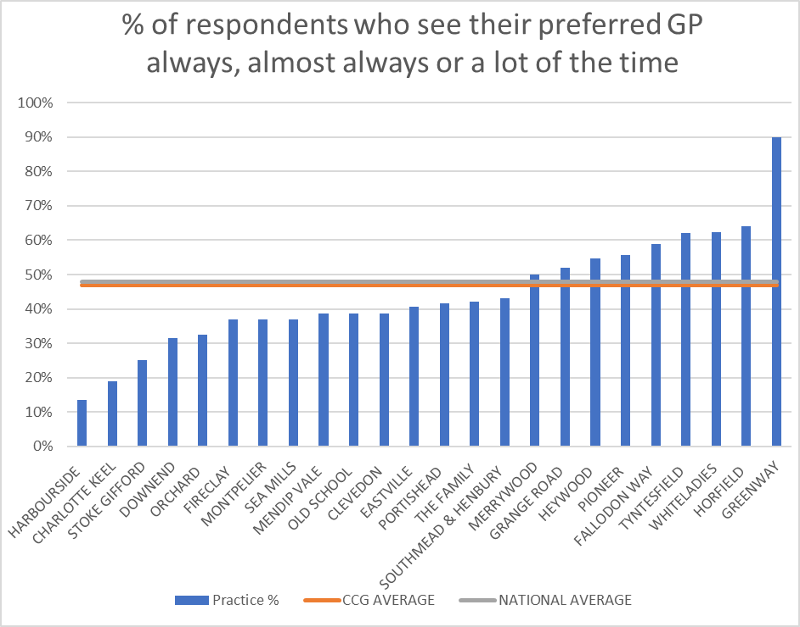
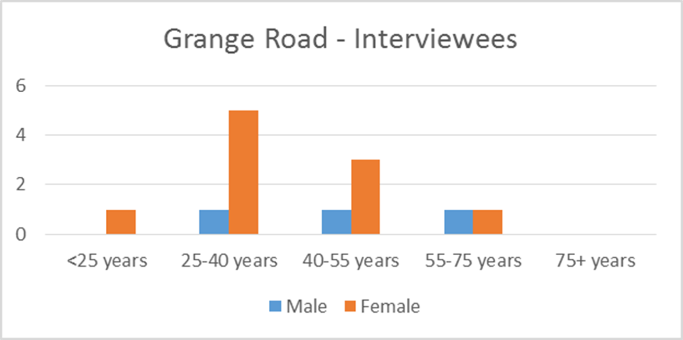
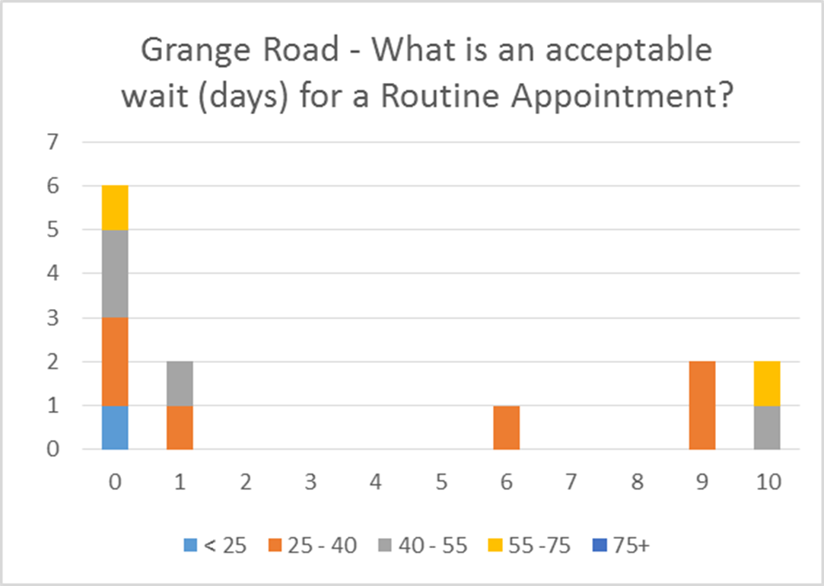
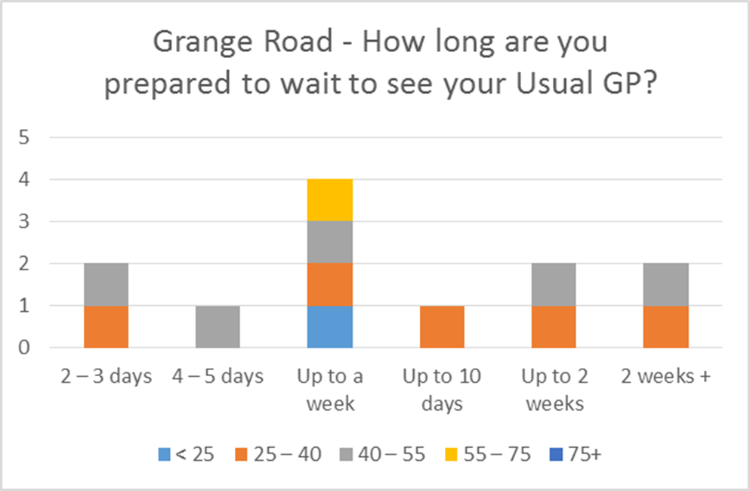
Why did we join?
Continuity of care is important to GPs at Grange Road and to our patients
GP Patient Survey Results 2019
Waiting Room Interviews
A small sample of patients in the waiting room were asked for their views. Most reported they did not think it was acceptable to wait for a Routine Appointment. However, many patients said they would wait for a week to see their Usual GP supporting our view on the importance of continuity of care.
According to the respondents, we are just above average so there is room to improve continuity of care.

Slide 5

Resources:
Letters
Letter to frequently attending mental health patients
Letter to frequently attending patients
GP Decision Action Sheet - EMILY
Telephone answering/holding message script:
“Continuity of care is extremely important so please try and book in with your regular GP when possible”.
Response:
2 patients were initially resistant to telephone triage

Slide 6
Appointment Booking
Patient contacts Reception Team to book an appointment.
Reception Team asks patient for name of their Usual GP.
On loading record, check done on Usual GP field and updated if needed.
If patient is part of the FA cohort, a pop up will be triggered letting Reception Team know the GP’s recommendations for booking this patient.
Reception Team following GP instructions and book appropriate appointment (urgent, routine or telephone triage) with Usual GP or member of Microteam at the next available appointment.
If there is no appointments within the next 2 weeks patient advised to call back (provided with a day where their usual GPs appointments are released), or booked in with ‘buddy’ if unable to wait.
Urgent appointments are also booked in with usual GP, or buddy if they are not available. If neither is in surgery this will fall to whichever GP is available/any GP they have seen before.

