Slide 1
Greenway Community Practice Dr Liz Grimshaw & Jade Hobden
Practice Overview
No of GPs | 8
Patient Population | 9,157
Location | Southmead, Bristol
CoC Approach | Usual GP & All Patients
CoC Status | Practice uses personal lists and has high levels of continuity.
March 2021

Slide 2
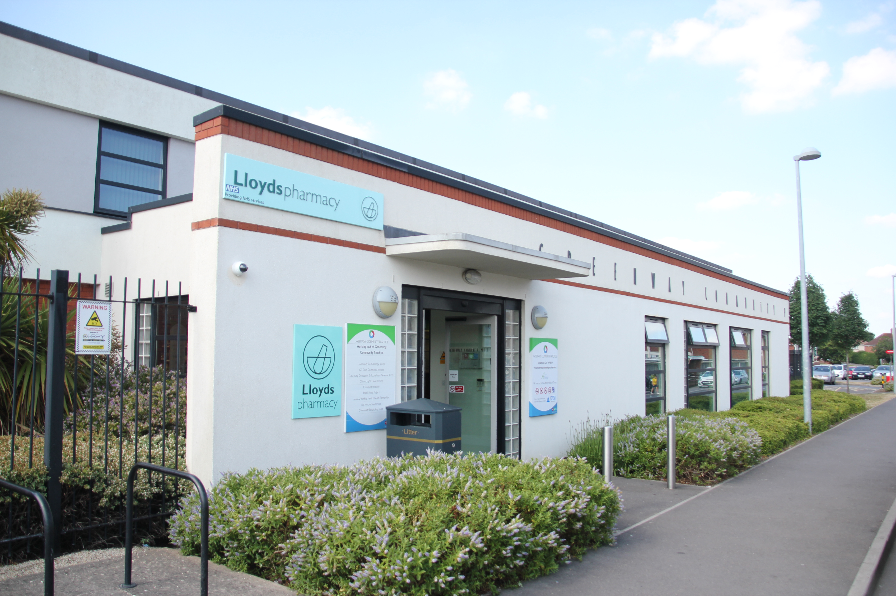
Where is the practice?
Practice Demographics
Greenway Community Practice, Greystoke Avenue, Southmead, Bristol, BS10 6AF
Our Mission
Our Practice is dedicated to providing quality, patient-centred health care by helping individuals achieve a sense of well being, whatever their particular needs, working in partnership with our local community.
Our Philosophy
We learn from all we do and value and support both our patients and staff.
Age Band | Total | Female | Male
0-4 | 557 | 264 | 293
5-16 | 1452 | 709 | 743
17-24 | 780 | 421 | 359
25-34 | 1478 | 757 | 721
35-44 | 1399 | 671 | 728
45-54 | 1150 | 560 | 590
55-64 | 940 | 464 | 476
65-74 | 677 | 348 | 329
75-84 | 499 | 284 | 215
85-89 | 150 | 92 | 29
90+ | 89 | 60 | 29
TOTAL | 9171 | 4630 | 4512

Slide 3
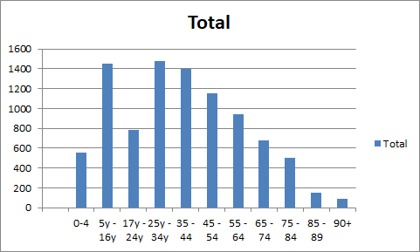
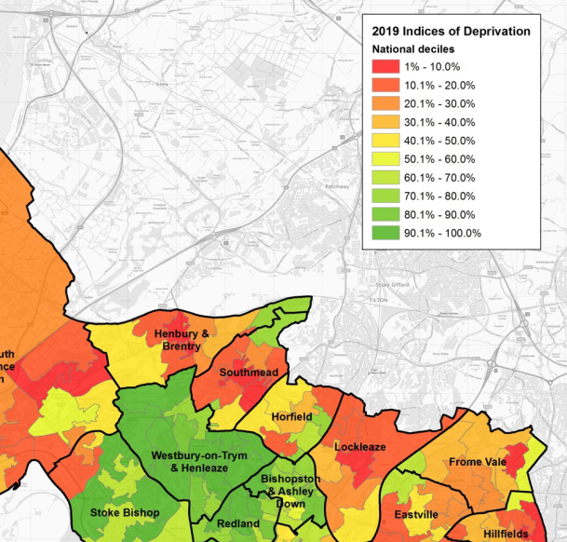
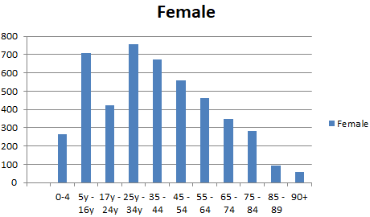
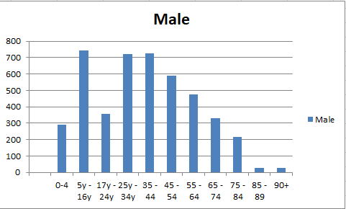
Practice Demographics

Slide 4
Greenway Community Practice
The practice has had personal lists since its inception more than 50 years ago.
We average 85 new patients per month and 50 deregister. There is a lot of movement of patients in temporary/council accommodation.
GP recruitment at GCP is relatively easy. Continuity provides greater job satisfaction and greater patient satisfaction and consequently decreases workload.
We have 7.3 WTE GPs.
Minimum sessions worked is 6.29 and the maximum is 7.29 (all including one admin session per week).
There are 3 male GPs and 5 female.
GPs all work across 4 days to provide better access for their patients.
All GPs work Mondays and Fridays.

Slide 5
Perspectives on Continuity of care
GPs We believe continuity of care is more efficient, increases job satisfaction, increases patient satisfaction, reduces home visits and reduces our workload overall. Reception Life is easier with continuity for our regular/long term patients, they have built a relationship with their GP who knows their history and understands their needs, this results in more efficient use of appointment times. These patients are willing to wait a few more days to see their UGP. The patients that only contact their GP occasionally can find this system frustrating , as do the new patients that have never met their UGP in person. They would prefer to see any doctor. Operating with a personal list can make life very challenging for a receptionist as they are restricted in what they can offer the patient.
Nurses
Patients like to see the same GP and build up a relationship. The GP is more aware of what is going on with 'their' patient rather than having to spend valuable time scanning back through patient history and letters.
Also either clinicians and admin staff know who the best point of contact is to discuss any issues regarding a specific patient.
The appointment list is run very efficiently so that patients can usually speak to or see their own GP within a couple of days. They have the option of speaking to the duty GP if their own GP is away or on a day off but they can also make their own decision re: if they are happy to wait and speak to their named GP. Anything that puts some responsibility for managing their own health on to the patient is a good thing.

Slide 6
Perspectives on Continuity of care
Patient
My doctor and I have a history, we have built a relationship over time. So that when I have a consultation there is a memory as well as a record of what has previously happened. This is important with ongoing medical conditions and saves time. There is a context for the conversation between the patient and the doctor. My GP has got to know me and knows that I am very keen on an element of Self Care in my treatment. She can suggest things which she knows I am receptive to. Trust is built up between the patient and doctor. I believe it offers an opportunity for the doctor to learn from the patient and puts ongoing problems in a context. When I am ill, I feel vulnerable and at times anxious, my doctor has learnt this about me and can reassure and contain me. If the named GP is not available then the receptionist can refer to the on call doctor, this works if it is an emergency if instant advice is needed or there is the option to wait for my named GP to return. I appreciate the discourse between me and my doctor. She will ask questions but also honestly says what she is thinking and clarifying my experience. The receptionist has an important role in this. In sensitively triaging the patient, in reliably taking a message and passing it on to the respective GP.
Greenway is a very efficient practice, they have systems in place that help the medical process. If my doctor says she will do something e.g. Make a referral it happens! She is reliable. Likewise the practice has a reliable system for processing routine tests, making appointments, repeat prescriptions etc.
For me Continuity of Care at Greenway helps me to manage my medical conditions with confidence as I know that I am working in partnership with my doctor and the practice for my health and wellbeing.
Norma Wilson, Patient and Co-chair of Greenway PPG.
2 March 2021

Slide 7
How does the practice maintain continuity?
At registration, a patient is given a photo of their new GP and timetable of their working days and hours. (Pre-Covid 19 this was a postcard. Currently they are directed to the website)
They are made aware that they will only ever be booked in with their own GP, except in a medical emergency, when their own GP is absent.
This information is available for patients on our website, practice leaflet and welcome letter.
The GP decides whether new patients require a face to face new patient check based on their past medical history.
The COVID – 19 pandemic has changed these face to face appointments into new patient telephone consults.
Families are kept with the same GP for generations.
The receptionist will always check who the usual GP is when booking an appointment.
Patients are prepared to wait 3-5 days to see their usual GP.
Patients are always asked by reception if they are phoning about something urgent that cannot wait until their own GP’s next working day.

Slide 8
How does the practice maintain continuity?
Patients are allowed to change GP once. After this, they are not allowed to switch again. This prevents “doctor shopping”.
Until this project, we have not formally measured our continuity at the practice. However, patient feedback has been consistently high and is demonstrated in the awards we have received, which we feel reflects on the great continuity of care at the practice.
In the event that a GP is on long term leave (e.g. maternity, sabbatical) the practice will employ a locum GP who will take on the absent GP’s list and continuity will continue.
Emergency appointments on a usual GP’s non working day and nursing appointments are not currently subject to our continuity of care guidelines.
If duty doctor speaks to a patient regarding a problem that is not urgent, they are reminded it is inappropriate and advised of the importance of continuity of care and booked with their usual GP to discuss.

Slide 9
Continuity Training
Appointment booking protocol
Ask patient to confirm name/dob/first line of address
This will bring the patients demographic details up on the screen
The demographic page includes contact details/nhs number/Usual GP
Patient to always be offered next available appointment with usual GP
If the patient indicates that the problem is urgent and cannot wait for their usual GP duty Doctor is to be offered.
Letter to patients - this is now sent to all new patients with the name of the GP they have been registered with.

Slide 10
Keys to Success
Ideally GPs need to work across 4 days. If this is not possible, then 2 GPs can share a list.
Reception needs to be consistent in booking appointments – no “just this once”.
GPs need to support their reception team. If a patient has booked inappropriately, it is the GP’s job to inform the patient and explain how they should book in the future.
Patients need to understand the appointment rules from the moment they register.
GP list sizes need to be constantly monitored (we look at ours weekly) to ensure equality through the GP team.
Continuity of Care Project Manager: Julia.Martineau@onecare.org.uk

