Slide 1
What did we do?
The Merrywood Practice
Dr Stone &
Vicki Staatz, Strategic Business Manager
Practice Overview
List size: c.7000 patients
7 GPs
Deprived with a large number of children
Approach: Usual GP and whole list approach
Notes:
Check practice overview is correct

Slide 2



The Merrywood Practice
At the Merrywood Practice we were already providing continuity of care for most of our routine appointments. We joined the project to improve our continuity of care.
We had 3 key areas of focus:
For our patients: informing, listening and learning
For our staff: sharing lessons learnt, finding out about the challenges and identifying opportunities
Technology: using it to support continuity of care

Slide 3
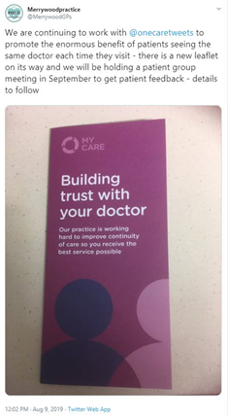
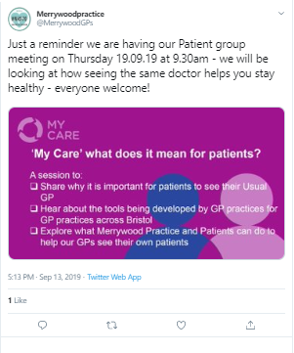
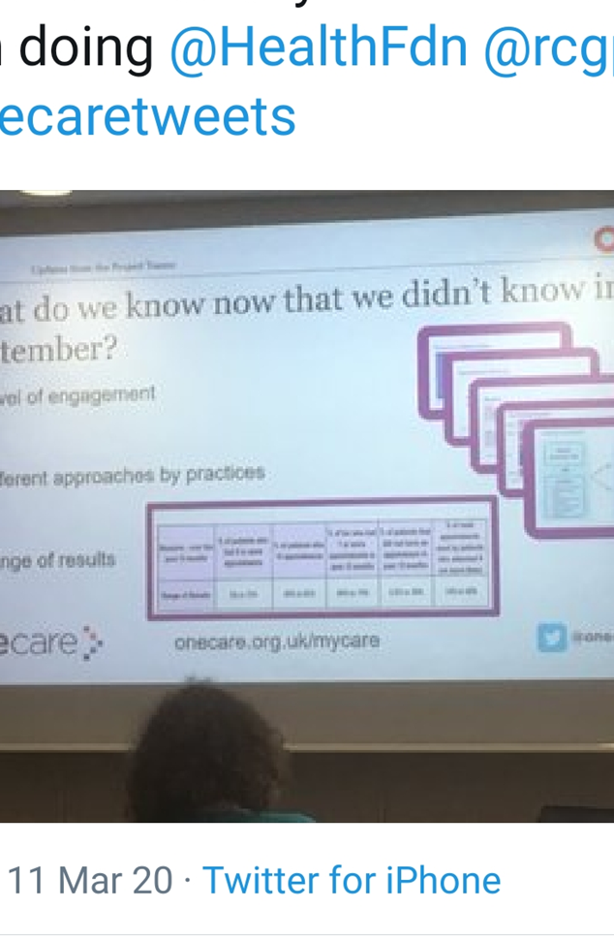
Patient Focused
Our journey has reminded us of the importance of communicating with our patients
You could be confident most of the time, if you are feeling down, a GP you don’t know won’t know this is not your usual behavior
The practice uses social media to engage with our patients, posting on Twitter and Facebook
We display posters, leaflets and run the animation in the waiting room to remind patients why continuity is important
We surveyed and talked with our patients to capture their views
The appointments are only 12 minutes long so the doctor you are seeing may not have a real understanding of you
I mainly see the same nurse in the treatment room, and I have a rapport with her as she understands my mental health problems.
Seeing the same doctor gives me more confidence. I wouldn’t necessarily share things with another doctor

Slide 4
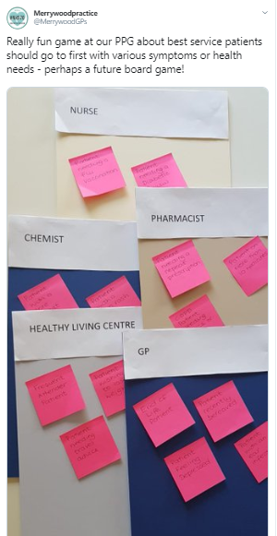
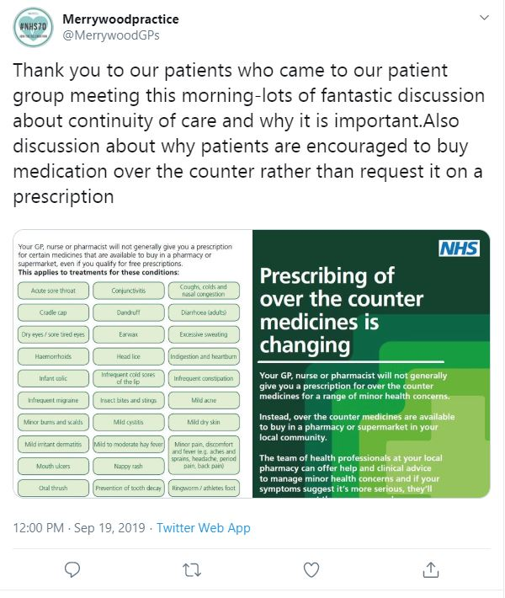
Patient Focused
We learnt from our Patient Participation Group
We invited patients to join a session on Continuity of Care. The session was well attended, reflecting the value patients place on continuity
We heard from our patients their views on why and when continuity is important. We used an activity to help our discussion
We learnt lots including:
the need for clarity on the roles of the high street chemist and the in-house pharmacists.
continuity with their GP is important for those who have been bereaved so the story does not need to be repeated

Slide 5
Practice Staff
We were reminded that care navigators are key in supporting continuity of care
Signposting | Care Navigators need to be fully conversant with where to sign post patients as there are a number of options Good navigation means we keep GP appointments for those who need them, and it supports continuity | For example…The Healthy Living Centre for those who are socially isolated, or for carers or patients needing well-being advice
Supporting | Practice staff are encouraged to look for opportunities to spread the message about the importance of continuity of care | For example,… telephone answering message (see our Resource slide)
Encouraging | Our Reception Team are vital in encouraging patients to wait to see their own GP rather than seeing another GP if its not urgent | For example… our Team uses every contact with the patient as an opportunity to remind them to see their own GP

Slide 6
Practice Staff
Patient Reviews | Patient reviews are undertaken by GPs, Nurses, HCAs and other healthcare professionals attached to the practice. Staff need to be up to date on the most appropriate healthcare professional for each type of review | For example,… medical reviews by our in-house practice pharmacist
Speaking & Listening | We found making time as a team to share the learning, the challenges and the opportunities for improving continuity was hugely beneficial We’ve shared our learning in the Reception Team Hints & Tips available in the Resource Toolkit | For example… It is important to be positive when talking with patients, don’t say “there isn’t an appointment until next week” but say “next week there is an appointment on”…. As a practice agree the maximum wait for a patient to see their GP before offering an alternative GP. Balancing with knowing the patients who may wait too long and become so poorly a home visit is needed

Slide 7
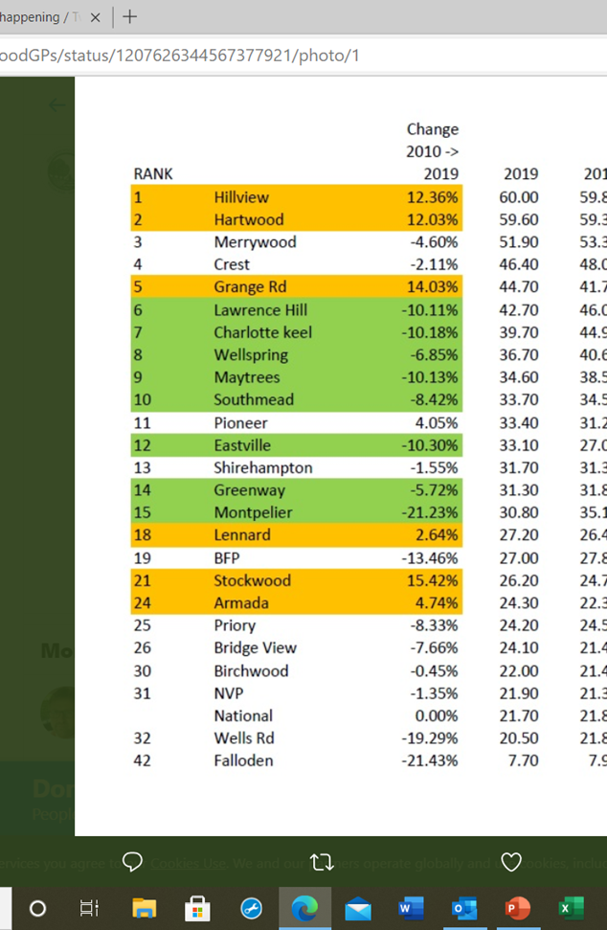
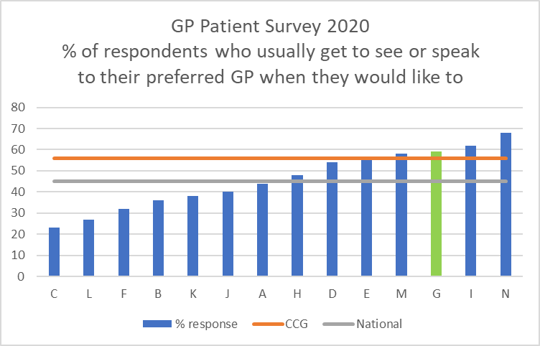
Technology
We were reminded of the importance of data and to use EMIS to support continuity
National general practice profiles: 2019 annual update
Public Health England national general practice profiles presents a range of GP practice level indicators using the latest available data. We found it useful in understanding the challenges for our practice which includes high deprivation
https://www.gov.uk/government/statistics/national-general-practice-profiles-2019-annual-update
Using EMIS
To maintain an up-to-date Usual GP Field requires processes that enable it to be done. The benefit of having the correct GP in the usual GP field means letters, results etc. can be processed without checking the patient record, there are workflow efficiencies
Regular reports to GP on how many of their own patients they saw in a session is a useful reminder about continuity
Making a note on EMIS of advice given to a patient trying to circumnavigate the system by talking to another member of reception is useful because the patients hears one message and the team feel supported
GP Patient Survey 2019
60% of respondents said they were always or almost always able to see their preferred GP when they would like to. It was good to share the news with staff that when benchmarked with other practices Merrywood was one of the best performing in the area and above CCG and national average

Slide 8

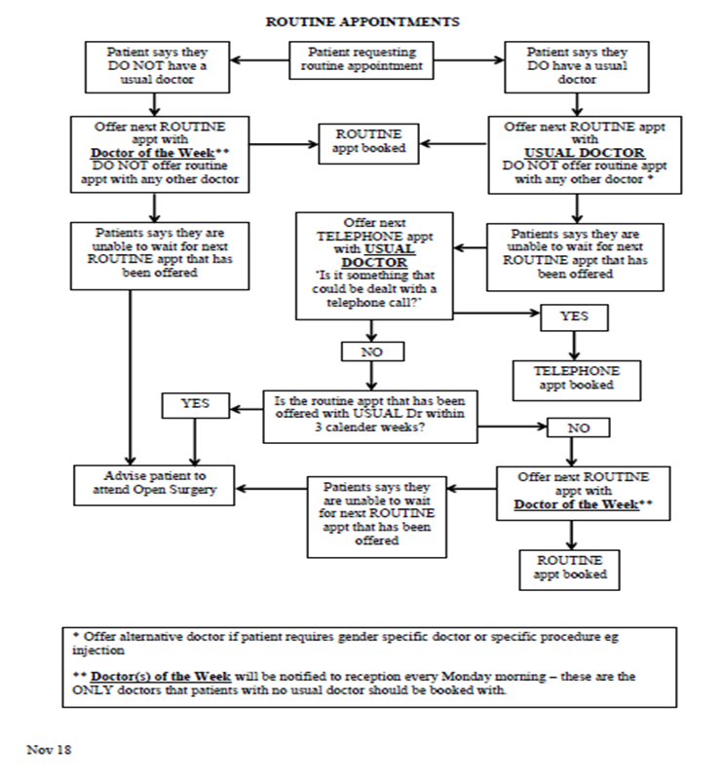
Our suggestions
Look for every opportunity to remind patients about continuity. E.g., on the Reception Telephone Welcome Message
Process mapping with the practice team enabled us all to see the flow and to question and improve it
Hello this is Dr Stone, welcome to the Merrywood Practice.
We think it is very important that you see the same doctor who can get to know you and better understand your health needs. Please book appointments with your usual doctor even if this means waiting a little longer.
Please note that for training and quality purposes all calls may be recorded.
Please hold and a member of our team will be with shortly.
(This was pre-Covid 19 message)

Slide 9

Resources
Reception Staff shared their hints, tips and challenges in our Reception Team Guide, which we’ve shared in the Improving Continuity of Care in General Practice Toolkit.
Run an EMIS Report on how many of their own patients a GP saw in a session as it provides useful insight

