Slide 1
Improving Continuity of Care in General Practice
<Practice Name>
Patient Participation Group
Produced with the insights and support of Bristol patients.
Special thanks to:
Dr Jill White, PPC Chair, Chair PPG, The Family Practice, Bristol
Mr David Shelton, The Family Practice, Bristol
Mr Toby Lumber, PPG Chair, Whiteladies Medical Group, Bristol

Slide 2
What is continuity of care?
“Seeing a clinician you know and trust, who knows and care about you”
Dr Haggerty,
Longton Grove,
Weston Super Mare
Views of continuity of care
“A GP that has an overview of my healthcare”
David Shelton, Patient,
Family Practice, Bristol
“Having a choice to wait and see my usual GP when they are free, or to see any GP if it feels urgent”
PPG Member, Whiteladies
Medical Practice, Bristol
“I know my patients well and they know me. This works for patients – I start in the middle of the story not at the beginning each time”
Dr Graham, Horfield Health Centre, Bristol
Professor Sir Denis Pereira Gray, a GP and Patron of the National Association of Patient Participation Groups is clear on the importance of having continuity of care from a GP or a team.
Sir Denis says "If GPs can listen to patients’ stories, not just their symptoms, they will be able to do so much more”
You can listen to the BBC interview with Sir Denis here
How would you define continuity of care?
Notes:
know my patients well and they know me. This works for patients – I start in the middle of the story not at the beginning each time.

Slide 3
Why is continuity important?
A summary of the benefits of continuity of care
Better medical outcomes
More likely to take your medication
Better relationship with doctors
Less likely to go to hospital
Improved longevity
More likely to follow doctor’s advice
Less likely to use other services
Better for doctors
Reduced costs
Nuffield Trust 2018
What is the experience of your members?
Notes:
For further information and detail please see slide on Research & Evidence in this pack

Slide 4
Types of continuity of care
A practice may improve continuity of care using a variety of types
Relational
Episodic
GP/team provide continuity of care during an episode of ill health
Informational
Good record keeping and information to help others to understand the patient and their conditions
Building good patient-professional relationships that benefit both the patient and the professional
Managerial
Co-ordinating a patient’s care especially when a team of/many professionals are involved
Are all types of CoC equally important?

Slide 5
What happens?
This shows what happens when there is continuity of care
Builds relationship
Improves satisfaction
Seeing the same GP
Builds trust
Promotes adherence and self management
Better health outcomes
No need to repeat the story
Reduced costs
Improves efficiency (time)
Awareness of patient’s life context
More appropriate decisions e.g. reduced hospital admissions
Better informed decisions
Image reproduced with permission from Professor Chris Salisbury. This logic model explains why we think continuity might be important and how it exerts its effects is based upon: Salisbury C, Sampson F, Ridd M and Montgomery AA (2009) How should continuity of care in primary health care be assessed? British Journal of General Practice 59 (561): 134-141. Available from: https://bjgp.org/content/59/561/e134
Can you think of any barriers to continuity?

Slide 6
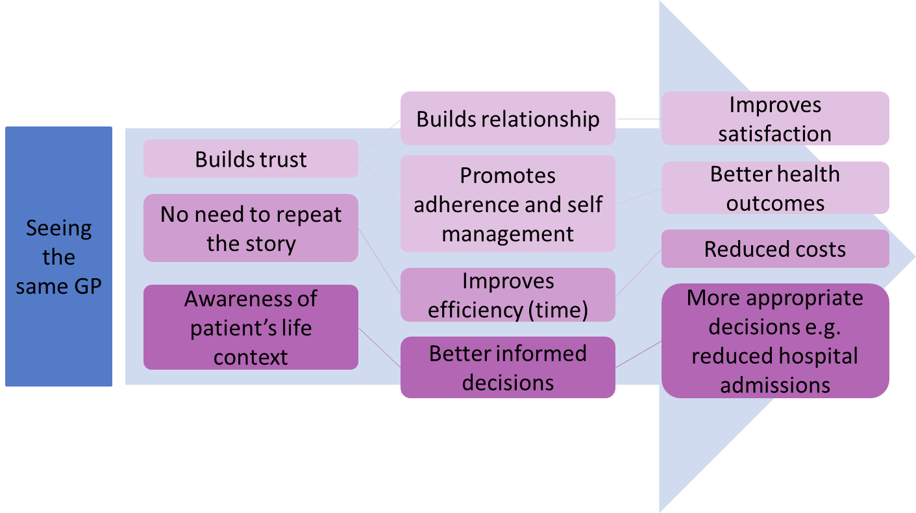
Patient barriers
Sometimes convenience more important than a relationship
It's possible to have a relationship with more than one person
What if it’s a GP you don’t want to see?
Perceived barriers from patients
More important to people with a story
Barrier | Response
What if it’s a GP you don’t want to see? | Patients can choose the GP they wish to see, providing the GP has capacity. As a practice you can change the field that holds Usual GP name to reflect this.
More important to people with a story | Everyone has a story, continuity of care is building up a picture of the patient and establishing trust with your GP.
It's possible to have a relationship with more than one person | Yes it is, many practice's share the care of their patients with colleagues either in Buddying to cover leave or Micro-teams when other professionals are involved.
Sometimes convenience more important than a relationship | Yes, if the condition is acute patients may need to see a GP sooner than they can see the GP they have continuity with, good informational continuity is important to support this.
Why does seeing the same GP lead to better informed decisions? | Continuity of care enables a GP to be responsible for a patient, rather than a patient circling around a number of GPs dealing with what is presented rather than the whole story.
Why does seeing the same GP lead to better informed decisions?

Slide 7
Research & evidence
The research into the benefits of continuity of care
When they receive continuity of doctor care, patients:
Are more satisfied​ | Baker and Streatfield (1995)​ Baker et al (2003)​ Adler et al (2010)
Are more likely to follow medical advice (adherence)​ | Warren et al (2015)​ Chen et al (2013)​
Are more likely to take up offers of personal preventive medicine​ | O’Malley et al (1997)​ Christakis et al (2003)​
Are more likely to have a good doctor patient relationship with their GP​ | Mainous et al (2001)​ Ridd et al (2011) ​
Are more likely to receive good quality of care​ | O’Connor et al (1998)​ Romano and Segal (2015)​
Are less likely to need to go to A&E​ | Brousseau et al (2004)​ Van den Berg et al (2016)
Are less likely to need a hospital admission, particularly for ambulatory care sensitive conditions​ | Barker et al (2017)​ ​
Are likely to live longer​ | Maarsingh et al (2016)​ Pereira Gray et al (2018)​
Have more cost effective healthcare (including meaning funding available for other things)​ | Starfield (1994)​ Weiss and Blustein (1996)​
When continuity of doctor care is provided, doctors:
Have an ‘accumulated knowledge’ about the patient. Doctors use such accumulated knowledge both for diagnosis and to tailor their advice.​ | Hjortdahl & Borchgrevink (1991) Hjortdahl (1992) Ridd et al (2011)​
Report that continuity enables them to provide a ‘higher-quality’ care. ​ GPs are then rewarded with more professional satisfaction through doing a better job.​ | Ridd, Shaw, & Salisbury (2006)​
Have improved problem recognition and quality of management for long term conditions​ | Saultz and Lochner (2005)​
Have reduced conflicts of responsibility , particularly reducing the ‘collusion of anonymity’ where succession of clinicians only deal with what is immediately most pressing​ | Freeman and Hughes (2010)​
Contribute to the reduced the use of specialist care, A&E, emergency admissions and outpatient appointments​ | Hansen et al (2013)​ Katz et al (2015​)
Reduce costs ​e.g. prescriptions and tests​ | Weiss and Blustein (1996)​ Saultz and Lochner (2005)​
Reduce cases of avoidable significant harm | Avery et al (2020)

Slide 8
Patient preferences
What are the reasons behind patient preferences?
Which factors influence a patient’s preference for continuity?
If their condition is physical or psychological
Perceived acuity and severity or ambiguity of a clinical problem
Prior relationship with a GP
Systems and structures of general practice
Age, sex, ethnicity, household income and education –
What are the characteristics of patients who prefer continuity?
Older
Affluent
Not in full time work
Have a long term or complex condition
Have a mental health condition
Trust in their GP
Continuity of care and the patient experience by The Kings Fund (2010)
Can you add any more?

Slide 9
Patient perspectives
When, why and where is continuity important to patients?
When is access more important than continuity?
Patient seeking same day appointment for a child
Patient has urgent physical condition
Those who are employed are 6 times more likely to value choice of time
Older patients will wait c. 2.5 days extra for an appointment with their GP of choice
Why do patients value continuity?
Not having to repeat their story
Have a good level of trust with their GP
Feel safe and listened to
Feel treated with respect
Feel their GP knows them
Where is continuity important?
All/some consultations at the practice
All home visits
All care homes
Extracted from documents referenced on Suggested Reading and Research & Evidence
Can you add or expand to these points?

Slide 10
Practice influences
What factors in the practice influence continuity of care?
Patients: Some patients will benefit more from continuity -patients with long term conditions, frail, anxious, learning disabilities and carers. Some patients do not value continuity.
Appointment Types: Routine, GP or nurse
Conditions: Continuity for acute treatment over several weeks/months or for long-term condition patients
Practice Staff: Staff culture, reception team encouraging continuity, matching patient with preferred GP gender, GPs welcome responsibility for a list of patients
High Profile Support: Royal College of GPs, HealthWatch, the Health Foundation and ongoing research
Patients
Appointments
Conditions
Practice Staff
Can you think of more examples for each factor?

Slide 11
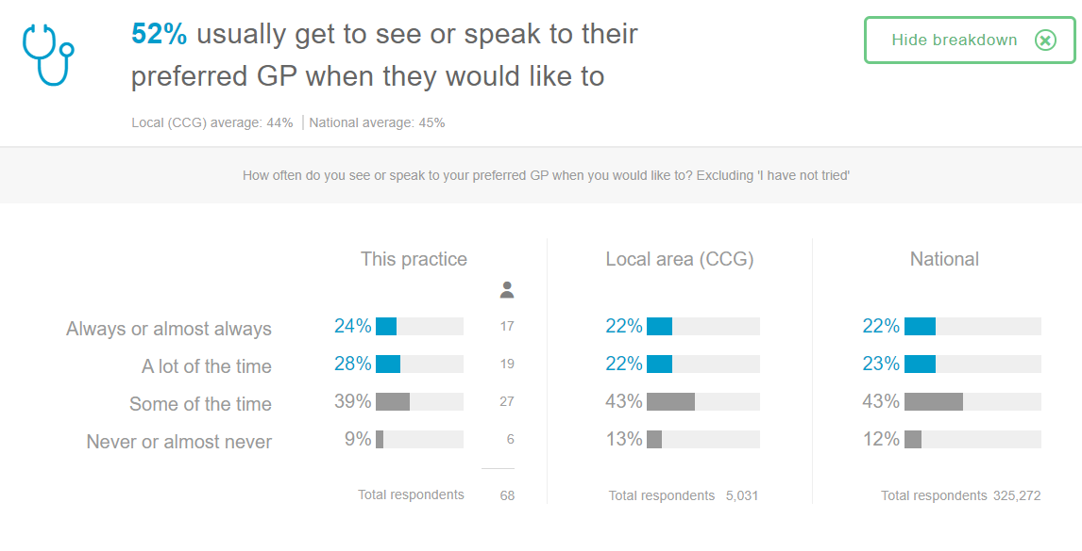
Annual GP Patient Survey
The GP Patient Survey provides a measure of continuity of care
Add your practice data here. An example is given showing just over half (52%) of the patients who responded said they see or speak to their preferred GP
Find your practice survey results at
The data is publicly available at
GP Patient Survey (gp-patient.co.uk
Notes:
Please see accompanying Guide which includes help on how to prepare your own slide showing your practice GP Patient Survey please

Slide 12
Approaches to continuity of care
Practices need to answer these 2 questions:
How will the practice team deliver continuity?
One GP with overall responsibility for the patient
Micro-Team (e.g. GP and GP Buddy or Multi-Disciplinary Team) responsible for patient
Which patients will be part of continuity project?
All patients
Groups of patients
What will determine which patients and how continuity is delivered at your practice?

Slide 13
System Challenges
Challenges to continuity of care from the system
GP recruitment & retention is reflected in move towards continuity provided by a microteam e.g. a GP and a GP buddy
GPs working part-time
Practice Recruitment and workforce turnover – personnel changes and unfilled vacancies
Day-to-day pressures on resources make it hard to deliver (e.g., current pandemic)
Practice Mergers – focus on efficiency and targets
Centralisation of services may reduce personalisation and continuity
Patient information – no one view of the patient, accessible across the providers
NHS performance targets focus on access not continuity of care
Perception - continuity of care is often perceived as an administrative function by those outside the system but it a key reason doctors are attracted to general practice
Any particular challenges for this practice?

Slide 14
Supporting the practice?
How can the PPG and Practice support each other?
PPG Support to the Practice
Canvas patient views – patient surveys, waiting room interviews
Promote continuity in your communications
Know the scope of the project e.g. which patients will benefit most from continuity of care
Practice support to the PPG
Establish direct communication between continuity of care lead at the practice and the PPG
Provide updates to the PPG on the project
Share results of the project

Slide 15
Suggested reading
For those who would like to know more about continuity
Continuity of care and the patient experience (kingsfund.org.uk) 2010
It explores why continuity is important in general practice, and what it looks like from both patient and staff perspectives.
Improving access and continuity in general practice | The Nuffield Trust) 2018
A research summary covering practice and policy lessons.
Improving continuity: THE clinical challenge (stleonardssurgery.co.uk)
Great introduction for practices, uses summary tables on key points by Prof Sir Denis Pereira Gray.
Continuity of care resources RCGP (2019)
Provides a good overview on improving continuity in general practice.

