Slide 1
White Ladies Road
Dr Ronan O’Connell & Mina Skelly
Practice Overview
No of GPs | 11
Patient Population | 16,043
Location | Bristol city
CoC Approach | Usual GP and Learning Disability Cohort

Slide 2
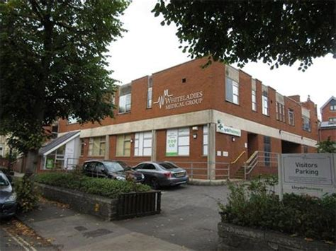
White Ladies Road
Single site practice based in Bristol
11 GPs – 3 GPs work 4 sessions per week and 8 GPs work 6 sessions per week
GP team is relatively stable, with one GP change during this project
Appointment length is 10 minutes
CQC Rating - Good

Slide 3
What did we do?
We joined the project in February 2020 as part of the Third Wave but due to Covid-19 pandemic we were unable to begin working on continuity until December 2020.
We assigned a GP lead and an operational lead and together they worked with colleagues to makes the changes needed to our working processes. We maintain momentum and interest by providing regular updates on progress.
We decided to start small and focus on improving continuity for our learning disability patient cohort.
A continuity of care flag was added to each patient record. The ‘usual GP’ field on EMIS was updated with the GP the patient usually sees. A pop-up reminder was added for our Reception Team to ensure patients were booked with the ‘usual GP’.

Slide 4
What’s happened so far?
Learning Disability Cohort
Between December 2020 and March 2021, the UPC Usual GP score for our learning disability patients doubled, from 14% to 28%. We continue to work to improve continuity for this cohort.
Measuring is key in knowing where you are. We also found out one of GPs was achieving a UPC Usual GP of 89%, giving us an opportunity to learn from each other.
The Bonus!
White Ladies’ continuity of care scores across the practice list have increased for both UPC and SLICC, by several percent.
Our Message
Start small and get your processes right and watch it create ripples of continuity across the practice.

Slide 5
Continuity of Care Project Manager: Julia.Martineau@onecare.org.uk

