Slide 1
Sepsis World Sepsis Day, 13th September 2017
Dr Rachel Marsden
RCGP Clinical Support Fellow for Sepsis
Dr Simon Stockley
RCGP Sepsis Clinical Champion

Slide 2
Overview
What is Sepsis
Why so topical
NICE Guidance 2016
Communication
Resources

Slide 3
Dr Simon Stockley, RCGP Clinical Champion for Sepsis, will be available throughout this webinar to take questions and will answer them live
A summary of the questions and answers will be made available after the presentation, alongside the slides themselves

Slide 4
What is sepsis? – 2016 Definition
Sepsis – Life-threatening organ dysfunction caused by a dysregulated host response to infection
European Society of Intensive Care Medicine and The Society of Critical Medicines Third International Consensus Definition for Sepsis and Septic Shock (Sepsis-3)

Slide 5
Put it simply
Infective Organism (Virus, Bacteria, Fungus) enters the body
Immune System reacts
Regulation of the immune system is lost, causing damage to the bodies tissues and organs
Rapid shock and organ failure
Death

Slide 6
Septic Shock
Sepsis with persisting hypotension requiring vasopressors to maintain MAP ≥ 65mm Hg and a serum lactate >2mmol/L despite adequate fluid resuscitation
This is a Secondary Care diagnosis
In the community this may present a patient who looks exceptionally unwell, with high Respiratory Rate, low bp, and a history suggestive of infection
Septic Shock is a time sensitive emergency, like stroke and MI

Slide 7
Time is perfusion
For each Hour IV antibiotics are delayed there is a 7.6% increase in mortality⁽¹⁾
The Sepsis Six
Administer Oxygen and maintain saturation >94%
Administer IV antibiotics
Consider IV fluid resuscitation
Check Serial Lactates
Commence hourly Urine Measurement
Take Blood Cultures
1 – Kumar A. Roberts D. Wood KE, et al. Duration of hypotension before initiation of effective anti-microbial therapy is the critical determinant of survival in human shock. Critical Care Medicine 2006;34(16): 1589-96

Slide 8
Scale of the problem
2014 – 123,000 cases of sepsis in England
1
37,000 deaths attributable
2
70% cases arising in the community
3
360 million patient contacts in the community a year
4

Slide 9
The Challenge For Primary Care
We don’t know who will go on to develop sepsis, ALTHOUGH, there are high risk groups which we will cover later
Most patients with an infection will not become septic as the majority of infections are mild and self limiting.
We see patients in a ten minute window, they may go on to become septic later
We also need to consider anti-biotic resistance, strains on the ambulance services, rising patient demand, pressure on GP services, multiple points of patient contact

Slide 10
Why all the fuss
Several High Profile Deaths and Enquiries
William Mead and Sam Morrish
Health Service Ombudsman reports
NCEPOD: Just Say Sepsis 2015

Slide 11
Sam Morrish 2010 - A Case Study
3 year old little boy who became unwell during flu season
After one week mum took to the GP – was assessed and given antibiotics, just in case
Next day called back, much worse. Placed on the on-call list at approx. 10.40, called back at 1.50pm by nurse, who handed on to on call GP
GP arranged a second appt, seen at 16.30 and given cough syrup

Slide 12
6.40pm – mum now very concerned and rang NHS direct.
7.00pm - Doctor called back, but mum didn’t get to the phone in time. Couldn’t call back as withheld number
9.00pm – mum called NHS direct back as nobody had called back. Was told to take to local walk in centre.
10.00pm Seen and immediately admitted to Torbay Hospital.
10.30pm Diagnosed with pneumonia, prescribed antibiotics and transferred to critical care. Antibiotics finally given at 1.30am
5.00am Sam died.

Slide 13
Ombudsmen comments on the case
GPs didn’t record respiratory rate pulse and temperature
On balance of probability Chest examination by 2nd GP was inadequate
Feverish under 5 guidance not followed by either GP in hindsight
GP safety netting difficult for parents to interpret if you already consider you have the sickest child you have ever had “what does worse look like?”

Slide 14
The saddest conclusion…
Had Sam received appropriate care and treatment he would have survived

Slide 15
What this Case Highlights
Sepsis can take hold rapidly
It may not be present at the time of initial presentation
Sepsis deaths often occur because of system failures, poor documentation or poor safety netting
Time is vital, quick action can save lives in Sepsis, delayed action can cost them

Slide 16
Remember…
The majority of high profile cases in the media are child cases
However…children represented 20,000 cases of the 123,000 in England in 2014
The majority of the burden from Sepsis is in adults and the over 65’s

Slide 17
Documentation Issues-NCEPOD
Key findings included
Only 50% pts had a temperature or BP recorded in their notes
Evidence of safety netting on less than 25%
Only 50% of pts admitted from hospital from Primary Care had a letter from the GP included in the case record.

Slide 18
NICE Guidance 2016

Slide 19
If you suspect infection in a patient
Can you identify the source?
Are there risk factors for sepsis?
Do the patients vital observations raise concern?
In essence always think…. Could this be Sepsis?

Slide 20
Nice NG51 – July 2016
Followed the Model of the Feverish Child Guidance
Aimed at helping stratify patients into risk categories
HIGH RISK
Moderate to High Risk
Low Risk
Uses History, Risk Factors and patient physiology to do so

Slide 21
High Risk Groups
EXTREMES OF AGE, <1YR, >75 OR FRAIL
IMPAIRED IMMUNE SYSTEMS (Chemotherapy, diabetes, splenectomy, sickle cell, long term steroids, immunosuppressants)
SURGERY OR INVASIVE PROCEDURE IN THE LAST SIX WEEKS
ANY BREECH IN THE SKIN INTERGRITY (Cuts, Burns)
IV DRUG USE
INDWELLING LINES OR CATHETERS
PREGNANT WOMEN, POST-NATAL/TERMINATION/MISCARRIAGE IN THE PAST 6 WEEKS

Slide 22
High Risk: Adults Age 12yrs +
Respiratory Rate >25
New need for O2 needed to maintain SATS >92% (88% in COPD)
Pulse >130 (OR <60)
SBP <90 (or <40mmhg below normal)
No PU in 18hrs or <0.5ml/KG/hr in catheterised
Skin – mottled or ashen in appearance, non blanching rash
New onset of confusion or altered behaviour
Age <17 with impaired immunity and 1 mod-high risk criteria

Slide 23
HIGH RISK
ANY ONE HIGH RISK CRITERIA SHOULD PROMPT REFERAL TO HOSPITAL FOR EMERGENCY CARE
Consider most appropriate mode of transportation, UK Sepsis Trust guidance recommends 999 ambulance
If more than an hour ?IV antibiotics
IM Benzyl Penicillin in suspected meningococcal disease
Detailed letter including risks factors, meds and observations ?NEWS
Oxygen to maintain saturation above 92% (88% COPD)
Pre-Alert Hospital that patient on its way/Speak to a clinician if patient not being admitted via A&E

Slide 24
MODERATE-HIGH RISK
Respiratory Rate 21-24
Pulse 91-130 OR 100-130 in Pregnancy
Systolic BP 91-110MMhg
Not PU in 12-18hrs 0r 0.5-1.0ml/kg/hr if catheterised
Signs of potential infection at surgical site or breakdown of wound
Acute deterioration of functional ability
Impaired Immune System
Trauma, Surgery or invasive procedure in the last 6 weeks

Slide 25
LOW RISK
NO High risk or mod-high risk criteria met but infection is suspected

Slide 26
Low & Moderate to High risk
Can you identify source?
If not reassess
1
Local guidance to guide anti-biotic prescribing
2
Can the patient or carer cope at home?
Can they manage own treatment?
3
Safety net – consider giving a leaflet, written information
4

Slide 27
Paediatric Values

Slide 28
Respiratory
 |  | Risk Category
 |  | High | Mod-High | Low
Respiration Rate | <1yr | 60+ | 50-59 | No higher criteria met
 | 1-2yr | 50+ | 40-49
 | 3-4yrs | 40+ | 35-39
 | 5y | 29+ | 24-28
 | 6-7yr | 27+ | 24-26
 | 8-11yr | 25+ | 22-24
O2 saturation | <5yr | <90% | <91% air
 | 5-11yr | <90% | <92%
Other | <5 | Grunting, Apnoea | Nasal Flaring

Slide 29
Cardiac
 |  | Risk Category
 |  | High | Mod-High | Low
Heart Rate | <1 | 160+ (or <60) | 150-159 | No Higher Risk Criteria met
 | 1-2yr | 150+ (or <60) | 140-149
 | 3-4yr | 140+ (or <60) | 130-139
 | 5y | 130+ (or <60) | 120-129
 | 6-7y | 120+ (or <60) | 110-119
 | 8-11yr | 115+ (or <60) | 105-114
BP | ≤11y | No Recommendations
Urine Output | ≤11y |  | Reduced Urine Output
Capillary Refill Time | ≤11y | No higher risk criteria | 3sec +

Slide 30
Skin & Temperature
 |  | Risk Category
 |  | High | Mod – High | Low Risk
Temperature | <3m | 38+C | <36C
 | 3-6m | 39+C | <36C
 | >6m | No Higher Temp | <36C
Skin | All Ages | Mottled or grey appearance, cyanosis, non blanching rash | Signs of potential infection or skin breakdown at surgical site | Normal colour, no non blanching rash

Slide 31
Behaviour
 | Risk Category
 | High | Mod-High | Low
<5y | Does not respond to usual social cues | No smile | Content and Smiling
 | Looks Ill to HCP | Wakes with prolonged stimulation only | Easy to rouse, stays alert
 | Doesn’t wake or unable to keep awake once roused | Not as active as normal | Normal cry or not crying,
 | Weak high pitched or continuous cry | Parent/carer worried
5-11y | Evidence of altered mental state or altered behaviour | Abnormal behaviour | Behaviour Normal
 | Looks Ill to HCP | Decreased activity levels
 | Doesn’t wake or unable to keep awake once roused | Parent /carer worried

Slide 32
Key Points
No Max temperature in the High risk >6months BUT low temp is a moderate –high risk factor
Ask about urine output
Respiratory Rate is Key, it is the most sensitive indicator of deterioration in Sepsis, ensure it is done and recorded
Looks ill to a GP professional is a red flag for sepsis
Parental/carer/patient concern should always be acknowledged and acted upon
Behaviour change can be an indication of sepsis in a patient with infection

Slide 33
Communication

Slide 34
A Shared Language
Communication is Key in a SEPSIS aware System
How can we best document the patients physiology and communicate concern/risk of sepsis to secondary care or to ambulance services
Can we make it easier for other members of primary care team (District Nurses, Practice Nurses, Nursing Home staff) to communicate risk/concern to us ?

Slide 35
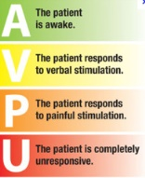
National Early Warning Score (NEWS)
Validated tool widely used in acute care comprising six biological measurements:
Respiration Rate
Oxygen Saturations
Temperature
Systolic Blood Pressure
Heart Rate
Level of Consciousness (defined by AVPU)
NEWS can be used for both initial assessment of acute-illness severity and as a track-and-trigger to identify acute clinical deterioration and response
In use in 95% of Acute English trusts
Inada-Kim et al 2017
0₂
Notes:
Mention in print NICE guidance
GP NEWS tools apps
Sepsis screening – lack of SIRs sensitivity and application to Primary Care

Slide 36
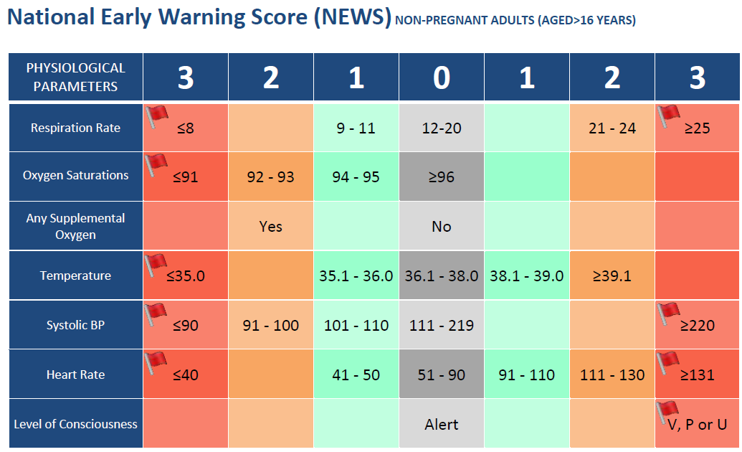
National Early Warning Score (NEWS)
Graded scoring system (0-20)
Based on aggregated scores and extreme variation in single parameters (the red flag)
The greater the deviation from the norm, the greater the potential for acute illness
Estimated could save 6,000 lives per year if everyone used NEWS
Notes:
Mention in print NICE guidance
GP NEWS tools apps
Sepsis screening – lack of SIRs sensitivity and application to Primary Care

Slide 37
Validation of NEWS
NEWS is shown to be as good at discriminating risk of acute mortality as the best of existing systems and better than others
At the recommended trigger levels for a clinical alert, NEWS is more sensitive than most existing systems
Small changes in parameters can be detected earlier using NEWS than waiting for obvious changes in individual parameters (e.g. a marked drop in SBP which is often associated with a terminal event)
NEWS is not a replacement for clinical judgement
For patients with infection, the risk of mortality associated with a NEWS score is:
NEWS | Mortality
0 | 0.5%
<5 | 5.5%
≥5 | 22%
≥7 | 27%
≥9 | 38%
Silcock DJ, Corfield AR, Gowens PA, Rooney KD. Validation of the National Early Warning Score in the prehospital setting.
Resuscitation. 2015; 89: 31-35

Slide 38
Safety Netting
Vital in a Sepsis Aware consultation
“Bring them back if they get worse” – What does worse look like?
Give pts and carers clear concise information and what signs they are to be looking for
Who should they contact, how quickly should they seek help, when to ring 999 / act urgently
Back up with written information and document your safety netting

Slide 39
Safety Netting
Sam Leaflet
http://www.southdevonandtorbayccg.nhs.uk/your-health/Documents/sam-sepsis-leaflet.pdf
Sepsis trust – Spotting Sepsis
http://sepsistrust.org/wp-content/uploads/2015/08/UST602_DL_6pp_SpottingSepsis_Leaflet_070716.pdf

Slide 40
Remote Assessment and Sepsis
Telephone Triage Vs Telephone Consultation
Patients often have concerns re possible infection and will communicate them quickly, often giving an indication of possible source
Can this be dealt with safely over the phone or is Face 2 Face needed
Identify pts with Sepsis risk factors

Slide 41
Action - FACE 2 FACE vs 999 vs direct transfer to Emergency Department
Time scales
Think about how to ask for signs over the phone to aid this decision
Breathing Rate
Cold hands feet
Some patient have BP machines
Colour

Slide 42
Resources

Slide 43
The TARGET Antibiotics Toolkit
The Sepsis and Target toolkits are available on the RCGP Website
www.rcgp.org.uk/TARGETantibiotics
Notes:
The Sepsis and Target toolkits are available on the RCGP website and both offer a range of resources to support GPs in caring for patients with infectious diseases.
Sepsis awareness and recognition and targeting of antibiotics to those most likely to benefit are both essential components good clinical care to patients with infectious diseases. Antibiotic stewardship and sepsis awareness are components of providing good clinical care. So how do we continue to improve and reduce the chance of making mistakes?

Slide 44
In Summary
NICE Guidance aimed at helping identify high risk induvial and uses observations to decided if a person is high, moderate or low risk
Think Could this be Sepsis? When seeing someone with infection
Document all observations (esp. Respiratory Rate), and safety netting information given
If no suspicion of Sepsis, act to protect the patient in the event sepsis should develop later
If not already using, consider NEWS scores as a way of monitoring physiology and communicating concern to ambulance services and secondary care

Slide 45
Links
BMJ Visual Summary
http://www.bmj.com/content/bmj/suppl/2016/08/11/bmj.i4030.DC1/sepsis_nice_v66_web_v6.pdf
Sepsis Trust Clinical Tool Kits
http://sepsistrust.org/clinical-toolkit/
RCGP Clinical Toolkit
http://www.rcgp.org.uk/clinical-and-research/toolkits/sepsis-toolkit.aspx
AHSN West of England NEWS Video
https://vimeo.com/208284106

Slide 46
THANK YOU

