Slide 1
Adopting a ‘systems approach’ to QI and safety work in frontline general practice
Quality Improvement [C1]
Dr Duncan McNab, Associate Advisor, NHS Education for Scotland
Dr Sarah Luty, Associate Advisor, NHS Education for Scotland
Dr Tom Blakeman, Clinical Senior Lecturer in Primary Care, University of Manchester
Notes:
Start by saying discuss systems and give framework – show a video – very simple event - have a go applying it and then 2 examples of application at different levels – practice and across interfaces – both relate to AKI.

Slide 2
Declaration of Financial Interests or Relationships
We do not have any financial interests or relationships to disclose with regard to the subject matter of this presentation.

Slide 3
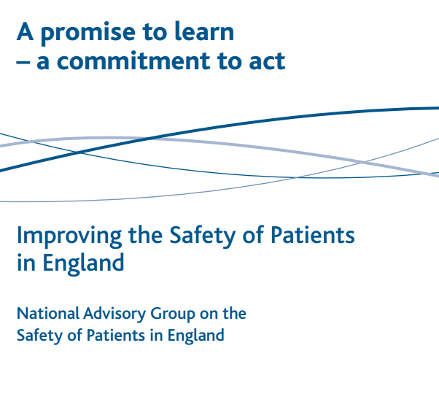
Systems thinking
What is a system?
Why should I think about it?
How can I think about it?
Notes:
Liam Donaldson, Berwick, Francis
Give framework – have a go – then examples

Slide 4
What is a system?
PURPOSE

Slide 5
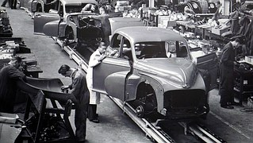
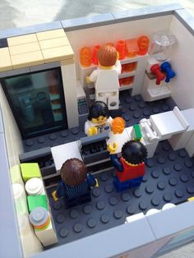
Different types of system
Linear
Complicated
Complex
Notes:
First of all: What is a system?
Components organised for a purpose – need purpose, boundary, components, interactions, between components and between systems
What is a systems approach?
Considering purpose, system as a whole, interactions and conditions

Slide 6
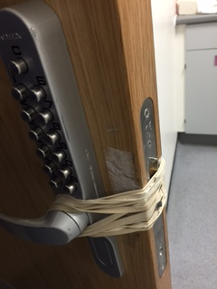
Work as done vs Work as imagined
Workarounds
Trade-offs
Efficiency Thoroughness
Notes:
WAD vs WAI

Slide 7
Why should I think about systems?
Blame
Targets
PURPOSE
Unexpected effects
Notes:
Talk safety-II here – WAD vs WAI

Slide 8
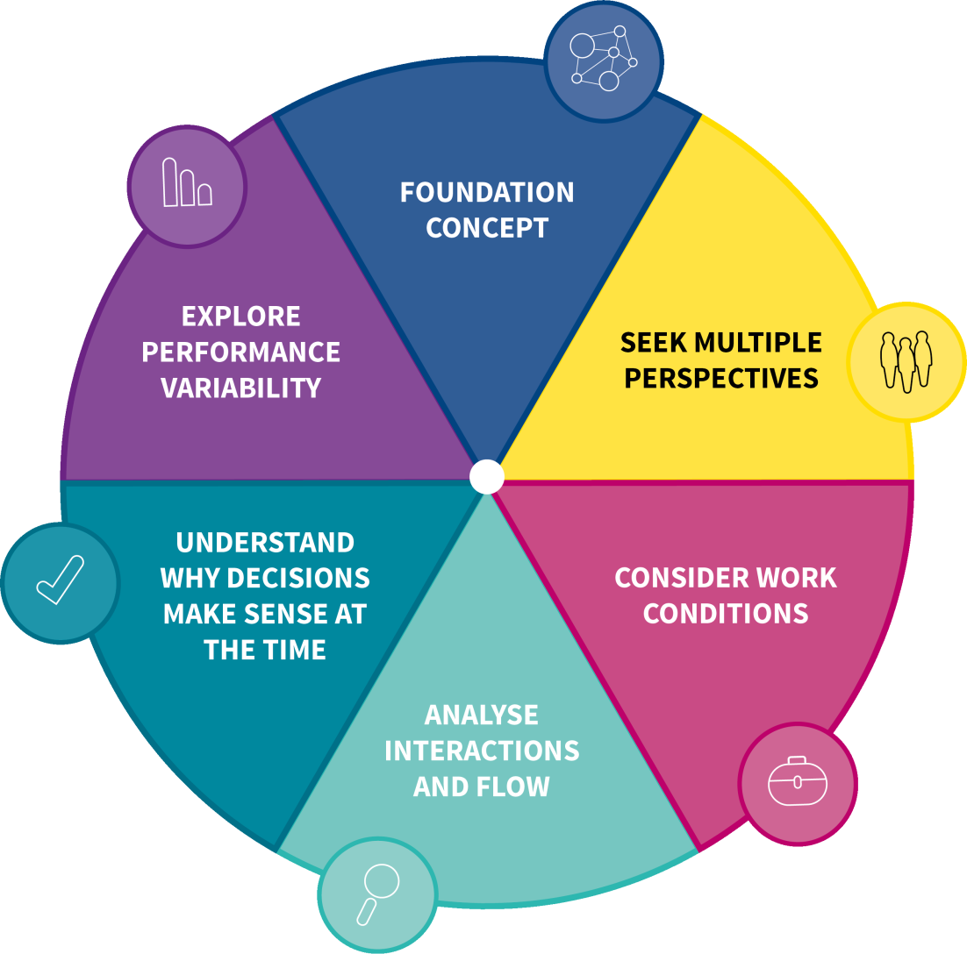
How can I think about systems?
Meet STEW (Systems Thinking for Everyday Work)
Notes:
Introduce each principle – small diagram to side from original cards??
Then use example to explain each principle as they read on cards/ infographic. Then let them have a go with video.

Slide 9
GP scenario video
Notes:
State based on research
Watch video
Consider each principle

Slide 10
Foundation concept
Overall system purpose
To optimise identification of patients who need urgent treatment
Agree boundaries
The practice
Community nursing
Other sectors of health and care
Nursing homes/ others

Slide 11
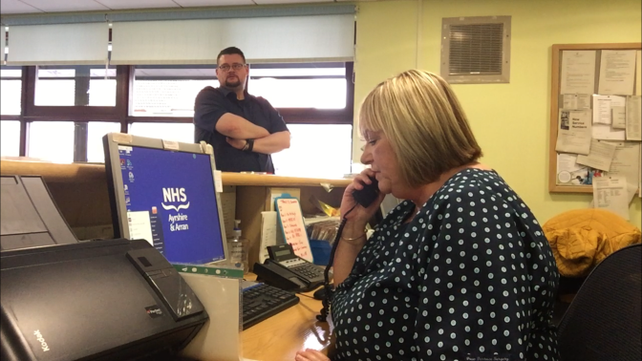
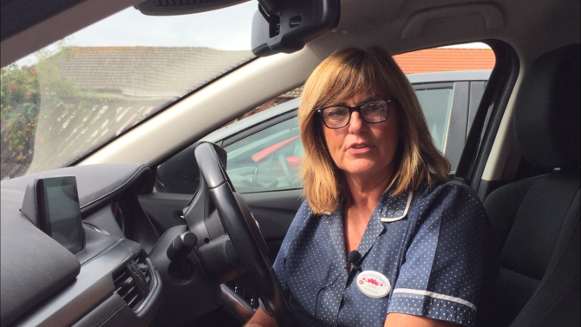
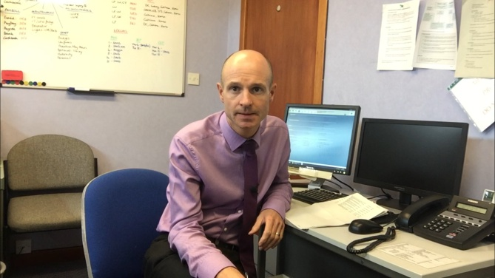
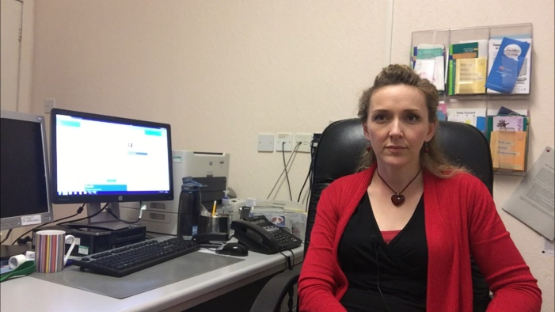
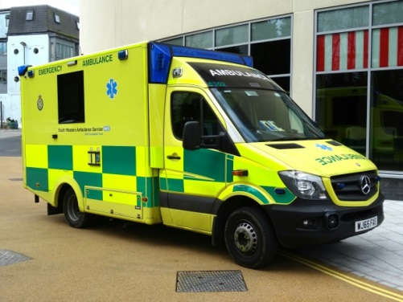
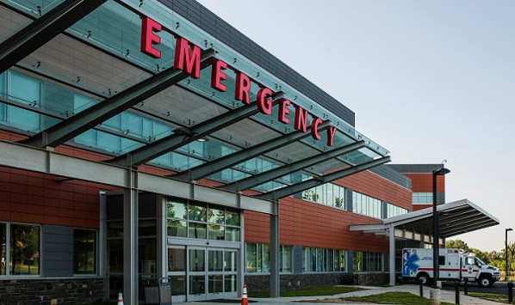
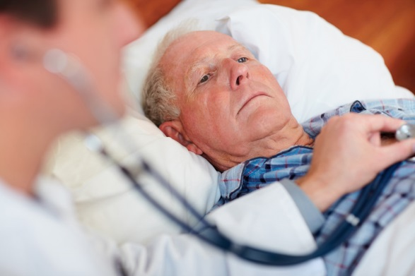
Seek Multiple Perspectives

Slide 12
Consider work conditions
Demand/ capacity
Front desk, phone calls, demand to work in a certain way
Demand
Capacity
Resources
Constraints
Number of visits, other tasks
Resources – equipment, information
Constraints – guidance, protocol

Slide 13
Analyse Interactions and Work Flow
Interactions of lack of information, other tasks, school traffic, fear of interrupting GP – influenced flow of work
If implement change – how would this affect other parts of the system?

Slide 14
Understand why decisions make sense at the time
Be wary hindsight bias and understand peoples goals
Deal with the immediate workload at front desk
Did not want to interrupt GP
Get through the work as quickly as possible while remaining safe
Avoid admission
Thought daughter would get medication

Slide 15
Explore performance variability
Workarounds and Trade-offs
Efficiency thoroughness trade-off – not measuring all values
Workaround – looking for historical information in old encounters, using family members
Notes:
GP ETTO, OOH GP looking for info

Slide 16
Design of an improvement intervention
Notes:
Cut out faces of all from video

Slide 17
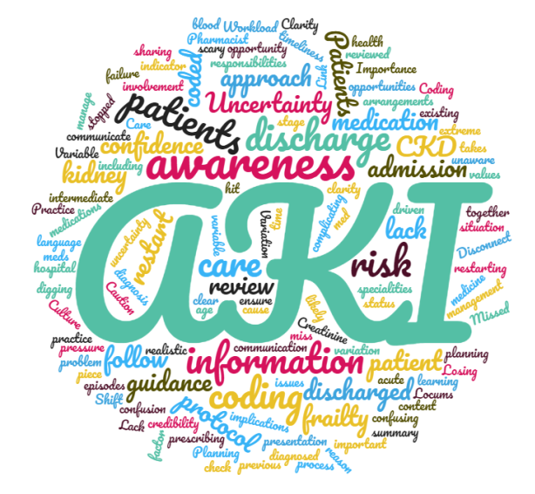
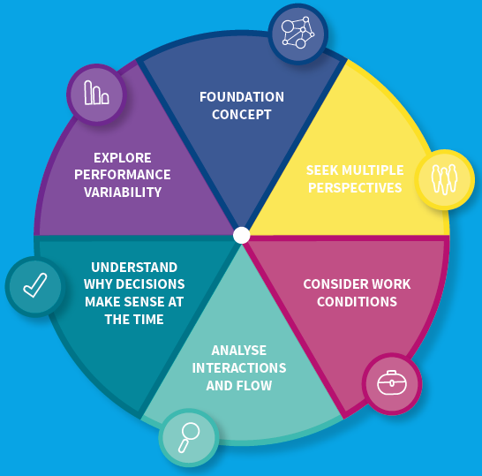
RCGP Acute Kidney Injury Quality Improvement Project Systems Thinking for Everyday Work Drs Tom Blakeman, Sarah Luty, Duncan Mcnab

Slide 18
RCGP AKI Quality Improvement Project Partners

Slide 19
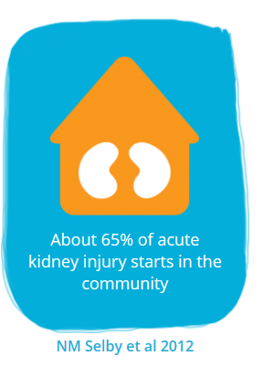
Acute Kidney Injury
Common
Harmful
Costly
Treatable
Potentially Avoidable

Slide 20
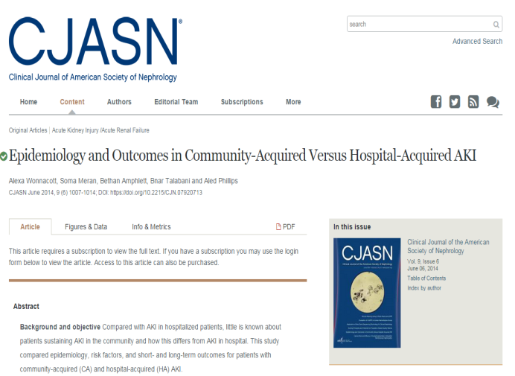
Acute Kidney Injury: A marker of poor health outcomes?
Hospital Admission complicated by AKI
1020 patients admitted 2 x DGH in Wales
Increased Mortality
Within 14 months of the AKI episodes
50% had died (287 in-hospital deaths)
Increased CKD Development/Progression
> 33% had de novo CKD or progression of pre-existing CKD
Increased Rehospitalisation
492 Rehospitalisation events within 6 months after discharge
Wonnacott et al, 2014C lin J Am Soc Nephrol 9: 1007

Slide 21
Acute Kidney Injury: A need to improve transitions of care?
18.6% unplanned readmissions ≤ 90 days
‘AKI is a strong, consistent and independent risk factor for unplanned readmissions – particularly readmissions with acute pulmonary oedema
Pre-emptive planning at discharge should be considered to minimise avoidable readmissions in this high risk group’
Sawnhey et al, BMC Nephrol 2017;18: 9

Slide 22
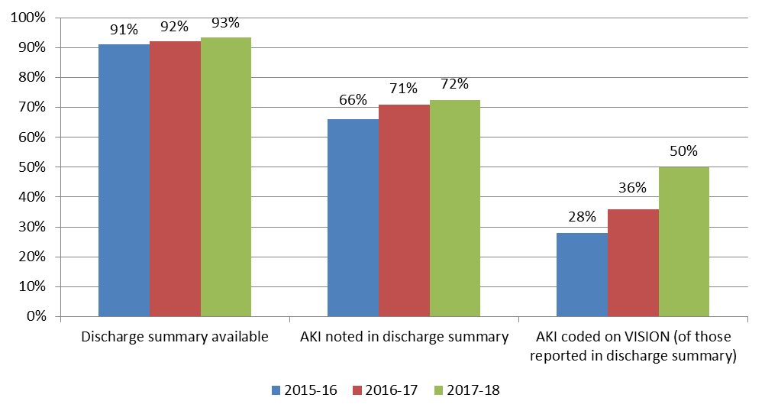
Understanding & Addressing Gaps in Post-AKI care
Percentage of episodes of admissions complicated by AKI with discharge summary available, AKI noted in discharge summary and AKI Read coded, Bury CCG (2015/16, 2016/17 and 2017/18)

Slide 23
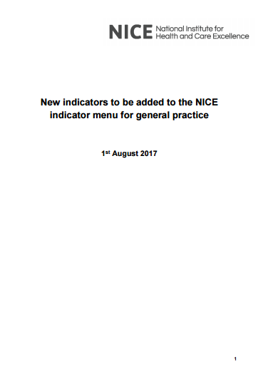
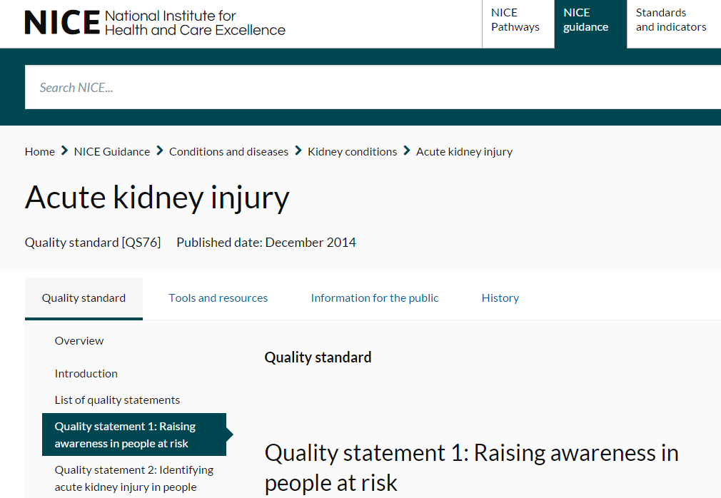
Post-AKI care: Recommended best practice
Structures
Develop AKI Registers in primary care
Processes
Diagnostic Coding
Medicines review
Kidney monitoring
Communication with patients & carers

Slide 24
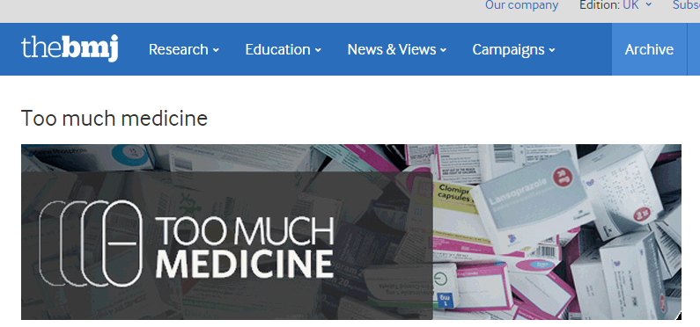
Key principles: The RCGP Quality Improvement Project
Develop evidence based interventions grounded in an in-depth understanding of routine clinical practice
Maximise clinical utility of AKI as a driver of quality & safety whilst minimise treatment burden for patients unnecessary clinician workload
Support system resilience through collaborative working across the interfaces of care

Slide 25
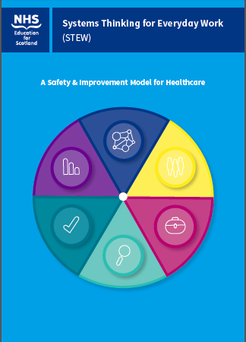
AKI Case Note Reviews + STEW
24 General Practices across England & Scotland
Responding to AKI Warning Stage Test Results
Post-AKI care
148 Case note reviews
Identify learning needs
Develop an action plan
Applied STEW to learning identified
Practice Level
Regional/ National Level

Slide 26
Post-AKI care: Systems Thinking for Everyday Work

Slide 27
RCGP AKI Toolkit

Slide 28
Questions?
STEW resources
STEW cards
STEW worksheets
Coming soon – e-learning resource
https://learn.nes.nhs.scot/6025/patient-safety-zone/safety-skills-and-improvement-research-collaborative-skirc/stew-model
RCGP AKI resources
http://www.rcgp.org.uk/aki

Slide 29
NIHR Acknowledgement & Disclaimer
‘This research was supported by the National Institute for Health Research (NIHR) Collaboration for Leadership in Applied Health Research and Care (NIHR CLAHRC Greater Manchester). The views expressed in this article are those of the author(s) and not necessarily those of the NHS, the NIHR, or the Department of Health and Social Care’.

