Slide 1
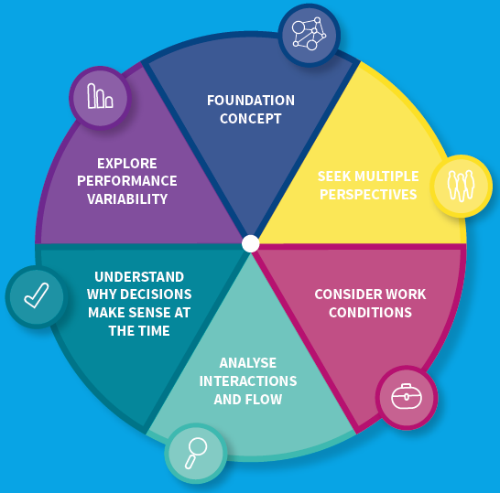
Systems Thinking for Everyday Work (STEW) Worksheet Post-AKI Care
People constantly have to vary how they do work to achieve successful outcomes due to changing system conditions
Explore the workarounds and trade-offs
Explore the difference between work-as-imagined and work-as-done
Discharge planning
WAI – Current policy recommendations (CQUIN): 1) Stage of AKI; 2) Med review; 3) Type of blood test required on discharge; 4) Frequency of blood test
WAD - Suggested workarounds: Better hand over required to reduce uncertainty and help determine the urgency of response. To achieve this, greater clarity required on: 1) AKI stage and cause(s); 2) baseline and discharge SCr; 3) changes and reasons for medication changes; 4) blood pressure at discharge; 5) evidence of communication with patients & carers.
Also, suggest hospital organise bloods test and BP follow-up on discharge (e.g. as per nurse follow of dressings) to ensure timely follow up, reduce patient burden in terms of reduced practice visits and more helpful subsequent review with GP/Pharmacist.
Post-AKI care process and outcome data: Low numbers of patients at practice level – benefit from aggregate data (e.g. CCG, Cluster) to understand impact of work
Consider the overall system rather than focussing on isolated parts, events or outcomes.
Agree boundaries
Agree purpose of system and parameters for success
Purpose AKI as a marker of frailty/vulnerability:
Recognition that AKI work is largely in the context of caring for people with complex health and social care needs.
AKI: an acute problem but which informs future management
Boundaries Common priorities to improve post-AKI care :
1. Coding AKI an important step to enhance subsequent primary care management
2. Work to Improve communication with patients
3. Work to ensure tailored and timely follow-up
4. Work to become a ‘kidney conscious’ practice: safer prescribing; better communication; better response to crises
Explore the experiences and views of all people who work in the system to better understand the work system and change implementation issues
RCGP Quality Improvement project 2017-2018:
1. Learning generated through 148 case note review conducted in 24 general practices across England and Scotland
2. Reflections, actions and improvements considered to address patient factors; professional factors; role of practice team; role of secondary care; other systems issues
3. Case note reviews discussed at practice meetings, including joint meetings with staff (AKI nurse specialists from secondary care).
4. Learning also generated through a workshop as well as a shared learning event comprising nephrologists; GPs; AKI specialist nurses; pharmacists; biochemist; medical student; patient representatives
Explore how conditions, interactions and personal and team goals at the time influenced decisions
Be wary of hindsight bias: Avoid blaming ‘human error’ and promote a ‘Just Culture’- understand what happened, support those involved and improve work systems to reduce the risk of recurrence.
Identifying opportunities for better information exchange: E.g. Case where OOH team did not have access to full records– identified need to use 1) enrich summary care records (Key Info Summary); 2) communicate with patients that might get an OOH call
Explore varying demand and capacity,
how resources (eg equipment, information and time) and constraints (guidelines, protocols) influence work-as-done
Identify leading indicators of impending trouble
Examine how conditions of work influence staff well-being
Demand
1. Anxieties over opening up a ‘Pandora’s box’ of new work v formalising existing work that has been part practice for ‘decades’
2. Feedback also that currently low numbers and therefore balance between manageable work v insufficient to be a priority
Capacity
1. AKI seen as a marker of vulnerability & frailty and therefore align with existing practice approach to care planning
2. Aligned with skillset of Practice Pharmacists - aware of relevance of kidney function in conducting med reviews. But caution to ensure realistic medicine approach rather than protocol driven care
Resources
1.Local incentive enabled practice buy-in to AKI work in context of competing priorities (work of educational event, audit; action plan)
2. Embedding Think Kidneys resources/guidelines into IT systems
3. Polypharmacy guidance to help decisions to restart/de-prescribe
3. Structure for creating a practice level action plan (I.e. QI resources)
Constraints
1.Lack of structure to follow-up - No practice plan for dealing with AKI
2. Variable documentation/communication from secondary care
(e.g. “GP to follow up”; no reasons for change in meds)
Consider how different activities interact and how flow is affected
When making changes consider the impact on overall system functioning
Key priority: Being able to determine the urgency and timeliness of follow up
Workload shift: Additional work required to manage the uncertainty created by variable discharge summaries - ‘Digging’ for information to piece it together takes time. e.g. find baseline and discharge serum creatinine. Generally ‘acquiesce’ to request from secondary care (e.g. when to repeat bloods).
Flow: Practice protocols and embedding AKI patient cohort into care planning procedures (I.e. New or review of care plan; need to be part of GP locum packs)
Bottleneck – Accurate Diagnostic coding (‘Beholden to what the junior doctor was writing’)
1. Practice Protocol helps flow with coding and follow-up. However, dependent on the quality of the discharge summary – a need for greater clarity
Bottleneck – Timely medication reviews
1. No documentation on reasons for changes to medication and often a lack of guidance on follow up including when to consider restart stopped medication
2. Delays in ‘fast direct communication’ affects med reviews – can lead to patients restart meds that have at home without guidance, adds to the confusion
3. Takes time to organise patient to come into practice - Practice Pharmacist taken on work but constrained by not doing home visits to complex housebound
Bottleneck – Communication with patients
1. Tendency to be unclear what has been discussed during admission - kidneys not part of ‘public consciousness’ e.g. patients with CKD not aware of AKI risk
2. AKI nurse specialists communicate AKI diagnosis with patients but usually at a time of critical illness and not then involved in care at time of discharge

