Slide 1
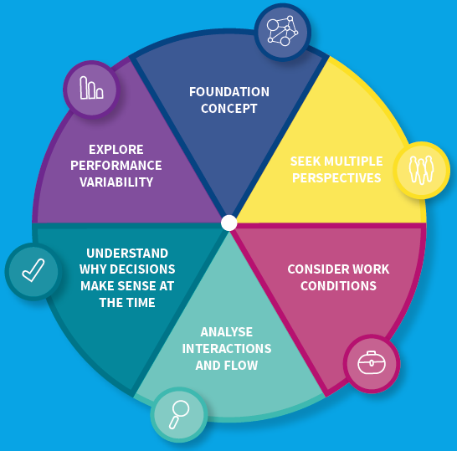
Systems Thinking for Everyday Work (STEW) Worksheet
People constantly have to vary how they do work to achieve successful outcomes due to changing system conditions
Explore the workarounds and trade-offs
Explore the difference between work-as-imagined and work-as-done
Discharge Letters
Work as Imagined– IDL : 1) Diagnosis coded ; 2) Med review; 3) Type of blood test required on discharge; 4) Frequency of blood test 5) Drugs reconciled 6) Patient contacted
Work as done - GP/Pharmacist reads IDL, contacts patient to reconcile drugs- no answer/ patient staying with family post discharge. Changes are made on records, task to contact patient handed over. Reception staff know daughter- contact made via work around. Message left to attend for blood tests. Coded for familiar CKD code.
Monitoring Follow up.
Work as Imagined- clear specification post AKI for bloods at 1 week/ 3 weeks with BP and decision to restart medications if needed.
Work as done - patient contacted to make appointment for recheck bloods- attends 2 weeks later, result goes to on call GP filed as normal. Medication remains off until next script due when patient may call in to request.
Work conditions GPs, pharmacy and admin staff may vary responses based on time of year, cover arrangements for leave, number of IDLs/ results to action, knowledge of patient.
Consider the overall system rather than focussing on isolated parts, events or outcomes.
Agree boundaries
Agree purpose of system and parameters for success
Purpose
AKI as a indicator of morbidity and prognostic
tool. Within the practice, identify patients at risk of AKI, monitor those diagnosed with AKI. Success will be
measured by care planning for those with AKI- with the
potential to reduce risk of death and (re) admission,
improve quality of life.
Boundaries
The boundaries are those that the practice can control,
systems within the practice for IDLs, and follow up
planning. There may be opportunities to influence
secondary care, and there may opportunities to share
learning within the cluster
Explore the experiences and views of all people who work in the system to better understand the work system and change implementation issues
Multiple Perspectives:
GPs. GPSTs in practice with experience of IDLs in hospital placements offer opinion on the discharge settings where letters are sometimes done by the on call team who may not know the whole history. Multiple discharges in one day.
Reception staff who are often tasked with contacting the patients for recall for bloods.
Practice and Community pharmacists- re dosset boxes and changes to deliveries for medications.
Explore varying demand and capacity,
how resources (eg equipment, information and time) and constraints (guidelines, protocols) influence work-as-done
Identify leading indicators of impending trouble
Examine how conditions of work influence staff well-being
Demand/ Capacity
Docman variable, and number of iDLs to deal with in practice. Some days 100+ documents to process. No built in time to deal with IDLs or results. Frustrating, difficult and at times boring task.
IDLs quality varies greatly with some follow up with hospital required sometimes e.g. why drugs stopped etc Instructions unclear- e.g. GP review.
Resources
GPs unaware of definition of AKI stages and recommendations for post discharge management.
Lack of guidelines on follow up of AKI
No lab algorithm- difficult to identify patients.
Often renal impairment recorded in body of text- not diagnosis code, harder to identify from IDL.
Constraints
1. Patients tel numbers not up to date with blood tests, so actioning some results can be difficult.
2. After hours contact with ward staff more difficult
3. Lack of structure to follow-up - No practice plan for dealing with AKI. Often best actions for patients were uncertain. Often GP who knows patient best left to make decisions with the patient and their carer.
4. Practice performs regular searches for triple whammy/ high risk prescribing,
but there is little guidance on how to manage these patients.
5. From case note review highlights problem with AKI in extreme elderly patient group- little available evidence on prescribing in this group.
Explore how conditions, interactions and personal and team goals at the time influenced decisions
Be wary of hindsight bias
Avoid blaming ‘human error’ and promote a ‘Just Culture’- understand what happened, support those involved and improve work systems to reduce the risk of recurrence.
On case note review- delays in actioning results- patient details not accurate, unable to contact them at night, task handed over but priority misunderstood by following day leading to delays.
Often decisions made by GP who knows patient best- and has the experience e.g. of blood pressure management in that person over years.
Consider how different activities interact and how flow is affected
When making changes consider the impact on overall system functioning
Interactions
Results often done at the end of the day when fatigued. Admin staff often unavailable to support with contacting patients, ward staff and pharmacists often after working hours.
Hard to get patients on the phone due to lack of up to date telephone numbers. Lack of repeat blood testing after ‘lab pick up’
Patients are often multi morbid with polypharmacy- clinical guidelines and specialist services are designed for single disease e.g.. Cardiologist renal team diabetes all have competing priorities.
Flow
Lack of available answers to queries re medications on IDL means follow up is done later/ handed over to pharmacy teams to chase up.
Reception left to inform patient at later date, information and priority can be lost in interim.
Delays in receiving formal discharge letter at busy times

