Slide 1
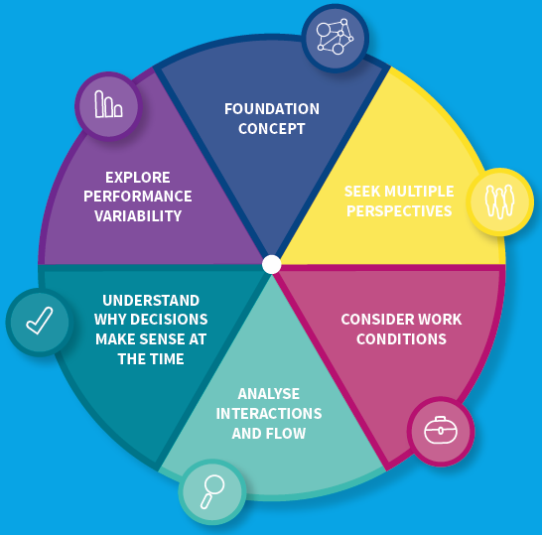
Systems Thinking for Everyday Work (STEW) Worksheet
People constantly have to vary how they do work to achieve successful outcomes due to changing system conditions
Explore the workarounds and trade-offs
Explore the difference between work-as-imagined and work-as-done
Consider the overall system rather than focussing on isolated parts, events or outcomes.
Agree boundaries
Agree purpose of system and parameters for success
Explore the experiences and views of all people who work in the system to better understand the work system and change implementation issues
Explore how conditions, interactions and personal and team goals at the time influenced decisions
Be wary of hindsight bias
Avoid blaming ‘human error’ and promote a ‘Just Culture’- understand what happened, support those involved and improve work systems to reduce the risk of recurrence.
Explore varying demand and capacity,
how resources (eg equipment, information and time) and constraints (guidelines, protocols) influence work-as-done
Identify leading indicators of impending trouble
Examine how conditions of work influence staff well-being
Consider how different activities interact and how flow is affected
When making changes consider the impact on overall system functioning

