Slide 1
An introduction to the updated RCGP Toolkit
GP Online Services Toolkit
September 2022

Slide 2
RCGP GP Online Services Toolkit
Some patients have had full access to their GP record for fifteen years or more
Patients would apply to their practice who would clinically assure that access would be safe form them before switching on access
From November 2022 patients 16 years of age or over, who have access to any GP online service, may automatically have access to their full prospective GP record from that date
The RCGP has updated the guidance for practices, previously known as the Patient Online Toolkit, to cover this change.

Slide 3
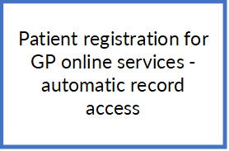
The structure of the toolkit
Working with online record access including automatic record access
        There are four sections in the Toolkit that cover aspects of how practices work with GP online services, concentrating on online record access
Clinical indications for online record access
Clinical exemplars
Adverse effects of online record access
Potentially harmful information

Slide 4
This introduction is structured differently
        This presentation is an introduction to the new and is laid out in five sections to reflect this purpose. Relevant guidance is highlighted.
      Clinical benefits of record access
      Possible adverse effects of record access
      The impact of automatic record access on patients and practices
      Practice reparations for safe record access
      Practice actions to avoid the adverse effects of record access

Slide 5
New content in the toolkit
        The purpose of this presentation is introduce the new Toolkit and how practices should manage automatic record access
        What changes in November 2022 and what stays the same
        What patients will see in their GPs’ records online
        The impact on clinical care and record keeping
        How to manage the risks to patients and colleagues now that around 50% of patients will have record access

Slide 6
Glossary: online record access
Prospective access is from a given date, e.g. 1 November 2022
Historical access includes the earliest digital data, maybe 30 years
Restricted or limited access, e.g., to the detailed coded record
Proxy access, for a trusted third party usually with patient consent
Patient facing services apps (PFS) on smartphones, tablets and computers – the means of online access to GP services
Identity verification by the practice or remotely (NHS Login)
Redaction – hiding patient record information from online access
See “Glossary of GP Online Services” in the Toolkit

Slide 7
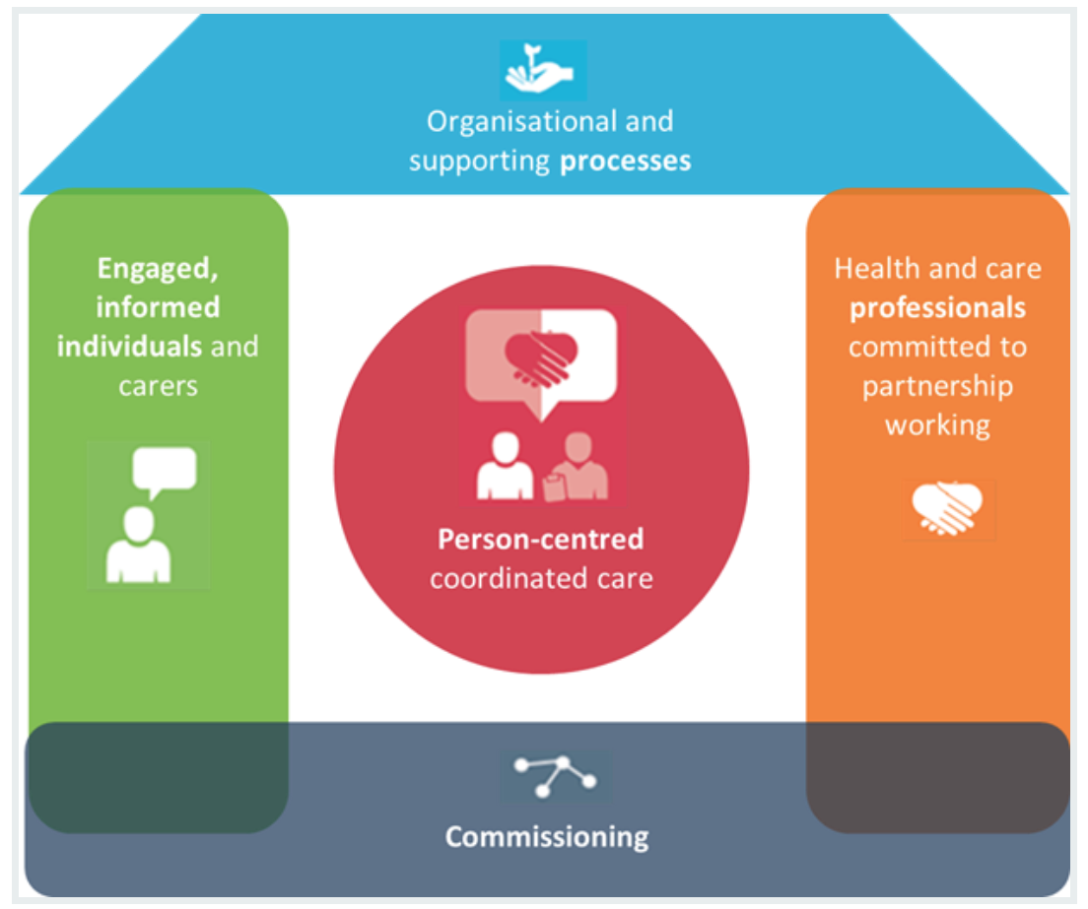
Section 1
The clinical benefits of online record access remain the same
It is a pillar of
patient-centred care
The House of Care

Slide 8
Patients have online access to …
Medication
Allergies and adverse reactions
Problems and diagnoses
Demographics
Consultations
Test results (numeric values and ref. range)
Documents, letters, referrals and attachments
Free text (including text added to codes, results and consultations)
Immunisations
All coded entries
Diary entries
Consent to sharing settings

Slide 9

How does record access change patient care?
“Two years ago I was at a stage in my understanding … that was so limited it placed the entire weight of responsibility for my care on the doctors treating my condition. I was a passenger, along for the ride.
Access to my medical data … in short I am no longer a passenger, I am now very much part of the management team for the effective treatment of my condition.”
O.C. Manchester

Slide 10
Reasons to recommended record access … (%) RCGP 2016
Results of an RCGP survey of the views of GPs, practice nurses and managers currently working with online record access

Slide 11
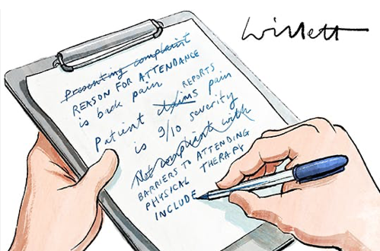
Record keeping for online access
Records ready for patients to read
Free text – rethink the purpose of the record for patient access
Planning for access – share understanding of the meaning of the record with the patient
Avoid ambiguous language and coding
Be aware of individual data items that should be redacted

Slide 12
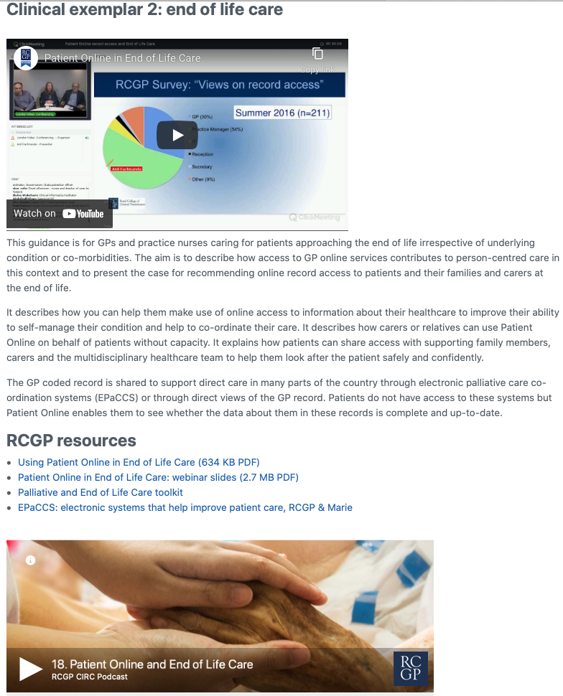
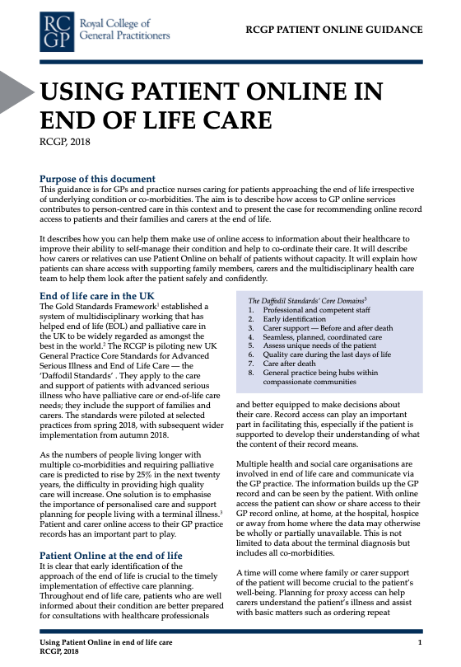
Person-centred care
The RCGP Toolkit contains guidance on how online record access can be used to improve the care of patients in five “Clinical Exemplars”
Diabetes mellitus
End of life care
Dementia
Inflammatory arthritis
Mental health disease

Slide 13

Section 2
Online record access may cause harm
Potentially harmful information
Safeguarding risks
Controlling coercion
Personal distress

Slide 14
Potentially harmful information
Personal disclosures by patients of abuse, information that may be used by or about perpetrators of abuse, including information on abuse from police, social care and education services
Confidential third-party information
Mental health, substance abuse, contraception, sexual health, pregnancy, terminations, gender identity, etc
Clinical opinion, suspicions of diagnosis, abnormal investigation results
Misleading, ambiguous or technically complex information
See “Managing Potentially Harmful Information”

Slide 15
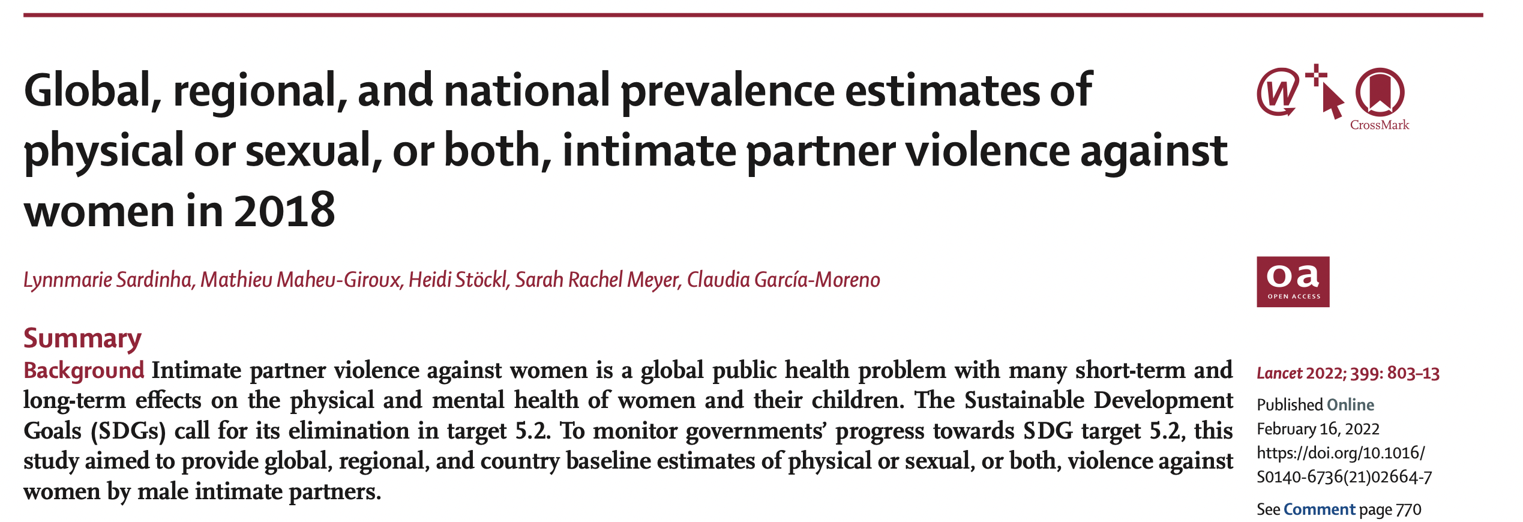
Prevalence of safeguarding risks
Domestic abuse in England and Wales
The police recorded a total of 912,181 domestic abuse-related incidents and crimes in England and Wales in the year ending June 2022.
Estimates from the most recent Crime Survey for England and Wales year ending March 2022 show 5.7% of adults aged 16 to 59 years (2.3 million) experienced domestic abuse in the 12 months prior. ONS, 2022
“Globally, 27% of ever-partnered women aged 15-49 years are estimated to have experienced physical .sexual, or both, intimate partner violence in their lifetime, with 13% experiencing it in the past year.” Sardinha et al., The Lancet, 2022

Slide 16
Safeguarding risks
Gaining access to the victim’s record enables abusers to monitor:
If the victim has revealed abuse
If the victim has accessed healthcare, especially issues like injuries, mental health, contraception or sexual health
Evidence in documents that other agencies have recognised abuse
Infer any of these from the absence of expected consultations or documents in the online record
See sections on Coercion, Safeguarding and Automatic Record Access

Slide 17
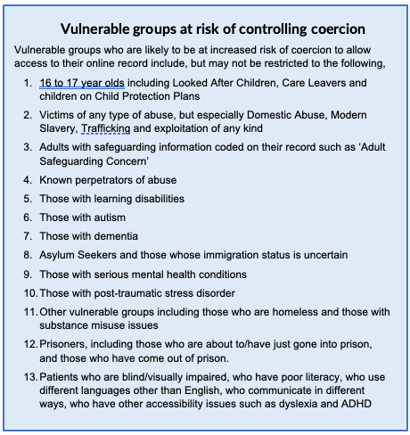
Groups vulnerable to coercion
Patients who fall in one or more of these groups are often vulnerable to controlling coercion and may not be able to keep their online record secure and private, or they may suffer serious harm by accessing their record
Practices have a legal responsibility to minimize risks arising from online record access
See sections on “Safeguarding and Vulnerable Groups” and “Safeguarding and Automatic Record Access”

Slide 18
Other harms from online record access
Failure to seek healthcare for fear of a lack of confidentiality
Trigger severe re-traumatizing psychological or physical responses
See bad news, e.g., a new serious diagnosis, or misunderstand the meaning of record content
Inadvertent disclosure of third-party confidential information
Aggressive behaviour towards the practice team because of record content

Slide 19
Current record access application process
Fully inform patient, orally and in writing about security, record content and to discuss concerns with practice
Patient must complete the application form including answering the coercion question:
Records checked for potentially harmful information by a GP
Patient identity verified, log-in details given and agreed level of access switched on.
Automatic access bypasses this opportunity to engage with patients and assess whether online access puts individual patients at risk, especially if the patient uses the NHS Login to access GP online services
      “Do you think that you may come under pressure to give access to someone else unwillingly?”
See: “RCGP GP Online Services Application Form Template”

Slide 20

Section 3
What is the impact of automatic record access and how should practices manage it?

Slide 21
Key changes with automatic access
Automatic record access is available to all patients aged 16 and over who have online access to any other GP service
Patients will not have to apply to the practice for online record access using a PFS app that works with the N HS Login
Access will be to the full GP record created after the date when automatic record access began or whenever they registered with their current practice, whichever date is the latest
Note that patients will still have to apply to their practice for access to historical information recorded before 1st November; to their record from their previous practices or for a trusted third-party to have proxy access

Slide 22
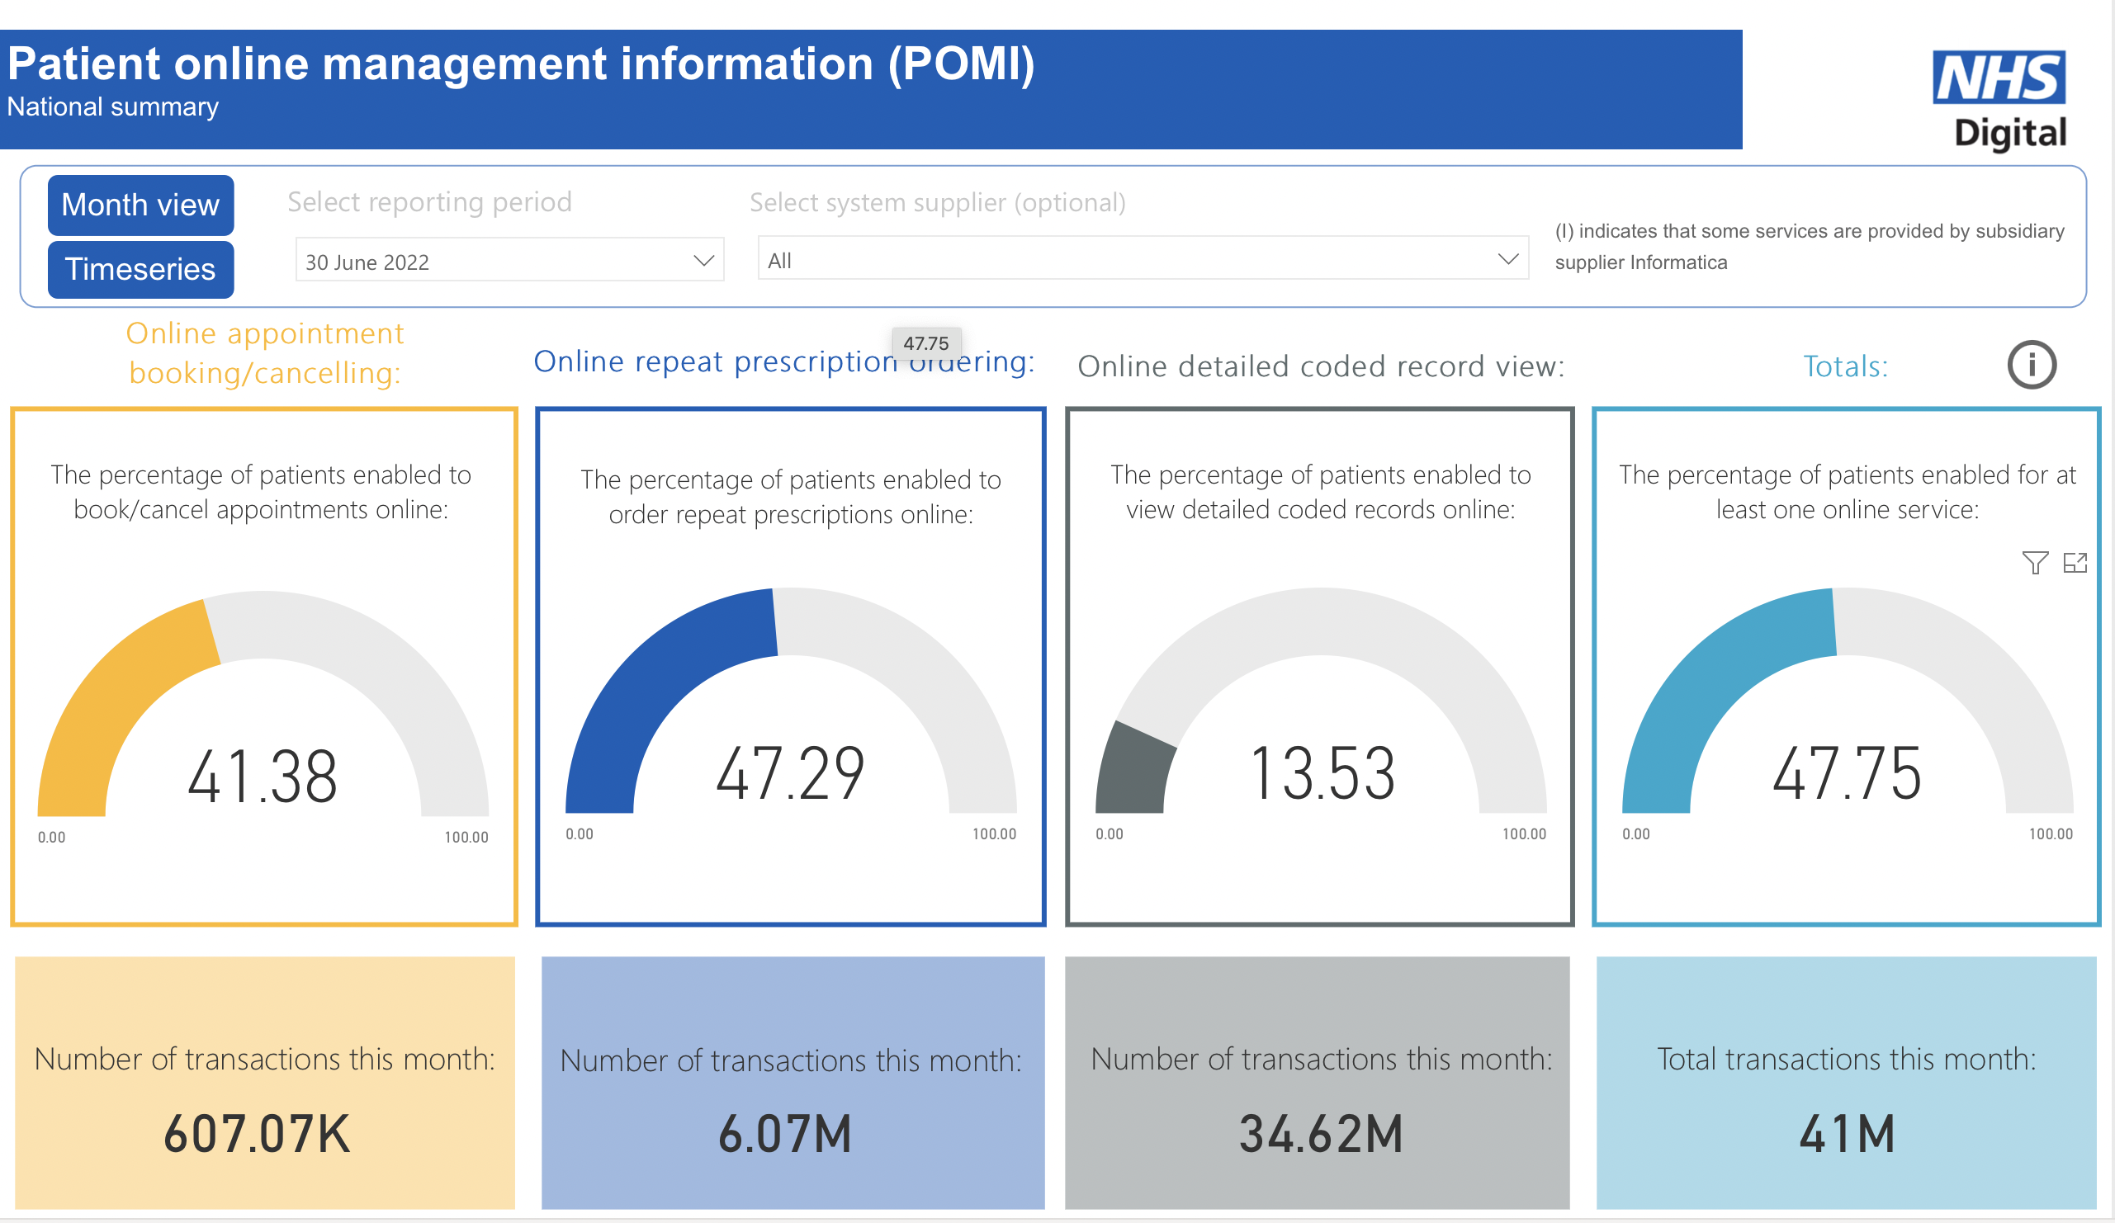
50% patients have online record access
Once NHS England switched on automatic online record access in November 2022, the proportion of patients with GP record access rose …
from 13% to 50%.
Anyone with any GP online service (47.75 % in June 2022) obtained automatic record access in November 2022

Slide 23
Section 4
AUTOMATIC ACCESS TRIGGERS
Patient obtains a new GP online services account
After 16th birthday
Registers at a new practice
What actions should practices consider to prepare for patients to have automatic online record access?

Slide 24
Practice actions for automatic record access
There are patients who do not currently have online record access
Patient safety – serious harm may result if they obtain automatic record access but cannot keep their online record access secure, or the record contains harmful information
Automatic record access can be blocked before patients get it – better than turning off access later
Practice policies and procedures should be ready to minimise the risk to patients e.g. data quality standards and redaction, safeguarding, privacy notices, data protection impact assessment
See: “Clinical Assurance for Automatic Record Access” and “Working With Automatic Record Access”

Slide 25
Prepare for automatic record access
Identify vulnerable patients possibly at risk from online access
Prevent individuals’-at-risk automatic access – SNOMED terms
Switch off auto-filing functions for lab results and documents
Review data quality and redaction systems
Staff learning needs assessment and training
Patient information campaign on automatic access
Practice safeguarding policy update
Data Protection Impact Assessment update
Consider health inequalities and digital exclusion

Slide 26
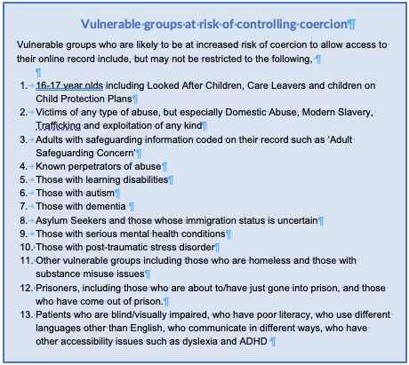
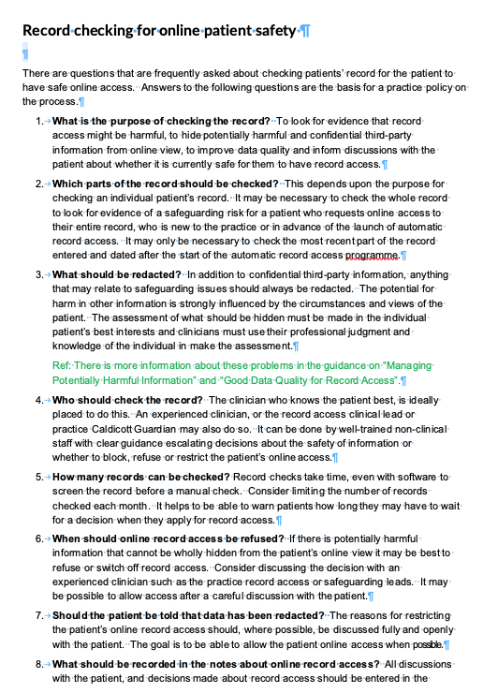
Identify patients at risk from record access
Step one: Search and check records and consult colleagues to find patients at risk, e.g.,
Safeguarding risks through coercion
Serious mental health disorders and PTSD
Impaired intellectual capacity
Substance misuse
Potentially harmful information
See: “Clinical Assurance for Automatic Record Access”
and: “Record Checking For Online Access - FAQ”

Slide 27
Block at-risk access and assess
Step two: Add the SNOMED term to at-risk patients’ records. It prevents record access being turned on automatically.
Enhanced review indicated before granting access to own health record (1364731000000104)
AUTOMATIC ACCESS TRIGGERS
Patient obtains a new GP online services account
After 16th birthday
Registers at a new practice
Review each patient individually, ideally with a confidential discussion with the patient. If the decision is to withhold record access, no more action need be taken.

Slide 28
If record access is deemed to be safe
Step three: Consider redacting any potentially harmful information that may become visible online on the future,
and add the following SNOMED term to the record to override the …104 term and allow automatic record access:
Enhanced review not indicated before granting access to own health record (1364731000000106)
From “SNOMED Terms That Control Automatic Record Access ”

Slide 29
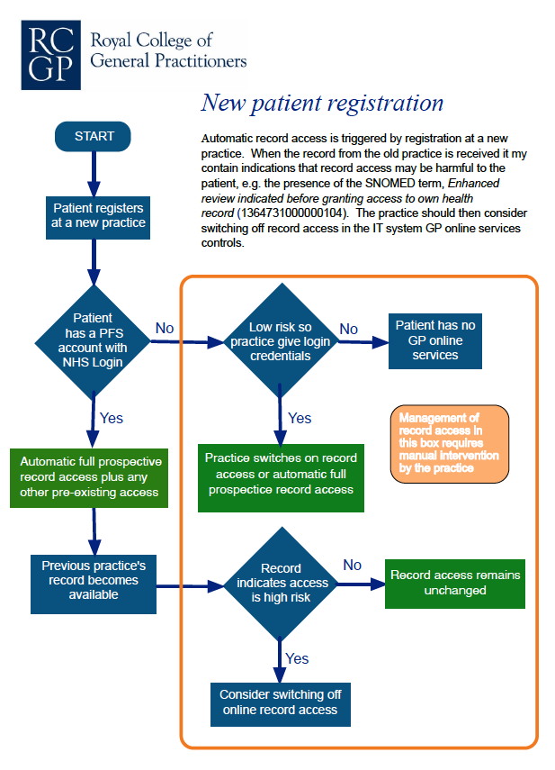
New patient registration – the challenge
When a new patient registers with the practice
Their access to the record from the old practice is lost
With a GP online services account and NHS Login, they automatically have full access to their new practice record, unless the new practice identifies risk and intervenes to block access
Redaction flags do not transfer with GP2GP
Review the old record when it is available for indications of risk
“Flowchart - New Patient Registration and Auto-access”

Slide 30
New guidance on preparing for auto-access
Safeguarding and vulnerable groups
Safeguarding and automatic record access
Checking patient records for safe online access - FAQ
SNOMED terms that control automatic record access
Clinical assurance automatic record access
Managing potentially harmful information – covers redaction
Flowchart - new patient registration and auto access
Working with automatic record access
Checklist – working with automatic record access

Slide 31

Section 5
Practice procedures that make online record access safer and beneficial for patients

Slide 32
Practice procedures for record access 1
High quality, safe, accessible records
Consider patient’s literary and numeracy and skills
Minimise the need to redact, by explaining record contents
Redact potentially harmful and confidential third-party information
Temporarily redact worrying information, beware “auto-filing” data
“Checklist – Working with Automatic Record Access”

Slide 33
Practice procedures for record access 2
Ensure all safeguarding information is correctly recorded
Communicate pro-actively with patients about information risks
If patients’ capacity declines, consider if they can secure their online access
Consider switching off record access if the patient’s risk appears too high
New patient registration: actively consider safeguarding and other risks
Checklist – working with automatic record access

Slide 34
Hiding information from online access
Also known as redaction, this function in GP systems enables users to hide potentially harmful information before it is visible online
Consultations, documents, laboratory reports, SNOMED terms, medication
Data is not deleted and remains visible in the practice record
It may be obvious in the online view that information is missing, e.g., an entire consultation
Can be reversed, e.g., after a discussion about abnormal results
Discuss redaction with the patient when possible

Slide 35
Challenges about access to the record
From patients or perpetrators of abuse about access being blocked or information redacted
Discuss the challenge face-to-face, ideally with the patient in alone in a safe environment. Emails and telephone calls may be monitored by a perpetrator
Information is hidden or access is blocked because of concern about patient safety
Patients may choose not to have record access or to have information hidden from view or access limited to Summary Care Record
If the patient denies abuse and significant concerns remain, consider involving the practice safeguarding lead, Caldicott guardian or others who may know the patient

Slide 36
Challenges about content of the record
From patients or others with or without formal proxy access to the record
Patients are often unaware of what is in their GP record and may be surprised when the first receive online access
There may be things they do not understand in the record, omissions, mistakes, or something that they find upsetting or with which they disagree.
Discuss comments and requests for changes openly and honestly, and make changes the record if appropriate, carefully noting the patient’s request and the reasons for the practice’s decision about the change.
The practice is under no obligation to change the record unless you think that the change is correct.
NICE provides guidance (NG10) on how to deal with challenging patients

Slide 37
Updated guidance for record access
Managing potentially harmful information
Flowchart - new patient registration and automatic access
Data quality for record access
Information governance for record access
Children and young people
Coercion
Template - RCGP GP online services application form
Proxy access template – proxy consent form
Patient Information themes for GP online services

Slide 38
RCGP GP Online Services Toolkit
        Author team
        Dr Ralph Sullivan, RCGP Clinical Lead for Patient Online
        Dr Imran Khan, Deputy Co-chair of Joint GP IT Committee
        Dr Joy Shacklock, RCGP Safeguarding Representative

